Slide 2
Using C and C++ in your Windows Phone 8 Apps
WPH-B308
Maarten Struys

Slide 3
Using C and C++ in your Windows Phone 8 App
WPH-B308
Maarten Struys

Slide 4
Agenda
Introduction
Why using C(++) for Windows Phone?
Legacy code
Using / Creating Runtime Components
Debugging Native / Managed Code
Q & A

Slide 5
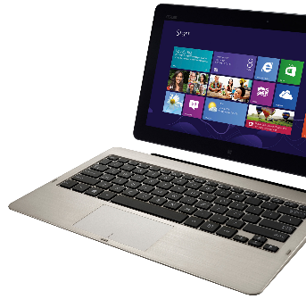
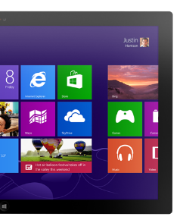
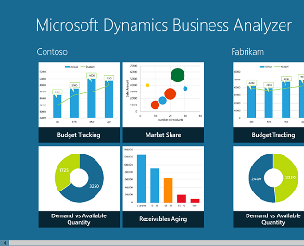
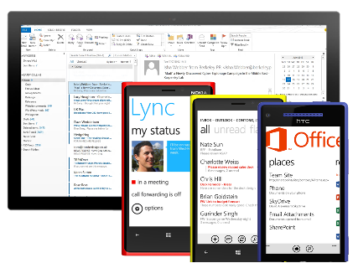
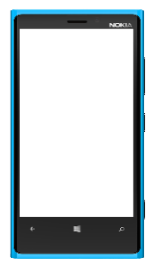
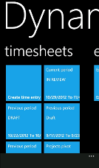
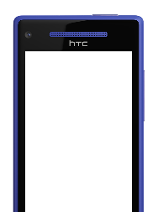
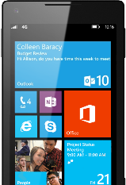
Windows Phone The Right Choice for Business
Great, consistent experience across devices
Productive and connected
Robust platform for mobile apps
Unified app and device management
Common core and security architecture

Slide 6
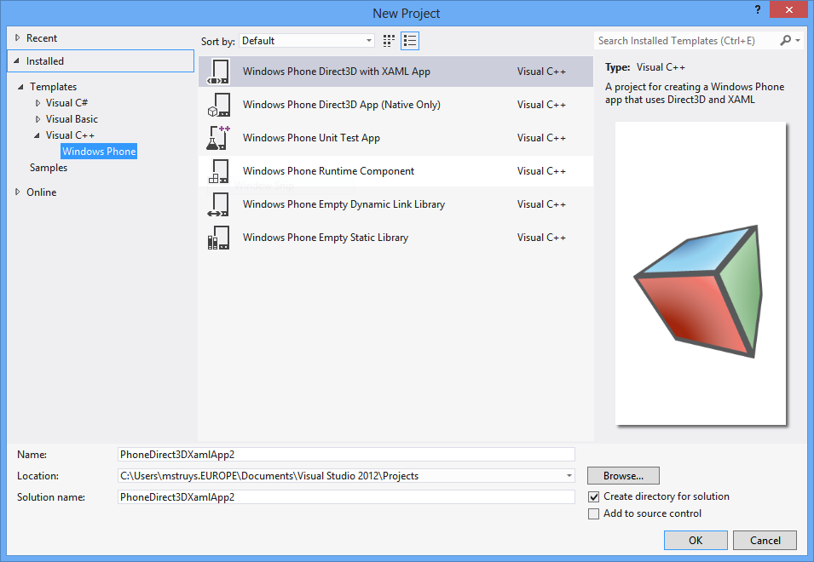
Introduction
Different development options for Windows Phone 8
Managed (XAML + C# / VB)
Managed (XNA Framework + C# / VB)
Native / Managed (Direct3D & XAML + C# / VB)
Native (Direct3D)
Native (Class Libraries / Components) + Managed (XAML + C# / VB)
Managed (XNA Framework + C# / VB)
Native (Class Libraries / Components) + Managed (XAML + C# / VB)

Slide 7
Introduction
Using C++ inside Windows Phone 8 Apps
Using Visual Studio 2012
Using the same compilers as Windows 8
Using new C++ 11 features in Windows Phone 8
Debugging of native code is supported

Slide 8
Demo
Different Windows Phone 8 Project Types

Slide 9
What is C++ in the year 2013?
A modern programming language with features that look similar to C# developers
auto keyword
Anonymous Functions & Lambda Expressions [](int x, int y) { return x + y; }
Strongly typed enumerations enum Enum1: unsigned int;
General purpose smart pointers std::unique_ptr
Pointer moves around methods and won’t leak memory when no longer in use

Slide 10
Why C++ on Windows Phone 8?
Portability
Reusing Code
New Projects
Extends the runtime
Legacy code
Use existing code (e.g. math functions / imaging libraries)
Performance

Slide 11
Where is C++ used on Windows Phone 8?
Unity
Cross Platform game engine, written in C / C++, primarily used to create mobile and web games with C#, Javascript and Boo language support
SQLite
Software library that implements a self-contained, serverless, zero-configuration, transactional SQL database engine that can easily be used in your app through a Visual Studio plugin

Slide 12
How to use C++ on Windows Phone 8?
Cannot ‘directly’ use existing C++ libraries
No way to link to DLL or LIB in a managed project
Can use existing C++ libraries ‘indirect’
Create Windows Phone Runtime Component
Link to DLL or LIB
Pass / Marshall data through this middle layer

Slide 13
Demo
Reusing existing C++ code
Using Legacy Code on Windows Phone 8
Using SQLite

Slide 14
Windows Phone 8 APIs
Windows Phone 8 supports
Managed application development using .NET and WinPRT API’s
Native application development using WinPRT and C runtime API’s
Game development using Direct3D or DirectX
WP8.0 Games DirectX/Direct 3D & C++
WP8.0 XAML & C#/VB with Direct3D Graphics
C++
WP8.0 XAML & C#/VB
C++
.NET API for Windows Phone
Windows Phone Runtime
Win32 & COM
Managed
Managed & Native
Native

Slide 15
Windows Phone 8 APIs
Use the API you feel comfortable with
Language Projection ‘binds’ things together
The choice of API becomes important for native/managed interop
You need WinPRT in this particular case

Slide 16
Using the ‘right’ APIs
Many of the APIs in Windows Phone Runtime exist to provide new functionality to Windows Phone
Other APIs exist to expose Windows Phone capabilities to both native and managed code developers and provide equivalent functionality to the .NET APIs
Managed code developers can use whichever API they like
Developers targeting WP7.1 and WP8 devices will prefer the .NET API
Developers sharing code between WP8 and W8 targets will tend to use the Windows Phone Runtime API

Slide 17
Using the ‘right’ APIs
.NET API | Windows Phone Runtime API
System.IO.IsolatedStorage | Windows.Storage
System.NET.Sockets | Windows.Networking.Sockets
System.Threading.ThreadPool | Windows.System.Threading.ThreadPool
Microsoft.Devices.Sensors | Windows.Devices.Sensors
System.Device.Location | Windows.Devices.GeoLocation

Slide 18
Design Considerations for using C++
Create a Windows Phone Runtime Component as wrapper around native code
Use WinPRT types to pass data to / from your app
Use native types to call native (legacy) code
Make your Windows Phone Runtime Component asynchronous
Even with synchronous underlying native function(s)

Slide 19
Debug Considerations when using C++
Debugging native code is similar to debugging managed code
Visual Studio uses different debuggers for managed and native code
Be aware when debugging applications that use both native and managed code
Try to localize suspect code (starts typically with managed code debugging)
If suspect code is in native, switch the debugger type in the project properties

Slide 20
Demo
Adding Async Behavior to your existing code

Slide 21
Key takeaways for using C++
All Windows Phone 8 Apps can use C++
C++ enables portability and code re-use
The Windows Phone Runtime is key to unlocking APIs

Slide 22
Windows Phone Breakout Sessions
Monday, June 3:
1:15pm - The phone that has everything the enterprise needs: Windows Phone 8
3:00pm – The top down guide for developers: Windows Phone 8
4:45pm – Radical perspectives on mobility strategy
Tuesday, June 4:
8:30am – The power of collaboration: Integrating Windows Phone with Office 365, Exchange and SharePoint Online
10:15am – All aboard for the future of HTML5 mobile & hybrid web apps for Windows Phone 8 and Windows Tablets
1:30pm – The Windows Phone 8 networking survival kit
3:15pm – Build it once for both: Writing code and designing for Windows 8 and Windows Phone 8
5:00pm – Secrets of using background agents for Windows Phone 8

Slide 23
Windows Phone Breakout Sessions
Wednesday, June 5:
8:30am – Mobile security in the enterprise: Windows Phone 8 answers the call
10:15am – Using C and C++ in your Windows Phone 8 applications
1:30pm – Developing large-scale enterprise mobile apps for Windows Phone 8
3:15pm – Speechifying your Windows Phone 8 applications
Thursday, June 6:
8:30am – Manage Windows Phone enterprise apps
10:15am – Support your demanding LOB apps with SQLite and Windows Phone 8
1:00pm – Creating Windows Phone 8 apps for SharePoint

Slide 24
Windows Phone Hands On Labs
Porting Windows 8 to Windows Phone 8
Windows Phone 8: File and Protocol Association
Windows Phone 8: Lock Screen Wallpaper
Windows Phone 8: Voice Command
Windows Phone 8: Tiles
Windows Phone 8: Purchase
Windows Phone 8: Wallet
Windows Phone 8: Running Tracker

Slide 25
Windows Phone Booth
Device Bar featuring the latest Windows Phones in the marketplace
Expert Area – Stop by the booth to get all your Windows Phone questions answered by Windows Phone experts
Theater Presentations:
The Windows connected experience
Get Hands on with Windows Phone for Business
Windows Phone 8 Developer focused sessions

Slide 26
Windows Phone Promotions
Windows Phone Hats – Stop by the Windows Phone booth to get your free hat. Wear the hat for a chance to win a Windows Phone.
Attend a Windows Phone theater session to be entered into a drawing for Windows Phones and other prizes.
Windows Phone Breakout Sessions – Attend Windows Phone breakout sessions and be entered into a drawing to win a Windows Phone.
Windows Phone Hoodie’s – Get a demo from the Windows Phone roaming demo team in the expo hall. Wear the hoodie for a chance to win a Windows Phone.

Slide 27
Track resources
For more information about Windows Phone:
http://www.windowsphone.com/business

Slide 28
Windows Phone Breakout Sessions
Monday, June 3:
1:15pm - The phone that has everything the enterprise needs: Windows Phone 8
3:00pm – The top down guide for developers: Windows Phone 8
4:45pm – Radical perspectives on mobility strategy
Tuesday, June 4:
8:30am – The power of collaboration: Integrating Windows Phone with Office 365, Exchange and SharePoint Online
10:15am – All aboard for the future of HTML5 mobile & hybrid web apps for Windows Phone 8 and Windows Tablets
1:30pm – The Windows Phone 8 networking survival kit
3:15pm – Build it once for both: Writing code and designing for Windows 8 and Windows Phone 8
5:00pm – Secrets of using background agents for Windows Phone 8

Slide 29
Windows Phone Breakout Sessions
Wednesday, June 5:
8:30am – Mobile security in the enterprise: Windows Phone 8 answers the call
10:15am – Using C and C++ in your Windows Phone 8 applications
1:30pm – Developing large-scale enterprise mobile apps for Windows Phone 8
3:15pm – Speechifying your Windows Phone 8 applications
Thursday, June 6:
8:30am – Manage Windows Phone enterprise apps
10:15am – Support your demanding LOB apps with SQLite and Windows Phone 8
1:00pm – Creating Windows Phone 8 apps for SharePoint

Slide 30
Windows Phone Hands On Labs
Porting Windows 8 to Windows Phone 8
Windows Phone 8: File and Protocol Association
Windows Phone 8: Lock Screen Wallpaper
Windows Phone 8: Voice Command
Windows Phone 8: Tiles
Windows Phone 8: Purchase
Windows Phone 8: Wallet
Windows Phone 8: Running Tracker

Slide 31
Windows Phone Booth
Device Bar featuring the latest Windows Phones in the marketplace
Expert Area – Stop by the booth to get all your Windows Phone questions answered by Windows Phone experts
Theater Presentations:
The Windows connected experience
Get Hands on with Windows Phone for Business
Windows Phone 8 Developer focused sessions

Slide 32
Windows Phone Promotions
Windows Phone Hats – Stop by the Windows Phone booth to get your free hat. Wear the hat for a chance to win a Windows Phone.
Attend a Windows Phone theater session to be entered into a drawing for Windows Phones and other prizes.
Windows Phone Breakout Sessions – Attend Windows Phone breakout sessions and be entered into a drawing to win a Windows Phone.
Windows Phone Hoodie’s – Get a demo from the Windows Phone roaming demo team in the expo hall. Wear the hoodie for a chance to win a Windows Phone.

Slide 33
Track Resources
For more information about Windows Phone:
http://www.windowsphone.com/business

Slide 34
Resources
Learning
Sessions on Demand
Microsoft Certification & Training Resources
http://channel9.msdn.com/Events/TechEd
www.microsoft.com/learning
TechNet
msdn
Resources for IT Professionals
Resources for Developers
http://microsoft.com/technet
http://microsoft.com/msdn

Slide 35
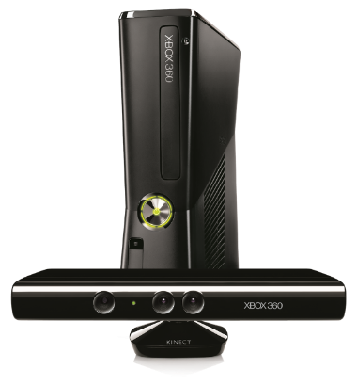
Complete an evaluation on CommNet and enter to win!

Slide 36
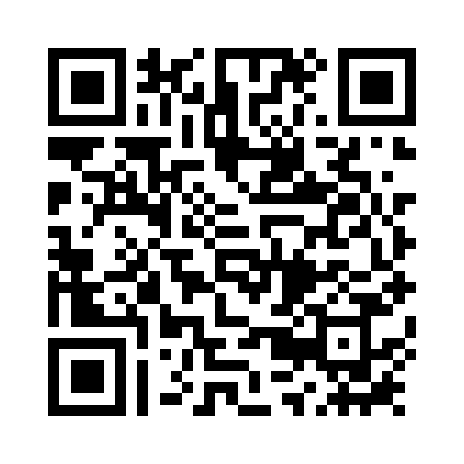
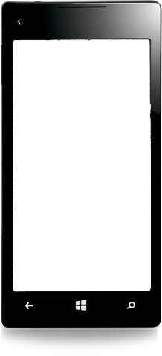
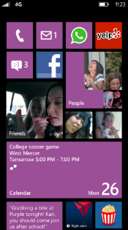
Evaluate this session
Required Slide
*delete this box when your slide is finalized
Your MS Tag will be inserted here during the final scrub.
Scan this QR code to evaluate this session and be automatically entered in a drawing to win a prize

Slide 37
© 2013 Microsoft Corporation. All rights reserved. Microsoft, Windows and other product names are or may be registered trademarks and/or trademarks in the U.S. and/or other countries.
The information herein is for informational purposes only and represents the current view of Microsoft Corporation as of the date of this presentation. Because Microsoft must respond to changing market conditions, it should not be interpreted to be a commitment on the part of Microsoft, and Microsoft cannot guarantee the accuracy of any information provided after the date of this presentation. MICROSOFT MAKES NO WARRANTIES, EXPRESS, IMPLIED OR STATUTORY, AS TO THE INFORMATION IN THIS PRESENTATION.

