Slide 2
Building the Modern Analytics Architecture
DBI-B210
Karen López

Slide 3
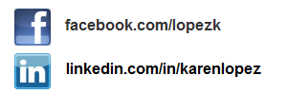
Karen Lopez
Senior Project Manager & Architect
Love Your Data
@datachick
InfoAdvisors.com

Slide 4
What we will be doing
Modern Analytics Architectural Components
Architecting versus building
Cost, benefit, risk
Building the Architecture in Microsoft Azure
Analytics
Importing external data
Using Power Query & HDInsight for analysis
Using Power View
Q&A and Call to Action

Slide 5
Modern Analytics Architectural Components & Concepts

Slide 6
Why Hadoop?
Schemaless
Data versus Processing
BIG DATA
Cloud
Scale
Variable Data
Analytics
Data Reservoir
Data Lake
Unstructured data

Slide 7
Hadoop Ecosystem (a Zoo)
Pipeline / Workflow
(Oozie)
JavaScript
C#, F#, .NET
Graph
(Pegasus)
Stats processing
(RHadoop)
Machine Learning
(Mahout)
Data Integration
( ODBC / SQOOP/ REST)
Relational
(SQL Server)
Legend
Red = Core Hadoop
Blue = Data processing
Purple = Microsoft integration points and value adds
Yellow = Data Movement
Green = Packages
Metadata
(HCatalog)
PDW Polybase
NoSQL Database
(HBase)
Scripting
(Pig)
Query
(Hive)
Event Driven Processing
Event Pipeline
(Flume)
Distributed Processing
(MapReduce)
Business Intelligence
(Excel, Power View, SSAS)
Distributed Storage
(HDFS)
Monitoring & Deployment (System Center)
World's Data (Azure Data Marketplace)
Azure Storage Vault (ASV)
Active Directory (Security)
Via Hadoop Ecosystem pptx, Cindy Gross. Used with permission

Slide 8
MapReduce
Shuffle and sort data
Get from large data to smaller data
Parallel processing

Slide 9
Hive
SQL-like query language
Abstraction on top of MapReduce
Metastructure on top of HDFS

Slide 10
Traditional DW Architecture
OLTP DB
Data Mart
OLTP DB
staging
EDW
OLTP DB
Data Mart
On Premises

Slide 11
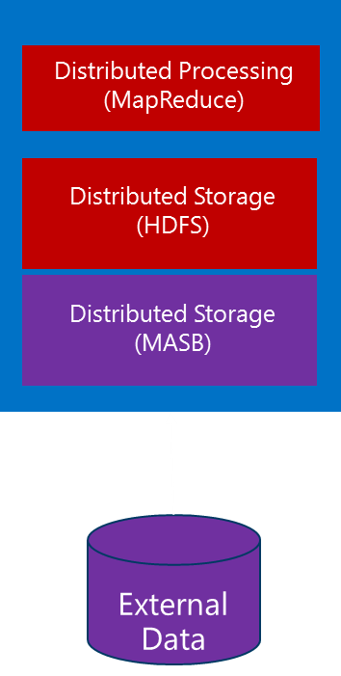
Modern DW Architecture
OLTP DB
Analytics Mart
staging
EDW
OLTP DB
OLTP DB
Data Mart
On Prem
On Prem
Microsoft Azure

Slide 12
Scale and Nodes
Scale up versus scale out
Nodes, not beefier servers
Data stays, clusters come and go
Quick Create for playing
Custom Create for architecting a solution

Slide 13
“Every design decision should include cost, benefit and risk”
- Karen Lopez

Slide 14
Building the Architecture in Microsoft Azure

Slide 15
HDInsight Demo Components
Blob Storage
Storage Container
HDInsight Cluster
PowerShell
Azure SQL DB

Slide 16
Demo: HDInsight Components
….Let’s get started

Slide 17
Let’s talk billing….
Per hour
Per node
head node
security node
data nodes
Data egress, not ingress
Geo-redunancy

Slide 18
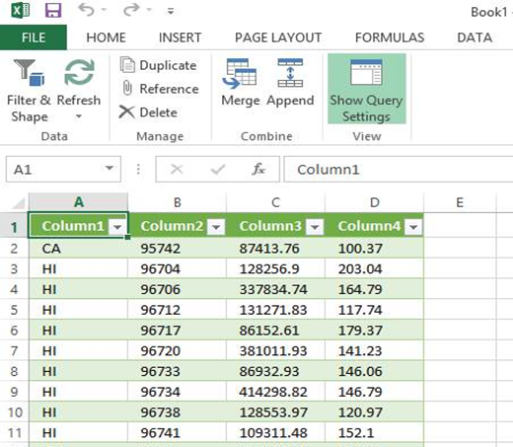
HDInsight Advantages
Separate Blob Storage from Cluster
Billing
Pay as you go
6 or 12 month plans
Tools you know
Skills you have
Skills users have

Slide 19
Analysis

Slide 20
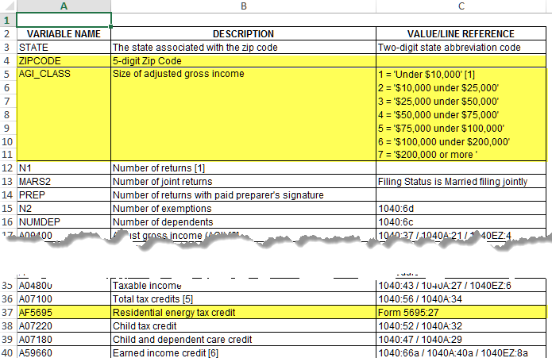
The Data Story
http://www.irs.gov/file_source/pub/irs-soi/zipcode08flds.xls
IRS Energy Tax Credit Data*
HDInsight
*http://www.dsireusa.org/incentives/incentive.cfm?Incentive_Code=US37F
Retail Data Warehouse
Power Query & Power View

Slide 21
Power BI Stack
Power View
Power Map
Power Pivot
Power Query

Slide 22
Demo: Analysis
Bringing it all together

Slide 23
Wrap up
HDInsight + SQL Server + External Data + Power BI

Slide 24
Related content
Breakout Sessions
DBI-B213 Details of Microsoft SQL Server 2012 Parallel Data Warehouse Appliance Update 1
DBI-B328 From Zero to Data Insights Using HDInsight on Microsoft Azure
DEV-B341 Using Big Data to Advance Your Cloud Service + Device Solutions
Labs
DBI-H306 What's New in Microsoft SQL Server 2014 for DBAs
Find Me Later At MSE Data Platform

Slide 25
Track resources
Download Microsoft SQL Server 2014
http://www.trySQLSever.com
Try out Power BI for Office 365!
http://www.powerbi.com
Sign up for Microsoft HDInsight today!
http://microsoft.com/bigdata

Slide 26
Resources
Learning
Sessions on Demand
Microsoft Certification & Training Resources
http://channel9.msdn.com/Events/TechEd
www.microsoft.com/learning
TechNet
msdn
Resources for IT Professionals
Resources for Developers
http://microsoft.com/technet
http://microsoft.com/msdn

Slide 27
Complete an evaluation and enter to win!

Slide 28
Evaluate this session
Scan this QR code to evaluate this session.

Slide 29
© 2014 Microsoft Corporation. All rights reserved. Microsoft, Windows, and other product names are or may be registered trademarks and/or trademarks in the U.S. and/or other countries.
The information herein is for informational purposes only and represents the current view of Microsoft Corporation as of the date of this presentation. Because Microsoft must respond to changing market conditions, it should not be interpreted to be a commitment on the part of Microsoft, and Microsoft cannot guarantee the accuracy of any information provided after the date of this presentation. MICROSOFT MAKES NO WARRANTIES, EXPRESS, IMPLIED OR STATUTORY, AS TO THE INFORMATION IN THIS PRESENTATION.

