Slide 1
Mind your IO: Resource Governor Shows You How
Amit Bansal
amit.bansal@peoplewareindia.com | @A_Bansal
eDominer Systems | Peopleware India
MCM, MVP, MCSM, MCT

Slide 2
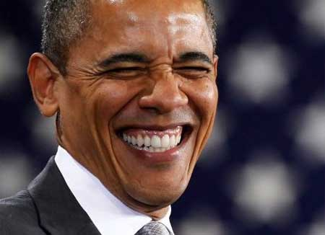
We all want good governance, Right?

Slide 3
Agenda
Resource Governor – Overview
Why care about IO governance?
What can you govern?
How can you do it?
Extended Events & PerfMon Counters
DEMO
Summary & Call to Action

Slide 4
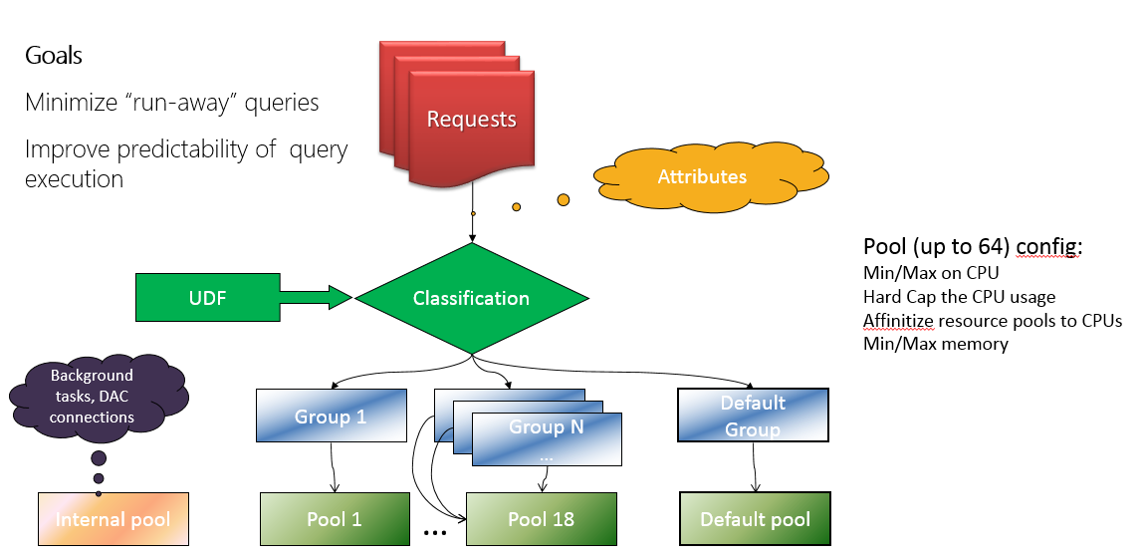
Resource Governor - Overview

Slide 5
Resource Governor - Overview
SQL Server 2008
  Resource Governor was introduced
  CPU & Memory governance
SQL Server 2008 R2
  No changes
SQL Server 2012
  CPU_CAP_PERCENT, AFFINITY
SQL Server 2014
  IO governance

Slide 6
Why care about IO governance?
IO: One of the three holy trinity
  Super-critical for SQL Server performance
IO isolation
Performance predictability
  Rogue workloads
  Throw away queries
  Maintenance operations

Slide 7
What can you govern?
Yes
  Read I/O
  Write I/O (some caveats)
  Physical Reads
  Data Files
No
  Internal Pool
  Logical Reads
  Log Files
Updates?

Slide 8
How Can You Do It?
CREATE RESOURCE POOL pool_name
[ WITH
(
[ MIN_CPU_PERCENT = value ]
[ [ , ] MAX_CPU_PERCENT = value ]
[ [ , ] CAP_CPU_PERCENT = value ]
[ [ , ] AFFINITY {SCHEDULER =
AUTO | ( <scheduler_range_spec> )
| NUMANODE = ( <NUMA_node_range_spec> )} ]
[ [ , ] MIN_MEMORY_PERCENT = value ]
[ [ , ] MAX_MEMORY_PERCENT = value ]
[ [ , ] MIN_IOPS_PER_VOLUME = value ]
[ [ , ] MAX_IOPS_PER_VOLUME = value ]
)
]
[;]

Slide 9
How Can You Do It?
ALTER RESOURCE GOVERNOR
{ DISABLE | RECONFIGURE }
|
WITH ( CLASSIFIER_FUNCTION = { schema_name.function_name | NULL } )
|
RESET STATISTICS
|
WITH ( MAX_OUTSTANDING_IO_PER_VOLUME = value)
[ ; ]

Slide 10
DMVs
Changed: sys.dm_resource_governor_resource_pools
  New columns for I/O max, I/O read/write queue, stall, and violations
Changed: sys.dm_resource_governor_configuration
  New columns for: I/O stall read/write latency
New: sys.dm_resource_governor_resource_pool_volumes
  Per pool: read/write queued, issued, completed, and violations

Slide 11
Extended Events
Two new XEvents to trace requests to the IO Resource Manager queues (file_write_enqueued and file_read_enqueued)
  Use these together with the events that trace issuing IO (file_read/file_written) and IO completion (file_read/write_completed)
6 new Performance Counters
  Track read/write IOs and bytes
  Track read/write latency (average msec)

Slide 12
Demo
Real-Time IO throttling
So what is our scenario?

Slide 13






Demo
Republicans
US Inc
Democrats
TechEd
Attendees

Slide 14
Summary & Call to Action
The feature is more matured now ☺
Download the scripts (@A_Bansal)
  Try it, Test it, play around with it
Read/explore more
  Try & Test again
Finally, Implement it :)

Slide 15
Thank you!
SQL 2014 Resource Governor with @A_Bansal #msteched @teched_na #sql #sql2014

Slide 16

Resources
Learning
  Sessions on Demand
  Microsoft Certification & Training Resources
http://channel9.msdn.com/Events/TechEd
www.microsoft.com/learning
TechNet
msdn
  Resources for IT Professionals
  Resources for Developers
http://microsoft.com/technet
http://microsoft.com/msdn

Slide 17



Complete an evaluation and enter to win!

Slide 18


Evaluate this session
Scan this
QR code
to evaluate
this session.

Slide 19


© 2014 Microsoft Corporation. All rights reserved. Microsoft, Windows, and other product names are or may be registered trademarks and/or trademarks in the U.S. and/or other countries.
The information herein is for informational purposes only and represents the current view of Microsoft Corporation as of the date of this presentation. Because Microsoft must respond to changing market conditions, it should not be interpreted to be a commitment on the part of Microsoft, and Microsoft cannot guarantee the accuracy of any information provided after the date of this presentation. MICROSOFT MAKES NO WARRANTIES, EXPRESS, IMPLIED OR STATUTORY, AS TO THE INFORMATION IN THIS PRESENTATION.

