Slide 2
Amazing Data Storytelling with Microsoft Power BI Q&A
DBI-B318
Carl Yates Perry
Group Program Manager
Microsoft

Slide 3
Session Objectives And Takeaways
Session Objective(s):
Learn about the technology behind Power BI Q&A
See how you can showcase the value of Q&A with your customers
Q&A is available today in Power BI
Additional language modeling capabilities will be available in the first half of this year

Slide 4
What Q&A is
How does it relate to operational reports, dashboards, personal BI, mashups
For data that needs to be the most widely-used
Where ad-hoc exploration of data can improve decision quality

Slide 5
Choosing the best answer
search for interpretations of question
score and select best interpretation
select best visual

Slide 6
“medal count by country for 2012”
from Olympics.xlsx show medal[medal count], medal[country] where olympics[year] = 2012
from Olympics.xlsx show medal[medal count], Olympics[host country] where olympics[year] = 2012
from Sales.xlsx select customer[country] where order[order year] = 2012
search for interpretations of question
score and select best interpretation
select best visual

Slide 7
“medal count by country for 2012”
from Olympics.xlsx show medal[medal count], medal[country] where olympics[year] = 2012
from Olympics.xlsx show medal[medal count], Olympics[host country] where olympics[year] = 2012
from Sales.xlsx select customer[country] where order[order year] = 2012
search for interpretations of question
score and select best interpretation
select best visual
0.86
0.72
0.46

Slide 8
“medal count by country for 2012”
from Olympics.xlsx show medal[medal count], medal[country] where olympics[year] = 2012
from Olympics.xlsx show medal[medal count], Olympics[host country] where olympics[year] = 2012
from Sales.xlsx select customer[country] where order[order year] = 2012
search for interpretations of question
score and select best interpretation
select best visual
0.86
0.72
0.46

Slide 9
“medal count by country for 2012”
from Olympics.xlsx show medal[medal count], medal[country] where olympics[year] = 2012
from Olympics.xlsx show medal[medal count], Olympics[host country] where olympics[year] = 2012
from Sales.xlsx select customer[country] where order[order year] = 2012
search for interpretations of question
score and select best interpretation
select best visual
0.86
0.72
0.46
show 1 measure, 1 member(geo) -> map
show 2 measure, 1 member -> scatter
show 1 measure, 1 member -> bar

Slide 10
Influencing the best answer
search for interpretations of question
score and select best interpretation
select best visual
Data modeling, synonyms
Workbooks in site, phrasings
Data modeling (data types, data categories)

Slide 11
Out of the Box - Good
Carl Yates Perry

Slide 12
data modeling tips
http://blogs.msdn.com/powerbi/

Slide 13
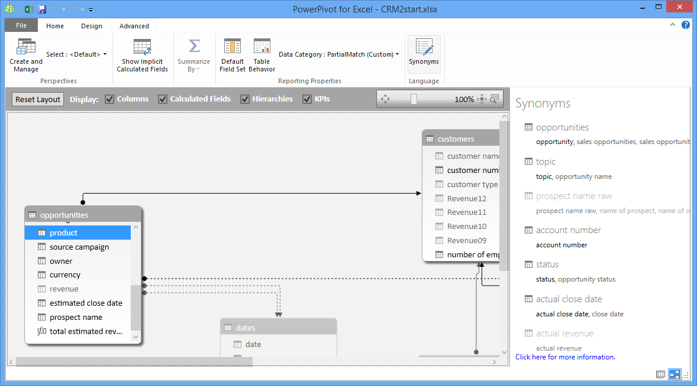
Language Synonyms in Power Pivot
C2R Excel
Subscription SKU
Instructions:
http://bit.ly/1evk8y3

Slide 14
Language Synonyms in the Cloud

Slide 15
Iterative approach
analysis
deploy
modeling
feedback
testing

Slide 16
1. Autogenerated from metadata > 2. Autogenerated from heuristics > 3. Synonyms > 4. Phrasings
Linguistic Schema

Slide 17
1. Autogenerated from metadata
Linguistic Schema
Customer
Primary noun: customer
Customer, Employee
Customer
Primary noun: customer
Customer, Order
customers have orders
employees have customers
Customer.Owner
Order
Primary noun: order
Employee
Primary noun: employee

Slide 18
1. Autogenerated from metadata > 2. Autogenerated from heuristics
Linguistic Schema
Customer
Primary noun: customer
Customer, Employee
Customer
Primary noun: customer
Customer, Order
customers have orders
employees have customers
Customer.Owner
employees own customers
Order
Primary noun: order
Employee
Primary noun: employee

Slide 19
1. Autogenerated from metadata > 2. Autogenerated from heuristics > 3. Synonyms
Linguistic Schema
Customer
Primary noun: customer
Synonyms: client, company
Customer, Employee
Customer
Primary noun: customer
Customer, Order
customers have orders
employees have customers
Customer.Owner
employees own customers
Order
Primary noun: order
Employee
Primary noun: employee

Slide 20
Simple Modeling - Better
Carl Yates Perry

Slide 21
1. Autogenerated from metadata > 2. Autogenerated from heuristics > 3. Synonyms > 4. Phrasings
Linguistic Schema
Customer
Primary noun: customer
Synonyms: client, company
Customer, Employee
Customer
Primary noun: customer
Customer, Order
customers have orders
employees have customers
Customer.Owner
customers place orders
employees own customers
Order
Primary noun: order
Employee
Primary noun: employee

Slide 22
1. Autogenerated from metadata > 2. Autogenerated from heuristics > 3. Synonyms > 4. Phrasings
Linguistic Schema
Customer
Primary noun: customer
Synonyms: client, company
Customer, Employee
Customer
Primary noun: customer
Customer, Order
customers have orders
employees have customers
Customer.Owner
customers place orders
employees own customers
important customers
Measure: LTV [desc]
Order
Primary noun: order
Employee
Primary noun: employee

Slide 23
1. Autogenerated from metadata > 2. Autogenerated from heuristics > 3. Synonyms > 4. Phrasings
Linguistic Schema
Customer
Primary noun: customer
Synonyms: client, company
Customer, Employee
Customer
Primary noun: customer
Customer, Order
customers have orders
employees have customers
Customer.Owner
customers place orders
employees own customers
important customers
Measure: LTV [desc]
Employee
Order
Primary noun: order
roles are subsets of employees
Employee
Primary noun: employee

Slide 24
Rich Model - Best
Carl Yates Perry

Slide 25
Deployment Considerations
Isolation
Security
Refresh

Slide 26
Getting Started
Accelerators
Upload your own data
Email cperry@microsoft.com for cloud modeling

Slide 27
Roadmap
First half of 2014
Advanced language modeling (phrasings)
Usage reporting
Natural language understanding improvements

Slide 28
Power BI for Office 365
Bring your data to life! Discover, model, visualize, and share your insights.
Power BI provides the familiarity of Office with the power of the Cloud, right in Excel.
Sign up for a free trial today!
http://powerbi.com

Slide 29
Track resources
Download Microsoft SQL Server 2014
http://www.trySQLSever.com
Try out Power BI for Office 365!
http://www.powerbi.com
Sign up for Microsoft HDInsight today!
http://microsoft.com/bigdata

Slide 30
Resources
Learning
Sessions on Demand
Microsoft Certification & Training Resources
http://channel9.msdn.com/Events/TechEd
www.microsoft.com/learning
TechNet
msdn
Resources for IT Professionals
Resources for Developers
http://microsoft.com/technet
http://microsoft.com/msdn

Slide 31
Complete an evaluation and enter to win!

Slide 32
Evaluate this session
Scan this QR code to evaluate this session.

Slide 33
© 2014 Microsoft Corporation. All rights reserved. Microsoft, Windows, and other product names are or may be registered trademarks and/or trademarks in the U.S. and/or other countries.
The information herein is for informational purposes only and represents the current view of Microsoft Corporation as of the date of this presentation. Because Microsoft must respond to changing market conditions, it should not be interpreted to be a commitment on the part of Microsoft, and Microsoft cannot guarantee the accuracy of any information provided after the date of this presentation. MICROSOFT MAKES NO WARRANTIES, EXPRESS, IMPLIED OR STATUTORY, AS TO THE INFORMATION IN THIS PRESENTATION.

