Slide 1


Slide 2
Improving Power Pivot Data Models for Microsoft Power BI
Marco Russo
marco.russo@sqlbi.com

Slide 3


Who is speaking
BI Consultant & Mentor
Founder of www.sqlbi.com
Book Writer
marco.russo@sqlbi.com
Twitter: @marcorus

Slide 4
Improving Power Pivot Data Models for Microsoft Power BI
General best practices for Power Pivot
Best practices for Power View
Best practices for Q & A

Slide 5
Power Pivot Data Model
Foundation of Power BI
  Data Structure: Tables, Columns, Relationships, Measures
  Data: content in table rows
  Metadata: Formatting, Category, Synonyms, other table and column properties
Starting point of any Power BI solution
  Starting with a good data model is important to use Power BI successfully:
    Performance
    Usability

Slide 6
Best practices for
Power Pivot

Slide 7
Design Power Pivot Data Model
Find the “right” normalization
  NO 3rd normal form
  NO single flat table
  YES star schema
One entity, one table
  Single table for Product
  Avoid snowflake (Product, Subcategory, Category)
Duplicate tables for role dimensions
  One table per role, with a different name
  Rename all the columns for each role (Shipping Date, Order Date, Shipping Month, Order Month, …)

Slide 8
Optimize Power Pivot Data Model
Remove useless columns
  Unused columns
  Primary key in fact table (of a star schema)
  Alternative keys for large tables not used in analysis
  Pictures in large tables
  GUIDs and timestamps
  Intermediate calculated columns
Optimize high density columns
  Consider split of required columns with high cardinality
    Split datetime in date and time, rounding time to minutes or seconds
    Split amount columns in quantity and price, calculating amount in a measure

Slide 9
Optimize Power Pivot Data Model
Avoid relationships through high cardinality columns
  Avoid relationship Order Details → Order Header
  Create two star schemas instead
    Duplicate Order Header foreign keys in Order Detail view

Slide 10
Optimize Power Pivot Data Model
Avoid unnatural hierarchies
  2014
    Q1
      January
        1/1/2014
        1/2/2014
        1/3/2014
        …
      February
      March
    Q2
    …
  2015
    Q1
      January
      …
Use natural hierarchies
  2014
    Q1 2014
      January 2014
        1/1/2014
        1/2/2014
        1/3/2014
        …
      February 2014
      March 2014
    Q2 2014
    …
  2015
    Q1 2015
      January 2015
      …

Slide 11
Naming Convention
Use meaningful names
  Avoid all caps (PRODUCT), pascal casing (ProductCategory), camel casing (productCategory)
  Use words separated by space (Product Category)
  Avoid acronyms, unless widely recognized in the organization
  Avoid abbreviations, use complete name when possible
Consistency has priority
  If acronyms/abbreviations are used, they are always used in the same way

Slide 12
Data Type and Format Properties
Set right data type for calculation
  Whole Number and Currency are stored internally as 64-bit integer
  Decimal Number and Date are stored as double floating point
  Thanks to compression, difference is important for semantic and calculation, not for mem. size (usually)
Set the format for columns and measures
  Automatic measures (Power Pivot and Power View) inherit format from the column
  Explicit measures can set format in measure grid
  Dynamic format for measures is not available (might use string measures instead, but losing semantic)

Slide 13
Advanced Properties
Summarize By
  Do not summarize any numeric column that should be only a filter (e.g. Year)
  Summarize by distinct count or average where required (customer key, age)
Data Category
  Helps other client tools choosing default visualization (Power View, Q&A)
  Used also by Suggest Related Data in Power Pivot designer

Slide 14
Expose Data, Hide Technical Details
Hide technical columns
  Columns used to “Sort column By”
  Surrogate keys
Hide or rename potential misleading columns
  Columns used for relationships on the “many” side
  Columns denormalized at a different granularity
    e.g. Total Order Amount at Order Detail level

Slide 15
Best practices for
Power View

Slide 16
Table Behavior
Row Identifier
  Unique column in the table, enables other properties of table behavior
  It also eliminate circular references using CALCULATE in more than one calculated column
  Can be expensive in fact table – see Optimize Power Pivot Data Model
Keep Unique Rows
  Different behavior between Power View and PivotTable
  Power View shows duplicated values for different keys
  PivotTable always group by distinct values of the column
  Use carefully, it could be misleading having two different visualizations for the same column

Slide 17
Advanced Properties for Power View
Default Field Set
  List of columns included by default creating a new table in the Power View canvas (click on table)
  Columns displayed in the defined order (can be changed in each report)
Default Label
  Most important column representing the entity in the table
  Used in Card View
  Non larger title if default label is not defined

Slide 18
Image Handling
Column Data Type
  Binary: include the image in the data model (JPEG, GIFF or BMP format)
  String: contains a URL that points to the image (save memory)
Data Category
  Image: the column contains the image (must be Binary data type)
  Image URL: the column contains URL with the image (must be String data type)
Default Image
  Automatic selection of picture in case there are more than one image columns for Card view

Slide 19
Image Handling: URL or in-memory?
Image (in memory)
  PRO: Render works on any device (also publishing on Power BI)
  CON: All images are stored in memory (ok if the number is low)
Image URL
  PRO: Memory saving by storing only URL
  CON: Does not work publishing on Power BI (as of May 2014)
  CON: Requires online access also to display images locally on desktop

Slide 20
Best practices for
Forecasting

Slide 21
Guidelines for column used in X-Axis
Data type and distribution
  Uniformly increasing number or date
  String not supported
Project data at quarter/month/week
  Create a date column that has the same day for the entire period (quarter/month/week)
  Power View displays partial date (e.g. month-year instead of day-month-year)
  More info:
  http://www.sqlbi.com/articles/prepare-data-for-power-view-forecasting-in-power-bi

Slide 22
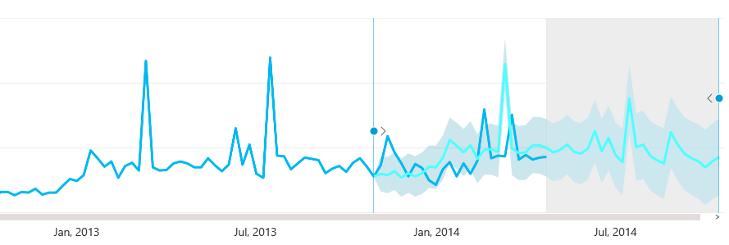

Slide 23
Best practices for
Q & A

Slide 24
Steps in Q&A
Search for interpretations of question
Score and select best interpretation
Select best visual
Q: Medal count by country for 2012 | Score
From Olympics.xlsx show medal[medal count], medal[country] … | 0.86
From Olympics.xlsx show medal[medal count], Olympics[host country] … | 0.72
From Sales.xlsx select customer[country] … (no medal count) | 0.45
Q: Medal count by country for 2012
From Olympics.xlsx show medal[medal count], medal[country] …
From Olympics.xlsx show medal[medal count], Olympics[host country] …
From Sales.xlsx select customer[country] … (no medal count)

Slide 25
Steps in Q&A
Search for interpretations of question
Score and select best interpretation
Select best visual
Content | Display
Show 1 measure, 1 member (geo) | Map
Show 2 measures, 1 member | Scatter
Show 1 measure, 1 member | Bar

Slide 26
Influencing the best answer
Search for interpretations of question
  Data Modeling
  Synonyms
Score and select best interpretation
  Phrasing
Select best visual
  Data Modeling
  Categories

Slide 27
Naming Rules
Table name corresponds to entity name
  Use single word if possible
Avoid abbreviations and acronyms
Omit data type in column name
Simple “objects” might be in a single column
  Attribute of entities, such as Color, Quantity, Price

Slide 28
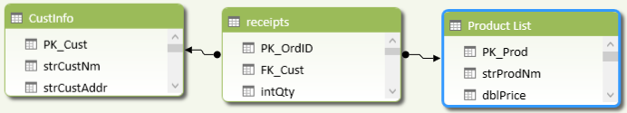
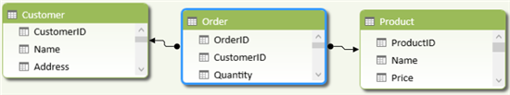
Naming Rules
Poor
Better

Slide 29
Hidden Objects
Hidden tables, columns and measures are ignored
  Q&A does not consider any hidden object
Hide internal data model details
  Does not expose to Q&A and other tools what is not meaningful for end user
Only active relationships are considered
  Missing relationship are like inactive relationship – ignored by Q&A

Slide 30
Standard Power Pivot Properties
Data Type
  Use the correct data type: dates as date, numbers as number, not strings
Summarize By
  Mark numeric columns as Do Not Summarize if not aggregatable (year, id, …)
  Use Average when sum is not correct (age, price, …)
Sort By Column
  Used to control display order of results

Slide 31
Data Category
Semantic Knowledge
  Add semantic knowledge about the content of a column beyond its data type
    e.g. numeric columns marked as Year or Zip Code
  Use Custom Category for Year
Choice of visual display
  Date or time are a good choice for the horizontal axis of a line chart or the play axis of a bubble chart
  Columns with geographical data categories suggest using a map
Better interpretation of questions
  The “when” in “When was John Smith hired?” is almost certain to map to a date column
  The “Brown” in “Count customers in Brown” is more likely to be a city than a hair color

Slide 32
Use of Advanced Properties
Default Field Set
  Columns shown by default when asking questions about a table
Default Label
  Help choosing what kind of graph or chart to use for displaying results
  Example: count orders by customer
    Default Label not set → Tabular result if there are many columns to display by default
    Default Label set to “Customer Name” → Bar chart using customer name for each value

Slide 33
Data Model Normalization for Q & A
One table per entity
  Star schema with Slowly Changing Dimension is ok (Type 1 and Type 2 – avoid Type 3)
One column per attribute
  Power View does not parse column content
Use active relationships between entities
  Relationships are translated in verbs (has, owns, …)

Slide 34
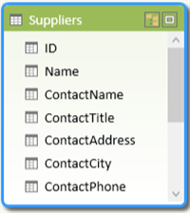
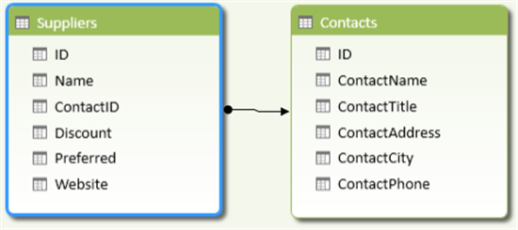
New Tables for Multi-Column Entities
Split column group in a different table
  Split in a different table multiple columns that act as a distinct unit (such as Contact* in Suppliers)
Poor
Better

Slide 35
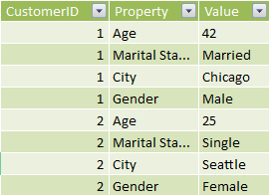

Pivot to Eliminate Property Bags
Property bags have many limitation with Q&A
  Pivot each property in a single column
Poor
Better

Slide 36


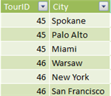
Union to Eliminate Partitioning
Merge partitioned tables in a single column
  Sales2000-2010 and Sales 2011-2020 should be in a single table Sales
Unpivot partitioned columns
  Split City1, City2, City3 in a City table
Better
Poor

Slide 37


One Column per Attribute
Split formatted columns
  Full address might be good for Power Map, but one column per attribute allows individual query
Poor
Better

Slide 38
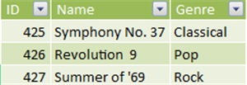
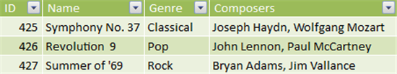
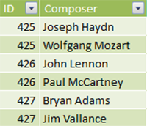
One Column per Attribute
New tables for multi-value columns
  Create one-to-many relationship for list of attributes
Better
Poor

Slide 39
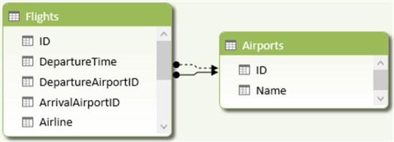
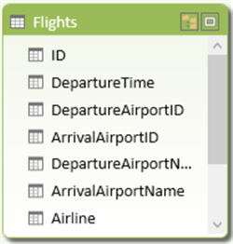
Avoid Inactive Relationships
Avoid multiple relationships between two tables
  Denormalize attributes with different names corresponding to roles
  Follow best practice for role dimensions in Power Pivot: rename table and all the columns for each role
Poor
Better

Slide 40
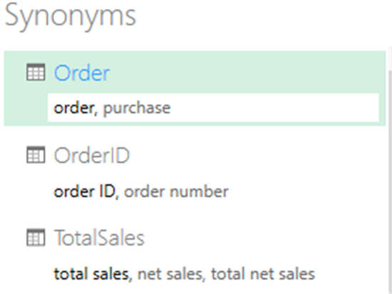
Synonyms
Effective dictionary used by Q&A
  List synonyms by using comma
  By default, first name is a copy of table/column/measure name
  Removing it is like renaming (Q&A does not consider names in the data model, just synonyms)

Slide 41
Phrasing
Relationships define verbs
  Column name on many side of a relationship define verb
  Default verb for a relationship is “have” (Customer have Cars)
  Use synonym or name to specify verbs
  Owner → owned by (Customer own Cars)
Additional reading (for future enhancements)
  Demystifying Power BI Q&A – Part 3
  http://blogs.msdn.com/b/powerbi/archive/2014/03/12/demystifying-power-bi-q-amp-a-part-3.aspx

Slide 42
Conclusion
Power Pivot Data Model for Power BI
  Use all the best practices in data modeling
  Optimization for memory consumption and query performance
  Benefits for client tools (PivotTable, Power View, Q&A)
Specific Patterns for Q&A
  Use naming synonyms to adapt naming convention
  Relationship have semantic meaning
  Refine model over time based on Q&A users’ feedback

Slide 43
Related content
Breakout Sessions
  DBI-B318 Amazing Data Storytelling with Microsoft Power BI Q&A (Formerly InfoNavigator)

Slide 44

Resources
Learning
  Sessions on Demand
  Microsoft Certification & Training Resources
http://channel9.msdn.com/Events/TechEd
www.microsoft.com/learning
TechNet
msdn
  Resources for IT Professionals
  Resources for Developers
http://microsoft.com/technet
http://microsoft.com/msdn

Slide 45



Complete an evaluation and enter to win!

Slide 46


Evaluate this session
Scan this
QR code
to evaluate
this session.

Slide 47


© 2014 Microsoft Corporation. All rights reserved. Microsoft, Windows, and other product names are or may be registered trademarks and/or trademarks in the U.S. and/or other countries.
The information herein is for informational purposes only and represents the current view of Microsoft Corporation as of the date of this presentation. Because Microsoft must respond to changing market conditions, it should not be interpreted to be a commitment on the part of Microsoft, and Microsoft cannot guarantee the accuracy of any information provided after the date of this presentation. MICROSOFT MAKES NO WARRANTIES, EXPRESS, IMPLIED OR STATUTORY, AS TO THE INFORMATION IN THIS PRESENTATION.

