Slide 1


Slide 2

Forecasting with the Microsoft Time Series
Data Mining Algorithm
DBI-B326
Peter Myers
Bitwise Solutions Pty Ltd

Slide 3



Presenter Introduction
Peter Myers
BI Expert, Bitwise Solutions Pty Ltd
BBus, SQL Server MCSE, MCT, SQL Server MVP (since 2007)
Experienced in designing, developing and maintaining Microsoft database and application solutions, since 1997
Focuses on education and mentoring
Based in Melbourne, Australia
peter.myers@bitwisesolutions.com.au
http://www.linkedin.com/in/peterjsmyers

Slide 4
Session Outline
Describing the Data Mining Process
Introducing the Microsoft Time Series Algorithm
  Including demonstrations to produce forecasts by using:
    Table Analysis Tools Excel Add-In
    Client Tools Excel Add-In
    SQL Server Data Tools (SSDT) Project
    Script (DMX)
    .NET Programming
Tuning a Time Series Mining Model
Describing Business Scenarios

Slide 5
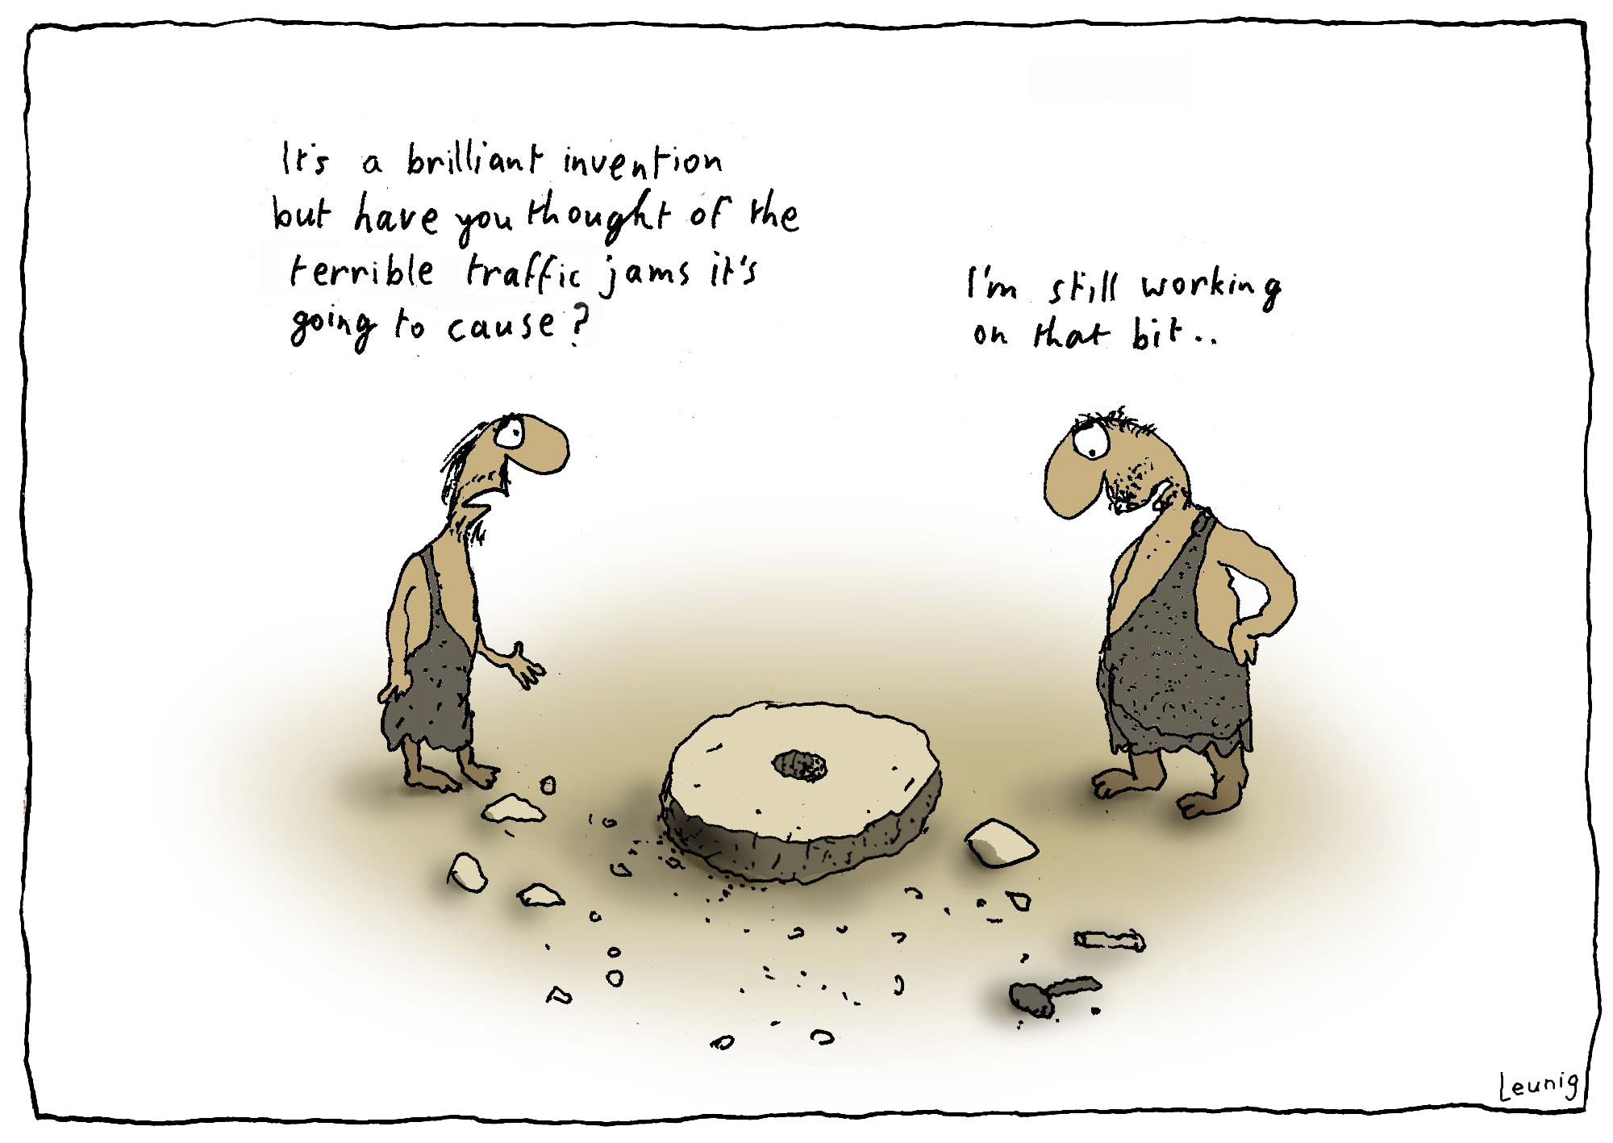
The History of Forecasting

Slide 6
The History of Forecasting

Slide 7



Slide 8
Time Series Forecasting
The development of data mining models to predict future values based on previously observed values

Slide 9
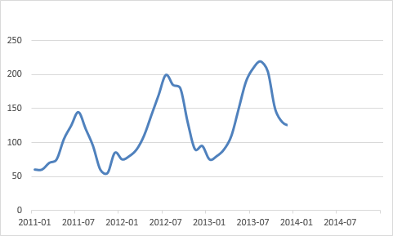
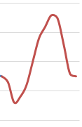

Slide 10
Describing the
Data Mining Process

Slide 11
Describing the Data Mining Process
Design ► Process ► Query
Mining Model

Slide 12
Describing the Data Mining Process
Design ► Process ► Query
Mining Model
Data Mining Engine
Training Data

Slide 13
Describing the Data Mining Process
Design ► Process ► Query
Mining Model
Data Mining Engine
Predicted Data
Data to Predict

Slide 14
Introducing the
Microsoft Time Series Algorithm

Slide 15
SQL Server 2012 Analysis Services
Data Modeling (BISM)
  Delivers intuitive, high-performance access to data
  Encapsulates calculations
Data Mining
  Includes a suite of nine algorithms
  Discovers patterns in data
  Enables knowledge discovery and predictive analytics

Slide 16
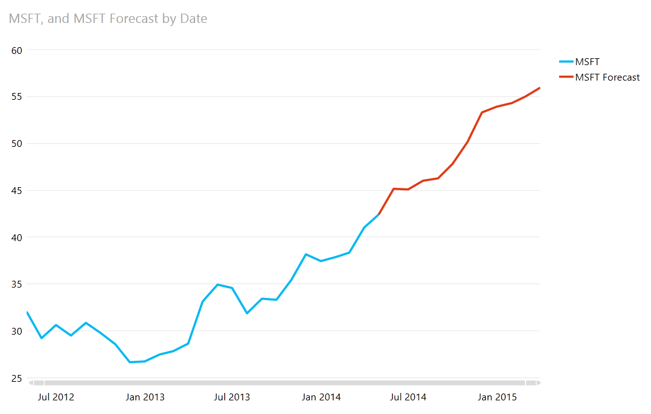
Microsoft Time Series Algorithm
First delivered in Analysis Services 2005
Provides the blending of two machine learning algorithms for forecasting continuous values (stock prices, sales, temperatures etc.)
  ARTxp
  ARIMA (since Analysis Services 2008)
The algorithm detects trends and
can use them to predict future
steps in a time series

Slide 17
Demo
Simple Forecasting by Using the
Table Analysis Tools Excel Add-In

Slide 18
Microsoft Time Series Algorithm
ARTxp Algorithm
AutoRegressive Tree (ART) with cross-series prediction (xp)
Cross-series prediction predicts the outcome of one series based on the behaviour of another
  For example, ice cream sales and temperature
  Only enabled in Business Intelligence and Enterprise editions
Developed by, and unique to, Microsoft
Based on the Microsoft Decision Trees algorithm
Considered the most accurate algorithm for predicting the next likely value(s) in a series

Slide 19
Demo
Exploring Different ARTxp Scenarios by Using the Data Mining Client Excel Add-In

Slide 20
Microsoft Time Series Algorithm
ARIMA Algorithm
AutoRegressive Integrated Moving Averages
Introduced in Analysis Services 2008
An industry-standard forecasting algorithm
Considered a more accurate and stable algorithm for long-term prediction
Does not support cross-series prediction

Slide 21
Time Series Model Definition
Each Time Series mining model must contain:
  One key time column
    Specifies the time slices
    Can be any data type – typically numeric
  Predictable column(s)
    Must contain continuous numeric values (no missing data points)
    Define the model columns as INPUT, or PREDICT to allow cross-series prediction
    In Standard Edition, all columns must be defined as PREDICT_ONLY
An optional series key column can be included for interleaved format
  Ensure training data is clean, representative and ordered chronologically
  Time series data must not have missing data points or values

Slide 22
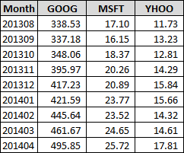
Time Series Data
Columnar Format
The key time and data series
are columns
Each row represents a distinct
time slice
Advantages:
  Easy to produce and interpret
  Allows specific column types
Disadvantage:
  Must add a new column to introduce a new series
Key time column
Predictable columns

Slide 23
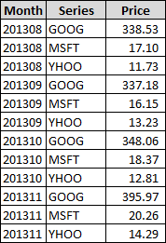
Time Series Data
Interleaved Format
Consists of unique time
and series combinations
Advantages:
  Series names come directly from data
  Can easily add new series
Disadvantages:
  More difficult to produce and interpret
  Uses same column types
Key time column
Data value
Series

Slide 24
Characteristics of Time Series Models
Time Series mining models differ from other types of mining models:
  Can be trained by using small data sets
  Training data must be loaded in chronologic order
  Model life time can be ephemeral (short-lived)
    Predicted values become obsolete once that time period has occurred
    Note: Mining models can be created as session models
  Models may require reprocessing as new time period data becomes available
  Models must be configured with DRILLTHROUGH enabled (certain metadata is sourced by drillthrough)
  Accuracy testing cannot involve hold out data

Slide 25
Time Series Model Querying
Forecasting is achieved with the PredictTimeSeries function
There are many overloaded forms
The function returns a nested table (hierarchical rowset), which can be flattened to return a table structure
Each table row represents a predicted step
PredictTimeSeries(<table column reference>, n)

Slide 26
Time Series Model Querying
Examples
Using columnar format:
Using interleaved format:
SELECT FLATTENED PredictTimeSeries([MSFT], 3) AS Forecast
FROM [StockForecast]
SELECT FLATTENED PredictTimeSeries([Price], 3) AS Forecast
FROM [StockForecastInterleaved]
WHERE [Series] = 'MSFT'

Slide 27
Demo
Querying a Mining Model by Using Excel

Slide 28
Time Series Model Querying
Additional Scenarios
The PredictTimeSeries function can start from a point before the last mining model case
A prediction join can be used to pass in additional data, to replace or extend mining model cases
  Introduced in Analysis Services 2008
  Available only in Business Intelligence and Enterprise editions
SELECT FLATTENED PredictTimeSeries([MSFT], -6, 0) AS Forecast
FROM [StockForecast]

Slide 29
Time Series Model Querying
Additional Scenarios (Continued)
REPLACE_MODEL_CASES
  Specifies that the data points in the mining model should be replaced with new data
  However, predictions are still based on the patterns in the existing mining model
EXTEND_MODEL_CASES
  Specifies that the new data should be added to the original training data set
  Future predictions are made on the composite data set only after the new data has been used
  Can be used to supplement series data to execute what-if scenarios

Slide 30
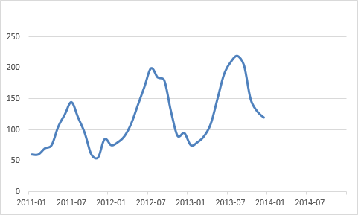
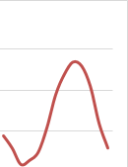
Time Series Model Querying
Additional Scenarios: Replacing Cases
What would future sales be if applied to a different
data series?

Slide 31

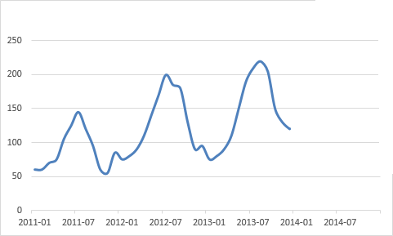
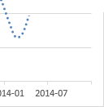
Time Series Model Querying
Additional Scenarios: Extending Cases
If we sold less in the next months, how would that impact on future sales?

Slide 32
Demo
Querying a Mining Model by Using
SQL Server Management Studio

Slide 33
Tuning a Time Series
Mining Model

Slide 34
Determining Prediction Accuracy
Additional data mining functions can be used to determine the quality of the prediction:
  PredictVariance
  PredictStdev (square root of variance)
SELECT FLATTENED
(SELECT *, PredictStDev() AS Stdev, PredictVariance() AS Var
FROM PredictTimeSeries([MSFT], 3)) AS Forecast
FROM [StockForecast]

Slide 35
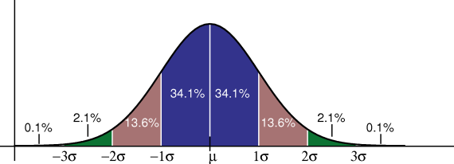
Determining Prediction Accuracy
(Continued)
The larger the deviations, the less reliable the mining model is for forecasting
  There is a 68% chance that the predicted value lies within 1 standard deviation of the prediction
  And, a 95% chance it lies within 2 standard deviations
High deviations may
be addressed by tuning
the mining model by
configuring the algorithm
parameters

Slide 36
Algorithm Parameters
MISSING_VALUE_SUBSTITUTION
  Once a series commences there should be no missing values
  PREVIOUS, MEAN or a constant value can be used to compute any missing values
PERIODICITY_HINT
  Where known cycles exist in a series, declare them to the model as a set: {12, 3}
  Periodicity is expressed as the number of time slices per cycle
  The Time Series algorithm is very sensitive to this parameter

Slide 37
Algorithm Parameters
(Continued)
FORECAST_METHOD
  Determines which algorithm is used:
    MIXED (default), ARTXP or ARIMA
  Setting to ARTXP will simulate Analysis Services 2005 behavior
  Enabled only in Business Intelligence and Enterprise editions
PREDICTION_SMOOTHING
  Controls the balance of the blend between ARTxp and ARIMA
  Only comes into effect if FORECAST_METHOD is set to MIXED
  Closer to 0 means more ARTxp; closer to 1 means more ARIMA
  Enabled only in Business Intelligence and Enterprise editions

Slide 38
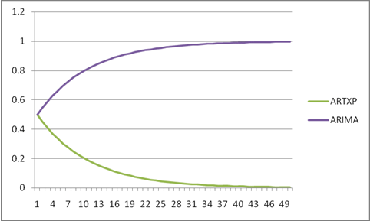
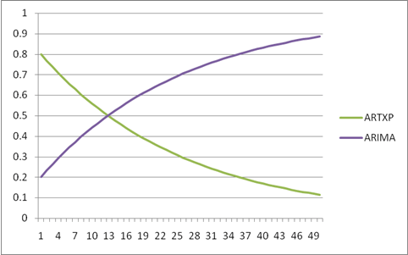
Algorithm Parameters
PREDICTION_SMOOTHING Scenarios
PREDICTION_SMOOTHING set to 0.5
Equal blending
PREDICTION_SMOOTHING set to 0.2
For step 0, the model weights ARIMA as 0.2 and ARTXP as 0.8
Thereafter, the weight of ARIMA exponentially increases and the weight of ARTxp exponentially decreases

Slide 39
Algorithm Parameters
(Continued)
INSTABILITY_SENSITIVITY
  Only valid when FORECAST_METHOD is set to ARTXP
  Values closer to 0 will reduce the impact of instability detection
  The default of 1 will simulate Analysis Services 2005 behavior
  Enabled only in Business Intelligence and Enterprise editions
MINIMUM_SERIES_VALUE
MAXIMUM_SERIES_VALUE
  Allows setting limits for the range of valid predictions
  Enabled only in Business Intelligence and Enterprise editions

Slide 40
Demo
End-to-end Forecasting by Using SSDT and DMX

Slide 41
Describing
Business Scenarios

Slide 42
Business Scenarios
Consider any scenario involving the need to know what is likely to happen
Extend trend analysis with “what could be” scenarios
Seed planning data based on forecasts
Embed forecasts into applications
  Microsoft data mining visualizations can be embedded directly into .NET Windows Forms applications
  Applications, or SQL CLR objects, can create and/or query mining models by using ADOMD.NET

Slide 43
Business Scenarios
(Continued)
For the IT Professional:
  Mine server performance counters to gauge when hardware upgrades may be required
  Mine ETL statistics to better understand the future growth of the data warehouse, and disk space requirements

Slide 44
Demo
Forecasting by Using a SQL CLR Function

Slide 45
Summary
The Time Series algorithm is used for forecasting
Choose the tool that fits your skills and requirements:
  Excel add-ins
  SSDT
  Script with DMX
  .NET programming
Algorithm parameters can be configured to tune the mining model for improved accuracy and reliability
Developers can embed forecasts into applications

Slide 46
Resources
SQL Server Predictive Analytics web site
  http://www.microsoft.com/en-us/sqlserver/solutions-technologies/business-intelligence/predictive-analytics.aspx
  Links to related documents, related sites, and community resources
MSDN Analysis Services Data Mining Documentation
  http://msdn.microsoft.com/library/bb510517.aspx
SQL Server Data Mining Community web site
  http://www.sqlserverdatamining.com
  Site designed and maintained by the SQL Server Data Mining engineering team
  Includes live samples, tutorials, webcasts, tips and tricks, and FAQ

Slide 47
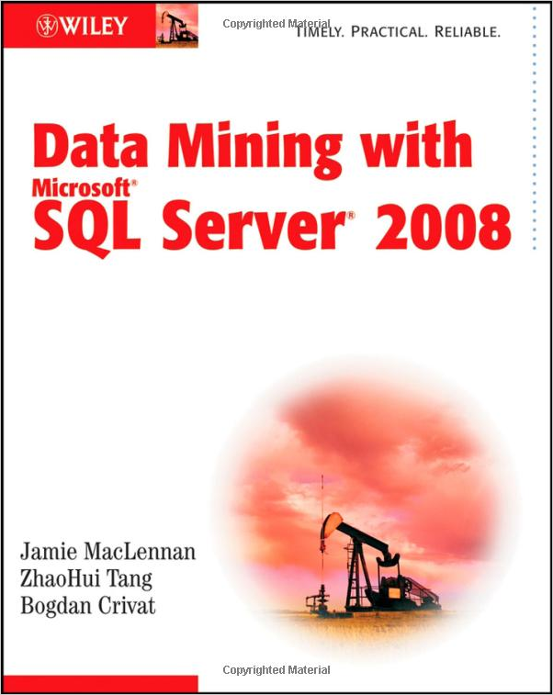
Resources
(Continued)
TechNet: Implementing Smart Reports with the Microsoft Business Intelligence Platform
  http://technet.microsoft.com/library/cc966451.aspx
  Describes how to develop a report that uses a session data mining model to forecast future sales with a SQL CLR stored procedure
Book: “Data Mining for SQL Server 2008”
  Publisher: Wiley
  Authors: , by Jamie MacLennan,
  ZhaoHui Tang and Bogdan Crivat
Paul the Octopus
  http://en.wikipedia.org/wiki/Paul_the_Octopus

Slide 48

Track resources
Download Microsoft SQL Server 2014
http://www.trySQLSever.com
Try out Power BI for Office 365!
    http://www.powerbi.com
Sign up for Microsoft HDInsight today!
    http://microsoft.com/bigdata

Slide 49

Resources
Learning
  Sessions on Demand
  Microsoft Certification & Training Resources
http://channel9.msdn.com/Events/TechEd
www.microsoft.com/learning
TechNet
msdn
  Resources for IT Professionals
  Resources for Developers
http://microsoft.com/technet
http://microsoft.com/msdn

Slide 50



Complete an evaluation and enter to win!

Slide 51


Evaluate this session
Scan this
QR code
to evaluate
this session

Slide 52


© 2014 Microsoft Corporation. All rights reserved. Microsoft, Windows, and other product names are or may be registered trademarks and/or trademarks in the U.S. and/or other countries.
The information herein is for informational purposes only and represents the current view of Microsoft Corporation as of the date of this presentation. Because Microsoft must respond to changing market conditions, it should not be interpreted to be a commitment on the part of Microsoft, and Microsoft cannot guarantee the accuracy of any information provided after the date of this presentation. MICROSOFT MAKES NO WARRANTIES, EXPRESS, IMPLIED OR STATUTORY, AS TO THE INFORMATION IN THIS PRESENTATION.

