Slide 2
Deriving Business Insights Using Microsoft BI Connected to the SAP ERP and BI Platform
Sanjay Soni | Sr. Technical Product Marketing Manager
Justin Martinson | Sr. Product Marketing Manager
Christoph Schuler | Connected ERP Principal Consultant

Slide 3
Agenda
Microsoft BI Integration Scenarios for SAP
Microsoft/SAP Partnership
Innovating for Success
Demos

Slide 4
Microsoft BI Integration Scenarios for SAP
User directly connected to SAP system
ETL/replication of SAP source data
Discover
Power Query in Excel
Integrate
Integration Services
into SQL Server DW
Analyze
Power Pivot, PivotTable in Excel
Report
Reporting Services

Slide 5
Microsoft/SAP Partnership
20+ Years of strategic partnering
35,000+ joint platform & infrastructure customers
1.0
Integrated Productivity Solutions – Cloud, Mobility, Devices
Global network of joint SI and ISV partners
1.0

Slide 6
Innovating For Your Success
Microsoft Top Priorities in the Enterprise Market
SAP Top Priorities for 2014
Cloud
Win 8 Tablets and Apps
Applications
Drive Deployment of Win, Office, IE & AD
Mobile & Industry
Mobile 1^{st &}
Simple UI/UX
Win every time with Office 365
Interoperability
Analytics
Win the Modern Datacenter
Platform and Infrastructure
Business Analytics & Mission Critical
Hana Platform

Slide 7
What We Hear From Customers
Convoluted data access and interaction
Need additional ROI from existing technology investments
Get data into the hands of more business users
Simplify

Slide 8
Reimagining Customer Investment Value
Single Version of Truth
Excel
Power BI
Instant Productivity
SAP BusinessObjects BI
Optimized Business Performance

Slide 9
Power BI Connectivity to SAP BusinessObjects BI
Discover
SAP BusinessObjects BI
Power Query
Key advantages:
Excel users have seamless and direct access to SAP data exposed via SAP BusinessObjects BI Universes
Excel is familiar front-end tool, no need to learn complex new tool set or skills
Semantic layer of SAP BusinessObjects BI Universes hides the complexity of the underlying SAP data source
Customers can leverages existing investments in Microsoft and SAP BI technologies
SAP data can be loaded into Excel table or Power Pivot data model
Requirements:
Excel 2010 or Excel 2013
Power Query add-in with SAP BusinessObjects BI Universe connectivity
SAP BusinessObjects BI 4.1 SP2 or higher

Slide 10
Demo
Excel/Power BI Connectivity to SAP BusinessObjects BI Universes

Slide 11
Microsoft BI Integration Scenarios for SAP
User directly connected to SAP system
ETL/replication of SAP source data
Discover
Power Query in Excel
Integrate
Integration Services
into SQL Server DW
Analyze
Power Pivot, PivotTable in Excel
Report
Reporting Services

Slide 12
SAP NetWeaver Gateway
Analyze
SAP ERP SAP BW
SAP NetWeaver Gateway
Excel
Key advantages:
NetWeaver Gateway enables standard OData access to SAP
NetWeaver Gateway supports other use cases, e.g. R/W integration with SharePoint, Office, mobile apps
Multitude of data sources are supported – Function Modules, BAPIs, ABAP objects
Works with SAP ERP, SAP CRM, … SAP BW, SAP HANA
Requirements:
SAP NetWeaver Gateway
Excel 2010 or Excel 2013

Slide 13
Demo
SAP NetWeaver Gateway

Slide 14
Microsoft Connector for SAP NetWeaver BI (SAP BW)
Integrate
SQL Server Integration Services
SQL Server Data Warehouse
SAP BW
Key advantages:
SAP certified for unloading data from SAP BW
Supports delta extraction and packaging; well suited for large amounts of data
Supports parallel extraction
Requirements:
Open Hub Services license and configuration in SAP BW
Works with Integration Services

Slide 15
Demo
Microsoft Connector for SAP NetWeaver BI

Slide 16
Theobald Software - Xtract IS
Integrate
SAP ERP SAP BW
SQL Server Integration Services
SQL Server Data Warehouse
Key advantages:
Easy to install with Setup Wizard
Access to virtually any SAP data object
SAP table, query, BAPI, BW cube, OHS, hierarchy, BW loader, report, DeltaQ
In any type of SAP system (SAP ERP, SAP CRM,… SAP BW)
SSO enabled via SNC (Secure Network Communication)
Easy to use. Search/browse for data objects in SAP by description
Requirements:
Works with Integration Services

Slide 17
Demo
Theobald Software - Xtract IS

Slide 18
Microsoft BI Integration Scenarios for SAP
User directly connected to SAP system
ETL/replication of SAP source data
Discover
Power Query in Excel
Integrate
Integration Services
into SQL Server DW
Analyze
Power Pivot, PivotTable in Excel
Report
Reporting Services

Slide 19
Track resources
PowerBI.com
http://www.microsoft.com/en-us/powerBI/SAP.aspx

Slide 20
Resources
Learning
Sessions on Demand
Microsoft Certification & Training Resources
http://channel9.msdn.com/Events/TechEd
www.microsoft.com/learning
TechNet
msdn
Resources for IT Professionals
Resources for Developers
http://microsoft.com/technet
http://microsoft.com/msdn

Slide 21
Complete an evaluation and enter to win!

Slide 22
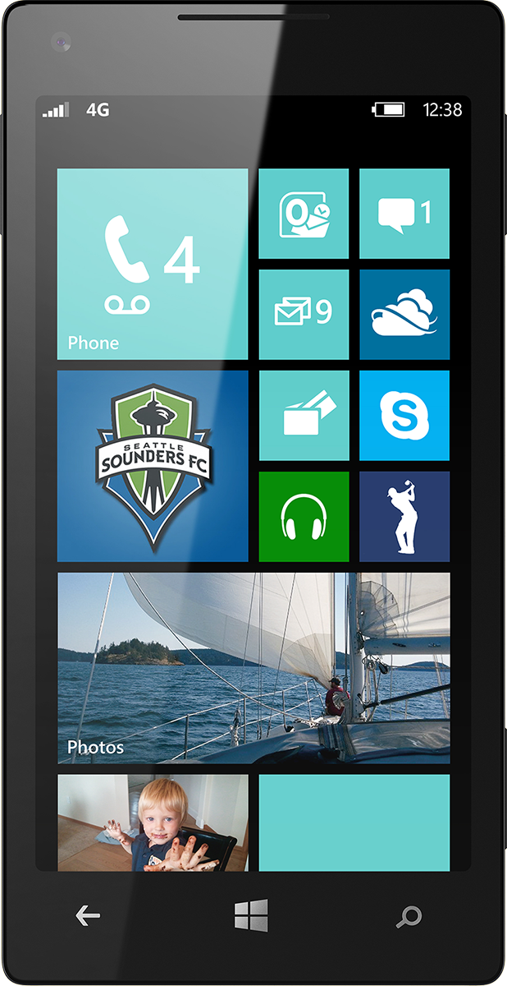
Evaluate this session
Scan this QR code to evaluate this session.

Slide 23
© 2014 Microsoft Corporation. All rights reserved. Microsoft, Windows, and other product names are or may be registered trademarks and/or trademarks in the U.S. and/or other countries.
The information herein is for informational purposes only and represents the current view of Microsoft Corporation as of the date of this presentation. Because Microsoft must respond to changing market conditions, it should not be interpreted to be a commitment on the part of Microsoft, and Microsoft cannot guarantee the accuracy of any information provided after the date of this presentation. MICROSOFT MAKES NO WARRANTIES, EXPRESS, IMPLIED OR STATUTORY, AS TO THE INFORMATION IN THIS PRESENTATION.

