Slide 2
Microsoft SQL Server 2014: In-Memory OLTP for Database Administrators
DBI-B385
Sunil Agarwal
Program Manager
sunila@microsoft.com

Slide 3
Session Objectives And Takeaways
Session Objective(s):
Understand the SQL Server 2014 In-Memory OLTP
Memory usage and Management
Storage usage and Management
Key Takeaway 1
Memory-optimized tables have new memory-optimized data structures and must fit in memory
Key Takeaway 2
Durability of memory-optimized tables requires consideration for storage and recovery

Slide 4
Memory Usage and Managment

Slide 5
In-Memory Data Structures
Rows
New row format
Structure of the row is optimized for memory residency and access
No data page containers
Rows are versioned (payload never updated in place) – Delete/Insert
Indexes
Nonclustered Indexes only
Indexes point to physical rows. No need for covering columns
<nonclustered hash> index for point lookups.
<nonclustered> index for range (inequality) and ordered scans
Not logged and do not exist on disk – maintained online or recreated during recovery
No index fragmentation on disk

Slide 6
Memory-optimized Table: Row Format
Row header
Payload (table columns)
8 bytes * (IdxLinkCount)
Begin Ts
End Ts
StmtId
IdxLinkCount
8 bytes
8 bytes
4 bytes
2 + 2 (padding)
bytes
Key Points
Begin/End timestamp determines row’s version validity and visibility
No data pages; just rows
Row size limited to 8060 bytes (@table create time) to allow data to be moved to disk-based table
Not every SQL table schema is supported (for example LOB and SQLVARIANT are not supported)

Slide 7
Memory Optimized Tables: Hash Indexes
Timestamps
Chain ptrs
Name
City
Hash index on Name
Hash index on City
f(Jane)
50, ∞
Jane
Prague
f(John)
f(Prague)
100, 200
John
Prague
f(Beijing) f(Bogota)
200, ∞
John
Beijing
90, 150
Susan
Bogota

Slide 8
Memory Optimized Tables: BW Tree
Page Mapping Table
Page size- up to 8K. Sized to the row
Logical pointers
Indirect physical pointers through Page Mapping table
Page Mapping table grows (doubles) as table grows
Sibling pages linked one direction
Require two indexes for ASC/DSC
No in-place updates on index pages
Handled thru delta pages or building new pages
No covering columns (only the key is stored)
0
Physical
Logical
1
Root
2
10
20
28
PageID-0
3
PageID-3
PageID-2
PageID -14
5
8
10
11
15
18
21
24
27
Non-leaf pages
1
2
4
6
7
8
25
26
27
leaf pages
14
Data rows
200, ∞
1
50, 300
2
15
Key
Key
100,200
1

Slide 9
Memory Management
Data resides in memory at all times
Must configure SQL server with sufficient memory to store memory-optimized tables
Failure to allocate memory will fail transactional workload at run-time
Integrated with SQL Server memory manager and reacts to memory pressure for GC (Garbage Collection)
Guidance for SQL2014 is not to exceed 256GB of in-memory table user data
Integrated with Resource Governor
Recommend using dedicated resource pool
To ensure performance stability for disk-based table workloads
“Bind” a database to a resource pool
Memory-optimized tables cannot exceed the limit of the resource pool
Hard top limit (function of the physical memory) to ensure system remains stable under memory pressure

Slide 10
Garbage Collection
Stale Row Versions
Updates, deletes, and aborted insert operations create row versions that (eventually) are no longer visible to any transaction
Slow down scans of index structures
Create unused memory that needs to be reclaimed (i.e. Garbage Collected)
Garbage Collection (GC)
Analogous to version store cleanup task for disk-based tables to support Read Committed Snapshot (RCSI)
System maintains ‘oldest active transaction’ hint
GC Design
Non-blocking, Cooperative, Efficient, Responsive, Scalable
Active transactions work cooperatively and pick up parts of GC work
A dedicated system thread for GC

Slide 11
Memory Optimized Tables: Garbage Cleanup
Timestamps
Chain ptrs
Name
City
Hash index on Name
Hash index on City
f(Jane)
50, ∞
Jane
Prague
f(John)
f(Prague)
100, 200
John
Prague
f(Beijing)
200, ∞
John
Beijing
90, 150
Susan
Bogota
T250: lowest Active Transaction Timestamp
Select * from <table> where name = ‘John’
Automatic Garbage Collection kicks in

Slide 12
Memory Usage and Monitoring
Table Data
Rule of thumb: 2 x data_size for physical memory allocation due to versioning overhead
Index Data
Nonclustered Hash index:
Fixed size (bucket_count*8B)
Nonclustered (Range) index:
Variable size (Key columns+8B)
Considerations
Configuration
Use resource governor
Monitoring
Use DMVs, SMO, SSMS and SSMS reports
Management

Slide 13
Demo: Memory Usage Sunil Agarwal

Slide 14
On Disk Storage

Slide 15
Disk-Based Tables – Storage Revisited
Page based
Latch contention due to concurrent access
Random IO when modified page is flushed to disk
Checkpoint can flood the IO and can cause temporary glitch in the workload
Transaction Log
Each change to the data and index row is logged separately
UNDO is part of the transaction log for rollback

Slide 16
Durability
Memory-optimized tables can be durable or non-durable
Default is ‘durable’
Non-durable tables are useful for transient data (“relational” cache scenario)
Only Committed transactions are logged
No UNDO is logged
A common system bottleneck; SSD or Fusion-IO recommended
Delayed durability support – define at the SP/Transaction level
Durable tables are persisted in memory-optimized filegroup
Storage used for memory-optimized has a different access pattern (Sequential IO) than for disk tables
Recommend SSD or fast (15K e.g.) SAS drives
Filegroup can have multiple containers (volumes) to aid in parallel recovery; recovery typically happens at the speed of IO

Slide 17
Storage in Memory-Optimized Filegroup
Filestream is the underlying storage mechanism
Checksums and single-bit correcting ECC on files
Data files
For machines <=16GB memory – size 16MB. For larger machines – 128MB
Writes in 256KB chunks at a time
Stores only the inserted rows (i.e. table content)
Chronologically organized streams of row versions
Delta files
For machines <=16GB memory – size 1MB. For larger machines – 8MB
Writes in 4KB chunks at a time.
Stores IDs of deleted rows

Slide 18
Storage: Data and Delta Files
0
100
Transaction Timestamp Range
Data File
TS (ins)
RowId
TableId
Row pay load
TS (ins)
RowId
TableId
Row pay load
TS (ins)
RowId
TableId
Row pay load
Data file contains rows inserted
within a given transaction range
Checkpoint File Pair
Delta File
TS (ins)
RowId
TS (del)
TS (ins)
RowId
TS (del)
TS (ins)
RowId
TS (del)
Delta file contains deleted rows
within a given transaction range

Slide 19
Populating Data/Delta files
SQL Transaction log
(from LogPool)
Del Tran1 (row TS150)
Log in disk Table
Del Tran2 (TS 450)
Del Tran3 (row TS 250)
Insert into Hekaton T1
Del Tran1(TS150)
Del Tran2 (row TS 450)
Del Tran3 (TS 250)
Insert into T1
Data file has pre-allocated size (128 MB or 16 MB on smaller systems)
Engine switches to new data file when the current file is full
Transaction does not span data files
Once a data file is closed, it becomes read-only
Row deletes are tracked in delta file
Files are append only
Offline Checkpoint Thread
Delete 150 TS
Delete 250 TS
Delete 450 TS
New Inserts
Memory-optimized Table Filegroup
Range 100-200
Range 200-300
Range 300-400
Range 400-500
Range 500-
Data file with rows generated in timestamp range
IDs of Deleted Rows (height indicates % deleted)

Slide 20
Merge Operations
What is a Merge Operation?
Merges one or more adjacent data/delta files pairs into 1 pair
Need for Merge
Deleting rows causes data files to have stale rows
DMV: sys.dm_xtp_checkpoint_files can be used to find inserted/deleted rows and freespace
Benefits of Merge
Reduces storage (i.e. fewer data/delta files) required to store active data rows
Improves the recovery time as there will be fewer files to load
Merge is a (non-blocking) background operation
Merge does not block concurrent deletes in the affected file pairs

Slide 21
Merge Operation
Files as of Time 500
Files as of Time 600
Memory-optimized data Filegroup
Memory-optimized data Filegroup
Range 100-200
Range 200-300
Range 300-400
Range 400-500
Range 100-200
Range 200-300
Range 200-400
Range 400-500
Range 500-600
Range 200-299
Range 300-399
Range 300-400
Merge
200-400
Data file with rows generated in timestamp range
IDs of Deleted Rows (height indicates % deleted)
Files Under Merge
Deleted Files

Slide 22
Logging for Memory-Optimized Tables
Uses SQL transaction log to store content
Log record: log record header followed by opaque memory optimized-specific log content.
All logging for memory-optimized tables is logical
No log records for physical structure modifications.
No index-specific / index-maintenance log records.
No UNDO information is logged
Recovery Models
All three recovery models (Simple, Full, Bulk) are supported

Slide 23
In-Memory OLTP: Checkpoint
Disk-based tables
Frequency is determined by the recovery interval configuration option
Can potentially flood IO queue when flushing dirty pages.
In-Memory OLTP
Automatic checkpoint done after 512MB of transaction log written the last checkpoint
Independent of the checkpoint for disk-based tables
No flooding of IO queue. Checkpoint writes meta-information (e.g. list of data/delta files)
Manual Checkpoint
Forces checkpoint for both disk-based tables and memory_optimized tables

Slide 24
Storage Considerations
Capacity
Capacity needed up to 4x size of durable memory optimized tables
Performance
Use sequential bandwidth sufficient to meet RTO
SSD Array or high end spinning media (15K SAS Array e.g.)
Data
Capacity
Log size is less than disk based tables but still ~ size of data change
Performance
Latency is important
(PCIe) SSD Array
Consider Delayed Durability for higher latency devices
Log

Slide 25
Backup for Memory-Optimized Tables
Integrated with SQL Database Backup
Memory-Optimized file group is backed up as part SQL database backup
Differential backup supported – only new data files since last full backup
Piecemeal backups supported
Existing backup scripts work with minimal or no changes
Transaction log backup includes memory-optimized log records transparently

Slide 26
In-Memory OLTP: Recovery
Impact on RTO
Load speed (IO) of data & Size of durable tables
Hash index with heavy collision (bucket count too low) and large nonclustered (Range) index have additional recovery overhead.
Memory
Optimized Tables
Recovery Data Loader
Recovery Data Loader
Recovery Data Loader
filter
filter
filter
Delta map
Delta map
Delta map
Data
File1
Delta
File1
Data
File2
Delta
File2
Data
File3
Delta
File3
Memory Optimized Container - 1
Memory Optimized Container - 2

Slide 27
In-Memory OLTP: High Availability
AlwaysOn Failover Clustering
Fully Supported
AlwaysOn Availability Group
All configuration Supported
Data is kept in-memory on the Secondary Replica. Instant failover
Offload query workload to Readable Secondary
Backups can be offloaded to Secondary Replica
Transaction Replication
Only supported as subscriber

Slide 28
Demo Logging and Storage
Note: scripts will be published with the deck (in the notes section)

Slide 29
Session Objectives And Takeaways
Session Objective(s):
Understand the SQL Server 2014 In-Memory OLTP
Memory usage
Storage usage
Key Takeaway 1
Memory-optimized tables have new memory-optimized data structures and must fit in memory
Key Takeaway 2
Durability of memory-optimized tables requires consideration for storage and recovery

Slide 30
Related content at TechEd
Breakout Sessions (in logical order)
DBI-B287 - Microsoft SQL Server 2014: In-Memory OLTP Overview
DBI-B386 - Microsoft SQL Server 2014: In-Memory OLTP for Database Developers
DBI-B385 - Microsoft SQL Server 2014: In-Memory OLTP for Database Administrators
DBI-B384 - Microsoft SQL Server 2014: In-Memory OLTP End-to-End: Preparing for Migration
DBI-B315 - Microsoft SQL Server 2014: In-Memory OLTP: Memory/Storage Monitoring and Troubleshooting
DBI-B488 - Microsoft SQL Server 2014: In-Memory OLTP Performance Troubleshooting
DBI-B313 - Microsoft SQL Server 2014: In-Memory OLTP Customer Deployments and Lessons Learned

Slide 31
Track resources
Download Microsoft SQL Server 2014
http://www.trySQLSever.com
Try out Power BI for Office 365!
http://www.powerbi.com
Sign up for Microsoft HDInsight today!
http://microsoft.com/bigdata

Slide 32
Resources
Learning
Sessions on Demand
Microsoft Certification & Training Resources
http://channel9.msdn.com/Events/TechEd
www.microsoft.com/learning
TechNet
msdn
Resources for IT Professionals
Resources for Developers
http://microsoft.com/technet
http://microsoft.com/msdn

Slide 33
Complete an evaluation and enter to win!

Slide 34
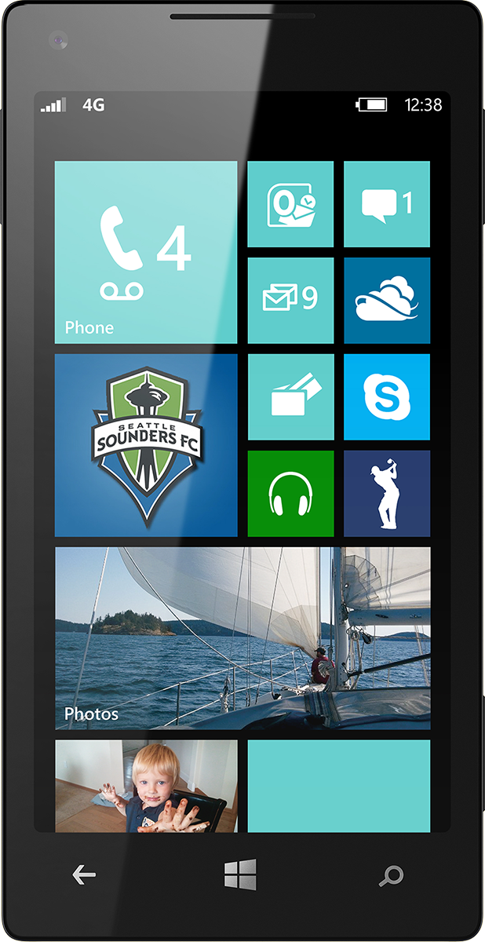
Evaluate this session
Scan this QR code to evaluate this session.

Slide 35
© 2014 Microsoft Corporation. All rights reserved. Microsoft, Windows, and other product names are or may be registered trademarks and/or trademarks in the U.S. and/or other countries.
The information herein is for informational purposes only and represents the current view of Microsoft Corporation as of the date of this presentation. Because Microsoft must respond to changing market conditions, it should not be interpreted to be a commitment on the part of Microsoft, and Microsoft cannot guarantee the accuracy of any information provided after the date of this presentation. MICROSOFT MAKES NO WARRANTIES, EXPRESS, IMPLIED OR STATUTORY, AS TO THE INFORMATION IN THIS PRESENTATION.

Slide 36
In-Memory OLTP: Integration and Application Migration
Application
Few improvements in comm layers
TDS Handler and Session Management
Key
SQL Server.exe
Existing SQL Component
Parser, Catalog, Optimizer
Execution Plan cache for ad-hoc T-SQL and SPs
Native-Compiled SPs and Schema
Hekaton Compiler
20-40x more efficient
Real Apps see 2-30x
T-SQL Interpreter
Hekaton Component
Access Methods
Hekaton Engine: Memory_optimized Tables & Indexes
Generated .dll
Non-durable Table option
Query Interop
Buffer Pool
T1
T2
T3
Tables
Reduced log contention; Low latency still critical for performance
T1
T2
T3
Indexes
Memory-optimized Table Filegroup
Transaction Log
Data Filegroup
T1
T2
T3
T1
T2
T3
T1
T2
T3
T1
T2
T3

Slide 37
Recovery for Memory-Optimized Tables
Analysis Phase
Finds the last completed checkpoint
Data Load
Load from set of data/delta files from the last completed checkpoint
Parallel Load by reading data files using 1 thread / file and 1 thread/container for delta files
Redo phase to apply tail of the log
Apply the transaction log from last checkpoint
Concurrent with REDO on disk-based tables
No UNDO phase for mem-opt tables
Since only committed transactions are logged

Slide 38
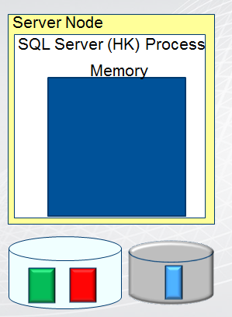
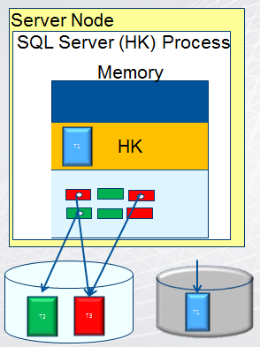
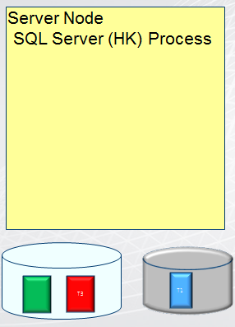
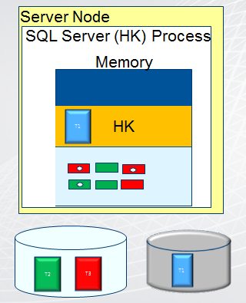
Hekaton: Recovery After Clean Shutdown
Checkpoint Done
HK: Table T1 is loaded
HK: SQL Process Restarts
HK: SQL Process Exits
SQL Server exits
HK: Checkpoint Done
SQL Server Restarts
SQL Server Process
SQL Server Process
SQL Server Process
Memory
Memory
HK
T1
T1
T2
T3

