Slide 2
In-Memory OLTP Perf Troubleshooting
DBI-B488
Jos de Bruijn
jodebrui@microsoft.com

Slide 3
Session Objectives And Takeaways
Session Objective(s):
Troubleshoot performance problems with In-Memory OLTP
Assess why you are not successful when migrating to In-Memory OLTP
Key Takeaways
In-Memory OLTP performance improvement can be limited due to slow log IO or lack of concurrency
Memory-optimized indexes are different from disk-based indexes, and require special consideration

Slide 4
Agenda
Troubleshooting Tools
Hardware and Concurrency
Index Troubleshooting
Troubleshooting Native Proc Plan Issues

Slide 5
Hardware and Concurrency

Slide 6
Performance Considerations
Where to expect performance improvements
Write-heavy
OLTP-style operations – limited number of rows
Point lookups – large index scans not so much
Nested-loops joins
High levels of concurrency
Using natively compiled stored procedures
The more logic in the proc, the better
Hardware
Log IO subsystem needs to keep up with transaction throughput – SSD is a must!
More cores: more concurrency: higher perf gain
2-4 sockets is sweet spot
Testing perf
Test at production scale
Test with hardware similar to production

Slide 7
Troubleshooting tools
Task Manager [CPU]
Resource Monitor [disk]
Perfmon [transaction throughput]
Ostress [workload driver]
SSMS
DMVs

Slide 8
Perfmon counters
Processor time
Latches\Latch Waits/sec
Databases\Transactions/sec
XTP Transactions\Transactions created/sec

Slide 9
Demo
Hardware and Concurrency
(script in the notes)
Notes:
-- cheats for low-memory systems: [for laptop-based demos]
/*
USE AdventureWorks2012
GO
DELETE FROM Sales.SalesOrderHeader_inmem
GO
DELETE FROM Sales.SalesOrderDetail_inmem
GO
CHECKPOINT
GO 3
USE master
GO
IF EXISTS (SELECT * FROM sys.resource_governor_resource_pools rp join sys.databases d on rp.pool_id=d.resource_pool_id WHERE d.name=N'AdventureWorks2012')
BEGIN
EXEC sp_xtp_unbind_db_resource_pool 'AdventureWorks2012'
END
GO
ALTER DATABASE AdventureWorks2012 SET OFFLINE WITH ROLLBACK IMMEDIATE
GO
ALTER RESOURCE GOVERNOR RECONFIGURE
GO
ALTER DATABASE AdventureWorks2012 SET ONLINE
GO
*/
USE [AdventureWorks2012]
GO
-- insert sales order in disk-based tables
IF object_id('Sales.usp_InsertSalesOrder_ondisk') IS NOT NULL
DROP PROCEDURE Sales.[usp_InsertSalesOrder_ondisk]
GO
CREATE PROCEDURE [Sales].[usp_InsertSalesOrder_ondisk]
@SalesOrderID int OUTPUT,
@DueDate [datetime2](7) ,
@CustomerID [int] ,
@BillToAddressID [int] ,
@ShipToAddressID [int] ,
@ShipMethodID [int] ,
@SalesOrderDetails Sales.SalesOrderDetailType_ondisk READONLY,
@Status [tinyint] = 1,
@OnlineOrderFlag [bit] = 1,
@PurchaseOrderNumber [nvarchar](25) = NULL,
@AccountNumber [nvarchar](15) = NULL,
@SalesPersonID [int] = -1,
@TerritoryID [int] = NULL,
@CreditCardID [int] = NULL,
@CreditCardApprovalCode [varchar](15) = NULL,
@CurrencyRateID [int] = NULL,
@Comment nvarchar(128) = NULL
AS
BEGIN
BEGIN TRAN
DECLARE @OrderDate datetime2 = sysdatetime()
DECLARE @SubTotal money = 0
SELECT @SubTotal = ISNULL(SUM(p.ListPrice * (1 - so.DiscountPct)),0)
FROM @SalesOrderDetails od JOIN Sales.SpecialOffer_ondisk so on od.SpecialOfferID=so.SpecialOfferID
JOIN Production.Product_ondisk p on od.ProductID=p.ProductID
INSERT INTO Sales.SalesOrderHeader_ondisk
(DueDate,
Status,
OnlineOrderFlag,
PurchaseOrderNumber,
AccountNumber,
CustomerID,
SalesPersonID,
TerritoryID,
BillToAddressID,
ShipToAddressID,
ShipMethodID,
CreditCardID,
CreditCardApprovalCode,
CurrencyRateID,
Comment,
OrderDate,
SubTotal,
ModifiedDate)
VALUES
(
@DueDate,
@Status,
@OnlineOrderFlag,
@PurchaseOrderNumber,
@AccountNumber,
@CustomerID,
@SalesPersonID,
@TerritoryID,
@BillToAddressID,
@ShipToAddressID,
@ShipMethodID,
@CreditCardID,
@CreditCardApprovalCode,
@CurrencyRateID,
@Comment,
@OrderDate,
@SubTotal,
@OrderDate
)
SET @SalesOrderID = SCOPE_IDENTITY()
INSERT INTO Sales.SalesOrderDetail_ondisk
(
SalesOrderID,
OrderQty,
ProductID,
SpecialOfferID,
UnitPrice,
UnitPriceDiscount,
ModifiedDate
)
SELECT
@SalesOrderID,
od.OrderQty,
od.ProductID,
od.SpecialOfferID,
p.ListPrice,
p.ListPrice * so.DiscountPct,
@OrderDate
FROM @SalesOrderDetails od JOIN Sales.SpecialOffer_ondisk so on od.SpecialOfferID=so.SpecialOfferID
JOIN Production.Product_ondisk p on od.ProductID=p.ProductID
COMMIT
END
GO
SET NOCOUNT ON
GO
-- disk-based: insert sales orders
declare @start datetime2
set @start = SYSDATETIME()
DECLARE
@i int = 0,
@od Sales.SalesOrderDetailType_ondisk,
@SalesOrderID int,
@DueDate datetime2 = sysdatetime(),
@CustomerID int = rand() * 8000,
@BillToAddressID int = rand() * 10000,
@ShipToAddressID int = rand() * 10000,
@ShipMethodID int = (rand() * 5) + 1;
INSERT INTO @od
SELECT OrderQty, ProductID, SpecialOfferID
FROM Demo.DemoSalesOrderDetailSeed
WHERE OrderID= cast((rand()*106) + 1 as int);
WHILE (@i < 2000)
BEGIN;
EXEC Sales.usp_InsertSalesOrder_ondisk @SalesOrderID OUTPUT, @DueDate, @CustomerID, @BillToAddressID, @ShipToAddressID, @ShipMethodID, @od;
SET @i += 1
END
select datediff(ms,@start, sysdatetime()) as 'elapse time in ms'
GO
-- interop procedure create
IF object_id('Sales.usp_InsertSalesOrder_inmem') IS NOT NULL
DROP PROCEDURE Sales.[usp_InsertSalesOrder_inmem]
GO
CREATE PROCEDURE [Sales].[usp_InsertSalesOrder_inmem]
@SalesOrderID int OUTPUT,
@DueDate [datetime2](7),
@CustomerID [int] ,
@BillToAddressID [int] ,
@ShipToAddressID [int] ,
@ShipMethodID [int] ,
@SalesOrderDetails Sales.SalesOrderDetailType_inmem READONLY,
@Status [tinyint] = 1,
@OnlineOrderFlag [bit] = 1,
@PurchaseOrderNumber [nvarchar](25) = NULL,
@AccountNumber [nvarchar](15) = NULL,
@SalesPersonID [int] = -1,
@TerritoryID [int] = NULL,
@CreditCardID [int] = NULL,
@CreditCardApprovalCode [varchar](15) = NULL,
@CurrencyRateID [int] = NULL,
@Comment nvarchar(128) = NULL
AS
BEGIN
BEGIN TRAN
DECLARE @OrderDate datetime2 = sysdatetime()
DECLARE @SubTotal money = 0
SELECT @SubTotal = ISNULL(SUM(p.ListPrice * (1 - so.DiscountPct)),0)
FROM @SalesOrderDetails od JOIN Sales.SpecialOffer_inmem so on od.SpecialOfferID=so.SpecialOfferID
JOIN Production.Product_inmem p on od.ProductID=p.ProductID
INSERT INTO Sales.SalesOrderHeader_inmem
(DueDate,
Status,
OnlineOrderFlag,
PurchaseOrderNumber,
AccountNumber,
CustomerID,
SalesPersonID,
TerritoryID,
BillToAddressID,
ShipToAddressID,
ShipMethodID,
CreditCardID,
CreditCardApprovalCode,
CurrencyRateID,
Comment,
OrderDate,
SubTotal,
ModifiedDate)
VALUES
(
@DueDate,
@Status,
@OnlineOrderFlag,
@PurchaseOrderNumber,
@AccountNumber,
@CustomerID,
@SalesPersonID,
@TerritoryID,
@BillToAddressID,
@ShipToAddressID,
@ShipMethodID,
@CreditCardID,
@CreditCardApprovalCode,
@CurrencyRateID,
@Comment,
@OrderDate,
@SubTotal,
@OrderDate
)
SET @SalesOrderID = SCOPE_IDENTITY()
INSERT INTO Sales.SalesOrderDetail_inmem
(
SalesOrderID,
OrderQty,
ProductID,
SpecialOfferID,
UnitPrice,
UnitPriceDiscount,
ModifiedDate
)
SELECT
@SalesOrderID,
od.OrderQty,
od.ProductID,
od.SpecialOfferID,
p.ListPrice,
p.ListPrice * so.DiscountPct,
@OrderDate
FROM @SalesOrderDetails od JOIN Sales.SpecialOffer_inmem so on od.SpecialOfferID=so.SpecialOfferID
JOIN Production.Product_inmem p on od.ProductID=p.ProductID
COMMIT
END
GO
-- insert sales orders
declare @start datetime2
set @start = SYSDATETIME()
DECLARE
@i int = 0,
@od Sales.SalesOrderDetailType_inmem,
@SalesOrderID int,
@DueDate datetime2 = sysdatetime(),
@CustomerID int = rand() * 8000,
@BillToAddressID int = rand() * 10000,
@ShipToAddressID int = rand() * 10000,
@ShipMethodID int = (rand() * 5) + 1;
INSERT INTO @od
SELECT OrderQty, ProductID, SpecialOfferID
FROM Demo.DemoSalesOrderDetailSeed
WHERE OrderID= cast((rand()*106) + 1 as int);
WHILE (@i < 2000)
BEGIN;
EXEC Sales.usp_InsertSalesOrder_inmem @SalesOrderID OUTPUT, @DueDate, @CustomerID, @BillToAddressID, @ShipToAddressID, @ShipMethodID, @od;
SET @i += 1
END
select datediff(ms,@start, sysdatetime()) as 'elapse time in ms'
GO
-- native procedure create
IF object_id('Sales.usp_InsertSalesOrder_inmem') IS NOT NULL
DROP PROCEDURE Sales.[usp_InsertSalesOrder_inmem]
GO
CREATE PROCEDURE [Sales].[usp_InsertSalesOrder_inmem]
@SalesOrderID int OUTPUT,
@DueDate [datetime2](7) NOT NULL,
@CustomerID [int] NOT NULL,
@BillToAddressID [int] NOT NULL,
@ShipToAddressID [int] NOT NULL,
@ShipMethodID [int] NOT NULL,
@SalesOrderDetails Sales.SalesOrderDetailType_inmem READONLY,
@Status [tinyint] NOT NULL = 1,
@OnlineOrderFlag [bit] NOT NULL = 1,
@PurchaseOrderNumber [nvarchar](25) = NULL,
@AccountNumber [nvarchar](15) = NULL,
@SalesPersonID [int] NOT NULL = -1,
@TerritoryID [int] = NULL,
@CreditCardID [int] = NULL,
@CreditCardApprovalCode [varchar](15) = NULL,
@CurrencyRateID [int] = NULL,
@Comment nvarchar(128) = NULL
WITH NATIVE_COMPILATION, SCHEMABINDING, EXECUTE AS OWNER
AS
BEGIN ATOMIC WITH
(TRANSACTION ISOLATION LEVEL = SNAPSHOT,
LANGUAGE = N'us_english')
DECLARE @OrderDate datetime2 NOT NULL = sysdatetime()
DECLARE @SubTotal money NOT NULL = 0
SELECT @SubTotal = ISNULL(SUM(p.ListPrice * (1 - so.DiscountPct)),0)
FROM @SalesOrderDetails od JOIN Sales.SpecialOffer_inmem so on od.SpecialOfferID=so.SpecialOfferID
JOIN Production.Product_inmem p on od.ProductID=p.ProductID
INSERT INTO Sales.SalesOrderHeader_inmem
(DueDate,
Status,
OnlineOrderFlag,
PurchaseOrderNumber,
AccountNumber,
CustomerID,
SalesPersonID,
TerritoryID,
BillToAddressID,
ShipToAddressID,
ShipMethodID,
CreditCardID,
CreditCardApprovalCode,
CurrencyRateID,
Comment,
OrderDate,
SubTotal,
ModifiedDate)
VALUES
(
@DueDate,
@Status,
@OnlineOrderFlag,
@PurchaseOrderNumber,
@AccountNumber,
@CustomerID,
@SalesPersonID,
@TerritoryID,
@BillToAddressID,
@ShipToAddressID,
@ShipMethodID,
@CreditCardID,
@CreditCardApprovalCode,
@CurrencyRateID,
@Comment,
@OrderDate,
@SubTotal,
@OrderDate
)
SET @SalesOrderID = SCOPE_IDENTITY()
INSERT INTO Sales.SalesOrderDetail_inmem
(
SalesOrderID,
OrderQty,
ProductID,
SpecialOfferID,
UnitPrice,
UnitPriceDiscount,
ModifiedDate
)
SELECT
@SalesOrderID,
od.OrderQty,
od.ProductID,
od.SpecialOfferID,
p.ListPrice,
p.ListPrice * so.DiscountPct,
@OrderDate
FROM @SalesOrderDetails od JOIN Sales.SpecialOffer_inmem so on od.SpecialOfferID=so.SpecialOfferID
JOIN Production.Product_inmem p on od.ProductID=p.ProductID
END
GO
-- insert sales orders
declare @start datetime2
set @start = SYSDATETIME()
DECLARE
@i int = 0,
@od Sales.SalesOrderDetailType_inmem,
@SalesOrderID int,
@DueDate datetime2 = sysdatetime(),
@CustomerID int = rand() * 8000,
@BillToAddressID int = rand() * 10000,
@ShipToAddressID int = rand() * 10000,
@ShipMethodID int = (rand() * 5) + 1;
INSERT INTO @od
SELECT OrderQty, ProductID, SpecialOfferID
FROM Demo.DemoSalesOrderDetailSeed
WHERE OrderID= cast((rand()*106) + 1 as int);
WHILE (@i < 2000)
BEGIN;
EXEC Sales.usp_InsertSalesOrder_inmem @SalesOrderID OUTPUT, @DueDate, @CustomerID, @BillToAddressID, @ShipToAddressID, @ShipMethodID, @od;
SET @i += 1
END
select datediff(ms,@start, sysdatetime()) as 'elapse time in ms'
GO
--empty tables for low-memory systems:
DELETE FROM Sales.SalesOrderHeader_inmem
DELETE FROM Sales.SalesOrderDetail_inmem
TRUNCATE TABLE Sales.SalesOrderHeader_ondisk
TRUNCATE TABLE Sales.SalesOrderDetail_ondisk
GO
--disk-based baseline
-- insert 40,000 orders using 20 threads
-- ostress.exe –n20 –r100 -S. -E -dAdventureWorks2012 -q -Q"DECLARE @i int = 0, @od Sales.SalesOrderDetailType_ondisk, @SalesOrderID int, @DueDate datetime2 = sysdatetime(), @CustomerID int = rand() * 8000, @BillToAddressID int = rand() * 10000, @ShipToAddressID int = rand() * 10000, @ShipMethodID int = (rand() * 5) + 1; INSERT INTO @od SELECT OrderQty, ProductID, SpecialOfferID FROM Demo.DemoSalesOrderDetailSeed WHERE OrderID= cast((rand()*106) + 1 as int); while (@i < 20) begin; EXEC Sales.usp_InsertSalesOrder_ondisk @SalesOrderID OUTPUT, @DueDate, @CustomerID, @BillToAddressID, @ShipToAddressID, @ShipMethodID, @od; set @i += 1 end"
--memory-optimized tables
-- ostress.exe –n20 –r100 -S. -E -dAdventureWorks2012 -q -Q"DECLARE @i int = 0, @od Sales.SalesOrderDetailType_inmem, @SalesOrderID int, @DueDate datetime2 = sysdatetime(), @CustomerID int = rand() * 8000, @BillToAddressID int = rand() * 10000, @ShipToAddressID int = rand() * 10000, @ShipMethodID int = (rand() * 5) + 1; INSERT INTO @od SELECT OrderQty, ProductID, SpecialOfferID FROM Demo.DemoSalesOrderDetailSeed WHERE OrderID= cast((rand()*106) + 1 as int); while (@i < 20) begin; EXEC Sales.usp_InsertSalesOrder_inmem @SalesOrderID OUTPUT, @DueDate, @CustomerID, @BillToAddressID, @ShipToAddressID, @ShipMethodID, @od; set @i += 1 end"
--clean up
EXEC Demo.usp_DemoReset
GO

Slide 10
Index Troubleshooting

Slide 11
Troubleshooting Index Issues
Hash index bucket count
Bucket_count too low; large number of duplicates
Index Selection
Hash – Search on subset of index key
Hash – Require sort-order
Nonclustered – Point lookups – use hash instead
Nonclustered – Slow insert, slow recovery

Slide 12
Demo
Index Troubleshooting
(script in the notes)
Notes:
-- ======================= troubleshooting hash index bucket_count
USE [AdventureWorks2012]
GO
IF object_id('Sales.SalesOrderHeader_test') IS NOT NULL
DROP TABLE [Sales].[SalesOrderHeader_test]
GO
CREATE TABLE [Sales].[SalesOrderHeader_test]
(
[SalesOrderID] int identity NOT NULL,
[OrderSequence] int NOT NULL,
[OrderDate] [datetime2](7) NOT NULL,
[Status] [tinyint] NOT NULL,
PRIMARY KEY NONCLUSTERED HASH ([SalesOrderID]) WITH ( BUCKET_COUNT = 262144 ),
INDEX IX_OrderSequence HASH (OrderSequence) WITH ( BUCKET_COUNT = 20000),
INDEX IX_Status HASH ([Status]) WITH ( BUCKET_COUNT = 8),
INDEX IX_OrderDate NONCLUSTERED ([OrderDate] ASC),
)WITH ( MEMORY_OPTIMIZED = ON , DURABILITY = SCHEMA_AND_DATA )
GO
SET NOCOUNT ON
GO
DECLARE @i int = 0
BEGIN TRAN
WHILE @i < 262144
BEGIN
INSERT Sales.SalesOrderHeader_test (OrderSequence, OrderDate, [Status]) VALUES (@i, sysdatetime(), @i % 8)
SET @i += 1
END
COMMIT
GO
-- verify number of unique index key values
-- PK index on SalesOrderID
SELECT (SELECT [bucket_count] FROM sys.hash_indexes
WHERE object_id=object_id('Sales.SalesOrderHeader_test') and name LIKE 'PK_%') as 'PK bucket_count',
count(*) AS row_count
FROM Sales.SalesOrderHeader_test
GO
-- IX_OrderSequence
SELECT (SELECT [bucket_count] FROM sys.hash_indexes
WHERE object_id=object_id('Sales.SalesOrderHeader_test') and name='IX_OrderSequence') as 'IX_OrderSequence bucket_count',
count(distinct OrderSequence) AS key_value_count
FROM Sales.SalesOrderHeader_test
GO
-- IX_Status
SELECT (SELECT [bucket_count] FROM sys.hash_indexes
WHERE object_id=object_id('Sales.SalesOrderHeader_test') and name='IX_Status') as 'IX_Status bucket_count',
count(distinct [Status]) AS key_value_count
FROM Sales.SalesOrderHeader_test
GO
-- check health of hash indexes
SELECT
object_name(hs.object_id) AS 'object name',
i.name as 'index name',
hs.total_bucket_count,
hs.empty_bucket_count,
floor((cast(empty_bucket_count as float)/total_bucket_count) * 100) AS 'empty_bucket_percent',
hs.avg_chain_length,
hs.max_chain_length
FROM sys.dm_db_xtp_hash_index_stats AS hs
JOIN sys.indexes AS i
ON hs.object_id=i.object_id AND hs.index_id=i.index_id
WHERE hs.object_id=object_id('Sales.SalesOrderHeader_test')
GO
DROP TABLE [Sales].[SalesOrderHeader_test]
GO
CREATE TABLE [Sales].[SalesOrderHeader_test]
(
[SalesOrderID] int identity NOT NULL,
[OrderSequence] int NOT NULL,
[OrderDate] [datetime2](7) NOT NULL,
[Status] [tinyint] NOT NULL,
PRIMARY KEY NONCLUSTERED HASH ([SalesOrderID]) WITH ( BUCKET_COUNT = 1000000 ),
-- correct too low bucket_count for IX_Sequence
INDEX IX_OrderSequence HASH (OrderSequence) WITH ( BUCKET_COUNT = 1000000),
-- using a nonclustered index:
INDEX IX_Status ([Status]),
-- alternative: over-size bucket_count for IX_Status to deal with duplicates
-- INDEX IX_Status HASH ([Status]) WITH ( BUCKET_COUNT = 100),
INDEX IX_OrderDate NONCLUSTERED ([OrderDate] ASC),
)WITH ( MEMORY_OPTIMIZED = ON , DURABILITY = SCHEMA_AND_DATA )
GO
select name, bucket_count from sys.hash_indexes
where object_id=object_id('Sales.SalesOrderHeader_test')
go
DECLARE @i int = 0
BEGIN TRAN
WHILE @i < 262144
BEGIN
INSERT Sales.SalesOrderHeader_test (OrderSequence, OrderDate, [Status]) VALUES (@i, sysdatetime(), @i % 8)
SET @i += 1
END
COMMIT
GO
-- check health of hash indexes
SELECT
object_name(hs.object_id) AS 'object name',
i.name as 'index name',
hs.total_bucket_count,
hs.empty_bucket_count,
floor((cast(empty_bucket_count as float)/total_bucket_count) * 100) AS 'empty_bucket_percent',
hs.avg_chain_length,
hs.max_chain_length
FROM sys.dm_db_xtp_hash_index_stats AS hs
JOIN sys.indexes AS i
ON hs.object_id=i.object_id AND hs.index_id=i.index_id
WHERE hs.object_id = object_id('Sales.SalesOrderHeader_test')
GO
-- ============================ start index troubleshooting sample
-- use in-memory OLTP sample based on AdventureWorks
USE [AdventureWorks2012]
GO
-- reset demo to make sure tables have data
EXEC Demo.usp_DemoReset
GO
-- create sample table
IF object_id('Sales.usp_InsertOrders_test') IS NOT NULL
DROP PROCEDURE Sales.usp_InsertOrders_test
GO
IF object_id('[Sales].[SalesOrderDetail_test]') IS NOT NULL
DROP TABLE [Sales].[SalesOrderDetail_test]
GO
CREATE TABLE [Sales].[SalesOrderDetail_test](
[SalesOrderID] int NOT NULL,
[SalesOrderDetailID] [int] NOT NULL,
[CarrierTrackingNumber] [nvarchar](25) NULL,
[OrderQty] [smallint] NOT NULL,
[ProductID] [int] NOT NULL INDEX IX_ProductID HASH WITH (BUCKET_COUNT=100000),
[SpecialOfferID] [int] NOT NULL,
[UnitPrice] [money] NOT NULL,
[UnitPriceDiscount] [money] NOT NULL,
[ModifiedDate] [datetime2] NOT NULL ,
CONSTRAINT [imPK_SalesOrderDetail_SalesOrderID_SalesOrderDetailID_test] PRIMARY KEY NONCLUSTERED HASH
(
[SalesOrderID],
[SalesOrderDetailID]
)WITH (BUCKET_COUNT=10000000)
) WITH (MEMORY_OPTIMIZED=ON)
GO
-- populate tables and update statistics
INSERT Sales.SalesOrderDetail_test SELECT * FROM Sales.SalesOrderDetail_inmem
GO
UPDATE STATISTICS Sales.SalesOrderDetail_test WITH FULLSCAN, NORECOMPUTE
GO
--verify row count
select count(*) as 'SalesOrderDetail_count' from Sales.SalesOrderDetail_test
go
-- clean out plan cache - note that native procs are not affected
DBCC FREEPROCCACHE
GO
-- disk-based baseline
declare @i int = 0,
@start datetime2,
@SalesOrderID int = (select top 1 SalesOrderID from Sales.SalesOrderHeader_ondisk),
@SalesOrderDetailID int,
@OrderQty int,
@ProductID int,
@OrderDate datetime2
set @start = SYSDATETIME()
while @i < 1000
begin
select @SalesOrderDetailID=sod.SalesOrderDetailID, @OrderQty=sod.OrderQty, @ProductID=sod.ProductID
from Sales.SalesOrderDetail_ondisk sod
where SalesOrderID = @SalesOrderID
select @OrderDate=soh.OrderDate, @ProductID=sod.ProductID
from Sales.SalesOrderHeader_ondisk soh
inner join
Sales.SalesOrderDetail_ondisk sod
on soh.SalesOrderID = sod.SalesOrderID
where soh.SalesOrderID = @SalesOrderID
set @i += 1
end
select datediff(ms,@start, sysdatetime()) as 'elapse time in ms'
go
-- memory-optimized tables
declare @i int = 0,
@start datetime2,
@SalesOrderID int = (select top 1 SalesOrderID from Sales.SalesOrderHeader_inmem),
@SalesOrderDetailID int,
@OrderQty int,
@ProductID int,
@OrderDate datetime2
set @start = SYSDATETIME()
while @i < 1000
begin
select @SalesOrderDetailID=sod.SalesOrderDetailID, @OrderQty=sod.OrderQty, @ProductID=sod.ProductID
from Sales.SalesOrderDetail_test sod
where SalesOrderID = @SalesOrderID
select @OrderDate=soh.OrderDate, @ProductID=sod.ProductID
from Sales.SalesOrderHeader_inmem soh
inner join
Sales.SalesOrderDetail_test sod
on soh.SalesOrderID = sod.SalesOrderID
where soh.SalesOrderID = @SalesOrderID
set @i += 1
end
select datediff(ms,@start, sysdatetime()) as 'elapse time in ms'
go
-- look at query exec stats
select --st.objectid,
--object_name(st.objectid) as 'object name',
SUBSTRING(st.text, (qs.statement_start_offset/2) + 1, ((qs.statement_end_offset-qs.statement_start_offset)/2) + 1) as [query text],
qs.creation_time,
qs.last_execution_time,
qs.execution_count,
qs.total_worker_time,
qs.last_worker_time,
qs.min_worker_time,
qs.max_worker_time,
qs.total_elapsed_time,
qs.last_elapsed_time,
qs.min_elapsed_time,
qs.max_elapsed_time
from sys.dm_exec_query_stats qs cross apply sys.dm_exec_sql_text(sql_handle) st
order by qs.total_worker_time desc
go
-- go back and look at the query plans
-- verify indexes on the tables
SELECT object_name(object_id) as 'table',
name as 'index',
type,
type_desc FROM sys.indexes
WHERE object_id=object_id('Sales.SalesOrderDetail_test')
-- order requirements
set statistics time on
go
-- disk-based baseline
select top 10 ProductID, SalesOrderID, SalesOrderDetailID
from Sales.SalesOrderDetail_ondisk
order by ProductID
select top 10 ProductID, SalesOrderID, SalesOrderDetailID
from Sales.SalesOrderDetail_ondisk
where ProductID > 1000
go
-- memory-optimized table
select top 10 ProductID, SalesOrderID, SalesOrderDetailID
from Sales.SalesOrderDetail_test
order by ProductID
select top 10 ProductID, SalesOrderID, SalesOrderDetailID
from Sales.SalesOrderDetail_test
where ProductID > 1000
go
set statistics time off
go
-- fix it!
IF object_id('[Sales].[SalesOrderDetail_test]') IS NOT NULL
DROP TABLE [Sales].[SalesOrderDetail_test]
GO
CREATE TABLE [Sales].[SalesOrderDetail_test](
-- change 1) add index on SalesOrderID
[SalesOrderID] int NOT NULL INDEX IX_SalesOrderID HASH WITH (BUCKET_COUNT=10000000),
[SalesOrderDetailID] [int] NOT NULL,
[CarrierTrackingNumber] [nvarchar](25) NULL,
[OrderQty] [smallint] NOT NULL,
-- change 2) change index on ProductID to nonclustered
[ProductID] [int] NOT NULL INDEX IX_ProductID NONCLUSTERED,
[SpecialOfferID] [int] NOT NULL,
[UnitPrice] [money] NOT NULL,
[UnitPriceDiscount] [money] NOT NULL,
[ModifiedDate] [datetime2] NOT NULL ,
CONSTRAINT [imPK_SalesOrderDetail_SalesOrderID_SalesOrderDetailID_test] PRIMARY KEY NONCLUSTERED HASH
(
[SalesOrderID],
[SalesOrderDetailID]
)WITH (BUCKET_COUNT=10000000)
) WITH (MEMORY_OPTIMIZED=ON)
GO
INSERT Sales.SalesOrderDetail_test SELECT * FROM Sales.SalesOrderDetail_inmem
GO
UPDATE STATISTICS Sales.SalesOrderDetail_test WITH FULLSCAN, NORECOMPUTE
GO
-- verify workloads
-- memory-optimized tables - point lookups
declare @i int = 0,
@start datetime2,
@SalesOrderID int = (select top 1 SalesOrderID from Sales.SalesOrderHeader_inmem),
@SalesOrderDetailID int,
@OrderQty int,
@ProductID int,
@OrderDate datetime2
set @start = SYSDATETIME()
while @i < 1000
begin
select @SalesOrderDetailID=sod.SalesOrderDetailID, @OrderQty=sod.OrderQty, @ProductID=sod.ProductID
from Sales.SalesOrderDetail_test sod
where SalesOrderID = @SalesOrderID
select @OrderDate=soh.OrderDate, @ProductID=sod.ProductID
from Sales.SalesOrderHeader_inmem soh
inner join
Sales.SalesOrderDetail_test sod
on soh.SalesOrderID = sod.SalesOrderID
where soh.SalesOrderID = @SalesOrderID
set @i += 1
end
select datediff(ms,@start, sysdatetime()) as 'elapse time in ms'
go
-- order requirements
set statistics time on
go
-- memory-optimized table
select top 10 ProductID, SalesOrderID, SalesOrderDetailID
from Sales.SalesOrderDetail_test
order by ProductID
select top 10 ProductID, SalesOrderID, SalesOrderDetailID
from Sales.SalesOrderDetail_test
where ProductID > 1000
go
set statistics time off
go
-- clean up
IF object_id('[Sales].[SalesOrderDetail_test]') IS NOT NULL
DROP TABLE [Sales].[SalesOrderDetail_test]
GO

Slide 13
Plan Troubleshooting for Native Procs

Slide 14
Troubleshooting tools
Interpreted T-SQL:
Same tools you would use for traditional tables
SHOWPLAN_XML, STATISTICS XML, query stats and plan cache DMVs, statement-level XEvents, FREEPROCCACHE, etc.
Table hints, query hints, plan forcing, etc…
Native procs:
Execution statistics:
Proc-level: dm_exec_procedure_stats – enable stats collection using sp_xtp_control_proc_exec_stats
Query-level: dm_exec_query_stats – enable stats collection using sp_xtp_control_query_exec_stats
Tracing:
Proc-level: sql/sp_statement_completed
Query-level: sp_statement_completed
Showplan support:
SHOWPLAN_XML is supported, but not all attributes are included
Uses generated .mat.xml file
STATISTICS XML is not supported
FREEPROCCACHE does not affect native procs or their plans
Supported table/query hints:
INDEX, FORCESEEK, FORCESCAN, FORCE ORDER, OPTIMIZE FOR
Showplan_xml and missing indexes:
Missing index details are in showplan_xml (interpreted T-SQL) and in missing index DMVs
Limitation (SQL14RTM): cases of mismatched index types (e.g., hash with inequality seek) and subset of index key (for hash) are not reflected

Slide 15
Demo
Native Proc Plan Troubleshooting
(script in the notes)
Notes:
-- ============================ start native proc troubleshooting sample
-- use in-memory OLTP sample based on Hekaton
USE [AdventureWorks2012]
GO
-- reset if necessary: EXEC Demo.usp_DemoReset
IF object_id('Sales.usp_OrderDiscountForSpecialOffer') IS NOT NULL
DROP PROC Sales.usp_OrderDiscountForSpecialOffer
GO
IF object_id('dbo.usp_test') IS NOT NULL
DROP PROC dbo.usp_test
GO
IF object_id('[Sales].[SalesOrderHeader_test]') IS NOT NULL
DROP TABLE [Sales].[SalesOrderHeader_test]
GO
CREATE TABLE [Sales].[SalesOrderHeader_test](
[SalesOrderID] int NOT NULL PRIMARY KEY NONCLUSTERED HASH WITH (BUCKET_COUNT=10000000),
[RevisionNumber] [tinyint] NOT NULL,
[OrderDate] [datetime2] NOT NULL ,
[DueDate] [datetime2] NOT NULL,
[ShipDate] [datetime2] NULL,
[Status] [tinyint] NOT NULL,
[OnlineOrderFlag] bit NOT NULL,
[SubTotal] [money] NOT NULL,
[TaxAmt] [money] NOT NULL,
[Freight] [money] NOT NULL,
[Comment] [nvarchar](128) NULL,
[ModifiedDate] [datetime2] NOT NULL ,
INDEX IX_OrderDate (OrderDate ASC)
) WITH (MEMORY_OPTIMIZED=ON)
GO
IF object_id('[Sales].[SalesOrderDetail_test]') IS NOT NULL
DROP TABLE [Sales].[SalesOrderDetail_test]
GO
CREATE TABLE [Sales].[SalesOrderDetail_test](
[SalesOrderID] int NOT NULL INDEX IX_SalesOrderID HASH WITH (BUCKET_COUNT=1000000),
[SalesOrderDetailID] [int] NOT NULL,
[CarrierTrackingNumber] [nvarchar](25) NULL,
[OrderQty] [smallint] NOT NULL,
[ProductID] [int] NOT NULL INDEX IX_ProductID NONCLUSTERED,
[SpecialOfferID] [int] NOT NULL,
[UnitPrice] [money] NOT NULL,
[UnitPriceDiscount] [money] NOT NULL,
[ModifiedDate] [datetime2] NOT NULL ,
CONSTRAINT [imPK_SalesOrderDetail_SalesOrderID_SalesOrderDetailID_test] PRIMARY KEY NONCLUSTERED HASH
(
[SalesOrderID],
[SalesOrderDetailID]
)WITH (BUCKET_COUNT=1000000)
) WITH (MEMORY_OPTIMIZED=ON)
GO
INSERT Sales.SalesOrderHeader_test SELECT
[SalesOrderID],
[RevisionNumber],
[OrderDate],
[DueDate],
[ShipDate],
[Status],
[OnlineOrderFlag],
[SubTotal],
[TaxAmt],
[Freight],
[Comment],
[ModifiedDate]
FROM Sales.SalesOrderHeader_inmem
GO
INSERT Sales.SalesOrderDetail_test SELECT * FROM Sales.SalesOrderDetail_inmem
GO
UPDATE STATISTICS Sales.SalesOrderHeader_test WITH FULLSCAN, NORECOMPUTE
GO
UPDATE STATISTICS Sales.SalesOrderDetail_test WITH FULLSCAN, NORECOMPUTE
GO
-- create proc for workload:
IF object_id('Sales.usp_OrderDiscountForSpecialOffer') IS NOT NULL
DROP PROC Sales.usp_OrderDiscountForSpecialOffer
GO
CREATE PROCEDURE Sales.usp_OrderDiscountForSpecialOffer @SpecialOfferID int
WITH NATIVE_COMPILATION, SCHEMABINDING, EXECUTE AS OWNER
AS
BEGIN ATOMIC WITH
(TRANSACTION ISOLATION LEVEL = SNAPSHOT,
LANGUAGE = N'us_english')
SELECT so.Description collate Latin1_General_100_BIN2,
soh.SalesOrderID,
SUM(sod.UnitPriceDiscount) as 'TotalDiscount'
FROM Sales.SalesOrderHeader_test soh
JOIN
Sales.SalesOrderDetail_test sod
on soh.SalesOrderID=sod.SalesOrderID
JOIN
Sales.SpecialOffer_inmem so
on sod.SpecialOfferID=so.SpecialOfferID
WHERE so.SpecialOfferID=@SpecialOfferID
GROUP BY so.Description collate Latin1_General_100_BIN2, soh.SalesOrderID, soh.OrderDate
ORDER BY soh.OrderDate DESC
END
GO
dbcc freeproccache
GO
set statistics time on
go
-- start workload:
-- ostress.exe –n50 -r1000000 -q -S. -E -dAdventureWorks2012 -Q"declare @i int = (rand() * 16)+1 EXEC Sales.usp_OrderDiscountForSpecialOffer @i"
--enable execution stats collection for native procs
-- on proc level
exec sp_xtp_control_proc_exec_stats 1
go
-- on query level
exec sp_xtp_control_query_exec_stats 1
go
-- small memory-optimized workload:
-- ostress.exe –n20 –r100 -S. -E -dAdventureWorks2012 -q -oc:\temp -Q"DECLARE @i int = 0, @od Sales.SalesOrderDetailType_inmem, @SalesOrderID int, @DueDate datetime2 = sysdatetime(), @CustomerID int = rand() * 8000, @BillToAddressID int = rand() * 10000, @ShipToAddressID int = rand() * 10000, @ShipMethodID int = (rand() * 5) + 1; INSERT INTO @od SELECT OrderQty, ProductID, SpecialOfferID FROM Demo.DemoSalesOrderDetailSeed WHERE OrderID= cast((rand()*106) + 1 as int); while (@i < 20) begin; EXEC Sales.usp_InsertSalesOrder_inmem @SalesOrderID OUTPUT, @DueDate, @CustomerID, @BillToAddressID, @ShipToAddressID, @ShipMethodID, @od; set @i += 1 end"
-- small disk-based workload:
-- ostress.exe –n20 –r100 -S. -E -dAdventureWorks2012 -q -Q"DECLARE @i int = 0, @od Sales.SalesOrderDetailType_ondisk, @SalesOrderID int, @DueDate datetime2 = sysdatetime(), @CustomerID int = rand() * 8000, @BillToAddressID int = rand() * 10000, @ShipToAddressID int = rand() * 10000, @ShipMethodID int = (rand() * 5) + 1; INSERT INTO @od SELECT OrderQty, ProductID, SpecialOfferID FROM Demo.DemoSalesOrderDetailSeed WHERE OrderID= cast((rand()*106) + 1 as int); while (@i < 20) begin; EXEC Sales.usp_InsertSalesOrder_ondisk @SalesOrderID OUTPUT, @DueDate, @CustomerID, @BillToAddressID, @ShipToAddressID, @ShipMethodID, @od; set @i += 1 end"
-- procedure stats
select ps.object_id,
object_name(ps.object_id) as 'object name',
sm.uses_native_compilation,
execution_count,
total_worker_time,
last_worker_time,
min_worker_time,
max_worker_time,
total_elapsed_time,
last_elapsed_time,
min_elapsed_time,
max_elapsed_time
from sys.dm_exec_procedure_stats ps join sys.sql_modules sm on ps.object_id=sm.object_id
where database_id=db_id()
order by total_worker_time desc
-- query stats
select st.objectid,
object_name(st.objectid) as 'object name',
SUBSTRING(st.text, qs.statement_start_offset/2, ((qs.statement_end_offset-qs.statement_start_offset)/2) + 1) as 'query text',
qs.execution_count,
qs.total_worker_time,
qs.last_worker_time,
qs.min_worker_time,
qs.max_worker_time,
qs.total_elapsed_time,
qs.last_elapsed_time,
qs.min_elapsed_time,
qs.max_elapsed_time
from sys.dm_exec_query_stats qs cross apply sys.dm_exec_sql_text(sql_handle) st
where st.dbid=db_id()
order by qs.total_worker_time desc
go
--disable execution stats collection for native procs
-- on proc level
exec sp_xtp_control_proc_exec_stats 0
go
-- on query level
exec sp_xtp_control_query_exec_stats 0
go
-- stop demo workload
-- check runtime
SET STATISTICS TIME ON
GO
DECLARE @i int = 16
EXEC Sales.usp_OrderDiscountForSpecialOffer @i
GO
SET STATISTICS TIME OFF
GO
-- inspect query plan
SET SHOWPLAN_XML ON
GO
DECLARE @i int
EXEC Sales.usp_OrderDiscountForSpecialOffer @i
GO
SET SHOWPLAN_XML OFF
GO
-- analyze plan - indexes needed:
-- SalesOrderHeader_test
--
--
--
-- SalesOrderDetail_test
--
--
--
-- evaluate missing indexes
select distinct object_name(object_id), equality_columns, inequality_columns from sys.dm_db_missing_index_details
GO
-- evaluate existing indexes vs. required indexes
SELECT object_name(i.object_id) as 'table',
i.name as 'index',
type_desc,
ic.index_column_id,
c.name as 'column',
ic.is_descending_key
FROM sys.indexes i join sys.index_columns ic on i.object_id=ic.object_id and i.index_id=ic.index_id join sys.columns c on ic.column_id=c.column_id and ic.object_id=c.object_id
WHERE i.object_id=object_id('Sales.SalesOrderDetail_test') OR i.object_id=object_id('Sales.SalesOrderHeader_test')
GO
-- fix indexes
IF object_id('Sales.usp_OrderDiscountForSpecialOffer') IS NOT NULL
DROP PROC Sales.usp_OrderDiscountForSpecialOffer
GO
IF object_id('[Sales].[SalesOrderHeader_test]') IS NOT NULL
DROP TABLE [Sales].[SalesOrderHeader_test]
GO
CREATE TABLE [Sales].[SalesOrderHeader_test](
[SalesOrderID] int NOT NULL PRIMARY KEY NONCLUSTERED HASH WITH (BUCKET_COUNT=10000000) ,
[RevisionNumber] [tinyint] NOT NULL,
[OrderDate] [datetime2] NOT NULL ,
[DueDate] [datetime2] NOT NULL,
[ShipDate] [datetime2] NULL,
[Status] [tinyint] NOT NULL,
[OnlineOrderFlag] bit NOT NULL,
[SubTotal] [money] NOT NULL,
[TaxAmt] [money] NOT NULL,
[Freight] [money] NOT NULL,
[Comment] [nvarchar](128) NULL,
[ModifiedDate] [datetime2] NOT NULL ,
-- use DESC order to support ORDER BY OrderDate DESC
INDEX IX_OrderDate (OrderDate DESC)
) WITH (MEMORY_OPTIMIZED=ON)
GO
IF object_id('[Sales].[SalesOrderDetail_test]') IS NOT NULL
DROP TABLE [Sales].[SalesOrderDetail_test]
GO
CREATE TABLE [Sales].[SalesOrderDetail_test](
[SalesOrderID] int NOT NULL INDEX IX_SalesOrderID HASH WITH (BUCKET_COUNT=1000000),
[SalesOrderDetailID] [int] NOT NULL,
[CarrierTrackingNumber] [nvarchar](25) NULL,
[OrderQty] [smallint] NOT NULL,
[ProductID] [int] NOT NULL INDEX IX_ProductID NONCLUSTERED,
[SpecialOfferID] [int] NOT NULL,
[UnitPrice] [money] NOT NULL,
[UnitPriceDiscount] [money] NOT NULL,
[ModifiedDate] [datetime2] NOT NULL ,
CONSTRAINT [imPK_SalesOrderDetail_SalesOrderID_SalesOrderDetailID_test] PRIMARY KEY NONCLUSTERED HASH
(
[SalesOrderID],
[SalesOrderDetailID]
)WITH (BUCKET_COUNT=1000000),
--add index to support lookup on SpecialOfferID, secondary sorting on SalesOrderID, to support grouping
INDEX IX_SpecialOfferID_SalesOrderID (SpecialOfferID, SalesOrderID),
--add nonclustered index on SalesOrderID to support grouping
INDEX IX_SalesOrderID_nonclustered (SalesOrderID)
) WITH (MEMORY_OPTIMIZED=ON)
GO
IF object_id('Sales.usp_OrderDiscountForSpecialOffer') IS NOT NULL
DROP PROC Sales.usp_OrderDiscountForSpecialOffer
GO
CREATE PROCEDURE Sales.usp_OrderDiscountForSpecialOffer @SpecialOfferID int
WITH NATIVE_COMPILATION, SCHEMABINDING, EXECUTE AS OWNER
AS
BEGIN ATOMIC WITH
(TRANSACTION ISOLATION LEVEL = SNAPSHOT,
LANGUAGE = N'us_english')
SELECT so.Description collate Latin1_General_100_BIN2,
soh.SalesOrderID,
SUM(sod.UnitPriceDiscount) as 'TotalDiscount'
FROM Sales.SalesOrderHeader_test soh
JOIN
Sales.SalesOrderDetail_test sod
on soh.SalesOrderID=sod.SalesOrderID
JOIN
Sales.SpecialOffer_inmem so
on sod.SpecialOfferID=so.SpecialOfferID
WHERE so.SpecialOfferID=@SpecialOfferID
GROUP BY so.Description collate Latin1_General_100_BIN2, soh.SalesOrderID, soh.OrderDate
ORDER BY soh.OrderDate DESC
END
GO
INSERT Sales.SalesOrderHeader_test SELECT
[SalesOrderID],
[RevisionNumber],
[OrderDate],
[DueDate],
[ShipDate],
[Status],
[OnlineOrderFlag],
[SubTotal],
[TaxAmt],
[Freight],
[Comment],
[ModifiedDate]
FROM Sales.SalesOrderHeader_inmem
GO
INSERT Sales.SalesOrderDetail_test SELECT * FROM Sales.SalesOrderDetail_inmem
GO
-- check runtime
SET STATISTICS TIME ON
GO
DECLARE @i int = 16
EXEC Sales.usp_OrderDiscountForSpecialOffer @i
GO
SET STATISTICS TIME OFF
GO
-- inspect query plan
SET SHOWPLAN_XML ON
GO
DECLARE @i int
EXEC Sales.usp_OrderDiscountForSpecialOffer @i
GO
SET SHOWPLAN_XML OFF
GO
-- check stats!
SELECT
object_name(s.object_id),
s.name,
s.stats_id,
sp.last_updated,
sp.rows
FROM sys.stats s cross apply sys.dm_db_stats_properties(s.object_id, s.stats_id) sp
WHERE s.object_id=object_id('Sales.SalesOrderDetail_test') OR
s.object_id=object_id('Sales.SalesOrderHeader_test')
GO
UPDATE STATISTICS Sales.SalesOrderDetail_test WITH FULLSCAN, NORECOMPUTE
GO
UPDATE STATISTICS Sales.SalesOrderHeader_test WITH FULLSCAN, NORECOMPUTE
GO
SELECT
object_name(s.object_id),
s.name,
s.stats_id,
sp.last_updated,
sp.rows
FROM sys.stats s cross apply sys.dm_db_stats_properties(s.object_id, s.stats_id) sp
WHERE s.object_id=object_id('Sales.SalesOrderDetail_test') OR
s.object_id=object_id('Sales.SalesOrderHeader_test')
GO
IF object_id('Sales.usp_OrderDiscountForSpecialOffer') IS NOT NULL
DROP PROC Sales.usp_OrderDiscountForSpecialOffer
GO
CREATE PROCEDURE Sales.usp_OrderDiscountForSpecialOffer @SpecialOfferID int
WITH NATIVE_COMPILATION, SCHEMABINDING, EXECUTE AS OWNER
AS
BEGIN ATOMIC WITH
(TRANSACTION ISOLATION LEVEL = SNAPSHOT,
LANGUAGE = N'us_english')
SELECT so.Description collate Latin1_General_100_BIN2,
soh.SalesOrderID,
SUM(sod.UnitPriceDiscount) as 'TotalDiscount'
FROM Sales.SalesOrderHeader_test soh
JOIN
Sales.SalesOrderDetail_test sod
on soh.SalesOrderID=sod.SalesOrderID
JOIN
Sales.SpecialOffer_inmem so
on sod.SpecialOfferID=so.SpecialOfferID
WHERE so.SpecialOfferID=@SpecialOfferID
GROUP BY so.Description collate Latin1_General_100_BIN2, soh.SalesOrderID, soh.OrderDate
ORDER BY soh.OrderDate DESC
END
GO
-- inspect query plan
SET SHOWPLAN_XML ON
GO
DECLARE @i int
EXEC Sales.usp_OrderDiscountForSpecialOffer @i
GO
SET SHOWPLAN_XML OFF
GO

Slide 16
In review: Session Objectives And Takeaways
Session Objective(s):
Troubleshoot performance problems with In-Memory OLTP
Assess why you are not successful when migrating to In-Memory OLTP
Key Takeaways
In-Memory OLTP performance improvement can be limited due to slow log IO or lack of concurrency
Memory-optimized indexes are different from disk-based indexes, and require special consideration

Slide 17
Related content at TechEd
Breakout Sessions (in logical order)
DBI-B287 - Microsoft SQL Server 2014: In-Memory OLTP Overview
DBI-B386 - Microsoft SQL Server 2014: In-Memory OLTP for Database Developers
DBI-B385 - Microsoft SQL Server 2014: In-Memory OLTP for Database Administrators
DBI-B384 - Microsoft SQL Server 2014: In-Memory OLTP End-to-End: Preparing for Migration
DBI-B315 - Microsoft SQL Server 2014: In-Memory OLTP: Memory/Storage Monitoring and Troubleshooting
DBI-B488 - Microsoft SQL Server 2014: In-Memory OLTP Performance Troubleshooting
DBI-B313 - Microsoft SQL Server 2014: In-Memory OLTP Customer Deployments and Lessons Learned

Slide 18
Related content online
In-Memory OLTP Sample Database and Workload (based on AdventureWorks)
http://msdn.microsoft.com/en-us/library/dn511655(v=sql.120).aspx
Hardware Considerations for In-Memory OLTP
http://blogs.technet.com/b/dataplatforminsider/archive/2013/08/01/hardware-considerations-for-in-memory-oltp-in-sql-server-2014.aspx
Indexes
Guidelines for using indexes: http://msdn.microsoft.com/en-us/library/dn133166(v=sql.120).aspx
Picking the right bucket_count: http://msdn.microsoft.com/en-us/library/dn494956(v=sql.120).aspx
Index troubleshooting:
http://blogs.technet.com/b/dataplatforminsider/archive/2013/10/09/troubleshooting-common-performance-problems-with-memory-optimized-hash-indexes.aspx
http://blogs.technet.com/b/dataplatforminsider/archive/2014/01/30/in-memory-oltp-index-troubleshooting-part-ii.aspx
Query Processing for memory-optimized tables:
http://technet.microsoft.com/en-us/library/dn205319(v=sql.120).aspx
Natively Compiled Stored Procedures:
Perf monitoring: http://technet.microsoft.com/en-us/library/dn452282(v=sql.120).aspx
Guidelines on usage: http://blogs.technet.com/b/dataplatforminsider/archive/2014/02/21/using-natively-compiled-stored-procedures-in-sql-server-2014.aspx
Analysis and Migration tools
http://technet.microsoft.com/en-us/library/dn205133(v=sql.120).aspx
http://technet.microsoft.com/en-us/library/dn284308(v=sql.120).aspx
http://technet.microsoft.com/en-us/library/dn358355(v=sql.120).aspx

Slide 19
Track resources
Download Microsoft SQL Server 2014
http://www.trySQLSever.com
Try out Power BI for Office 365!
http://www.powerbi.com
Sign up for Microsoft HDInsight today!
http://microsoft.com/bigdata

Slide 20
Resources
Learning
Sessions on Demand
Microsoft Certification & Training Resources
http://channel9.msdn.com/Events/TechEd
www.microsoft.com/learning
TechNet
msdn
Resources for IT Professionals
Resources for Developers
http://microsoft.com/technet
http://microsoft.com/msdn

Slide 21
Complete an evaluation and enter to win!

Slide 22
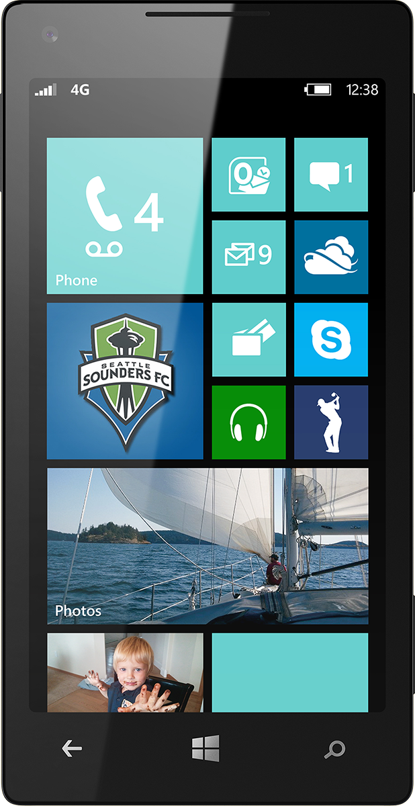
Evaluate this session
Scan this QR code to evaluate this session.

Slide 23
© 2014 Microsoft Corporation. All rights reserved. Microsoft, Windows, and other product names are or may be registered trademarks and/or trademarks in the U.S. and/or other countries.
The information herein is for informational purposes only and represents the current view of Microsoft Corporation as of the date of this presentation. Because Microsoft must respond to changing market conditions, it should not be interpreted to be a commitment on the part of Microsoft, and Microsoft cannot guarantee the accuracy of any information provided after the date of this presentation. MICROSOFT MAKES NO WARRANTIES, EXPRESS, IMPLIED OR STATUTORY, AS TO THE INFORMATION IN THIS PRESENTATION.

Slide 24
Appendix – Hardware and Concurrency

Slide 25
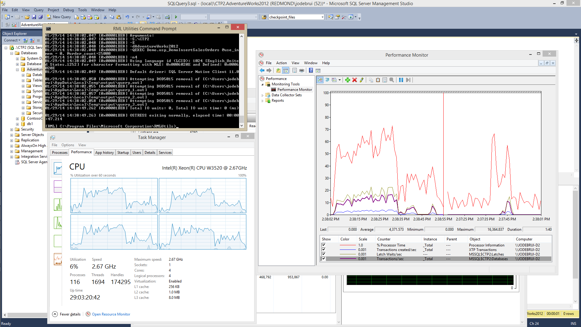
Notes:
Baseline run on desktop machine

Slide 26
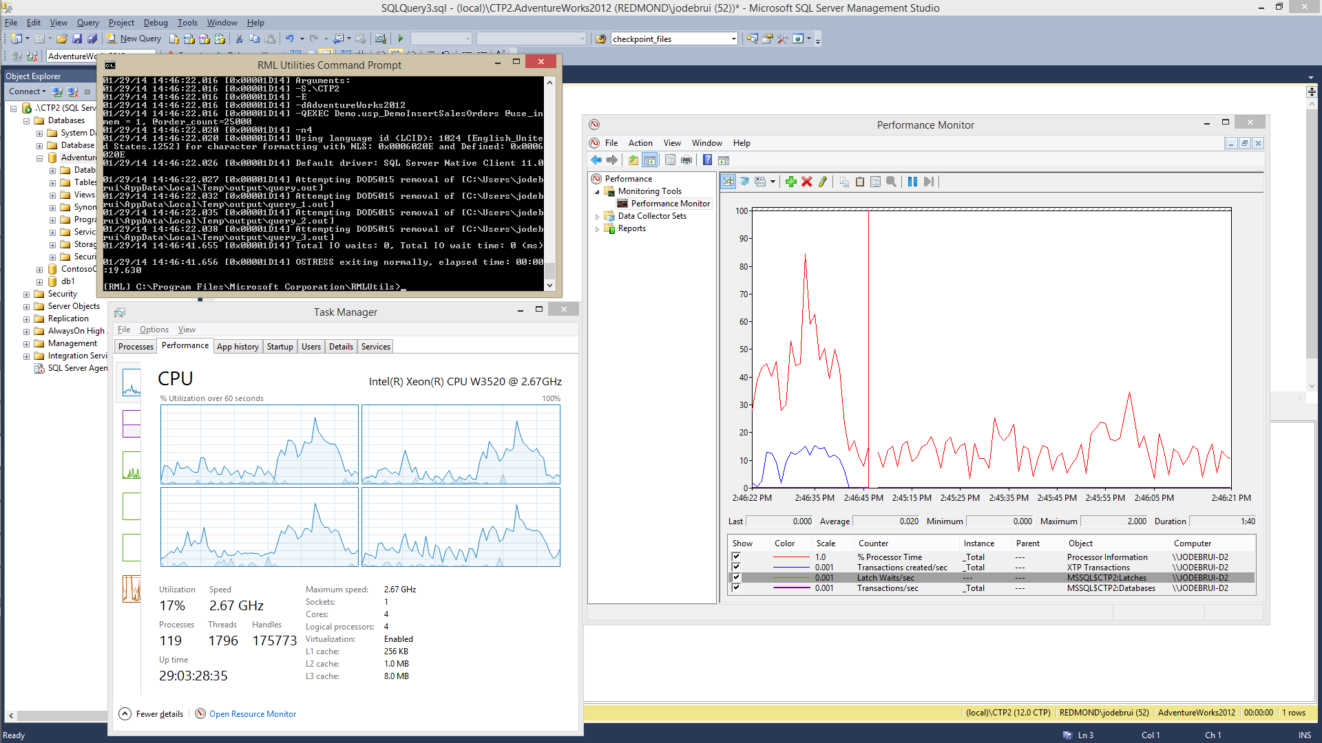
Notes:
Run after migration to In-Memory OLTP

Slide 27
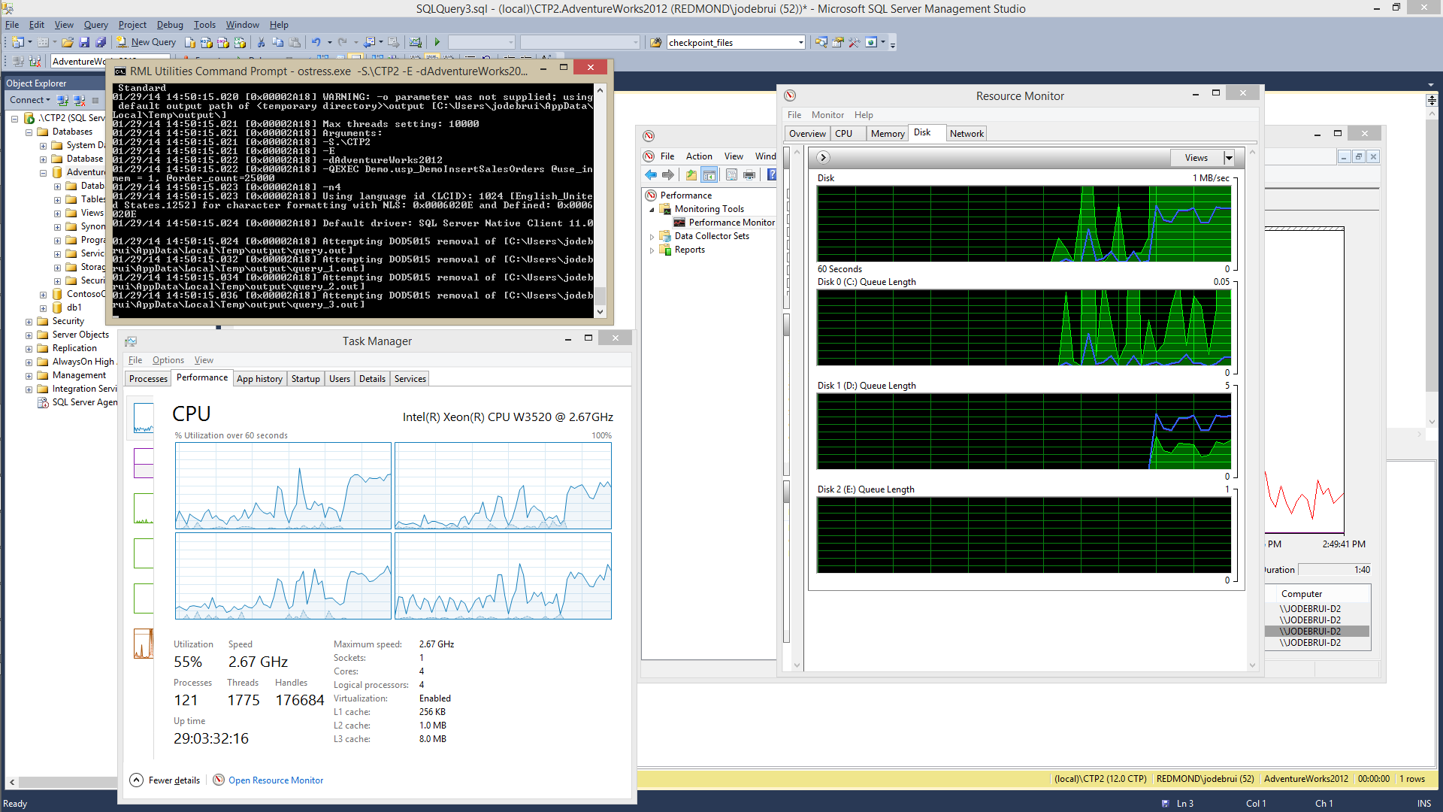
Notes:
Showing disk queue length. The log file is on D:.

Slide 28
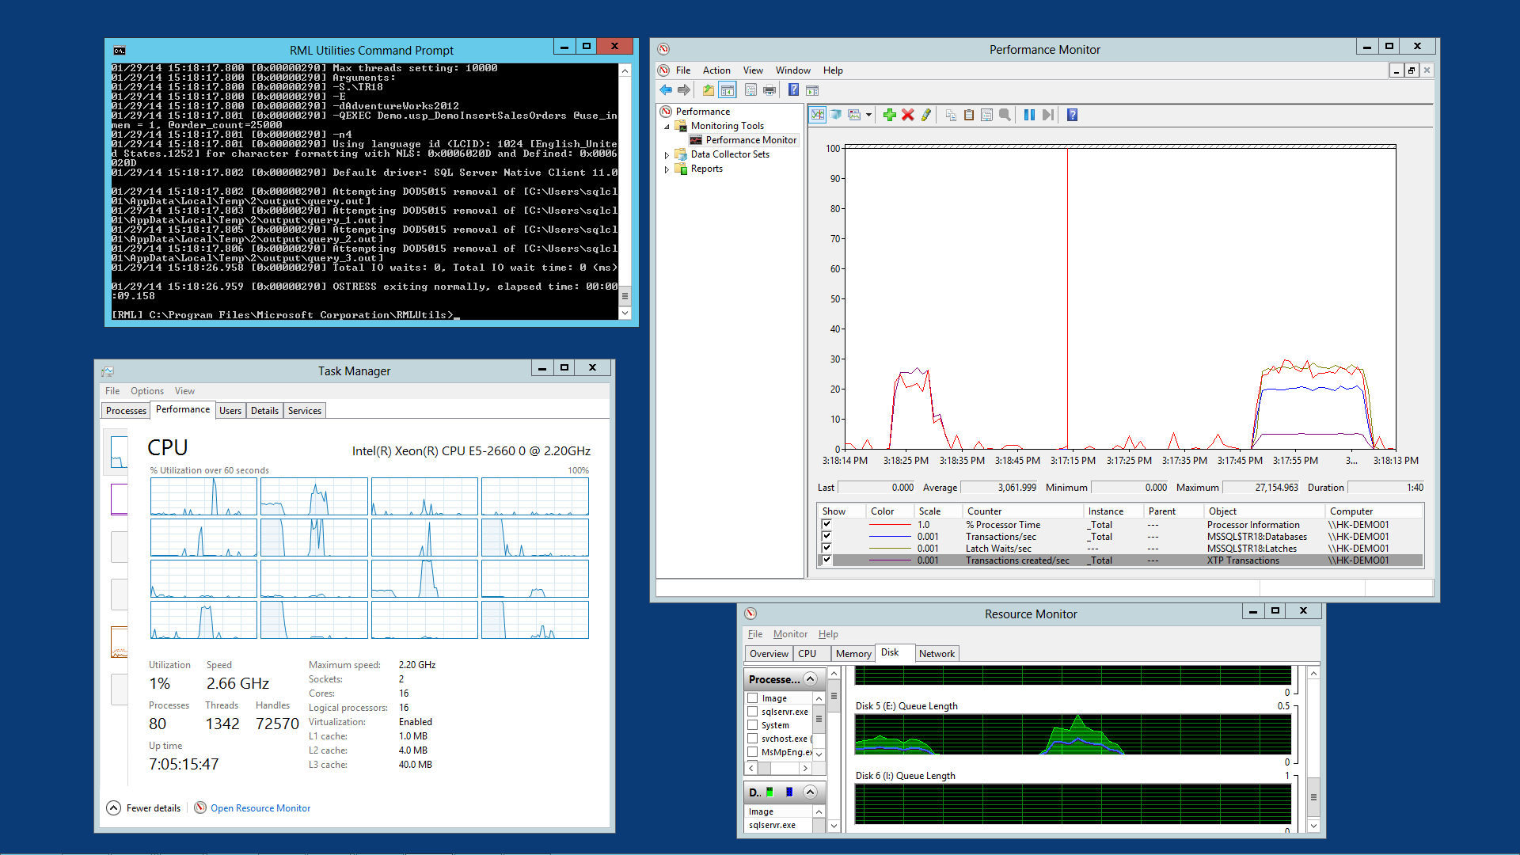

Slide 29
Notes:
Run baseline on server with 4 threads

Slide 30
Notes:
In-memory OLTP version with 4 threads

Slide 31
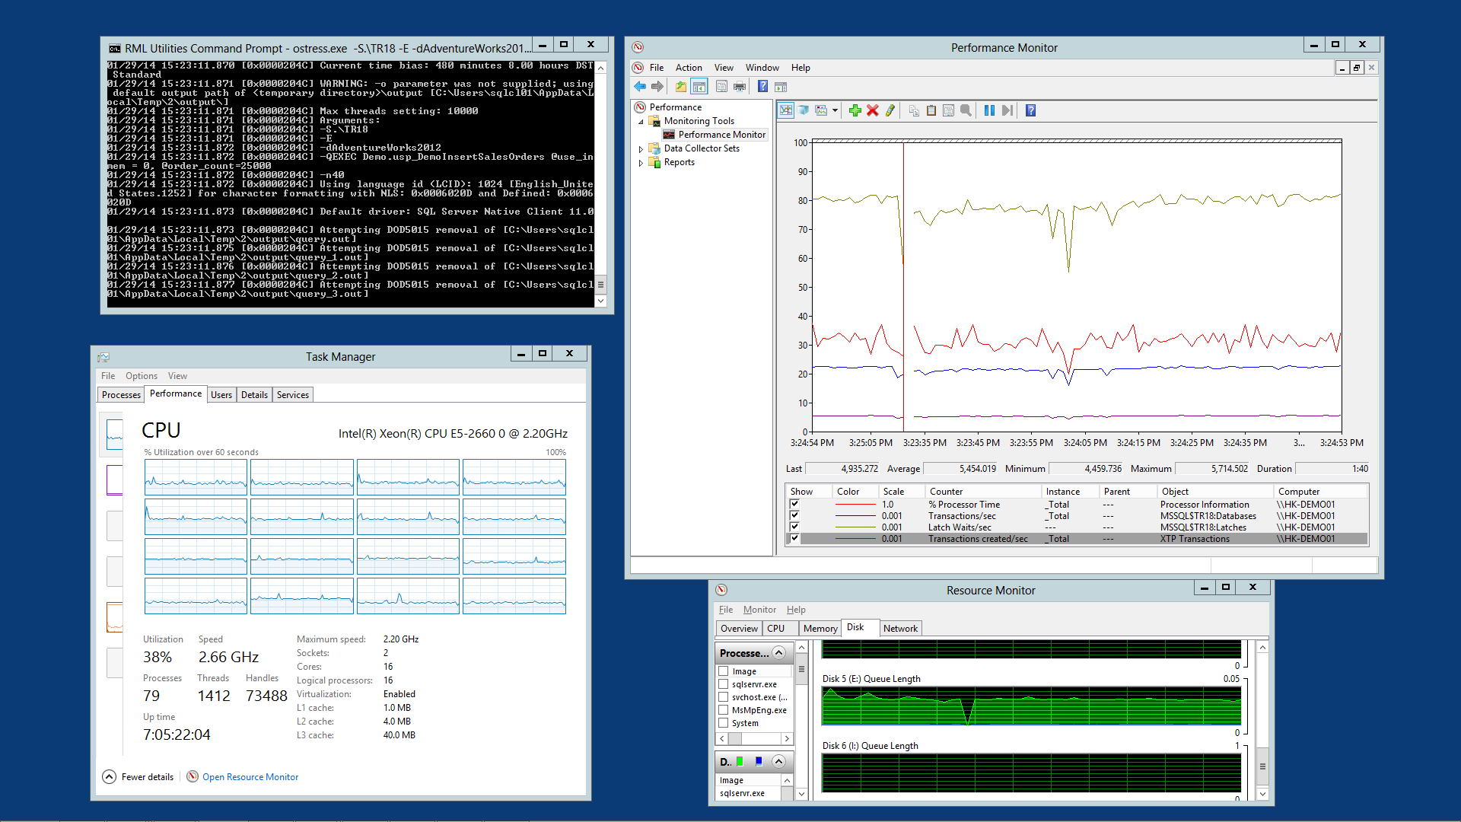
Notes:
Baseline run with 40 threads

Slide 32
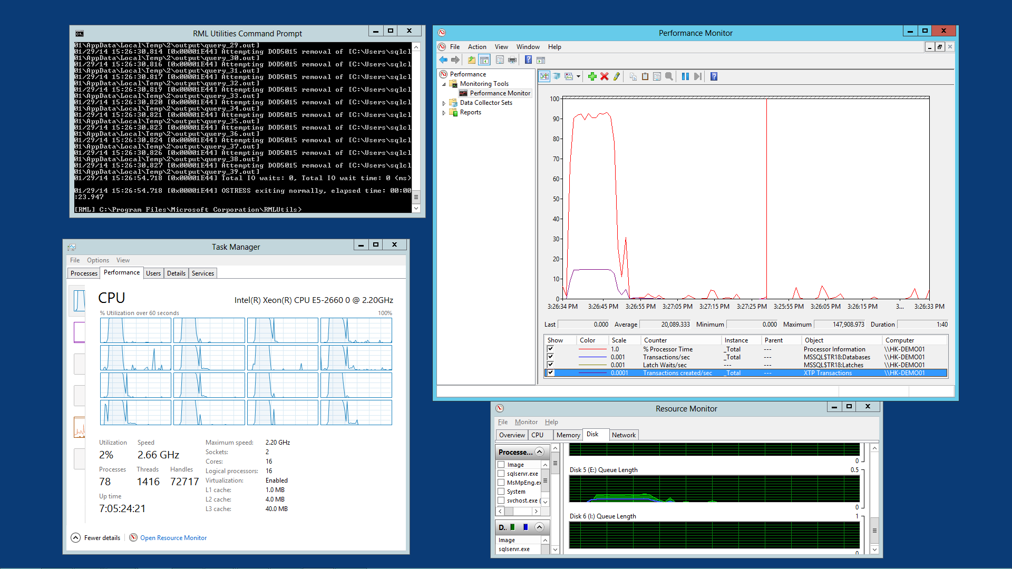
Notes:
In-Memory OLTP run with 40 threads, each inserting 25,000 orders

Slide 33
Notes:
In-Memory OLTP run with 100 threads, each inserting 25,000 orders

