Slide 2
Transforming the business of cloud Cloud Cruiser financial analytics for Microsoft Cloud OS
Nick van der Zweep

Slide 3
Agenda
Cloud Cruiser and Microsoft Cloud OS Positioning
Cloud Cruiser Express
Installation overview
Product demo in WAP
Microsoft Azure Public Cloud/Demo
Cloud Cruiser demo of APC integration
Cloud Cruiser (full version)
Product and Advanced Analytics Demo

Slide 4
What is the market saying?
Want to be able to easily optimize and control IT costs
Want to manage multi-cloud environments
Want to provide critical financial intelligence to lines of business

Slide 5
What is the reality today?
No visibility across multi-cloud/hybrid IT environments
Time-consuming, error-prone spreadsheet management
No IT spend accountability
Shadow IT is rampant
IT supply and demand is ‘best guess’ when deploying cloud
Economics of cloud are marginally realized

Slide 6
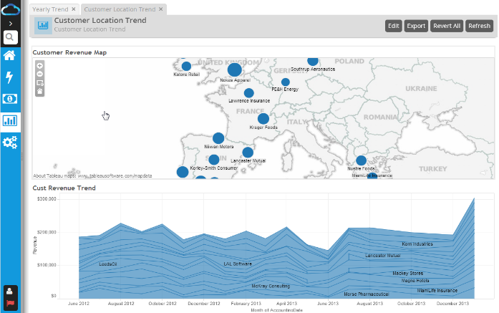
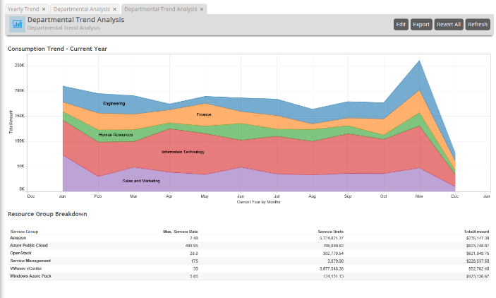
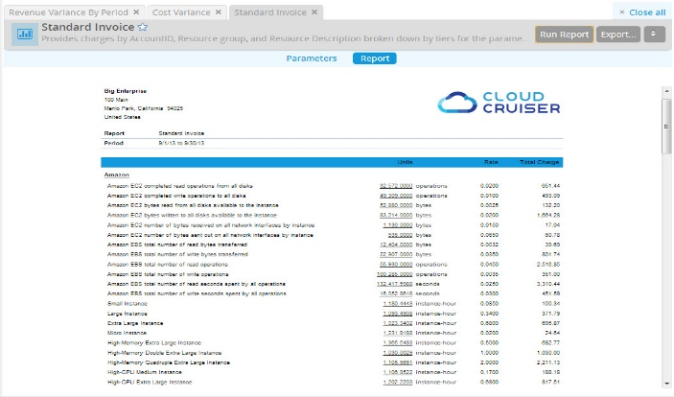
About Cloud Cruiser
Leading Cloud Financial Management Solution for Hybrid IT
Financial insights at every phase of the cloud adoption lifecycle
PLAN
DEPLOY
OPTIMIZE

Slide 7
Cloud Cruiser company overview
Founded: 2009, Campbell, CA
Product: Cloud Financial Management for Hybrid IT
Target Customers: Global 2000 enterprise & Hosters
Microsoft integrations: WAP, System Center, Hyper-V, Windows Server, Azure Public Cloud

Slide 8
PRIVATE CLOUD
PUBLIC CLOUD
Windows Azure Pack (WAP)
Azure Public Cloud
HYBRID IT
TRADITIONAL IT
System Center

Slide 9
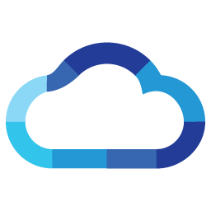
PRIVATE CLOUD
PUBLIC CLOUD
Windows Azure Pack (WAP)
Azure Public Cloud
HYBRID IT
TRADITIONAL IT
System Center

Slide 10
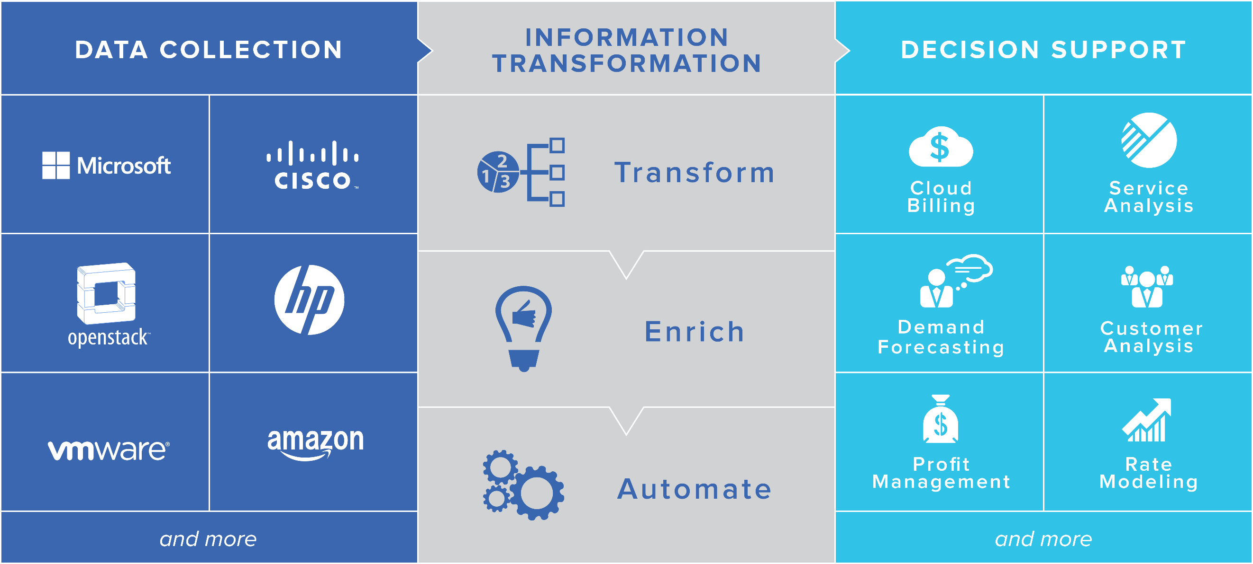
Cloud Financial Management overview

Slide 11
Cloud Cruiser for WAP

Slide 12
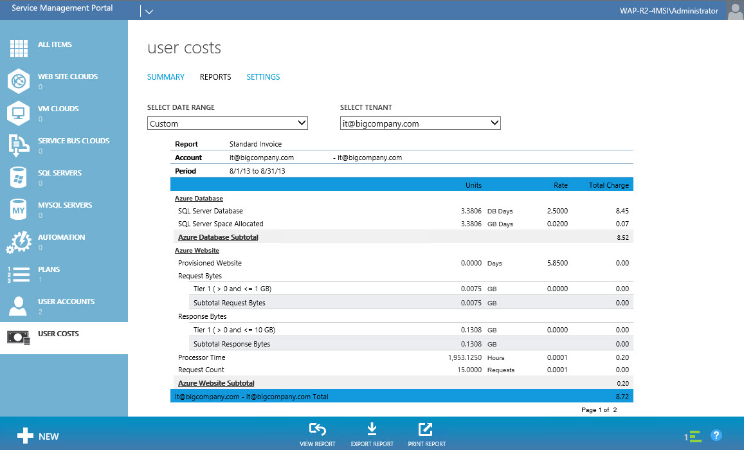
What is Cloud Cruiser for WAP?
Easy way to view IT usage and spending in your WAP environment
Automatically provided with your WAP download
<10 minute installation
Cloud Cruiser Express version is at no cost to you

Slide 13
Cloud Cruiser Express overview
Data Collection from WAP
Information Transformation
Decision Support
Website instances
Virtual machines
Databases
Other WAP-managed objects
Gridpro Request Management
Chargeback & billing
Service analysis
Customer analysis
Demand forecasting
Trends & variances
Budgets & alerts
Transform
Enrich
Automate

Slide 14
Cloud Cruiser Express installation overview
1
Install WAP + CC Express UI via WEBPI
2
Install Cloud Cruiser Backend
Usage API
VM with Cloud Cruiser
Windows Azure Pack
+ CC UI Extensions
API
SQL SERVER

Slide 15
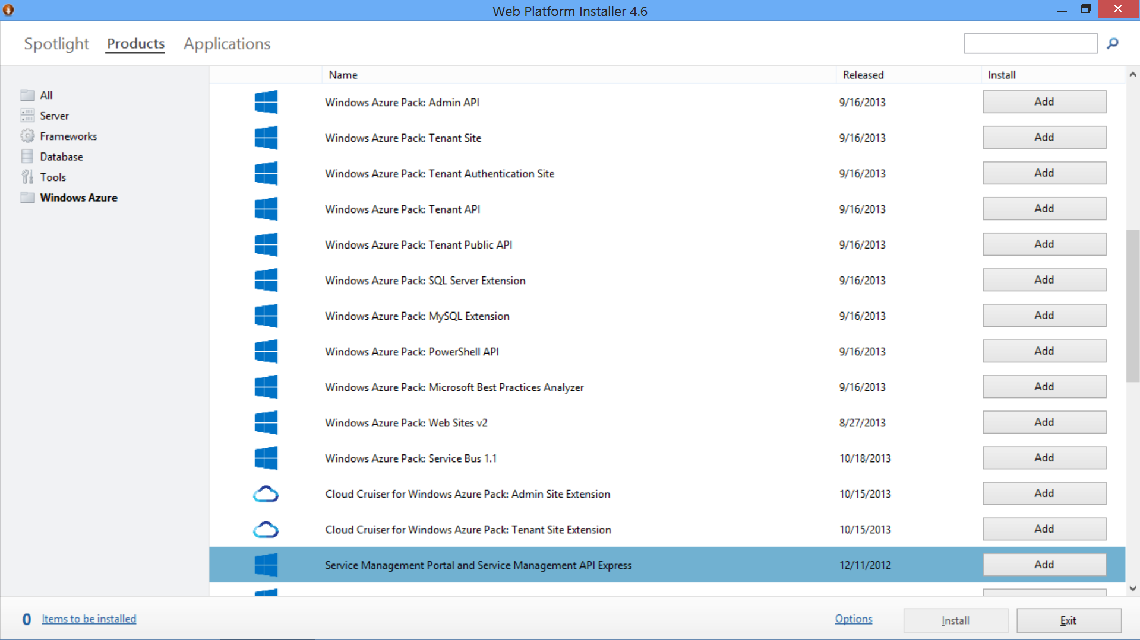
WEB Platform Installer

Slide 16
Configuring Cloud Cruiser Express
Follow steps in the Cloud Cruiser Express Guide
Run the wizard
Enter user data
Enter database connection information
Enter Azure Pack parameters
Register the API with Windows Azure Pack
Access the Cloud Cruiser Express Portal

Slide 17
Configuring System Center
System Center
Website Cloud
Usage Collector
Financial Management
Resource Providers
Usage Service
VM Clouds
Usage Database
Operations Manager
SPF
Service Bus Clouds
Resource Provider Interface
2
3
4
Usage Service API
ETL
Data Analytics
Cloud Cruiser Database
Usage Metering
SQL Servers
MySQL Servers
1
Gridpro
Virtual Machine
Manager
5

Slide 18
Getting help
Refer to the following Microsoft blogs for more information:
IaaS Usage and Service Reporting using System Center 2012 R2 and Windows Azure Pack
Configuring VMM and OM for IaaS usage and metering
Configuring SPF and Windows Azure Pack for IaaS usage and metering

Slide 19
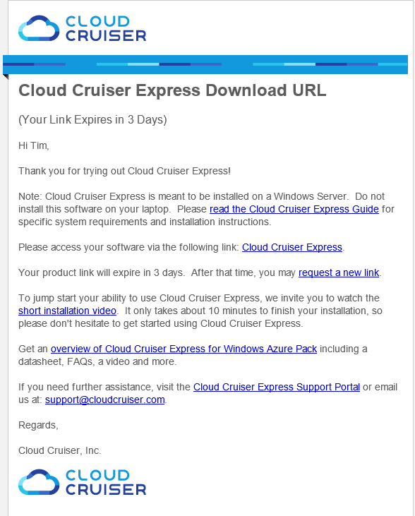
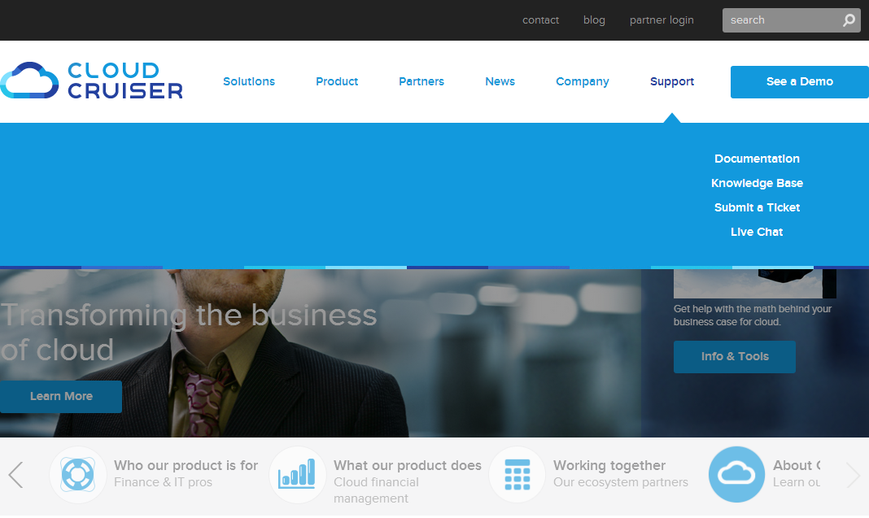
How to access resources
Cloud Cruiser Express download request triggers email with key links
Documentation and Knowledge Base
direct from Cloud Cruiser website:
Basic information
Videos
Tips on getting help
Tips on troubleshooting
Cloud Cruiser Express documentation
Additional links including SC config

Slide 20
Demo #1
Cloud Cruiser for Windows Azure Pack
Show Cloud Cruiser Express integration with WAP
Explore standard invoices and reports

Slide 21
Cloud Cruiser for APC connecting to azure public cloud

Slide 22
Azure Public Cloud support
Adds collection of Azure Public Cloud usage
Enables financial management of both WAP and APC from a single pane of glass
Requires an upgrade to Cloud Cruiser (full version)
Upgrade also allows collection of other resource information (discussed later)

Slide 23
Demo #2
Azure Public Cloud
View Azure Public Cloud resources
View an invoice with Azure Public Cloud billing

Slide 24
Cloud Cruiser financial management for hybrid IT

Slide 25
Advanced decision support for entire IT ecosystem
Unlimited Scope
Unlimited Scale
Unlimited Answers
More public clouds
More private clouds
Traditional IT infrastructure
Financial data
Expand your services
Expand your customers
Expand your IT
Know your costs
Understand your customers
Increase your profitability
Plan for growth
Unlimited Support
Partner for success

Slide 26
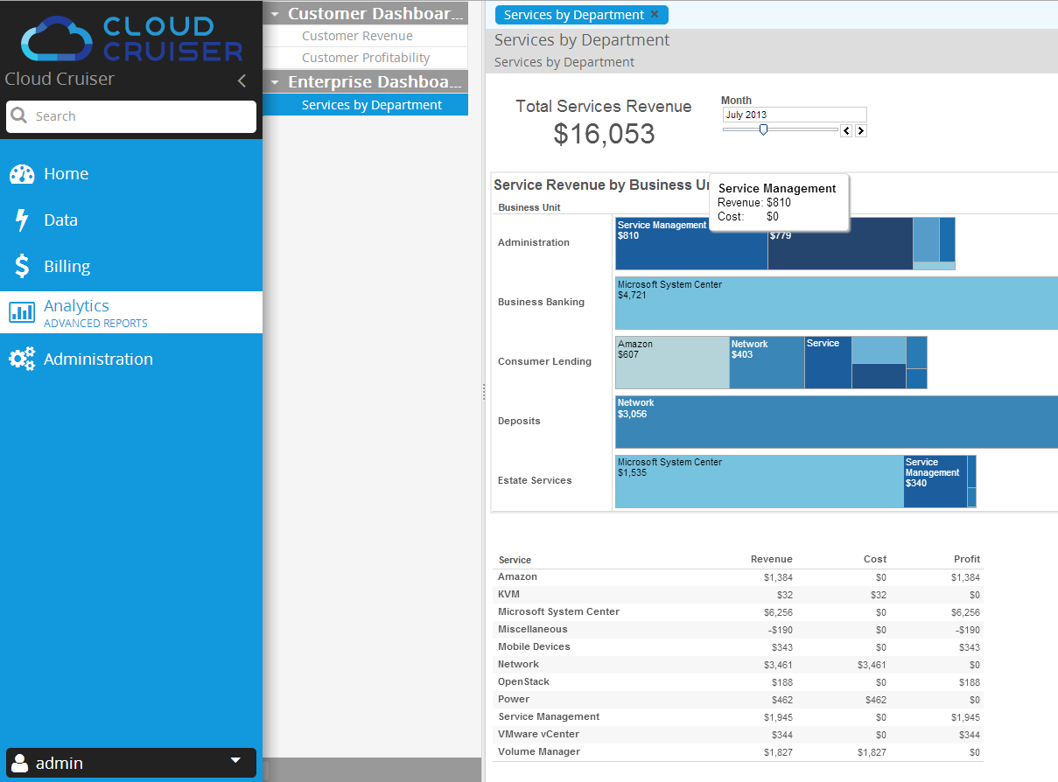
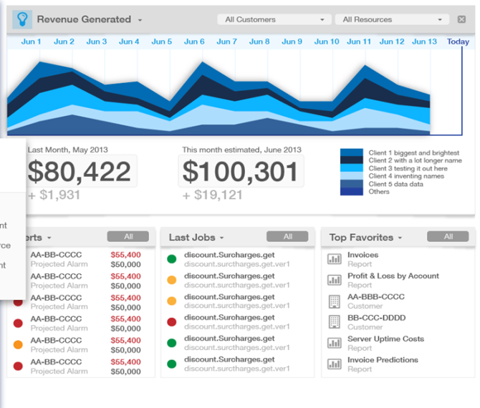
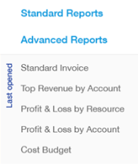
Cloud Financial Intelligence at your fingertips
How profitable are my services?
Who’s consuming the most resources?
What is my spending forecast?
Which customer is most profitable?
Which geos are growing the fastest?
How do I automate my cloud billing?
Is my enterprise ready for chargeback?

Slide 27
Demo #3
Cloud Cruiser
Explore Cloud Cruiser chargeback/billing capabilities
Explore Cloud Cruiser advanced analytics

Slide 28
Product Benefits

Slide 29
Benefits of Microsoft-Cloud Cruiser solution
Completes the Microsoft cloud solution stack with best-in-class financial management
Enables high-value business decisions at all stages of the cloud adoption lifecycle
Answers RFP requirements for chargeback and billing, meeting all Gartner required, recommended and optional criteria
Seamlessly works in any customer cloud environment

Slide 30
Benefits to enterprises
Understand the real costs associated with running workloads in the cloud
Shape demand and increase fiscal responsibility
Maximize use of valuable cloud assets
Justify cloud investment

Slide 31
Benefits to hosters
Automate multi-tenant billing across hybrid cloud
Support agile pricing models to gain competitive advantage
Gain deep insights into service costs & revenue, customer usage patterns, forecasted demands, etc.
Eliminate costly billing reconciliations with auditable financial records

Slide 32
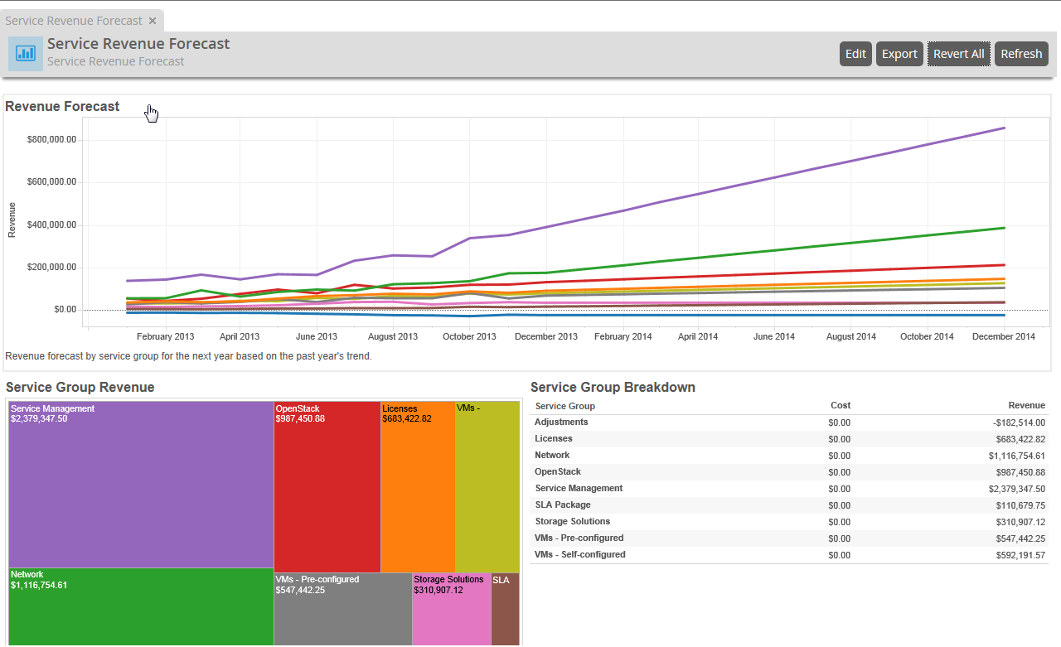
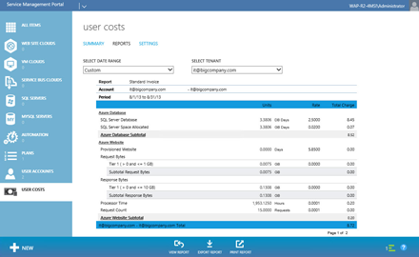
Cloud Cruiser
Multi-tenant showback, chargeback, and cloud billing for hybrid IT, with advanced reporting and analytics for customer & service analysis, demand forecasting, profit management, what-ifs, and more

Slide 33
Engaging with Cloud Cruiser
For questions, customer referral or pricing
microsoft@cloudcruiser.com
For product information, collateral, videos and more
www.cloudcruiser.com/microsoft

Slide 34
For More Information
Windows Server
Windows Server 2012 R2
http://technet.microsoft.com/en-US/evalcenter/dn205286
System Center
System Center 2012 R2
http://technet.microsoft.com/en-US/evalcenter/dn205295
Azure Pack
Azure Pack
http://www.microsoft.com/en-us/server-cloud/products/windows-azure-pack
Microsoft Azure
Microsoft Azure
http://azure.microsoft.com/en-us/
Come Visit Us in the Microsoft Solutions Experience!
Look for Datacenter and Infrastructure Management TechExpo Level 1 Hall CD

Slide 35
Resources
Learning
Sessions on Demand
Microsoft Certification & Training Resources
http://channel9.msdn.com/Events/TechEd
www.microsoft.com/learning
TechNet
msdn
Resources for IT Professionals
Resources for Developers
http://microsoft.com/technet
http://microsoft.com/msdn

Slide 36
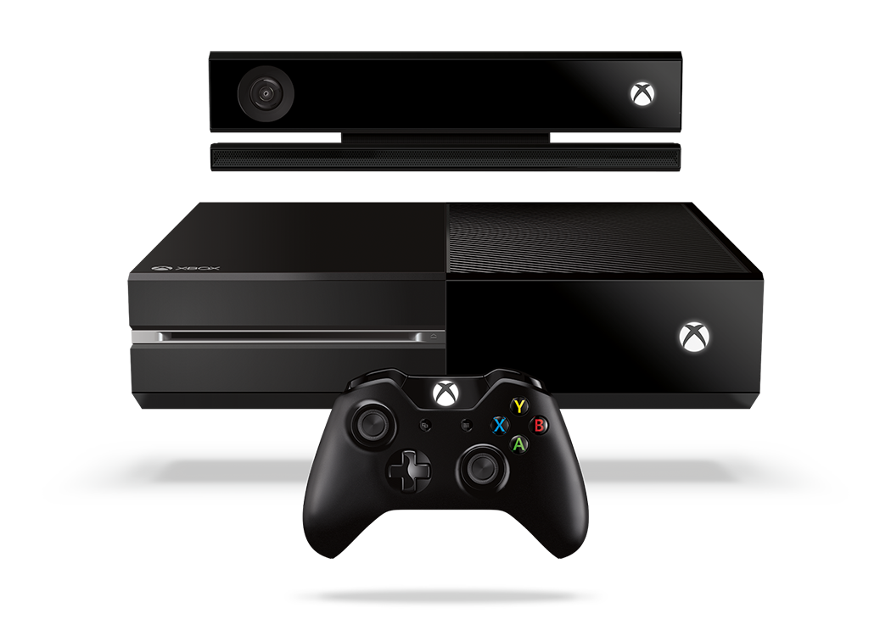
Complete an evaluation and enter to win!

Slide 37
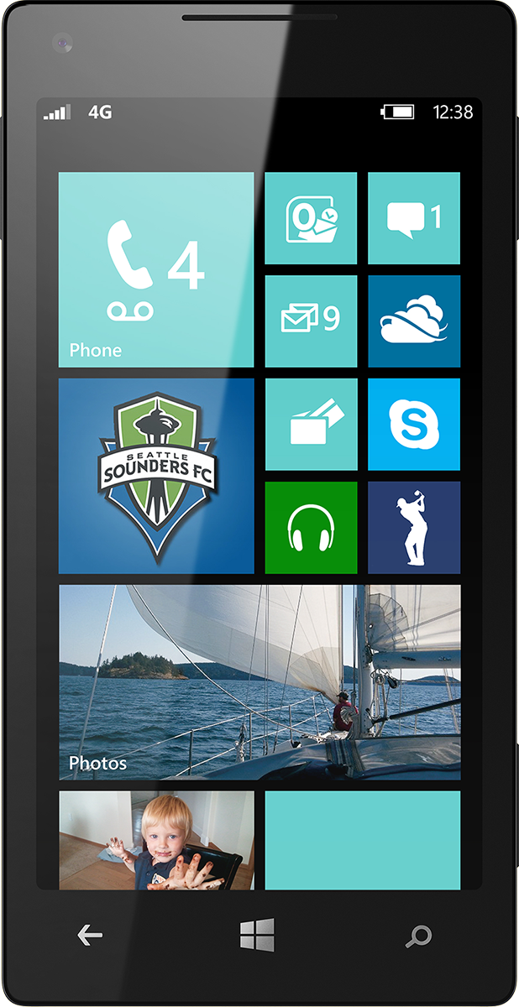
Evaluate this session
Scan this QR code to evaluate this session.

Slide 38
Thank you

Slide 39
Appendix

Slide 40
Where to find Cloud Cruiser Express
Installed by default during the WAP installation
If you did not install Cloud Cruiser during the WAP installation or want to install a new version, you can find the executable in the WEBPI installer
Cloud Cruiser for Windows Azure Pack: Admin Site Extension
Cloud Cruiser for Windows Azure Pack: Tenant Site Extension

Slide 41
Cloud Cruiser Analytics Platform
The premium version of Cloud Cruiser comes standard with:
1 license for Cloud Cruiser Analytics Desktop
- enables worksheet authoring
5 licenses for Cloud Cruiser Analytics Server
- enables analytics usage and worksheet editing

Slide 42
Beyond chargeback & reporting
Agile pricing engine
Fixed, tiered, promotional, discounts, state-based pricing, bundles, SLAs, etc.
Budgets & alerts
Custom budgets per tenant, company, BU, etc.
Automatic alert notification by dashboard and email
Consumption forecasting

Slide 43
Reporting options
WAP portal reporting
detailed showback/chargeback/cloud billing per tenants
summary usage reporting
Cloud Cruiser portal standard reporting
designed to answer most common questions
drill-down capability
examples include: invoices, top costs, trends, variances, P&L
Cloud Cruiser portal advanced reporting
Customized reporting based on any available metadata
examples include: reporting by VM name, subscription ID, usage date, and more

Slide 44
Cloud Cruiser Meets all Gartner’s Required, Preferred & Optional Functionality
REQUIRED
PREFERRED
OPTIONAL
Web-based administrative interface
Reporting, budgets, trends & agile resource pricing
Multi-tenant charging
Allocation & consumption-based charging by tenant
Cost reporting
On demand or scheduled reporting by user, group, service, resource
Allocation-based charging model
Standard, catalog, SLA, and resource charging
Agile Pricing
Per object, per cloud resource pool, and per service level bundle pricing
Budgets & Alerts
Hierarchical budget alerts and automatic notification by dashboard and email
API integration with CMP to restrict provisioning
Overage Charging
Tiered pricing for overage charging
Cost Trends
Trends & consumption forecasting
Advanced Pricing Models
Consumption-based, reservation-based, and resource state pricing
Per network bandwidth consumption pricing
Multiple Currency Support
Service VM Charging
Service VM charging outside VS objects
Cost Simulator
Cost of catalog objects over time
Gartner: Alessandro Perilli, ‘Evaluation Criteria for Cloud Management Platforms,’ 19 July 2012

