Slide 2
New DevOps Agent: Application Performance Monitoring in Microsoft System Center 2012 R2
DCIM-B218
Byron Ricks
Senior Technical Writer
Microsoft

Slide 3
Today’s agenda
What is DevOps?
Introduce Microsoft Monitoring Agent 2013
Compare monitoring approaches
Show installation of Microsoft Monitoring Agent
Demo: Microsoft Monitoring Agent as a stand-alone monitoring and diagnostic tool
Vision

Slide 4
What is DevOps?

Slide 5
DevOps is:
A way to develop software that emphasizes
communication
collaboration
integration
between development and IT operations teams.

Slide 6
The problem
With different toolsets, information needs, and workflow processes, communication, collaboration, and integration between development and IT operations teams can be a challenge.

Slide 7
Application Lifecycle – Common Challenges
No actionable feedback resulting in high MTTR
Operations
PROBLEM ASSIGNED TO ENGINEERING
Production incidents are hard to debug
Development & testing
Develop
Rapid reaction to feedback
Users detect defects in production
Fix
Monitor
Operate
Software to value delivery
Unable to reproduce error in development environment
OPS
BACKLOG
Isolated operations tools and workflows
Long deployment cycle times
WORKING SOFTWARE

Slide 8
Dev and IT operations have different goals
Development
Driven by needs for frequent delivery of new features
IT Operations
Focus on availability, stability, and cost efficiency

Slide 9
Business impact
Loss of efficiency
Reduced agility
Customer dissatisfaction

Slide 10
“Houston, we’ve had a problem.”
Apollo 13

Slide 11
Value of DevOps
Integrate IT and Dev tools for greater efficiency
Quickly detect and fix problems
Decrease the time it takes for application maintenance
Optimize for a fast-moving service environment

Slide 12
Introducing Microsoft Monitoring Agent

Slide 13
Value of Microsoft Monitoring Agent
Increases efficiency and agility
Developers can monitor & troubleshoot
No waiting for IT operations to monitor app
Designed for use in production

Slide 14
Application Lifecycle – Common Challenges
No actionable feedback resulting in high MTTR
Operations
PROBLEM ASSIGNED TO ENGINEERING
Production incidents are hard to debug
Development & testing
Develop
Rapid reaction to feedback
Users detect defects in production
Fix
Monitor
Operate
Software to value delivery
Unable to reproduce error in development environment
OPS
BACKLOG
Isolated operations tools and workflows
Long deployment cycle times
WORKING SOFTWARE

Slide 15
Once, there were 3 “monitoring” agents…
And each did its part
.NET Application Performance Monitoring (AVIcode)
Operations Manager Agent
IntelliTrace Collector

Slide 16
Now, there’s only 1 agent…
Microsoft Monitoring Agent
Operations Manager Agent
.NET APM (AVIcode)
IntelliTrace Collector

Slide 17
That delivers:
Infrastructure monitoring
Detailed app monitoring in production
Integration with the developer environment
Monitored Entity (i.e. Windows Computer or .NET Application)
AppInsights
Operations Manager
Management Packs, configuration, PowerShell
MMA
Local

Slide 18
What is Microsoft Monitoring Agent?
A service that monitors computer infrastructure and application health. Collects various diagnostic data, such as performance metrics, event logs, and traces.
Includes the full functionality of System Center Operations Manager agent, .NET APM, and IntelliTrace Collector. Can be used for monitoring applications that are running in production environments.
Can be used as part of Application Insights for Visual Studio Online, as a stand-alone monitoring tool, or together with Operations Manager.
Visual Studio Ultimate lets you analyze the collected application traces (IntelliTrace logs) and troubleshoot issues with application code.

Slide 19
Comparing Monitoring Approaches for .NET Applications

Slide 20
Comparing Monitoring Approaches for .NET Apps
Three ways to monitor .NET Apps
Operations Manager and .NET APM
Application Insights (Visual Studio Online)
Stand-alone monitoring with local collection
- Always on monitoring
- On demand monitoring

Slide 21
Comparing Monitoring Approaches for .NET Apps
Continuous monitoring with System Center APM
Use when you have System Center Operations Manager
Continuous monitoring good for baseline performance and notification of failures
Configure using .NET APM template in Operations Manager
Typically IT Operations approach to receive alerts about app performance/failures
IT Ops can convert data from APM alerts into Microsoft IntelliTrace format and route alerts to Visual Studio TFS work items by using TFS synchronization
IT Operations owns the environment

Slide 22
Comparing Monitoring Approaches for .NET Apps
Monitoring with Application Insights
No infrastructure to host (in contrast to APM) – Application Insights is hosted by Microsoft
Rich data and visualization, significantly more data collected and shown for apps compared to local monitoring
Needs subscription, Internet connection, and sends data

Slide 23
Comparing Monitoring Approaches for .NET Apps
Local Monitoring: Always on & On demand
Always on
Use when you want to collect data snapshots whenever you want
You are the owner of an environment
Know the best times to collect traces
On demand
Use when you want to collect more data for troubleshooting specific issues
Option to define collection plan with app-specific settings
You control when to start and stop monitoring

Slide 24
Stand-alone monitoring with local collection
Value: A lightweight monitoring solution that doesn’t need heavy infrastructure from IT Operations
Helps Developers and IT Ops troubleshoot app source code
PowerShell cmdlets control monitoring
Outputs to IntelliTrace file format that is natively understood by Visual Studio 2013 Ultimate
Detects application exceptions and performance degradations
Less than 5 minutes to download, install, and begin to use

Slide 25
Installing Microsoft Monitoring Agent

Slide 26
Two downloads available
Two downloads of Microsoft Monitoring Agent are available on the Download Center:
Microsoft Monitoring Agent 2013 (RTM) also packaged with System Center 2012 R2 Operations Manager
Microsoft Monitoring Agent 2013 Update 1 Preview
Local monitoring can be used with both
Reporting to Application Insights is available only in Microsoft Monitoring Agent 2013 Update 1 Preview

Slide 27
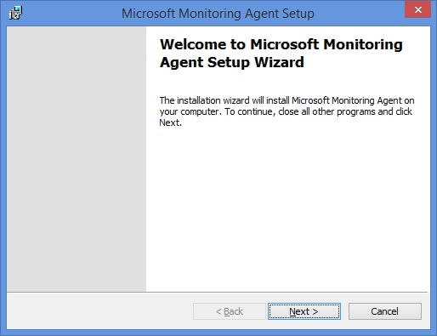
Installing Microsoft Monitoring Agent

Slide 28
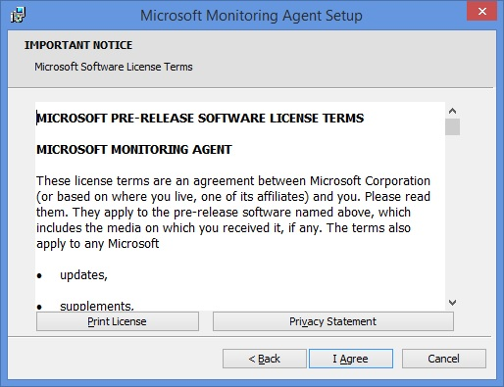
Installing Microsoft Monitoring Agent

Slide 29
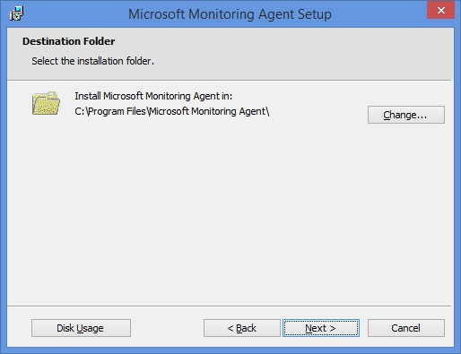
Installing Microsoft Monitoring Agent

Slide 30
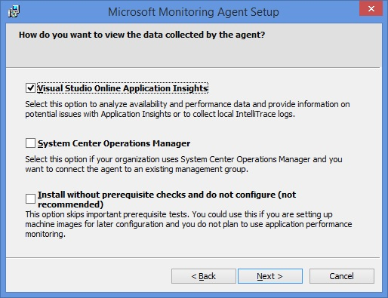
Installing Microsoft Monitoring Agent

Slide 31
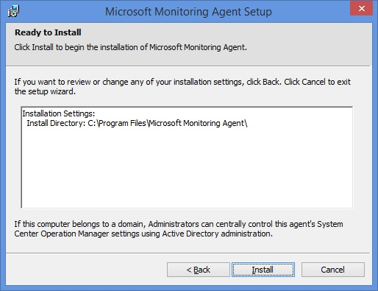
Installing Microsoft Monitoring Agent

Slide 32
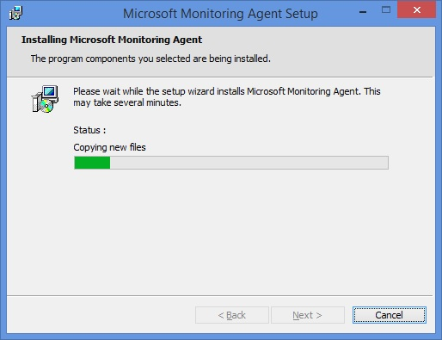
Installing Microsoft Monitoring Agent

Slide 33
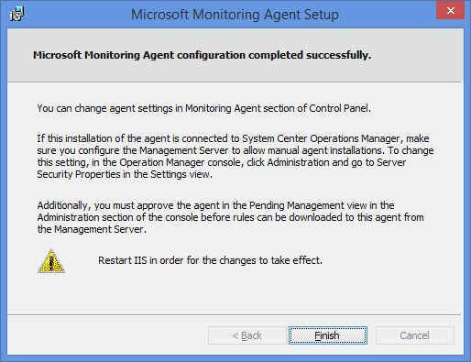
Installing Microsoft Monitoring Agent

Slide 34
Using Microsoft Monitoring Agent for stand-alone monitoring

Slide 35
The power of historical debugging
Why do I need IntelliTrace logs?
Debug errors that are hard to reproduce or that happen outside Visual Studio, for example, in production or other environments.
Debug only actionable performance traces that exceeded the configured SLA thresholds.
IntelliTrace log is one of the key artifacts in the Microsoft DevOps story, integrated into Development and Operations systems from Microsoft.

Slide 36
Control monitoring with 4 commands
Start-WebApplicationMonitoring – Starts monitoring an IIS web application
Stop-WebApplicationMonitoring – Stops monitoring an IIS web application and creates an IntelliTrace file with data collected while monitoring
Checkpoint-WebApplicationMonitoring – Creates a snapshot of the IntelliTrace file and continues monitoring
Get-WebApplicationMonitoringStatus – Gets the monitoring status of all monitored web applications. See what’s being monitored

Slide 37
Demo
Byron Ricks

Slide 38
Vision

Slide 39
Communicate + Collaborate Integrate ______________________________________________ Your best work

Slide 40
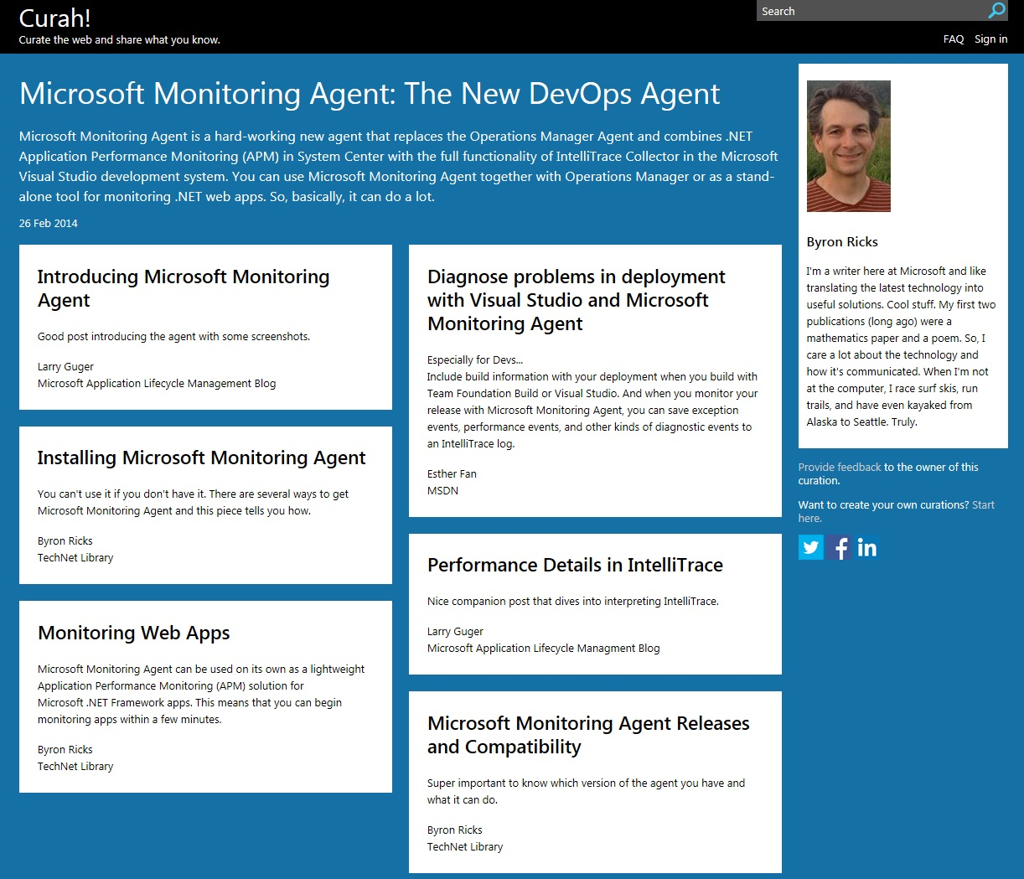

Slide 41
Resources
TechNet
Resources for IT Professionals
msdn
Resources for Developers
System Center Operations Manager
Visual Studio
Monitoring with Microsoft Monitoring Agent
Microsoft Monitoring Agent: The New DevOps Agent
Viewing and Investigating Alerts for .NET Applications (Server-side Perspective)
How to Configure Monitoring for .NET Applications
Collect IntelliTrace Data Outside Visual Studio with the Standalone Collector
Debug Your App with IntelliTrace Log (.iTrace) Files

Slide 42
Q&A Byron Ricks – byronr@microsoft.com

Slide 43
For More Information
Windows Server
Windows Server 2012 R2
http://technet.microsoft.com/en-US/evalcenter/dn205286
System Center
System Center 2012 R2
http://technet.microsoft.com/en-US/evalcenter/dn205295
Azure Pack
Azure Pack
http://www.microsoft.com/en-us/server-cloud/products/windows-azure-pack
Microsoft Azure
Microsoft Azure
http://azure.microsoft.com/en-us/
Come Visit Us in the Microsoft Solutions Experience!
Look for Datacenter and Infrastructure Management TechExpo Level 1 Hall CD

Slide 44
Resources
Learning
Sessions on Demand
Microsoft Certification & Training Resources
http://channel9.msdn.com/Events/TechEd
www.microsoft.com/learning
TechNet
msdn
Resources for IT Professionals
Resources for Developers
http://microsoft.com/technet
http://microsoft.com/msdn

Slide 45
Complete an evaluation and enter to win!

Slide 46
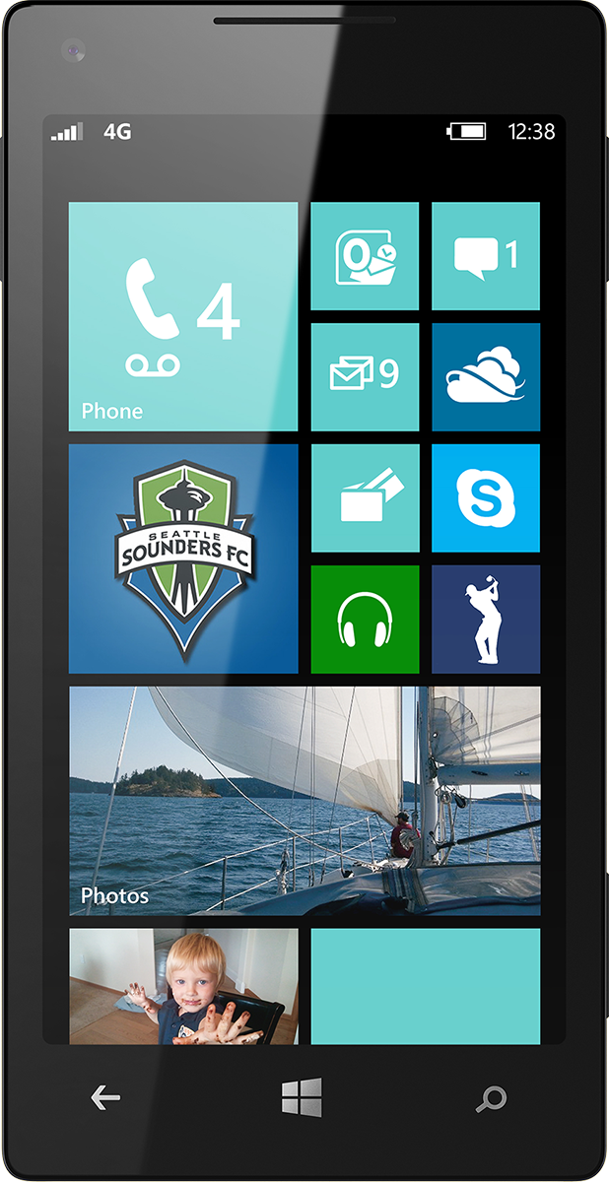
Evaluate this session
Scan this QR code to evaluate this session.

Slide 47
© 2014 Microsoft Corporation. All rights reserved. Microsoft, Windows, and other product names are or may be registered trademarks and/or trademarks in the U.S. and/or other countries.
The information herein is for informational purposes only and represents the current view of Microsoft Corporation as of the date of this presentation. Because Microsoft must respond to changing market conditions, it should not be interpreted to be a commitment on the part of Microsoft, and Microsoft cannot guarantee the accuracy of any information provided after the date of this presentation. MICROSOFT MAKES NO WARRANTIES, EXPRESS, IMPLIED OR STATUTORY, AS TO THE INFORMATION IN THIS PRESENTATION.

