Slide 1


Slide 2

Secure Design and Best Practices for Your Private Cloud
DCIM-B219
Sam Chandrashekar
Patrick Lang

Slide 3
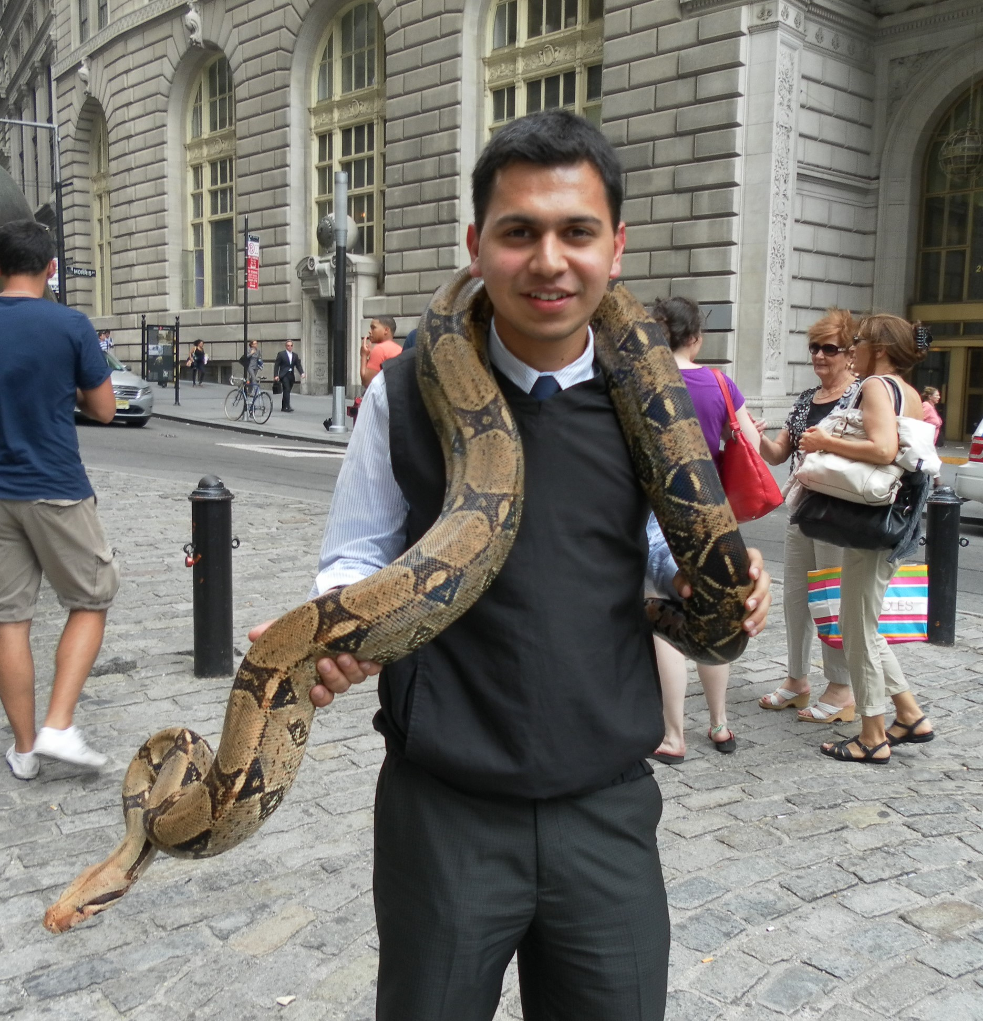
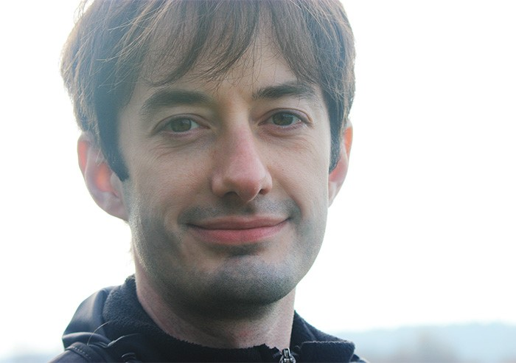
Who are we?
Patrick Lang
  Started IT career in 1998 to help a city survive “Y2K”
  Graduated from UT Austin in 2004 and joined Microsoft focusing on anti-malware
  Has managed Hyper-V since before it was beta, and joined the engineering team in 2010
Sam Chandrashekar
  Graduated form Carnegie Mellon; worked on supercomputers at IBM and electronic trading at Morgan Stanley before joining the Hyper-V team in 2012

Slide 4
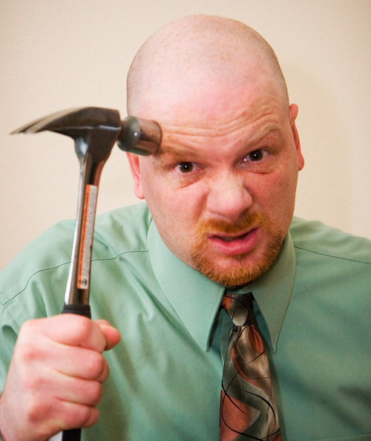

Why are we doing this?
Security can be hard
  Without planning
We’ve been there
  Access denied… or should it have been?
Mistakes cost
  Time, Credibility, Customers

Slide 5

Security model
Hyper-V assumes the worst
All guest VMs either
  have no security
  or have been compromised
  and thus are malicious

Slide 6
Hyper-V Architecture

Slide 7
Management OS
Guest VM 1
Guest VM n
User Mode
User Mode
User Mode
Kernel Mode
Kernel Mode
Kernel Mode
…
Hypervisor
Hardware

Slide 8
Management OS
Guest VM 1
Guest VM n
User Mode
User Mode
User Mode
Kernel Mode
Kernel Mode
Kernel Mode
…
Hypervisor
Hardware

Slide 9
User Mode
Kernel Mode
Trusted Compute Base
Management OS
Hypervisor
Hypervisor
Hardware

Slide 10
Management OS
Guest VM 1
Guest VM n
User Mode
User Mode
User Mode
Kernel Mode
Kernel Mode
Kernel Mode
…
Hypervisor
Hardware

Slide 11
Management OS
Guest VM 1
Guest VM n
User Mode
User Mode
User Mode
Kernel Mode
Kernel Mode
Kernel Mode
…
Hypervisor
Hypercalls
Scheduler
Partition Manager
Address Manager
Model Specific Registers
Interrupt Controller
Hardware

Slide 12
Management OS
Guest VM 1
Guest VM n
VM Worker Processes
User Mode
User Mode
VM Management Service
Kernel Mode
Kernel Mode
Kernel Mode
…
Hypervisor
Hypercalls
Scheduler
Partition Manager
Address Manager
Model Specific Registers
Interrupt Controller
Hardware

Slide 13
Management OS
Guest VM 1
Guest VM n
VM Worker Processes
User Mode
User Mode
VM Management Service
VID
…
WinHv
WinHv
WinHv
Hypervisor
Hypercalls
Scheduler
Partition Manager
Address Manager
Model Specific Registers
Interrupt Controller
Hardware

Slide 14
Management OS
Guest VM 1
Guest VM n
VM Worker Processes
User Mode
User Mode
VM Management Service
VID
…
WinHv
WinHv
WinHv
VM Bus
VM Bus
VM Bus
Hypervisor
Hypercalls
Scheduler
Partition Manager
Address Manager
Model Specific Registers
Interrupt Controller
Hardware

Slide 15
Management OS
Guest VM 1
Guest VM n
VM Worker Processes
User Mode
User Mode
VM Management Service
VID
VSPs
Virtualization Service Client (VSC)
Virtualization Service Client (VSC)
…
WinHv
I/O stack
WinHv
WinHv
drivers
VM Bus
VM Bus
VM Bus
Hypervisor
Hypercalls
Scheduler
Partition Manager
Address Manager
Model Specific Registers
Interrupt Controller
Hardware

Slide 16
Hyper-V Administrator
Blue VM Administrator
Simplified Threat Model
Blue VM
VM Management Service
Management OS kernel and device drivers
VM Worker Process
Hypervisor
Kernel Mode
User Mode
Physical Host

Slide 17
















Microsoft Security Development Lifecycle
Conception
Systematic architectural analysis
Line by line code reviews
Fuzzing, and lots of it
  We write programs to randomly attack ourselves
  We have hundreds of them
Even so, we must have a process to fix bugs
  Windows Update is never going away
Best Practices
and Learning
Product
Development
Incident Response
Secure
Design
Microsoft Security
Response Center
Final
Security Review
Secure
Implementation
Release
Beta Testing
Internal Testing
Verification

Slide 18
Protecting the Host
Reduce attack surface
  Use server core
  Don’t install other roles on the host
  Don’t install third party apps on the host (including anti-virus)
Stay up to date
  Patching
    Management Operating System
    Integration Components
  Drivers
    RemoteFX
    VirtualFC
    SR-IOV
    …

Slide 19
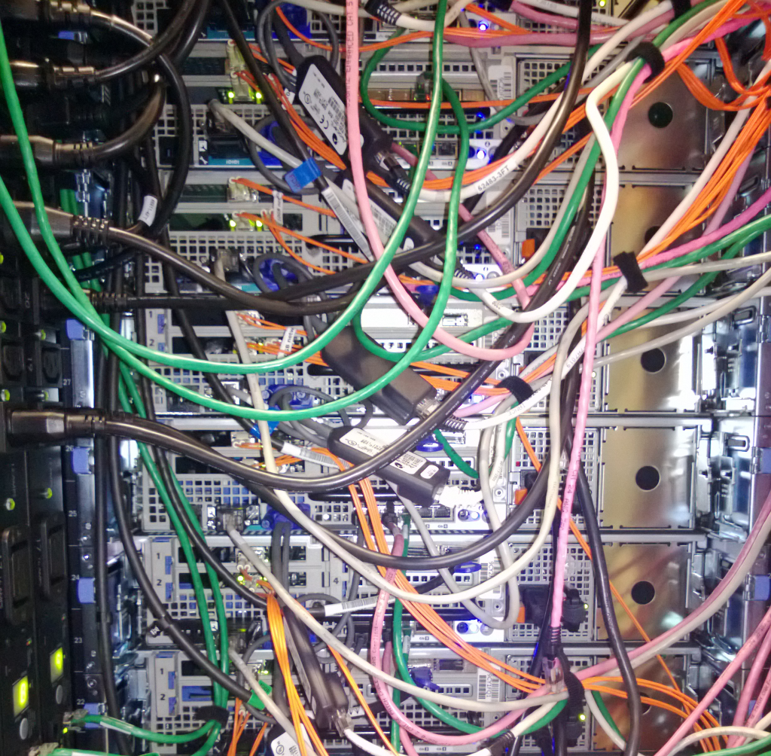
Management and Network Security

Slide 20
Network Isolation
VM
VM
VM
VM
VM
VM
Host
Host
MGMT
MGMT
Cluster
LiveMigration
MGMT
SMB
SMB
SMB
File Server

Slide 21
Management Network
Used for
  Hyper-V Manager
  VMConnect
  Windows PowerShell
  VMM
  ... And so on
Host
Host
MGMT
MGMT
MGMT
File Server

Slide 22
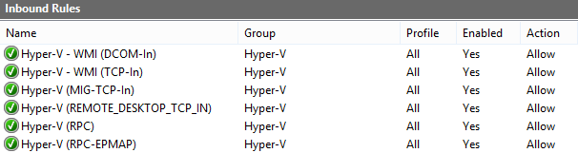
Enabling Hyper-V Management
Types of Traffic
  WMI, DCOM
    Use Firewall Rules: Hyper-V-*, Hyper-V – WMI *
  DCOM
    If no domain trust between client and server – enable anonymous login
  Remote Desktop
    Used for VMConnect on alternate port

Slide 23


Hyper-V Management Roles
Hyper-V
Administrators
Administrators
Virtual Machines
Virtual Switches
Hyper-V Settings
Manage Host OS
Mount VHD files

Slide 24
Failover Clustering
Traffic Types
  Heartbeat
  CSV redirection
Encryption Available
  (Get-Cluster). SecurityLevel = 2
Host
Host
MGMT
MGMT
Cluster

Slide 25
Live Migration
Configuration Options
  Network address range
    Or choose from Cluster Networks
  Authentication method
  Protocol (TCP + Compression, SMB)
VM Security
  VM memory contents could contain secrets
    Use private network or enable IPSEC
Host
Host
MGMT
LiveMigration

Slide 26
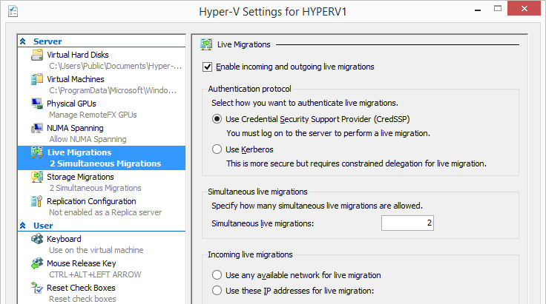
Live Migration Authentication
CredSSP
  Requires login
    Remote Desktop
    PowerShell
Kerberos
    Requires delegation

Slide 27
Storage Networking
Protocols
  SMB
  iSCSI
VM is down without reliable storage
DCIM-B337 File Server Networking for a Private Cloud Storage Infrastructure in Windows Server 2012 R2
DCIM-B378 Converged Networking for Windows Server 2012 R2 Hyper-V
Host
Host
MGMT
SMB
SMB
SMB
File Server

Slide 28
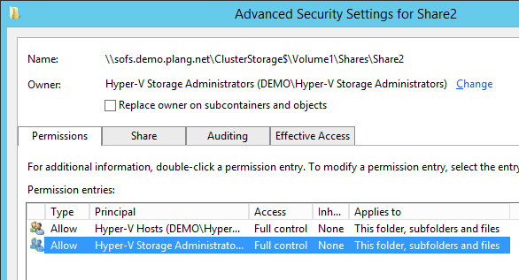
Securing File Shares
Full Control required for:
  Servers running VM
    Consider future migrations
  Admins creating or changing VHDX files
Use security groups
  Simplifies addition & revocation

Slide 29
Constrained Delegation
Host
Host
MGMT
LiveMigration
SMB
SMB
File Server

Slide 30
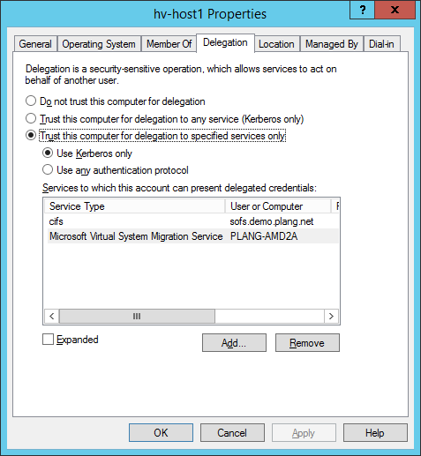
Constrained Delegation
Scenarios
  Live Migration
    All Hyper-V Servers
  Storage Migration & Management
    All File Servers
    Simplified with Enable-SmbDelegation cmdlet on Windows Server 2012R2
Configured in Active Directory
  Requires Domain Admin
  Set on Hyper-V Server’s computer account

Slide 31
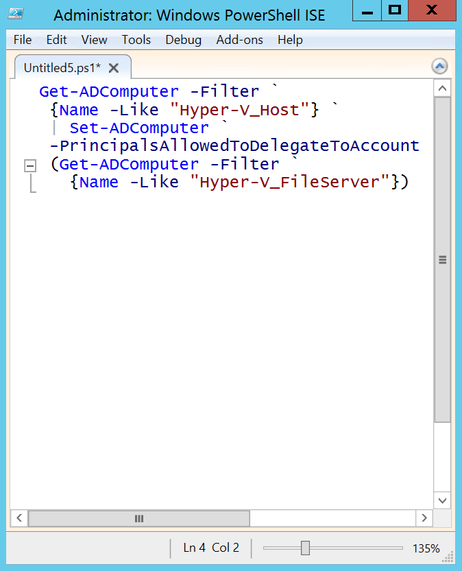
Resource Based Delegation
Allows The Hyper-V Server To Retrieve a Proxy Ticket For Any User To Named Resources
Enabled On The Hyper-V Server’s Computer Account
Requirements
  Windows Server 2012 KDC Active On Front/Back End Domains
  Computer Account Write Privileges To Configure
Helpful Blog Posts
  Live Migration and Storage Migration Without Constrained Delegation Using PrincipalsAllowedToDelegateToAccount
  Remote Administration Without Constrained Delegation Using PrincipalsAllowedToDelegateToAccount

Slide 32
Hyper-V Replica
HTTP
  Kerberos Authentication
  No Encryption
HTTPS
  End to end authentication & encryption
  Certificate configured on primary server
    Enhanced Key Usage required for client & server authentication
  Replica server confirms root of certificate is in “Trusted Root Certification Authorities”
DCIM-H202 Introduction to Microsoft Virtualization, Part 2: Virtual Machine Management

Slide 33
Virtual Machine Manager
Central Management & Delegation
  Build private clouds and delegate administrative roles
    Fabric, Tenant, and Application (self service) Administrator
    Read-Only Administrator
  VMM Agent installed on hosts as needed
    Delegated actions use stored “RunAs” accounts
DCIM-H304 Constructing Your Private Cloud with Windows Server and Microsoft System Center, Part 1
DCIM-H304 Part 2

Slide 34
Protecting Virtual Machines

Slide 35
VMs at rest
Virtual machine is made up of securable objects
  Virtual hard disks and differencing disks (VHDXs and AVHDXs)
  Checkpoint files
  Saved states
  Configuration file

Slide 36

Virtual Machine Directories
DACL grants read, create directory and create file access to VM Group SID
If the directory to store VM artifacts is changed from the defaults, be sure to set the right access settings

Slide 37
Virtual Machine Files
Virtual machine configuration file
  DACL grants full access to the VM SID

Slide 38
Virtual Machine Files
Zero or more checkpoint configuration files
  Stored in Snapshots directory of configuration store directory
  DACL grants full access to the VM SID

Slide 39
Virtual Machine Files
Saved state files
  The VSV file contains virtual machine, virtual motherboard and device state
  The BIN file contains the RAM contents
  Stored in directory adjacent to configuration file
  DACL grants full access to the VM SID

Slide 40
Virtual Machine Files
VHDX files
  Stored in an arbitrary location
  The DACL on leaf VHDX files grants full access to the VM SID
  The DACL on non-leaf (i.e. parent) VHDX files grants read-only access to VM Group SID

Slide 41
Virtual Machine Files
AVHDX files
  Stored in same directory as VHDX file
  The DACL on AVHDX files grants full access to the VM SID

Slide 42
Virtual Machine Files
BitLocker may be used to protect files at rest
  Active Directory authentication needed to unlock Cluster Shared Volumes
  Can make use of physical TPM on the host
Safer decommissioning of storage
  Even if it wasn’t intentional
Caveat
  Not compatible with deduplication

Slide 43
Protecting running VMs
Discretionary Access Control Lists (DACL) are used to improve isolation between:
  VMWPs and the rest of the system (VM Group SID)
  VMWP instances (VM SID)
DACLs cannot be used to define Hyper-V administrative boundaries

Slide 44
Windows Server Switch Features
Server 2012+
Up through Windows Server 2008 R2
Each virtual switch is equivalent to a physical unmanaged Ethernet switch
VLANs for traffic isolation
Very simple policies enforced
  By default, no MAC address spoofing
  ARP Spoofing protection
Tenant Isolation
Port ACL
Private VLAN
Trunk mode
Traffic Shaping
Bandwidth Minimum
Bandwidth Cap
Security
DHCP Guard
Router Guard
IPsec Task Offload
Performance
Dynamic VMQ
SR-IOV *
Diagnostics
Port Mirroring
Event Tracing (ETW)
Unified Tracing (UT)
Network Virtualization

Slide 45
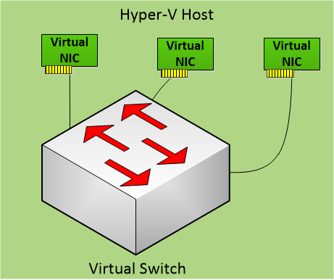
Network Security – Hyper-V Extensible Switch
3rd party extensions augment the vSwitch
Capturing: monitor traffic
Filtering: monitor or filter traffic
Forwarding: all + forwarding of packets
Capturing Extension
Filtering Extension
Forwarding Extension

Slide 46
Network Virtualization
Blue Network
Red Network
  Secure Isolation for traffic segregation, without VLANs
  VM migration flexibility & Seamless Integration
  Customer Address – VM Guest OS IP addresses within the VM Networks
10.10.10.10
10.10.10.11
10.10.10.12
10.10.10.10
10.10.10.11
10.10.10.12
192.168.2.10
192.168.2.11
192.168.2.12
192.168.2.13
192.168.2.14
Network/VSID | Provider Address | Customer Address
Blue (5001) | 192.168.2.10 | 10.10.10.10
Blue (5001) | 192.168.2.10 | 10.10.10.11
Blue (5001) | 192.168.2.12 | 10.10.10.12
Red (6001) | 192.168.2.13 | 10.10.10.10
Red (6001) | 192.168.2.14 | 10.10.10.11
Red (6001) | 192.168.2.12 | 10.10.10.12

Slide 47
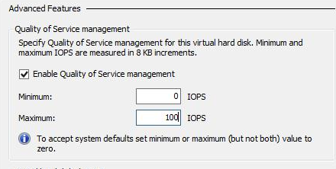
Storage QoS
Storage QoS helps set IOPS limits for each VM
Prevents a rogue VM from monopolizing IOPS on the system.

Slide 48
So now what?
Protect the host
  Design network for security
  Reduce attack surface
    Other roles & software belong in VMs
    Run Server Core
  Keep things patched
  Use least privilege
    Separate hosts into dedicated OU
    Use appropriate groups
Protect VMs
  Store them securely
  Secure LiveMigration
  Restrict VM network settings
  Keep things patched
Security Guide for Hyper-V in Windows Server 2012
http://technet.microsoft.com/en-us/library/dn741280.aspx

Slide 49

For More Information
Windows Server
Windows Server 2012 R2
http://technet.microsoft.com/en-US/evalcenter/dn205286
System Center
System Center 2012 R2
http://technet.microsoft.com/en-US/evalcenter/dn205295
Azure Pack
Azure Pack
  http://www.microsoft.com/en-us/server-cloud/products/windows-azure-pack
Microsoft Azure
Microsoft Azure
  http://azure.microsoft.com/en-us/
  Come Visit Us in the Microsoft Solutions Experience!
  Look for Datacenter and Infrastructure Management
  TechExpo Level 1 Hall CD

Slide 50

Resources
Learning
  Sessions on Demand
  Microsoft Certification & Training Resources
http://channel9.msdn.com/Events/TechEd
www.microsoft.com/learning
TechNet
msdn
  Resources for IT Professionals
  Resources for Developers
http://microsoft.com/technet
http://microsoft.com/msdn

Slide 51



Complete an evaluation and enter to win!

Slide 52


Evaluate this session
Scan this
QR code
to evaluate
this session.

Slide 53


© 2014 Microsoft Corporation. All rights reserved. Microsoft, Windows, and other product names are or may be registered trademarks and/or trademarks in the U.S. and/or other countries.
The information herein is for informational purposes only and represents the current view of Microsoft Corporation as of the date of this presentation. Because Microsoft must respond to changing market conditions, it should not be interpreted to be a commitment on the part of Microsoft, and Microsoft cannot guarantee the accuracy of any information provided after the date of this presentation. MICROSOFT MAKES NO WARRANTIES, EXPRESS, IMPLIED OR STATUTORY, AS TO THE INFORMATION IN THIS PRESENTATION.

