Slide 1


Slide 2
Microsoft Azure for SharePoint Admins
DCIM-B300
Michael Washam
Opsgility – http://www.opsgility.com
Microsoft Azure Training Experts

Slide 3
Agenda
Introduction
SharePoint Farms in Azure
Hybrid Connectivity
Best Practices
Getting Started

Slide 4

SharePoint Cloud Continuum
Value Prop
  Auto HA, Fault-Tolerance
  Friction-free scale
  Self-provisioning, mgmt. @ scale
Office 365 (SaaS)
Value Prop
  100% of API surface area
  Easy migration of existing apps
  Roll-your-own HA/DR/scale
Value Prop
  Full h/w control – size/scale
  Roll-your-own HA/DR/scale
COST-EFFICIENCY
SharePoint
(On-premises)
SharePoint (IaaS)
SharePoint
Hosted SharePoint
CONTROL

Slide 5
16 regions worldwide in 2014
Azure footprint

Slide 6






What are Infrastructure Services?
Cloud Based Virtual Machines
Hyper-V Based Hosting Technology
Run workloads in Azure that were traditionally run on-premises
Networking
Virtual Networks: Private IPV4 Network support, and hybrid connectivity to on-premises
Access Control Lists, External and Internal Load Balancing, Reserved IPs
Run Traditional workloads in the cloud with little to no changes

Slide 7
SharePoint in a Microsoft Azure VM?
Why Host in Microsoft Azure Virtual Machines?
  Control - hosting in Microsoft Azure gives you a similar level of control to hosting on premises minus managing the hardware.
  Agility – quickly spin up or copy development and test environments.
  Smaller Laptops – Consultants, you should appreciate this!
SharePoint Server 2010 and 2013 supported
  Platform base image available for 2013
  License Mobility through Software Assurance
  SharePoint 2010 create custom image: KB2728976
  Fast Search Server 2010 is NOT supported in Microsoft Azure

Slide 8
Cloud Only SharePoint Virtual Machine
Scenarios
Development or Test
Demo Environment
Concepts
Virtual Machine Sizes
Cloud Services
Storage

Slide 9
Virtual Machine Instance Sizes
Size Name | CPU Cores | Memory | Max. data disks | Max. IOPS
ExtraSmall | Shared | 768 MB | 1 | 1x500
Small | 1 | 1.75 GB | 2 | 2x500
Medium | 2 | 3.5 GB | 4 | 4x500
Large | 4 | 7 GB | 8 | 8x500
ExtraLarge | 8 | 14 GB | 16 | 16x500
A5 | 2 | 14 GB | 4 | 4X500
A6 | 4 | 28 GB | 8 | 8x500
A7 | 8 | 56 GB | 16 | 16x500
A8 | 8 | 56 GB | 16 | 16x500
A9 | 16 | 112 GB | 16 | 16x500
SharePoint Virtual Machines
Each data disk can hold up to 1 TB of storage.

Slide 10
Cloud Service Introduction
Cloud Service
A container for VMs that acts as a network and security boundary.
Allow external traffic into one or more VMs create an endpoint.
Cloud Service IP Address
Cloud service URL is mapped to a public IP http://spdemo.cloudapp.net = 137.135.67.36
All external traffic to virtual machines uses this IP.
IP can be lost if all VMs are de-allocated (unless using a reserved IP).
Input Endpoints
Port forwarding (mapping a public port to a private port).
Load Balancing (External VIP and Internal)
spdemo.cloudapp.net
137.135.67.36
Public Port 80
Local Port 80
SPDEMO
spdemo.cloudapp.net

Slide 11
Reserved IP Addresses
New Feature for Virtual Machines
Persistent External IP address for Cloud Service
IP Survives even if all virtual machines are de-allocated.
New-AzureReservedIP -ReservedIPName "SharePointIP" -Location "West US" -Label "SPIP"
New-AzureVM <VM Creation Params> -ReservedIPName "SharePointIP"

Slide 12
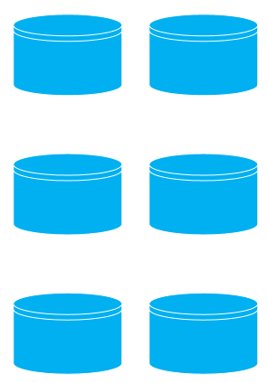
Microsoft Azure Storage
Durable and Highly Scalable Cloud Storage
SharePoint Virtual Machine Disk Storage
Storage Accounts are Created per Region
Upload Existing SharePoint VHDs to Storage with PowerShell
spstorage - West US
C: OS Disk (127 GB)
D: Local Temporary Storage
F: Data Disk (500 GB)
G: Data Disk (1 TB)

Slide 13
DEMO
Getting Started with SharePoint in Infrastructure Services
Michael Washam

Slide 14

SharePoint farms in Microsoft Azure
Scenarios
Production Internet
Development or Test
Demo Environment
Concepts
Virtual Network
Availability Sets
Load Balancer
Access Control Lists

Slide 15
Microsoft Azure Virtual Networks
Declare your own address space in the cloud
  Private and Persistent IP Addresses (unless you de-allocate the VM)
  Support for Static Internal IP addresses (even if you de-allocate a VM)
Advanced Connectivity
  Support for Hosting Active Directory in Azure Virtual Machines
  Connect multiple cloud services privately on the same virtual network
  Connect Virtual Networks in the same or separate regions
  Support for Internal Load Balancing
  Optional - Hybrid Connectivity – Site to Site, Point to Site and ExpressRoute
Virtual Networks are Required for a SharePoint Farm
NEW
NEW

Slide 16
IP Allocation with Virtual Networks
IPs are allocated based on order of provisioning. (1st 4 IPs are reserved)
Subnet: 10.0.0.0/24
1. VM1 = 10.0.0.4
2. VM2 = 10.0.0.5
If VMs are re-allocated in a different order they get different IP addresses
1. VM2 = 10.0.0.4
2. VM1 = 10.0.0.5
Use Static IP addresses to retain IP regardless of order
Set-AzureStaticVNetIP

Slide 17

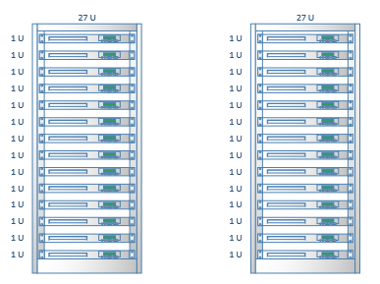
Availability Sets
What is an "Availability Set"?
  A label that tells Microsoft Azure your virtual machines perform the same workload
Guaranteed physical redundancy
  router/switch
  power supply
  network cables
  physical machine
Microsoft Azure has knowledge of application topology. Will not take all VMs down during host updates.
99.95% SLA
SPWFE-02
SPWFE-01

Slide 18
SharePoint Farms and Availability Sets
SPVNET
For each tier
create an
Availability Set
Availability Sets do not span cloud services
Cloud Service
AV Set: SPWFE
AV Set: SPAPP
AV Set: SQL
AV Set: AD
SP-WFW-01
Subnet WEB
10.0.3.4
SP-APP-01
Subnet APPS
10.0.4.4
SQL-AO-01
Subnet SQL
10.0.1.4
AD-VM-01
Subnet AD
10.0.2.4
SP-WFE-02
Subnet WEB
10.0.3.5
SP-APP-02
Subnet APPS
10.0.4.5
SQL-AO-01
Subnet SQL
10.0.1.5
AD-VM-02
Subnet AD
10.0.2.5
SP-APP-02
Subnet APPS
10.0.4.5
SQLWITNESS
Subnet SQL
10.0.1.6
AD-VM-03
Subnet AD
10.0.2.6
SP-WFE-02
Subnet WEB
10.0.3.5

Slide 19
External Load Balancing
SPVNET
Cloud Service
AV Set: SPWFE
AV Set: SPAPP
AV Set: SQL
AV Set: AD
Load Balancer
External – public sites
Uses health probes for additional availability
Use Reserved IP for Public IP addresses or map external domains using a CNAME
SP-WFW-01
Subnet WEB
10.0.3.4
SP-APP-01
Subnet APPS
10.0.4.4
SQL-AO-01
Subnet SQL
10.0.1.4
AD-VM-01
Subnet AD
10.0.2.4
SP-WFE-02
Subnet WEB
10.0.3.5
SP-APP-02
Subnet APPS
10.0.4.5
SQL-AO-01
Subnet SQL
10.0.1.5
AD-VM-02
Subnet AD
10.0.2.5
SP-APP-02
Subnet APPS
10.0.4.5
SQLWITNESS
Subnet SQL
10.0.1.6
AD-VM-03
Subnet AD
10.0.2.6
SP-WFE-02
Subnet WEB
10.0.3.5

Slide 20
Load Balancing with Always On Listener
SPVNET
Cloud Service
Load Balancer
SQL Always On uses external load balancer for listener virtual name.
Use Reserved IP for Public IP.
SQL AO will stop working if external IP changes.
AV Set: SPWFE
AV Set: SPAPP
AV Set: SQL
AV Set: AD
SP-WFW-01
Subnet WEB
10.0.3.4
SP-APP-01
Subnet APPS
10.0.4.4
SQL-AO-01
Subnet SQL
10.0.1.4
AD-VM-01
Subnet AD
10.0.2.4
SP-WFE-02
Subnet WEB
10.0.3.5
SP-APP-02
Subnet APPS
10.0.4.5
SQL-AO-01
Subnet SQL
10.0.1.5
AD-VM-02
Subnet AD
10.0.2.5
SP-APP-02
Subnet APPS
10.0.4.5
SQL-AO-03
Subnet SQL
10.0.1.6
AD-VM-03
Subnet AD
10.0.2.6
SP-WFE-02
Subnet WEB
10.0.3.5

Slide 21
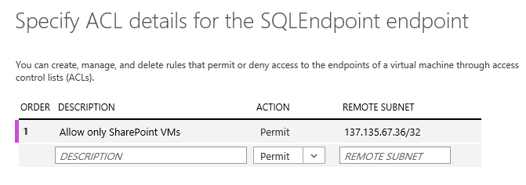
Access Control Lists
Used to restrict access to endpoints
Protect SQL Listener Load Balanced Endpoint
Add Permit rule for SharePoint Cloud Service IP
(Denies everyone else)

Slide 22
Internal Load Balancing (NEW)
On Premises
192.168.0.0/16
Virtual Network Address Space: 10.0.0.0/16
Cloud Service
AV Set: SPWFE
AV Set: SPAPP
AV Set: SQL
AV Set: AD
Active Directory Replication
Access on-premises resources
Access intranet over hybrid connection
AD-DC-01
192.168.0.1
SP-WFW-01
Subnet WEB
10.0.1.4
SP-APP-01
Subnet APPS
10.0.2.4
SQL-AO-01
Subnet SQL
10.0.3.4
AD-VM-01
Subnet AD
10.0.4.4
Hybrid Connection
AD-DC-02
192.168.0.2
http://spintranet
SQL-AO-01
Subnet SQL
10.0.3.5
AD-VM-02
Subnet AD
10.0.4.5
SP-WFE-02
Subnet WEB
10.0.1.5
SP-APP-02
Subnet APPS
10.0.2.5
https://spintranet
Map to: 10.0.0.100
Set Internal Load Balancer IP
New-AzureInternalLoadBalancerConfig
SP-WFE-02
Subnet WEB
10.0.1.5
SP-APP-02
Subnet APPS
10.0.2.5
SQLWITNESS
Subnet SQL
10.0.3.6
Other
Servers

Slide 23
Setting the Internal Load Balancer
# IP Address from VNET – map IP to DNS entry (http://spintranet)
$internalLBIP = "10.0.0.100"
$ilConfig = New-AzureInternalLoadBalancerConfig `
-InternalLoadBalancerName "SPILB" `
-StaticVNetIPAddress $internalLBIP `
-SubnetName "Web"
# Add to each virtual machine to be load balanced
Add-AzureEndpoint -Name "intranet" -Protocol tcp -LocalPort 80 -PublicPort 80 `
-InternalLoadBalancerName "SPILB" -LBSetName "SPILB" -VM $vmConfig1
New-AzureVM <VM Creation Parameters> -InternalLoadBalancerConfig $ilConfig

Slide 24
DEMO
SharePoint Farm in Azure
Michael Washam

Slide 25
Hybrid SharePoint Farm – Site to Site
Scenarios
Production SharePoint Farm (Intranet or Extranet)
Extend Access to or from On-Premises
Active Directory
BCS Data Sources
Concepts
Site to Site
Contoso Inc
VPN DEVICE
Public Internet
IP/SEC
VNET GATEWAY

Slide 26
Site to Site
Devices Supported
Cisco, Juniper, F5, Brocade, CheckPoint, Fortinet
Individual Devices: http://msdn.microsoft.com/en-us/library/azure/jj156075.aspx
Software VPN Support
Microsoft Routing and Remote Access, OpenSwan

Slide 27
Hybrid SharePoint Deployment – Site to Site
On Premises
192.168.0.0/16
Virtual Network Address Space: 10.0.0.0/16
Cloud Service
AV Set: SPWFE
AV Set: SPAPP
AV Set: SQL
AV Set: AD
Active Directory Replication
Access on-premises resources
Management Traffic
SP-WFW-01
Subnet WEB
10.0.1.4
SP-APP-01
Subnet APPS
10.0.2.4
SQL-AO-01
Subnet SQL
10.0.3.4
AD-VM-01
Subnet AD
10.0.4.4
AD-DC-01
192.168.0.1
Public Internet
IP/SEC
http://contoso.com
SP-WFE-02
Subnet WEB
10.0.1.5
SP-APP-02
Subnet APPS
10.0.2.5
SQL-AO-01
Subnet SQL
10.0.3.5
AD-VM-02
Subnet AD
10.0.4.5
AD-DC-02
192.168.0.2
SP-WFE-02
Subnet WEB
10.0.1.5
SP-APP-02
Subnet APPS
10.0.2.5
SQL-AO-03
Subnet SQL
10.0.3.6
Other
Servers

Slide 28

Microsoft Azure ExpressRoute
Scenarios
Private, Low Latency Connectivity to Cloud
Production SharePoint Farm (Extranet or Intranet)
Extend Enterprise Identity
Access On-Premises or Co-Located Resources
Disaster Recovery
Concepts
ExpressRoute
Microsoft Azure
Public services
Customer’s dedicated connection
Connectivity Provider
Infrastructure
Azure
Edge
10 Mbps to 10 Gbps
Customer’s
network
Traffic to public IP addresses in Microsoft Azure
Traffic to Virtual Networks in Microsoft Azure

Slide 29
Express Route (Internet Exchange Provider)
High speed (up to 10 Gbps) and Low Latency
Private (direct connect from data center to Azure)
INTERNET
On Premises
192.168.0.0/16
IXP Cage
Co-Located HW
Microsoft Azure
Access Microsoft Azure Services directly without crossing the Internet
AD-DC-01
192.168.0.1
Ethernet
SERVER-05
SERVER-06
Virtual Network
Express Route Circuit
Cloud Service
Cloud Service
AD-DC-02
192.168.0.2
Exchange Provider
Equinix
Level3
Supported Bandwidth
200,500 Mbps
1 Gpbs
10 Gpbs
SERVER-07
SERVER-08
Web
Worker
Other
Servers

Slide 30
Express Route (Network Service Provider)
High speed (up to 1 Gbps) and Low Latency
Private (direct connect one or more data centers to Azure via MPLS VPN)
INTERNET
On-Premises
Site 2
Microsoft Azure
Access Microsoft Azure Services directly without crossing the Internet
SERVER-03
SERVER-04
On-Premises
Site 1
Virtual Network
Cloud Service
Cloud Service
MPLS VPN
AT&T
Level3
Bandwidth
10,50,100,500 Mbps
1 Gbps
SERVER-01
SERVER-02
Express Route Circuit
SERVER-07
SERVER-08
Web
Worker

Slide 31
ExpressRoute and SharePoint DR
Equinix – Silicon Valley
SQL Always On
SharePoint
WEB
SharePoint
App
Active Directory
SQL
Witness
F5 BIG IP
Load Balancer
SharePoint
WEB
SharePoint
App
SQL Primary
Active Directory
ExpressRoute Circuit (1Gps)
Microsoft Azure - West US
AVSET: SPWEB
AVSET: SPAPP
SQL Replica
AVSET: AD
Sync Commit
for
Auto-Failover
Domain Controller

Slide 32
DEMO
SharePoint Hybrid DR
Michael Washam

Slide 33
Putting it all Together - Recap
Virtual Network
Cloud Service
AV Set: SPWFE
AV Set: SPAPP
AV Set: SQL
AV Set: AD
http://myspsite.com
Static IP
Static IP
Static IP
Static IP
External Load Balancer
If handling external HTTP/HTTPS traffic or SQL AO with listener
Reserved IP for External VIP
Access Control List for SQL AO Endpoint
SP-WFE-01
Subnet WEB
10.0.3.4
SP-APP-01
Subnet APPS
10.0.4.4
SQL-AO-01
Subnet SQL
10.0.1.4
AD-VM-01
Subnet AD
10.0.2.4
Static IP
Static IP
Static IP
Static IP
Internal Load Balancer
Must be set at virtual machine provisioning
Uses an IP from your Virtual Network
On Premises
192.168.0.0/16
SP-WFE-02
Subnet WEB
10.0.3.5
SP-APP-02
Subnet APPS
10.0.4.5
SQL-AO-01
Subnet SQL
10.0.1.5
AD-VM-02
Subnet AD
10.0.2.5
Hybrid Connection
Site to Site
Or
ExpressRoute
Static IP
Static IP
Static IP
Static IP
http://spintranet
SP-APP-02
Subnet APPS
10.0.4.5
SQL-AO-03
Subnet SQL
10.0.1.6
AD-VM-03
Subnet AD
10.0.2.6
SP-WFE-02
Subnet WEB
10.0.3.5

Slide 34
Putting it all together with PowerShell
Michael Washam

Slide 35
SharePoint in Microsoft Azure Virtual Machines Best Practices

Slide 36
SharePoint
Deployment Tips
  Only SharePoint is on the C: drive
  Put each SharePoint logical tier into its own availability set (WFE, APP etc…)
  Put blob cache on a data disk to increase available IOPS. D: may be considered just remember that it may be deleted and refreshing blob cache can be painful.
  Use Static IP addresses to avoid issues if virtual machines started out of order.

Slide 37
SQL Server Best Practices
Storage Recommendations
Split content databases across multiple disks for increased IOPS
Verify Disk Cache Settings on Data Disks (See whitepaper link below)
Avoid using OS drive for databases
Put database and transaction log files on separate drives
Use SQL Server File Groups instead of Disk Striping
  SharePoint relies heavily on TempDB – Split and move TempDB to data disks
Database Recommendations
Consider using database page compression to reduce I/O
High Availability Recommendations
Consider latency between primary and replica when choosing sync mode
Use Availability Sets
SQL Server Performance Whitepaper: http://go.microsoft.com/fwlink/?LinkId=306266

Slide 38
More on Storage for SQL Server
Performance Considerations
Do not use the temporary disk (D:\) (including for TempDB)
Use SQL file groups across multiple disks instead of disk striping
Put logs, data and backup on separate disks
Disable geo-replication on storage account for consistency
Remember storage account capacity planning.
20,000 IOPS per Storage Account – 500 IOPS per disk
Consider compressing any data files when transferring in/out of Windows Azure.
Scale Out Not Up
  Move content databases to separate SQL Servers
  Move search databases to separate SQL Servers
  Add more WFE for scaling SharePoint services
  Add dedicated Search Servers and SQL Server
SQL Server Performance Whitepaper: http://go.microsoft.com/fwlink/?LinkId=306266

Slide 39
Storage Capacity and Planning
Each Disk up to 500 IOPS
IOPS Per Storage Account 20,000
  Supports up to 40 data disks using maximum IOPS per disk
 | Random I/O (8 KB Pages) |  | Sequential I/O (64 KB Extents) |  | Sequential I/O (256 KB Blocks)
 | Reads | Writes | Reads | Writes | Reads | Writes
IOPS | 500 | 500 | 500 | 300 | 300 | 300
Bandwidth | 4 MB/s | 4 MB/s | 30 MB/s | 20 MB/s | 70 MB/s | 70 MB/s

Slide 40
Active Directory Design Considerations
Should only be deployed in a virtual network
  Predictable and stable IP Addresses
  Specify Static IP to ensure persistence (Set-AzureStaticVNetIP in PowerShell)
  Active Directory should be deployed in an AD specific subnet to guarantee the IP address will not be acquired by another virtual machine.
DIT / SYSVOL Location
  Deploy DIT / SYSVOL on a data disk or disable OS Disk caching. Default OS Disk (C:) is not acceptable.
Guidelines for deploying AD in Azure Virtual Machines
http://msdn.microsoft.com/en-us/library/azure/jj156090.aspx

Slide 41
How to get started?
Free trial
http://azure.microsoft.com $200 of usage for 30 days
MSDN subscribers have built in Microsoft Azure benefits
  Discounted Rates for Development and Test!
Professional | Premium | Ultimate
$50 / Month | $100 / Month | $150 / Month

Slide 42
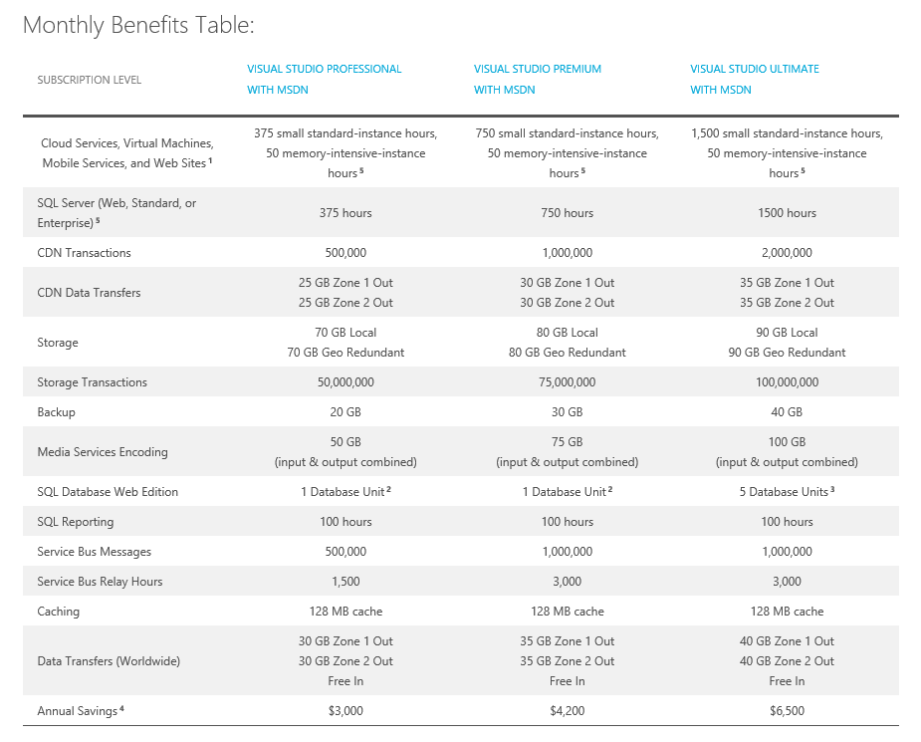
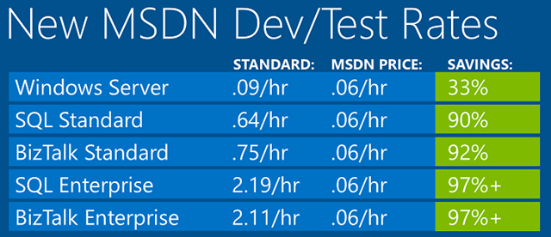
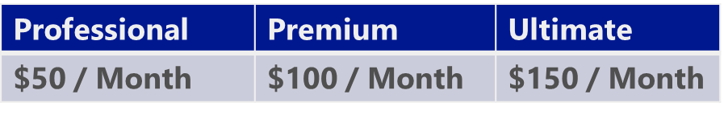
MSDN Dev and Test Pricing
MSDN products can be used on Virtual Machines
Single monetary credit instead of plethora of meters.
Focusing on Dev/Test Usage

Slide 43
SharePoint 2013 Automation Scripts
Automation Scripts
PowerShell Scripts that use Remote PowerShell for automated deployment of Active Directory, SQL Server and SharePoint 2013.
Two Sample Configurations Available (uses Trial Image)
HighlyAvailable and SingleVMs
Download from GitHub
https://github.com/azure/azure-sdk-tools-samples

Slide 44
More at TechEd
DCIM-B305 What’s New in Microsoft Azure Networking
Wednesday, May 14 1:30 PM - 2:45 PM Room: Hilton L2 Ballrm C
DCIM-B388 Extending Your Premises to Microsoft Azure with Virtual Networks and ExpressRoute
Thursday, May 15 8:30 AM - 9:45 AM Room: 370A
DBI-B334 SQL Server on Microsoft Azure Virtual Machines: The Important Details
Wednesday, May 14 1:30 PM - 2:45 PM Room: 350D
DCIM-B383 What's New in Microsoft Azure IaaS
Monday, May 12 1:15 PM - 2:30 PM Room: 370A

Slide 45
More Resources
SQL Server on Microsoft Azure Virtual Machines Performance
http://msdn.microsoft.com/en-us/library/windowsazure/jj870962.aspx
SQL Server Always On with Microsoft Azure Tutorial
http://msdn.microsoft.com/en-us/library/dn249504.aspx
Active Directory on Microsoft Azure Virtual Machines
http://channel9.msdn.com/Events/TechEd/Europe/2013/MDC-B300
SharePoint on Microsoft Azure Guidance
http://www.microsoft.com/en-us/download/details.aspx?id=38428

Slide 46
Summary
Introduction
SharePoint Farms
Hybrid Connectivity
Best Practices
Getting Started

Slide 47

For More Information
Windows Server
Windows Server 2012 R2
http://technet.microsoft.com/en-US/evalcenter/dn205286
System Center
System Center 2012 R2
http://technet.microsoft.com/en-US/evalcenter/dn205295
Azure Pack
Azure Pack
  http://www.microsoft.com/en-us/server-cloud/products/windows-azure-pack
Microsoft Azure
Microsoft Azure
  http://azure.microsoft.com/en-us/
  Come Visit Us in the Microsoft Solutions Experience!
  Look for Datacenter and Infrastructure Management
  TechExpo Level 1 Hall CD

Slide 48

Resources
Learning
  Sessions on Demand
  Microsoft Certification & Training Resources
http://channel9.msdn.com/Events/TechEd
www.microsoft.com/learning
TechNet
msdn
  Resources for IT Professionals
  Resources for Developers
http://microsoft.com/technet
http://microsoft.com/msdn

Slide 49



Complete an evaluation and enter to win!

Slide 50


Evaluate this session
Scan this
QR code
to evaluate
this session.

Slide 51


© 2014 Microsoft Corporation. All rights reserved. Microsoft, Windows, and other product names are or may be registered trademarks and/or trademarks in the U.S. and/or other countries.
The information herein is for informational purposes only and represents the current view of Microsoft Corporation as of the date of this presentation. Because Microsoft must respond to changing market conditions, it should not be interpreted to be a commitment on the part of Microsoft, and Microsoft cannot guarantee the accuracy of any information provided after the date of this presentation. MICROSOFT MAKES NO WARRANTIES, EXPRESS, IMPLIED OR STATUTORY, AS TO THE INFORMATION IN THIS PRESENTATION.

