Slide 1
Public Cloud Security:
Surviving in a Hostile Multitenant Environment
Mark Russinovich
Technical Fellow, Azure

Slide 2
The Third Computing Era
Security Could Ruin Everything!

Slide 3
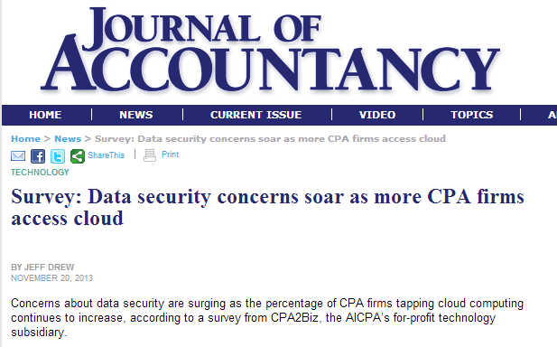
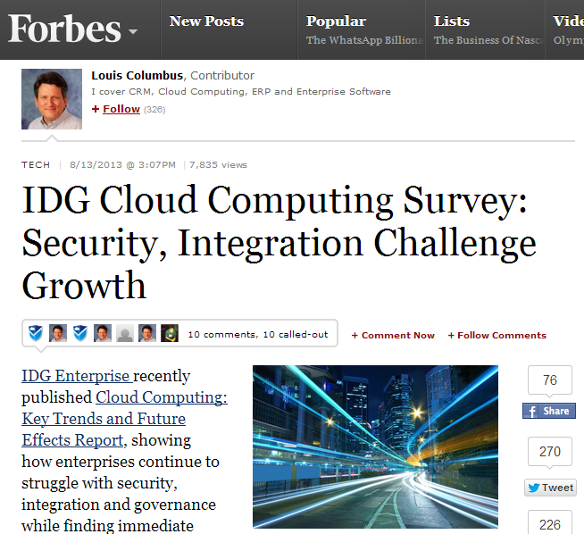
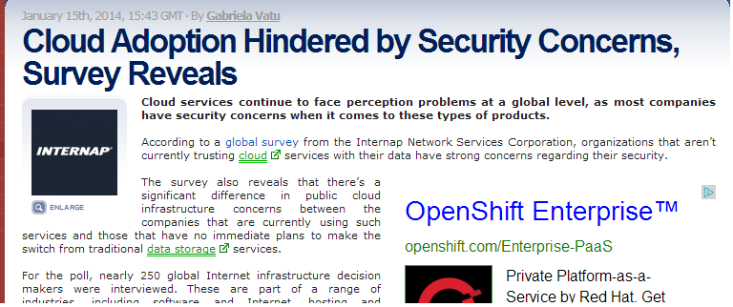

Slide 4
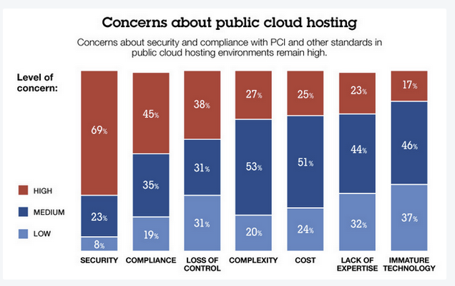
Source: 451 Research, Dec 2012

Slide 5
Goals of this Session
Identify threats
Discuss risk
Explore mitigations

Slide 6
Cloud Architecture
Enterprise
Enterprise
Consumer
Attacker
Private Network
Internet
Cloud Service APIs
Deployer
Private Network
Hypervisor
Hypervisor
Hypervisor
DevOps
Cloud Operations
DC Ops
Datacenter
Cloud Service Provider

Slide 7
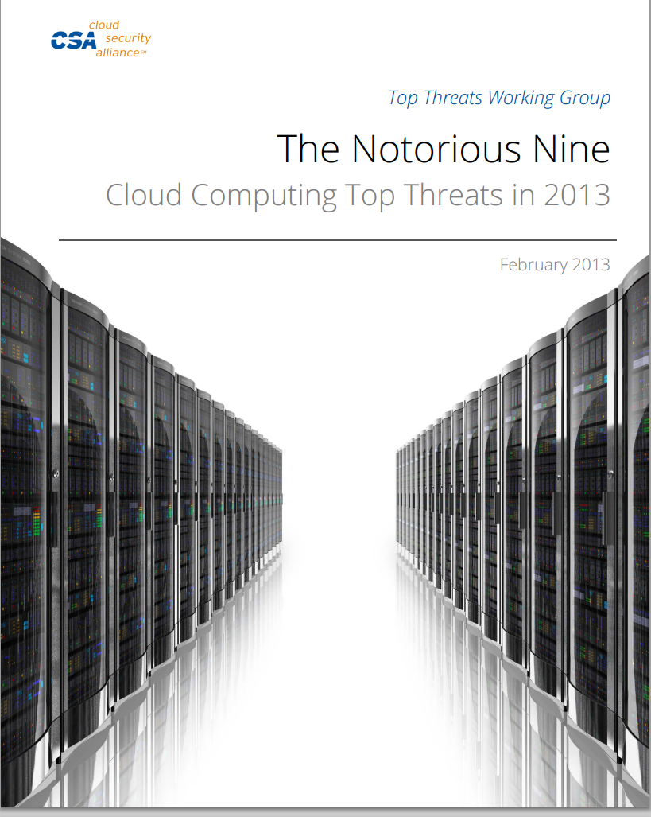
The Cloud Security Alliance “Notorious Nine”
CSA periodically surveys industry experts to identify top cloud computing threats
First report published in 2010
  Seven top threats
Most recent report published in February 2013
  Nine top threats
  So close to a top ten list…
https://cloudsecurityalliance.org/research/top-threats/

Slide 8
10. Shared Technology Issues: Exposed Software
Some shared code defines the surface area exposed to customers:
  CPU firmware/microcode
  Hypervisor
  Web server
  API support libraries
  …
Cloud Service APIs
Hypervisor
Hypervisor
Hypervisor
Hypervisor
Datacenter

Slide 9
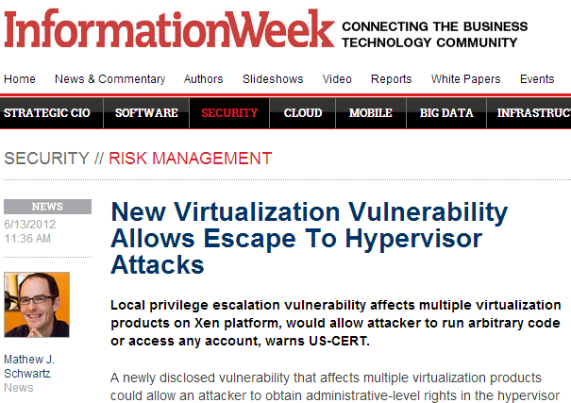
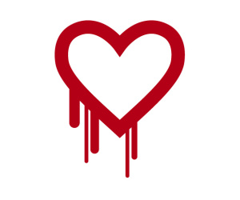
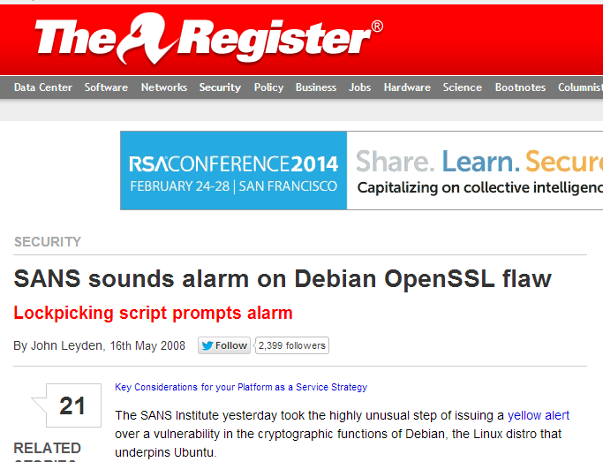
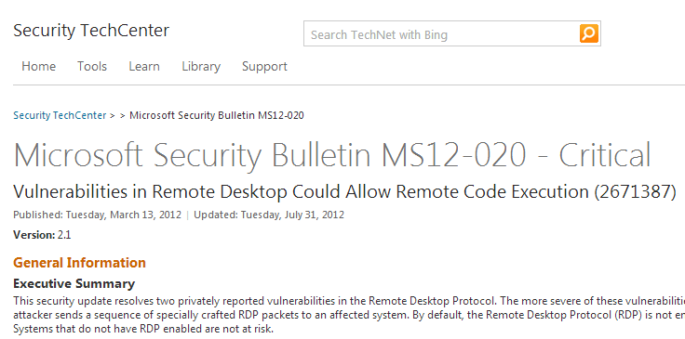
10. Shared Technology Issues
What if there’s a vulnerability?

Slide 10
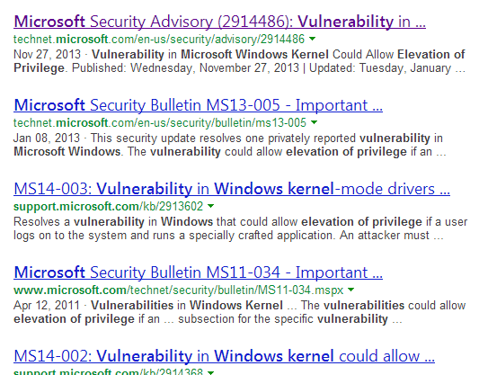
10. Shared Technology Vulnerabilities:
The Enterprise Approach
Stability and security are balanced against each other
Assumes infrastructure is accessible only by trusted actors
Corporate and legal mechanisms for dealing with attackers
Enterprise Multi-tenancy

Slide 11
10. Shared Technology Vulnerabilities:
The Cloud Risk
Customer A
Attacker
Customer B
A vulnerability in publically accessible software enables an attacker to puncture the cloud
  Breach exposes data of other customers
  Single incident can cause catastrophic loss of customer confidence
  Customers (potential attackers) are anonymous and in diverse jurisdictions
Hypervisor
Hypervisor
Hypervisor

Slide 12
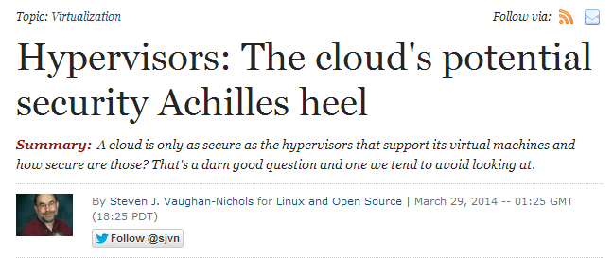
10. Shared Technology Vulnerabilities:
The Cloud Risk
http://www.zdnet.com/hypervisors-the-clouds-potential-security-achilles-heel-7000027846/

Slide 13

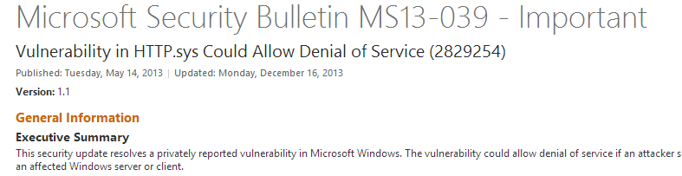
10. Shared Technology Vulnerabilities:
The Cloud Risk
A vulnerability in publically accessible software enables an attacker to puncture the cloud
  Breach exposes data of other customers
  Single incident can cause catastrophic loss of customer confidence
  Customers (potential attackers) are anonymous and in diverse jurisdictions
New bug classification: “Cloud Critical”
Hostile Multi-tenancy

Slide 14
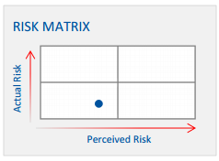
10. Shared Technology Vulnerabilities: Bottom Line
Enterprises and clouds are exposed to this risk
Clouds are at higher risk of exploitation:
  Data from many customers makes it a rich target
  API surface is trivial to access
Clouds are generally better at response:
  Their business depends on it
  Automated software deployment and patching required for cloud scale
  Breach detection/mitigation necessary for preserving trust
My assessment
CSA assessment

Slide 15
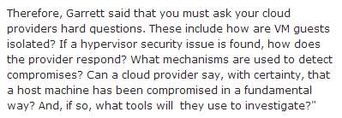
10. Shared Technology Vulnerabilities: Bottom Line

Slide 16
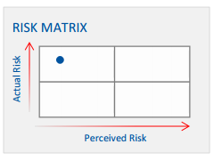
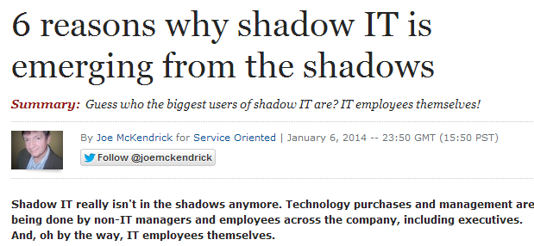
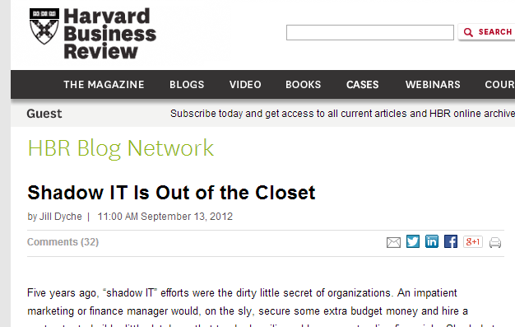
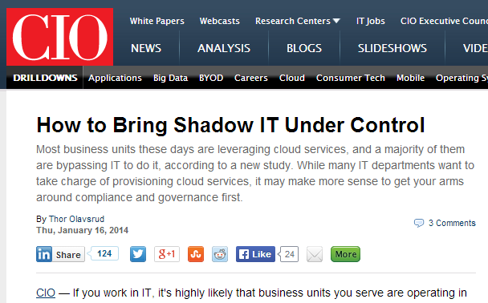
9. Insufficient Due Diligence
Many companies are moving to the cloud and side-stepping IT processes:
  Shadow IT: when business units bypass IT to deploy applications and store data in the cloud
  IT management, auditing, forensics, and access control systems are designed for on-premises servers and applications
Bottom line:
  IT must determine how to enable business units while enforcing corporate governance
  IT must lead responsible adoption – it’s happening with or without them
“Bring Your Own IT”
(BYOIT)

Slide 17
8. Abuse of Cloud Services
The agility and scale of the cloud is attractive to attackers, too
  Use of compute as malware platform (Botmaster, DDOS platform)

Slide 18
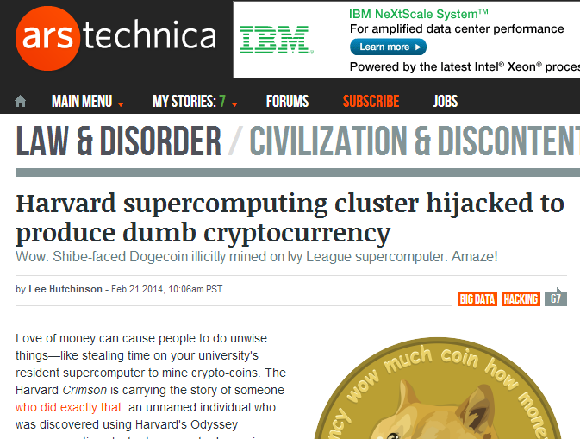
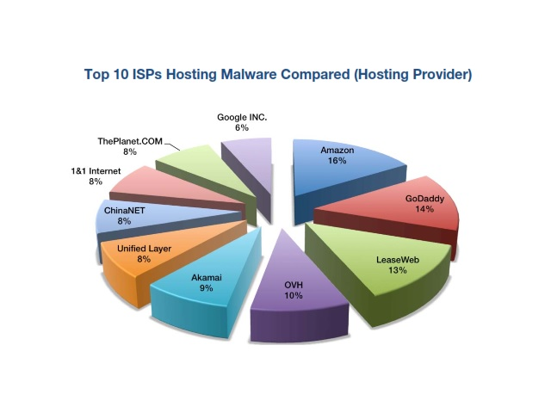
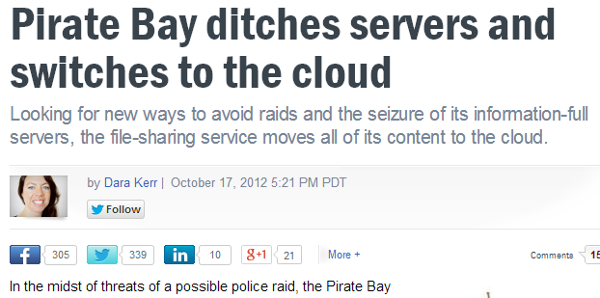

8. Abuse of Cloud Services
The agility and scale of the cloud is attractive to attackers, too
  Use of compute as malware platform (Botmaster, DDOS platform)
  Use of storage to store and distribute illegal content
  Use of compute to mine digital currency
Enterprise
Attacker
Friend
Attacker
AWS
Hypervisor
Hypervisor

Slide 19
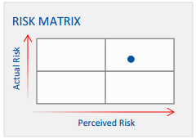
8. Abuse of Cloud Services: It’s Happening
Attackers can use cloud resources and
remain anonymous
  Free trial offers
  Stolen credit cards
  Hijacked accounts
Bottom line: reputation and COGS risk for
cloud service providers
For Cloud Service Providers Only

Slide 20
7. Malicious Insiders

Slide 21

7. Malicious Insiders
Many cloud service provider employees have access to cloud:
  Developers that write and devops cloud service code
  Operators that deploy code
  Datacenter operations personnel
Cloud Service APIs
Deployer
Private Network
Hypervisor
Hypervisor
Hypervisor
DevOps
Cloud Operations
DC Ops
Datacenter
Cloud Service Provider

Slide 22
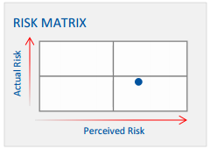
7. Malicious Insiders
Mitigations:
  Employee background checks
  Limited as-needed access to production
  Controlled/monitored access to production
  services
Bottom line: real risk that is better understood via third-party audit/certification

Slide 23
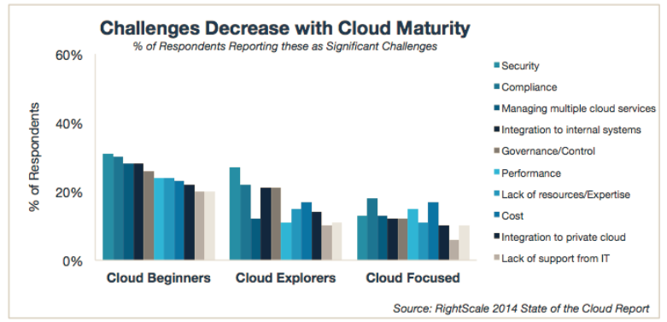

Slide 24
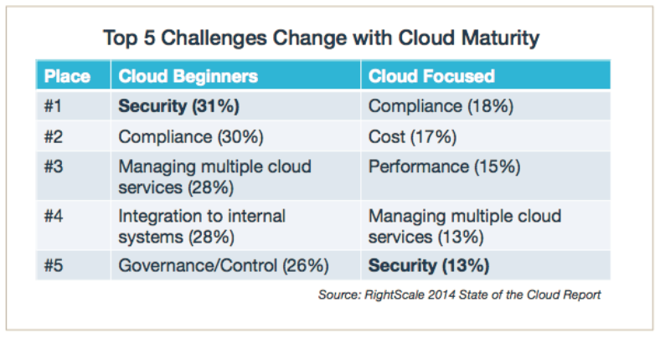

Slide 25
7. Malicious Insiders: Azure
Employee background checks
Just-in-time controls, auditing
Certifications:
  SO/IEC 27001:2005
  SOC 1 and SOC 2 SSAE 16/ISAE 3402 Attestations
  Cloud Security Alliance Cloud Controls Matrix
  Federal Risk and Authorization Management Program (FedRAMP)
  Payment Card Industry (PCI) Data Security Standards (DSS) Level 1
  United Kingdom G-Cloud Impact Level 2 Accreditation
  HIPAA Business Associate Agreement (BAA)
  Family Educational Rights and Privacy Act (FERPA)

Slide 26
6. Denial of Service
The public cloud is…
well, public

Slide 27
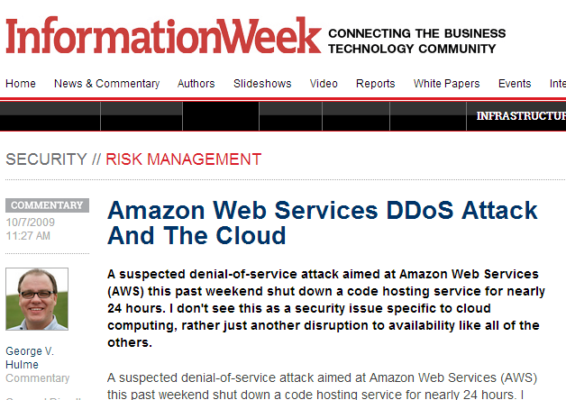
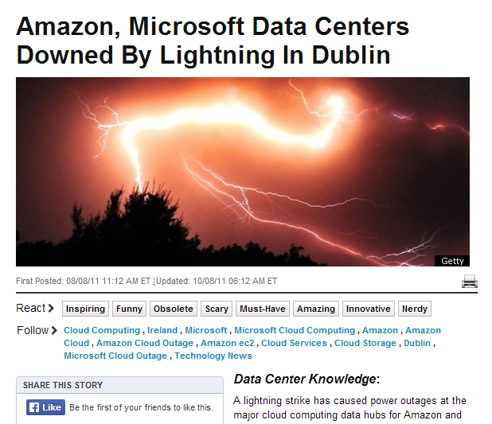
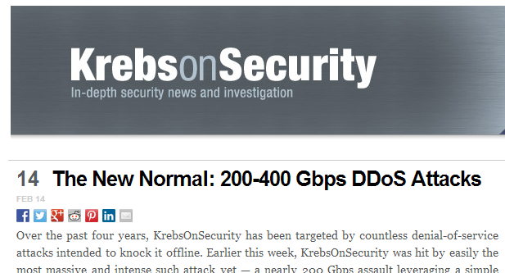
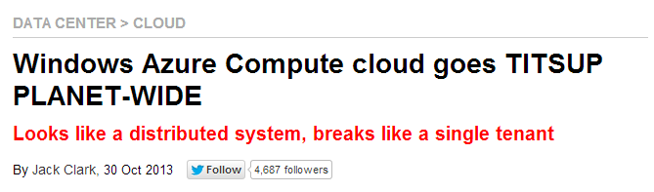
6. Denial of Service
The public cloud is…well, public
  Service endpoints are subject to DDOS attacks
  Customer applications are subject to targeted DDOS
Cloud outages are a form of DOS
Enterprise
Attacker
Internet
Cloud Service APIs
Hypervisor
Hypervisor
Hypervisor
Datacenter

Slide 28
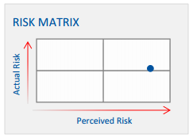
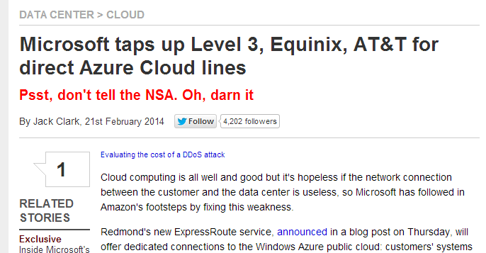
6. Denial of Service: Bottom Line
DOS is a significant threat
Mitigations:
  Cloud providers invest heavily in DDOS prevention
  Non-public applications can be isolated from the Internet
  Geo-available cloud providers can provide resiliency against many cloud outage vectors
Azure:
  DDOS prevention systems
  Geo-regions for failover

Slide 29
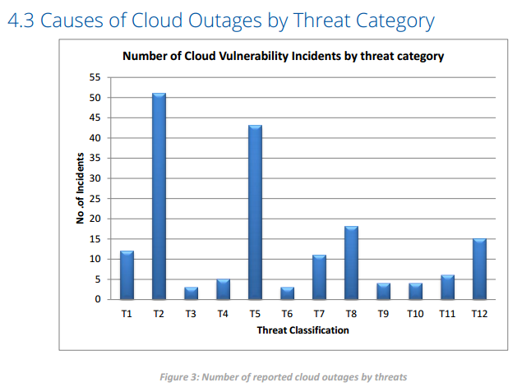
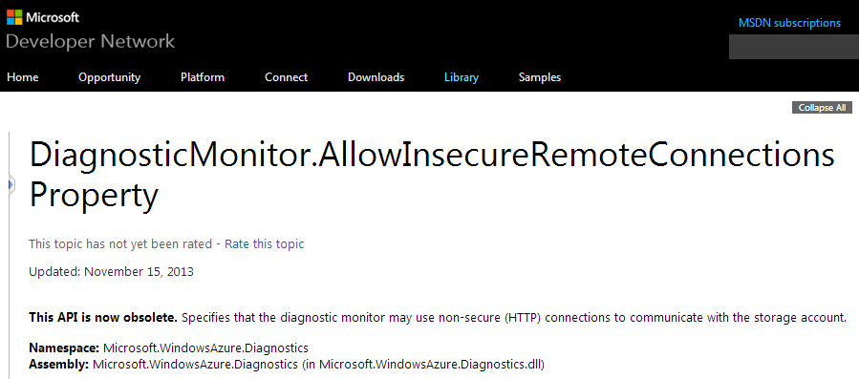
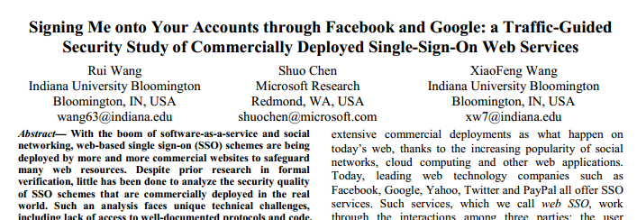
5. Insecure Interfaces and APIs
Cloud is new and rapidly evolving, so lots of new API surface
Examples:
  Weak TLS crypto
  Incomplete verification of encrypted content
Source: CSA - Cloud Computing Vulnerability Incidents: A Statistical Overview

Slide 30
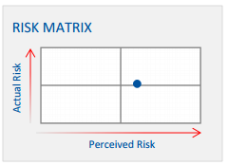
5. Insecure Interfaces and APIs
Bottom line:
  Cloud providers must follow SDL
  Customers should validate API behavior

Slide 31
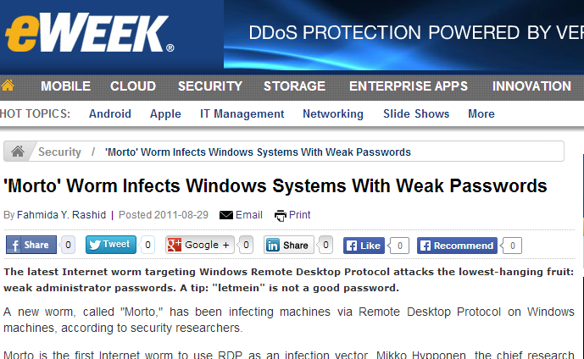
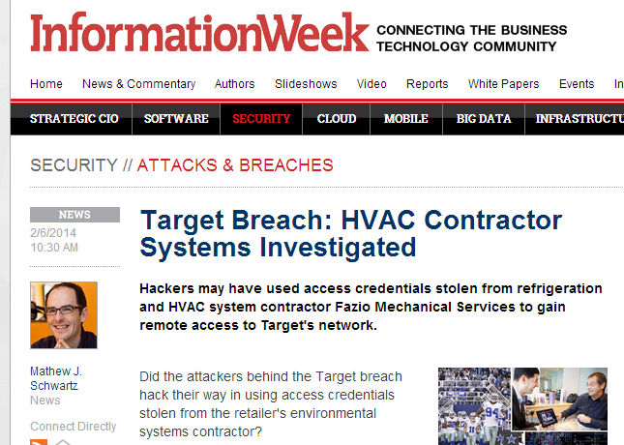
4. Account or Service Traffic Hijacking
Account hijacking: unauthorized access to an account
Possible vectors:
  Weak passwords
  Stolen passwords
  Password reuse

Slide 32
4. Account or Service Traffic Hijacking: Cloud Infrastructure Threats
Account hijacking is not specific to the Cloud, but:
  Cloud use may result in unmanaged credentials
  Publically accessible applications/services may allow for brute forcing
  Applies to cloud provider: cloud support infrastructure is a back door
Attacker
Cloud Service APIs
Hypervisor
Hypervisor
Hypervisor
Cloud Operations

Slide 33
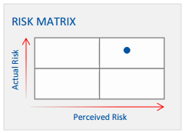
4. Account or Service Traffic Hijacking: Bottom Line
Mitigations:
  Turn off unneeded endpoints
  Strong passwords
  Multifactor authentication
  Breach detection
Azure:
  VM and Cloud Service Microsoft Antimalware
  IP ACLs (with static IP address)
  Point-to-Site, Site-to-Site, ExpressRoute
  Azure Active Directory MFA

Slide 34
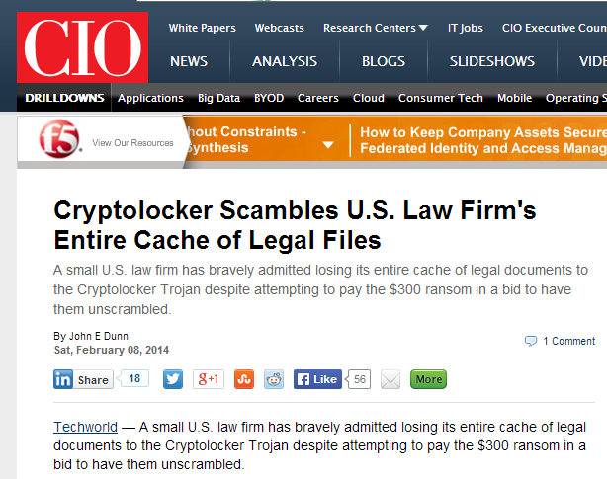
3. Data Loss
There are multiple ways to lose cloud data:
  Customer accidentally deletes or modifies it
  Attacker deletes or modifies it
  Cloud provider accidentally deletes or modifies it
  Natural disaster destroys datacenter

Slide 35
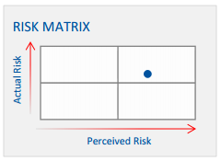
3. Data Loss: Bottom Line
Mitigations:
  Customer: point-in-time backups matter,
  even in the cloud
  Customer: geo-redundant storage
  Cloud Provider: deleted resource tombstoning
Azure:
  Globally Replicated Storage
  VM Capture
  Storage snapshots
  Azure Site Replica
US North (primary)
US South (secondary)

Slide 36
2. Data Breaches
Really represents a collection of threats:
  Insider threat, vulnerability in shared technology, etc.
Ultimately, a company’s main asset is its data
How does a company ensure its data is protected even in the face of successful breach?
  Need to look at the threats individually…

Slide 37
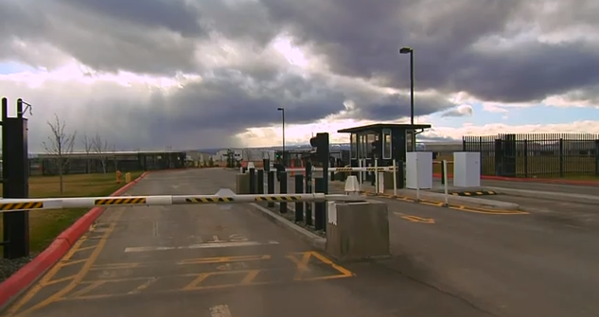
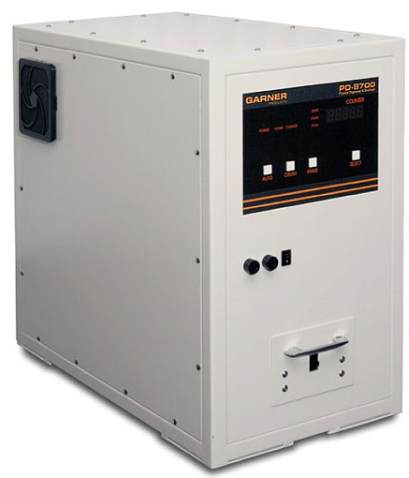
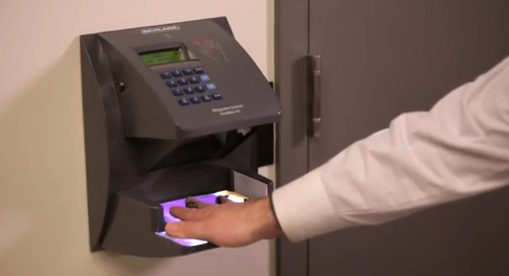
2. Data Breaches: Physical Attacks on Media
Threat: attacker gains access to media removed from datacenter
Mitigation: cloud provider physical controls
Enhanced mitigations:
  Third-party certifications (e.g. FedRamp)
  Encryption at rest
Azure: third-party encryption
DC Ops

Slide 38
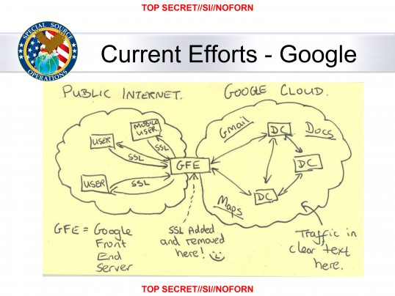
2. Data Breaches: Physical Attacks on Data Transfer
Threat: attacker man-in-the-middle snooping on data links
Mitigations:
  Cloud provider encrypts inter-DC traffic
  Cloud provider APIs use TLS
  Customer uses TLS
  Customer encrypts outside of cloud
Azure:
  Brad Smith public promise
Enterprise
Attacker
Cloud Service APIs

Slide 39
2. Data Breaches: Side-Channel Attacks
Threat: Collocated attacker can infer secrets from processor side-effects

Slide 40
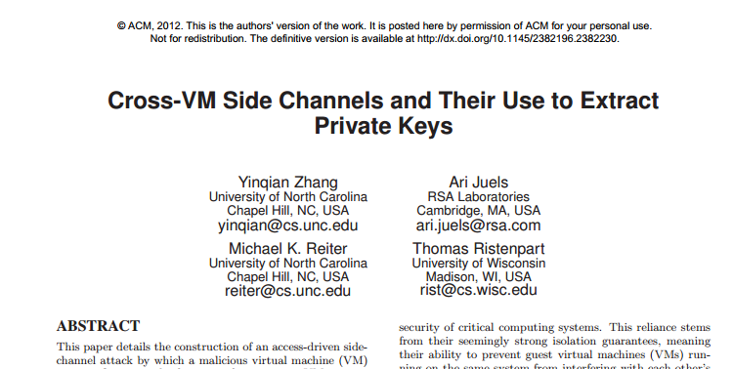
2. Data Breaches: Side-Channel Attacks
Threat: Collocated attacker can infer secrets from processor side-effects
Hypervisor
https://www.cs.unc.edu/~reiter/papers/2012/CCS.pdf

Slide 41
2. Data Breaches: Side-Channel Attacks
Researcher assumptions:
  Attacker knows precise cryptographic code customer is using and key strength
  Attacker can collocate on same server
  Attacker VM shares same physical core as customer VM
  Customer VM continuously executes cryptographic code
  Other customers performing similar algorithms do not share physical core
Bottom line: not currently a risk in practice

Slide 42
2. Data Breaches: Logical Attack on Storage
Threat: attacker gains logical access to data
Mitigations:
  Defense-in-depth prevention
  Monitoring/auditing
Encryption-at-rest: not a significant mitigation
  Assume attacker can use keys
Attacker
Cloud Service APIs

Slide 43
2. Data Breaches: Bottom Line
Media breach is not a significant risk
  Encryption-at-rest doesn’t buy much
Network breach is a risk
  Encryption-on-the-wire is recommended
Logical breach is a risk
  Encryption-at-rest doesn’t buy much

Slide 44
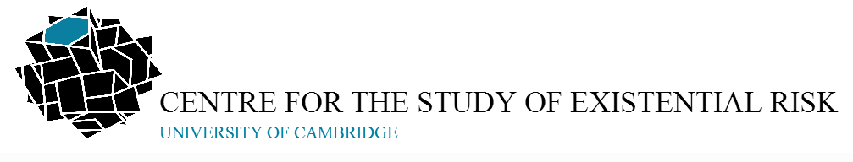
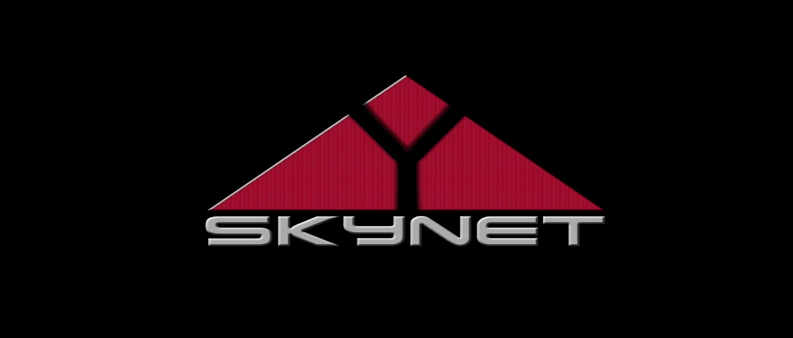
1. Self-Awareness
Enterprise
Enterprise
Consumer
Attacker
Private Network
Internet
http://cser.org
Cloud Service APIs
Deployer
Private Network
Hypervisor
Hypervisor
Hypervisor
DevOps
Cloud Operations
DC Ops
Datacenter
Cloud Service Provider

Slide 45
The Top-10
1. Self-awareness
2. Data breaches
3. Data loss
4. Account or service traffic hijacking
5. Insecure interfaces and APIs
6. Denial of service
7. Malicious insiders
8. Abuse of cloud services
9. Insufficient due diligence
10. Shared technology vulnerabilities

Slide 46
Summary
As with any new technology, there are new risks
It’s our responsibility to educate our businesses and customers
We can also develop tools and processes to mitigate risk

