Slide 1


Slide 2
Advanced Lessons learned from Implementing System Center 2012 R2 Service Manager
DCIM-B308
Anders Asp
MVP, Principal Consultant @ Lumagate

Slide 3
Agenda
Service Manager Do’s and Dont’s
  Lessons learned from my five years of working with Service Manager
  Scenarios of different complexity – from basic to advanced

Slide 4
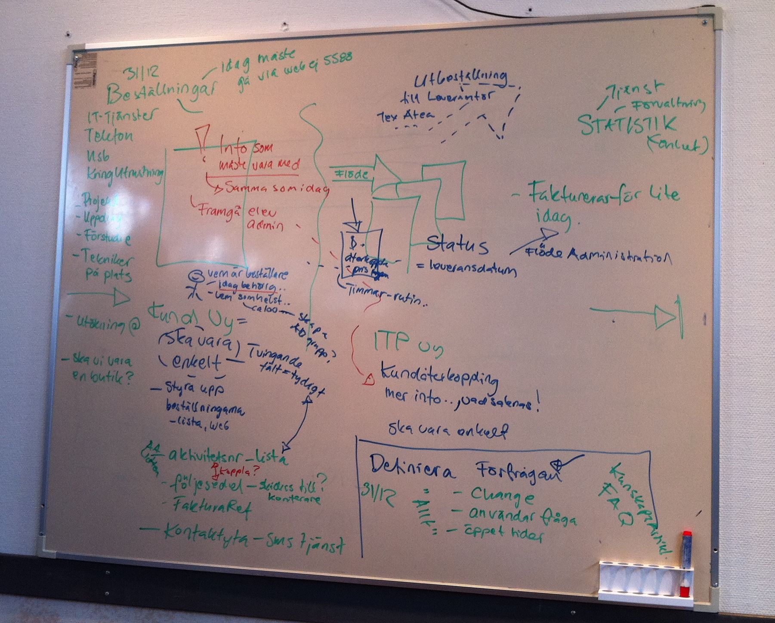
Processes – The core of Service Manager
”Service Manager doesn’t make a bad process any better”

Slide 5
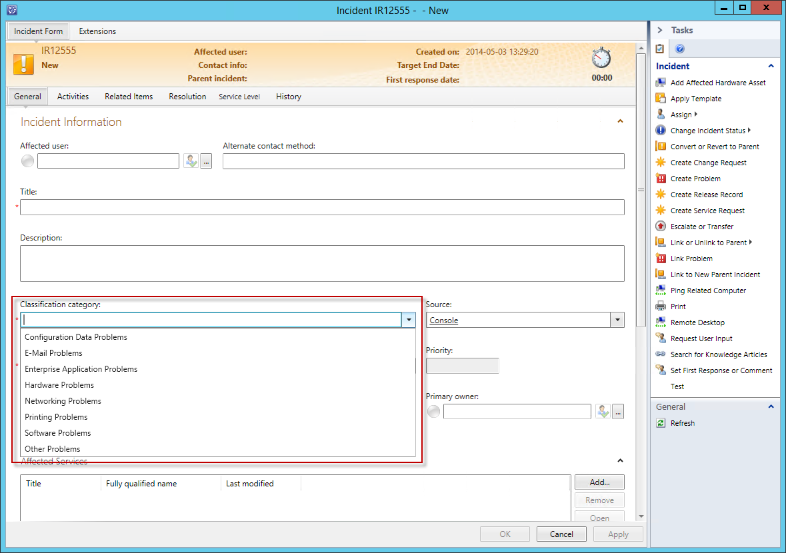
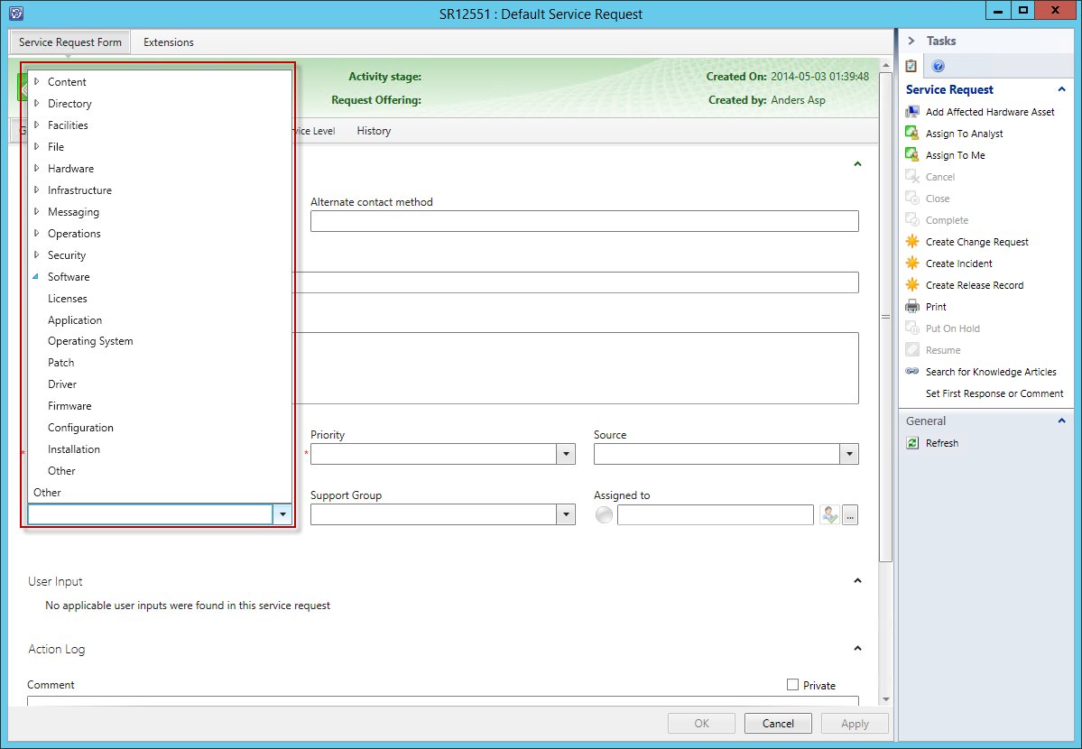
Category/Area lists
The Category and Area lists

Slide 6
Category/Area - an example of a Don’t
284 Categories
88 of these were used less than 10 times a year
The top 9 items represented 75% of all Incidents

Slide 7
Category/Area – My Do’s
The Category and Area lists
  Keep the list short, around 10 list items
    Child items is ok, but don’t over do it
  To get the whole picture, combine Category/Area with Affected CI/Services
  Avoid using ”Other” as a list item
  Try to use the same base list in all processes

Slide 8
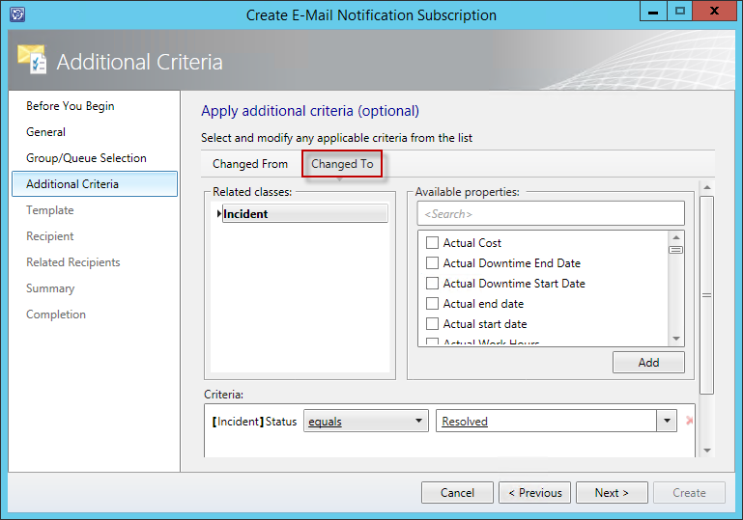
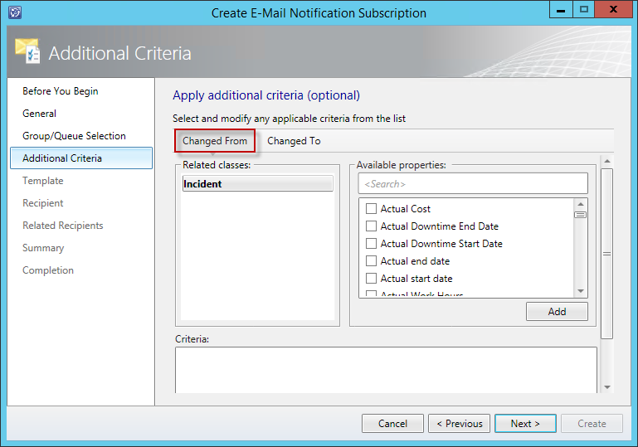
Working with workflows and subscriptions
The importance of using a ”tight criteria” – The Don’t

Slide 9
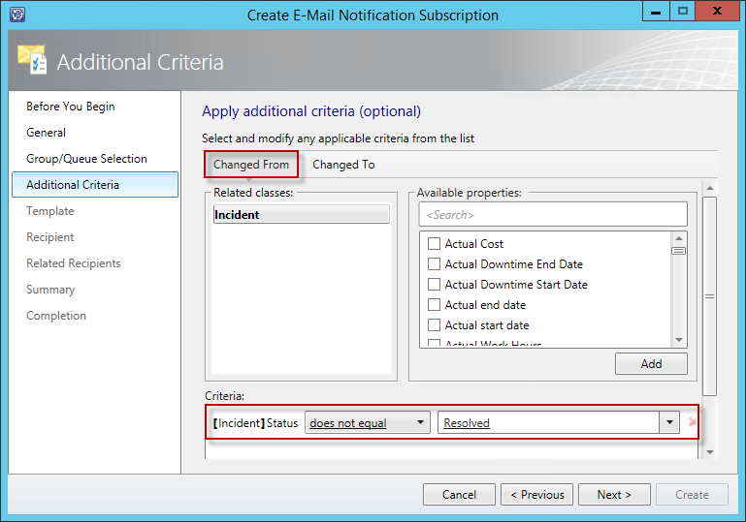
Working with workflows and subscriptions
The importance of using a ”tight criteria” – The Do

Slide 10
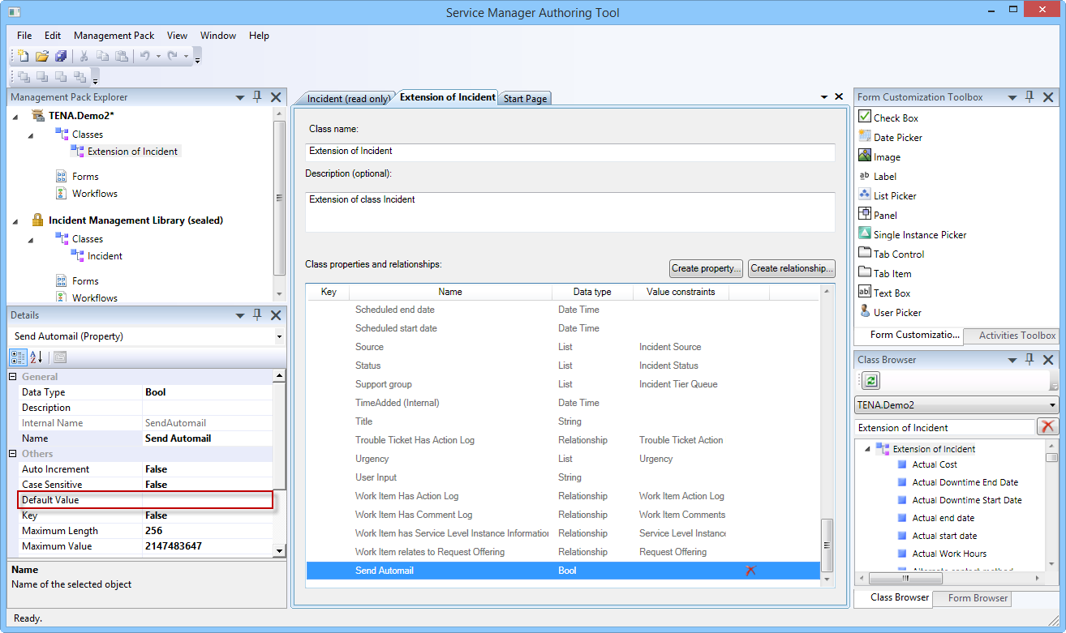
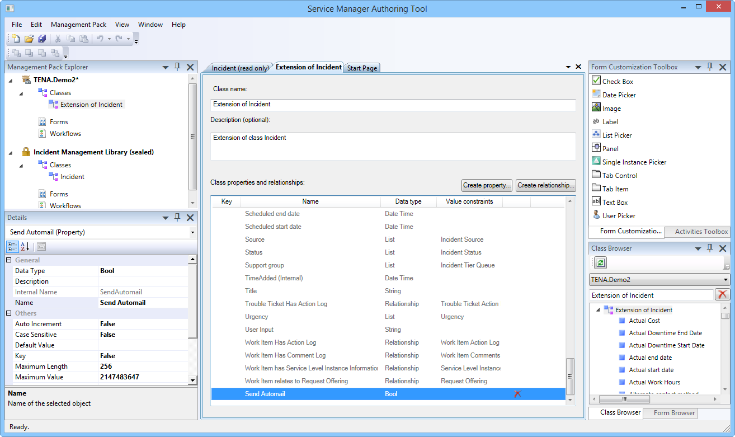
Extending Service Manager
Things to keep in mind when doing a class extension

Slide 11
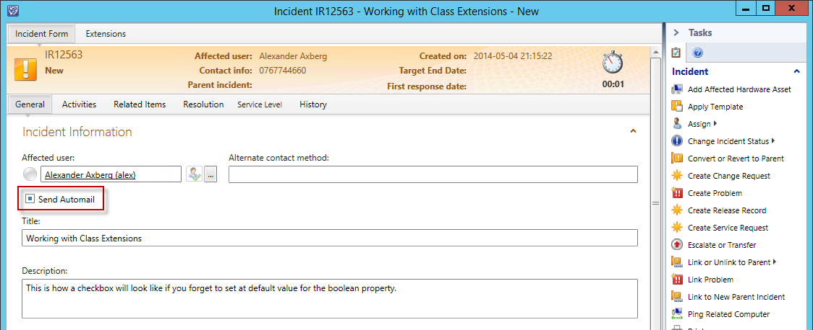
Extending Service Manager
Things to keep in mind when doing a class extension

Slide 12
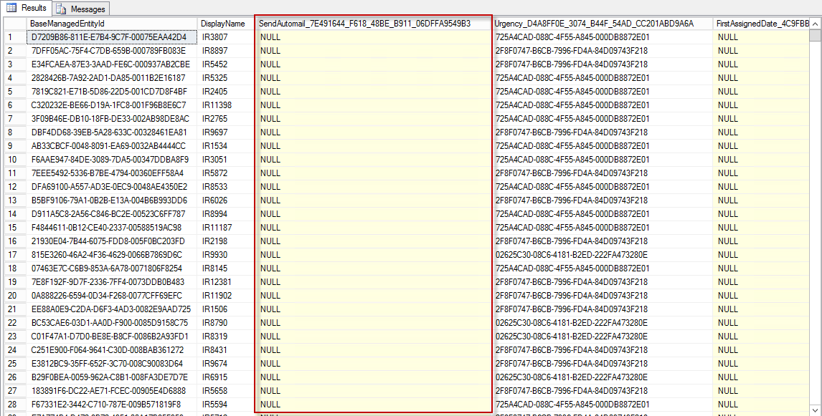
Extending Service Manager
Things to keep in mind when doing a class extension

Slide 13
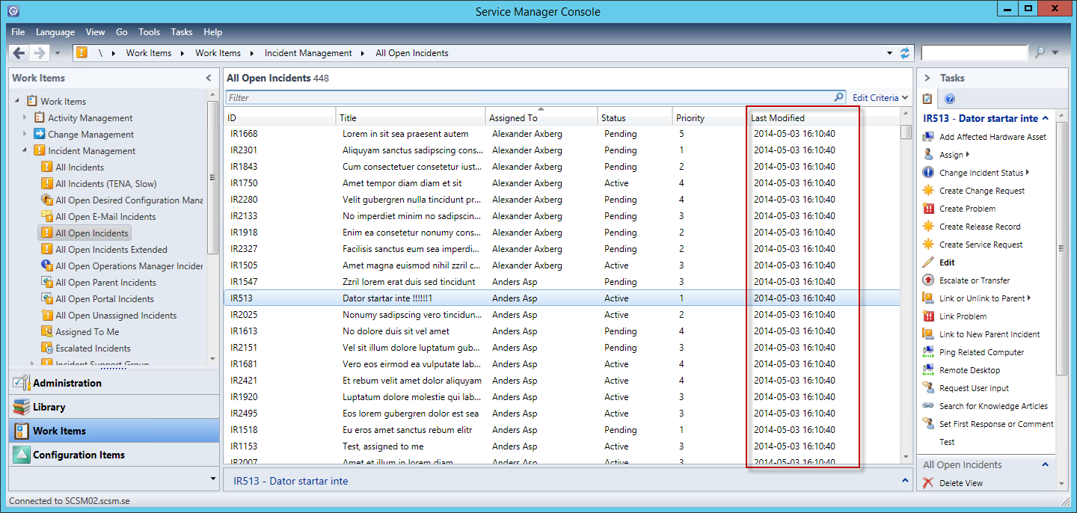
Extending Service Manager
Things to keep in mind when doing a class extension

Slide 14
Demo

Slide 15
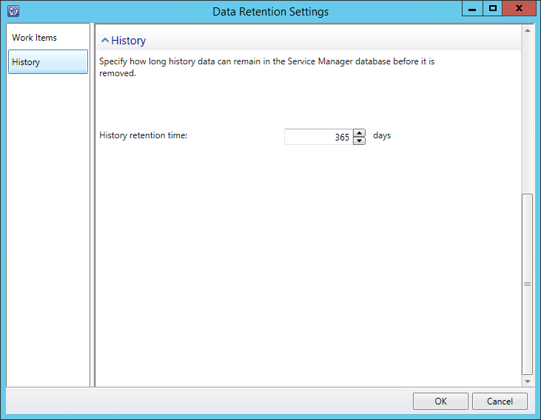
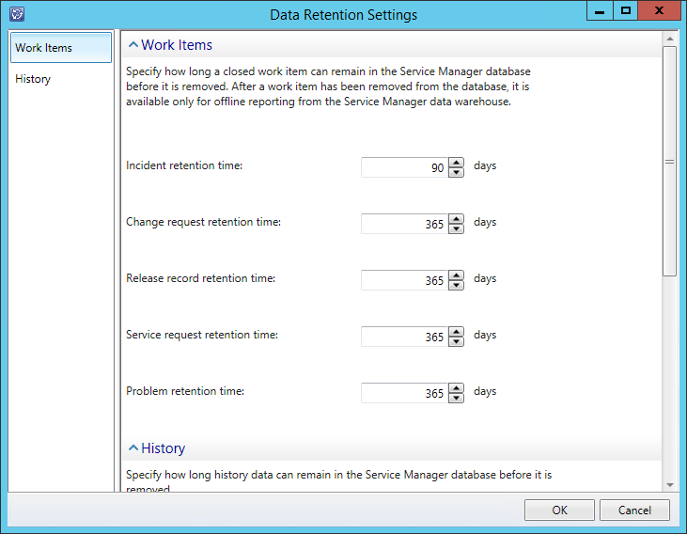
Grooming
How the Data Retention Settings affect the performance of Service Manager

Slide 16
History of objects
Why does History have an impact on performance?
All updates is stored as a transaction in the EntityTransactionLog table
select * from EntityTransactionLog where EntityTransactionLogId = '155170'

Slide 17
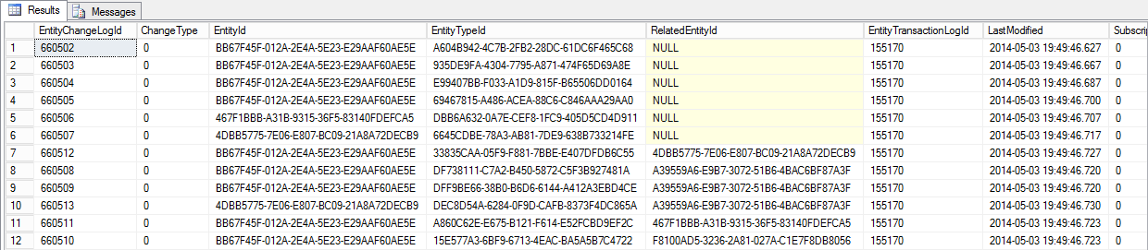
History of objects
Why does History have an impact on performance?
To see all the updates in a single transction, look in the EntityChangeLog table
select * from EntityChangeLog where EntityTransactionLogId = '155170'

Slide 18
History of objects
Why does History have an impact on performance?
So what was changed? Look at the MT_..._Log table (in this example, MT_System$WorkItem$Incident_Log)
select * from MT_System$WorkItem$Incident_Log where EntityChangeLogId = '660502'

Slide 19
Grooming
Tweaking your Data Retention Settings
Set the Data Retention Setting to as low as possible, this goes for both WIs and History.
For larger Organizations, try changing it to a week (yes, that is 7 days!)

Slide 20
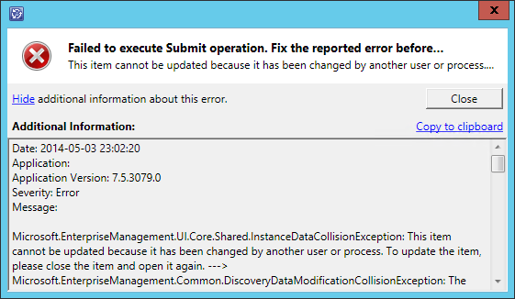
”This object has been updated by another user or process”
Understand why you get this error and how to minimize the occurrence of it

Slide 21
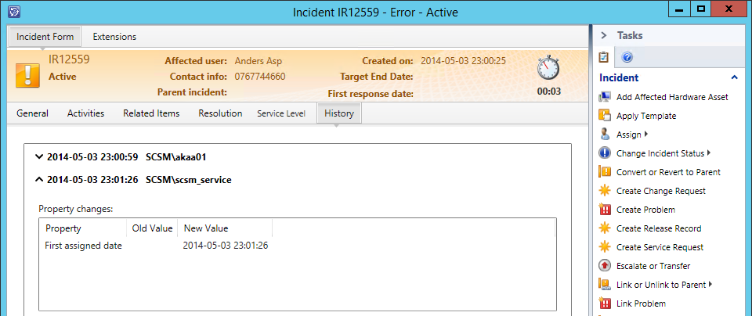
”This object has been updated by another user or process”
The FirstAssignedDate workflow

Slide 22
Demo

Slide 23
Connectors
AD and SCCM connector performance
AD Data Consumer batch size
AD Data Provider batch size
Based upon LFX, Linking Framework
Name | BatchSize
ADUsers | 2000
ADComputers | 2000
ADPrinters | 2000
ADGroups | 2000
Name | BatchSize
AD_User_Out | 50
AD_UserPreference_Out | 50
v_AD_UserManager | 50
AD_UserNotificationPoint_Out | 50
AD_GroupNotificationPoint_Out | 50
AD_Computer_Out | 200
AD_Printer_Out | 200
AD_Group_Out | 50
Data Provider
Data Consumer
AD/SCCM
ServiceManager

Slide 24
Connectors
AD and SCCM connector performance
Changes directly to the database is NOT supported!
To see the current batch size setting:
select DataName,DefaultBatchSize from lfx.datatable where DataName in ('AD_User_Out','AD_UserPreference_Out','v_AD_UserManager','AD_UserNotificationPoint_Out','AD_GroupNotificationPoint_Out','AD_Computer_Out','AD_Printer_Out','AD_Group_Out')

Slide 25
Connectors
AD and SCCM connector performance
Changes directly to the database is NOT supported!
To set a new batch size:
Update LFX.DataTable
Set DefaultBatchSize =1000
where DataName in ('AD_User_Out','AD_UserPreference_Out',
'v_AD_UserManager','AD_UserNotificationPoint_Out','AD_GroupNotificationPoint_Out',
'AD_Computer_Out','AD_Printer_Out','AD_Group_Out')

Slide 26
Implied Permissions
What is Implied Permissions?
Part of the security model that allows users that are related to objects by certain relationships to have certain permissions on those objects.
Affected User of an Incident →
Reviewer in a Review Activity →
Custodian of a Computer →
User in CMDB →
View and Edit the Incident
Vote on the Review Activity
View the Computer CI
View and Edit CI information, such as e-mail address and locale

Slide 27
Implied Permissions
How does it affect performance?
Implied Permissions runs as a workflow in the background
Implied Permissions are used during AD Connector sync
Implied Permission Relationship Type | Purpose
ImpliedIncidentAffectedUser | Grants users permission to view/edit those incidents for which they are the affected user
ImpliedConfigItemCustodian | Grant users the ability to view any CI for which they are the custodian
ImpliedPrimaryComputerUser | Grant users the ability to view any computer for which they are the primary computer user
ImpliedReviewer | Grant users the ability to vote on review activities which they are a reviewer on. This applies only to the person himself and not to reviewer groups which the user is member of
ImpliedUserPreference | Grant users the permission to view/edit the notification address and locale information associated with themselves
ImpliedActivityEditor | Grant users the permission to view/edit any manual activity for which they are the assigned user

Slide 28
Implied Permissions
Disabling Implied Permissions
...
<Overrides>
<RulePropertyOverride ID="DisableMicrosoftEnterpriseManagementSystemCenterImplicitUserRoleAdministrator" Context="System!System.Entity" Enforced="false" Rule="IP!Microsoft.EnterpriseManagement.SystemCenter.ImplicitUserRoleAdministrator" Property="Enabled">
<Value>false</Value>
</RulePropertyOverride>
</Overrides>
...

Slide 29
Implied Permissions
Disabling Implied Permissions
To compensate for disabling Implied Permissions, you would need to do the following.
Disabled Permission | What do you do to compensate?
ImpliedIncidentAffectedUser | Put NT Authority\Authenticated Users in the Incident Resolver* user role.
ImpliedConfigItemCustodian | Put NT Authority\Authenticated Users in the Incident Resolver* user role.
ImpliedPrimaryComputerUser | Put NT Authority\Authenticated Users in the Incident Resolver* user role.
ImpliedReviewer | Create a group in AD of people that are responsible for approving review activities. Put that AD user group in the Advanced Operator* user role.
ImpliedUserPreference | This permission is not necessary unless end users are somehow given a user experience for changing these settings. Service Manager does not provide a user experience for this out of the box.
ImpliedActivityEditor | Create a group in AD of people that are responsible for implementing manual activities. Put that AD user group in the Activity Implementers* user role.

Slide 30
Demo

Slide 31
Find more information here
First Assigned Date override (incl. MP)
http://www.scsm.se/?p=853
How to manually execute WorkItem Grooming in Service Manager
http://blogs.technet.com/b/mihai/archive/2012/12/12/how-to-manually-execute-workitem-grooming-in-service-manager.aspx
Modifying the batch size of AD and SCCM connector
http://blogs.technet.com/b/mihai/archive/2013/08/14/tweaking-the-ad-and-cm-connectors-in-service-manager-2012.aspx
Implied Permissions (incl. MP)
http://blogs.technet.com/b/servicemanager/archive/2014/03/19/improving-ad-connector-performance.aspx

Slide 32

Related content
Breakout Sessions
  DCIM-B332: Bringing ITSM Capabilities from System Center Service Manager to Windows Azure Pack
  DCIM-B355: Microsoft System Center 2012 R2 Service Manager in the Hybrid Cloud
  DCIM-B370: Transform Fortune 100 IT Organizations Using IT Service Management with Microsoft System Center 2012 R2 and Office365
Labs
  DCIM-IL306 Speed Lab! Microsoft System Center 2012 R2 Overview
  DCIM-H203 Speed Lab! Microsoft System Center 2012 R2 Overview
  DCIM-H312 IT Service Management with Microsoft System Center 2012 R2 Service Manager
  DCIM-H313 Microsoft System Center 2012 R2 Lab 4: IT Service Management

Slide 33

For More Information
Windows Server
Windows Server 2012 R2
http://technet.microsoft.com/en-US/evalcenter/dn205286
System Center
System Center 2012 R2
http://technet.microsoft.com/en-US/evalcenter/dn205295
Azure Pack
Azure Pack
  http://www.microsoft.com/en-us/server-cloud/products/windows-azure-pack
Microsoft Azure
Microsoft Azure
  http://azure.microsoft.com/en-us/
  Come Visit Us in the Microsoft Solutions Experience!
  Look for Datacenter and Infrastructure Management
  TechExpo Level 1 Hall CD

Slide 34

Resources
Learning
  Sessions on Demand
  Microsoft Certification & Training Resources
http://channel9.msdn.com/Events/TechEd
www.microsoft.com/learning
TechNet
msdn
  Resources for IT Professionals
  Resources for Developers
http://microsoft.com/technet
http://microsoft.com/msdn

Slide 35



Complete an evaluation and enter to win!

Slide 36
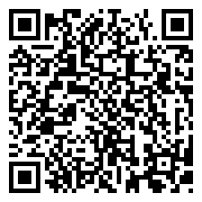

Evaluate this session
Scan this
QR code
to evaluate
this session.

Slide 37


© 2014 Microsoft Corporation. All rights reserved. Microsoft, Windows, and other product names are or may be registered trademarks and/or trademarks in the U.S. and/or other countries.
The information herein is for informational purposes only and represents the current view of Microsoft Corporation as of the date of this presentation. Because Microsoft must respond to changing market conditions, it should not be interpreted to be a commitment on the part of Microsoft, and Microsoft cannot guarantee the accuracy of any information provided after the date of this presentation. MICROSOFT MAKES NO WARRANTIES, EXPRESS, IMPLIED OR STATUTORY, AS TO THE INFORMATION IN THIS PRESENTATION.

