Slide 2
Bare Metal OS Deployment in Microsoft System Center 2012 R2 Virtual Machine Manager: This Is How It Is Done!
DCIM-B309
Mikael Nystrom - MVP

Slide 3
I…
Live in Sweden
Work as Consultant and Trainer
Have done OS Deployment since 8” floppys.
Build and connect Clouds
Love questions
Script samples @ www.deploymentbunny.com
You find me at @mikael_nystrom

Slide 4
Agenda
The benefit
How it works
Prerequisite
Deployment

Slide 5
The benefit
Control
Automation
Boot from VHD

Slide 6
How it works
Run GCEs & Configure partitions
5
New Hyper-V Server
OOB Reboot
Enable Hyper-V Role
1
9
8
VMM Server
Bare Metal Server
Customize & Domain join
Boot from PXE
2
DC = Contoso
Inject drivers
7
Authorize PXE Boot
3
4
Download VHD
6
WDS Server
Library Server

Slide 7
Prerequisite
SCVMM
PXE
IPMI/SMASH
Compute profiles
Logical Network
VM Network
Drivers
Image
WSUS?
Crossed fingers

Slide 8
Prepare for deployement
Mikael Nystrom

Slide 9
Deployment
Pre OSD Tasks
Hardware configuration
OSD
Deploy and configure the OS, Hyper-V, network and agent
Post OSD Tasks
Adding network configuration
Adding/configure featres and functions
Adding hardware related software
Adding DPM and OM agents
Switcing to production mode

Slide 10
Deployment Using the UI
Mikael Nystrom

Slide 11
Doing that for one host is ok, but I have 52 more to go…

Slide 12
Deployment Using PowerShell
Mikael Nystrom

Slide 13
Still questions?
Mikael.nystrom@truesec.se
http://deploymentbunny.com
@mikael_nystrom

Slide 14
For More Information
Windows Server
Windows Server 2012 R2
http://technet.microsoft.com/en-US/evalcenter/dn205286
System Center
System Center 2012 R2
http://technet.microsoft.com/en-US/evalcenter/dn205295
Azure Pack
Azure Pack
http://www.microsoft.com/en-us/server-cloud/products/windows-azure-pack
Microsoft Azure
Microsoft Azure
http://azure.microsoft.com/en-us/
Come Visit Us in the Microsoft Solutions Experience!
Look for Datacenter and Infrastructure Management TechExpo Level 1 Hall CD

Slide 15
Resources
Learning
Sessions on Demand
Microsoft Certification & Training Resources
http://channel9.msdn.com/Events/TechEd
www.microsoft.com/learning
TechNet
msdn
Resources for IT Professionals
Resources for Developers
http://microsoft.com/technet
http://microsoft.com/msdn

Slide 16
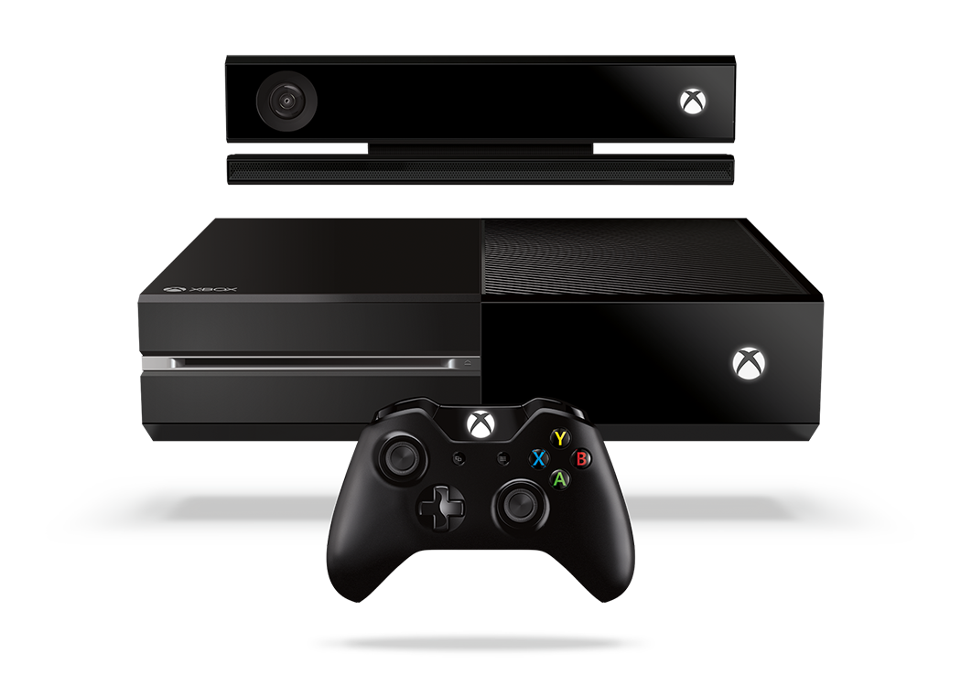
Complete an evaluation and enter to win!

Slide 17
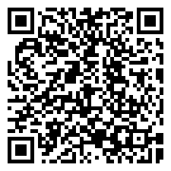
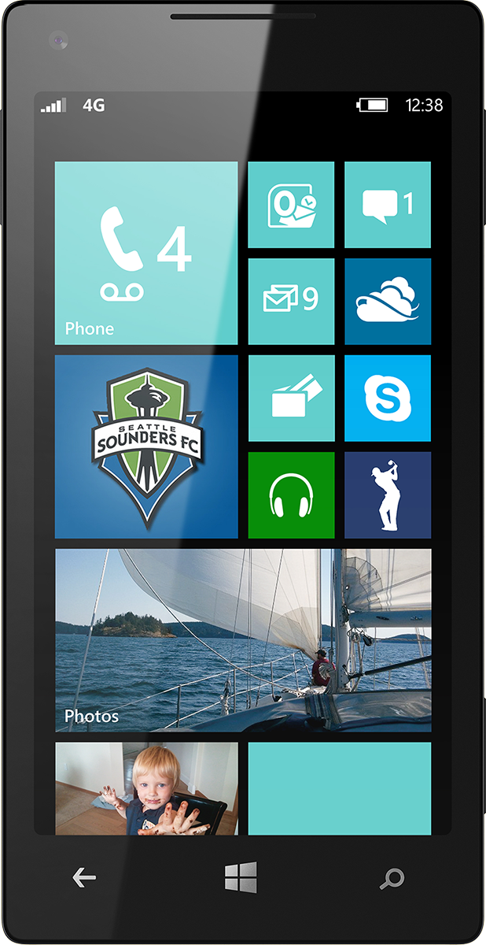
Evaluate this session
Scan this QR code to evaluate this session.

Slide 18
© 2014 Microsoft Corporation. All rights reserved. Microsoft, Windows, and other product names are or may be registered trademarks and/or trademarks in the U.S. and/or other countries.
The information herein is for informational purposes only and represents the current view of Microsoft Corporation as of the date of this presentation. Because Microsoft must respond to changing market conditions, it should not be interpreted to be a commitment on the part of Microsoft, and Microsoft cannot guarantee the accuracy of any information provided after the date of this presentation. MICROSOFT MAKES NO WARRANTIES, EXPRESS, IMPLIED OR STATUTORY, AS TO THE INFORMATION IN THIS PRESENTATION.

