Slide 2
Extend Datacenter Networking with Partner Solutions
DCIM-B314
Bob Combs

Slide 3

Cloud OS
Microsoft delivers a complete datacenter solution with Windows Server 2012 R2 out-of-the-box
Customer
Enterprise-grade platform
Hybrid design
People-focused approach
ONE
Consistent
Platform
Microsoft
Service
Provider
Development Management Identity Virtualization Data
Notes:
Enterprise-grade Platform
We understand your existing IT systems and challenges better than any technology company out there.
IDC predicts that 70% of CIOs will embrace a cloud-first strategy in 2016. To get there, organizations need to move at their own pace over a number of years, with many living in a hybrid environment for quite some time. That flexibility – to live in both worlds – even with a cloud-first strategy – is non-negotiable. (Source: IDC CIO Agenda webinar).
So, we aren’t going to tell you to move everything to the cloud. We’ll help you take what you have, upgrade through our Cloud OS strategy and take the journey with you.
Some vendors are making this transition more confusing by calling feature-limited apps “cloud-ready” or force you to use different sign-ons for every online experience or won’t even guarantee continuous availability. Cloud shouldn’t mean lowering your expectations or making compromises.
Microsoft believes you shouldn’t expect any less from the cloud – you should expect more.
It MUST be an enterprise-grade platform
Hybrid Design
By design, our hybrid cloud builds commonalities into the platform, unifying resources across premises to let data and apps flow freely.
Hybrid is the core of Microsoft’s Cloud OS vision. We’re uniquely able to take a hybrid cloud approach to deliver unified compute, storage and networking across a customer’s datacenters, the public cloud and hosted clouds – creating a single application, data and device management platform.
You benefit from a common and consistent approach to development, management, identity, virtualization and data – spanning on-premises to cloud – your cloud, a service provider cloud and Microsoft’s cloud
This gives you the ability, from a one view, to manage apps and data beyond your own private cloud – to a partner cloud – to a public cloud – in a consistent way.
Helps you be very flexible in thinking about how you deploy your apps across the multitude of cloud environments
People-focused Approach
Our people-focused approach means IT professionals, developers and users can leverage existing skills in this new hybrid world.
For years, Microsoft has been delivering experiences that appeal to end-users driving maximum productivity, regardless of location or device.
Microsoft brings that same focus on people to IT and developers – mirroring the familiarity and ease-of-use from our on-premises products into our Cloud services.
The unifying technologies in the Cloud OS enable the flow, management and governance of data and apps across premises and devices to keep employees productive and connected, wherever they are (IT professionals, developers and users).
This all leads to higher satisfaction – from employees to IT – and improved productivity with lower training costs.
With such a large solution and developer footprint – adoption by our enterprise customers speaks for itself – and is also a huge driver of our focus on people and their experiences
(ADDITIONAL OPTIONAL HYBRID DETAILS NOT IN NOTES SLIDES)
This is powerful because we will deliver a flexible development environment for the developer so that it can code once and deploy anywhere; deploy on premises, deploy out to a partner cloud, deploy out to Azure cloud. But they only have to write the app once on the power of our .NET framework.
Unified management is our ability to use System Center, sitting in your datacenter to administer all the automation scripts to manage and pool the resources of that datacenter. Well while you’re looking in that pane of glass, to be able to provision and move VMs, objects, data from your datacenter out through a service provider or out to Azure for bottomless storage, for redundancy, for disaster recovery.
Common identity is a third element of our consistent platform, using Active Directory group policies that you’ve already set up in your enterprise. You merely get the benefit of those group policies extended through Active Directory Federation Services and Azure based Active Directory, so that the group policies you set, extend out to the cloud automatically. You don’t have to manage multiple federation common identity across different clouds.
Integrated virtualization is a fourth area. You no longer have to have a third part bolt on to virtualize your compute. Not only are we giving you compute capability, virtualization of your compute capability imbedded in Windows Server, we’re giving that to you around software defined networking and around virtualization of storage, also.
Lastly, being able to have a complete data platform where your data can reside anywhere across these three clouds in a seamless way is a value proposition that’s huge as well. You can optimize your storage costs in this dimension. All that capability integrated in how we think about the complete data platform for a customer across all clouds.

Slide 4
Hyper-V extensible switch as the policy edge
Parent partition
Virtual Machine
Host NIC
VM NIC
  Rich
  Policies with ACLs, QoS, SLAs, isolation, DHCP guard, router guard
  Extensible
  Switch extensions
  Automated
  Using System Center VMM and PowerShell
Virtual switch
Extension protocol
Capture extensions
Filtering extensions
Forwarding extension
Extension miniport
Physical NIC

Slide 5

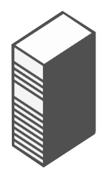
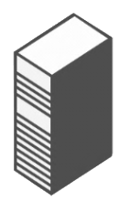
Hyper-V Network
Virtualization
(HNV) for tenant network overlays
Contoso
virtual machine
Fabrikam
virtual machine
Contoso network
Fabrikam network
  Onboard customer networks
  (with overlapped addresses)
  Live migrate VMs across
  subnets without touching
  the physical network
  Support network isolation
  across millions of tenants
Virtualization
Physical server
Physical network
Notes:
5

Slide 6
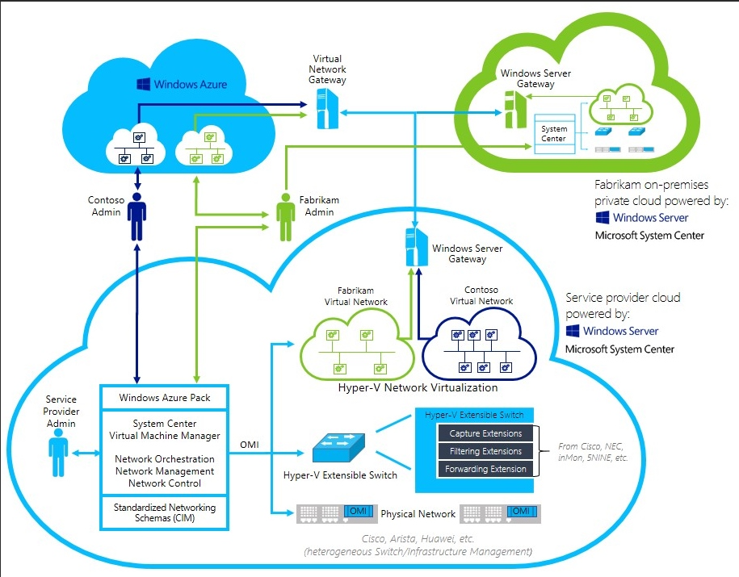
Delivering networking without boundaries

Slide 7
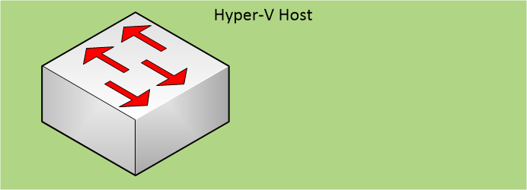
And it is Extensible …
VM₁
VM₂
VM₃
SCVMM
Virtualization
3rd Party components
Root Partition
Capture Extension
VMM
Service
VMM Agent
Filtering Extension
Forwarding Extension
Vendor
SCVMM
Plugin
Physical NIC
Vendor network mgmt console
Hyper-V switch extensions and
SCVMM extensions from partners
Policy database

Slide 8
Agenda
5Nine will show how to configure security groups using Cloud Security for Hyper-V
NEC will show how to configure their OpenFlow switch and Hyper-V Network Virtualization using Programmable Flow Virtual Switch PF1000
Cisco will show how to configure the vSwitch and Hyper-V Network Virtualization using Nexus 1000V for Hyper-V

Slide 9
5Nine
Cloud Security for Hyper-V
Konstantin Malkov
CTO

Slide 10


5Nine Cloud Security for Hyper-V
Enterprise-grade
Aggregate security control
Simplified deployment
Agentless Virtual
Firewall
Isolate VMs: manage security programmatically per VM
Control and protect inbound, outbound, intra-VM traffic
Multi-Tenant protection and support of network virtualization
Stateful, deep packet inspection
Granular QoS
Aggregate, analyze, audit logs
Virtual Machine Security Groups
User/Role - level access: support of Security and Auditor accounts
Application-level protection against a wide range of exploits (WAF)
Agentless Intrusion
Detection
Industrial-strength
Real-time threat monitoring
Signature-based
Block application-level attacks (WAF)
Behavioral: build baseline for known attacks (WAF)
Pro-active - detect, warn, block (WAF)
Agentless Anti-Virus/
Anti-Malware
Agentless: no degradation
All versions of guest OS supported by Microsoft Hyper-V
Fastest AV Scans available
Orchestrate scans and set thresholds across VMs
Staggered scanning
Caching across VMs
Centralized management

Slide 11

Security groups and VMs isolation
Virtual Machine 1
Virtual Machine 2
Web Servers
Security Group
DB Servers
Security
Group
Virtual Machine 3

Slide 12
5Nine Cloud Security for Hyper-V

Slide 13
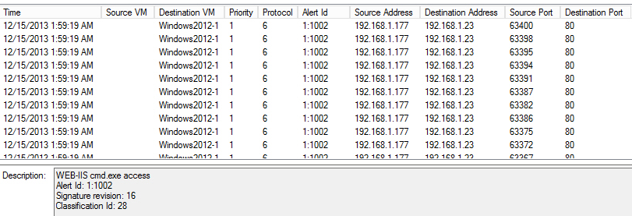
Intrusion Detection
Network Attack Emulation
Virtual Machine
Snort
Web Servers

Slide 14
NEC
ProgrammableFlow Virtual Switch PF1000
Peter Lee
Advisory Software Engineer

Slide 15
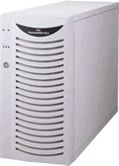




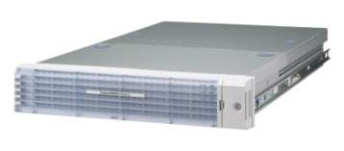
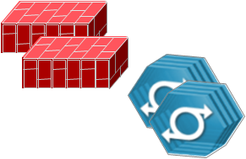
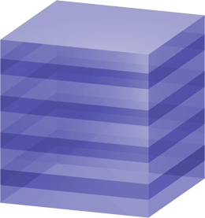

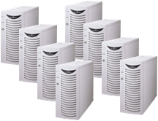
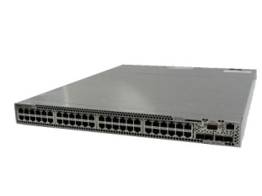
What is ProgrammableFlow?
ProgrammableFlow is a new networking solution that combines NEC’s unique functionalities and next generation network technology OpenFlow.
The VTN network design enables deployment of virtual networks on top of any underlying physical network topology, reducing complexity of traditional network design and increasing service agility.
Virtual Networks (VTNs)
Independent and secure virtual networks
VTN1
VTN2
Physical Network
ProgrammableFlow Switch
Control
ProgrammableFlow
Controller
Network Appliance Pool
Network Switch Pool
Server Pool

Slide 16







Demo Environment
VMM Setup: VMM 2012 R2 server with PF1000 VSEM Provider, managing 2 Hyper-V hosts
ProgrammableFlow Setup: PF6800(Controller), PF5240(Physical Switch), PF1000(Virtual Switch)
  Each switch is redundantly connected to other switch
VMM
VSEM Provider
PF6800
Tenant
Red
Tenant
Red
PF1000
PF1000
Hyper-V
Host
Hyper-V
Host
VTN for HNV tenant
VLAN: 200
VTN for Others
Path policy1
Path policy2
PF5240
PF5240

Slide 17
Demo Overview
Fabric Operation
Add Network Service
VM
Configure HNV Logical NW
VM network
Create IP Pool
VM Subnet
IP Pool
Create Port Profile
Create Logical Switch
Virtual port
VMs and Services Operation
Logical switch
PF1000
PF1000
PF1000
Uplink port
Create Virtual Switches
Hyper-V
Host
Hyper-V
Host
Configure Virtual Switches
Logical network
Create VM Networks
Network site
Create IP Pools
IP Pool
VLAN-Subnet
Connect VMs to VM NWs
PF5240
PF5240
Path-Control over Fabric Network

Slide 18
ProgrammableFlow Virtual Switch PF1000

Slide 19
Related content
DCIM-B315 Cloud Optimized Networking in Windows Server 2012 R2
DCIM-B378 Converged Networking for Windows Server 2012 R2 Hyper-V
DCIM-B344 Network Tuning for Specific Workloads
Find us at the TechExpo hall

Slide 20
Cisco
Nexus 1000V for Hyper-V
Sujit Khale
Technical Leader
Cisco

Slide 21
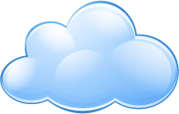
Nexus 1000V Architecture
Respects DC Operational Model for P→V
Virtual Appliance
Network
Admin
VSM-1 (active)
NX-OS
Control Plane
VSM-2 (standby)
Supervisor-1 (Active)
Supervisor-2 (StandBy)
Back Plane
Linecard-1
Linecard-2
…
NX-OS
Data Plane
Linecard-N
Extensible Switch
Nexus 1000V VEM
Forwarding
Modular Switch
Capture
VEM-2
VEM-N
Filtering
Hypervisor
Hypervisor
Hypervisor
VSM: Virtual Supervisor Module
VEM: Virtual Ethernet Module
Server
Admin

Slide 22
Port Profiles, Network Segments and VMs
Clients
Guests
# port-profile database-client
ip port access-group dbclient in
no shut
state enabled
Database Network
# port-profile database-server
ip port access-group dbserver in
no shut
state enabled
# port-profile database-admin
ip port access-group dbadmin in
no shut
state enabled
# network-segment database1
switchport mode access
switchport access vlan 10

Slide 23
Nexus 1000V Installation Workflow …

Slide 24
Nexus 1000V Installation Workflow …

Slide 25
Demo 1 – Nexus 1000V Installation

Slide 26
VXLAN and HNV Support
Both VXLAN and HNV are multi-tenant aware Network Virtualization overlay technologies
VXLAN more focused on Layer 2 (same service as a VLAN)
HNV more focused on Layer 3 (same service as a router)
Different Tenants can reuse the same network addresses
Nexus 1000V for Hyper-V is the first to support both

Slide 27
Demo 3 – Nexus 1000V & Network Virtualzation

Slide 28



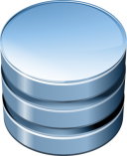
Cisco Virtual Security Gateway
Context-based, Multi-tenant, Workload Segmentation
Cisco PNSC
VM
VM
VM
VM
VM
VM
VM
VM
VM
VM
VM
VM
VM
VM
VM
VM
VM
VM
VM
Nexus 1000V
Distributed Virtual Switch
vPath
VSG
(active)
Secure Segmentation
(VLAN agnostic)
Efficient Deployment
(secure multiple hosts)
Dynamic policy-based provisioning
Transparent Insertion
(topology agnostic)
High Availability
Mobility aware
(policies follow Migration)
Log/Audit

Slide 29

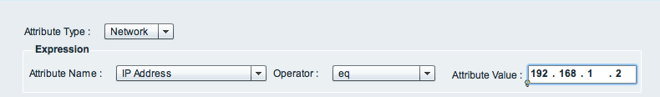

Cisco Virtual Security Gateway
Security Rules with VM & Custom attributes
Rule
☑
☑
Source Condition
Destination Condition
Action
Attribute Type
Network
VM
User Defined
vZone
Condition Match Criteria
Match All (And)
Match Any (Or)
Condition
VM Attributes
VM Name
Guest OS name
Port Profile Name
VM DNS Name
Network Attributes
IP Address
Network Port
Operator
eq
neq
gt
lt
range
Not-in-range
Prefix
Operator
member
Not-member
Contains
And (Global Level)
Or (Global Level)

Slide 30
VSG Workflow

Slide 31
Demo 2 – Nexus 1000V & Virtual Security Gateway (VSG)

Slide 32

For More Information
Windows Server
Windows Server 2012 R2
http://technet.microsoft.com/en-US/evalcenter/dn205286
System Center
System Center 2012 R2
http://technet.microsoft.com/en-US/evalcenter/dn205295
Azure Pack
Azure Pack
  http://www.microsoft.com/en-us/server-cloud/products/windows-azure-pack
Microsoft Azure
Microsoft Azure
  http://azure.microsoft.com/en-us/
  Come Visit Us in the Microsoft Solutions Experience!
  Look for Datacenter and Infrastructure Management
  TechExpo Level 1 Hall CD

Slide 33

Resources
Learning
  Sessions on Demand
  Microsoft Certification & Training Resources
http://channel9.msdn.com/Events/TechEd
www.microsoft.com/learning
TechNet
msdn
  Resources for IT Professionals
  Resources for Developers
http://microsoft.com/technet
http://microsoft.com/msdn

Slide 34



Complete an evaluation and enter to win!

Slide 35
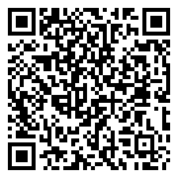

Evaluate this session
Scan this
QR code
to evaluate
this session.

Slide 36

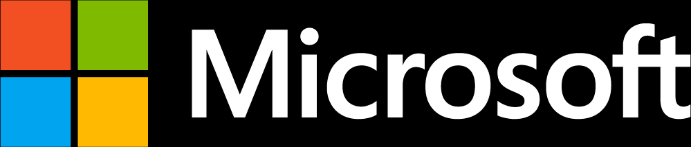
© 2014 Microsoft Corporation. All rights reserved. Microsoft, Windows, and other product names are or may be registered trademarks and/or trademarks in the U.S. and/or other countries.
The information herein is for informational purposes only and represents the current view of Microsoft Corporation as of the date of this presentation. Because Microsoft must respond to changing market conditions, it should not be interpreted to be a commitment on the part of Microsoft, and Microsoft cannot guarantee the accuracy of any information provided after the date of this presentation. MICROSOFT MAKES NO WARRANTIES, EXPRESS, IMPLIED OR STATUTORY, AS TO THE INFORMATION IN THIS PRESENTATION.

