Slide 1


Slide 2
Lessons Learned:
Designing and Deploying Windows Azure Pack in the Real-World
DCIM-B317
Bradley Bartz & Marc van Eijk

Slide 3
Agenda
One platform
Windows Azure Pack
Designs
Choices & Challenges
Q&A

Slide 4


Transforming IT to address new questions
Mobility
Apps
Mobility
Great user experience from anywhere
Microsoft’s answer:
Apps
Modern, agile apps for new scenarios
Big data
Easy access to any data, any size, anywhere
Powerful analytics in familiar tools
The Cloud OS
Big data
Cloud
Cloud
On-demand scale, real-time performance
Infrastructure designed to withstand failure
Resources managed at datacenter scale

Slide 5
With Microsoft’s Cloud OS vision, customers can…
Enable modern business apps
Empower people-centric IT
Customer
ONE
Consistent
Platform
Unlock insights on any data
Transform
the datacenter
Microsoft
Service
Provider

Slide 6






Microsoft cloud experience
Windows Server
Microsoft Azure

Slide 7
Bringing our learning to your datacenter
Windows Server
High performance
storage on industry-
standard hardware
Windows Server
Multi-tenant environments
with isolation
Software-defined networking
Policy-based automation
Application
elasticity
Microsoft Azure
Windows Azure
and many others….

Slide 8
Enterprises want….
Flexible cloud choice, familiar technology, no lock-in.
Their own multi-tenant cloud, that’s as easy as Azure.
Chargeback.
Simple, automated operations.
More effective utilization of existing hardware assets.
Tenant choice and dynamic control.
Commodity and custom cloud offerings.
Integration with LOB systems.

Slide 9
Service providers want….
To win more enterprise customers’ business.
Multi-tenant, self-service IaaS and PaaS offerings.
Usage billing.
Extreme automation.
Optimized hardware monetization.
Opportunities to upsell and increase customer usage.
Customized offerings, public cloud differentiation.
Portal integration and branding.

Slide 10
Common requirements
Enterprise friendly frictionless cloud.
Multi-tenant IaaS based on Windows Azure.
Usage billing.
Automation.
Maximized hardware utilization.
Tenant choice.
Offer management.
Portal integration and branding.

Slide 11

Microsoft Azure technology
Customers
Customer Portal & API
IT Admin
Compute, Storage, Network
Microsoft Azure

Slide 12
In your datacenter
Customers
Your datacenter
IT Admin
Tenant Portal & API
System Center + Windows Server
Compute, Storage, Network

Slide 13
In your datacenter
Customers
Your datacenter
IT Admin
Admin Portal & API
Tenant Portal & API
Resource Clouds
Auto-mation
Billing
Tenant Mgt
Hosting Plans
System Center + Windows Server
Compute, Storage, Network

Slide 14
In your datacenter
Customers
Your datacenter
IT Admin
Windows Azure Pack
Admin Portal & API
Tenant Portal & API
Resource Clouds
Auto-mation
Billing
Tenant Mgt
Hosting Plans
System Center + Windows Server
Compute, Storage, Network

Slide 15
Customer-ready services
Management Portal
Service Management REST API
Web sites
Virtual machines
Service bus
Virtual Networks
Database
Web Platform application Services (PaaS)
Infrastructure Services (IaaS)
Reliable messaging
Virtual Networking
SQL Server and MySQL database

Slide 16



For service providers and enterprises
Enterprise class
Easy and cost effective
Open and interoperable
Windows Azure Pack
Windows Server + System Center
Windows Azure technology in your datacenter
Familiar technology
On-prem connect
Azure consistent
Virtualization
Management
Service bus
Multi-tenant cloud
Web PaaS, and IaaS
Templated services
Standard hardware
Automation
VM portability
Web App Portability
OData Integration API
Node.js, PHP, ASP.NET
GitHub, BitBucket etc
Linux support

Slide 17


Slide 18

Security
Networking
Windows
Development

Slide 19
Choices & Challenges
Windows Azure Pack
Authentication
Service Provider Foundation
Network Virtualization
Service Management Automation
Remote Console
Virtual Machines

Slide 20
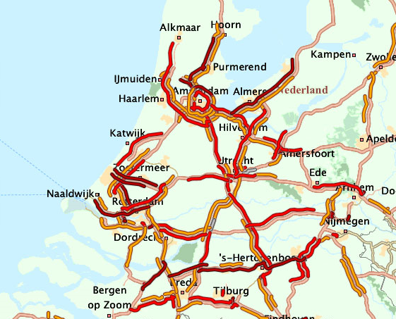
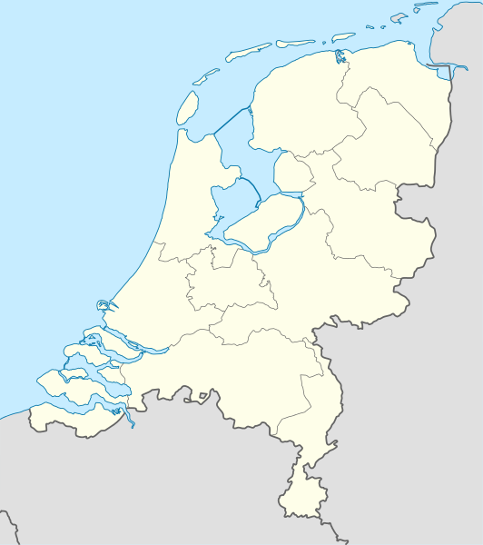
Januari 15, 2013

Slide 21



Enterprise Organisation
Service Provider
Firewall
DMZ
Tenants
Tenant workloads
WAP Tenant
RD Gateway
Web App Proxy
WAP Tenant
RD Gateway
Web App Proxy
ACL
SQL
WAP Admin
DC
WAP Admin
Firewall
MGT
Admins
SPF
ADFS
SMA Web
VMM
SQL
SMA Runbook
DC
Hyper-V Hosts

Slide 22
Windows Azure Pack

Slide 23
Windows Azure Pack
How many components?
7
11
13
14

Slide 24
Windows Azure Pack
Tenants
Firewall
DMZ
DMZ Subnet
Internet Facing
172.21.1.0/24
Tenant workloads
Web App Proxy
WAP Tenant
RD Gateway
ACL
DMZ Subnet
Privileged Services
172.20.1.0/24
DC
SQL
WAP Admin
Firewall
MGT
Admins
SPF
ADFS
SMA Web
VMM
SQL
SMA Runbook
DC
Hyper-V Hosts

Slide 25
Windows Azure Pack
Tenants
Tenant Site
Tenant Public API
Firewall
DMZ
Admin Site
Tenant Site
WAP Tenant
Admin Auth Site
Tenant Auth site
Admin API
Tenant Public API
ACL
Tenant API
PowerShell API
SQL
WAP Admin
BPA
Portal & API Express
Firewall
SQL Server Ext
MySQL Ext
MGT
Admins
Websites
Service Bus

Slide 26
Demo
Windows Azure Pack Tenant Public API

Slide 27
Authentication

Slide 28

Authentication
Out of the box
ADFS
Web Application Proxy
Azure AD
Multi Factor Authentication

Slide 29


Authentication
Tenants
Firewall
DMZ
Tenant workloads
Web App Proxy
WAP Tenant
RD Gateway
ACL
DC
SQL
WAP Admin
Firewall
MGT
Admins
SPF
ADFS
SMA Web
VMM
SQL
SMA Runbook
DC
Hyper-V Hosts

Slide 30
Demo
Federate Windows Azure Pack Tenant Site with ADFS

Slide 31
Service Provider Foundation

Slide 32

Service Provider Foundation
Tenants
Firewall
Groups
MGT\GRP_SPF_Admins
MGT\GRP_SPF_Provider
MGT\GRP_SPF_Usage
MGT\GRP_SPF_VMM
Users
MGT\SVC_SPF
<SPF Server>\SVC_SPF_REG
Registration
Only one SPF registration in WAP
Maximum of 5 VMM servers
DMZ
Tenant workloads
Web App Proxy
WAP Tenant
RD Gateway
ACL
DC
SQL
WAP Admin
Firewall
MGT
Admins
SPF
ADFS
SMA Web
VMM
SQL
SMA Runbook
DC
Hyper-V Hosts

Slide 33
Network Virtualization

Slide 34

Network Virtualization
Location
Firewall
Dependency

Slide 35
Network Virtualization
Tenants
Firewall
DMZ
Gateway VMs
Tenant workloads
Web App Proxy
WAP Tenant
RD Gateway
Gateway Hosts
ACL
DC
SQL
WAP Admin
DC
Firewall
MGT
Admins
SPF
ADFS
SMA Web
VMM
SQL
SMA Runbook
DC
Hyper-V Hosts

Slide 36
Demo
Windows Azure Pack integration with Network Virtualization

Slide 37
Service Management Automation

Slide 38


Slide 39

Automation
Use case
Constructing the oven

Slide 40
Service Management Automation
Tenants
Firewall
VM Clouds
SPF must trust SMA cert
Add SPF App Pool ID to local smaAdminGroup on SMA Web Server
DMZ
Tenant workloads
Web App Proxy
WAP Tenant
RD Gateway
ACL
DC
SQL
WAP Admin
Firewall
MGT
Admins
SPF
ADFS
SMA Web
VMM
SQL
SMA Runbook
DC
Hyper-V Hosts

Slide 41
Remote Console

Slide 42
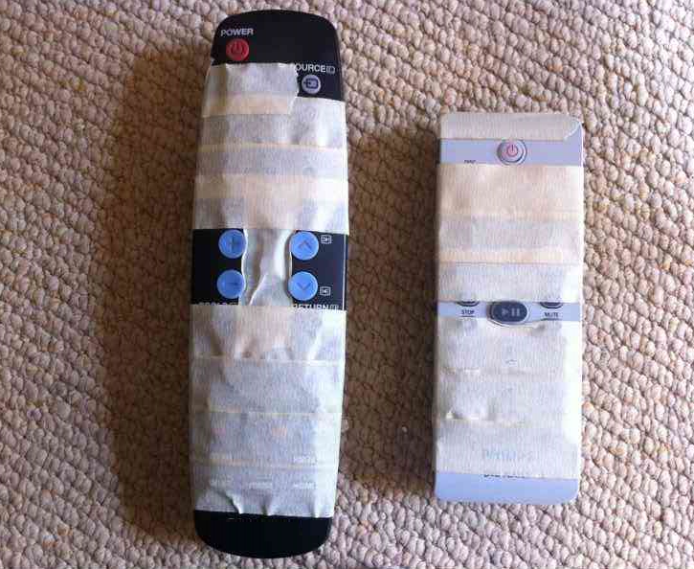
There Grandma, I Fixed it

Slide 43




Remote Console
Tenants
Firewall
DMZ
Tenant workloads
Web App Proxy
WAP Tenant
RD Gateway
ACL
DC
SQL
WAP Admin
Firewall
MGT
Admins
SPF
ADFS
SMA Web
VMM
SQL
SMA Runbook
DC
Hyper-V Hosts

Slide 44
Virtual Machine Role

Slide 45
Virtual Machines
VM Template
  Classification
  Dynamic Memory
VM Role
  Applications
  Scale
  Differencing disks

Slide 46
Call to action
Take the Lessons
Build your cloud
Powered by the CloudOS

Slide 47
Thank you!
QUESTIONS?

Slide 48

Related content
Breakout Sessions (session codes and titles)
Labs (session codes and titles)
Microsoft Solutions Experience Location (MSE)
Related Certification Exam
Find Me Later At. . .

Slide 49

For More Information
Windows Server
Windows Server 2012 R2
http://technet.microsoft.com/en-US/evalcenter/dn205286
System Center
System Center 2012 R2
http://technet.microsoft.com/en-US/evalcenter/dn205295
Azure Pack
Azure Pack
  http://www.microsoft.com/en-us/server-cloud/products/windows-azure-pack
Microsoft Azure
Microsoft Azure
  http://azure.microsoft.com/en-us/
  Come Visit Us in the Microsoft Solutions Experience!
  Look for Datacenter and Infrastructure Management
  TechExpo Level 1 Hall CD

Slide 50

Resources
Learning
  Sessions on Demand
  Microsoft Certification & Training Resources
http://channel9.msdn.com/Events/TechEd
www.microsoft.com/learning
TechNet
msdn
  Resources for IT Professionals
  Resources for Developers
http://microsoft.com/technet
http://microsoft.com/msdn

Slide 51



Complete an evaluation and enter to win!

Slide 52
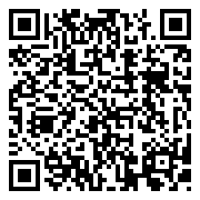

Evaluate this session
Scan this
QR code
to evaluate
this session.

Slide 53


© 2014 Microsoft Corporation. All rights reserved. Microsoft, Windows, and other product names are or may be registered trademarks and/or trademarks in the U.S. and/or other countries.
The information herein is for informational purposes only and represents the current view of Microsoft Corporation as of the date of this presentation. Because Microsoft must respond to changing market conditions, it should not be interpreted to be a commitment on the part of Microsoft, and Microsoft cannot guarantee the accuracy of any information provided after the date of this presentation. MICROSOFT MAKES NO WARRANTIES, EXPRESS, IMPLIED OR STATUTORY, AS TO THE INFORMATION IN THIS PRESENTATION.

