Slide 2
PowerShell Unplugged with Jeffrey Snover & Don Jones
DCIM-B318

Slide 3
My favorite Cmdlet?
PS> Get-Help

Slide 4
Keys to learning PowerShell
Learn how to learn
Get-Help & Update-Help
Get-Command & Show-Command
Get-Member & Show-Object
Get-PSDrive

Slide 5
Community Resources
http://PowerShell.org
The Scripting Games!
The PowerShell Summit (Europe and North America)!
Free PowerShell-related eBooks!
Friendly Q&A Forums!
TechLetter monthly newsletter!
TechSession monthly webinars!
Desired State Configuration (DSC) Hub!
Tons More!
Everything’s community-produced and community-owned!

Slide 6
For More Information
Windows Server
Windows Server 2012 R2
http://technet.microsoft.com/en-US/evalcenter/dn205286
System Center
System Center 2012 R2
http://technet.microsoft.com/en-US/evalcenter/dn205295
Azure Pack
Azure Pack
http://www.microsoft.com/en-us/server-cloud/products/windows-azure-pack
Microsoft Azure
Microsoft Azure
http://azure.microsoft.com/en-us/
Come Visit Us in the Microsoft Solutions Experience!
Look for Datacenter and Infrastructure Management TechExpo Level 1 Hall CD

Slide 7
Resources
Learning
Sessions on Demand
Microsoft Certification & Training Resources
http://channel9.msdn.com/Events/TechEd
www.microsoft.com/learning
TechNet
msdn
Resources for IT Professionals
Resources for Developers
http://microsoft.com/technet
http://microsoft.com/msdn

Slide 8
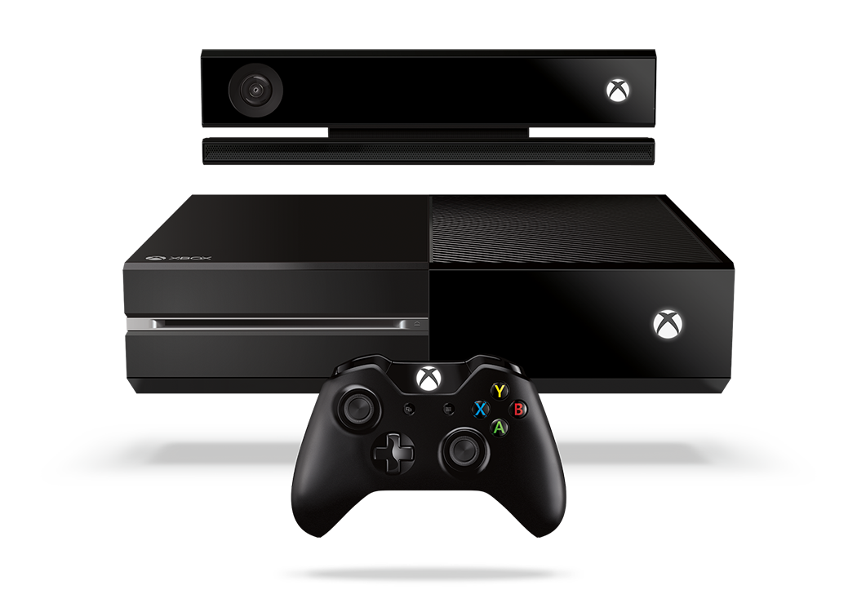
Complete an evaluation and enter to win!

Slide 9
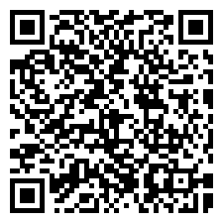
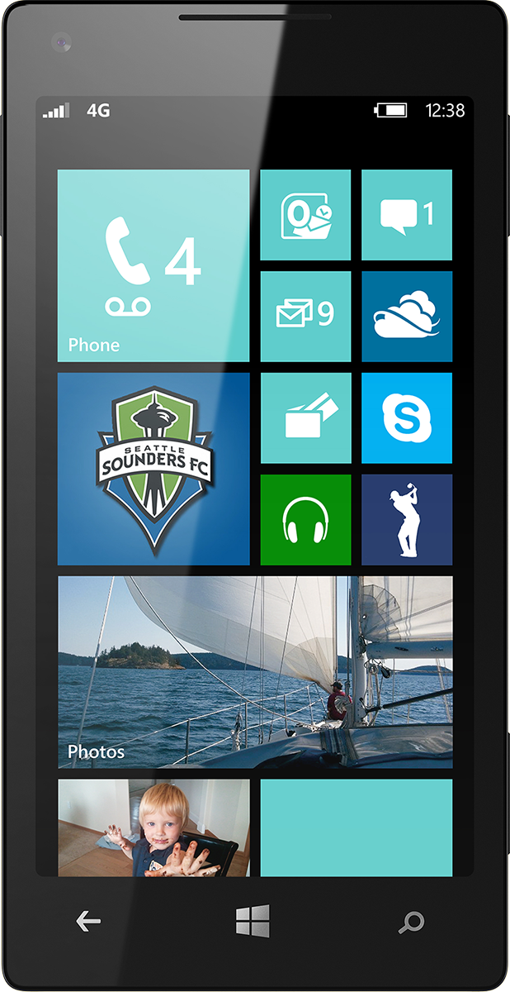
Evaluate this session
Scan this QR code to evaluate this session.

Slide 10
© 2014 Microsoft Corporation. All rights reserved. Microsoft, Windows, and other product names are or may be registered trademarks and/or trademarks in the U.S. and/or other countries.
The information herein is for informational purposes only and represents the current view of Microsoft Corporation as of the date of this presentation. Because Microsoft must respond to changing market conditions, it should not be interpreted to be a commitment on the part of Microsoft, and Microsoft cannot guarantee the accuracy of any information provided after the date of this presentation. MICROSOFT MAKES NO WARRANTIES, EXPRESS, IMPLIED OR STATUTORY, AS TO THE INFORMATION IN THIS PRESENTATION.

