Slide 1


Slide 2
Building a Real-World Hybrid Cloud with Seamless Application Portability
DCIM-B323
Rakesh Malhotra
Michael Apprenda

Slide 3
Why Hybrid Cloud?
Provide your customers with the best service
  Sometimes you provide it directly
  Sometimes you serve as a broker to a third party (i.e. public cloud)
Use the best service delivery vehicle
  Based upon business requirements and cost
It’s not about migration
  Think of public cloud as a logical extension and feature of your private cloud

Slide 4
Why Hybrid Cloud is Hard
Reconcile existing investments with future strategy
Requires alignment across many operational IT silos
Requires buy-in from app owners and business units
There are many moving technical parts
VM mobility doesn’t always “just work”

Slide 5
Current State of Enterprise IT
Ops has become very good at spinning up VMs fast
  Allows rapid deployment across public and private form factors
  Dramatically improved overall agility and h/w utilization
  Works with nearly any type of application
However….

Slide 6
“When all you have is a hammer, everything looks like IT infrastructure”

Slide 7
VMs Aren’t Perfect
VM sprawl is a real issue
  Average VM utilization hovers around 20%
A VM as a unit of management is cumbersome
  For scaling, migration, chargeback, deployment etc.
Simply running your VMs on somebody else’s servers shouldn’t be the end goal

Slide 8
Cloud is about moving to a shared, application centric service model

Slide 9
It’s All About the Apps
Infrastructure economics will continuously improve
  Position yourself to take advantage of this trend!
Abstract apps and app owners from infrastructure
  It enables flexibility and efficiency for IT
  It puts the focus on application delivery, not servers

Slide 10
Key Requirements for Hybrid Cloud
Integrated management
  Includes policy, security, capacity planning etc.
Works for new and existing apps
  No re-writes!
Seamless portability
  Easily move applications between infrastructure and clouds
Seamless user experience
  For both application owners and IT operations

Slide 11
Apprenda
Apprenda is a software layer that enables any organization to transform existing datacenter assets and public cloud infrastructure into a self-service PaaS cloud for .NET and Java. Apprenda drives order of magnitude improvements in infrastructure utilization, developer productivity, organizational agility and governance

Slide 12
Enterprise Hybrid Application Platform
Application Layer
Apprenda Platform
Platform Layer
ENHANCED: .NET CLR • JAVA • TOMCAT • IIS • SQL SERVER/ORACLE
Windows / Linux
Infrastructure Layer
PRIVATE
HYBRID
PUBLIC
i.e. Hyper-V, Bare Metal
i.e. Azure IaaS

Slide 13


















Apprenda/Azure Implementation
Private/Public Cloud Services Ecosystem
Federation
END USERS
Apprenda Provides
App Store
Authentication/Authorization
You Provide
Account Portal
App Store APIs
Fault Detection
Logging and Auditing
RBAC
Tenant Mgmt
ALM
Windows Azure Pack
Dynamic Scaling
Multi-Tenacy
Billing
Metering
Policy Engine
Dev Portal / CLI/API
Custom Add-on
Add-on System
Plug-ins
(Change Databases, Approval Systems, etc.)
DEVELOPERS
Ops Portal
Hybrid Cloud Placement Policy Engine
IT STAFF/OPERATIONS
Other Infrastructure
(Windows and/or Linux)
Public/Private
Virtual/Physical
Your Datacenter
Windows Azure

Slide 14
Apprenda/Azure Solution Benefits
Agility
Developer productivity
Infrastructure efficiency
Operations overhead
Complexity
2,000x faster!
Deploy apps in minutes, not months and seamlessly move between private/public infrastructure
Eliminate 20+% of developer tasks
Apprenda simplifies “cloud enabling” application architectures and simplifies onboarding existing applications
Save 50% on operating costs, realize a 5x-10x boost in utilization
Run your datacenter like a world class cloud provider
Up to 90% reduction in costs associated with application deployment, updates, and maintenance
Simplify and standardize
Reduce VM and OS sprawl (cut licensing costs by 50%+), standardize architecture patterns
Move beyond server virtualization
11

Slide 15
Demo
Apprenda + Microsoft Hybrid Cloud

Slide 16
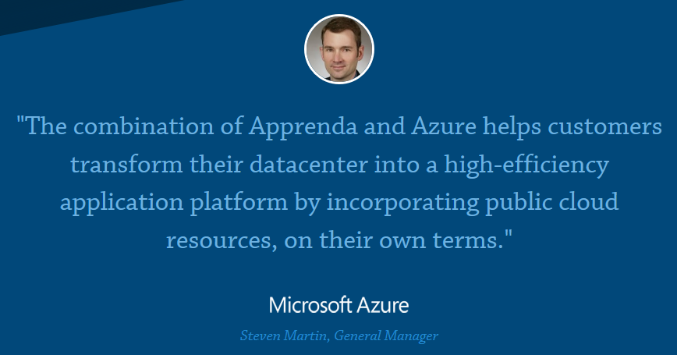
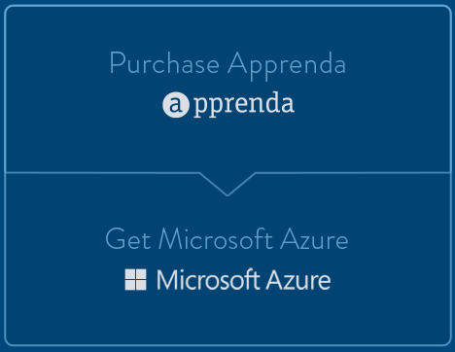
INTRODUCING APPRENDA ONECLOUD WITH MICROSOFT AZURE
The Industry’s First Turnkey Hybrid Cloud Solution
Microsoft & Apprenda
GTM
APPRENDA INCLUDES AZURE LICENSES
Azure Licenses at no additional cost
AZURE
DEPLOYMENT
$15K Per Customer
http://apprenda.com/lp/onecloudms/

Slide 17
Questions?

Slide 18
Related content
Come see me and Apprenda at Booth 301!

Slide 19

For More Information
Windows Server
Windows Server 2012 R2
http://technet.microsoft.com/en-US/evalcenter/dn205286
System Center
System Center 2012 R2
http://technet.microsoft.com/en-US/evalcenter/dn205295
Azure Pack
Azure Pack
  http://www.microsoft.com/en-us/server-cloud/products/windows-azure-pack
Microsoft Azure
Microsoft Azure
  http://azure.microsoft.com/en-us/
  Come Visit Us in the Microsoft Solutions Experience!
  Look for Datacenter and Infrastructure Management
  TechExpo Level 1 Hall CD

Slide 20

Resources
Learning
  Sessions on Demand
  Microsoft Certification & Training Resources
http://channel9.msdn.com/Events/TechEd
www.microsoft.com/learning
TechNet
msdn
  Resources for IT Professionals
  Resources for Developers
http://microsoft.com/technet
http://microsoft.com/msdn

Slide 21



Complete an evaluation and enter to win!

Slide 22


Evaluate this session
Scan this
QR code
to evaluate
this session.

Slide 23


© 2014 Microsoft Corporation. All rights reserved. Microsoft, Windows, and other product names are or may be registered trademarks and/or trademarks in the U.S. and/or other countries.
The information herein is for informational purposes only and represents the current view of Microsoft Corporation as of the date of this presentation. Because Microsoft must respond to changing market conditions, it should not be interpreted to be a commitment on the part of Microsoft, and Microsoft cannot guarantee the accuracy of any information provided after the date of this presentation. MICROSOFT MAKES NO WARRANTIES, EXPRESS, IMPLIED OR STATUTORY, AS TO THE INFORMATION IN THIS PRESENTATION.

