Slide 1
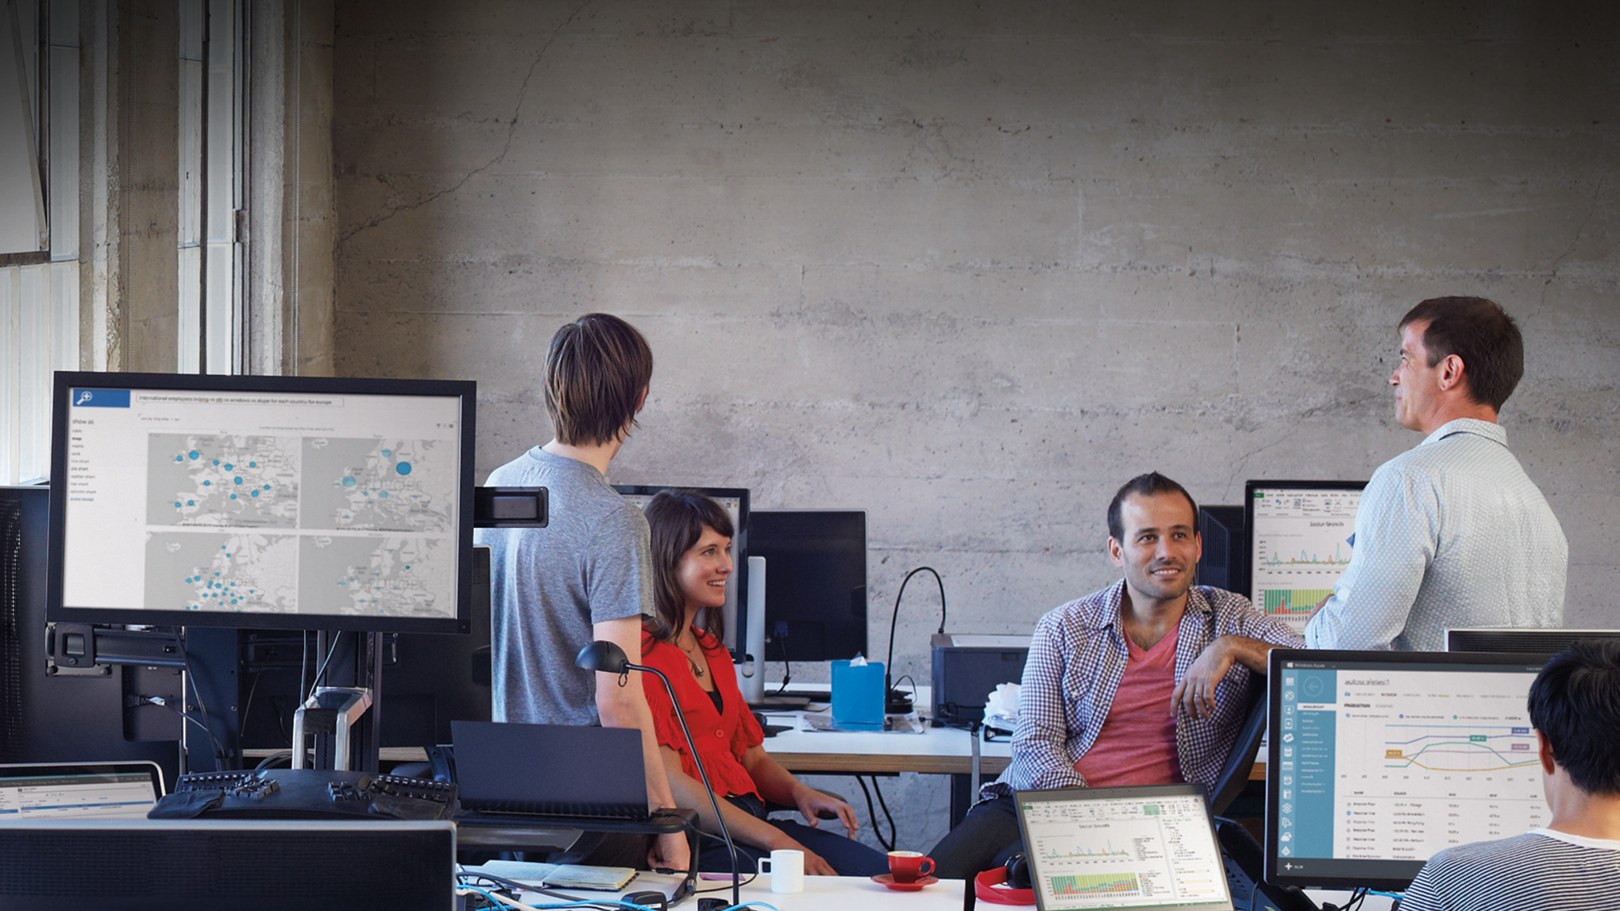

Slide 2

Cluster-in-a-Box Using Windows Server 2012 R2: Solutions and Applications
DCIM-B327
John Loveall
Principal Program Manager

Slide 3
Topics
The Cluster in a Box (CiB) Strategy
  Bringing Continuous Availability to the volume market
New CiB Solutions
  New generations of hardware and new product offerings
CiB Customer Applications
  Examples of businesses using CiB solutions
Scaling Windows Server Storage to the Datacenter
  Beyond Cluster in a Box

Slide 4
The Cluster in a Box (CiB) Strategy
Bringing Continuous Availability to the volume market

Slide 5
Availability: From storage to the cloud
HA Storage
2-node Cluster OOBE
Windows Storage Server 2008 R2
CA Server & Storage
CA SMB3 and NFS
Clustered DAS
Windows Server & Windows Storage Server 2012
Cluster in a Box (CiB)
Released systems from Dell, HP, Fujitsu, Quanta, DataON, XIO, Wiwynn
CiB Next-Gen
4-node Cluster OOBE
Storage Spaces Parity, Tiering
Windows Server & Windows Storage Server 2012 R2
Storage availability
Server + storage continuous availability
Volume platform for availability
Next-gen ready for the datacenter / hoster
Work continues!

Slide 6
Availability Matters …
Why now?
What customers want
Server virtualization
Server consolidation
User expectations
Keep my data safe
Keep my services running
Keep my business running
SLA (Service Level Agreement)

Slide 7
What is Continuous Availability (CA)?
Continuously available software and hardware platforms are designed to support transparent failover without data loss
Transparent failover
is ability to survive planned
moves or unplanned failures –
without errors,
without losing data, and
while performing well at scale

Slide 8
Extending the market for Continuous Availability
New systems expand choices of cost and features
Features
Existing markets
High Availability
Simple OOBE
Storage Spaces configurations
HW RAID capability
SSD perf capability
Market expansion with CiB
Scale out Server Cluster
Cluster in a Box
Storage Arrays
(iSCSI/FC, SMB/NFS)
Optional JBOD
storage expansion
Extended scale out
Advanced replication
Advanced power management
Advanced performance options
…
Target markets for Cluster in a Box solutions
SMB
Branch
Private Cloud
Small to medium hosters
Single node servers
JBOD storage
$$
IT
Expertise
IT Generalist
IT Specialist
PB 1 - 3
PB 4+

Slide 9


What hardware?
What are the hardware design goals for CA?
What are the best system configurations?
Availability: Service and data remain available despite the failure and repair of any single component
Simplicity: Pre-configured, pre-cabled
Flexibility: Hardware expansion, placement, power
How can standard servers and direct-attached storage be used to build economical, high-availability systems?
How can systems be designed and prepared for fast, simple deployment?

Slide 10
System Design Considerations for Continuous Availability
2-node Design Example (with Direct-Attached SAS)
Availability
At least one node and storage always available, despite failure or replacement of any component
Dual power domains
1/10G E or Infiniband
1/10G E or Infiniband
Network
Network
Server Enclosure
x8 PCIe
x8 PCIe
Server A
Server B
CPU
1/10G Ethernet cluster
connect (through midplane)
CPU
x8 PCIe
x8 PCIe
Simplicity
Pre-wired, internal interconnects between nodes, controllers, and storage
Storage Controller
x4 SAS (through midplane)
Storage Controller
x4 SAS
x4 SAS
SAS Expander
0
1
23
B ports
SAS Expander
A ports
…
Flexibility
PCIe slots for flexible LAN options
External SAS ports for JBOD expansion
Office-level power, cooling, and acoustics
to fit under a desk
External JBOD
SAS Expander
1
B ports
SAS Expander
0
…
23
A ports
Additional JBODs …

Slide 11
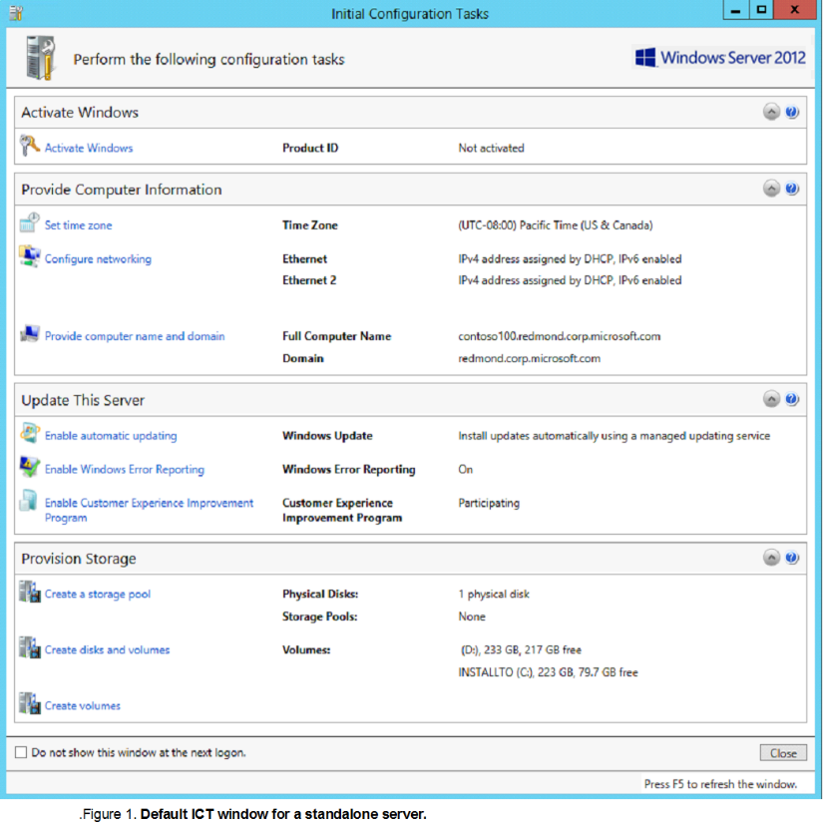
Out of Box Experience (OOBE)
Easy setup of Cluster in a Box systems
Fast
  ~10-40 minutes from power-on to operation
Simple
  Minimal steps with guided workflow
Single console
  Configure CiB’s from only one node
Extensible
  Customization framework enables unique OEM tasks that can include proprietary tools.

Slide 12
New CiB Solutions
New generations of hardware and new product offerings

Slide 13
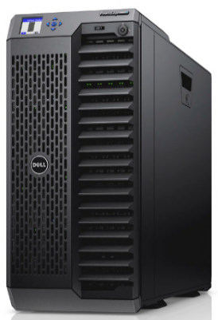
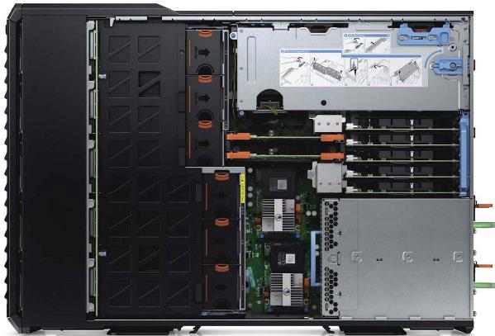
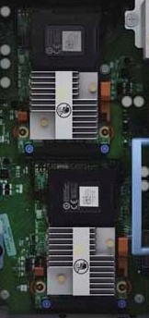
Dell PowerEdge VRTX
Shipping optional redundant PowerEdge Raid Controller (PERC)
  Provides fault tolerance within the chassis
  Active-Passive configuration
    If the Active PERC fails, the Passive PERC will become Active with no user intervention
    At TechEd TechExpo
    Booth 1601
Dell PowerEdge VRTX
4-node Windows Server Cluster in a Box
Office level acoustics and power

Slide 14
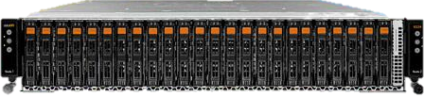
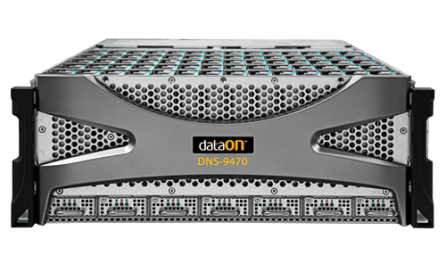
DataON
Announcing new CiB solutions at TechEd 2014
CiB-9224 Cluster-in-a-Box
  2U, 24-bay 2.5” Dual Node
  Next-generation Intel Xeon platform
  12Gb/s SAS
CiB-9740v2 Cluster-in-a-Box
  4U 70-bay 3.5” Dual Node
  12Gb/s SAS
  420TB capacity in a 4U (with supported 6TB drives)
DataON Management Utility Setup Tool (MUST™)
OOBE setup wizard
Storage/hardware status monitoring, event logs, alert notification
Chassis management
Performance engine for whole CiB environment tuning
    At TechEd TechExpo
    Booth 1727

Slide 15
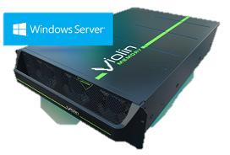
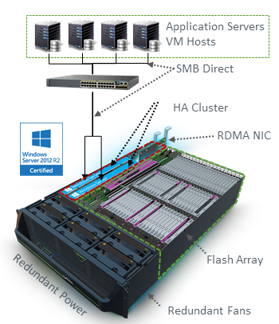
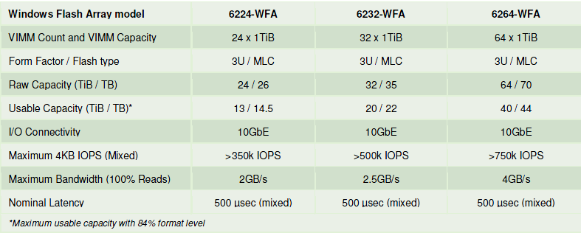
Violin Memory
Shipping Windows Flash Array (WFA)
Windows Storage Server 2012 R2
Dual compute nodes (memory gateways)
  Each compute node has:
  Two Intel Xeon E5-2448L processors (8 cores, 20MB L3 cache)
  24GB of memory (upgradeable to 48GB)
Storage
  Violin Intelligent Memory Modules (VIMMs)
RDMA NIC options
  Chelsio T-520CR Dual-Port 10 Gigabit Ethernet adapters
  Mellanox ConnectX-3 Dual-Port VPI adapters (MCX354A-FCBT), 56Gb/s Infiniband or 40/56 Gigabit Ethernet per port
    At TechEd TechExpo
    Booth 135

Slide 16
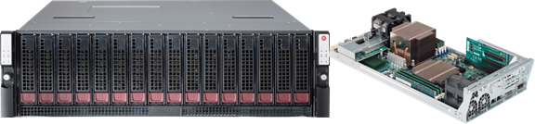
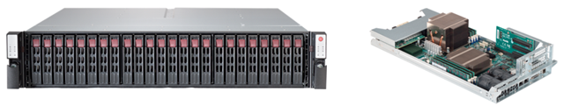
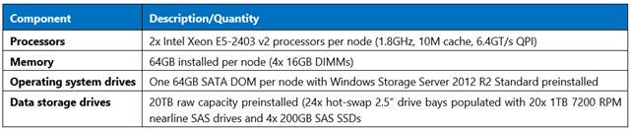
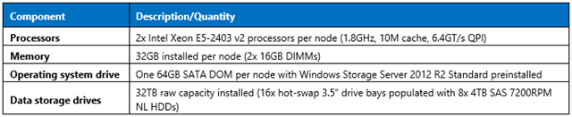
SuperMicro
Shipping two new Windows Storage Server 2012 R2 CiB storage solutions
Capacity: SSG-6037B-CIB032
3U, 16-bay, supports 16x 3.5" hot-swap drives (SAS1/SAS2) Raw capacity of 64 terabytes (TB) when fully populated with 4TB 3.5” SAS drives
Performance: SSG-2027B-CIB020H
2U, 24-bay, ships with 20x 1TB 2.5” hot-swap nearline SAS drives and 4x 200GB SAS SSDs.

Slide 17
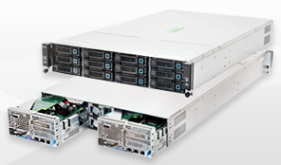
Quanta
Shipping upgraded Windows Storage Server 2012 R2 CiB
CB220
Windows Storage Server 2012 R2 Standard Edition
2U Chassis, 2 nodes
(2) Intel® Xeon® E5-2609 per node
(12) 2.5" or 3.5" SASII hot-plug HDDs per system
(2) 2.5" internal SATA for OS installation per node
Up to 48 TB (raw) internal capacity
(1) PCIe G3 x8 riser card for (1) PCIe slot and (1) Mezz slot
Value SKU
32 GB 1333MHz DDR3 RDIMM per node
Storage controller
  LSI SAS HBA 9211-8i
NICs:
  (2) Intel® I350 GbE RJ45 ports per node
Performance SKU
64 GB 1333MHz DDR3 RDIMM per node
Storage controller
  LSI Syncro CS
NICs:
  (2) Intel® I350 GbE RJ45 ports per node and (2) Intel® 10GbE SFP+ ports per node

Slide 18
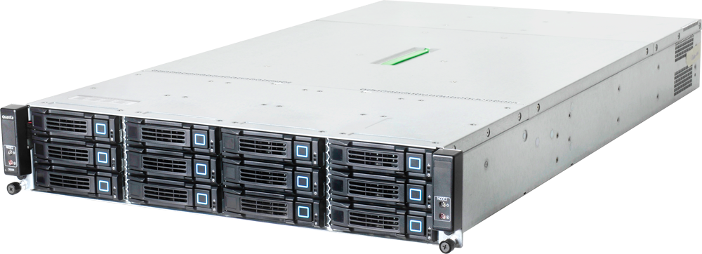
Tarox
Shipping Windows Server and Windows Storage Server 2012 R2 CiB solutions
TAROX ParX R2123i4 G4
2U dual node server:
2x Intel E5-2600v2 CPUs
LSI SAS HBA 9211-8i
up to 512GB DDR3 ECC RAM
up to two internal SSD for OS
up to 96TB of internal storage capacity
two internal 10GBit Ethernet NICs
IPMI KVM over IP
Intel Neteffect Adapter (RDMA support for SMB3.0)

Slide 19
CiB Customer Applications
Examples of businesses using CiB solutions

Slide 20




Case 1: Virtualization server
Getting things under control
Biotech – Aaron Marks (DataON)
Customer
  Biotech company (Seattle-based, publically traded) creating oncology products that improve the lives and outcomes of cancer patients.
  Focus on therapeutic candidates aimed at targeting cancer in specific/effective ways
  Pipeline includes synthetic vaccines for a variety of cancer indications
IT Provider
Aaron Marks IT Consulting,
IT services and solution provider
Problem
Current production servers aging, ranging in age from 4-10 years old
Need for modernization and infrastructure restructuring
Upgrades needed for performance, security, compliance, and to enable the implementation of new technology solutions.

Slide 21
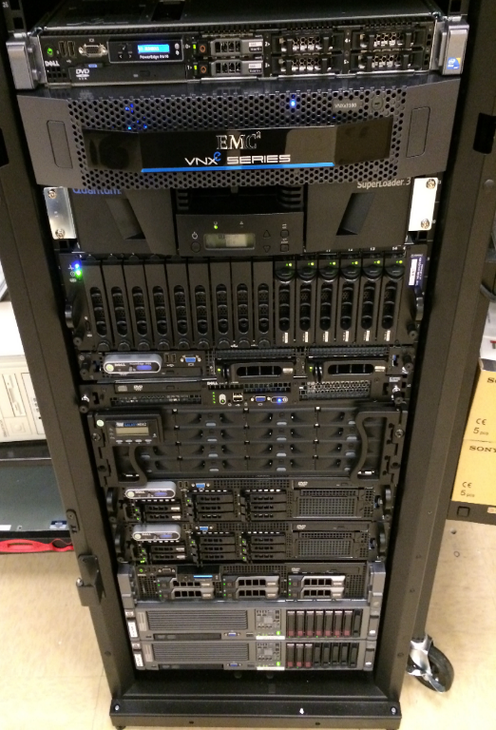
Biotech – Aaron Marks (DataON)
Workloads
Virtualized
AD FS 2.0 Proxy Server
AD Server – Tertiary (DC/GC/DNS)
Azure Active Directory (AAD) Sync + AD FS 2.0
BES 5 Server (Windows Server 2008)
CentOS Linux: Asterisk Server for VoIP conference phones
Exchange 2013 Hybrid Coexistence Server
Linux: VMware vCenter 4.1 Server
Management Server (RSAT + Other Tools)
Server 2008 R2 SSTP/PPTP VPN + ‘Remote Desktop Gateway’ Server
SharePoint 2007 Server
SharePoint 2010 Server
SharePoint 2013 Server
SQL Server 2008 R2 Standard
Ubuntu Linux: Clinical MySQL Database
Ubuntu Linux: Lab backups
Ubuntu Linux: Lab Freezer Monitoring
Ubuntu Linux: Lab MySQL Database
Physical
AD (DC/GC, DHCP)
AD (DC/GC, NPS, AD CS)
BackupExec 2010 R3
ERP application
ERP Terminal Server
Exchange 2007 Server
File servers (2)
Print server
SQL Server 2005 Standard (ERP SQL)
Previous hardware
Virtualization servers, vSphere 4.1 (2)
Dell R610, 64GB RAM, RAID1 146GB 15k SAS, 8x1GbE
Dell R620, 64GB RAM, RAID1 146GB 15k SAS, 8x1GbE,
Physical Servers (9)
Dell PowerEdge 2950, 16GB, 3x73GB 10k SAS, 4x1GbE
Dell PowerEdge 2950, 16GB, 3x73GB 10k SAS, 4x1GbE
Dell PowerEdge 1950, 16GB, 250GB (7.2k SATA), 2x1GbE
Dell R200, 4GB, 2x 160GB, 2x 1GbE
Dell R200, 4GB, 160GB (2x 160GB 7.2k SATA), 2x 1GbE
Dell R710, 4GB, 5x500GB RAID5, 4x1GbE
HP, 16GB, 3x RAID1 73GB SAS, 4x1GbE
HP, 16GB, 1x RAID1 73GB SAS, 4x1GbE
HP, 16GB, 1x RAID1 73GB SAS, 4x1GbE
Storage (3)
Dell MD3000 SAS DAS, 5TB (6x1TB 3.5” 7.2k RAID5)
EMC VNXe iSCSI SAN, 10TB (12x1TB 3.5” 7.2K RAID6)
Fiber Channel DAS, 2.4TB (16x300GB 3.5” 15k RAID6)
Photo courtesy Aaron Marks IT Consulting

Slide 22

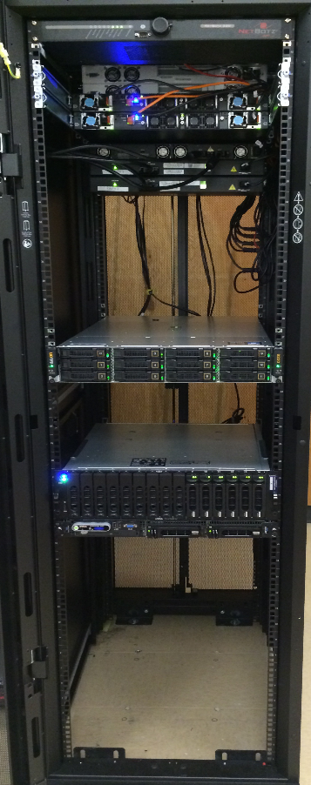
Biotech – Aaron Marks (DataON)
CiB solution
Workloads
All workloads running as Hyper-V VMs on CiB
  Windows Server 2012 R2 Datacenter
Servers + Storage
DataON CiB-9220V:
  Per node:
    256GB RAM, 128GB SSD SATA RAID1, 2x10GbE built-in + 2x10GbE SFP+
  Internal SAS JBOD:
    Storage Spaces Pool: 4x 200GB STEC SSD, 8x 4TB 7.2k SAS
      Storage Spaces Virtual Disks: 6TB Tiered Mirrored (primary VM storage), 4GB Mirrored (quorum), 8TB Parity (Local backup storage),
      Clustered Volumes: 6TB ReFS CSV for VMs, 4GB NTFS Quorum, 8TB ReFS CSV for Backups
Photo courtesy Aaron Marks IT Consulting

Slide 23
Results
✓ SOX compliance
  Compliance report reduced from 150 pages (2013) to 30 pages (2014 Q1)
  System Center DPM-based backup, self-contained in the CiB, solved all backup reporting and auditing problems.
  Change Management is vastly simplified by the new CiB, from check-pointing production systems, cloning systems to test changes, performing rollbacks from Hyper-V checkpoints or DPM backups.
  “Fully compliant change management has gone from being almost impossible to an afterthought.”
✓ Performance
  24 virtual machines running with up to 30 tested on CiB in production without any performance issues
  “Storage Spaces SSD auto-tiering in new CiB more than met the client’s IO needs”
  “The 256GB per-node in the CiB has allowed us to have up to 128GB of VMs running at any given time so that the entire environment can fail-over to a single node”
✓ Backup / DR
  “Licensing … Windows Server and the entire System Center suite, the client was able to back up their environment to a VM DPM server (located on the CiB) which is then backed-up off-site over a site-to-site VPN by a secondary/collocated DPM server.”
✓ Storage
  “Mirrored and Tiered Storage Spaces performance is awesome. The SSD tiering has exceeded our IO requirements meaning that we now have a solid foundation for the entire virtualization environment.”
✓ Future expansion
  “Adding a server now is as easy as duplicating our Library base VMs out of System Center Virtual Machine Manager. We can now create a new VM and have it up and running with VMM in under 2 minutes.”
Biotech – Aaron Marks (DataON)

Slide 24
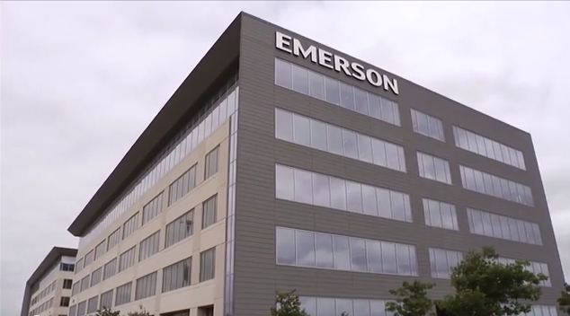

Case 2: Virtualization server
Keep it simple
Emerson (Dell)
Customer
Emerson Process Management
Global automation process and solution provider
Multi-industry, including oil & gas, power, food & beverage, pulp & paper, gas, pharmaceutical
Problem
Existing solution for Hyper-V virtualization cluster required:
12-16 hours to build
Significant IT expertise
½ rack footprint
Click to play case study video (courtesy Dell)

Slide 25
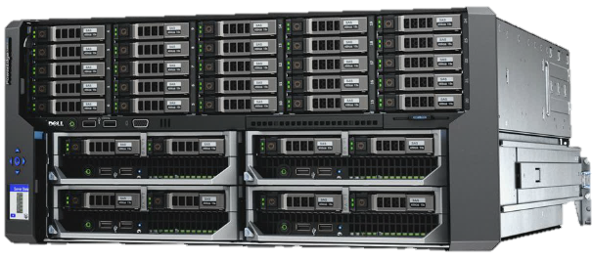
Emerson (Dell)
CiB solution & results
Servers
Dell PowerEdge VRTX
Results
“Within three hours we had a clustered, Hyper-V solution up and running.”
“With VRTX it really does come down to ease. It’s more ‘open and play’ as opposed to ‘open and build’.”
Form factor | Tower or 5U rack enclosure
Storage bays | Up to 12 x 3.5in NLSAS, SAS, or SAS SSD hot-plug drives (option 1)
 | Up to 25 x 2.5in NLSAS, SAS, or SAS SSD hot-plug drives (option 2)
Storage controllers | Single shared PERC8 with optional second redundant shared PERC8 available
Network | 1GbE internal switch module (standard) with 16 internal 1GbE ports and 8 external ports
PCIe expansion | 3 full-height/full-length slots (150W) with double-wide card support (225W) 5 low-profile/half-length slots (25W)
Power | 100V-240V auto-sensing redundant power supplies support 2+2 (AC redundancy), and 3+1 and 2+1 (power supply redundancy) modes

Slide 26
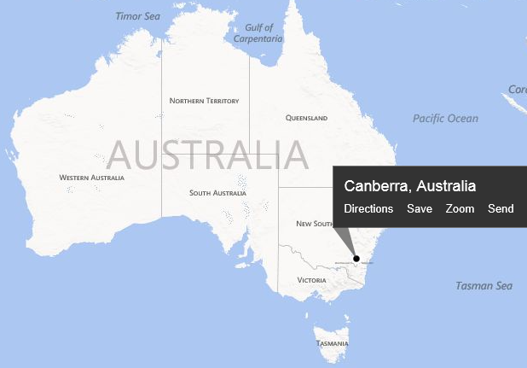
Case 3: Datacenter storage server
The need for speed
Australia DOD (Violin Memory)
Customer
Australia Department of Defense
  Canberra, Australia
  Base: HMAS Harman - Royal Australian Navy communication and logistics facility
Activities include communications, network operations, and information systems
Workloads
Monitoring/reporting on network performance, corporate and COTS applications and 94 software services
  110,000+ user network over 450 plus sites with over 550 data collection points
All processing needs to be completed within the allocated data load windows
  Software services: 5 minute window for data feeds from 200+ devices in 15 SQL instances
  BI: 15 minute data loads.
  Network performance and system analysis: data is loaded every 6 and 24 hours
Problems
Need for better server and storage consolidation
Increased performance
Desire to remove server layer between Hyper-V compute cluster and block storage (using SMB3 shared folders)

Slide 27
Australia DOD (Violin Memory)
Evaluation configuration
Compute servers
HP ProLiant DL580 Gen8
  15Core X4 socket, 120LP 256GB RAM, 4 Mellanox ConnectX-3 IPoIB Adapter
IBM System x3550 M4 Server
  24LP 64GB RAM, 4 Mellanox ConnectX-3 IPoIB Adapter
Storage
Violin Windows Flash Array V-6264
  2x 8-core Sandybridge CPU, 24GB DRAM per Memory Gateway, 44TB useable flash capacity, Windows Server 2012 R2
Configuration
LUN0 Quorum disk
LUN1 Scale Out File Server (SOFS) 1
LUN2 Scale Out File Server (SOFS) 2
IBM server mapped to SOFS 1 with 12 test files, 1 file per thread
    sqlio running 4k block, 12 Threads, 24 queue depth, 250 seconds, 10 second warm up
HP server mapped to SOFS 2 with 15 test files, affinity set to processors 0-15 on NUMA NODE 0
  sqlio running 4k block,15 threads, 64 Queue depth, 250 second test time, 10 second warm up

Slide 28
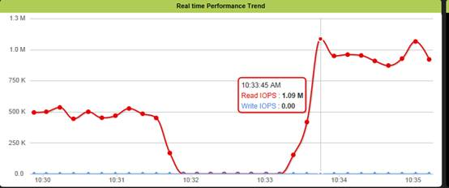
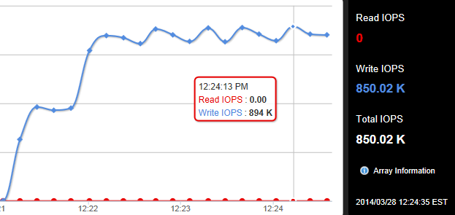
Australia DOD (Violin Memory)
Evaluation results
Read IOPS, Hyper-V config: 1.09M
Write IOPS, Hyper-V config: 894K
Conclusions & next steps
Met or exceeded all performance requirements
“This consolidated the storage requirements under one clustered storage array with all the benefits [Windows Storage Server 2012 R2] has to offer (SOFS, File server, vhdx Deduplication etc).”
“Within the virtual space utilizing SMB3 and RDMA we can now move all the system drives from the virtual server environment to Tier 2 HP storage allowing the WFA storage to be wholly used for the database drives.”

Slide 29
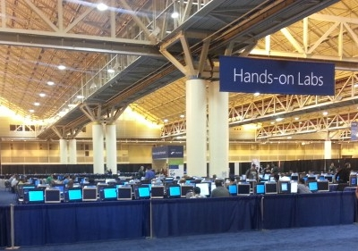
Case 4: TechEd Hands-On Labs (HOL) storage
10,000+ VMs a day, every day
TechEd HOL – holSystems (DataON)
Customer
TechEd 2014
TechEd North America is Microsoft’s premier technology conference for IT Professionals and Enterprise Developers
IT Provider
holSystems
Global provider of virtual machine platforms and management with a focus on training, demos, labs, and events
Workloads
For TechEd Hands-on Labs, deploy 3K to 4K labs per day
Requires 12K to 16K VMs
VMs need to deploy quickly and reliably
  Training VMs must deploy on-demand, yet only have a lifetime of about 45 minutes
Problems
Need less expensive, simpler storage solution
  Costs based on power, rack space, and administration
Need multiple, isolated fault domains to minimize impact of system failures

Slide 30
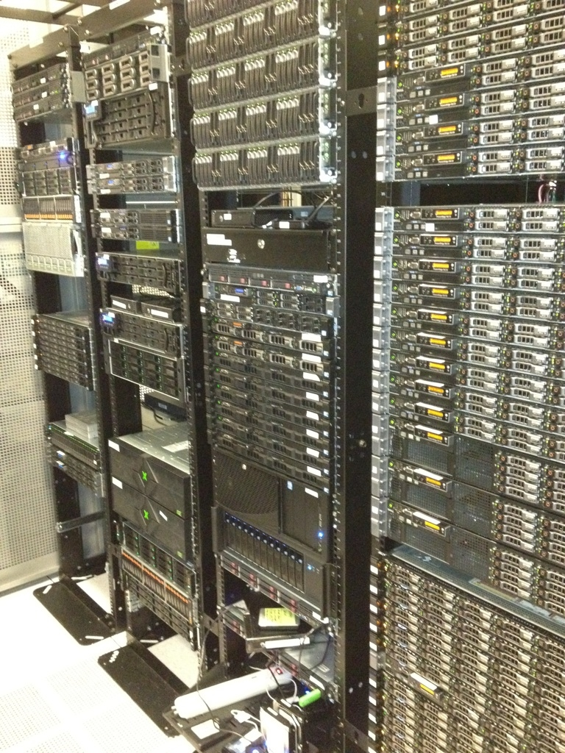
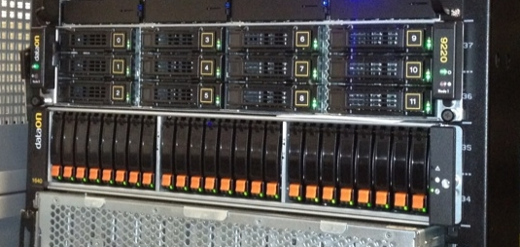
TechEd HOL – holSystems (DataON)
Existing Configuration
Discreet servers and external storage array
  Windows Server 2012, Windows Failover Cluster, Scale-Out File Server
  FibreChannel SAN storage
CiB solution
DataON CiB-9220 + JBOD (DNS-1640)
  CiB (hot tier)
    2U 12-bay Dual-Node cluster
    Per node: Dual Xeon E5-2620, 128GB, Dual 10GbE/s
    12 x SSD (hot tier) 400GB STEC SAS (4.8TB raw capacity)
  JBOD (cold tier)
    2u 24-bay JBOD
    24 x 10K SAS HDD 1.2TB (28.8TB raw capacity)
Results
“About as fast as FibreChannel but cheaper”
Deployed as multiple, small clusters to isolate fault domains
Windows Server Manager used for all deployment/configuration
“We used to rely on one expert that could do deployment. Now we can use two additional people.”
Photos courtesy holSystems

Slide 31
Case study information
Case 1: Getting things under control
Aaron Marks IT Consulting Case study info: Aaron Marks IT Consulting Case Study,, Contact: Aaron Marks, aaron@
DataON Trenton Baker, trentonb@
Case 2: Keep it simple
Dell www.Dell.com/PowerEdgeVRTX
Case 3: The need for speed
Violin Memory Joseph Slember, joe@
Case 4: 10,000+ VMs a day, every day
holSystems Corey Hines, corey.hynes@
DataON Trenton Baker, trentonb@
aaronmarks.com
areasys.com
vmem.com
holsystems.com
areasys.com

Slide 32
Scaling Windows Server Storage to the Datacenter
Beyond Cluster in a Box

Slide 33
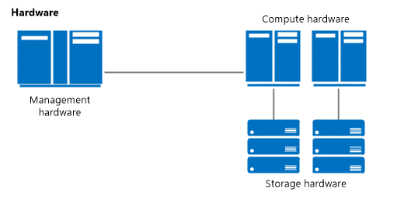
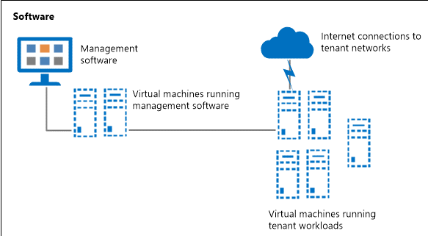
Designing a Windows Datacenter
What a datacenter solution needs
Converged / integrated hardware designs
Less expensive storage options
Simplified deployment and management tools
Scalability
Availability

Slide 34
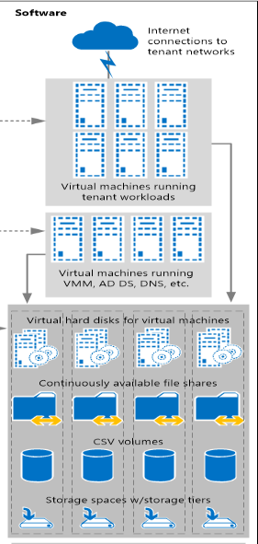
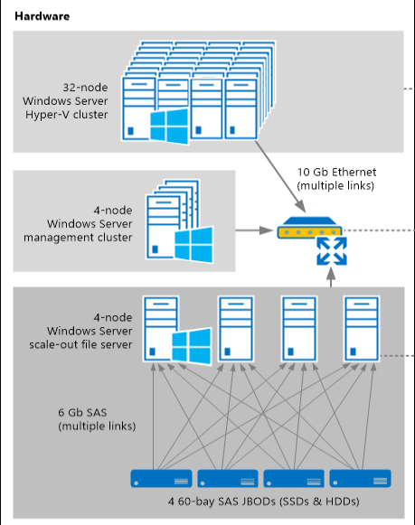
Scaling Storage
N+2 redundancy
  4-node storage cluster
  4 JBODs
  Enclosure-aware 3-way mirror or dual parity
Performance
  SSDs configured in tiered Storage Spaces
  RDMA-capable NICs
Many details
  Drive firmware
  Expander configuration
  Disk controller supported configs
  …

Slide 35
Availability: From storage to the cloud
HA Storage
2-node Cluster OOBE
Windows Storage Server 2008 R2
CA Server & Storage
CA SMB3 and NFS
Clustered DAS
Windows Server & Windows Storage Server 2012
Cluster in a Box (CiB)
Released systems from Dell, HP, Fujitsu, Quanta, DataON, XIO, Wiwynn
CiB Next-Gen
4-node Cluster OOBE
Storage Spaces Parity, Tiering
Windows Server & Windows Storage Server 2012 R2
Why isn’t your business highly available?
Storage availability
Server + storage continuous availability
Volume platform for availability
Next-gen ready for the datacenter / hoster

Slide 36
Related content
Key Breakout Sessions
  DCIM-B354: Failover Clustering: What's New in Windows Server 2012 R2 (5/13, 1:30PM-2:45PM)
  DCIM-B337: File Server Networking for a Private Cloud Storage Infrastructure in Windows Server 2012 R2 (5/13, 3:15PM-4:30PM)
  DCIM-B349: Software-Defined Storage in Windows Server 2012 R2 and Microsoft System Center 2012 R2 (5/14, 8:30AM-9:45AM)
  DCIM-B346: Best Practices for Deploying Tiered Storage Spaces in Windows Server 2012 R2 (5/14, 8:30AM-9:45AM)
Key Labs
  DCIM-IL308-R: Windows Server 2012 R2: Introduction to Failover Clustering with Hyper-V (5/13, 1:30PM-2:45PM)
  DCIM-IL200-R: Build Your Storage Infrastructure with Windows Server 2012 R2 (5/14, 5:00PM-6:15PM)
Tech Expo – visit the partner booths!

Slide 37
Related content, continued
Microsoft Solutions Experience Location (MSE)
  Datacenter and Infrastructure Management
Find Me Later At. . .
  MSE: Datacenter and Infrastructure Management
    Tuesday 10:45 – 12:30
    Wednesday 12:45 – 3:15

Slide 38

For More Information
Windows Server
Windows Server 2012 R2
http://technet.microsoft.com/en-US/evalcenter/dn205286
System Center
System Center 2012 R2
http://technet.microsoft.com/en-US/evalcenter/dn205295
Azure Pack
Azure Pack
  http://www.microsoft.com/en-us/server-cloud/products/windows-azure-pack
Microsoft Azure
Microsoft Azure
  http://azure.microsoft.com/en-us/
  Come Visit Us in the Microsoft Solutions Experience!
  Look for Datacenter and Infrastructure Management
  TechExpo Level 1 Hall CD

Slide 39

Resources
Learning
  Sessions on Demand
  Microsoft Certification & Training Resources
http://channel9.msdn.com/Events/TechEd
www.microsoft.com/learning
TechNet
msdn
  Resources for IT Professionals
  Resources for Developers
http://microsoft.com/technet
http://microsoft.com/msdn

Slide 40



Complete an evaluation and enter to win!

Slide 41


Evaluate this session
Scan this
QR code
to evaluate
this session.

Slide 42


© 2014 Microsoft Corporation. All rights reserved. Microsoft, Windows, and other product names are or may be registered trademarks and/or trademarks in the U.S. and/or other countries.
The information herein is for informational purposes only and represents the current view of Microsoft Corporation as of the date of this presentation. Because Microsoft must respond to changing market conditions, it should not be interpreted to be a commitment on the part of Microsoft, and Microsoft cannot guarantee the accuracy of any information provided after the date of this presentation. MICROSOFT MAKES NO WARRANTIES, EXPRESS, IMPLIED OR STATUTORY, AS TO THE INFORMATION IN THIS PRESENTATION.

