Slide 2
Building Highly Effective Dashboards in Microsoft System Center 2012 R2 Operations Manager
DCIM-B329
Ryan Benson
Charlie Satterfield

Slide 3
Agenda
OpsMgr Dashboards in Review
New Dashboard Widgets!
New Object State Dashboard!
Demos & Examples
New Widgets in Action
Q&A

Slide 4
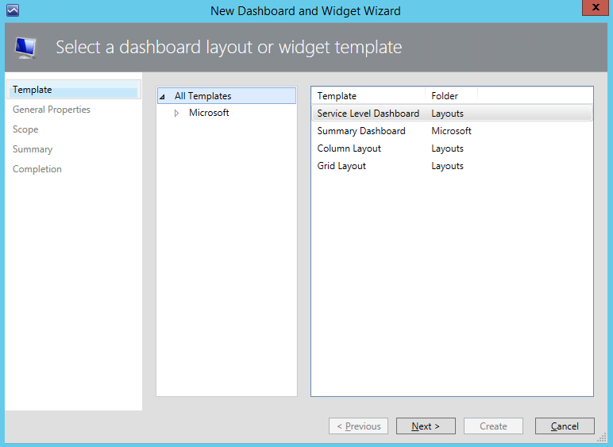
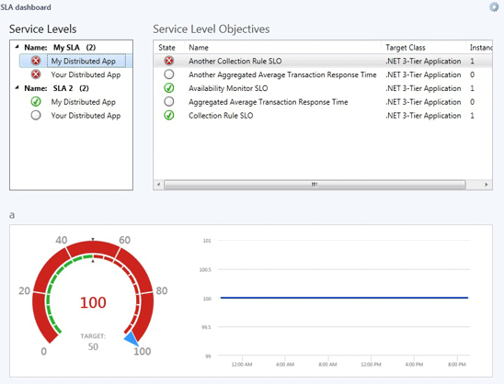
OpsMgr Dashboards
Introduced with OpsMgr 2012
Greatly simplified dashboard creation
Select a template
Select and customize widgets
Few template and widget types limited dashboard usefulness
We heard your feedback!

Slide 5
New Widgets Types!
Available in 2012 R2 UR2 & 2012 SP1 UR6
Defined Object Widgets
Topology Widget
Object Detail Tiles Widget
State Tiles Widget
SLA Tiles Widget
Image Widget
Object Health Widget
Contextual Widgets
Contextual Health Widget
Contextual Alert Widget
Extensibility Widgets
PowerShell Grid Widget
Web Browser Widget
PowerShell Web Browser Widget

Slide 6
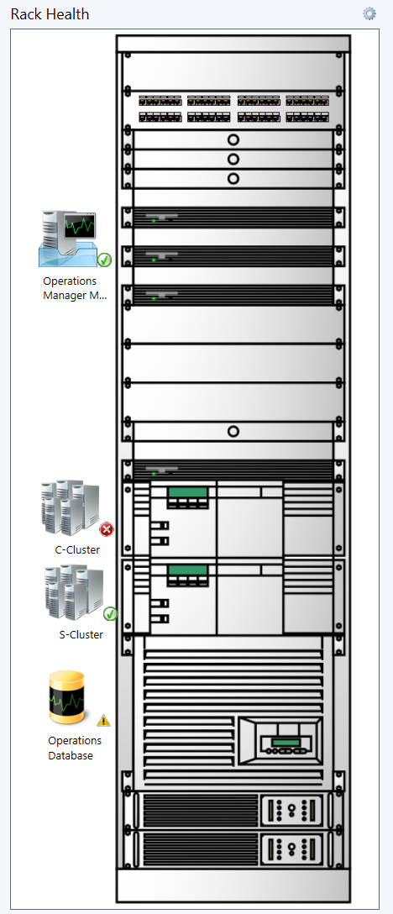
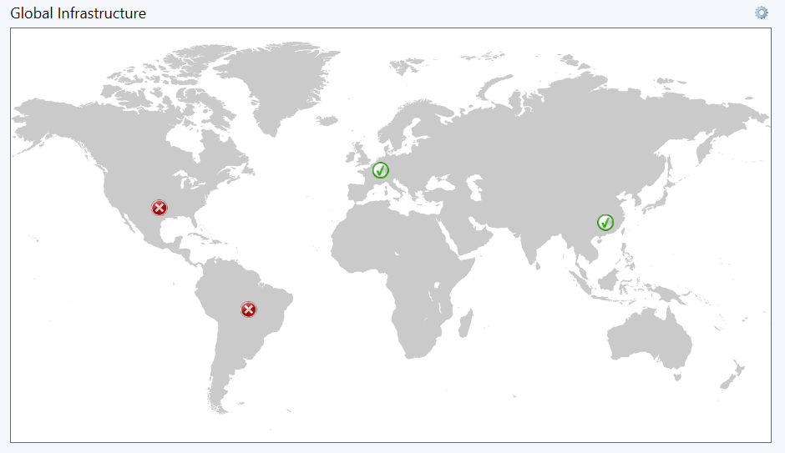
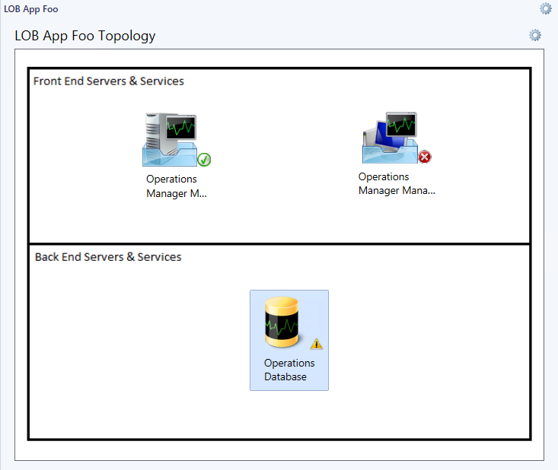
Topology Widget
Displays object health states with spatial context
Select objects to display
Select background image
Multiple size World map options
Select your own custom image
Pin objects to the desired location

Slide 7
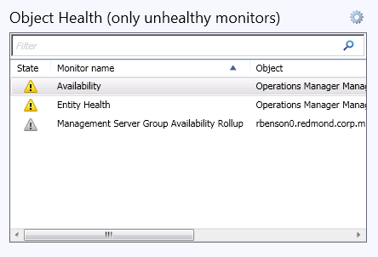
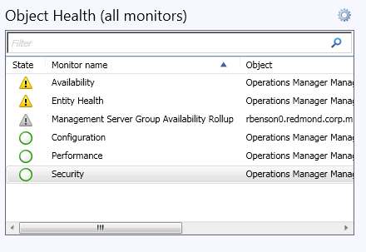
Object Health Widget
Display Monitor Health for specific group or object
Select a group or object
Filters on unhealthy monitors by default
Users can select to display all monitors

Slide 8
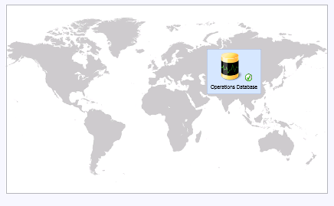
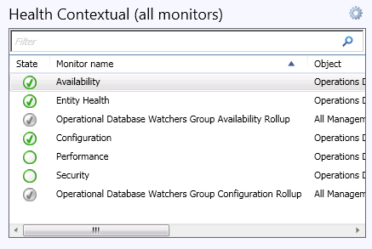
Contextual Health Widget
Display contextual Monitor Health for selected objects in other widgets
No configuration
Add to existing dashboard
Select an object in a different widget to display monitor health
Filters on unhealthy monitors by default
Users can select to display all monitors

Slide 9
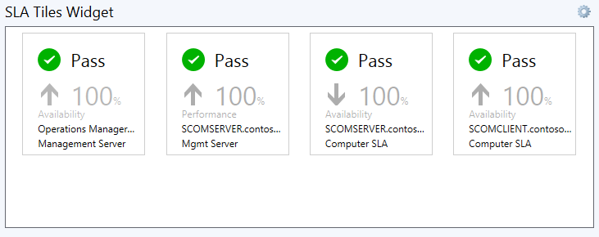
SLA Tiles Widget
Display multiple SLA tiles with status and %
Select time range
Select SLA

Slide 10
Demo
Global Infrastructure Health & SLA

Slide 11
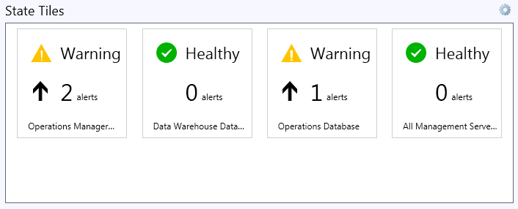
State Tiles Widget
Great for displaying health state and alert counts with trend
Select objects and groups to display
Select alert display criteria

Slide 12
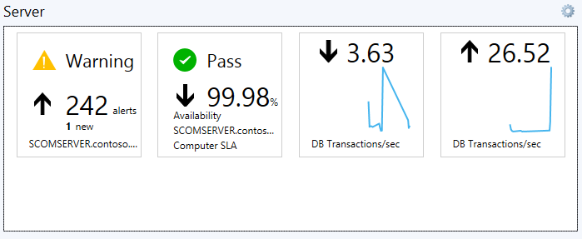
Object Detail Tiles Widget
Great for displaying multiple metrics for a selected property (health, alerts count, perf metrics, and SLA)
Select object or group to display
Select alert display criteria
Select desired performance counters
Select SLA

Slide 13
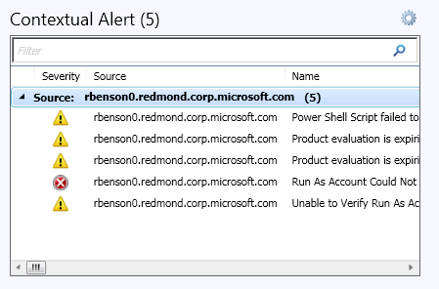
Contextual Alert Widget
Display contextual Alert list for selected objects in other widgets
Select alert display criteria (severity, priority, state)
Add to existing dashboard
Select an object in a different widget to display alerts

Slide 14
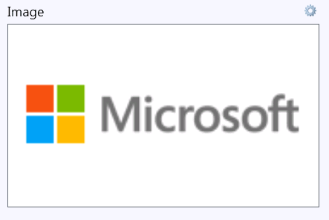
Image Widget
Display an image for dashboard branding
Select an image

Slide 15
Demo
Dashboard Montage

Slide 16
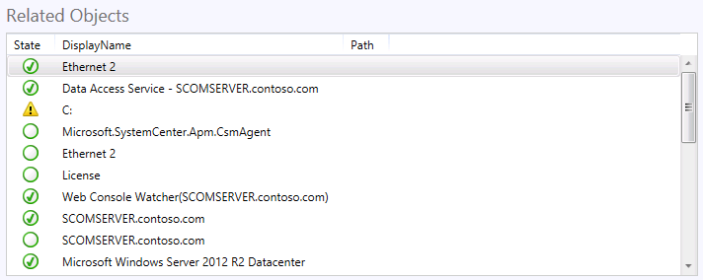
PowerShell Grid Widget
Display the result of a PowerShell script in a grid
Enter your PowerShell script
Data returned in grid format

Slide 17
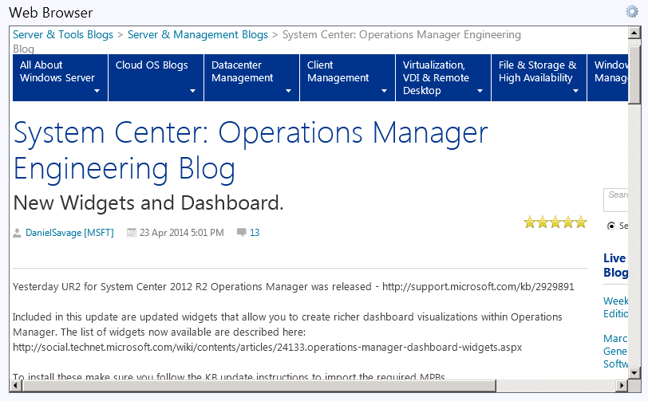
Web Browser Widget
Display a web page as a widget
Enter the destination URL
Select Management Group ID, Object ID and/or Alert ID as contextual query string parameters
Select an object in a different widget to change the query string

Slide 18
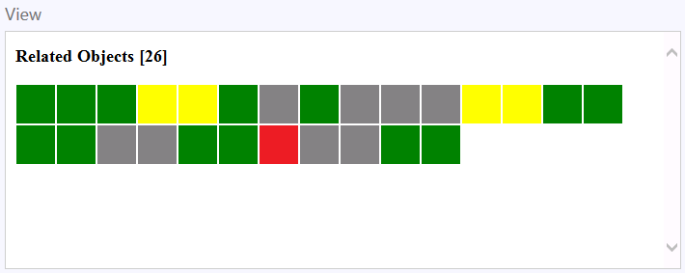
PowerShell Web Browser Widget
Extend beyond existing widget types
Display custom built or 3rd party web applications within your dashboard
Use PowerShell to form a web request containing Operations Manager data
The web page can interact with the console through JavaScript or navigation
Select an object or alert
Open the context menu
Open a dashboard
Execute console command
line arguments

Slide 19
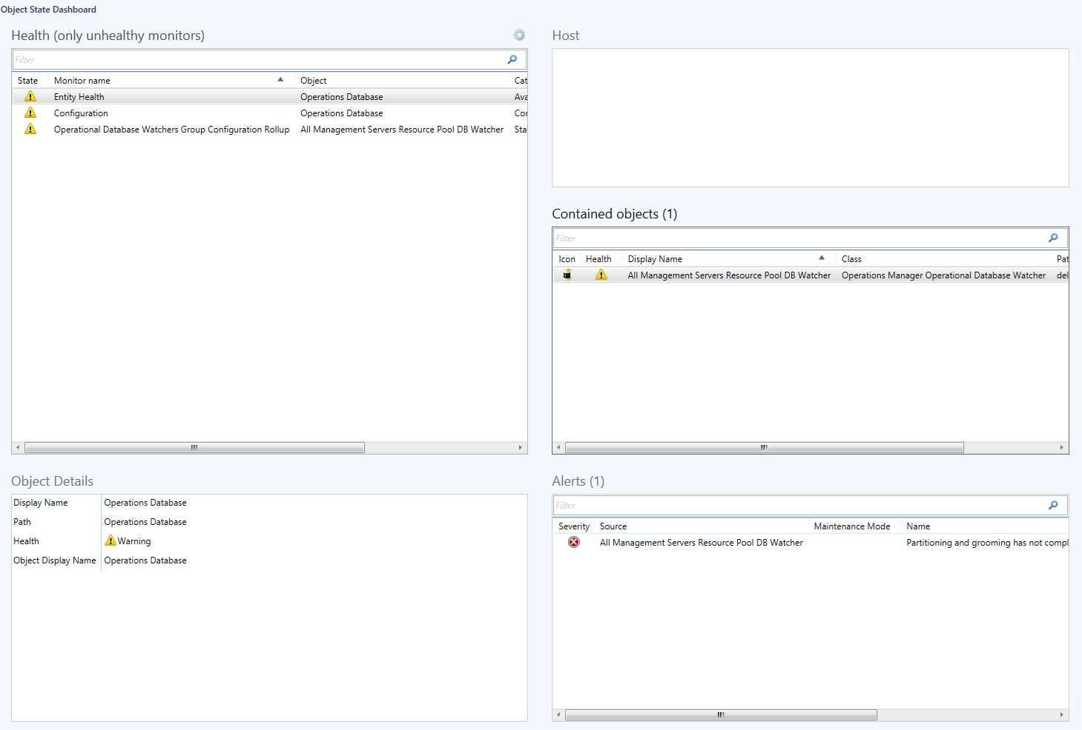
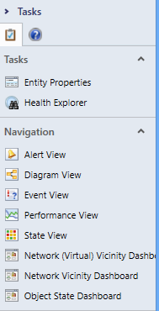
Object State Dashboard
A 360° view of an object

Slide 20
Demo
PowerShell Widgets in Action

Slide 21
Related content
Breakout Sessions
DCIM-B381 Overview and Enhancements in Microsoft System Center 2012 R2 Operations Manager
DCIM-B415 Microsoft System Center 2012 R2 Operations Manager: Mastering Historical Monitoring Data
DCIM-B419 Monitoring SQL Server with Microsoft System Center 2012 R2 Operations Manager
DCIM-B228 Effective Capacity Planning of Your Infrastructure Resources with Microsoft System Center 2012 R2 Operations Manager Reporting
DCIM-B369 Extending Microsoft System Center 2012 R2 Operations Manager
Labs
DCIM-IL309 Building Highly Effective Dashboards with Microsoft System Center 2012 R2 Operations Manager
DCIM-H310 Monitoring Your Datacenter with Microsoft System Center 2012 R2 Operations Manager
DCIM-H307 Microsoft System Center 2012 R2 Lab 2: Infrastructure Monitoring
Find Me Later At. . .
Data and Infrastructure Management Booth

Slide 22
For More Information
Windows Server
Windows Server 2012 R2
http://technet.microsoft.com/en-US/evalcenter/dn205286
System Center
System Center 2012 R2
http://technet.microsoft.com/en-US/evalcenter/dn205295
Azure Pack
Azure Pack
http://www.microsoft.com/en-us/server-cloud/products/windows-azure-pack
Microsoft Azure
Microsoft Azure
http://azure.microsoft.com/en-us/
Come Visit Us in the Microsoft Solutions Experience!
Look for Datacenter and Infrastructure Management TechExpo Level 1 Hall CD

Slide 23
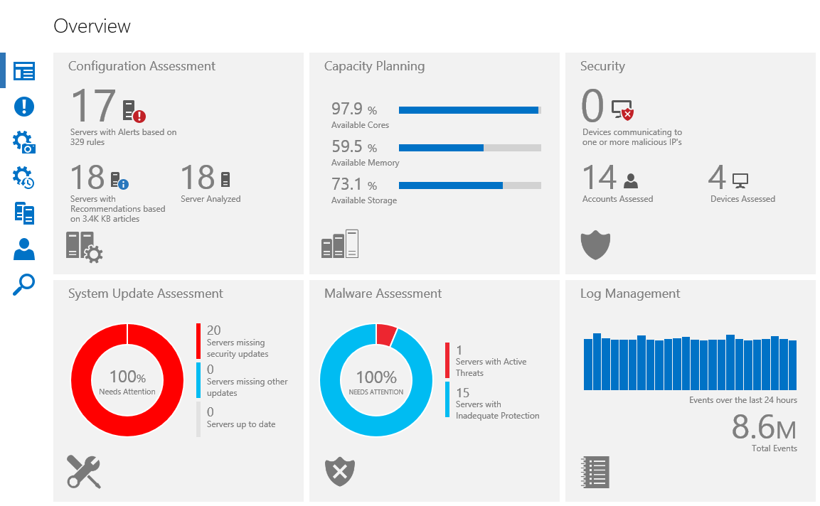
OpsMgr Customer Feedback Session
WHEN: MAY 14TH WEDNESDAY @ 5:00PM
WHERE: ROOM 335.B HILTON AMERICAS
WHAT: OPSMGR CUSTOMER-PRODUCT TEAM MEETUP
WHEN: MAY 15TH THURSDAY @ 1:00PM
WHERE: GRAND BALLROOM A
SESSION: DCIM-B369 Extending Opsmgr 2012 R2
WHAT: come see how the 'new' Advisor (Limited Preview) will change the way you investigate Operational Issues with new powerful search capabilities and intelligence.

Slide 24
Resources
Learning
Sessions on Demand
Microsoft Certification & Training Resources
http://channel9.msdn.com/Events/TechEd
www.microsoft.com/learning
TechNet
msdn
Resources for IT Professionals
Resources for Developers
http://microsoft.com/technet
http://microsoft.com/msdn

Slide 25
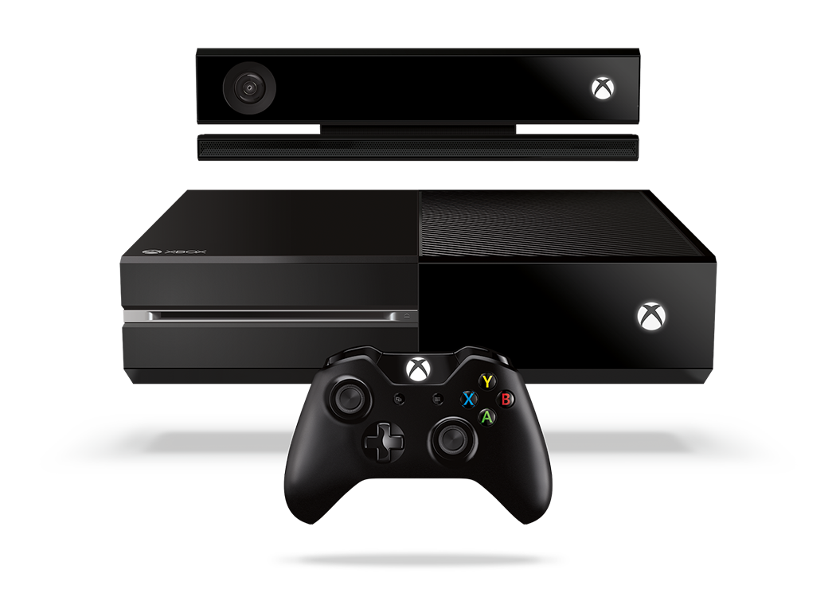
Complete an evaluation and enter to win!

Slide 26
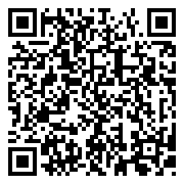
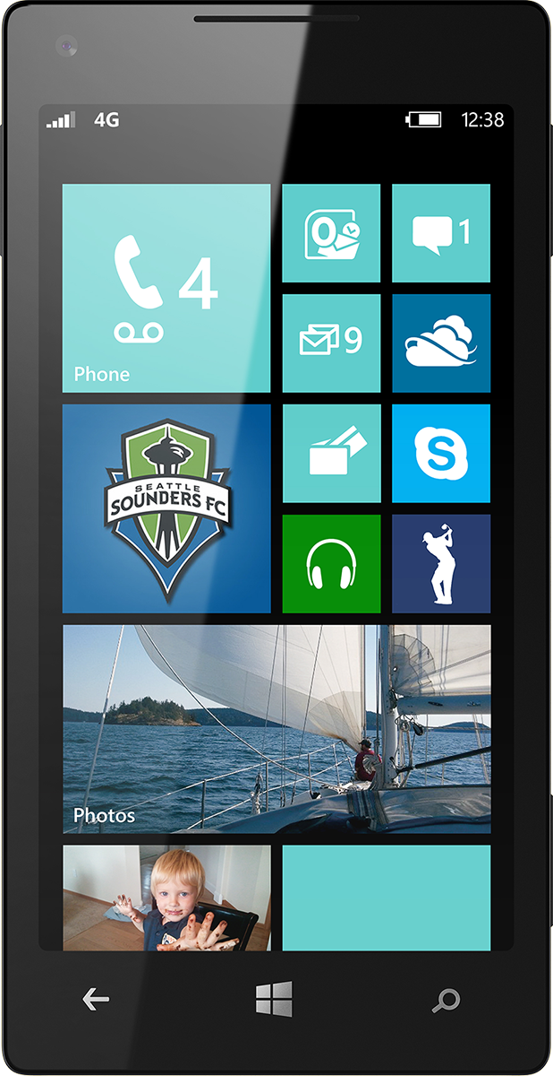
Evaluate this session
Scan this QR code to evaluate this session.

Slide 27
© 2014 Microsoft Corporation. All rights reserved. Microsoft, Windows, and other product names are or may be registered trademarks and/or trademarks in the U.S. and/or other countries.
The information herein is for informational purposes only and represents the current view of Microsoft Corporation as of the date of this presentation. Because Microsoft must respond to changing market conditions, it should not be interpreted to be a commitment on the part of Microsoft, and Microsoft cannot guarantee the accuracy of any information provided after the date of this presentation. MICROSOFT MAKES NO WARRANTIES, EXPRESS, IMPLIED OR STATUTORY, AS TO THE INFORMATION IN THIS PRESENTATION.

