Slide 2
Best Practices Integrating On-Premise Datacenters with Azure IaaS
DCIM-B330
Rand Morimoto, Ph.D., MVP
Chris Amaris, MCITP, CISSP

Slide 3
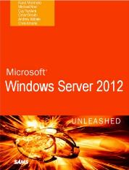
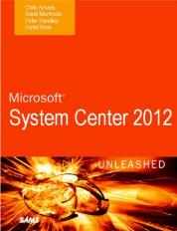
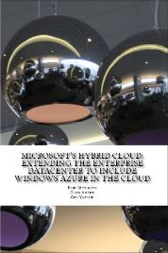
About the Speakers
Rand Morimoto / Chris Amaris
Co-authors of dozens of books on Windows, System Center, Exchange, Azure, Enterprise Security
Early adopter implementers of Microsoft technologies
Hands-on consultants for some of the largest enterprises in the world

Slide 4
Datacenters of the Past
Storage
Network
Compute
Today’s datacenter

Slide 5
Datacenter of the (New) Present “Datacenter without boundaries”
Storage
Network
Compute
Service Provider
(ie: Rackspace, Latisys, etc)
On-premises infrastructure

Slide 6
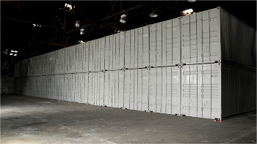
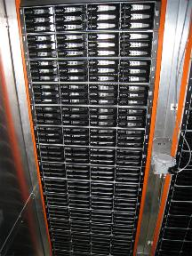
Optimized Datacenter
CCO has worked with some of the largest datacenters in the world
“Server Pods” – 1160 16-core Host Servers in a shipping container at 57% less cost than the deepest corporate discount for HP, Dell, Fujitsu, IBM servers
“Cheap Storage” – Instead of $2500/TB (times 2 for site redundancy), storage costs in bulk (JBOD) now $300/TB (times 3 for high availability and site redundancy), so $5,000/TB or $900/TB???
“Virtual Networking” – Instead of appliances and devices, just embed switching and internetworking within the Hosts, Pods, Servers, and Apps (decrease of $10,000-$25,000 per site or per connection)
“Service Automation” – Spin up 2,350 VMs in 1-hour. Failover 1,000 VMs within a site in 30-seconds. Failover 1,000 VMs across sites in 3-minutes
THIS hosted datacenter efficiency (now at $.46/$1, heading to $.37/$1 within 6 months) drives down the cost of a VM, and puts pressure on internal IT departments to improve their internal IT efficiencies…

Slide 7
Simple Way to Start…
Storage
Network
Compute
Microsoft “Network Virtualization”, extending on-premise to the cloud
Extend to Azure Services as Needed
Running simple servers (like www.cco.com, file system storage, time and billing entry server, etc)
Extending the corporate network (so the cloud is seen and managed just like a virtual guest on the corporate network)
Servers are geo-replicated (so 99.9% guaranteed uptime)
Leverage Azure AD for “shared directory” between multiple orgs (SharePoint scenarios, a better “file sharing” solution)
Service Provider
[Rackspace]
On-premises infrastructure
Onsite (Existing) Datacenter
Run Active Directory for identity
Focus on Business Applications (Accounting, HR, etc)
Manage Compliance (on-premise and cloud)
Support Endpoint Devices
Copy systems (HyperV VHDs) to the cloud
Remote (RDP) to the guest session and manage just as you would a local virtual guest, so 100% control
Monthly cost $57/month for a full running VM
http://www.networkworld.com/community/blog/virtual-networks-windows-2012-and-azure-vms

Slide 8
Building this Session Scenario
Establishing a solid base datacenter infrastructure (AD, WS2012R2, SC2012R2, VMM, AppController)
Stretching the on-premise environment to Microsoft Azure (NVGRE)
Monitoring, Alerting, Reporting, and Tasks – On-premise and Azure-based systems (SCOM)
Managing On-premise and Azure-based systems (SCCM)
Automating Common Hybrid Tasks (Orchestrator)

Slide 9
1) Establishing a solid base datacenter infrastructure (AD, WS2012R2, SC2012R2, VMM, AppController)
Active Directory – Joins everything (on-premise and Azure) VMs together
Hyper-V 2012 R2 – Could use VMware, but with Hyper-V VMs, easier to move things around in/out of the cloud
Windows Server 2012 R2 VMs – Could be other guest OSs, just keep them consistent between on-prem and cloud, easier to manage / administer
System Center Virtual Machine Manager / AppController – Base tools to build, deploy, and access VMs on-prem and in the cloud

Slide 10
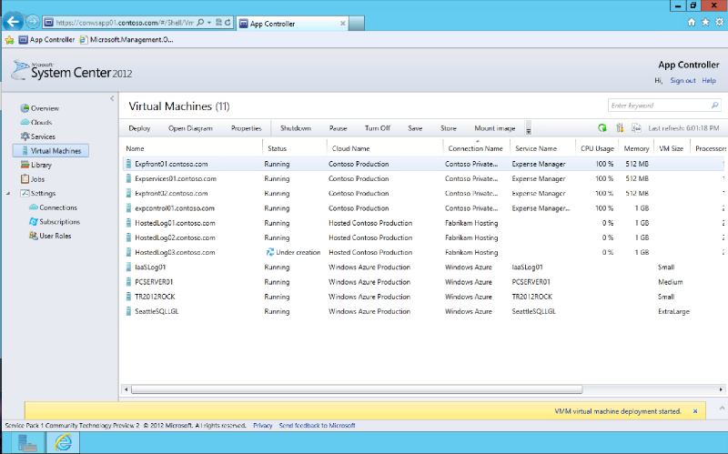
Demo
App Controller
Microsoft Azure

Slide 11
2) Stretching the on-premise environment to Microsoft Azure (NVGRE)
Creating a Site to Site VPN between your enterprise datacenter and Microsoft Azure
Access Azure VMs just as if they were on your enterprise backbone (for management, maintenance, support)
Can use industry standard S2S appliances (ie: Cisco, etc) or Microsoft Routing and Remote Access (RRAS)

Slide 12
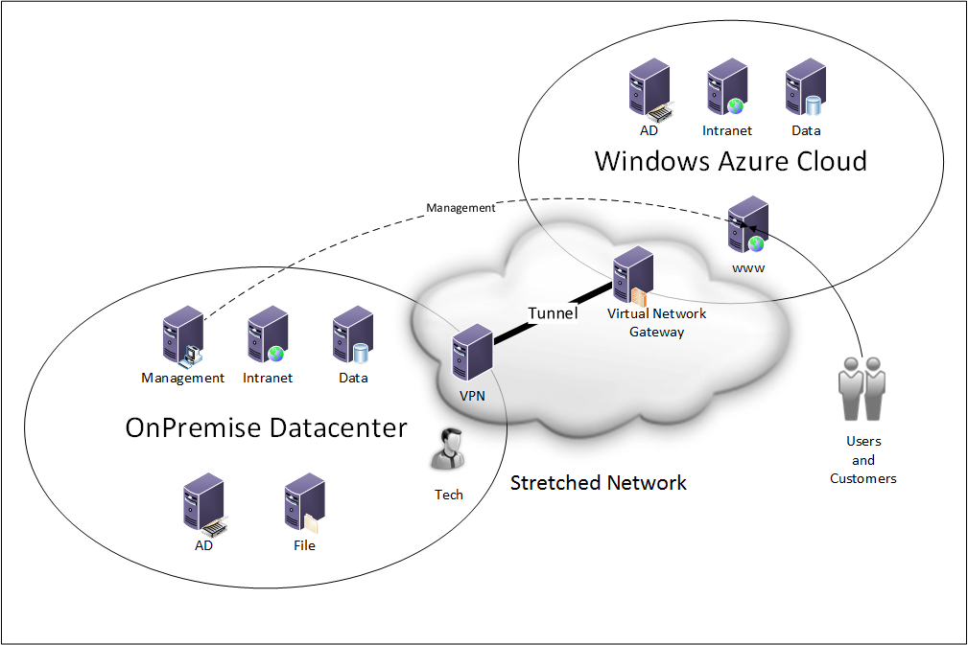
Demo
Network
Virtualization
On-prem to
Azure

Slide 13
3) Monitoring, Alerting, Reporting, and Tasks – On-premise and Azure-based systems (SCOM)
Adding System Center Operations Manager (SCOM) agents to the guest sessions on-premise and in Azure
Utilizing Management Packs (Windows Server, Hyper-V, Microsoft Azure) to monitor guest sessions
Managing Alerts and Reports on the unified hybrid environment

Slide 14
Demo
SCOM
OnPrem
Azure

Slide 15
4) Managing On-premise and Azure-based systems (SCCM)
Manage Azure-based VMs just like On-premise VMs
Deploy Applications through System Center Configuration Manager
Patch / Update through SCCM as well
Maintain Standard Configurations both On-premise and in Microsoft Azure using Compliance Settings (formerly known as Desired Configuration Manager (DCM)) in SCCM

Slide 16
Standard Patching / Updating - SCCM
Live status of available / deployed updates
Baseline Monitoring
Application revision usage
Tracking of Change Management
“Compliance Settings” (formerly DCM)
Identifies base configuration
Maintains (or notifies) when base configuration changes
Keeps guest session configurations identical
Keeps systems patched and updated in lock step

Slide 17
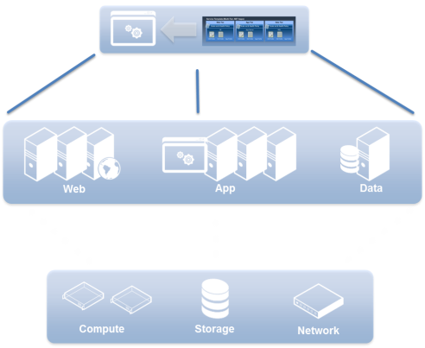
Managing Applications with a Cloud Approach
Standardized Application Provisioning
Easily Upgrade Applications
App
Ops
Service template (Multi-tier .NET applications)
Web tier
Application tier
Data tier
Scale out & health policy
Scale out & health policy
Scale out & health policy
App
Ops
IIS
Application server
SQL
Server Application Virtualization
HW profile
OS profile
App profile
HW profile
OS profile
App profile
HW profile
OS profile
App profile
OS
.NET
Java
DC
Admin

Slide 18
5) Automating Common Hybrid Tasks (Orchestrator)
Creating and Leveraging Standard Processes in System Center Orchestrator
Utilizing PowerShell / Microsoft Azure PowerShell for Scripting Processes
Alert Driven Remediation – Spin up Guest Sessions to Add Capacity (true agility and scalability in the cloud)

Slide 19
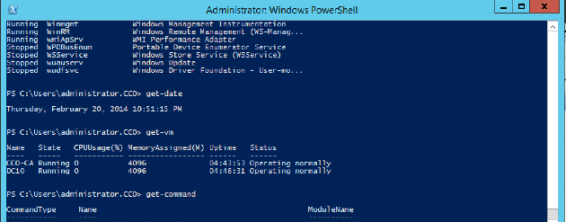
Demo
Orchestrator

Slide 20
Related content
Breakout Sessions (session codes and titles)
Tues, 5/13, 1:30pm, “How to Develop a Successful Hybrid Cloud Strategy” – DCIM-B210
Tues, 5/13, 5pm, “Designing Network Infrastructures for Hybrid Cloud” - DCIM-B352
Weds, 5/14, 8:30am, “Introduction to Microsoft Azure Automation” – DCIM-B347
Weds, 5/14, 10:15am, “How Azure Architectural Patterns Change Approaches” – DCIM-B214
Weds, 5/14, 1:30pm, “System Center 2012 R2: Continuous Availability” – DCIM-B416
Thurs, 5/15, 8:30am, “Extending your Premise to Azure” – DCIM-B388

Slide 21
Available Resources
Rand’s Blog Site (including Sample Code from Today’s Session): http://www.networkworld.com/community/morimoto
Microsoft Azure Training Kit (technical content and hands-on step-by-step labs) - http://www.microsoft.com/en-us/download/details.aspx?id=8396
Microsoft Azure Demos, Presentations, Hands-on Labs: http://windowsazure-trainingkit.github.io/labs.htm
Download System Center 2012 R2: http://msdn.microsoft.com/en-us/library/dn205295.aspx
Hydration Kit for System Center 2012 R2: http://www.deploymentresearch.com/Research/tabid/62/EntryId/149/The-Hydration-Kit-for-System-Center-2012-R2-is-available-for-download.aspx
Building Clouds Blog : http://blogs.technet.com/b/privatecloud/
Azure Virtual Network Supported Device List: http://msdn.microsoft.com/en-us/library/azure/jj156075.aspx

Slide 22
For More Information
Windows Server
Windows Server 2012 R2
http://technet.microsoft.com/en-US/evalcenter/dn205286
System Center
System Center 2012 R2
http://technet.microsoft.com/en-US/evalcenter/dn205295
Azure Pack
Azure Pack
http://www.microsoft.com/en-us/server-cloud/products/windows-azure-pack
Microsoft Azure
Microsoft Azure
http://azure.microsoft.com/en-us/
Come Visit Us in the Microsoft Solutions Experience!
Look for Datacenter and Infrastructure Management TechExpo Level 1 Hall CD

Slide 23
Resources
Learning
Sessions on Demand
Microsoft Certification & Training Resources
http://channel9.msdn.com/Events/TechEd
www.microsoft.com/learning
TechNet
msdn
Resources for IT Professionals
Resources for Developers
http://microsoft.com/technet
http://microsoft.com/msdn

Slide 24
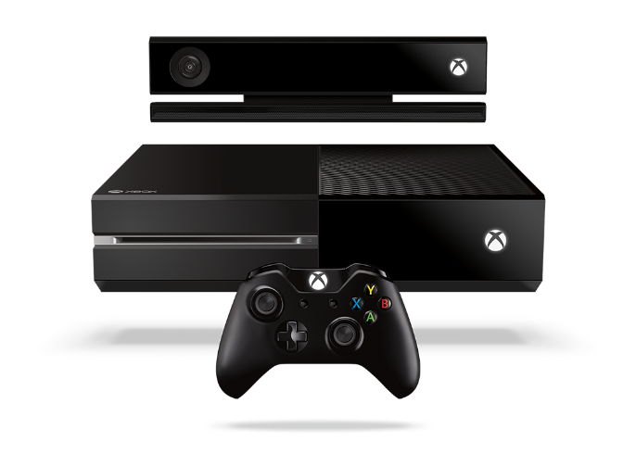
Complete an evaluation and enter to win!

Slide 25
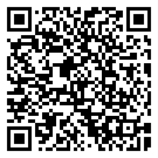
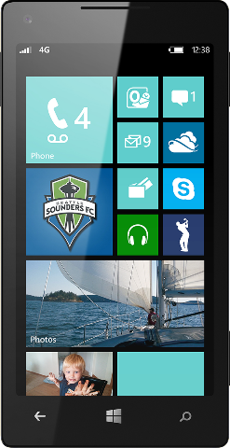
Evaluate this session
Scan this QR code to evaluate this session.

Slide 26
© 2014 Microsoft Corporation. All rights reserved. Microsoft, Windows, and other product names are or may be registered trademarks and/or trademarks in the U.S. and/or other countries.
The information herein is for informational purposes only and represents the current view of Microsoft Corporation as of the date of this presentation. Because Microsoft must respond to changing market conditions, it should not be interpreted to be a commitment on the part of Microsoft, and Microsoft cannot guarantee the accuracy of any information provided after the date of this presentation. MICROSOFT MAKES NO WARRANTIES, EXPRESS, IMPLIED OR STATUTORY, AS TO THE INFORMATION IN THIS PRESENTATION.

