Slide 1


Slide 2

Extend Microsoft System Center 2012 R2: Manage Hybrid Cloud Distributed Application and Dynamic Application Maps
DCIM-B343
Vic Nyman
BlueStripe Software

Slide 3
Agenda & Objectives
Putting Big Picture Applications into System Center
  Using BlueStripe and System Center to manage multi-tier distributed applications
  Application management across Azure Hybrid Cloud systems
  Using business applications in problem troubleshooting, monitoring, and automation
Live demo, “How to” examples
  Dynamic application mapping, monitoring and SLA alerting in System Center
  IT Operations view of the whole multi-tier application and infrastructure
  End-to-end application management across Azure Hybrid Cloud systems
Customer examples
  Azure Hybrid Cloud management
  Using System Center to manage IT Operations

Slide 4

BlueStripe Software
System Center Depth ISV Alliance Partner
IT Operations & Support teams use BlueStripe to:
  Discover and track enterprise-wide applications… on any platform, on any architecture.
  Manage the hop-by-hop transaction & application performance.
  Bring integrated application views and performance to System Center.

Slide 5

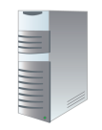


What Users Want to Do With System Center?
Bridge between Business Services and
Infrastructure they can control… using System Center.
See which systems are in which apps
Including Windows, Linux, Unix, cloud, and mainframe systems
Monitor the whole
distributed app
In one view, monitor each component of the application
Know the impact of changes
Determine how a change to one server affects other connected components

Slide 6
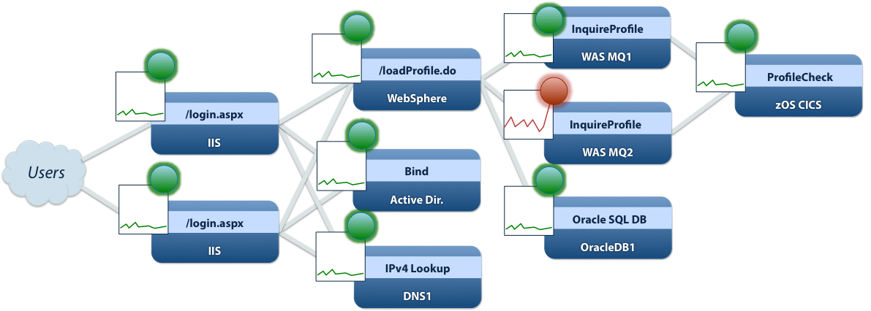
Monitor transactions & infrastructure tier SLAS
Login transaction
1,481 ms
IIS web tier
36 ms
WebSphere tier
50 ms
AD tier
27 ms
MQ tier
1,365 ms
Response Time Alert
Requests from WebSphere to WASMQ2 > 800ms.
Sent May 13, 2014 at 7:24 PM <details>
Oracle tier
36 ms
CICS tier
13 ms

Slide 7
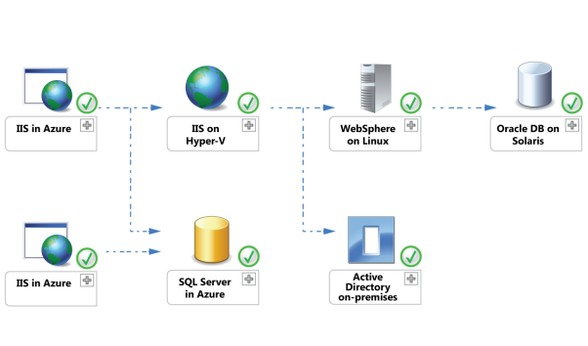
In a nutshell: BlueStripe puts real applications in System Center 2012 R2
System Center Operations Manager 2012 R2
End-to-end Application Monitoring & Management
Map: Dynamic Distributed Applications
Monitor: Tier-by-tier, cross-platform, response time status
Manage: Automate responses to issues and avoid change accidents
Works great with Orchestrator & Service Manager too!

Slide 8
Demo
Mapping & monitoring applications with System Center and BlueStripe

Slide 9
Reveiwer Notes:
There will be 3 basic “how to” demo sessions
This first demo segment will introduce basic System Center Operations Manager and Distributed Applications
It will focus on using SCOM as a primary management platform
It will introduce BlueStripe’s FactFInder product and how it works mapping applications and integrating them with System Center.

Slide 10
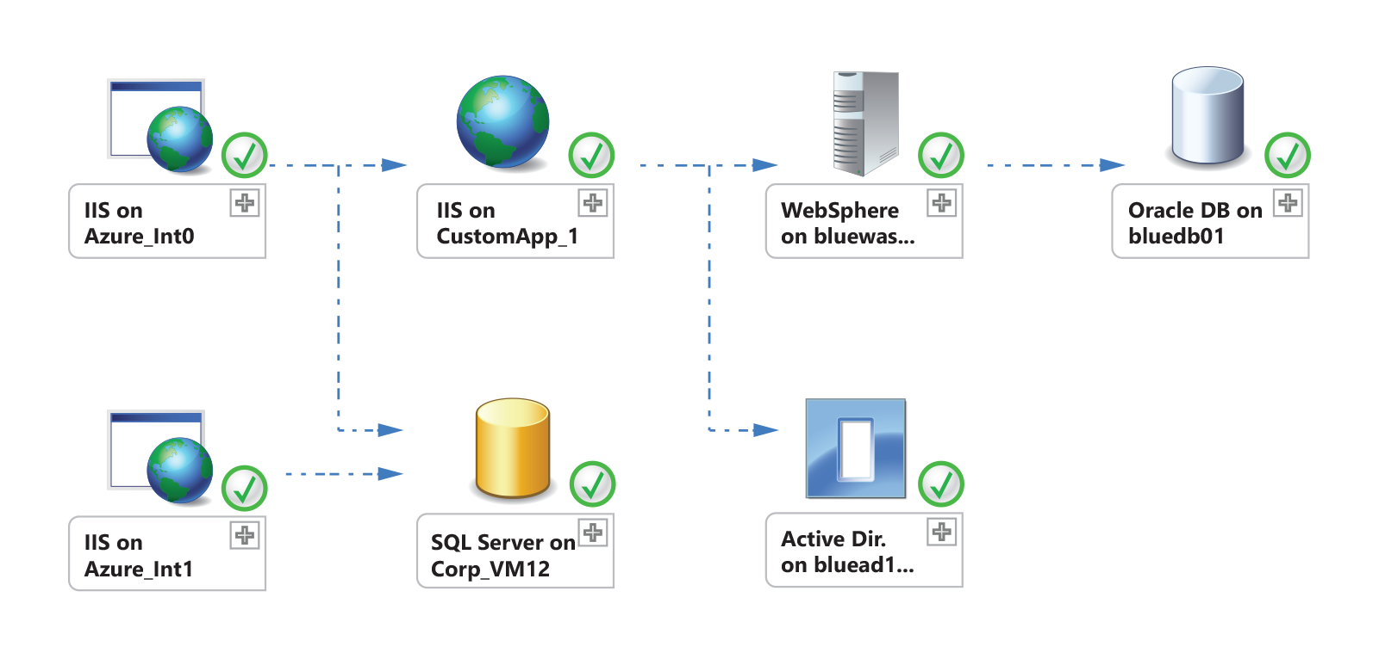
Bringing Application Status into System Center
Operations Manager Distributed Application — Your App
Alert: Your App had an average response time over 2,000ms
Alert: SQL Server on Corp_VM12 had an average response time over 1,000ms
Monitor the service levels your apps are delivering.
See which component is slow, for Windows, Unix, mainframes, and 3rd Party Web Services.
See BlueStripe response time alerts together with Operations Manager health status.

Slide 11
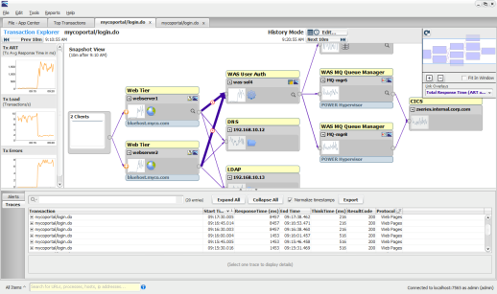

Application Maps & Status in System Center
System Center 2012
Orchestrator
System Center 2012
Operations Manager
BlueStripe FactFinder
SLA Alerts
SLA driven runbooks
Automate actions based on tier-by-tier service level issues
Maps
Status
Dist. Apps.
System Center 2012
Service Manager
Automatically discovers transaction path topology
Monitors server resources and transaction performance
Direct connection to Ops Mgr
Dynamically updates Distributed Applications
Takes advantage of all the monitoring data already in Ops Mgr about each server
Automatic Business Service Definitions
Updated regularly for changes

Slide 12
Demo
Automating business application operations using Orchestrator and System Center Service Manager

Slide 13
Reviewer Notes:
Demo segment number two will cover extended System Center family using Business Applications
System Center Orchestrator and System Center Service Manager

Slide 14
System Center User

Slide 15
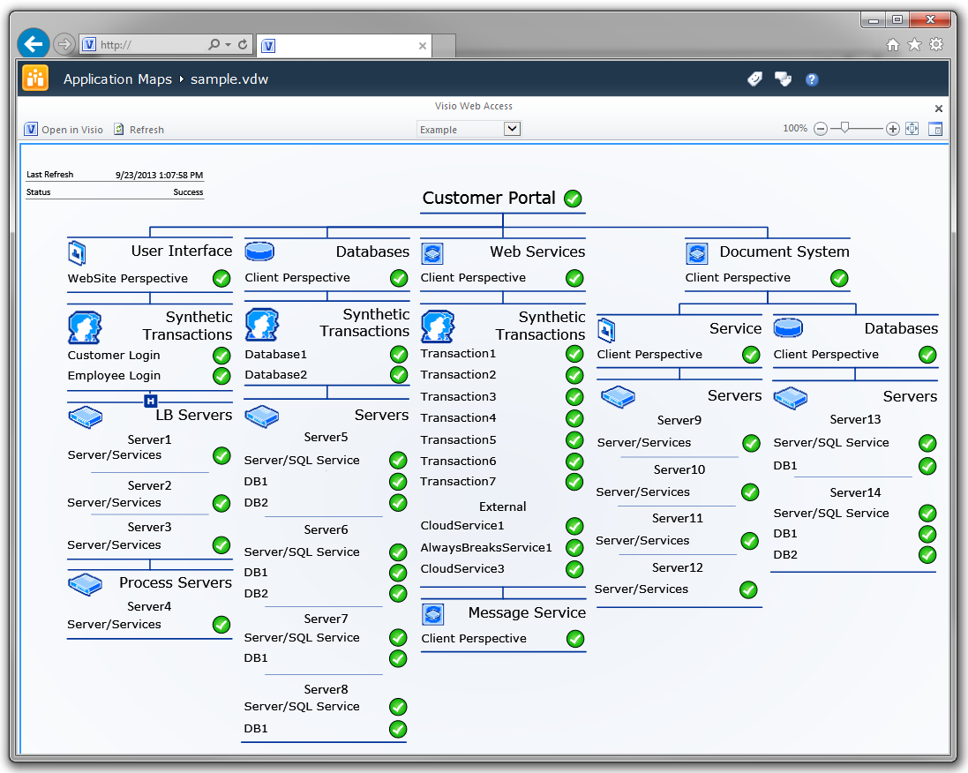

Customer Example: State Auto Insurance
System Center dashboards across the IT organization
Recorded Speaker:
Shawn Pearson
State Auto, Enterprise
Monitoring and Event Mgmt

Slide 16
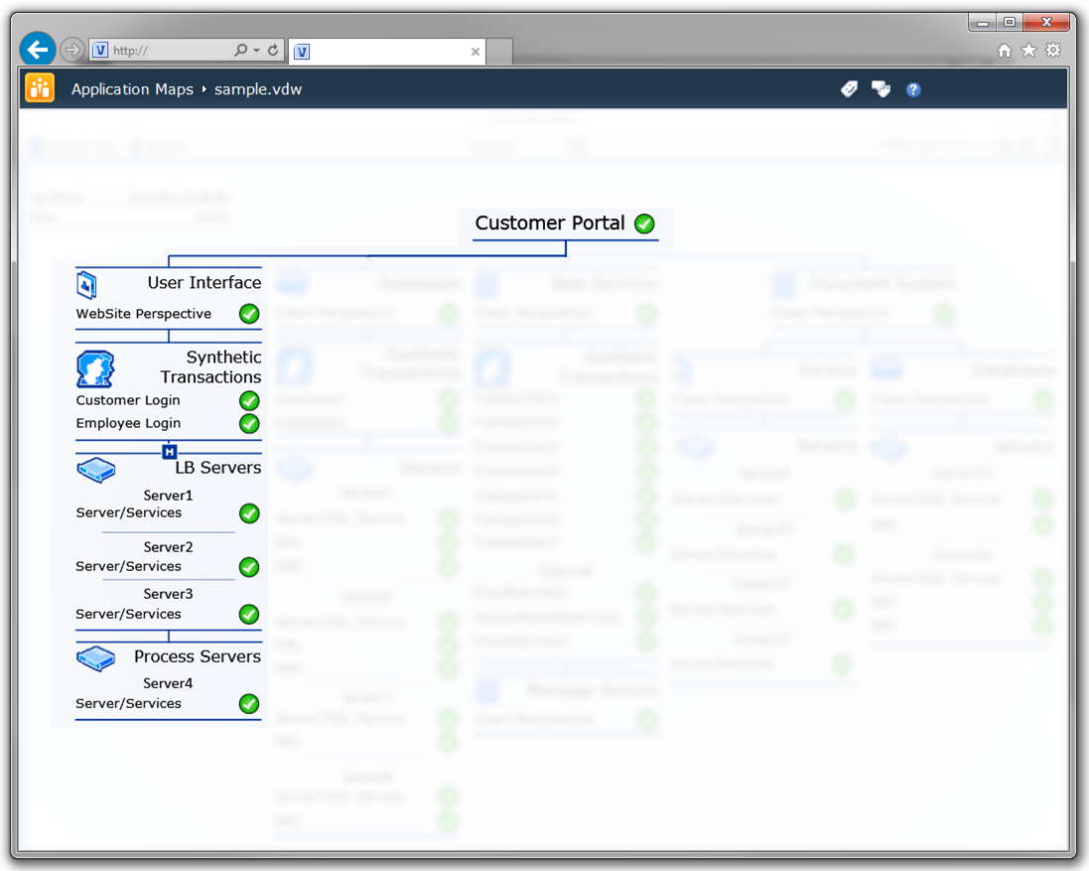
StateAuto: System Center & BlueStripe
Real customer transactions now trigger application level incidents
FactFinder quantifies customer impact
Operations Manager isolates technical causes
Describing customer impact + actionable technical items = The Real Win

Slide 17
Cross-Organization Management View

Slide 18
Azure Hybrid Cloud
Project

Slide 19
Large tax firm’s Azure Hybrid Cloud project
On-premises IT systems
Presentation layers
Middleware
Unix/
Mainframe
Datacenter
Customers
Azure PaaS & IaaS systems
The move would break firm’s
end-to-end management views
Pre-requisite for move:
Single end-to-end view of customer tax processing transactions, same as datacenter today
All in one place… on-premises… in System Center, if possible.

Slide 20

The Challenge: Getting an end-to-end view
On-premises IT systems
?
?
?
?
?
Customers
?
?
Using System Center family of products
  Operations Manager, Application Mgmt…
Using Azure Admin tools & services
Non-Windows backend platforms
Federal & State Government transactions
Lacking unified, end-to-end view of user transactions

Slide 21
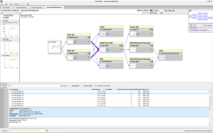

Managing Datacenter and Cloud
On-premises IT systems
Datacenter
Customers
Azure PaaS & IaaS systems
FactFinder
BlueStripe FactFinder
One view of complete application
Follows transactions across Azure & datacenter systems
Automatically discovers & maps hybrid apps
Monitors performance & finds problems
System Center
One view – Whole Application

Slide 22
Demo
Monitoring and troubleshooting Azure Hybrid Applications using System Center and BlueStripe

Slide 23
Reviewer Notes:
Demo segment number two will cover extended System Center family using Business Applications
System Center Orchestrator and System Center Service Manager

Slide 24
TechED Special Offer
Free FactFinder licenses!
  3 datacenter server licenses for FactFinder for one year
  Includes full mapping, monitoring, and problem triage capabilities
  Includes complete System Center feature set
How? take this card to the BlueStripe booth #1726

Slide 25
Related content
DCIM-B381 Overview and Enhancements in Microsoft System Center 2012 R2 Operations Manager
BlueStripe live demos in exhibit hall booth #1726
Find Me Later at booth #1726, bring the card!

Slide 26

For More Information
Windows Server
Windows Server 2012 R2
http://technet.microsoft.com/en-US/evalcenter/dn205286
System Center
System Center 2012 R2
http://technet.microsoft.com/en-US/evalcenter/dn205295
Azure Pack
Azure Pack
  http://www.microsoft.com/en-us/server-cloud/products/windows-azure-pack
Microsoft Azure
Microsoft Azure
  http://azure.microsoft.com/en-us/
  Come Visit Us in the Microsoft Solutions Experience!
  Look for Datacenter and Infrastructure Management
  TechExpo Level 1 Hall CD

Slide 27

Resources
Learning
  Sessions on Demand
  Microsoft Certification & Training Resources
http://channel9.msdn.com/Events/TechEd
www.microsoft.com/learning
TechNet
msdn
  Resources for IT Professionals
  Resources for Developers
http://microsoft.com/technet
http://microsoft.com/msdn

Slide 28



Complete an evaluation and enter to win!

Slide 29


Evaluate this session
Scan this
QR code
to evaluate
this session.

Slide 30


© 2014 Microsoft Corporation. All rights reserved. Microsoft, Windows, and other product names are or may be registered trademarks and/or trademarks in the U.S. and/or other countries.
The information herein is for informational purposes only and represents the current view of Microsoft Corporation as of the date of this presentation. Because Microsoft must respond to changing market conditions, it should not be interpreted to be a commitment on the part of Microsoft, and Microsoft cannot guarantee the accuracy of any information provided after the date of this presentation. MICROSOFT MAKES NO WARRANTIES, EXPRESS, IMPLIED OR STATUTORY, AS TO THE INFORMATION IN THIS PRESENTATION.

