Slide 1


Slide 2
Best Practices for Deploying Tiered Storage Spaces in Windows Server 2012 R2
Bryan Matthew
Chris Robinson

Slide 3
Session Agenda
Customer deployments
Brief overview of Software-Defined Storage Stack
Deployment planning & sizing recommendations
Step-by-step deployment validation guidance
Ongoing monitoring & troubleshooting

Slide 4
History
IaaS customers needed a platform which dramatically lowered cost and complexity
Microsoft software-defined E2E stack shipped with Windows Server 2012:
  Storage Spaces
  Scale-Out File Server with SMB 3.0 & RDMA
  Windows Clustering
  Hyper-V
  SCVMM & PowerShell
Enhanced with R2, tiered storage, dual parity, parity in cluster, parallel rebuild

Slide 5
Case Study: Hoster
Brief background
  Needed a storage platform to reduce capital expenditure, able to scale linearly, and easy to manage
Deployment
  Capex savings of 30% over traditional storage
  Scalable just-in-time online expansion
  End-to-end management of deployment
Market differentiation
  Agile platform for faster time to market
  Tiering allows them to differentiate customers based on service needs – can pin tenants to HDD or SSD tier, or allow heat to determine best placement

Slide 6
Case Study: Energy Company
Brief background
  Large data storage requirements and high I/O workload to store and process seismic data
Deployment topology
  4x file servers with 6x 60-bay enclosures
    Each with 12x 400GB SAS SSD and 48x 3TB NL-SAS HDD
    898 TB of raw capacity in 28U
  Replica site with similar configuration
Advantages
  Exceptional performance, driving both VMs and Seismic data analysis
  2.5x greater raw capacity density (TB/U) than traditional storage
  4.5x lower $/TB for raw capacity than traditional storage

Slide 7
The software-defined storage stack

Slide 8

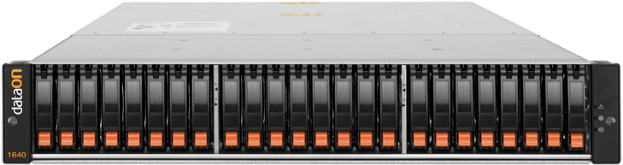
Capabilities Overview (1)
Pooling of disks
Flexible resilient storage spaces
Native data striping
Enclosure awareness
Parallelized rebuild of failed drives
Storage Spaces
…
Mirror Space
Mirror Space
Mirror Space
Parity Space
…
Data Copy 1
Data Copy 2
Disk Failure!
…
Physical Disks from SAS Enclosures
Storage Pool
Data is rebuilt to multiple disks simultaneously, using spare capacity

Slide 9

Capabilities Overview (2)
Automated movement of hot/cold data between SSD and HDD
  Use the best capabilities of HDD for capacity, and SSD for performance in a single volume
  Provides exceptional IOPS/$ and $/TB
Admins can override automatic placement, and pin files to a Tier
  Can be used, for example, to offer different performance levels to tenants
Write-Back Cache absorbs write bursts
  Helps smooth workloads which are bursty, reducing seeks on HDDs
  WBC uses SSD capacity
Compute Nodes
I/O Activity Accumulates Heat at Sub-File Granularity
Storage Space
SSD Tier and WBC
SAS SSD
Hot Data
Cold Data
HDD Tier
SAS HDD

Slide 10
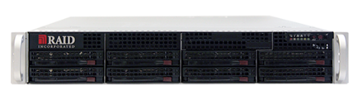
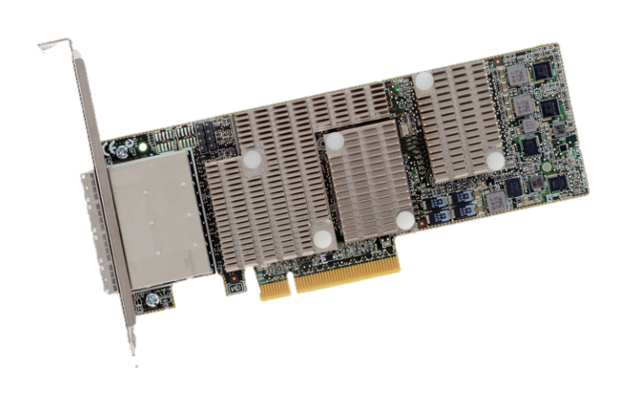
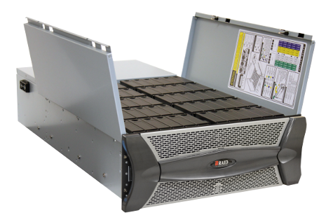
Building up the hardware configuration
Two SAS HBAs per
Windows File Server
24Gbps per SAS Cable
768Gbps Shared SAS Links
768Gbps Shared SAS Links
I/O Module A
I/O Module B
SAS Enclosure
SAS Enclosure
SAS Enclosure
SAS Enclosure

Slide 11
Building up the software configuration
Compute Nodes
(running your workloads!)
SMB
SMB
SMB
SMB
Unified Cluster Shared Volume Namespace
CSV
\\SRV\VDI_Mrktg
\\SRV\VDI_Dev
\\SRV\Folders
\\SRV\DB
Storage Pools
Clustered Storage Pools & Storage Spaces
Storage Space
Storage Space
Storage Space
Storage Space
Clustered File Servers
High-Speed Ethernet
768Gbps Shared SAS Links
768Gbps Shared SAS Links
SAS Enclosure
SAS Enclosure
SAS Enclosure
SAS Enclosure

Slide 12
Planning a Deployment

Slide 13
Planning a Deployment
Choose SSDs, HDDs, Enclosures, and Servers
Resiliency Needs
  How many drive failures must the deployment be resilient against?
  What level of resiliency to enclosure failure is necessary?
Capacity Needs
  Overhead necessary for resiliency
Performance Needs
  Workload dependent
  Can start to characterize based on raw IOPS and Throughput

Slide 14
Capacity Planning (1)
Select drive capacities and number of enclosures according to resiliency requirements and intended workload
Scale to 80 disks in a clustered pool, and 4 pools per cluster
  Pools can span multiple enclosures, and enclosures can have multiple pools
Example: 100TB raw capacity equates to roughly 50TB usable capacity with Two-Way Mirroring
Resiliency Scheme | Resilient to # of Disk Failures | Capacity Efficiency | Minimum Number of Enclosures Required for EA | Recommended Workloads
Simple | 0 | 100% | N/A | Suitable for workloads where resiliency is not required or provided by another mechanism.
Two-Way Mirror | 1 | 50.0% | 3 | Recommended for all workloads.
Three-Way Mirror | 2 | 33.3% | 3
Dual Parity (4+3 LRC*) | 2 | 57.1% | 4 | Recommended for archival workloads.
Dual Parity (14+3 LRC*) | 2 | 82.4% | N/A
*LRC is our Dual-Parity Encoding Scheme co-developed with Microsoft Research
Ask me more about it after the presentation if you are interested to learn more! MSR Paper

Slide 15
Capacity Planning (2)
Plan additional capacity to reserve for:
  Parallel rebuild capacity for each storage tier
    At least 1 or 2 physical disks worth, depending on resiliency
  SSD Write-Back Cache for each Storage Space
  SSD Tier expansion on tiered volumes, after workloads have been established

Slide 16
Understanding Striping and Mirroring
Performance and Resiliency with Mirroring can be understood with:
  Number of Data Columns
  Number of Data Copies
Max Read Perf* = Columns x Copies x SingleDiskPerf
Max Write Perf* = Columns x SingleDiskPerf
Minimum number of drives required to expand storage space = Columns x Copies
2 Data Columns
2 Data Copies
2-Column 2-Way Mirrored Space
I/O is distributed among the physical disks
1
2
3
4
5
6
7
8
Physical Disks
*Ideal performance of a single I/O operation, aggregate performance can be higher depending on queue depth (parallelism) and extent distribution.

Slide 17
General Performance Planning (1)
Resiliency schemes have different ideal performance characteristics
Spaces gives you linear scaling as you add more drives
  Ensure you evaluate performance at latencies which are acceptable for your workload
Tested with 7200 RPM SAS HDDs, no WBC, maximum of 8 columns, 2-way mirror. Queue depth was maintained consistent between tests at an effective 3 QD/Disk to attain an average latency of at most 30ms

Slide 18
General Performance Planning (2)
Ensure you have sufficient SSDs in the pool for WBC to match number of data copies on virtual disk
Consider starting with the defaults for advanced settings
  Column Count
  Interleave
  Write-Back Cache Size
Storage Spaces Performance Paper:
http://social.technet.microsoft.com/wiki/contents/articles/15200.storage-spaces-designing-for-performance.aspx
Resiliency Setting | Simple | Two-Way Mirror | Three-Way Mirror | Single Parity | Dual Parity
Minimum Number of SSDs for WBC | 1 | 2 | 3 | 2 | 3

Slide 19
General Performance Planning (3)
Ensure sufficient hardware (Compute, Cabling, PCI-E, etc.) to drive Throughput and IOPS
Use MPIO (SAS) and SMB Multichannel (Ethernet) to aggregate throughput of multiple links for fault-tolerance and performance
Use synthetic benchmarks to determine bottlenecks!
  Small Random I/O – Latency & IOPS
  Large I/O – MB/s (Throughput)

Slide 20
Sizing guidance for Tiered Spaces
Design for what’s practical for number of drive slots
  Spaces don’t constrain the number of SSDs or SSD capacity
  Invest in sufficient number of SSDs for:
    Sufficient column count for both SSD and HDD tiers
    Sufficient throughput and IOPS from SSD tier
Buy as much SSD capacity as your workload’s working set
  Working set observed to be on average 8% of capacity with tested workloads
Recommended Minimum Number of SSDs
Resiliency Type | 24-bay JBOD (2 columns) | 60-bay JBOD (4 columns)
Two-Way Mirror | 4 | 8
Three-Way Mirror | 6 | 12

Slide 21
VDI Pooled Desktop Guidance
Recommendations:
  Pin the parent vhdx file for pooled desktop collections to the SSD Tier
  Use separate user profile disks
  Run Tier Optimization manually after collection creation
Results from testing:
  Login VSI “medium” workload
  1x Dell MD1220 24-Bay JBOD, 2 paths
  2x Dell PowerEdge R720 Server
Configuration (Two-way Mirror) | Users | Utilized Capacity | Peak IOPS
4x 400GB SSD | 150 | 700GB | 3,100
4x 400GB SSD 20x 1TB 7.2K HDD | 700 | 2.4TB | 16,240
To host 700 Virtual Desktops, SSDs alone have insufficient capacity and, HDDs alone have insufficient performance. Tiering gives you the best of both – capacity and performance.

Slide 22
VDI Personal Desktop Guidance
Recommendations:
  Use data deduplication in VDI mode to optimize capacity utilization
  After deployment of collection, run data deduplication immediately
  Best performance and capacity savings for workloads with low write churn
Results from testing:
  Login VSI “medium” workload
  1x Dell MD1220 24-Bay JBOD, 2 paths
  2x Dell PowerEdge R720 Server
Configuration (Two-way Mirror) | Users | Peak IOPS
4x 400GB SSD 20x 1TB 7.2K HDD | 720 | 16,140
Tiering and Data Deduplication offer best IOPS/$ and $/TB for VDI personal desktops, at approximately 90% capacity savings.

Slide 23
Components
Spaces requires certified components
  Solid State Drives
  Disk Enclosures
  SAS HBA without hardware RAID
  Server, Networking, NICs, etc.
Highly recommended to select solutions from an OEM
Check the Windows Server Catalog:
  http://www.windowsservercatalog.com/default.aspx

Slide 24
Validating Hardware and Software Configuration

Slide 25
Validating Hardware and Software
Choose & Install H/W
Validate H/W (validation tests)
Configure Cluster, Pool, Spaces, and File Shares
Validate Cluster Storage & File Share
Run YOUR workload
Ongoing Monitoring & Troubleshooting
✓
Validate H/W (validation tests)
Spaces Physical Disk Validation Script
Validates basic requirements for Storage Spaces Physical Disks and Enclosures
Validates Performance Consistency between Like Model Physical Disks
http://gallery.technet.microsoft.com/scriptcenter/Storage-Spaces-Physical-7ca9f304
Cluster Storage Validation
Validates hardware and software configuration for all cluster nodes
Validates storage subsystem is compatible with Windows Fail-Over Clustering
http://technet.microsoft.com/en-us/library/jj134244.aspx

Slide 26
Validating Hardware and Software
Choose & Install H/W
Validate H/W (validation tests)
Configure Cluster Storage & File Share
Validate Cluster Storage & File Share
Run YOUR workload
Ongoing Monitoring & Troubleshooting
✓
✓
How-To Deploy Clustered Storage Spaces
http://technet.microsoft.com/en-us/library/jj822937.aspx
Step-By-Step for Tiered Storage Spaces
http://blogs.technet.com/b/josebda/archive/2013/08/28/step-by-step-for-storage-spaces-tiering-in-windows-server-2012-r2.aspx
Configure Cluster, Pool, Spaces, and File Shares

Slide 27
Validating Hardware and Software
Choose & Install H/W
Validate H/W (validation tests)
Configure Cluster, Pool, Spaces, and File Shares
Validate Cluster Storage & File Share
Run YOUR workload
Ongoing Monitoring & Troubleshooting
✓
✓
✓
Validate Cluster Storage & File Share
SQLIO Disk Subsystem Benchmark Tool
http://www.microsoft.com/en-us/download/details.aspx?id=20163

Slide 28
Demo: Validating performance local and remote
Bryan Matthew

Slide 29
Ready to run your workload!
Choose & Install H/W
Validate H/W (validation tests)
Configure Cluster, Pool, Spaces, and File Shares
Validate Cluster Storage & File Share
Run YOUR workload
Ongoing Monitoring & Troubleshooting
✓
✓
✓
✓
Run YOUR workload

Slide 30
Monitoring and Troubleshooting

Slide 31
Monitoring and Troubleshooting
Choose & Install H/W
Validate H/W (validation tests)
Configure Cluster, Pool, Spaces, and File Shares
Validate Cluster Storage & File Share
Run YOUR workload
Ongoing Monitoring & Troubleshooting
✓
✓
✓
✓
Monitoring Hardware Health
✓
Ongoing Monitoring & Troubleshooting
Monitoring Latencies
Monitoring Tier Usage

Slide 32
Monitoring Health
Performance degradations can be a result of failed hardware, degraded spaces, or in-progress rebuilds
Can use PowerShell, Server Manager, SCVMM to monitor health, and progress of any rebuilds
  Additional monitoring for Storage Enclosure Health with http://support.microsoft.com/kb/2913766

Slide 33
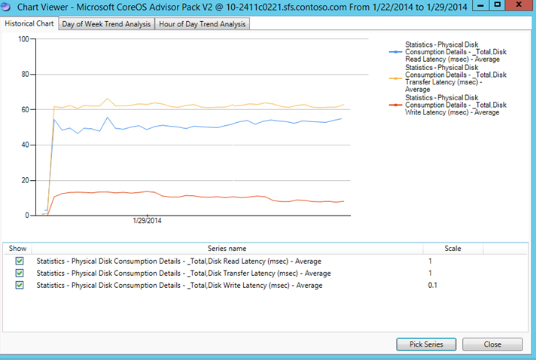

Ongoing Performance Monitoring
Server Performance Analyzer (SPA)
  Outbox tool to monitor storage performance
  Uses familiar performance counters
  Alerts based on configurable thresholds
  http://msdn.microsoft.com/en-us/library/windows/hardware/dn481522.aspx

Slide 34
How to debug storage performance issues?
Break down the problem
  Check health – any failed virtual disks, nodes, VMs? Any rebuilds in progress?
  Find where in the stack the performance degrades the most
    (For example: Where do the latencies start to build up? Where does the throughput degrade?)
Compute Nodes
Virtual Machines
SMB Client
SMB
File Server Nodes
SMB Server
Storage Spaces
Physical Disks

Slide 35
Demo: Performance troubleshooting
Bryan Matthew

Slide 36
Troubleshooting Tiered Volumes
Data is moved daily between tiers according to activity, but there are situations where performance may not be optimal:
  Some workloads have very high churn within a day
  There are hardware issues specific to devices of a certain tier
  There is insufficient SSD tier size to contain the majority of the working set of the workload
Tool | What? | Where?
Tiering Optimization Report | Displays Tiering information which can be used to optimize performance (next slide) | defrag.exe <drive> /g /h defrag.exe /c /g /h (all tiered volumes)
Performance Counters | Determine performance of underlying physical disks, both SSDs and HDDs | Performance Monitor Get-Counter
Pinning Files | Pin files to specific tiers to debug tier performance | Set-FileStorageTier Get-FileStorageTier

Slide 37
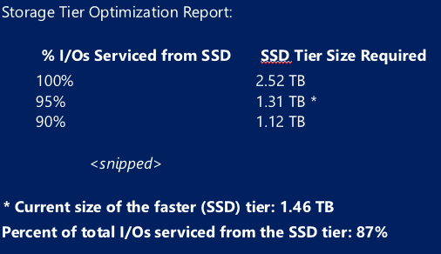
Optimizing Performance of Tiered Volumes
Total I/O Tracked by Tiering Engine
(indicates the majority of I/O)
Ideal I/O distribution with current SSD tier size for the current workloads
Current I/O distribution post-optimization
Insufficient SSD capacity if ideal I/O distribution too low
    Can expand SSD Tier with capacity reserved earlier or with additional SSDs
    Can re-balance subset of workloads to volumes with greater ideal I/O distributions
  High workload churn if current I/O distribution does not improve after successive scheduled optimization runs
    Can immediately run optimization
    Can increase the frequency of optimization schedule (see appendix)
    Can pin workloads expected to generate high churn to SSD tier

Slide 38
Wrapping up
Spaces provides high-performance scalable storage with Exceptional IOPS/$ and $/TB
Carefully plan storage deployments for:
  Capacity
  Performance
  Resiliency & Enclosure Awareness
Use Windows Certified hardware
Systematically validate hardware & software configuration
  Performance Validation Script
  Cluster Validation
  Synthetic Performance Tests Local & Remote
Monitor performance and health over time
  Tweak/tune where necessary

Slide 39
Related content
Breakout Sessions
  DCIM-B349: Software-Defined Storage in Windows Server 2012 R2 and Microsoft System Center 2012 R2
  DCIM-B311: Delivering Exceptional IOPS/$ with Windows Server 2012 R2
  DCIM-B397: Maximizing Storage Efficiency with Storage Spaces
Find Me Later At. . . The Storage Booth and ATE Event

Slide 40

Resources
Learning
  Sessions on Demand
  Microsoft Certification & Training Resources
http://channel9.msdn.com/Events/TechEd
www.microsoft.com/learning
TechNet
msdn
  Resources for IT Professionals
  Resources for Developers
http://microsoft.com/technet
http://microsoft.com/msdn

Slide 41



Complete an evaluation and enter to win!

Slide 42


Evaluate this session
Scan this
QR code
to evaluate
this session.

Slide 43


© 2014 Microsoft Corporation. All rights reserved. Microsoft, Windows, and other product names are or may be registered trademarks and/or trademarks in the U.S. and/or other countries.
The information herein is for informational purposes only and represents the current view of Microsoft Corporation as of the date of this presentation. Because Microsoft must respond to changing market conditions, it should not be interpreted to be a commitment on the part of Microsoft, and Microsoft cannot guarantee the accuracy of any information provided after the date of this presentation. MICROSOFT MAKES NO WARRANTIES, EXPRESS, IMPLIED OR STATUTORY, AS TO THE INFORMATION IN THIS PRESENTATION.

Slide 44
Appendix: Breaking down perf issues
Peel the proverbial onion
  Check health – any failed virtual disks, nodes, VMs? Any rebuilds in progress?
  Find where in the stack the performance degrades the most
    (for example, where does the latencies start to build up?)
Layer | Useful Performance Counters | Most frequently observed cause of performance issue at this layer
Virtual Machine | Hyper-V (*) | Oversubscribed CPU and/or Memory
SMB Client (compute) | SMB Client Shares | Network issue, SMB credit stall, SMB witness shares unbalanced
SMB Server (storage) | SMB Server Shares | Imbalanced cluster resource ownership
Storage Space | Logical Disk (on owner node) | Overloaded storage for current workload, hardware issues, workload changing more frequently than Tiering can keep up with current run schedule
Physical Disk | Physical Disk | Overloaded storage, hardware issues

Slide 45

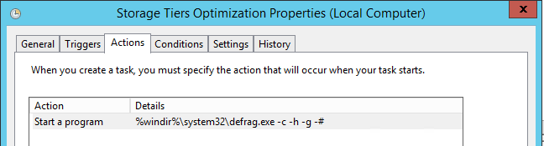
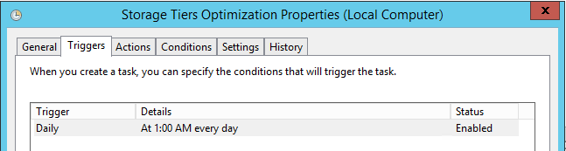
Appendix: Tiering Scheduled Task
Can change task to run more frequently, and/or to save Tiering report after run
In task scheduler, navigate to “Storage Tiers Management”
The task to change is:
Change the task for all Cluster nodes, don’t change the initialization task
Saving the Tiering Optimization Report
Changing the Optimization Schedule
FROM: %windir%\system32\defrag.exe -c -h -g -#
TO: %windir%\system32\defrag.exe -c -h -g -# > %windir%\tieringOut.txt
Default Frequency: 1am Daily
Recommended Maximum Frequency: Every 6 Hours*
*Without going into further advanced configuration, we recommend running Tiering only as frequently as every 6 hours.

Slide 46
Appendix: Additional Perf Planning
Need to ensure sufficient bandwidth and CPU cycles in Server, SAS, Network, HBA to drive IOPS and MB/s
Use MPIO (SAS) and SMB Multichannel (Ethernet) to aggregate throughput of multiple links for fault-tolerance and performance
  Single 10Gbps Ethernet Cable: ~1GB/s
  Single 24Gbps SAS Cable: ~2.4GB/s
Use PCI-E Gen3 System Bus and HBAs/NICs
  Large improvements over PCI-E Gen2 for both MB/s and IOPS
Use fast multi-core processors and dual-sockets for systems which will drive high IOPS (>500K)
  Ensure that System Firmware settings do not disable NUMA (for example, Node Interleaving)
Use synthetic benchmarks to determine bottlenecks!
  Small Random I/O – Latency & IOPS, Large I/O – MB/s (Throughput)

Slide 47
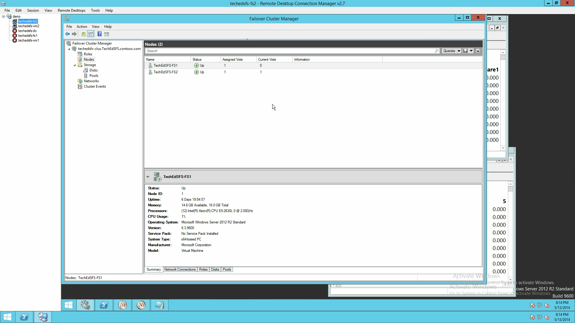
Validating Performance Local and Remote

Slide 48
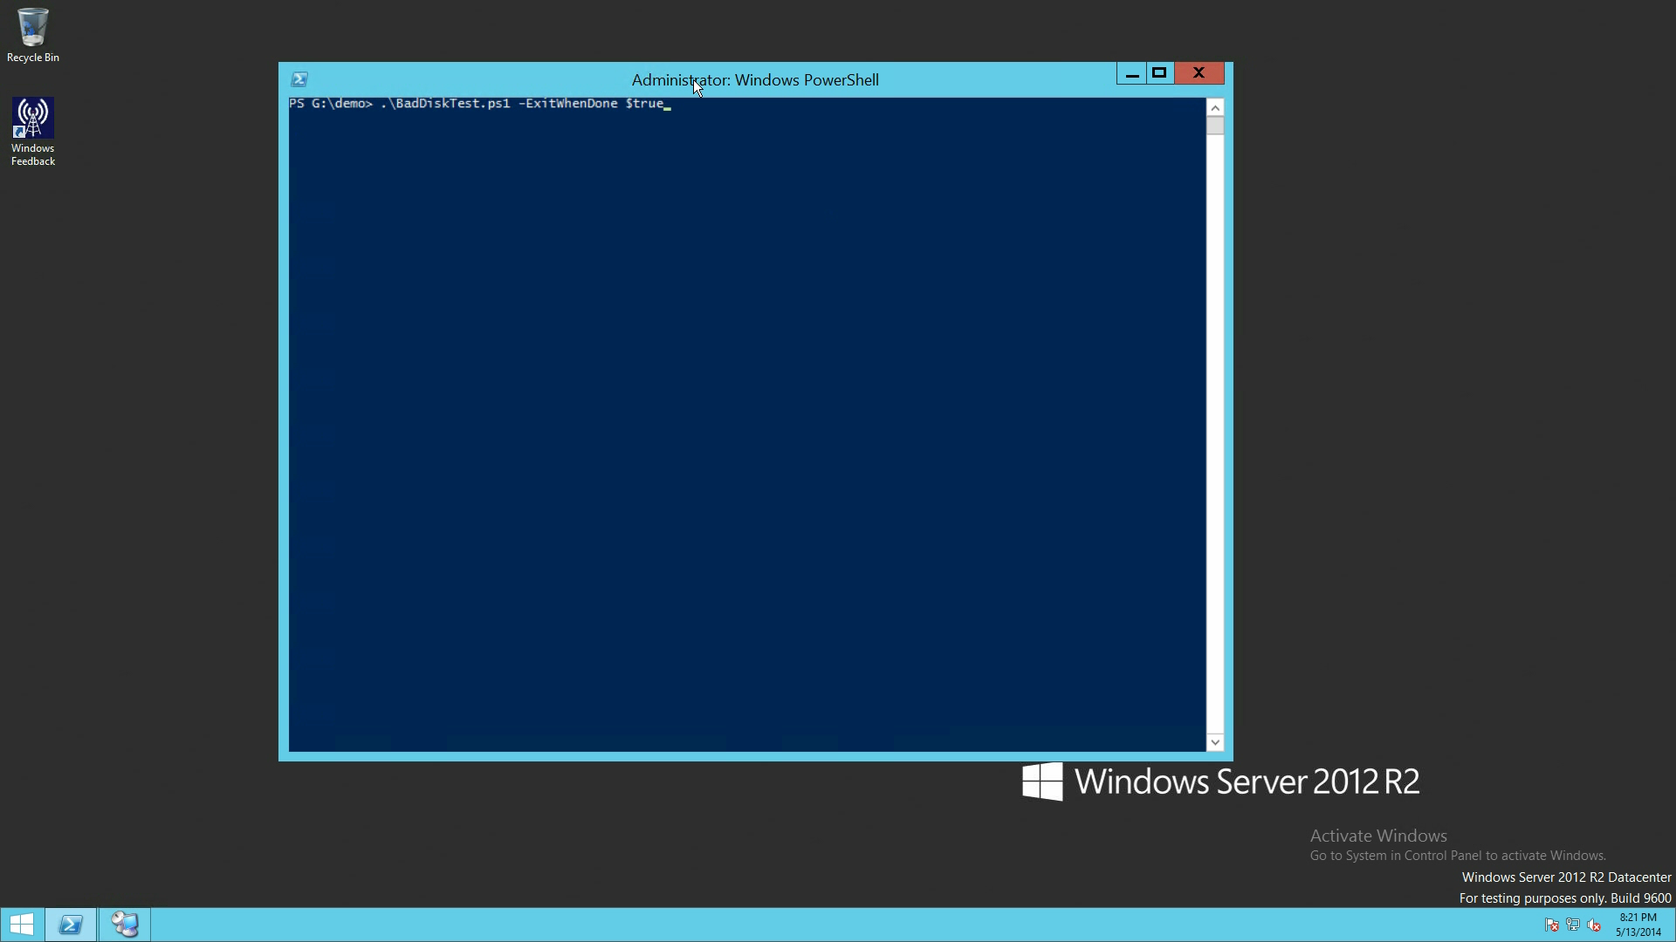
Performance Troubleshooting

