Slide 2
Management Pack Authoring for IT Admins
DCIM-B348
Raúl E. González Microsoft
Liz Kim Microsoft
Harold Dyck Silect Software

Slide 3
Session Objectives And Takeaways
Session Objective(s):
Identify which tools are available to build System Center Operation Manager Management Packs.
Identify which scenarios work best for each tool.
Takeaways
I know about the available tools for Management Pack authoring.
I have a general idea of what can MP Author do.
I have a general idea of how MP Studio can help management the lifecycle of Management Packs.

Slide 4
Agenda
Microsoft Investments in Management Packs (MP) space
Alternatives for authoring MP for OpsMgr
MP Author capabilities
Product Demo
Takeaways and Resources
Q&A

Slide 5
Investments in MP space
Sustain engineering
Common Engineering Criteria (CEC)
Simplifying the release process
Release schedule
Crowd-sourcing

Slide 6
Management Pack Authoring
IT Pros - Non Coding Required
MP Author
Developers
MP Visual Studio Authoring Extensions (VSAE)

Slide 7
Silect Software
www.silect.com
Visit Silect in Booth #1348
Founded in 2003, founding member of Microsoft System Alliance
Specializes in authoring, management and reporting solutions for System Center Operations Manager and Configuration Manager
MP Studio
MP Reporter
MP Author
ConfigWise
CP Studio
SCCM Reporter
Microsoft Gold ISV Partner

Slide 8
MP Author
A free management pack development tool for OpsMgr 2007 and 2012
Design and develop new MPs for applications
Customize existing MPs
Wizard-driven designer with pre-populated and modifiable settings
Create and configure discoveries, targets, rules and monitors

Slide 9
Demo Scenarios
Create an MP for a single server application
Create a Management Pack to discover and monitor a single server application
Show the end-to-end workflow of authoring and deploying a Management Pack using MP Author

Slide 10
Demo Scenarios
Create an MP for a single server application | Create an MP for a multi-tiered application
Create a Management Pack to discover and monitor a single server application | Create a Management Pack for a distributed application with a Web front end, a service middle tier and a database backend
Show the end-to-end workflow of authoring and deploying a Management Pack using MP Author | Demonstrate how MP Author and the 3 tier MP creation wizard can be used for more complex authoring scenarios

Slide 11
Demo Scenarios
Create an MP for a single server application | Create an MP for a multi-tiered application | Customization options for an existing MP
Create a Management Pack to discover and monitor a single server application | Create a Management Pack for a distributed application with a Web front end, a service middle tier and a database backend | Customize the newly created 3 tier Management Pack prior to deployment
Show the end-to-end workflow of authoring and deploying a Management Pack using MP Author | Demonstrate how MP Author and the 3 tier MP creation wizard can be used for more complex authoring scenarios | Show how MP Author and MP Studio can be used to customize unsealed and sealed Management Packs

Slide 12
Demo Scenarios
Create an MP for a single server application | Create an MP for a multi-tiered application | Customization options for an existing MP | Best practices for deploying and managing MPs
Create a Management Pack to discover and monitor a single server application | Create a Management Pack for a distributed application with a Web front end, a service middle tier and a database backend | Customize the newly created 3 tier Management Pack prior to deployment | Analyze, document and tune a Management Pack prior to deployment and manage multiple versions post-deployment
Show the end-to-end workflow of authoring and deploying a Management Pack using MP Author | Demonstrate how MP Author and the 3 tier MP creation wizard can be used for more complex authoring scenarios | Show how MP Author and MP Studio can be used to customize unsealed and sealed Management Packs | Show how MP Studio can be used as a best practices framework within a System Center environment

Slide 13
MP Author
A free management pack development tool for OpsMgr 2007 and 2012
Design and develop new MPs for applications
Customize existing MPs
Wizard-driven designer with pre-populated and modifiable settings
Create and configure discoveries, targets, rules and monitors

Slide 14
MP Studio
Management Pack analysis, reporting and documentation
Override management
Management Pack version control
View running workflows
Management Pack pre-deployment testing and tuning

Slide 15
Users Worldwide are Enjoying the Benefits of Silect MP Author

Slide 16
Resources
@ TechEd: Visit Silect Software in booth #1348
Where to get the tools?
MP Author: www.mpauthor.com (tool, FAQs, documentation)
MP Studio: www.silect.com/content/request-trial
Contacts
Support for tools: support@silect.com
MP Author feedback: www.mpauthor.com/feedback
www.silect.com

Slide 17
Q&A

Slide 18
In Review: Session Objectives And Takeaways
Session Objective(s):
Identify which tools are available to build OpsMgr Management Packs
Identify which scenarios work best for each tool
Takeaways
Non Coders should use MP Author or other tools available for Management Pack authoring.
Coders should consider MP Author or MP Visual Studio Authoring Extensions depending on the needs of the project.
MP Author will not help on MP lifecycle management.

Slide 19
Related content
DCIM-B348 Management Pack Authoring for IT Admins
Wednesday May 14 8:30 AM – 9:45 AM
DCIM-B381 Overview and Enhancements in Microsoft System Center 2012 R2 Operations Manager
Wednesday, May 14 10:15 AM - 11:30 AM
DCIM-IL309 Building Highly Effective Dashboards with Microsoft System Center 2012 R2 Operations Manager
Tuesday, May 13 1:30 PM - 2:45 PM
Visit Silect in Booth #1348

Slide 20
For More Information
Windows Server
Windows Server 2012 R2
http://technet.microsoft.com/en-US/evalcenter/dn205286
System Center
System Center 2012 R2
http://technet.microsoft.com/en-US/evalcenter/dn205295
Azure Pack
Azure Pack
http://www.microsoft.com/en-us/server-cloud/products/windows-azure-pack
Microsoft Azure
Microsoft Azure
http://azure.microsoft.com/en-us/
Come Visit Us in the Microsoft Solutions Experience!
Look for Datacenter and Infrastructure Management TechExpo Level 1 Hall CD

Slide 21
Resources
Learning
Sessions on Demand
Microsoft Certification & Training Resources
http://channel9.msdn.com/Events/TechEd
www.microsoft.com/learning
TechNet
msdn
Resources for IT Professionals
Resources for Developers
http://microsoft.com/technet
http://microsoft.com/msdn

Slide 22
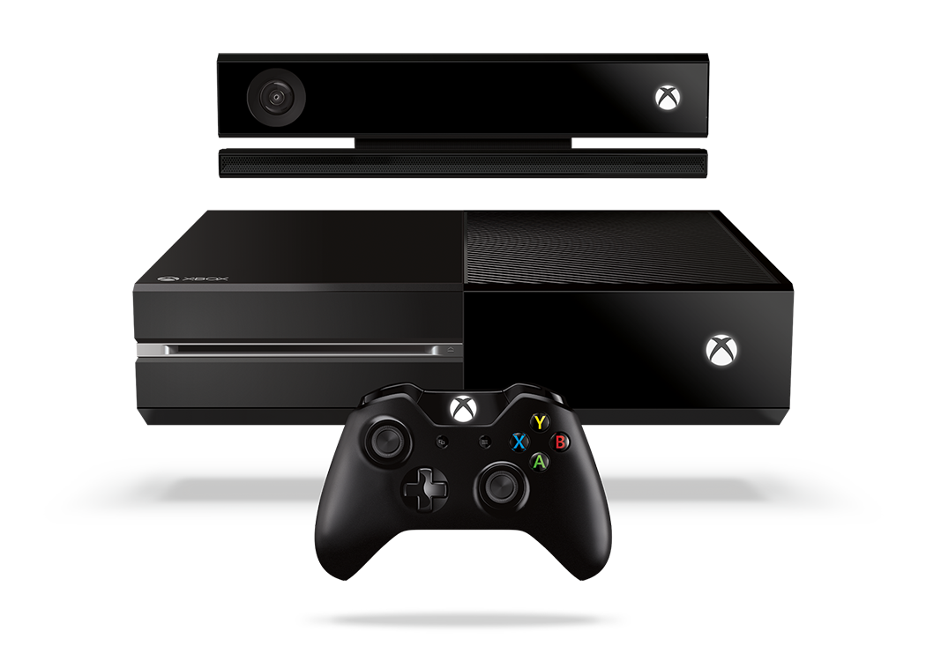
Complete an evaluation and enter to win!

Slide 23
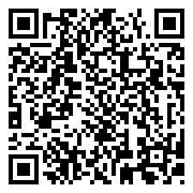
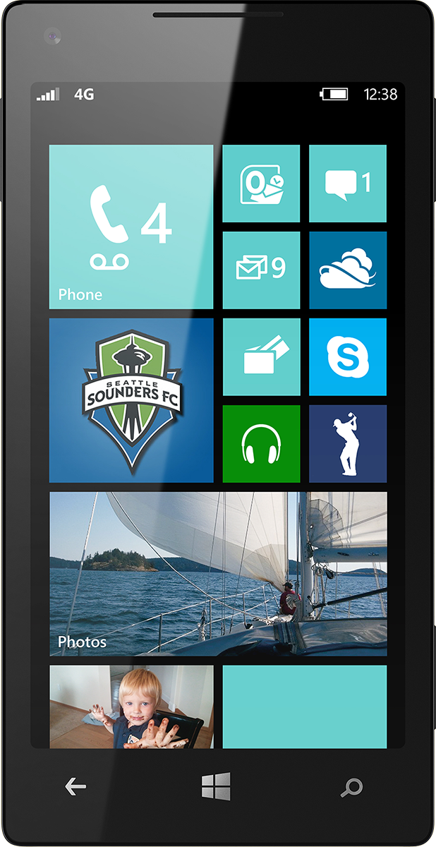
Evaluate this session
Scan this QR code to evaluate this session.

Slide 24
© 2014 Microsoft Corporation. All rights reserved. Microsoft, Windows, and other product names are or may be registered trademarks and/or trademarks in the U.S. and/or other countries.
The information herein is for informational purposes only and represents the current view of Microsoft Corporation as of the date of this presentation. Because Microsoft must respond to changing market conditions, it should not be interpreted to be a commitment on the part of Microsoft, and Microsoft cannot guarantee the accuracy of any information provided after the date of this presentation. MICROSOFT MAKES NO WARRANTIES, EXPRESS, IMPLIED OR STATUTORY, AS TO THE INFORMATION IN THIS PRESENTATION.

