Slide 2

Running Linux and FreeBSD on Hyper-V:
What You Need to Know
DCIM-B356
Abhishek Gupta {abgupta@microsoft.com}

Slide 3
Linux and FreeBSD Integration Services for Hyper-V
  Product goals and availability.
  Supported Linux and FreeBSD distributions.
  New and upcoming features.
  Feature demo.
  Known issues, tips and tricks.

Slide 4
Product Goals
Customers have an amazing experience while running Linux and FreeBSD on Microsoft public and private cloud infrastructure.
      Provide great functionality and performance.
Customers have great choice and availability in running Linux and FreeBSD distributions.
      On going integration in to new releases.
Customers can easily manage and extend their Linux and FreeBSD workloads.
      Product integrates well with System Center and all source code open sourced for customization and extension.

Slide 5
Running OSs on Hyper-V
OS runs on x86/ x64?
Have
Integration
Services?
Yes
Yes
Start
No
No
Dead end
Not going to run on
Hyper-V.
Emulated Devices
No Hyper-V integration
Limited manageability
Limited functionality
OK CPU, weak disk/net
Synthetic Devices
Full Hyper-V integration
Best manageability
Best functionality
Perf near bare metal
AIX, HP-UX,
Solaris SPARC,
Windows RT
Solaris x86,
Linux with no IS,
BSD with no IS
Linux with IS,
FreeBSD with IS
Windows with IS

Slide 6
Integration Services (IS): What Are They?
Hyper-V presents synthetic devices to the guest OS
  Synthetic devices seen by the guest OS are the same, regardless of the real hardware under Hyper-V
Guest OS needs drivers for these synthetic devices
  Just like an OS needs drivers for devices it sees when running on real hardware
Integration Services == the drivers for the Hyper-V synthetic devices
  They run in the guest OS so must follow the device driver model for that guest OS
  Windows IS are different from Linux IS are different from FreeBSD IS
  Linux and FreeBSD integration services also include some user-space daemons that interact with the drivers

Slide 7

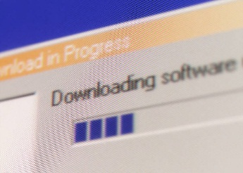





LIS Development, Distribution & Support
Microsoft
developers
LIS for Hyper-V
LIS for Hyper-V
Linux kernel main
Linux community
MS
download
center
Customer installs LIS
Support issues flow in reverse direction
Distro vendors
. . . .
Customer servers w/Hyper-V
Linux distro w/LIS

Slide 8

Supported Linux Distributions
  Key Linux vendors include LIS in their distros
  Support strategy
    Vanilla Linux questions: Contact the Linux vendor
    Issues running Linux on Hyper-V: Contact the Linux vendor or Microsoft
Distribution | Version |  | LIS Availability
Red Hat Enterprise Linux & CentOS | 5.5 - 5.8 | 6.0 - 6.3 | Download LIS 3.5 from Microsoft
 | 5.9, 5.10 | 6.4, 6.5 | LIS built-in and certified by Red Hat
 | 7.0 RC |  | LIS built-in
SUSE Linux Enterprise Server | 11 SP2, 11 SP3, Open SUSE 12.3 |  | LIS built-in
Ubuntu Server | 12.04, 12.10, 13.04, 13.10, 14.04 |  | LIS built-in
Debian | 7.0 - 7.4 |  | LIS built-in
Oracle Linux | 6.4, 6.5, UEK R3 QU1 |  | LIS built-in and certified by Oracle

Slide 9
New LIS Features
Feature | Description
Generation 2 support | Allows Linux virtual machines to be run in UEFI enabled Generation 2 mode.
File Copy from Host to Guest | Allows copying of files from host to guest without using the network interface.
Dynamic memory | Provides higher virtual machine density/host for Linux hosters.
2D video driver | Provides enhanced graphics performance and superior resolution for Linux desktop users.
VHDX online resize | Allows expansion of live mounted fixed sized Linux VHDs.
Synthetic fibre channel | Allows Linux virtual machines to natively access high speed fibre channel networks.
Live backup | Provisions uninterrupted backup support for live Linux virtual machines.
TRIM support | Allows Linux virtual machines to optimize storage consumption through technologies such as Thin Provisioning. Particularly useful for Linux virtual machines hosted in Azure.

Slide 10
Coming Soon LIS Features
Feature | Description
vRSS | Virtual Receive Side Scaling – distributes network interrupts to multiple vCPUs to avoid single vCPU bottleneck Mostly complete
Network performance improvements | New offloads and network optimizations to improve performance for 10Gbps network cards.

Slide 11
New Feature Availability
Feature | RHEL 7 | Ubuntu 14.04 | Ubuntu 13.10 | SLES 11 SP3
Generation 2 VMs | ✓ | ✓
File Copy from Host to Guest | ✓ | ✓
Dynamic memory | ✓ | ✓ | ✓ | ✓
2D video driver | ✓ | ✓ | ✓ | ✓
VHDX online resize | ✓ | ✓ | ✓ | ✓
Synthetic fibre channel | ✓ | ✓ | ✓ | ✓
Live backup | ✓ | ✓ | ✓ | ✓
TRIM support |  | ✓ | ✓

Slide 12
Dynamic Memory
Configuration parameters include Startup Memory, Minimum Memory and Maximum Memory.
As memory demand increases memory is Hot-Added to the virtual machine.
  Hot-Add mechanism increases the amount of memory available to (or addressable by) the virtual machine.
  The maximum amount of memory that can be made available to a virtual machine is capped by the Maximum Memory parameter.
As memory demand changes, Hyper-V uses Ballooning to allocate/deallocate memory from the virtual machine.
  The amount of memory assigned to a virtual machine varies between the Minimum Memory parameter and the available memory.
  Virtual machine does not know the exact amount of assigned memory.

Slide 13
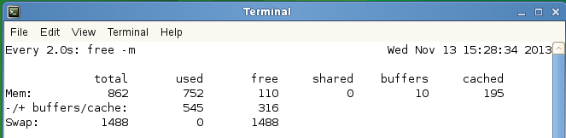
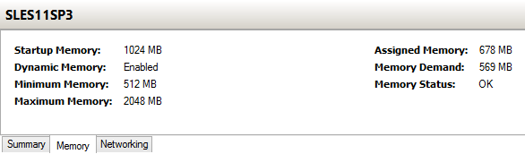
Dynamic Memory
Available/Addressable memory in MB
Output of “watch free –m” command in Linux bash shell.
Actual Allocated Memory
Output of Memory tab in Hyper-V Manager

Slide 14
Dynamic Memory Notes
Actual assigned memory to a virtual machine may be lower than what the virtual machine perceives.
  At times Hyper-V may not be able to service memory allocation requests.
Hot-Add mechanism requires certain amount of pre-existing memory in the guest.
  Large sudden memory demands which require Hot-Add operation may fail.
  Applications that consume all available memory may prevent further Hot-Add of memory.
Linux Hot-Add support still evolving.
  Working on infrastructure to improve pressure reporting.

Slide 15
Live Virtual Machine Backup
❸ LIS VSS components freeze the file system and flush in memory buffers
User Space
VSS*
Daemon
Linux
Guest
❷ Hyper-V signals LIS inside the Linux guest to do backup steps
File sys
buffers
VSS*
Driver
❶ Utility tells Hyper-V to start VM backup
Kernel
Hyper-V Host
Backup
Utility
❹ Hyper-V creates a
VM checkpoint & tells
LIS to unfreeze the FS.
❺ VSS in Hyper-V creates a snapshot of volume hosting the VHD
❻ Utility copies file-system consistent VHD from the snapshot
Guest
VHD
Hyper-V Storage
Backup
Storage
*Somewhat mis-named. Does not implement Windows VSS.

Slide 16
Demo

Slide 17
New LIS Documentation
Determining what features are supported where is complicated
  Version of LIS
  Linux distro
  Version of Hyper-V
  Various exceptions and notes
New documentation has grids with supported features:
  http://technet.microsoft.com/en-us/library/dn531030.aspx

Slide 18
LIS Source Code
Where to find it
Upstream availability:
http://git.kernel.org/cgit/linux/kernel/git/next/linux-next.git/tree/?id=HEAD
F: arch/x86/include/asm/mshyperv.h
F: arch/x86/include/uapi/asm/hyperv.h
F: arch/x86/kernel/cpu/mshyperv.c
F: drivers/hid/hid-hyperv.c
F: drivers/hv/
F: drivers/input/serio/hyperv-keyboard.c
F: drivers/net/hyperv/
F: drivers/scsi/storvsc_drv.c
F: drivers/video/hyperv_fb.c
F: include/linux/hyperv.h
F: tools/hv/

Slide 19
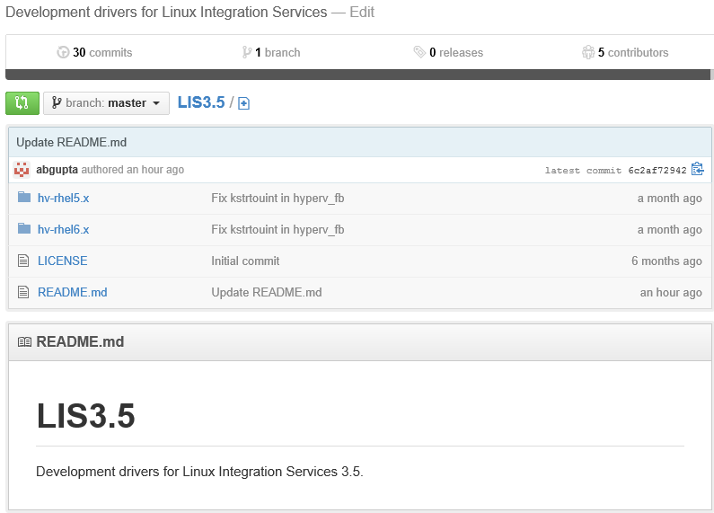
LIS Source Code
Where to find it
  LIS 3.x source code included in ISO downloadable from Technet
  Have also set up Github repo for LIS 3.5 - https://github.com/LIS/LIS3.5

Slide 20
LIS 3.5
Newest downloadable LIS package from Microsoft
  Binaries available for RHEL/CentOS 5.5-5.8/6.0-6.3
  Can install into Linux kernels that have no LIS or have LIS 3.x
  Only for distros that do not have LIS already built-in. Can not install on distros with built-in LIS.
  Mind the gap: LIS 3.5 provides some features that are not available in 5.9, 5.10, and 6.4
What’s New?
  Support for RHEL & CentOS 5.5 & 5.6: response to customer demand for older versions
  Dynamic memory – Ballooning only.
  Works with PAE kernels (PAE = physical address extension, for 32-bit kernels on >4Gbyte physical mem)
  Live Backup Support
  Synthetic Fiber Channel support

Slide 21
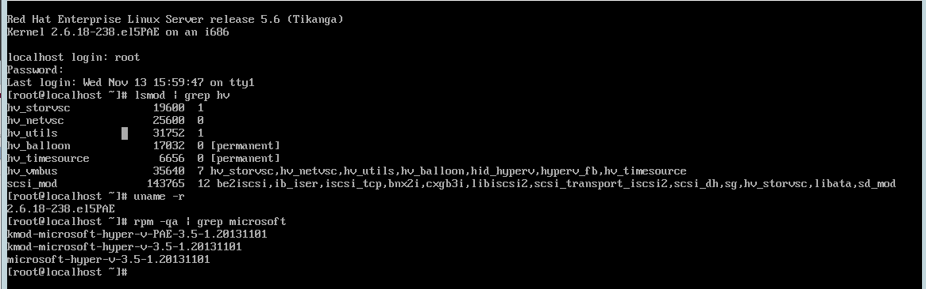
PAE Enabled RHEL 5.6 Server with LIS 3.5
PAE Enabled
LIS 3.5

Slide 22
LIS 3.5 vs LIS 3.4 – Feature Comparison
Feature | Hyper-V Version | RHEL 6.0-6.3 |  | RHEL 5.7-5.8 |  | RHEL 5.5-5.6
Availability |  | LIS 3.5 | LIS 3.4 | LIS 3.5 | LIS 3.4 | LIS 3.5 | LIS 3.4
Core | 2012 R2, 2012, 2008R2 | ✓ | ✓ | ✓ | ✓ | ✓
Networking
Jumbo Frames | 2012 R2, 2012, 2008R2 | ✓ | ✓ | ✓ | ✓ | ✓
VLAN tagging and trunking | 2012 R2, 2012, 2008R2 | ✓ | ✓ | ✓ | ✓ | ✓
Live Migration | 2012 R2, 2012, 2008R2 | ✓ | ✓ | ✓ | ✓ | ✓
Static IP Injection | 2012 R2, 2012 | ✓ | ✓ | ✓ |  | ✓
Storage
VHDX Resize | 2012 R2 | ✓ |  | ✓ |  | ✓
Virtual Fibre Channel | 2012 R2 | ✓ |  | ✓ |  | ✓
Live VM Backup | 2012 R2 | ✓ |  | ✓ |  | ✓
TRIM Support | 2012 R2

Slide 23
LIS 3.5 vs LIS 3.4 – Feature Comparison
Feature | Hyper-V Version | RHEL 6.0-6.3 |  | RHEL 5.7-5.8 |  | RHEL 5.5-5.6
Memory |  | LIS 3.5 | LIS 3.4 | LIS 3.5 | LIS 3.4 | LIS 3.5 | LIS 3.4
Configuration of MMIO gap | 2012 R2 | ✓ | ✓ | ✓ | ✓ | ✓ | ✓
Dynamic Memory – Hot Add | 2012 R2, 2012, 2008R2
Dynamic Memory – Ballooning | 2012 R2, 2012 | ✓ |  | ✓ |  | ✓
Video
Hyper-V Specific Video Device | 2012 R2, 2012, 2008R2 | ✓ |  | ✓ |  | ✓
Miscellaneous
Key/Value pair | 2012 R2, 2012, 2008R2 | ✓ | ✓ | ✓ |  | ✓
Non-Maskable Interrupt | 2012 R2 | ✓ | ✓ | ✓ | ✓ | ✓ | ✓

Slide 24
LIS: Known Issues
Network performance with 10 Gbit NICs
  May experience throughput in the range of 2GBps to 7GBps. Not quite at par with Windows VMs.
  Fixes to improve performance up to 8.xGBps available in upstream kernel and distributions scheduled for release in Fall 2014.
Linux VM images that run on Hyper-V 2008 R2 may not run on Hyper-V 2012 or 2012 R2
  Hyper-V 2012 introduced an incompatibility that causes some versions of LIS to not work
  Two Upgrade Paths
    Install LIS 3.5 into these images while still running on 2008 R2, then migrate.
    Start fresh by installing base Linux on 2012 or 2012 R2, then install LIS 3.5.

Slide 25
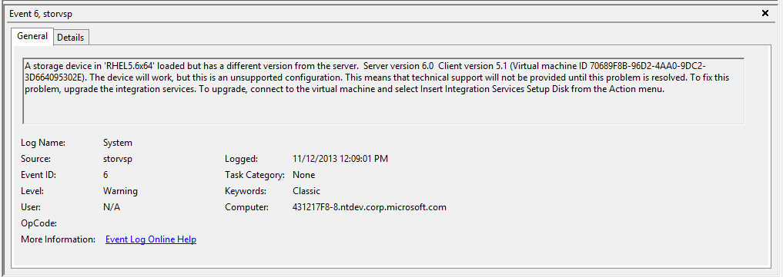
LIS: Version Mismatch Message in Event Log
Ignore Hyper-V messages about incompatible LIS version and being in an unsupported state. (KB 2956569)

Slide 26
LIS: What version do I have?
LIS is a collection of drivers – no single version #
For distributions with built in LIS components (Ubuntu 13.10, SLES 11 SP3) no need to determine version numbers.
      Ignore messages that indicate LIS version to be 3.1
For distributions that require manual LIS installation (RHEL 5.5-5.8/6.0-6.3), use the following steps to determine LIS version number:
  # rpm –qa | grep hyper-v
  The above command should result in an output similar to below:
  # microsoft-hyper-v-rhel6012.3.5-1.20131031.x86_64
  The highlighted yellow portion of the above string indicates that the installed LIS version is 3.5.

Slide 27
LIS Tips and Tricks
Use Static MAC Addresses in High Availability (HA) Scenarios.
Use I/O scheduler NOOP for better disk I/O performance.
Use manual steps to install Hyper-V related daemons on certain distributions.
    On Ubuntu install the hv-kvp-daemon-init package.
    On CentOS/Oracle/RHEL use installation GUI to ensure that daemons are installed.

Slide 28
FreeBSD
Initial Integration Services now complete
Built-in to FreeBSD 10
  KVP support is available in a separate port
Ports available for FreeBSD 8.3, 9.1, 9.2
Community support only for now
No System Center support at this time
Currently trying to bring virtual appliance manufacturers on board.
    FreeNAS 9.2.1 for Hyper-V available - http://download.freenas.org/9.2.1/HYPERV/RELEASE/

Slide 29
FreeBSD Feature Chart
Feature | Hyper-V Version | 10 | 9.2 | 9.1 | 8.3
Availability |  | Built in | FreeBSD Ports | FreeBSD Ports | FreeBSD Ports
Core | 2012 R2, 2012, 2008R2 | ✓ | ✓ | ✓ | ✓
Networking
Jumbo Frames | 2012 R2, 2012, 2008R2
VLAN tagging and trunking | 2012 R2, 2012, 2008R2
Live Migration | 2012 R2, 2012, 2008R2 | ✓ | ✓ | ✓ | ✓
Static IP Injection | 2012 R2, 2012 | ✓ | ✓ | ✓ | ✓
Storage
VHDX Resize | 2012 R2
Virtual Fibre Channel | 2012 R2
Live VM Backup | 2012 R2
TRIM Support | 2012 R2

Slide 30
FreeBSD Feature Chart
Feature | Hyper-V Version | 10 | 9.2 | 9.1 | 8.3
Memory |  | Built in | FreeBSD Ports | FreeBSD Ports | FreeBSD Ports
Configuration of MMIO gap | 2012 R2 | ✓ | ✓ | ✓ | ✓
Dynamic Memory – Hot Add | 2012 R2, 2012, 2008R2
Dynamic Memory – Ballooning | 2012 R2, 2012, 2008R2
Video
Hyper-V Specific Video Device | 2012 R2, 2012, 2008R2
Miscellaneous
Key/Value pair | 2012 R2, 2012, 2008R2 | ✓ (Note 1) | ✓ | ✓ | ✓
Non-Maskable Interrupt | 2012 R2 | ✓ | ✓ | ✓ | ✓
Note 1: Key/Value pair for FreeBSD 10 will be available through a separate FreeBSD port

Slide 31
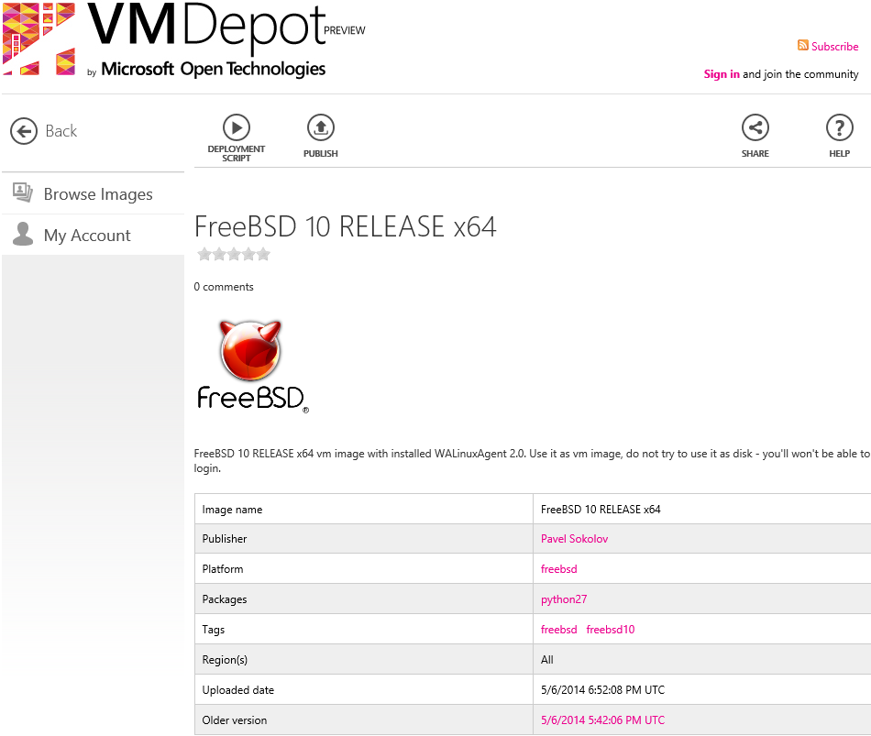
Availability on Azure
FreeBSD 10 Virtual Machine Image
available in VMDepot
For the community, by the community.

Slide 32
Related content
Breakout Sessions (session codes and titles)
DCIM-B217 Managing Linux with Windows Server 2012 R2 Hyper-V and Microsoft System Center 2012 R2: For the Windows Administrator
DCIM-B342 Linux/UNIX Compliance and Patch Management with Microsoft System Center 2012 R2
PCIT-B336 Managing Mac OS X Clients and Linux Servers Using Microsoft System Center Configuration Manager
Labs (session codes and titles)
DCIM-H326 Managing Linux Servers with Microsoft System Center 2012 R2
PCIT-H311 Implementing Linux Clients in Microsoft System Center 2012 R2 Configuration Manager

Slide 33
Links of Interest
Channel 9 Talk on Linux/FreeBSD Integration Services on Hyper-V
  http://channel9.msdn.com/Shows/Edge/Edge-Show-87-Linux-Integraton-Services-for-Hyper-V
Linux Virtual Machines on Hyper-V
  http://technet.microsoft.com/en-us/library/dn531030.aspx
Linux Integration Services for Microsoft Hyper-V Forum
  http://technet.microsoft.com/en-us/library/dn531030.aspx

Slide 34

For More Information
Windows Server
Windows Server 2012 R2
http://technet.microsoft.com/en-US/evalcenter/dn205286
System Center
System Center 2012 R2
http://technet.microsoft.com/en-US/evalcenter/dn205295
Azure Pack
Azure Pack
  http://www.microsoft.com/en-us/server-cloud/products/windows-azure-pack
Microsoft Azure
Microsoft Azure
  http://azure.microsoft.com/en-us/
  Come Visit Us in the Microsoft Solutions Experience!
  Look for Datacenter and Infrastructure Management
  TechExpo Level 1 Hall CD

Slide 35

Resources
Learning
  Sessions on Demand
  Microsoft Certification & Training Resources
http://channel9.msdn.com/Events/TechEd
www.microsoft.com/learning
TechNet
msdn
  Resources for IT Professionals
  Resources for Developers
http://microsoft.com/technet
http://microsoft.com/msdn

Slide 36



Complete an evaluation and enter to win!

Slide 37


Evaluate this session
Scan this
QR code
to evaluate
this session.

Slide 38


© 2014 Microsoft Corporation. All rights reserved. Microsoft, Windows, and other product names are or may be registered trademarks and/or trademarks in the U.S. and/or other countries.
The information herein is for informational purposes only and represents the current view of Microsoft Corporation as of the date of this presentation. Because Microsoft must respond to changing market conditions, it should not be interpreted to be a commitment on the part of Microsoft, and Microsoft cannot guarantee the accuracy of any information provided after the date of this presentation. MICROSOFT MAKES NO WARRANTIES, EXPRESS, IMPLIED OR STATUTORY, AS TO THE INFORMATION IN THIS PRESENTATION.

