Slide 1


Slide 2

Deploying Microsoft SQL Server 2014 with
Cluster Shared Volumes
DCIM-B364
Subhasish Bhattacharya
Program Manager
Microsoft

Slide 3
Prerequisites
Good grasp of Failover Clustering fundamentals
Proficiency with SQL Server deployment using “traditional” cluster storage

Slide 4
Agenda
Cluster Shared Volumes (CSV) overview
Value of deploying SQL Server over CSV
Deployment Considerations
Step-by-step deployment of SQL 2014 with CSV

Slide 5
Cluster Shared Volumes Overview

Slide 6
What is Cluster Shared Volumes (CSV)
Clustered file system in Windows Server
Layer of abstraction above NTFS
All cluster nodes can read/write to the CSV volume
LUN ownership by node abstracted from SQL
SQL Server failover without drive ownership changes
No dismounting and remounting of volumes
Faster failover times (less downtime)
Reference: Cluster Shared Volumes Reborn in Windows Server 2012: Deep Dive, TechEd 2012

Slide 7


Cluster Shared Volumes (CSV)
I/O synchronization overview
Metadata
Simultaneous read/write access on all Cluster Nodes
Server side metadata synchronization
- Avoids I/O interruptions
Read/Write
Shared Storage
Shared LUN
DB
DB
DB

Slide 8


Cluster Shared Volume data path
Node 1
Node 2
Coordination Node
Node 3
Cluster Shared Volume File System (CSVFS)
CSV Proxy File System
Stack
CSV Proxy File System
Stack
CSV Proxy File System
Stack
NTFS Stack
SMB 3.0
Disk
LBFO/RDMA
Disk
Storage Connection Broken or not present
Shared Storage

Slide 9
Cluster Shared Volume metadata path
Node 1
Node 2
Coordination Node
Node 3
Cluster Shared Volume File System (CSVFS)
SMB 3.0
SMB 3.0
CSV Proxy File System
Stack
CSV Proxy File System
Stack
CSV Proxy File System
Stack
NTFS Stack
Disk
LBFO/RDMA
Disk
Storage Connection Broken or not present
Shared Storage

Slide 10
When do Metadata Updates Occur
  SQL Server Database
  Open/Close
  Initial provisioning
  Extend (With auto log increment enabled – not recommended)
  Backup - Snapshot creation
Key Takeaways
Metadata updates are small operations, infrequent for SQL scenarios
Parallel metadata updates - non-disruptive for SQL

Slide 11
Cluster Shared Volume Architecture
Node 1
Node 2
Coordination Node
Node 3
Cluster Shared Volume File System (CSVFS)
SMB 3.0
SMB 3.0
File System Redirected I/O
CSV Proxy File System
Stack
CSV Proxy File System
Stack
CSV Proxy File System
Stack
NTFS Stack
SMB 3.0
Disk
LBFO/RDMA
Disk
Block Redirected I/O
Storage Connection Broken or not present
Direct I/O
Shared Storage

Slide 12




CSV Node Fault Tolerance
Node Failure
SQL running on Node 2 is unaffected
Brief queuing of I/O while volume ownership is changed
Volume relocates to a healthy node
DB

Slide 13
CSV Network Fault Tolerance
SMB Multi-channel with failover to NetFT (Cluster Fault-Tolerant TCP Connections)
Metadata Updates Rerouted to redundant network
SQL running on Node 2 is unaffected
Volume mounted on Node 1
Network Path Connectivity Failure
DB

Slide 14
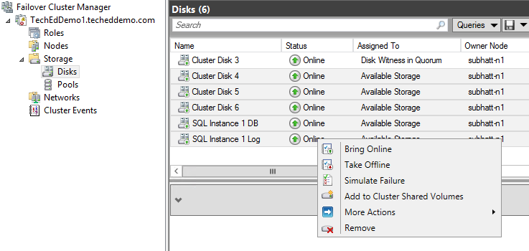
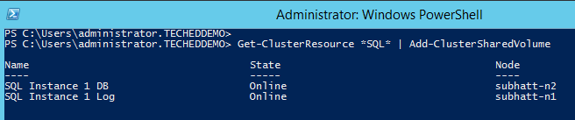
Adding storage to Cluster Shared Volumes
Failover Cluster Manager
Multi-select disks to add
Right-Click
Choose Add to Cluster Shared Volumes
PowerShell
Use the Add-ClusterSharedVolume cmdlet

Slide 15
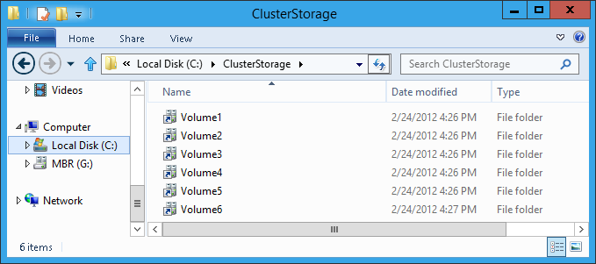
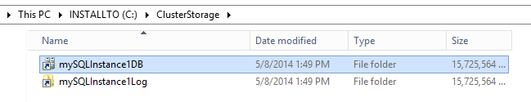
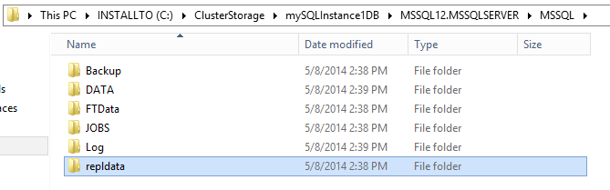
Single Namespace
Consistent view across the cluster
Single consistent file name space
Files have same name & path on any cluster node
Volumes exposed under “ClusterStorage” root directory
VolumeX directory name can be renamed. Should be done before SQL Server deployment.

Slide 16
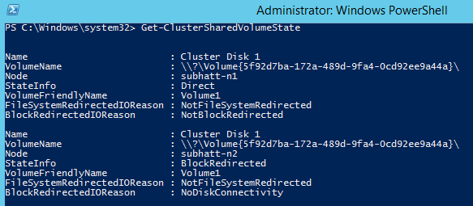
Determining the state of your CSV
CSV State
Displays on a per-node basis the CSV I/O mode
Displays reason if in a redirected mode
Direct I/O, Block level redirected mode, File system level redirected mode
Get-ClusterSharedVolumeState PowerShell cmdlet
Displays CSV I/O mode
Reports why
Reference: Understanding the State of your Cluster Shared Volumes in Windows Server 2012 R2

Slide 17
Demo
Configuring
Cluster Shared Volumes

Slide 18
Value of Deploying
SQL Server with CSV

Slide 19
Challenges with your SQL Server deployment today
Manageability
Multi-path and masking of large numbers of LUNs
Flexibility
A LUN per SQL instance
…
1
2
12
Capacity
Poor SAN space utilization
Scalability
Limited to ~24 SQL instances
…
DB1
LUN1
Log1
LUN2
DB2
LUN3
Log2
LUN4
DB12
LUN23
Log12
LUN24

Slide 20
Value of Deploying SQL Server on CSV
Consolidation
Simplified storage management
Consolidation of multiple instances onto single LUN
Better capacity planning, storage utilization
Addresses drive letter limitations
Greater than 24 SQL instances on single cluster
…
1
2
49
…
…
DB1
DB49
Log1
Log2
Log49
DB2
CSV1 on LUN1
CSV2 on LUN2

Slide 21
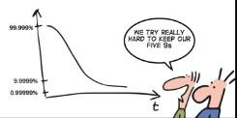
Value of Deploying SQL Server on CSV
Increased Availability
Faster Failover times
No dismounting, remounting volumes required
Databases moved without requiring drive ownership changes
Resiliency to Storage Failures
CSV Chkdsk integration
File system correction with zero downtime

Slide 22


Resiliency to Storage Failures
SQL on Traditional Storage
SQL on CSV
I/O Redirected via network
SQL running on Node is unaffected
SQL running on Node is unavailable
Coordination Node
SAN Connectivity Failure
SAN Connectivity Failure
DB
DB

Slide 23
CSV Chkdsk Integration
Chkdsk Improvements
Scanning process separated from repair process
Volume scanned online
Zero offline time for repair with CSV
Based on number of errors to fix rather than size of volume
Repair now takes seconds not hours!
<3 seconds of repair time
Reference: NTFS Health and Chkdsk
How to Run ChkDsk and Defrag on Cluster Shared Volumes in Windows Server 2012 R2

Slide 24


Value of Deploying SQL Server on CSV
Performance and Security
CSV block level cache
Distributed read-only cache for unbuffered I/O to SQL databases
BitLocker encrypted CSV
Enables physical security for deployments outside of
secure datacenters e.g. Branch Offices
Volume level encryption for compliance requirements
Reference: How to enable CSV Cache
How to configure BitLocker Encrypted Clustered Disks in Windows Server 2012

Slide 25
Roadmap from PolyServe to CSV
PolyServe end-of-life (Feb 2014)
CSV | PolyServe “QuickSpecs”
P | SQL Server Consolidation
P | High Availability for Mission-Critical Applications
P | Real-Time Resource Allocation Adjustments
P | Scale System Capacity Online
P | Simplify Infrastructure Management
P | Backups/Snapshots
64 | Servers Supported per Cluster
Reference: http://h18000.www1.hp.com/products/quickspecs/12741_na/12741_na.PDF

Slide 26
Deployment Considerations

Slide 27
SQL Server Failover Cluster Instance (FCI)
FCI with Local Shared Storage
Aggregated Storage Configuration
CSV supported in >= WS2012 + SQL Server 2014

Slide 28

SQL Server Failover Cluster Instance (FCI)
FCI with Remote Storage - Scale-Out File Server(SoFS)
SQL FCI
Disaggregated Storage Configuration
SoFS
Cluster
Share
Share
Share
Supported in
>= WS2012 +
>= SQL Server 2012
CSV
Reference: Hyper-V over SMB Scenario, TechEd 2013

Slide 29
SQL Server Deployment Guidance
SQL Scenario | Storage | Supported Versions
 |  | Windows | SQL
Failover Cluster Instance (FCI) | Cluster Shared Volumes (Aggregated) | >= WS2012 | SQL 2014
 | Scale-out File Server (Disaggregated) | >= WS2012 | >= SQL 2012
Others | “Traditional” Cluster Disk | All¹ | All¹
1 – All versions supported by Microsoft. Refer to www.microsoft.com/lifecycle

Slide 30
SQL Server Failover Cluster Instance (FCI)
FCI with Direct Attached Storage (DAS) and Third-Party Storage Replication
Third-Party
Software Storage Replication
Hardware Storage Replication
CSV supported in WS2012 + SQL Server 2014
CSV not supported

Slide 31
SQL Server Availability Groups (AGs)
Primary Site
DR Site
CSV not supported. Requirement for unique SQL DB name across sites

Slide 32
Storage Considerations
Log and DB locations for a FCI
Keep on CSVs carved out of different physical disks
Helps avoid IO Contention
…
1
2
49
…
…
DB1
DB49
Log1
Log2
Log49
DB2
CSV1 on LUN1
CSV2 on LUN2

Slide 33
Network Planning for CSV
Network path may be leveraged for CSV
Metadata updates which are infrequent for SQL Server
No storage connectivity for failure recovery, asymmetric configurations
Provision appropriate network bandwidth
Avoid bottleneck for SMB traffic from nodes to CSV coordinator node.
Distribute CSVs owners across cluster
Disable iSCSI networks for cluster use
Prevents use for CSV traffic
Reference: Failover Clustering Networking Essentials, TechEd 2013

Slide 34
Step-by-step deployment of SQL Server with CSV

Slide 35
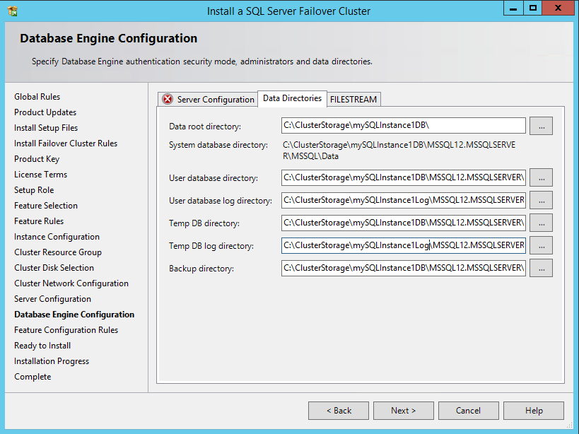
Deploying SQL Server with CSV
Provision Shared Storage for Cluster
Add Storage to CSV
Install SQL 2014 on first node
  On Database Engine Configuration Page indicate CSV storage to be used for instance.
Add remaining nodes to SQL Server FCI
Use the CSVs provisioned in Step 2
Reference: Deploying SQL Server 2014 with Cluster Shared Volumes

Slide 36
Demo
Deploying
SQL Server 2014 with CSV

Slide 37

Key Takeaways
Value of deploying SQL Server with CSV
Scalability
Consolidation of multiple SQL instances
Better capacity planning, storage utilization
Addresses drive letter limitation
Allows > 24 SQL instances on cluster
Availability
Resilience from storage failures
Fast failover
No dismounting/remounting of volumes
DB moved without drive ownership changes
Zero downtime Chkdsk
Operability
Simple management
Manage from any node
Abstraction to which node owns the disk
Solution for PolyServe End-of-life
Performance and Security
CSV Block Cache
Read-only cache for unbuffered I/O to SQL databases
BitLocker Encrypted CSV

Slide 38
Related content
Breakout Sessions
  DBI-B332 AlwaysOn in Microsoft SQL Server 2014
  DCIM-B354 Failover Clustering: What's New in Windows Server 2012 R2
  DCIM-IL308 Windows Server 2012 R2: Introduction to Failover Clustering with Hyper-V
  DCIM-B327 Cluster-in-a-Box Using Windows Server 2012 R2: Solutions and Applications
  DCIM-B337 File Server Networking for a Private Cloud Storage Infrastructure in Windows Server 2012 R2
  DCIM-B349 Software-Defined Storage in Windows Server 2012 R2 and Microsoft System Center 2012 R2
Labs
  DCIM-IL200 Build Your Storage Infrastructure with Windows Server 2012 R2

Slide 39

Resources
  Failover Clustering Blog
  Failover Discussion Forum
http://social.technet.microsoft.com/Forums/en/winserverClustering/
http://blogs.msdn.com/b/clustering/
  Ask The Core Team Blog
http://blogs.technet.com/b/askcore/archive/tags/failover+cluster/default.aspx

Slide 40

For More Information
Windows Server
Windows Server 2012 R2
http://technet.microsoft.com/en-US/evalcenter/dn205286
System Center
System Center 2012 R2
http://technet.microsoft.com/en-US/evalcenter/dn205295
Azure Pack
Azure Pack
  http://www.microsoft.com/en-us/server-cloud/products/windows-azure-pack
Microsoft Azure
Microsoft Azure
  http://azure.microsoft.com/en-us/
  Come Visit Us in the Microsoft Solutions Experience!
  Look for Datacenter and Infrastructure Management
  TechExpo Level 1 Hall CD

Slide 41

Resources
Learning
  Sessions on Demand
  Microsoft Certification & Training Resources
http://channel9.msdn.com/Events/TechEd
www.microsoft.com/learning
TechNet
msdn
  Resources for IT Professionals
  Resources for Developers
http://microsoft.com/technet
http://microsoft.com/msdn

Slide 42



Complete an evaluation and enter to win!

Slide 43


Evaluate this session
Scan this
QR code
to evaluate
this session.

Slide 44


© 2014 Microsoft Corporation. All rights reserved. Microsoft, Windows, and other product names are or may be registered trademarks and/or trademarks in the U.S. and/or other countries.
The information herein is for informational purposes only and represents the current view of Microsoft Corporation as of the date of this presentation. Because Microsoft must respond to changing market conditions, it should not be interpreted to be a commitment on the part of Microsoft, and Microsoft cannot guarantee the accuracy of any information provided after the date of this presentation. MICROSOFT MAKES NO WARRANTIES, EXPRESS, IMPLIED OR STATUTORY, AS TO THE INFORMATION IN THIS PRESENTATION.

