Slide 2
Fighting Evil with Good
DCIM-B374
Ivan Macalintal
AM Scan Team
Developer Services,
Product Release and Security Services

Slide 3

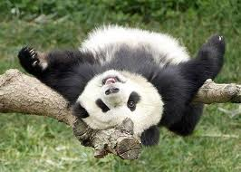
MSFT Product Release and Security Services –
AM Scan
(’96) Started as PRS
(‘98, VB) Randy Abrams introduced AM Scanning in Product Release space
(’01, VB) VCS (Virus Checking Service) introduced
(’06-’09, AVAR) Evolution, Improvement, Advancements by Jonathan Poon and Ian McMillan
(’13, BSides Redmond) “Operation Dead Panda”, Metadata Intelligence and more improvements presented by Roland de la Paz and Ivan Macalintal
(‘14, Digital Crimes Consortium) “Fighting Evil with Good” by Ivan Macalintal

Slide 4
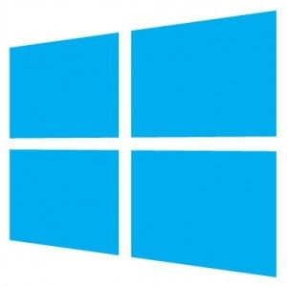
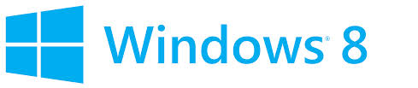




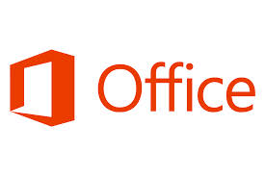


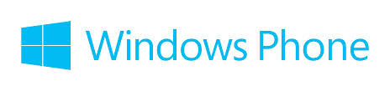

Slide 5
MSFT Product Release and Security Services –
AM Scan (cont)
Product Release, CodeSign, VCS
Systems, workstations, servers span multiple regions
Pre-Job → File-Copy → Explode → Scan → Post-Release

Slide 6
2,000++
500++
1.73B++
2.65T++
400++
100++
30++
52G++

Slide 7
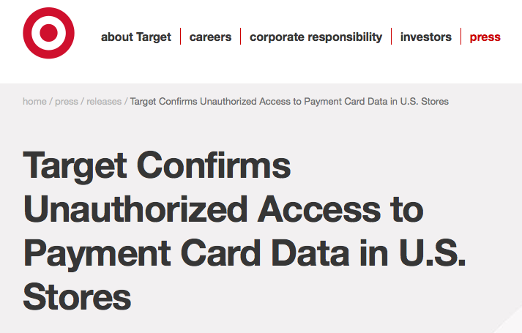
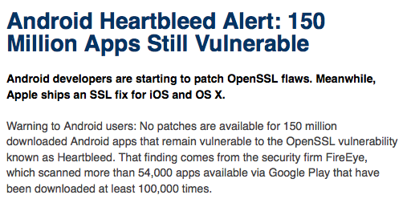
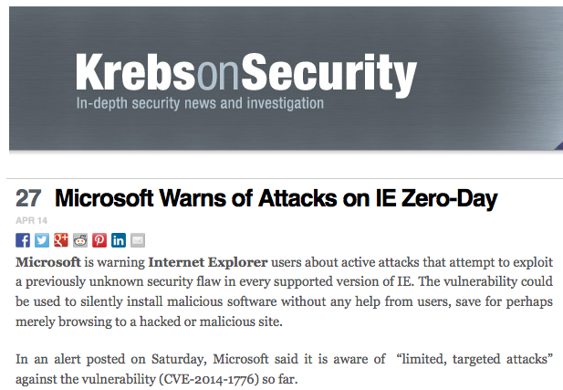


Slide 8
Files
URLs
Emails
IPs, Netblocks
DNS, ASN, BGP,
…
Email
Addresses
Aliases
Web forum
Accounts
Social
Network
Accounts
…
Threat Intelligence

Slide 9
industry and community exchanges
security mailing lists/forums
free web services
open source
…

Slide 10
STIX
Structured Threat Information Expression
TAXII
Trusted Automated Exchange of Indicator Information
IODEF
Incident Object Description Exchange Format
CIF
Collective Intelligence Framework
…and many more out there!

Slide 11
There is an increasing demand in the industry for clean file metadata intelligence as opposed to traditional threat intelligence, and Microsoft is taking part and helping in jump-starting this effort to supply and provide this value to customers, partners and the overall security community as well.

Slide 12


Slide 13
Original Product Names
Files (binaries)*
File hashes
File sizes
File names
Dates of file creation
Dates of file release
Digital
certificates
Locations
SWIDs
…
Clean-File Meta-Data
Intelligence

Slide 15
Compliment Traditional Blacklisting and Whitelisting Efforts
Effects
of
False Positives
=
Effects
of
Malware
>

Slide 16
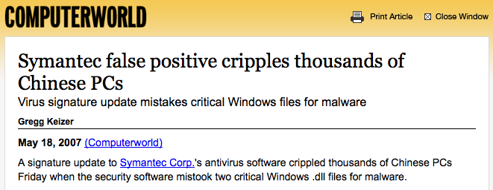
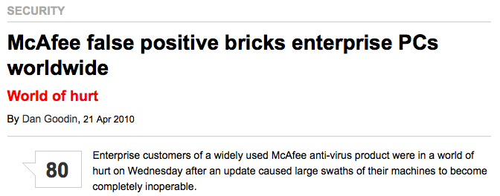
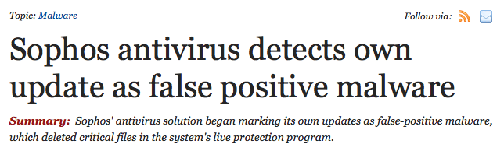
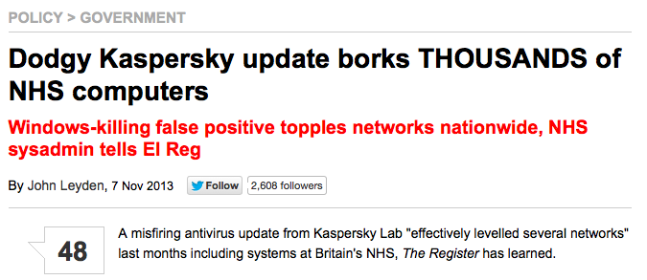

Slide 17
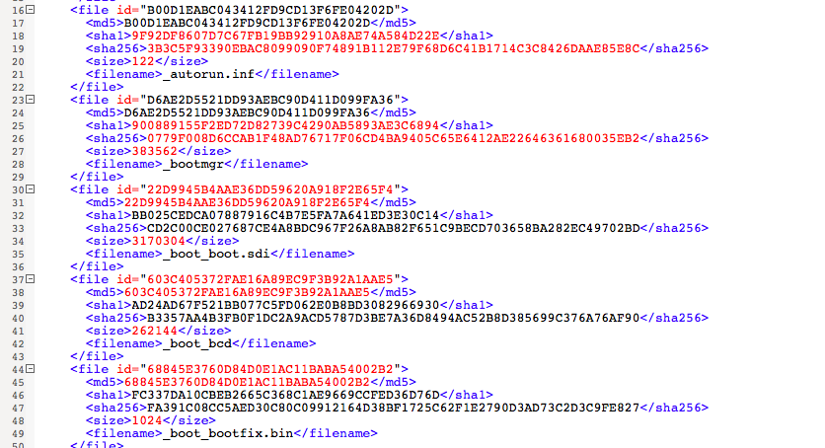
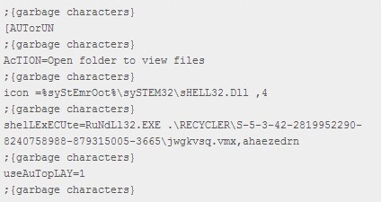
Trojanized Microsoft Files
trojanized, infected, patched, modified
= same potato = BAD
Example: autorun.inf

Slide 18
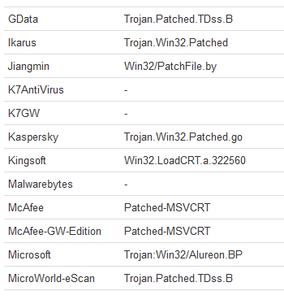
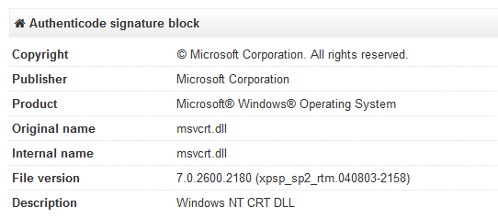
Trojanized Microsoft Files (cont)
Msvcrt.dll
Part of MSFT C Runtime Lib
Used in a recent cyber-crime campaign (Alureon/DNSChanger/TDSS)

Slide 19
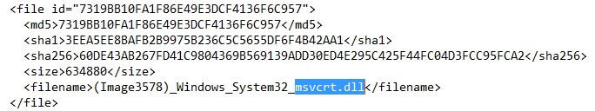
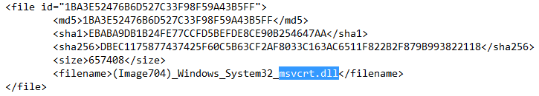
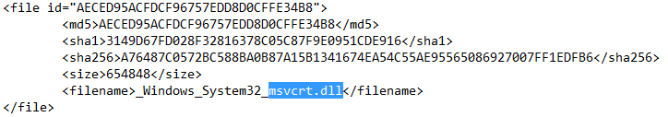
Trojanized Microsoft Files (cont)
EVIL | GOOD
228c81e206100aabcd651027044153dd019fc6c6 | 3EEA5EE8BAFB2B9975B236C5C5655DF6F4B42AA1
64596898a80378600dd9dbb0a9a7f885c1c99b58 | EBABA9DB1B24FE77CCFD5BEFDE8CE90B254647AA
ee829fc4072fc6751e413a62f263ddcc7b16de18 | 3149D67FD028F32816378C05C87F9E0951CDE916
305fdf72e5f5e0f1b4995f9ea4dc445e842532d6
015f00225d415d62d53a168569e50b180f9d0029
64fab06d03265d2e7f9b1df34b362c5879a7f1d7
e70e6b5c5a55d9da8c8d75e17650af60aac35c8e
47ce99362c6b8b48be175bf0a97648ceec90a3a4
c55b6652ae215b287cd800d55f1c5633ce0facc5
bd821f5c3438763564302f2f5f507df5a3da15e0
6a08e0a1321922a7b74565b3ba20090fe805bb48
And many more…

Slide 20
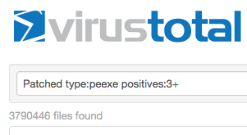
Trojanized Microsoft Files (cont)

Slide 21
DLL Side-Loading
Brand name/reputation compromise
Attempts to bypass traditional anti-malware detection technologies
Targeted files from NVidia, Mcafee/Intel, Google, Trend Micro and at least 3 files from Microsoft:
  rc.exe
  msidb.exe
  oinfop11.exe

Slide 22
DLL Side-Loading (cont)
Attack using PlugX (RAT)
Spear-Phishing Email with evil attachment (exploiting CVE-2012-0158)
|
|→ 721cca40df0f7eab5b5cb069ee8fda9d (ews.exe)
|
|→ a31cad2960a660cb558b32ba7236b49e (OinfoP11.exe)
|
|→ b355dedbabb145bbf8dd367adac4f8c5 (Oinfo11.ocx)
|
|-> 128e3fc5ffba06abdd3edab2aff3753f (Oinfo11.iso)
|
|→ 0wned by PlugX!

Slide 23
DLL Side-Loading (cont)
OINFOP11.EXE
a31cad2960a660cb558b32ba7236b49e (MD5), b9aaaade26a07000d13550ec2de5008315750d65 (SHA-1)
119872 bytes
Part of Office 2003
File version 11.0.5510
In NSRL (National Software Reference Library)
with verified Microsoft Digital Signature, signed 6:57 AM 7/15/2003
Certificate validity from 1:55AM 5/25/2002 to 2:05AM 11/25/2003…
There have been newer versions since!

Slide 24
Aid in Anti-Software Piracy Efforts
Brand/reputation compromise
Loss of income; tax issues
Can lead to exploitation, malware compromise, user 0wned
What if we have an Authoritative Manifest (in the form of meta-data) of shipped and installed software? Can this help?

Slide 25
Aid in Anti-Software Piracy Efforts (cont)
Recent anti-piracy investigation
Windows XP and Windows 7
Laptops purchased in different cities in a certain country
All with pirated Windows
Malwares: Citeary, Smee, Grey Pigeon, Nitol, FlyAgent
Adwares/Spywares: IESuper, OpenCandy, StartPage

Slide 26
Vital factor in Litigation and Legal Proceedings
WHAT
WHEN
WHERE
WHO

Slide 27
Threat-Intelligence, Big Data Analytics and the Cloud

Slide 28
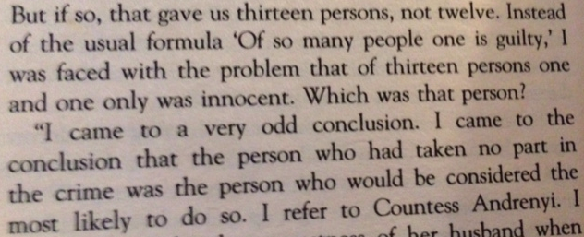

Slide 29

A Missing Piece…
Threat Intelligence
Clean File Meta-Data Intelligence

Slide 30
Now Showing!
Win7 and WinXP Meta-Data NOW Available (As-Is)
Microsoft Code-Signed and with a Microsoft disclaimer
Shared with Anti-Malware industry as a Proof-of-Concept
Working with the IEEE CMX (Management Committee)
  Clean File Metadata Exchange
  Presented already in other conferences, most recent in AVAR 2014
Semi-Automated, not yet Real-Time
Sharing and Distribution Approved by Legal

Slide 31


Now Showing!
As a pioneer to provide this new kind of intelligence to the community and the industry…
May 2014!

Slide 32
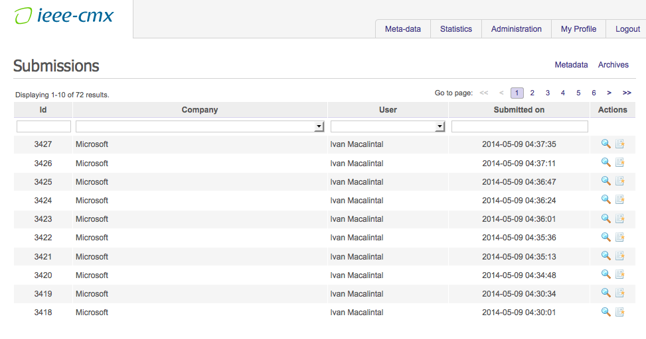

Slide 33
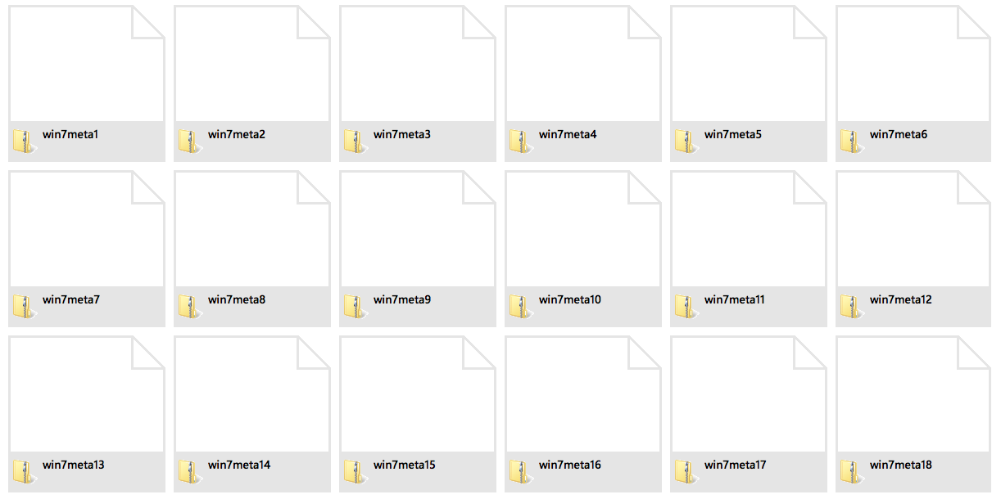

Slide 34
Disclaimer

Slide 35
Next Attraction…
Work with Trustworthy Computing, Microsoft Security Response Center, Microsoft Malware Protection Center and Digital Crimes Unit teams
Windows 8, 8.1 and others (Office, Visual Studio, hot-fixes, patches, etc.)
More automation, More real-time
More meta-data types (certificate thumbprints, location data, SWID, etc.) and telemetry
Clean-File Meta-Data Intelligence portal
Work with other vendors and partners

Slide 36


Slide 37
Q&A

Slide 38
Thanks!
Microsoft Product Release and Security Services,
Developer Services, AM Scan Team
Trustworthy Computing (TwC), Microsoft Malware Protection Center (MMPC), Microsoft Security Response Center (MSRC), Digital Crimes Unit
YOU!
email:Ivan.Macalintal@microsoft.com

Slide 39

For More Information
Windows Server
Windows Server 2012 R2
http://technet.microsoft.com/en-US/evalcenter/dn205286
System Center
System Center 2012 R2
http://technet.microsoft.com/en-US/evalcenter/dn205295
Azure Pack
Azure Pack
  http://www.microsoft.com/en-us/server-cloud/products/windows-azure-pack
Microsoft Azure
Microsoft Azure
  http://azure.microsoft.com/en-us/
  Come Visit Us in the Microsoft Solutions Experience!
  Look for Datacenter and Infrastructure Management
  TechExpo Level 1 Hall CD

Slide 40

Resources
Learning
  Sessions on Demand
  Microsoft Certification & Training Resources
http://channel9.msdn.com/Events/TechEd
www.microsoft.com/learning
TechNet
msdn
  Resources for IT Professionals
  Resources for Developers
http://microsoft.com/technet
http://microsoft.com/msdn

Slide 41



Complete an evaluation and enter to win!

Slide 42
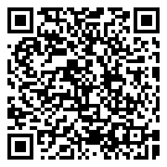

Evaluate this session
Scan this
QR code
to evaluate
this session.

Slide 43


© 2014 Microsoft Corporation. All rights reserved. Microsoft, Windows, and other product names are or may be registered trademarks and/or trademarks in the U.S. and/or other countries.
The information herein is for informational purposes only and represents the current view of Microsoft Corporation as of the date of this presentation. Because Microsoft must respond to changing market conditions, it should not be interpreted to be a commitment on the part of Microsoft, and Microsoft cannot guarantee the accuracy of any information provided after the date of this presentation. MICROSOFT MAKES NO WARRANTIES, EXPRESS, IMPLIED OR STATUTORY, AS TO THE INFORMATION IN THIS PRESENTATION.

