Slide 1
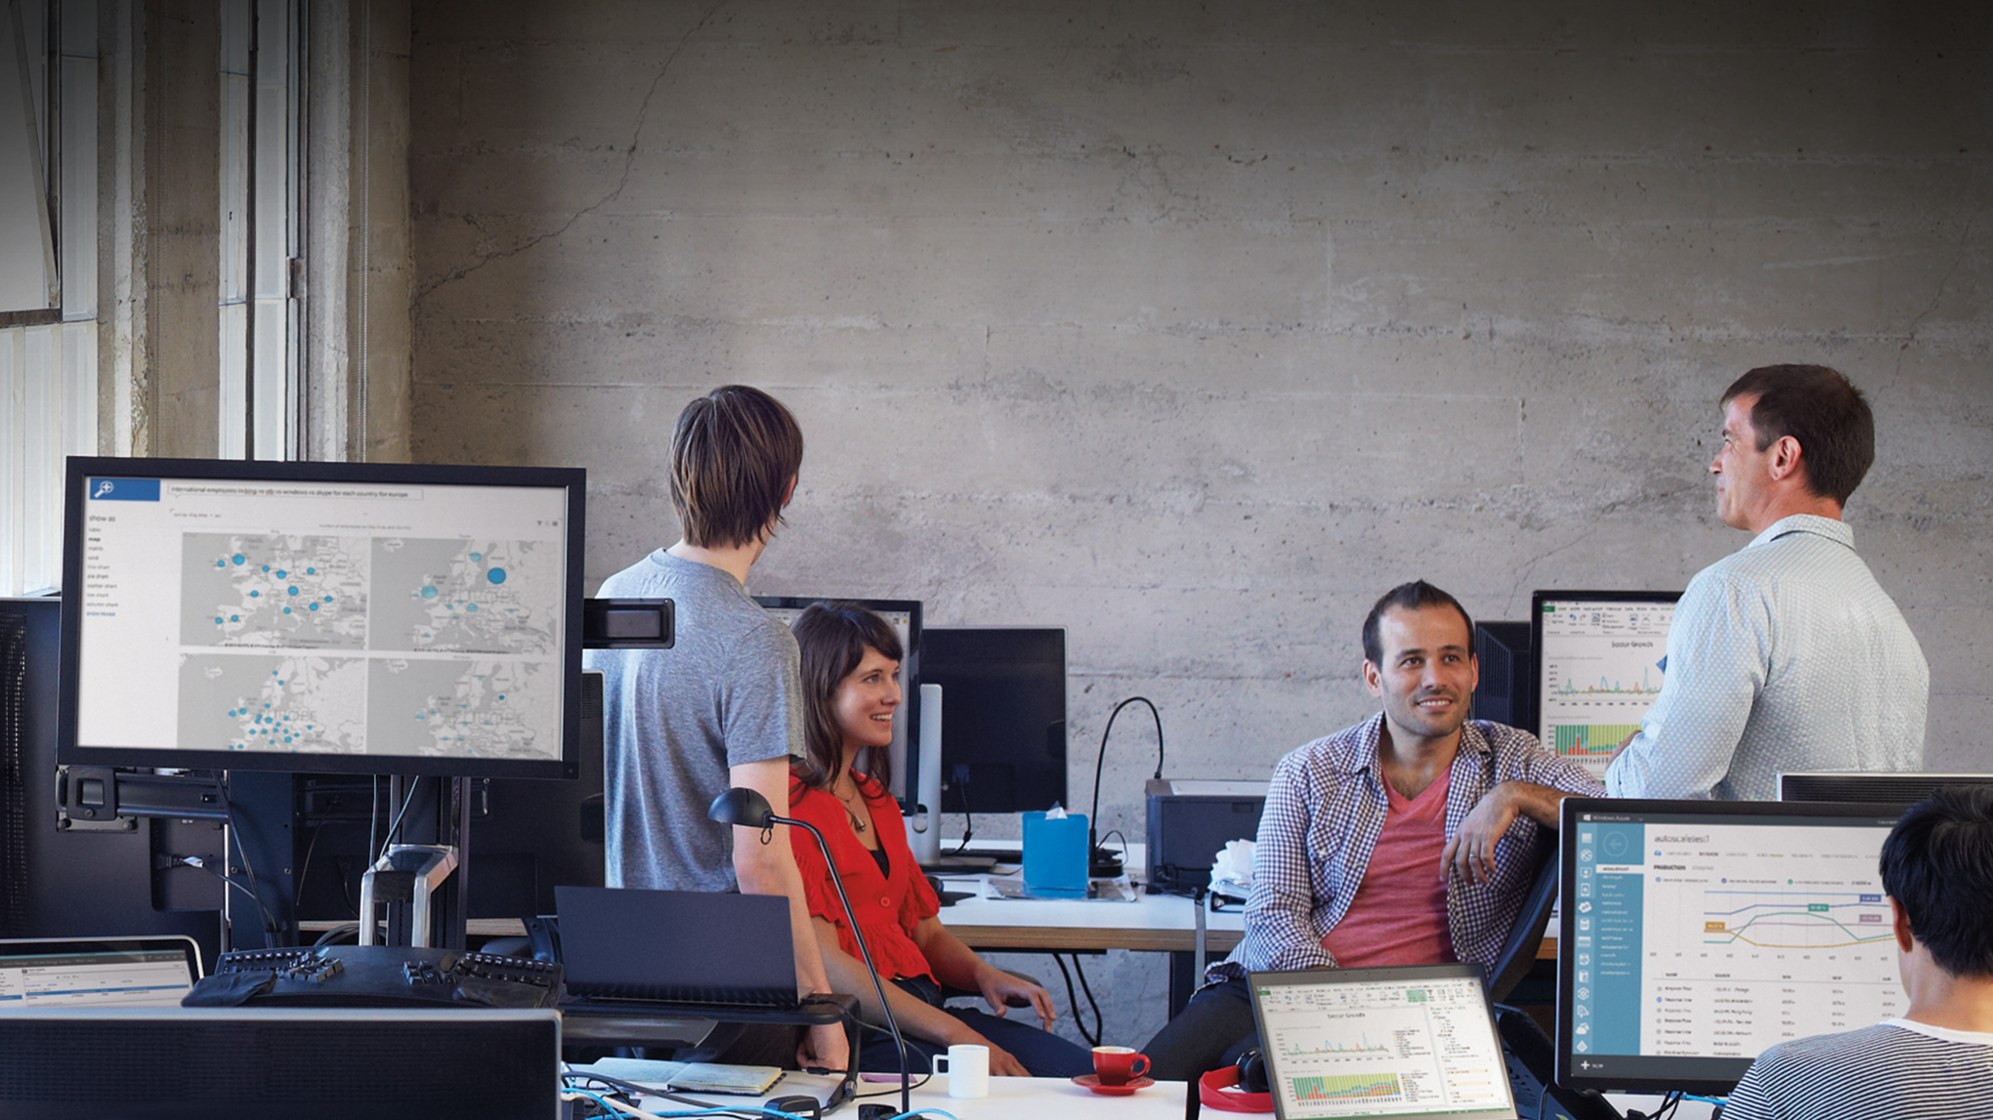

Slide 2

DCIM-B380 What’s New in Windows Server 2012 R2 Hyper-V
Ben Armstrong
Principal PM, Hyper-V
Microsoft
@VirtualPCGuy
Didier Van Hoye
Technical Architect
FGIA
@WorkingHardInIT

Slide 3
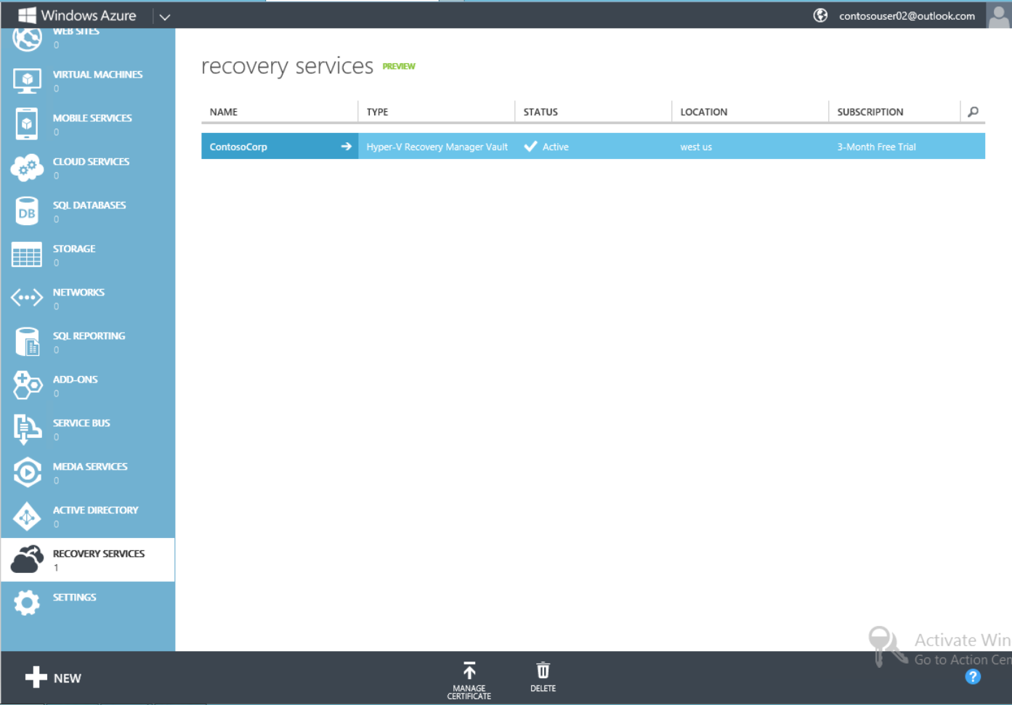
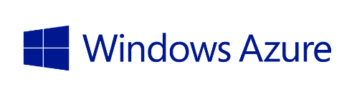
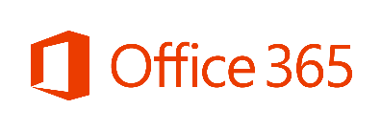


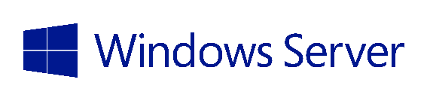
Microsoft Cloud OS Vision
Public Cloud
Azure Virtual Machines
Windows Azure Pack
1
Windows Azure Pack
Consistent
Platform
Private Cloud
Service Providers
DEVELOPMENT
MANAGEMENT
DATA
IDENTITY
VIRTUALIZATION

Slide 4
What we delivered in Windows Server 2012

Slide 5
Recap: Windows Server 2012 R2 Hyper-V
High performance live migration (Compression/RDMA)
Zero downtime upgrades
Automatic VM Activation
Live VM export
App consistent guest backup
Enhanced VMConnect
Dynamic memory host balancing
First class Linux support – Dynamic memory, file system consistent host based backup
RemoteFX over WAN
Generation 2 Virtual Machines
Secure boot in a VM
High performance auto tiered storage with spaces
Write back cache with spaces
Storage QoS
Shared VHDX for guest clustering
VHDX online resize
Storage deduplication with live VMs for VDI
Hyper-V Recovery Manager (Microsoft Azure Site recovery)
Azure Backup
Inbox multi-tenant site-to-site VPN gateway for physical & virtual networks
Protected VM Networks/Virtual RSS
Enhanced LBFO performance with NIC teaming

Slide 6
Hyper-V host scale and scale-up workload support
System | Resource | Maximum number |  | Improvement factor
 |  | Windows 2008 R2 | Windows Server 2012
Host | Logical processors on hardware | 64 | 320 | 5×
 | Physical memory | 1 TB | 4 TB | 4×
 | Virtual processors per host | 512 | 2,048 | 4×
Virtual machine | Virtual processors per virtual machine | 4 | 64 | 16×
 | Memory per virtual machine | 64 GB | 1 TB | 16×
 | Virtual disk capacity | 2 TB | 64 TB | 32x
 | Active virtual machines | 384 | 1,024 | 2.7×
Cluster | Nodes | 16 | 64 | 4×
 | Virtual machines | 1,000 | 8,000 | 8×
6
Notes:
6

Slide 7
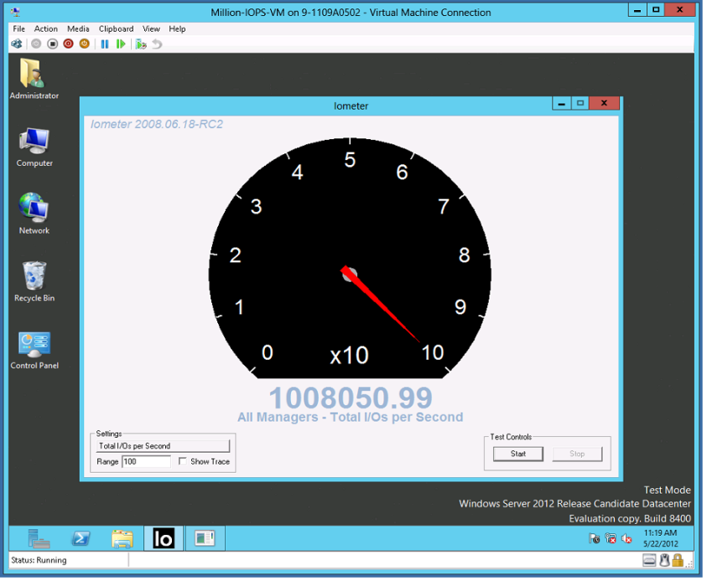
Hyper-V: Over 1 Millions IOPs from a Single VM
Industry Leading IO Performance
  VM storage performance on par with native
  Performance scales linearly with increase in virtual processors
  Windows Server 2012 Hyper-V can virtualize over 99% of the world’s SQL Server.
Windows Server 2008 R2 | Windows Server 2012
250,000 IOPs | 1,000,000+ IOPs

Slide 8
Storage Demo
Didier Van Hoye

Slide 9
Taking those learnings to Windows Server 2012 R2

Slide 10
Your Feedback
Datacenter licensing is great, activation is a challenge
PXE Boot/OS Deployment
  Thanks for not implementing a memory tax
  The Emulated NIC works, but it’s another thing to manage
WS2012 Storage investments are great, more please…
Guest Clustering is difficult
  Maximize your investment
  Let’s build the best cloud together

Slide 11

Cloud Service Providers & Activation
Service Providers activate their hosts with their infrastructure
How do tenant VMs/Services activate?
Tenant 1 Network
Tenant 2 Network
Tenant VMs/Services
Cloud Service Provider Infrastructure
Compute
Storage
Networking
Hoster Network

Slide 12
Automatic VM Activation with 2012 R2
  Windows Server Datacenter provides unlimited guest OS instance for Windows Server
  With activated hosts, automatically activates guest OS
  Eases deployments for cloud service providers and EE
  Host Requirement
    Windows Server 2012 R2 Datacenter with Hyper-V
  Guest Requirements
    Windows Server 2012 R2 Standard/Datacenter/Essentials
    Channel Independent: OEM, VL, FPP, MSDN

Slide 13
Hyper-V VMs Today…
This VM has been highly optimized, but we want to do more.
It’s time to advance the state of the art.

Slide 14
New Hyper-V VMs: Generation 2 VMs
Ease of Management and Operations
  Gen 2 VMs PXE boot VMs using the optimized virtual NIC; (Emulated NIC removed)
  Reduced infrastructure network requirements (managing two MAC/IP addresses); Less possibility of erroneous configurations
Dynamic, Flexible Storage
  Use UEFI firmware and can boot from virtual SCSI (virtual IDE removed)
  Support GPT partitioned disks >2.2 TB OS boot disks
  OS boot disk can be dynamically resized with Windows Server 2012 R2 Online disk resizing
  Hot Add/Remove DVD
Security
  Now supports Secure Boot

Slide 15
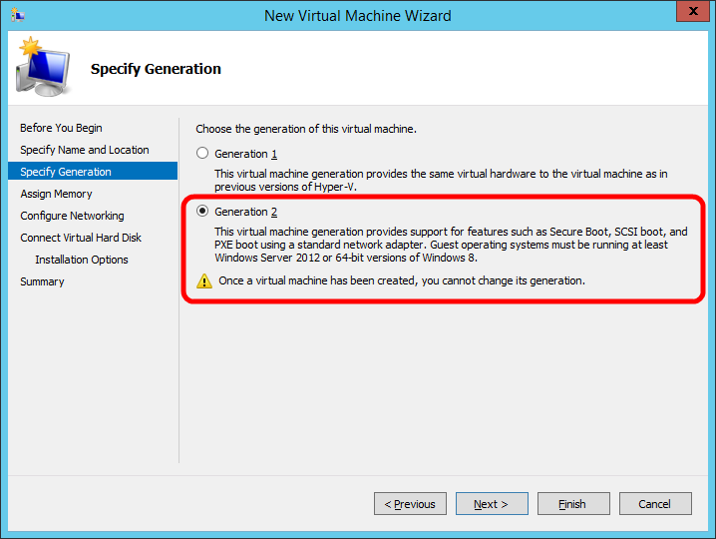
Creating a Generation 2 VM
Create a New VM
Choose type
  Generation 1
  Generation 2
  Note: Once a VM has been created you cannot change its generation.

Slide 16
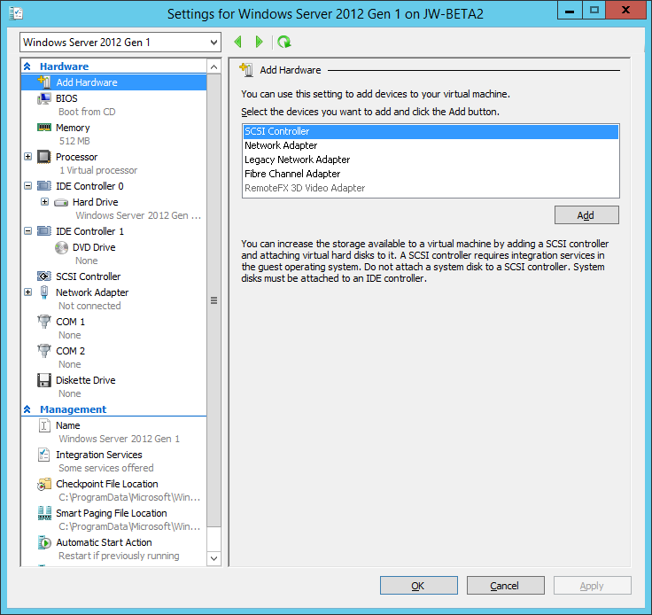
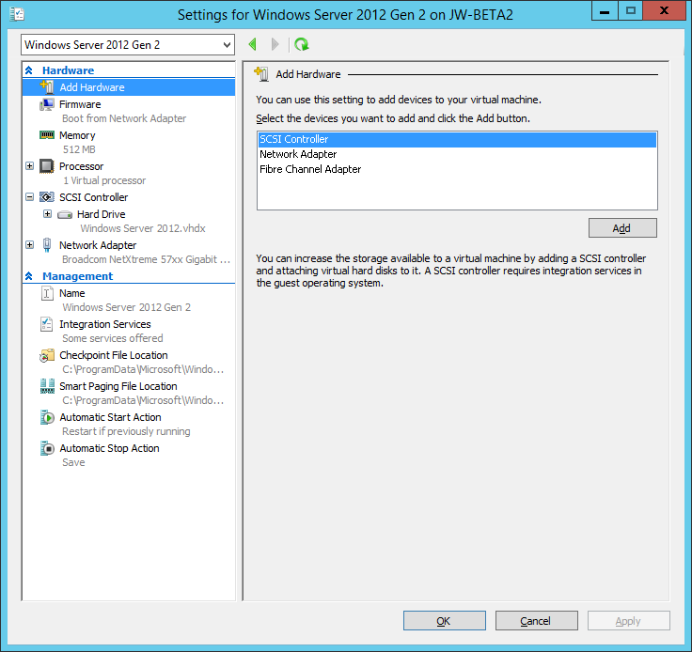
VM Settings: Gen 1 & Gen 2
Generation 1
Generation 2

Slide 17
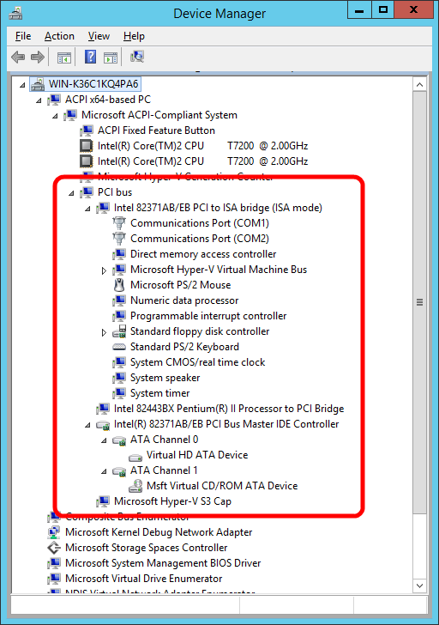
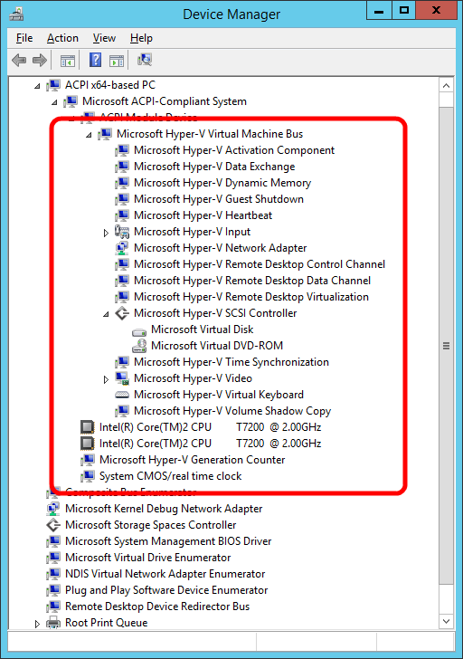
New VMs: Generation 2 VMs
PCI Bus
PCI to
ISA Bridge
COM Ports
Floppy
Controller
Processor to
PCI Bridge
IDE
Controller
Generation 1
Generation 2

Slide 18
Generation 2 Virtual Machine Hardware
Legacy Devices Removed | Replacement Devices | Enhancements
IDE Controller | Virtual SCSI Controller | Boot from VHDx (64TB max size, online resize)
IDE CD-ROM | Virtual SCSI CD-ROM | Hot add/remove
Legacy BIOS | UEFI firmware | Secure Boot
Legacy NIC | Synthetic NIC | Network boot with IPv4 & IPv6
Floppy & DMA Controller | No floppy support
UART (COM Ports) | Optional UART for debugging | Faster and more reliable
i8042 keyboard controller | Software based input | No emulation – reduced resources
PS/2 keyboard | Software based keyboard | No emulation – reduced resources
PS/2 mouse | Software based mouse | No emulation – reduced resources
S3 video | Software based video | No emulation – reduced resources
PCI Bus | VMBus
Programmable Interrupt Controller (PIC) | No longer required
Programmable Interrupt Timer (PIT) | No longer required
Super I/O device | No longer required

Slide 19
New VMs: Generation 2 VMs
Not for Everyone
  x64 VMs only
  Guest support:
    Windows 8/2012 and later
    Support for Linux underway
Your investment in Hyper-V is safe
    All your existing Hyper-V VMs will run without modification on WS2012 R2
    Gen 1 and Gen 2 VMs run great together

Slide 20
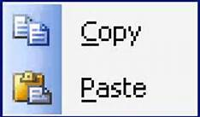

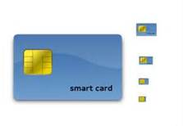
Enhanced VM Interaction
Remote Desktop over VMBus
Full remote desktop capabilities
  Shared clipboard
  Audio redirection
  Enhanced login
  and more….
Enabled even when the network is down
  Integrates with Remote Desktop Gateway
Integrated into Hyper-V Management experience
(Yes, all of this just works with Live Migration…)

Slide 21
Your Feedback on Storage
We would like to dynamically resize virtual storage
We need to manage storage to an SLA
  Keep making more storage investments
  Help us protect against the “noisy neighbor”
Guest Clustering is difficult to manage
De-dupe is great for VM libraries but we need more…
  We want to maintain separation between the cloud infrastructure and tenants
  A top reason for VDI deployment failures. Lack of IOPs and immense storage requirements.

Slide 22
Hyper-V Storage
  Online Virtual Disk Resize
    Dynamically Grow or Shrink SCSI VHDX Virtual Disks on the fly…
    Windows and Linux

Slide 23
Noisy neighbors
Scenario:
  Cloud Service Provider has storage that provides 1000 IOP/s
  10 customers, with 10 VMs. Everything is running fine
  Customer 1 running VM 1 Fires up a SQL Server consuming 950 IOPs. Customer 1 is thrilled.
  Customers 2-10 are not. Their performance has fallen off a cliff. They are calling support demanding to know what’s wrong and calling sales to demand an immediate refund.
950+ IOPs
Tenant VMs/Services
Cloud Service Provider Infrastructure
Compute
Storage
Networking

Slide 24
Noisy neighbors
Outcome:
  Cloud Service Provider needs to resolve situation quickly
  Turns off Customer 1 VM
950+ IOPs
Tenant VMs/Services
Cloud Service Provider Infrastructure
Compute
Storage
Networking

Slide 25
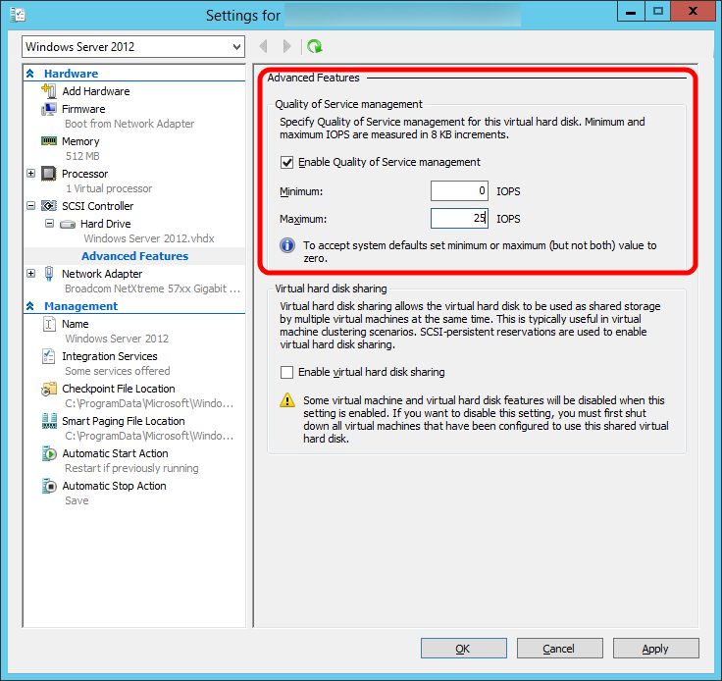
Storage QoS
Bandwidth Management allows you to set hard caps on a per virtual disk basis
Great solution for “noisy neighbors”
Dynamically configurable
Work with:
  Virtual IDE, virtual SCSI
  Gen 1 or Gen 2

Slide 26
Storage QoS Demo
Didier Van Hoye

Slide 27
More Details on Storage QoS
http://workinghardinit.wordpress.com/2014/01/13/how-to-monitor-storage-qos-minimum-iops-and-identify-the-virtual-hardidsk-in-windows-server-2012-r2-hyper-v/
Search for “Storage QoS working hard in it”

Slide 28
Challenges of Guest Clustering
Infrastructure Administrators
  Focused on uptime, agility, performance and lowering cost
  VMs and Services are provisioned, but physical resources are opaque to users
Customers demand high availability for their applications
Guest Clustering requires opening a hole to present a LUN from physical infrastructure
Tenant VMs/Services
Cloud Service Provider Infrastructure
Compute
Storage
Networking

Slide 29
Solving the Challenge of Guest Clustering
Introducing Shared VHDX Virtual Disks
  Virtual disks that can be shared without presenting real LUNs to tenants
Enabling Guest Clustering
  Eases operations and management
  Provides a business opportunity
Tenant VMs/Services
Cloud Service Provider Infrastructure
Compute
Storage
Networking

Slide 30
Guest clustering with shared virtual disks
Guest Clustering
Guest Clustering with commodity storage
Sharing VHDX files provides shared storage for Hyper-V Failover Clustering
Maintains separation between infrastructure and tenants
  Cluster Shared Volumes (CSV)
  on block storage
  Scale-Out File Server
  for file based storage
Block Storage
File Based Storage
Virtual SAS
VM presented a shared virtual SAS disk
Appears as shared SAS disk to VM
VHDX
VHDX

Slide 31
Deduplication with Running VMs!
Hyper-V VDI
Optimize open VHD/VHDX files on remote VDI storage
CSV volume support
Provides:
  Increased VDI storage density
  Faster read/write of optimized files
  Improved optimization speed
  Advanced caching of duplicated data
  More space savings
SMB
Scale-out File Server
Dedup
VHD
Cluster Shared Volumes

Slide 32
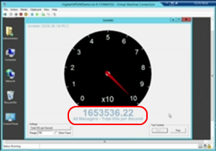
Hyper-V 2012 R2: 1.6+ Million 8k IOPs from a Single VM
…Industry Leading I/O Performance
  VM storage performance on par with native
  Performance scales linearly with increase in virtual processors
  Windows Server 2012 R2 Hyper-V can virtualize even larger OLTP workloads with confidence
Windows Server 2008 R2 | Windows Server 2012 | Windows Server 2012 R2
250,000 4k IOPs | 1,000,000+ 4k IOPs | 1,600,000+ 8k IOPs

Slide 33
Solving Tough Problems…
Scenario: You get an error in production. What do you do?
You’re left with two options:
    Option 1: Take the service down and investigate
    Option 2: Leave the service running and hope it was transient
R2: Live Export of a VM (Live Cloning)
  New Option 3: Take a live clone and go have a look; debug offline
You can:
  Export a complete copy – including memory state
  Export any snapshot of a virtual machine

Slide 34
Your Input on HA/Mobility/Replica
Windows Server 2012 NIC Teaming is great, keep improving network availability and performance.
Make it easier to upgrade the cloud infrastructure
  Uptime is paramount.
  We want to take advantage of new infrastructure features as soon as possible
Hyper-V Live Migration is awesome. Push it further.
Hyper-V Replica is awesome. Can we configure the replication frequency?
  No tradeoffs.
  We have good network connectivity and are willing to use more for replication…

Slide 35
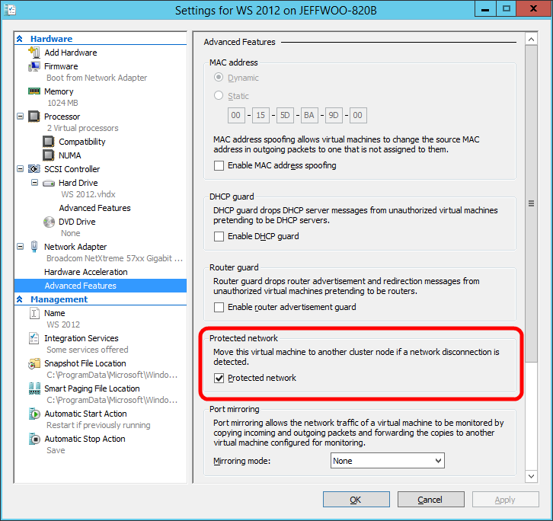
Protecting VMs from Network Outages
  Taking HA to the network
  Detects network failure
    Cable unplugged
    Network Adapter failure
    Works with Windows Server NIC Teaming

Slide 36
Virtual RSS (vRSS)
Get near line rate to a VM on existing hardware
Virtualize traditionally physical workloads that required high network performance
How does this work?
  Virtual Receive-side scaling is feature in Windows Server 2012 R2 that allows the load from a virtual network adapter to be distributed across multiple virtual processors in a virtual machine.
36

Slide 37
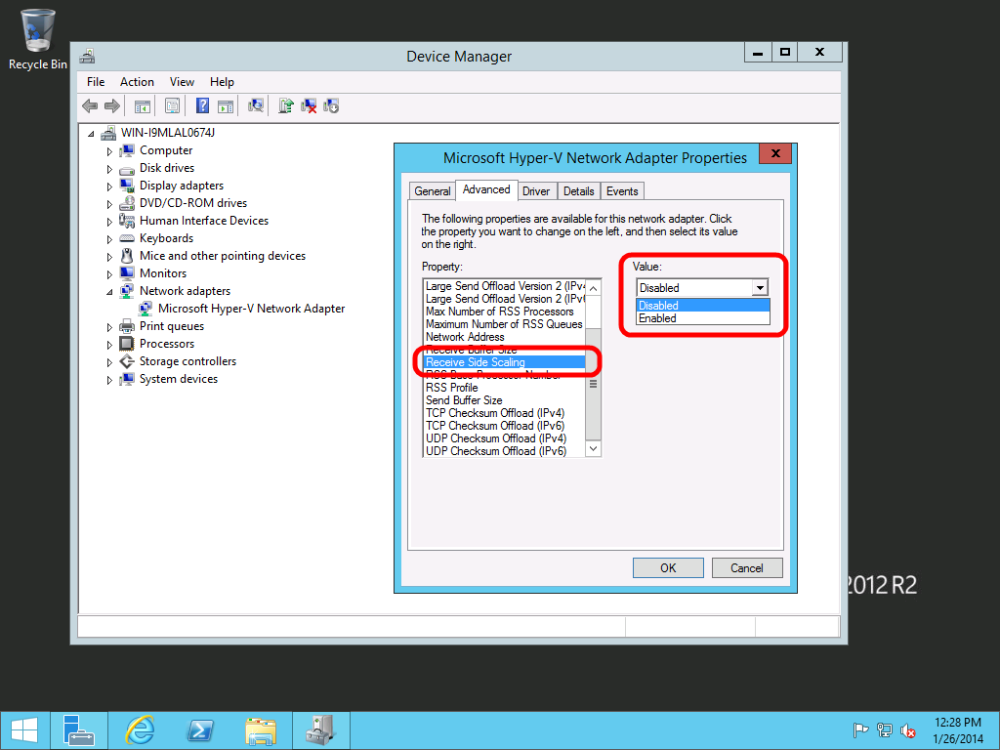
Virtual RSS (vRSS)
Disabled by default
Enabling is easy
  Device Manger
  Advanced Tab->Receive Side Scaling
  Enable
Via PowerShell
  Enable-NetAdapterRSS –Name <AdapterName>
37

Slide 38
Zero-downtime upgrade
Live migrate virtual machines from
Windows Server 2012 to Windows Server 2012 R2
Includes shared nothing live migration

Slide 39
Faster Live Migration
Compression
  Over 2x improvement in live migration time
  No hardware changes are required
  Enabled by default
SMB Direct
  Utilizes existing and new high-end networks
  Enables super high-speed live migrations
  Supports SMB Multichannel to leverage multiple interfaces

Slide 40
vRSS & Live Migration in Action
Didier Van Hoye

Slide 41
Why is this important?
Scenario: You need to patch an 8 node cluster. Each node has 192-256 GB of memory
With Windows Server 2012:
  ~8 hours
With Windows Server 2012 R2 Compression:
  ~4 hours
Windows Server 2012 R2 RDMA:
  ~1 hour

Slide 42
Faster Live Migration
Simple guidance:
If your live migration network is….
10 Gbit or less – use compression
Over 10 Gbit – use SMB / SMB Direct

Slide 43
Hyper-V Linux Support

Slide 44
Continuing Linux Guest Support
Full dynamic memory
Online backup
Online VHDX resize
New video driver

Slide 45
Linux Support
Ben Armstrong

Slide 46
Hyper-V Replica

Slide 47
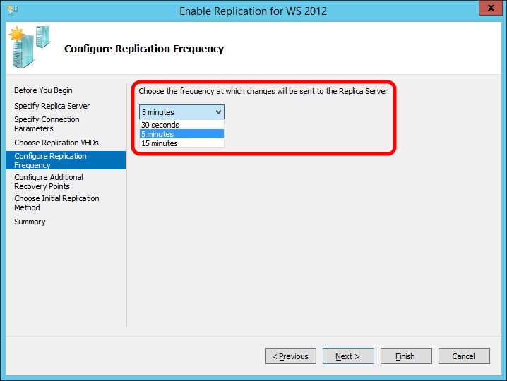
Near Synchronous Replication
Top Replica Request
  Default is still 5 minutes
New Options:
  30 seconds
  15 minutes

Slide 48
Windows Server 2012 Replica…
Integrated VM Replication
  Customers Love It
Service Provider Opportunity
  One challenge though…
Fail
Replication
Customer
Service Provider

Slide 49
Windows Server 2012 R2 Replica…
Even Better for Cloud Service Providers
Extended Replication in the Box
Fail
Replication
Replication
Customer
Service Provider Site 1
Service Provider Site 2

Slide 50

Protection and recovery of assets across datacenters
Windows Azure
Hyper-V Recovery Manager
VM replication with Hyper-V Replica
New: Configurable syncs down to 30 seconds
  New: Extended Replication Support
  Seamless integration with Hyper-V and clustering
Recovery orchestration
with Windows Azure Hyper-V
Recovery Manager
At-scale disaster recovery with Windows
Azure-enabled process automation
Communication
Channel
Communication
Channel
Fail
Replication
Channel
Datacenter 1
Datacenter 2

Slide 51
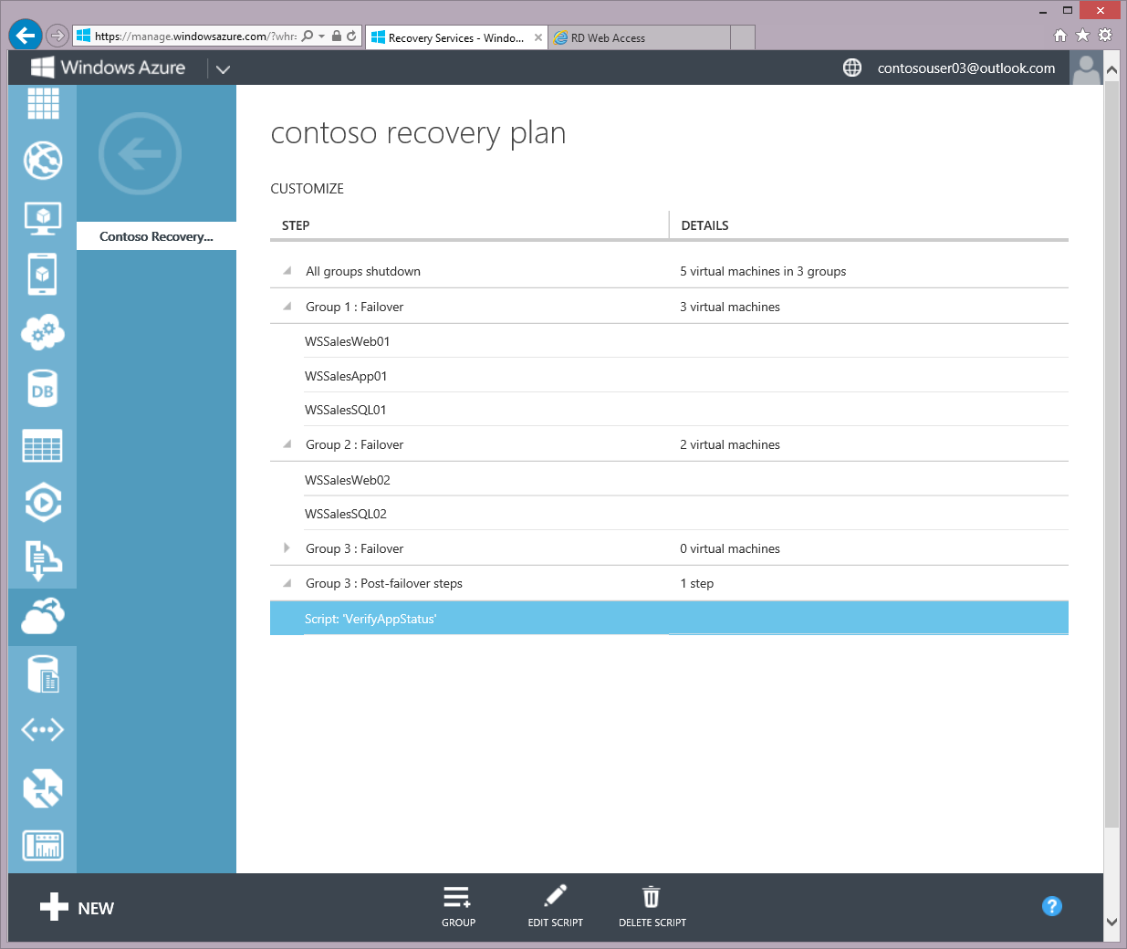
Hyper-V Recovery Manager
Easily create Recovery Plans
Flexible script support
Configure from a browser

Slide 52
Microsoft Hyper-V Server 2012 R2

Slide 53
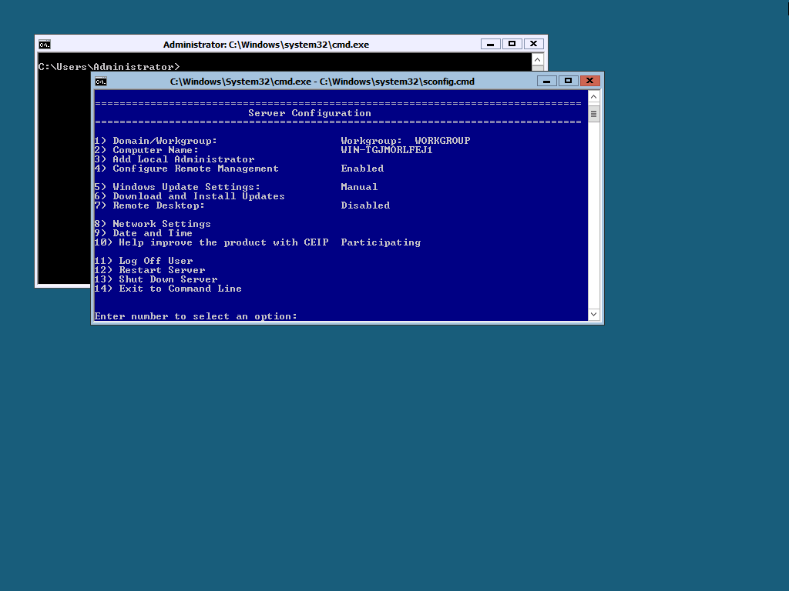
What is Microsoft Hyper-V Server?
Enterprise-class, Microsoft hypervisor
  Local Command Line Interface
  Does not include guest OS licenses
Standalone Hyper-V
Free ISO download from Microsoft.com website
Designed for remote management
Contains all Hyper-V features

Slide 54
Great Reasons to use MS Hyper-V Server
Linux VM Consolidation
VDI platform
Hoster virtualization platform

Slide 55
MS Hyper-V Server 2012 Q&A (1/2)
Is this an evaluation version? Is their Activation?
  No and No. Enterprise class hypervisor for everyone.
Is this supported in production?
  Yes, since day one.
Does Hyper-V Server have reduced/limited scale?
  No
Is System Center required for Live Migration or Live Storage Migrate VMs?
  No. You can manage using free RSAT tools, or System Center or via PowerShell

Slide 56
MS Hyper-V Server 2012 Q&A (2/2)
Is clustering included with Hyper-V Server 2012?
  Yes. It has been since Hyper-V Server 2008 R2.
Does Hyper-V Server include Live Migration?
  Yes. Yes. Yes.
Shared Nothing Live Migration?
  Yes. Yes. Yes.
Does this include the new Extensible Switch?
  Yes. Yes. Yes.
Does this include Hyper-V Replica?
  Yes. Yes. Yes.

Slide 57
“I’m getting ready to purchase new storage for cloud infrastructure. What should I look for?”

Slide 58
File Based Storage Features to Look For:
SMB 3.0
  Not SMB 1.x/2.x
SMB Direct/RDMA
  Superior performance File Server and Hyper-V without additional CPU utilization
  Microsoft investing heavily in this technology
Spaces Certified JBOD
  You can find these on the Windows Server Catalog

Slide 59
SAN Array Features to Look For:
Offloaded Data Transfer (ODX)
  Secure, copy offload
NPIV
  If you’re going to use virtual fibre channel this is required
  Make sure it’s certified hardware and on the Windows Server Catalog
Trim/Unmap
SMI-S Support

Slide 60
Networking Features to Look For:
VMQ
  Virtual RSS requires physical NICs to support VMQ
NV-GRE
  Flexibility between clouds.
SR-IOV
Open Management Infrastructure (OMI)
  Look for support in switches and routers
Plugins for System Center
  Virtual Machine Manager and Operations Manager

Slide 61
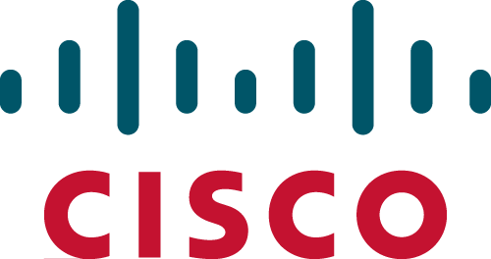








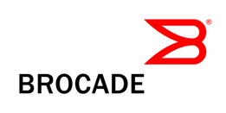


Networking partner ecosystem
Gateway appliances
OMI-based
top-of-rack switch
Hyper-V switch
extensions
Chipset
extensions

Slide 62
The Best Platform for Microsoft Apps
If you’re creating a virtualization or cloud infrastructure, the best platform for…
  Microsoft Dynamics
  Microsoft Exchange
  Microsoft Lync
  Microsoft SharePoint
  Microsoft SQL Server
  …is Microsoft Windows Server with Microsoft Hyper-V managed by Microsoft System Center.
This is the best tested, best performing, most scalable solution and is supported end to end by Microsoft.

Slide 63

Resources
Learning
  Sessions on Demand
  Microsoft Certification & Training Resources
http://channel9.msdn.com/Events/TechEd
www.microsoft.com/learning
TechNet
msdn
  Resources for IT Professionals
  Resources for Developers
http://microsoft.com/technet
http://microsoft.com/msdn

Slide 64



Complete an evaluation and enter to win!

Slide 65


Evaluate this session
Scan this
QR code
to evaluate
this session.

Slide 66


© 2014 Microsoft Corporation. All rights reserved. Microsoft, Windows, and other product names are or may be registered trademarks and/or trademarks in the U.S. and/or other countries.
The information herein is for informational purposes only and represents the current view of Microsoft Corporation as of the date of this presentation. Because Microsoft must respond to changing market conditions, it should not be interpreted to be a commitment on the part of Microsoft, and Microsoft cannot guarantee the accuracy of any information provided after the date of this presentation. MICROSOFT MAKES NO WARRANTIES, EXPRESS, IMPLIED OR STATUTORY, AS TO THE INFORMATION IN THIS PRESENTATION.

