Slide 1


Slide 2

Cloud Identity and Access Management:
Azure Active Directory Premium
DCIM-B382
Nasos Kladakis,
Sr. Product Marketing Manager , Azure

Slide 3


Technology trends: driving cloud adoption
BENEFITS
2 weeks
to deliver new services vs. 6-12 months with traditional solution
(Case Study: HarperCollins Publishers)
349% ROI
(FORRESTER TES 2013)
Speed
Scale
Economics
Scale from
Cloud Trend:
70%
30,000 to
250,000
site visitors instantly
(Case Study: Autocosmos)
of CIOs will embrace a cloud-first strategy in 2016
(IDC CIO Agenda webinar)
12B+
Microsoft Azure AD authentications per week
280%
year-over-year
database growth in Microsoft Azure
54%
of Fortune 500 use Microsoft Azure
MICROSOFT AZURE ADOPTION

Slide 4
Externalization and Consumerization of IT
Data and Services in the cloud
Accessing everything from everywhere
Shadow IT

Slide 5





A world of devices and SaaS Applications
EC2
force.com
Amazon.com
AWS
System Center
Salesforce.com
Private cloud

Slide 6


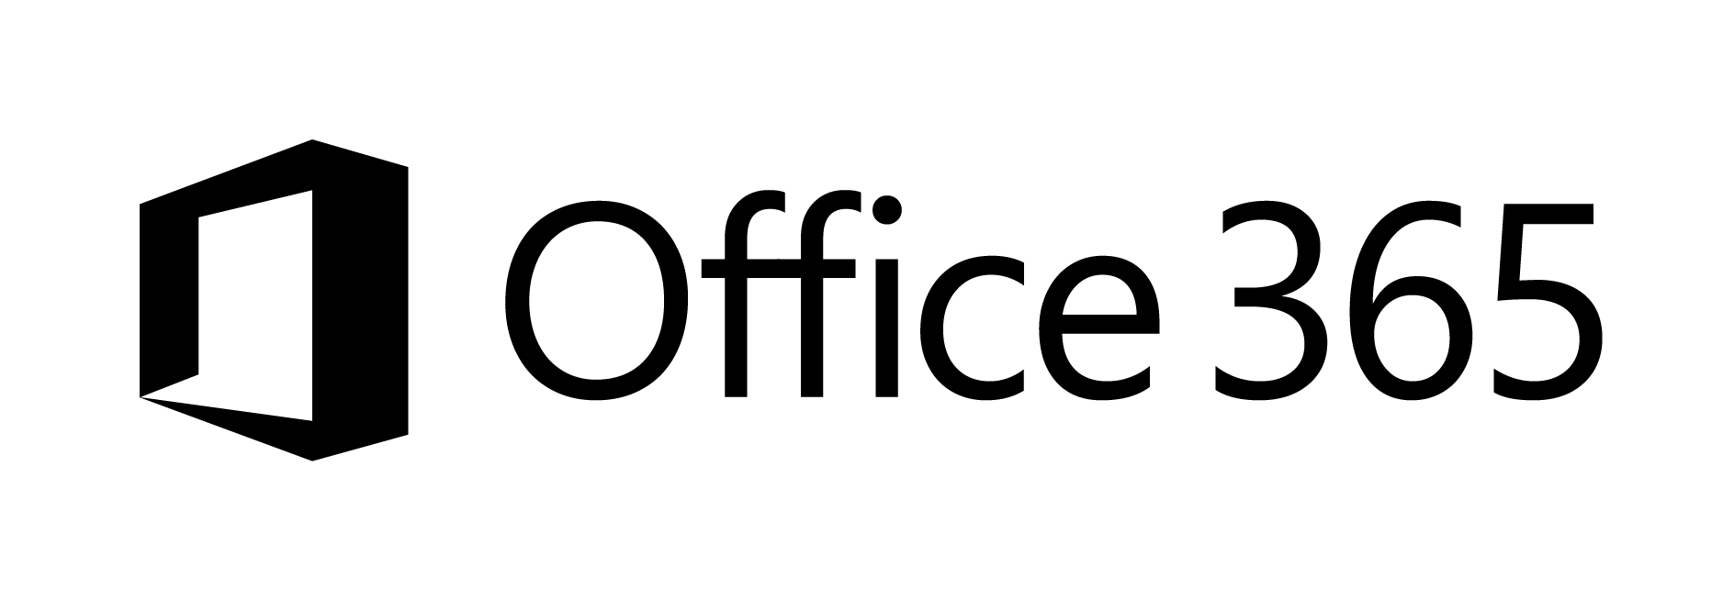
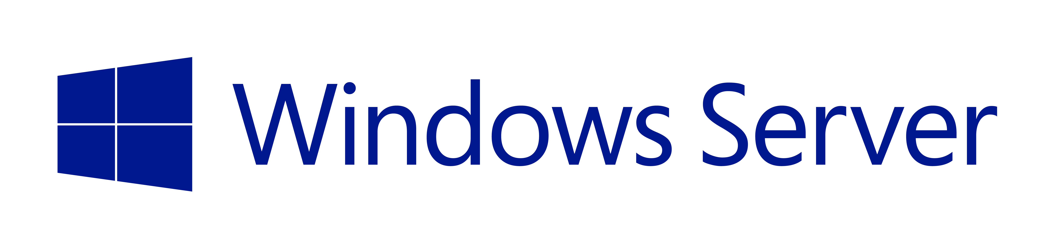
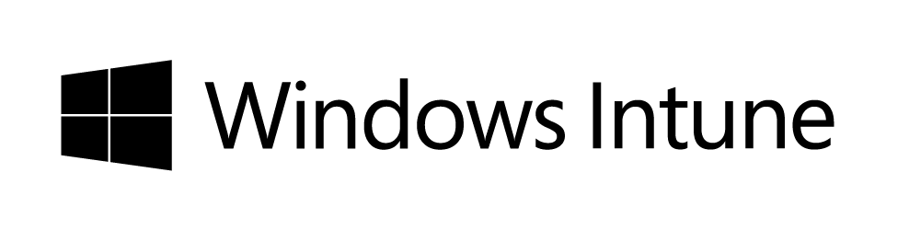




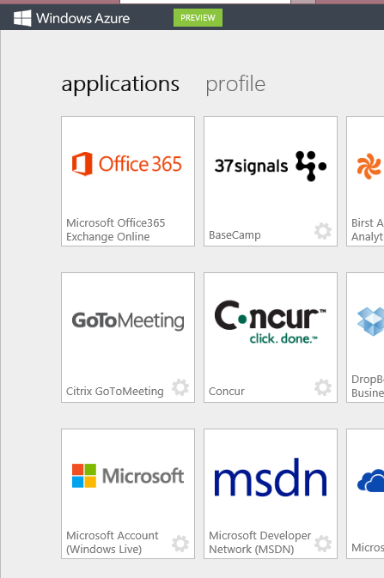
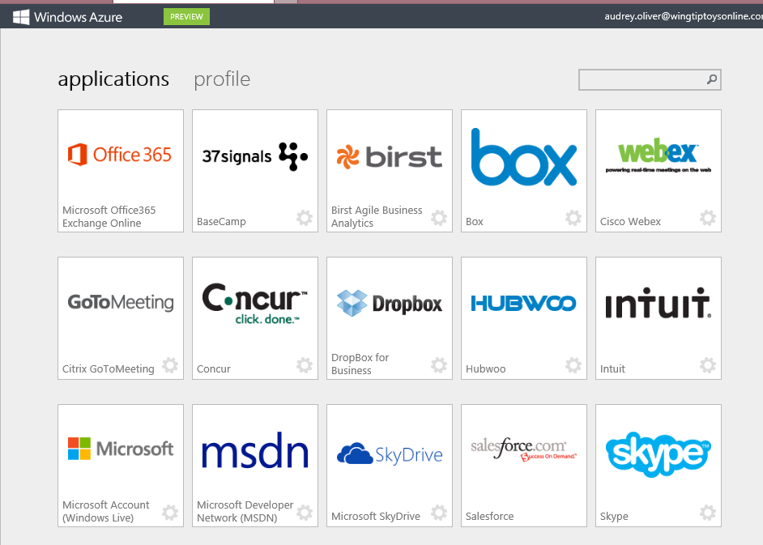
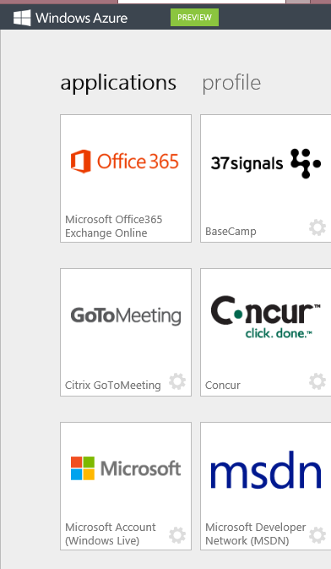
Public Identity as the control point
Active Directory
Microsoft apps
Other Directories
Active Directory
Custom
LOB apps
ISV/CSV
apps
Non-MS cloud-based apps
PCs and devices

Slide 7
What is Azure Active Directory?
A comprehensive identity and access management cloud solution.
It combines directory services, advanced identity governance, application access management and a rich standards-based platform for developers
Azure Active Directory Premium is an advanced offering that includes IAM capabilities for on-premises, hybrid and cloud environments

Slide 8

Azure Active Directory Premium
Built on top of the free offering, provides a robust set of capabilities to empower enterprises with demanding needs on identity and access management
Additionally, Azure AD premium offers:
An Enterprise SLA of 99.9%
Usage rights to Identity Manager Server and CALs

Slide 9
A world of devices and SaaS Applications : Is this my problem?
EC2
Organizations risk fragmented, complex and non-compliant use of cloud-based resources¹
IT is ill-equipped to handle this challenge
Lack of insights: Limited data about how many or which cloud apps are being used
Lack of control: Don’t know how to assess the risk much less control it.
Lack of tools: Traditional network and endpoint security measures no longer effective¹
1: The Growing Importance of Cloud Access Security Brokers: Gartner
force.com
Amazon.com
AWS
System Center
Salesforce.com
Private cloud

Slide 10
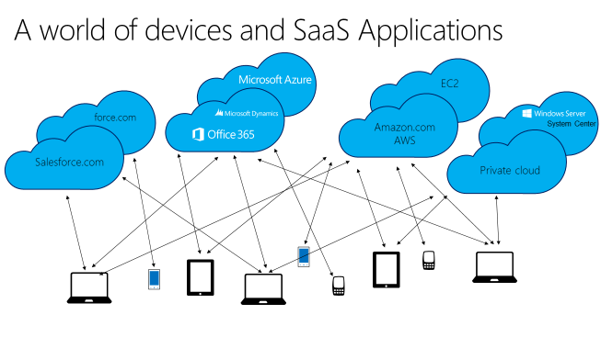
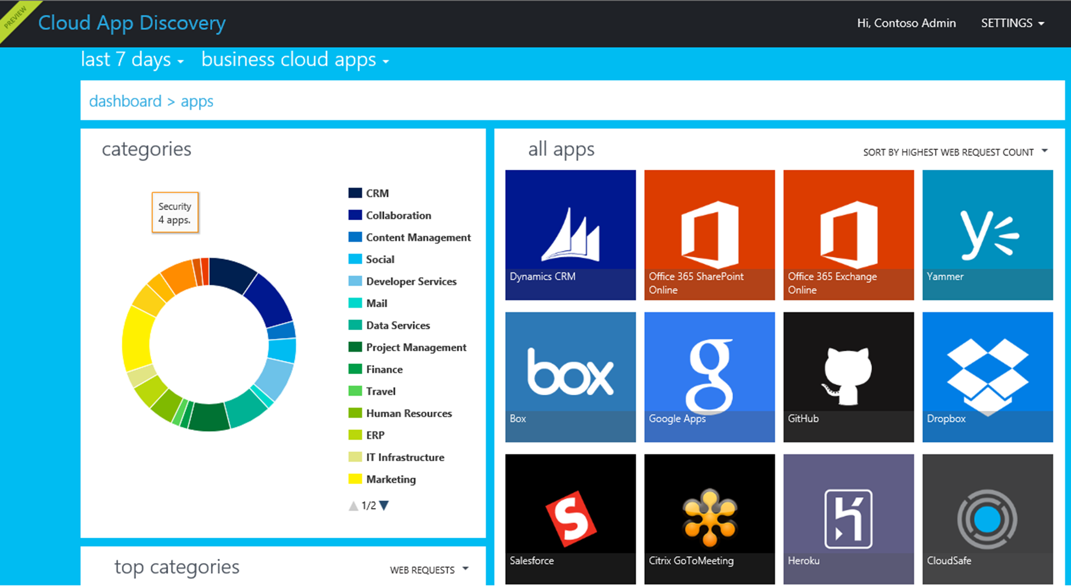
Cloud App Discovery
AD Agent
Logs
Active Directory
Cloud App Discovery

Slide 11


Slide 12
Windows Azure Active Directory usage scenarios
Your Directory on the cloud
Centrally managed identities and access.
Monitor and protect access to cloud applications.
Empower Users
SaaS apps

Slide 13
Your Directory on the cloud
Centrally managed identities and access.
Monitor and protect access to cloud applications.
Empower Users
SaaS apps

Slide 14
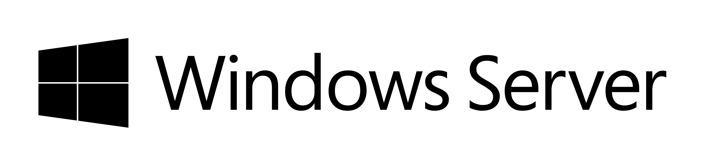
Your Directory on the cloud
Connect and Sync on-premises directories with Azure.
Active Directory
*
PowerShell
LDAP v3
SQL (ODBC)
Web Services
( SOAP, JAVA, REST)
*Azure AD Sync
Other
Directories

Slide 15
Delivering a seamless user authentication experience
Active Directory
Identity Synchronization with password hash sync
User attributes are synchronized using Identity Synchronization services including a password hash, Authentication is completed against Azure Active Directory
Active Directory
Identity Synchronization
Active Directory
Active Directory
User attributes are synchronized using Identity Synchronization tools, Authentication is passed back through federation and completed against Windows Server Active Directory
AD FS

Slide 16
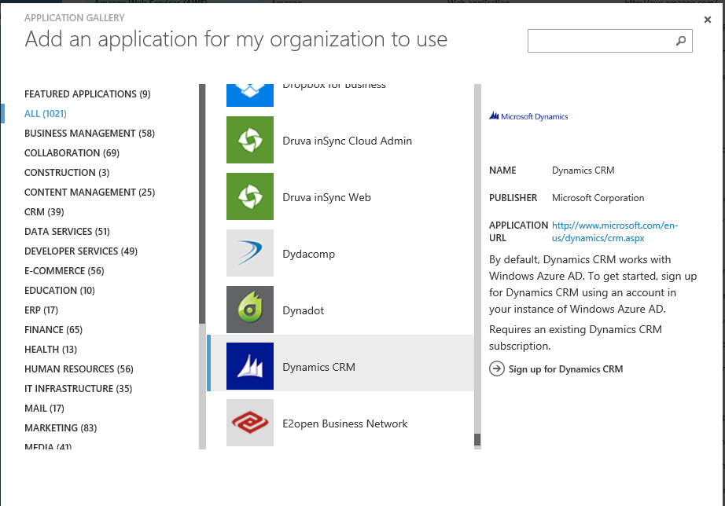
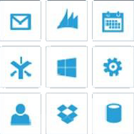
Your Directory on the cloud
Connect and Sync on-premises directories with Azure.
Active Directory
1200+ Preintegrated popular
SaaS apps.
Other
Directories
SaaS apps

Slide 17
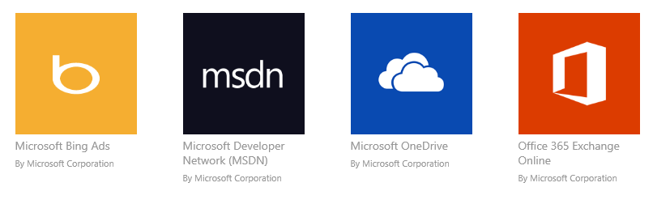
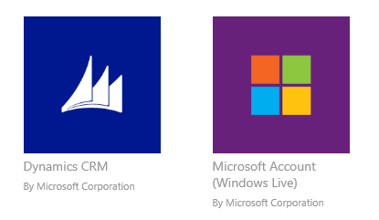
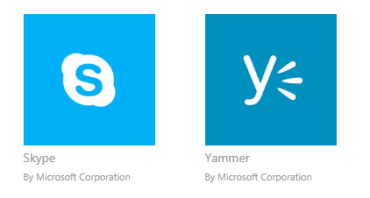
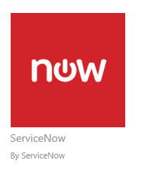
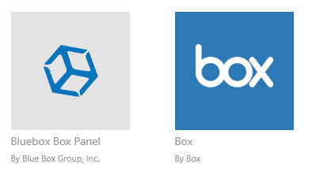
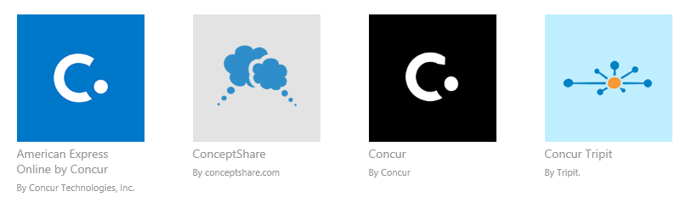
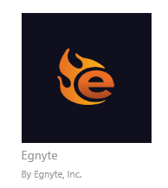


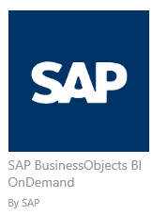
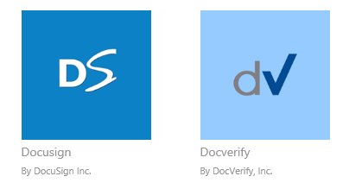
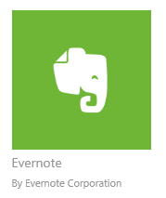
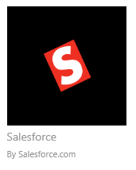

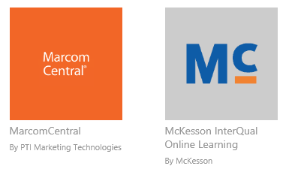
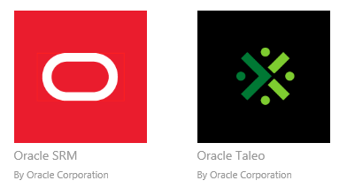
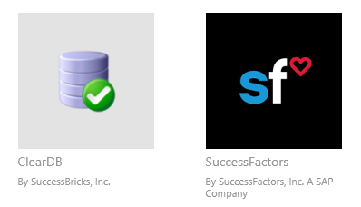

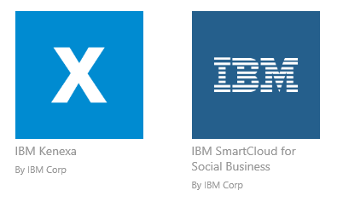
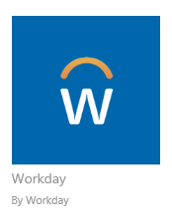
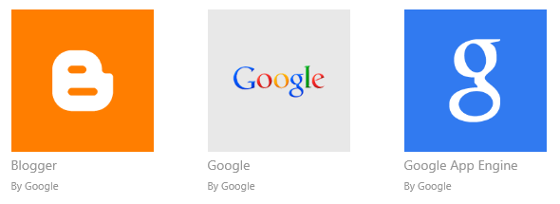
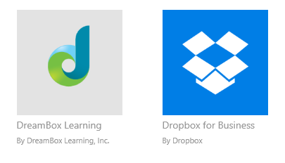
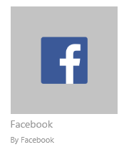
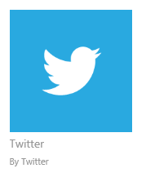
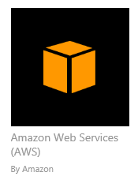

Preintegrated SaaS apps in the application gallery

Slide 18
Your Directory on the cloud
Connect and Sync on-premises directories with Azure.
Active Directory
1200+ Preintegrated popular
SaaS apps.
Other
Directories
Easily add custom cloud-based apps. Facilitate developers with
identity management through a rich standards-based platform.
SaaS apps
LOB and custom apps
Integrated custom apps
Identities and applications in one place.

Slide 19
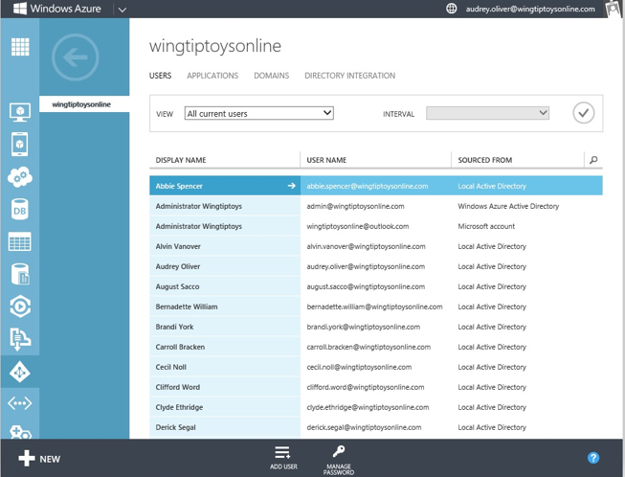
Centrally managed identities and access
SaaS apps
Comprehensive identity and
access management console.
Centralized access administration for preintegrated SaaS apps and other Cloud-based apps.
SaaS apps
Secure business processes with advanced access
management capabilities.
IT professional
Your cloud apps ready when you are.

Slide 20
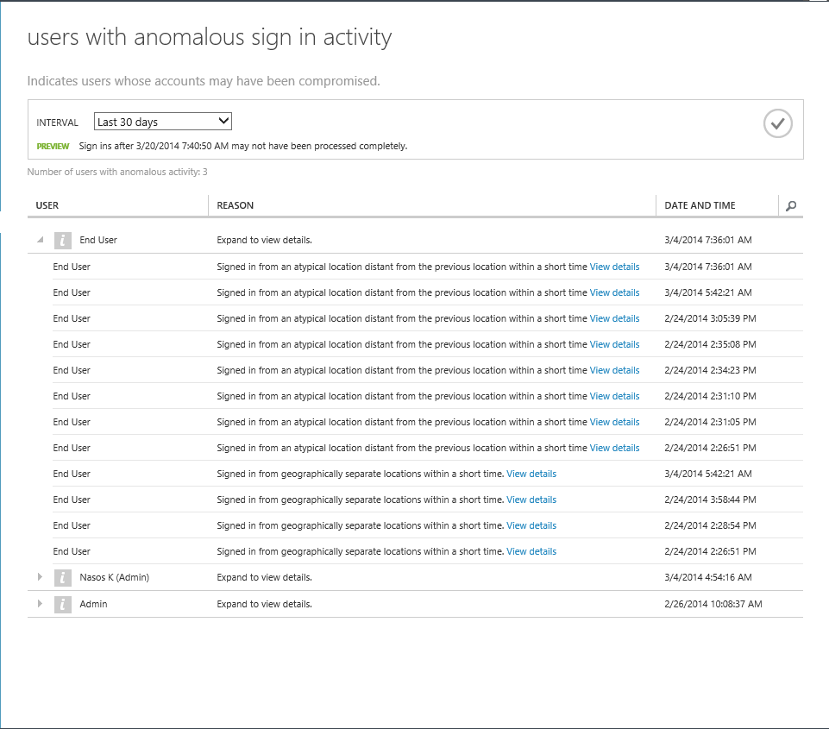
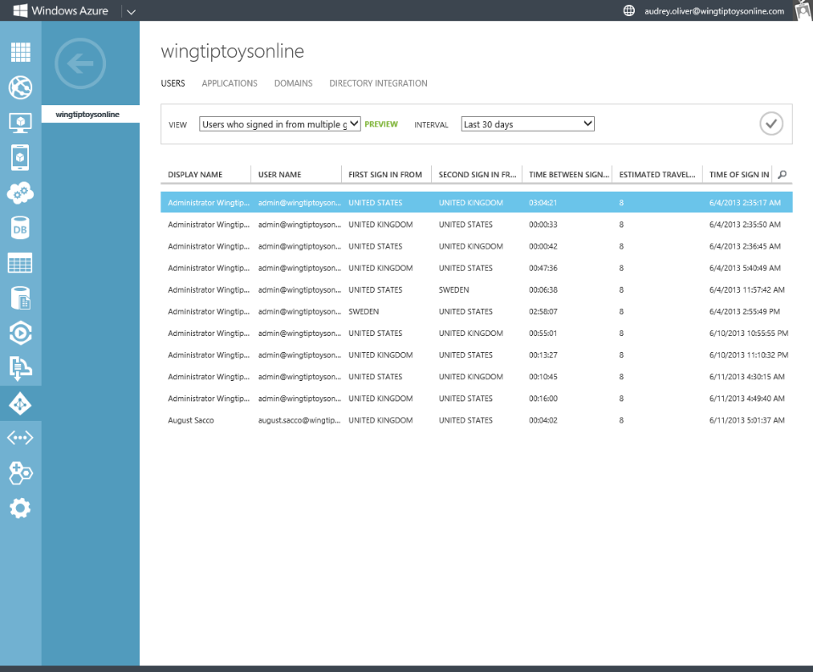

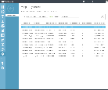
Monitor and protect access to enterprise apps
Built-in security features.
Security reporting that tracks inconsistent access patterns, analytics and alerts.

Slide 21
Monitor and protect access to enterprise apps
Built-in security features.
XXXXX
Security reporting that tracks inconsistent access patterns, analytics and alerts.
XXXXX
Step up to Multi-Factor authentication.
XXXXX
Ensure secure access and visibility on usage patterns for SaaS and cloud-hosted LOB applications.

Slide 22
What is Azure Multi-Factor Authentication?
A stand-alone Azure Identity and Access management service also included in Azure Active Directory Premium
Prevents unauthorized access to both on-premises and cloud applications by providing an additional level of authentication
Trusted by thousands of enterprises to authenticate employee, customer, and partner access.

Slide 23
How It Works
Mobile apps
Phone calls
Text messages
1 4 5 6 7 6
ALERT

Slide 24
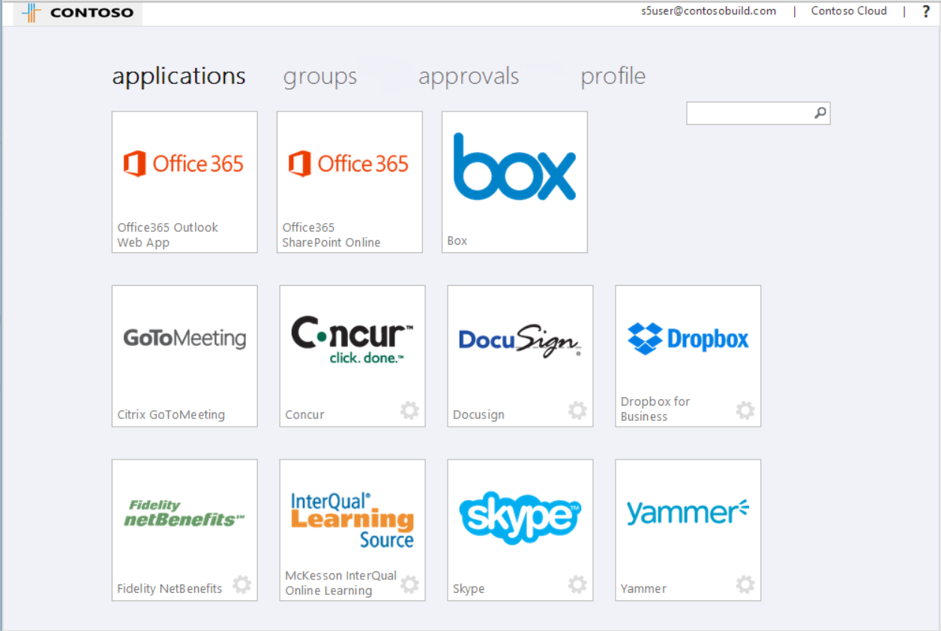
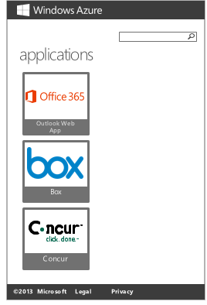
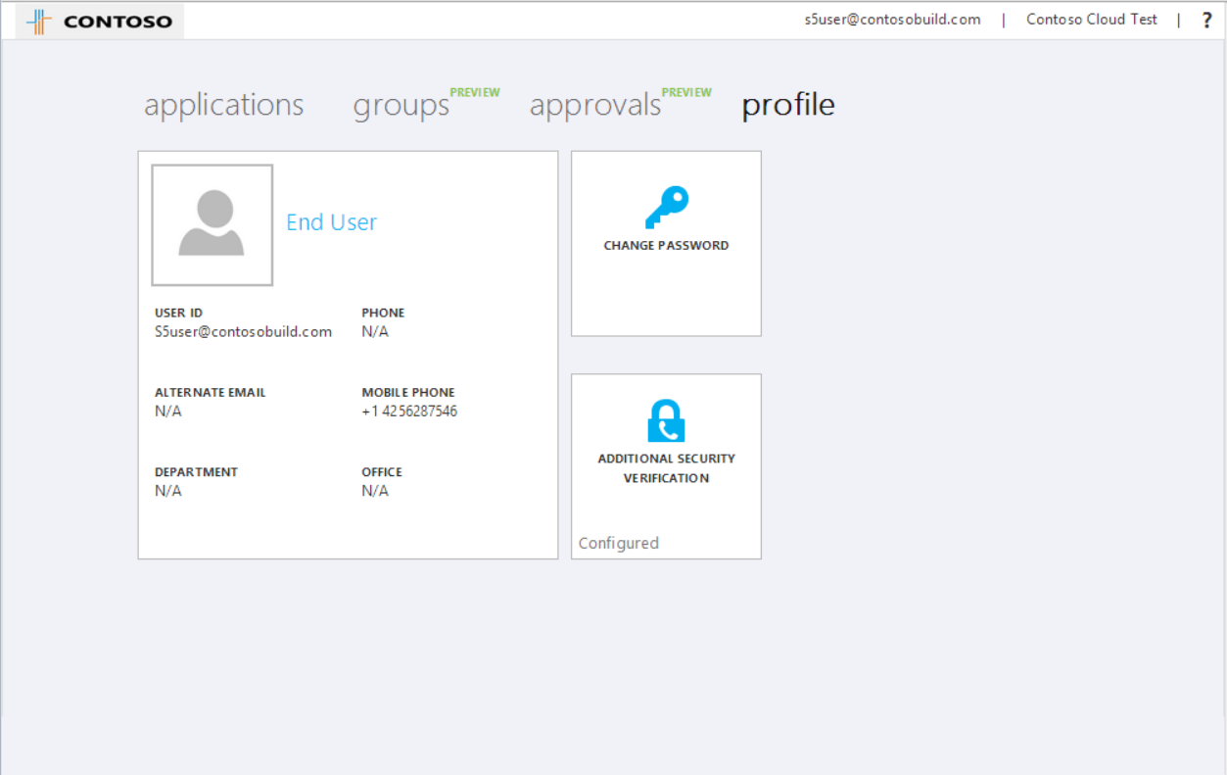

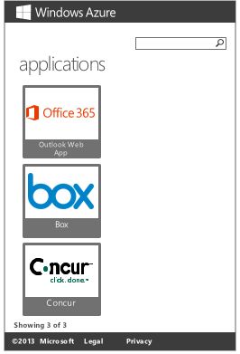
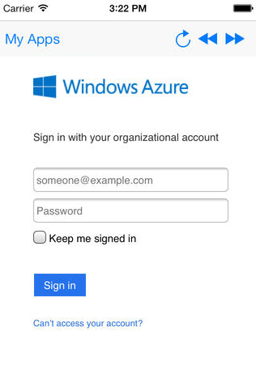
Empower Users
Company branded, personalized application Access Panel :
http://myapps.microsoft.com
+ Mobile Apps
Manage you account

Slide 25
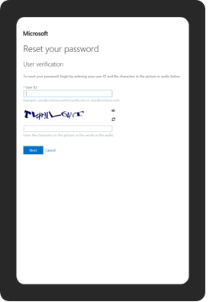
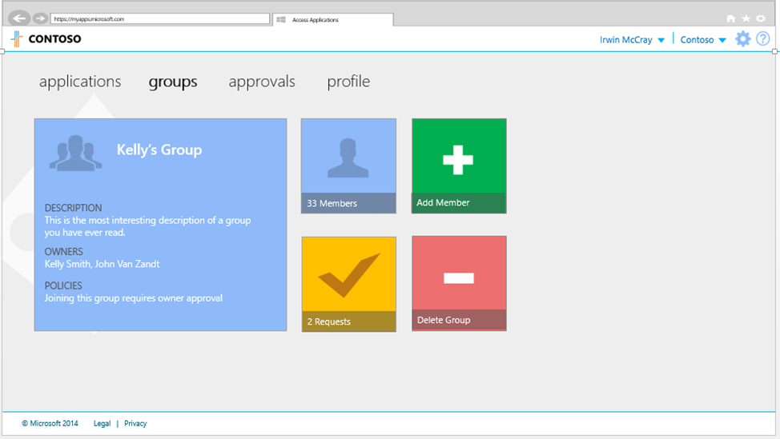
Empower Users
Company branded, personalized application Access Panel :
http://myapps.microsoft.com
+ Mobile Apps
Manage your account
Self Service Password Reset and delegated group management
for cloud users

Slide 26
Demo
Cloud Application Discovery
Managing Azure Active Directory Premium
End-User Experience

Slide 27
Azure Active Directory free and premium offerings feature comparison
 |  | Azure AD Free | Azure AD Premium
Common Features | Directory as a Service | up to 500K Objects | No Object Limit
 | User/Group Management | Yes | Yes
 | SSO to pre-integrated SAAS Applications /Custom Apps | 10 apps per user | No Limit
 | Identity Synchronization Tool (WSAD Extension,Multi Forest,3rd party)* | Yes | Yes
 | User-Based access management/provisioning | Yes | Yes
 | Self-Service Password Change for cloud users | Yes | Yes
 | Basic Security Reports | Yes | Yes
 | Cloud App Discovery* | Yes | Yes
Premium Features | Group-based access management/provisioning |  | Yes
 | Self-Service Password Reset for cloud users |  | Yes
 | Self-Service Password Reset/Change with on-premises write-back* |  | Yes
 | Company Branding (Logon Pages/Access Panel customization) |  | Yes
 | Identity Synchronization Tool advanced write-back capabilities * |  | Yes
 | Self-Service Group Management |  | Yes
 | Advanced Security Reporting (machine learning-based) |  | Yes
 | Advanced Usage Reporting |  | Yes
 | MFA Cloud and On-premises (MFA Server) |  | Yes
 | Identity Manager CAL + Identity Manager Server |  | Yes
 | SLA |  | Yes
* Features currently in Public Preview (May 2014)

Slide 28
Putting it all together
Active Directory
Microsoft apps
Other Directories
Active Directory
Custom
LOB apps
ISV/CSV
apps
Non-MS cloud-based apps
PCs and devices

Slide 29
Related content
Session | Title | Timeslot
FDN02 | Enabling Enterprise Mobility with Windows Intune, Microsoft Azure, and Windows Server | Monday, May 12 11:00 AM - 12:00 PM
PCIT-B334 | Multi-Factor Authentication Deep Dive: Securing Access On-Premises and in the Cloud | Thursday, May 15 1:00 PM - 2:15 PM
OFC-B250 | Multi-Factor Authentication for Office 365 | Wednesday, May 14 10:15 AM - 11:30 AM
PCIT-B212 | Design Considerations for BYOD | Tuesday, May 13 10:15 AM - 11:30 AM
PCIT-B213 | Access Control in BYOD and Directory Integration in a Hybrid Identity Infrastructure | Wednesday, May 14 3:15 PM - 4:30 PM
PCIT-B310 | Empowering Your Users and Protecting Your Corporate Data | Monday, May 12 1:15 PM - 2:30 PM
PCIT-B313 | Hybrid Identity: Extending Active Directory to the Cloud | Monday, May 12 4:45 PM - 6:00 PM
PCIT-B314 | Understanding Microsoft’s BYOD Strategy and an Introduction to New Capabilities in Windows Server 2012 R2 | Tuesday, May 13 8:30 AM - 9:45 AM
PCIT-B330 | Active Directory + BYOD = Peace of Mind | Thursday, May 15 8:30 AM - 9:45 AM
Find us later at Azure Booth.
twitter : @akladakis

Slide 30
Track resources
Azure Active Directory Documentation:
http://azure.microsoft.com/en-us/documentation/services/active-directory/
MSDN Library : http://msdn.microsoft.com/en-us/library/azure/hh967611.aspx

Slide 31

For More Information
Windows Server
Windows Server 2012 R2
http://technet.microsoft.com/en-US/evalcenter/dn205286
System Center
System Center 2012 R2
http://technet.microsoft.com/en-US/evalcenter/dn205295
Azure Pack
Azure Pack
  http://www.microsoft.com/en-us/server-cloud/products/windows-azure-pack
Microsoft Azure
Microsoft Azure
  http://azure.microsoft.com/en-us/
  Come Visit Us in the Microsoft Solutions Experience!
  Look for Datacenter and Infrastructure Management
  TechExpo Level 1 Hall CD

Slide 32

Resources
Learning
  Sessions on Demand
  Microsoft Certification & Training Resources
http://channel9.msdn.com/Events/TechEd
www.microsoft.com/learning
TechNet
msdn
  Resources for IT Professionals
  Resources for Developers
http://microsoft.com/technet
http://microsoft.com/msdn

Slide 33



Complete an evaluation and enter to win!

Slide 34
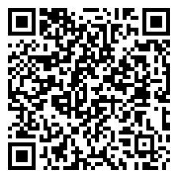

Evaluate this session
Scan this
QR code
to evaluate
this session.

Slide 35


© 2014 Microsoft Corporation. All rights reserved. Microsoft, Windows, and other product names are or may be registered trademarks and/or trademarks in the U.S. and/or other countries.
The information herein is for informational purposes only and represents the current view of Microsoft Corporation as of the date of this presentation. Because Microsoft must respond to changing market conditions, it should not be interpreted to be a commitment on the part of Microsoft, and Microsoft cannot guarantee the accuracy of any information provided after the date of this presentation. MICROSOFT MAKES NO WARRANTIES, EXPRESS, IMPLIED OR STATUTORY, AS TO THE INFORMATION IN THIS PRESENTATION.

