Slide 1
What’s new in Microsoft Azure IaaS?
Corey Sanders
Drew McDaniel

Slide 2
Mobile First
Cloud First

Slide 3
Why cloud?
Agility
When?
How?
DevOps
Automation
Easy Dev/Test
Pay-Per-Use
Unified Identity
Global Reach
Cost Savings
Time to Market

Slide 4
The Azure platform
Programming languages + tools
PowerShell, TFS + Git, Eclipse, .NET, Java, NodeJS, PHP, Python, Ruby
IaaS
Windows VMs
Linux VMs
Storage
Networking
PaaS
Web
Mobile
Gaming
Cloud Services
Data
Analytics
Media
Identity
Microsoft Cloud infrastructure

Slide 5
Unique Azure value
Hyper scale
Enterprise grade
Hybrid

Slide 6
>25
>2.5
Greater than
1,000,000
TRILLION storage objects
MILLION requests per second
SQL Databases in Azure
Hyper scale
16 regions worldwide
in 2014
>300
>13
MILLION
BILLION
AD users
authentications
per week

Slide 7
16 regions worldwide in 2014

Slide 8
→ Game sessions hosted using Azure
→ Hosted using >100,000 Azure Virtual Machines

Slide 9
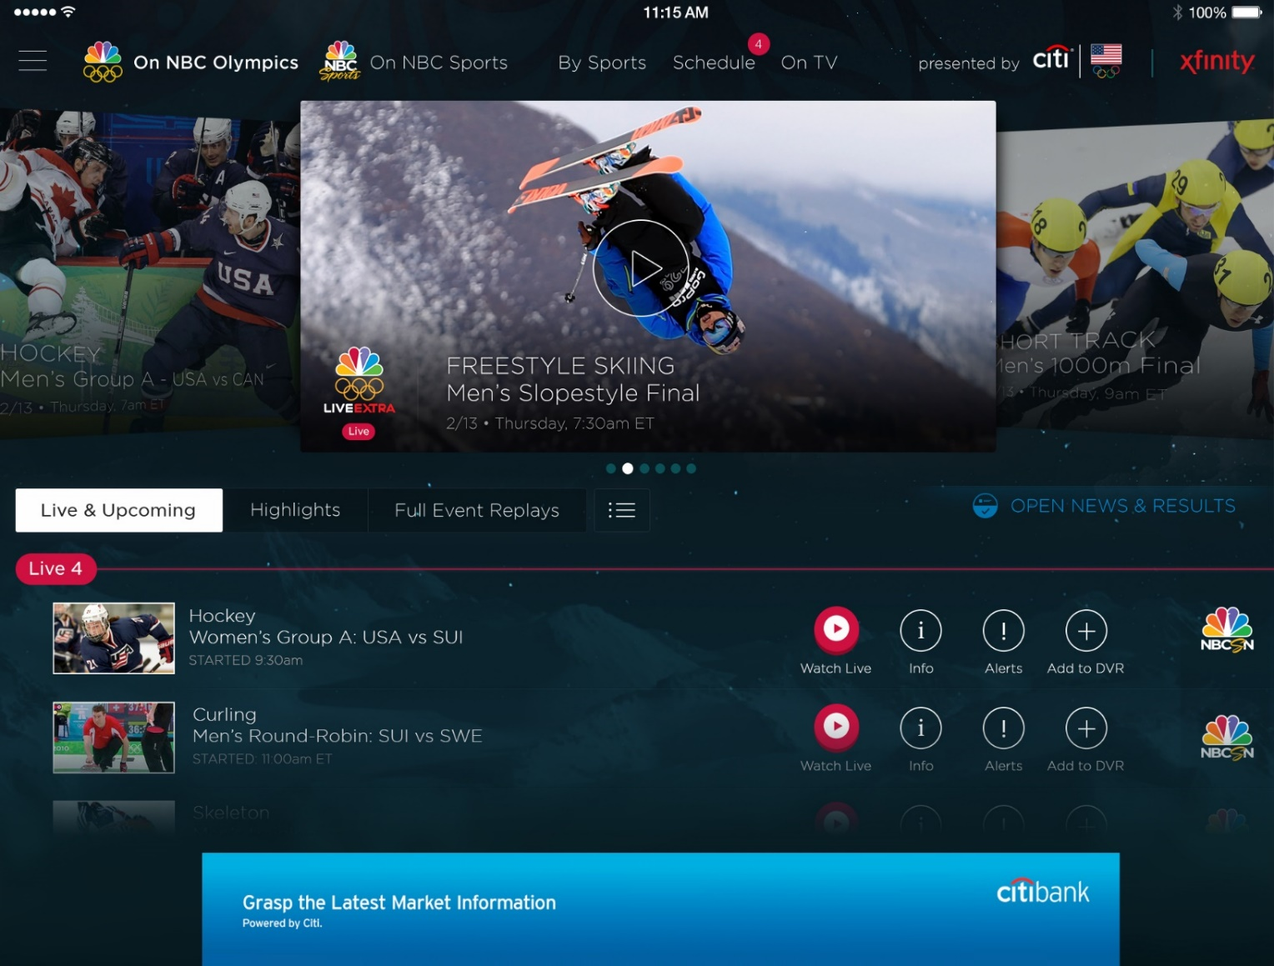
Olympics NBC Sports
Live video encoding and streaming
Web + mobile
100 million viewers
2.1 million concurrent HD viewers during the US versus Canada hockey match

Slide 10
Enterprise grade
http://www.bing.com/
Corporate Assurance
Manageability

Slide 11
Enterprise grade
Security and Ecosystem
Trustworthy Compliance
Enterprise-Class Support
Disaster recovery
Cloud DR and HA
Corporate Assurance
Site recovery

Slide 12
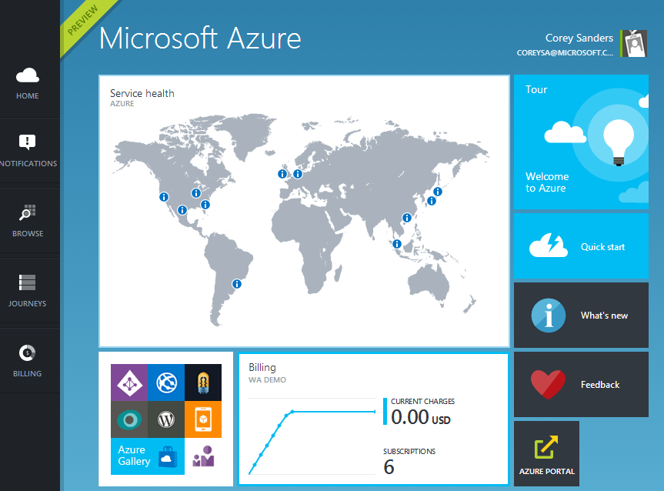
Enterprise grade
DevOps
Development IDE
Management Integration
Manageability

Slide 13
Hybrid
Infrastructure
Identity
Data
Application

Slide 14
Hybrid
Infrastructure

Slide 15
Hybrid
Identity
Active Directory
Active Directory

Slide 16
Hybrid
Data
Azure files
Import/export

Slide 17
Hybrid
Application

Slide 18
Enterprise Grade IaaS

Slide 19
Enterprise Grade IaaS
Development and DevOps
Management and System Center
Security and Ecosystem
DR and Networking

Slide 20
Development
Related: DEV-B328
MSDN Offer for Dev and Test
Windows
SQL Server and BizTalk
Special Images
BASIC VM Sizes for Dev, Test and Prod
Best value VMs
BYOLB and BYOAutoScale
BASIC.A1
$152.92 / year (8x5 work)
$91.52 / year (8x5 and MSDN)

Slide 21
Announcing: Windows Client for Dev / Test use in Azure
MSDN benefit subscription use only

Slide 22
Demo
MSDN Gallery on Azure

Slide 23
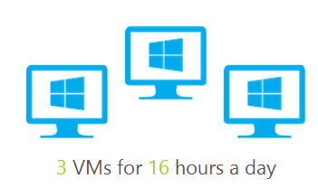
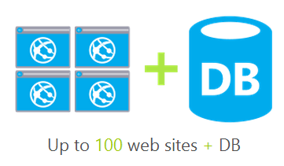
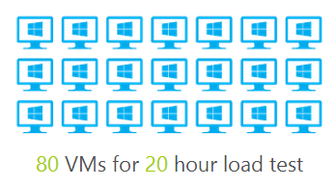
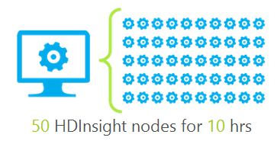
MSDN Usage Options – Premium MSDN
24
100

Slide 24
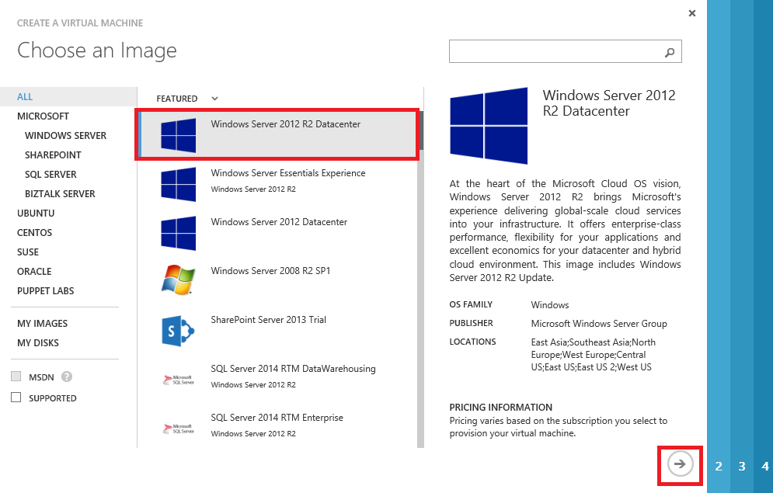
VM Extensions
Extending the power of your VM
Enable easier management
Support partner ecosystem
Full control still with you!
IaaS, meet PaaS
Curated Extensions
Agent
Azure

Slide 25
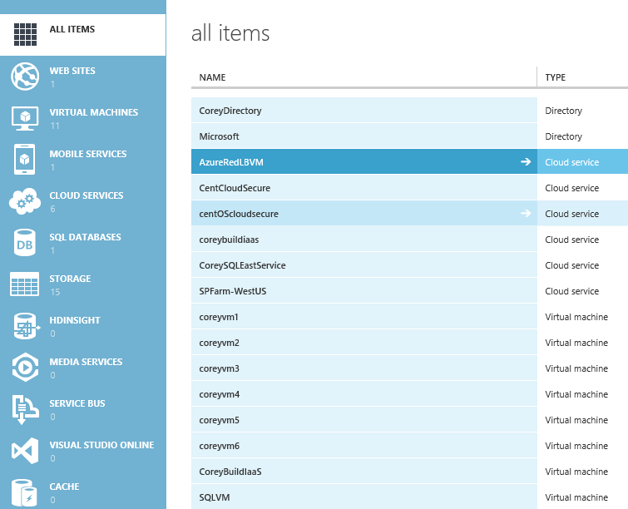
Helper Extensions
BGInfo
Useful VM information added to the VM desktop
VM Access
Reset admin password, rename admin account, reset network configuration (coming)
Virtual Machine Manager
Use VMM configuration files on Azure VMs
RDMA Drivers
Enable low-latency networking on A8 and A9 VM sizes

Slide 26
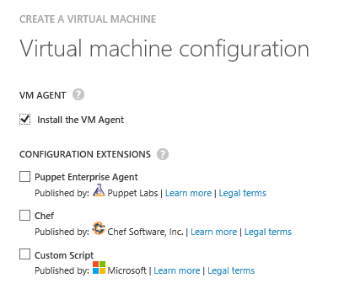
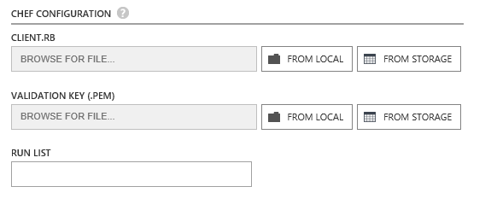
Configuration

Slide 27
Development
WebDeploy
Easily deploy websites from Visual Studio directly to an Azure VM
Remote Debugging
Directly connect Visual Studio debugger to process in Azure VM

Slide 28
Demo
Extensions and Visual Studio

Slide 29
Enterprise Grade IaaS
Development and DevOps
Management and System Center
Security and Ecosystem
DR and Networking

Slide 30
Windows Management Framework V5 Preview
Related: DCIM-B324
PowerShell Desired State Config
Use DSC to drive configuration
PowerShell OneGet
Finds and installs software packages
Chocolatey community repository

Slide 31
Demo Walkthrough: Publish to Blob
configuration Main
{
Import-DscResource -Module xWebAdministration
# Install the IIS role
WindowsFeature IIS
{
Ensure = "Present"
Name = "Web-Server"
}
# Install the ASP .NET 4.5 role
WindowsFeature AspNet45
{
Ensure = "Present"
Name = "Web-Asp-Net45"
}
. . . .
. . . .
# Create a new website
xWebsite BakeryWebSite
{
Ensure = "Present"
Name = "FourthCoffee"
State = "Started"
PhysicalPath = "C:\inetpub\FourthCoffee"
DependsOn = "[File]WebContent"
}
}
Azure Blob
BootStrapper
CLIENT
Configuration

Slide 32
Demo Walkthrough: Configure Azure VM
Resource Gallery
Azure Blob
BootStrapper
BootStrapper
CLIENT
Script Extension
AZURE VM
Configuration
Configuration
DSC Resources
Parse

Slide 33
Demo
PowerShell and OneGet

Slide 34
VM Images
Captures all disks attached
Best effort disk consistency
Re-deploy as a new VM
Sysprep and non-Sysprep
OS Images
(legacy)
Data
Log
VM Image

Slide 35
Demo
VM Images

Slide 36
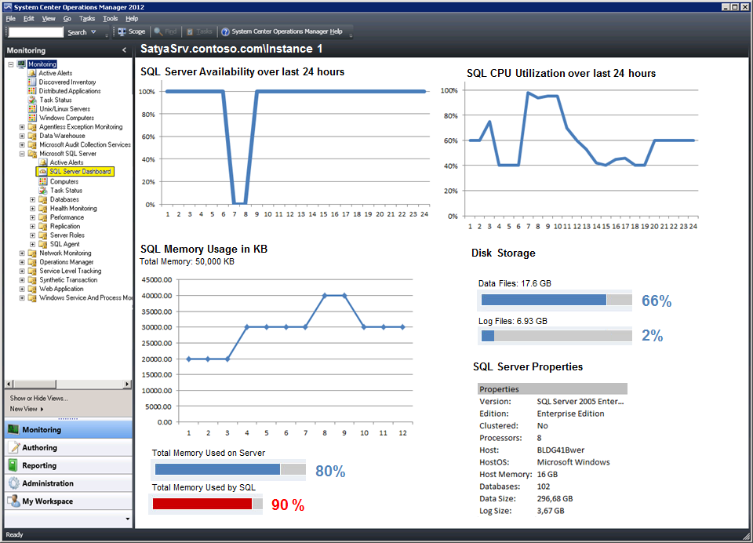
System Center Management
Microsoft Virtual Machine Converter 2.0
Internet
Microsoft Azure
Public VIP
Customer Network
External Load Balancer
Customer on premises
Back end
Front end
Azure
Server
VMDK
Server

Slide 37
Announcing: Support included SUSE Linux Enterprise Server
New VM image with premium SLES support included

Slide 38
SLES Support Included Image
Based on Gallery Image
Select SLES – Premium Support image to get started
Integrated with Azure Support
Must have Azure support contract
Initiate support incident through standard Azure channels for support incidents
Per-minute Premium
An additional per-minute charge on the VM while running

Slide 39
Demo
SUSE Supported SLES VM

Slide 40
Announcing: Compute Intensive VM Size A8 and A9

Slide 41
Compute Intensive VM Sizes
Name | Virtual cores | RAM
A8 | 8 | 56 GB
A9 | 16 | 112 GB
Faster Processors
More Memory
Faster inter-connect
40Gbit/s RDMA NIC (Windows Only)

Slide 42
Growing our feature scale…
Virtual Networking
Virtual Networking
Azure Server
Azure Server
Azure Server
Azure Server
Azure Server
Azure Server
Azure Server
Azure Server
Azure Server
Azure Server
Azure Server
Azure Server
Azure Server
Azure Server
Azure Server
Azure Server
Azure Server
Azure Server
Azure Server
Azure Server
Azure Server
Azure Server
Azure Server
Azure Server
Scale Unit
Scale Unit
Scale Unit

Slide 43
Demo
Compute Intensive VMs in a region-wide VNET

Slide 44
Enterprise Grade IaaS
Development and DevOps
Management and System Center
Security and Ecosystem
DR and Networking

Slide 45
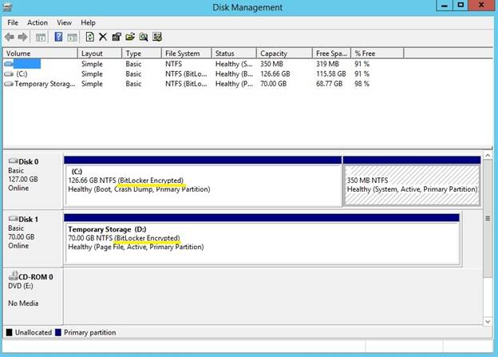
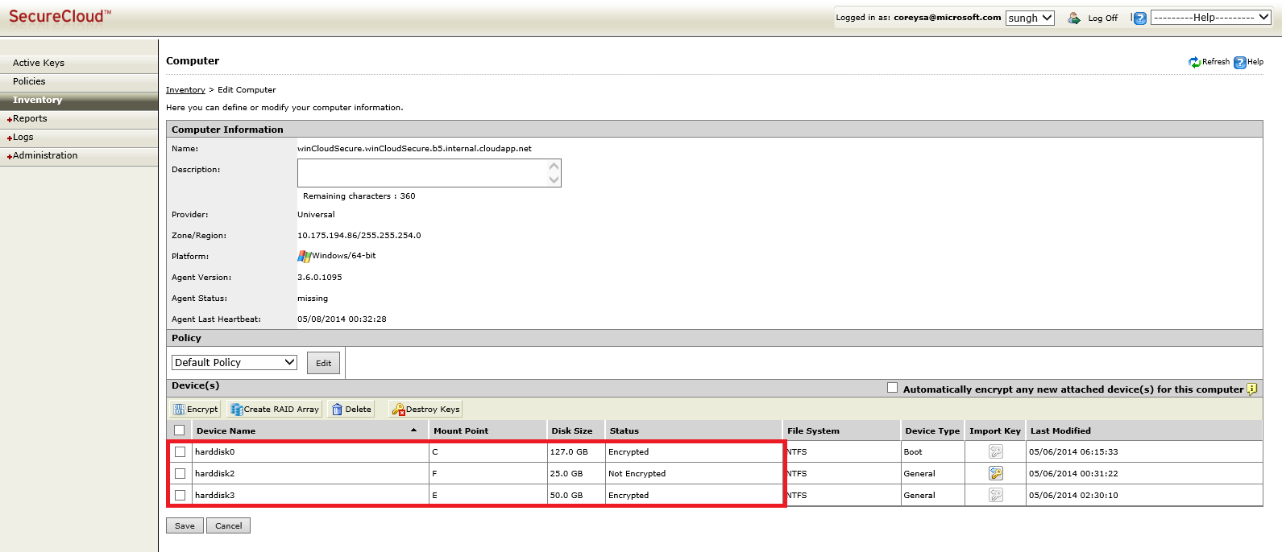
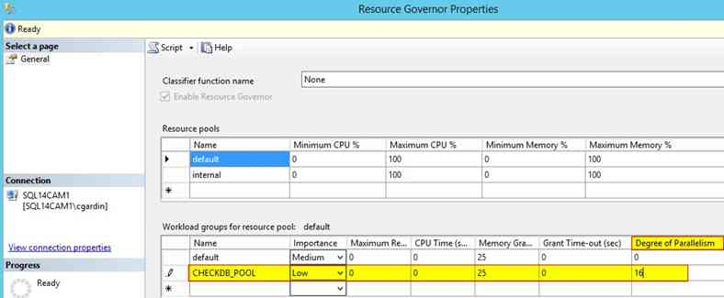
Security Application and Data
Related: DCIM-B385
Access control
Bitlocker Encryption
SQL Data Encryption (TDE)
TrendMicro SecureCloud
Afore Solutions
Operation Audit

Slide 46
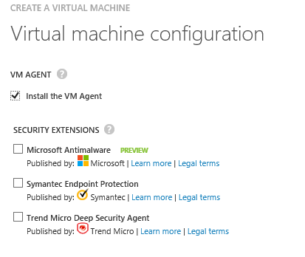
Announcing Security and Ecosystem
Related: DCIM-B385

Slide 47
Enterprise Grade IaaS
Development and DevOps
Management and System Center
Security and Ecosystem
DR and Networking

Slide 48
Related: DCIM-B322
Transform the Datacenter
Orchestrated disaster recovery to a second site
Microsoft Azure Hyper-V Recovery Manager
Communication Channel
Replication channel: Hyper-V Replica
Windows Server
Primary Site
Recovery Site
Windows Server

Slide 49
Related: DCIM-B322
Transform the datacenter
Orchestrated disaster recovery to a second site or to Azure
Microsoft Azure Site Recovery
Microsoft Azure Site Recovery
Communication Channel
Communication and Replication
Replication channel: Hyper-V Replica
Windows Server
Primary Site
Recovery Site
Windows Server
Primary Site
Windows Server
Key features include:
Automated VM protection and replication
Remote health monitoring
Customizable recovery plans
No-impact recovery plan testing
Orchestrated recovery when needed

Slide 50
Networking
Related: DCIM-B305
VNet-to-VNet Connectivity
IP Reservation for VIPs
Instance Level Public IP
Internal Load-balancing

Slide 51
Enterprise Grade: Networking
VNet-to-VNet Connectivity
Cross-region VNET connectivity enabling communication to any Azure datacenter
For HA and DR, customers create virtual networks in different Azure regions
Before
Connect through Crop
After
Direct VNet-to-VNet
VNet1
West Europe
VNet2
North Europe
VNet1
West Europe
VNet2
North Europe
Cross-subscription connectivity
Virtual networks in different subscriptions can securely communicate using private IP addresses
One-to-one
connection
Contoso HQ

Slide 52
Cross-region SQL Always On
Related: DBI-B314
SQL replica synchronized across Azure regions for geo-redundancy
VNet
Central US
VNet West US
SQL Always On
Cluster
AD/DNS
Cross-region secure channel
SQL Replica Sync Traffic & AD/DNS Traffic

Slide 53
Enterprise Grade: Networking
IP Reservation for VIPs &
Instance Level Public IP
Internet
IP reservation for VIPs:
Reserve public IP addresses
Customers can own IP addresses and assign them to cloud services
1
1
Reserved VIP
2
LB
IP: A.B.C.D
Instance-level Public IPs
Assign public IPs to VMs
Enables scenarios like FTP services, monitoring VMs by IP, etc.
2
Microsoft Azure
Cloud Service - 1
Cloud Service - 2
VM2
VM1
VM4
VM3

Slide 54
Enterprise Grade: Networking
Related: DCIM-B305
Internal Loadbalancing
Internet
Internal Loadbalancing:
Loadbalance VMs without public facing endpoints
Enables load balancing among VMs with private IP addresses
Load balanced endpoint accessible only by customer’s virtual and on-premises networks or just within the cloud service
Microsoft Azure
Internal VIP
Public VIP
Internal Load Balancer
Customer Network
External Load Balancer
Customer on premises
Back end
Front end

Slide 55
Demo
Networking Features

Slide 56
Hybrid IaaS

Slide 57
Hybrid: Networking
Related: DCIM-B305
Express Route GA
Multiple Site-to-Site VPN

Slide 58
Virtual network and ExpressRoute
IPsec VPN over internet
Exchange provider
Network service provider
Microsoft Azure
Microsoft Azure
Public
internet
Public
internet
Customer site 3
Customer site 2
Microsoft Azure
WAN
Customer site
ExpressRoute
partner location
Customer site 1
Public
internet
Customer DC
Connect via an encrypted link over public internet
Peer at an ExpressRoute location, an Exchange Provider facility
Connection from WAN provided by Network Service Provider.
Azure becomes another site on the customer’s WAN.
Virtual Network—Compute only.
ExpressRoute—Provides customer choice and includes access to compute, storage, and other Azure services.

Slide 59
Hybrid: Networking
Multiple Site-to-Site VPN
Connect to multiple on-premises locations
Multiple Site-to-Site connections
Multiple on-premises sites connect to same virtual network
customer may have geographically dispersed locations
VNet1
US West
VNet2
East Asia
Contoso NorthAm HQ (10.0.0.0/16)
Contoso East Asia (10.3.0.0/16)

Slide 60
Azure Files
Related: DCIM-B384
SMB 2.1
The Azure Storage System (3 copies)
Shared Settings, Diagnostic Share
Lift and Shift Applications
Azure
Files
Azure VM
Azure VM
Azure VM

Slide 61
Demo
Azure Files

Slide 62
The Azure cloud
TitanFall
NBC
Lots of Regions
Lots of compute
Hyper scale
Security and Ecosystem
Trustworthy Compliance
Enterprise-Class Support
Disaster recovery
Cloud DR and HA
DevOps
Development IDE
Management Integration
Infrastructure
Identity
Data
Application
Enterprise grade
Hybrid

Slide 63
Azure Announcements at TechEd
Generally Available
ExpressRoute
Multiple Site-to-Site
In-Region and Cross-Region VNET
Compute-intensive A8 & A9
IP Reservation for VIPs
Microsoft Azure Import/Export
Azure Managed Cache Service
Traffic Manager External End Points
Azure Store (EA only)
BizTalk Server 2013 R2 launch
Linux distributions phone support
PowerShell Script Deployment
Ecosystem Security
Windows Client in MSDN
Preview
Instance level Public IPs
Azure Redis Cache Service
RemoteApp
Internal Loadbalancing
Azure File
Azure API Management
BizTalk Hybrid Connections
Coming Soon
Site Recovery

Slide 64
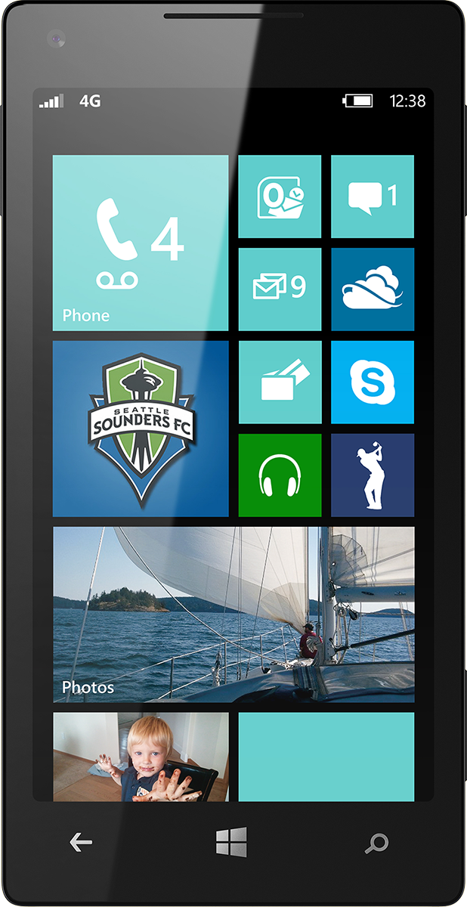
Evaluate this session
Scan this QR code to evaluate this session.

Slide 65
© 2014 Microsoft Corporation. All rights reserved. Microsoft, Windows, and other product names are or may be registered trademarks and/or trademarks in the U.S. and/or other countries.
The information herein is for informational purposes only and represents the current view of Microsoft Corporation as of the date of this presentation. Because Microsoft must respond to changing market conditions, it should not be interpreted to be a commitment on the part of Microsoft, and Microsoft cannot guarantee the accuracy of any information provided after the date of this presentation. MICROSOFT MAKES NO WARRANTIES, EXPRESS, IMPLIED OR STATUTORY, AS TO THE INFORMATION IN THIS PRESENTATION.

Slide 66
Related content
Links
VMDK Converter -- http://www.microsoft.com/en-us/download/details.aspx?id=42497
Breakout Sessions
DCIM-B384 - Microsoft Azure Storage (Monday 3:00PM)
DCIM-B223 - The Future of Microsoft Azure DevOps: Building, Deploying, Managing, and Monitoring Your Cloud Applications in the New Azure Portal (Monday 4:45PM)
DCIM-B385 Security and Microsoft Azure IaaS (Tuesday 10:15AM)
DEV-B328 – Running Your Dev/Test in Microsoft Azure (Tuesday 1:30PM)
DCIM-B222 - Transform Your IT Skills in a DevOps World (Tuesday 1:30PM)
DCIM-B300 - Microsoft Azure for SharePoint Farm Administrators (Tuesday 5:00 PM)
DCIM-B324 PowerShell Desired State Configuration and DevOps in Microsoft Azure
DCIM-B422/3 ExpressRoute: Connecting Private and Public Clouds through Exchange Providers (Wednesday 8:30AM)

Slide 67
Related content
Breakout Sessions (Cont)
DCIM-B386 - Mark Russinovich and Mark Minasi on Cloud Computing (Wednesday 10:15AM)
DCIM-B305 - What’s New in Microsoft Azure Networking (Wednesday 1:30PM)
DCIM-B388 - Extending Your Premises to Microsoft Azure with Virtual Networks and ExpressRoute (Thursday 8:30AM)
DEV-B419 - Diagnosing Issues with Cloud Applications Hosted in Microsoft Azure Using Visual Studio (Thursday 8:30AM)
DCIM-B423 - ExpressRoute: Connecting Private and Public Clouds through WAN Providers (Thursday 1:00PM)
DCIM-B303 - SAP in Microsoft Azure: Scenarios and Considerations (Thursday 1:00PM)
DBI-B314 - CAT: Microsoft SQL Server High Availability and Disaster Recovery in Microsoft Azure (Thursday 2:45PM)

Slide 68
Related content
Labs
DCIM-IL210 Introduction to Microsoft Azure Virtual Machines

Slide 69
Resources
Learning
Sessions on Demand
Microsoft Certification & Training Resources
http://channel9.msdn.com/Events/TechEd
www.microsoft.com/learning
TechNet
msdn
Resources for IT Professionals
Resources for Developers
http://microsoft.com/technet
http://microsoft.com/msdn

Slide 70
Complete an evaluation and enter to win!

