Slide 2
A Practical Overview of Desired State Configuration
DCIM-B417
Don Jones
Concentrated Tech

Slide 3
Welcome
Don Jones
Microsoft MVP Award Recipient
President and CEO of PowerShell.org, Inc.
Senior Partner and Principal Technologist at Concentrated Tech
Author, “Learn Windows PowerShell in a Month of Lunches” and other books
Desired State Configuration
Microsoft’s declarative configuration technology, built on Windows PowerShell and introduced in Windows Management Framework 4.0.
Available for Windows 7, Windows Server 2008 R2, and later.
Free ebook: “The DSC Book” is available at http://powershell.org/wp/ebooks.

Slide 4
Q&A
Please ask as we go!
Most of this session consists of live demonstration of main DSC techniques, with a minimum of slides. Feel free to pop in with questions whenever you feel the urge.
If I can’t answer every question, please find me at The TechNet Script Center pod in the expo area, or look for a book signing time at the TechEd Bookstore.

Slide 5
What is DSC?
The “End Game”
This technology was the “final destination” in the “Monad Manifesto.” That’s the document written by Windows PowerShell inventory Jeffrey Snover, wherein he described his vision for changing administration in a Microsoft environment.
In some respects, DSC eliminates the need for some administrators to even learn Windows PowerShell. It’s that important.
In the future, expect DSC to be the primary administrative interface for Microsoft products and services.

Slide 6
DSC Architectural Overview
Configuration Script
MyConfig.ps1
Pushed
MOF on Target Node
Compiled
Calls
MOF
SERVER2.mof
DSC Resources specialized Windows PowerShell modules
Authoring
Deployment

Slide 7
Two Deployment Modes
Push
Use Start-DscConfiguration to copy MOF to target node(s). Node(s) evaluate configuration immediately and again every 15 minutes (by default).
Manual process. Non-core DSC resources must be manually deployed to nodes.
Pull
Use push mode to enroll target node(s), configuring them with their pull server information. Target node(s) check the pull server every 30 minutes (default) and re-apply configuration.
MOF files must be copied to pull server, and must be accompanies by a checksum file.
DSC resources must be ZIPped and placed on pull server. Nodes will copy down any resources they are missing.

Slide 8
Pull Servers
HTTP(S)
Windows Server 2012 R2 and later only (can service nodes of any version)
Use xPSDesiredStateConfiguration resource module to deploy (demo coming up)
Communicates over HTTP or HTTPS (requires SSL certificate)
Load balance / high availability by any usual web server means
SMB
Any file server with a shared folder
Communicates over Server Message Blocks (SMB)
Load balance / high availability by DFS and/or clustering
Target nodes must be configured with a valid credential to access the share

Slide 9
Local Configuration Manager
LCM
Run on all target nodes (part of WMF 4.0)
Has its own meta-configuration (pull mode, refresh interval, application mode, etc)
Is responsible for reviewing MOFs and, if configured, for implementing the configuration they describe

Slide 10
Remoting
Required!
Most inter-computer DSC communications are by means of PowerShell Remoting (e.g., that’s how you push a MOF to a target node). So Remoting is more or less a pre-requisite for this entire technology.

Slide 11
Integration
System Center Virtual Machine Manager
Can inject MOFs into new virtual machines upon creation.
For example, tell each new VM where the pull server is.
You deploy “empty” VMs and let their configuration tell them what to install, what to copy, what domain to join… everything.

Slide 12
Demo
DSC Configurations
Building a DSC Pull Server
Enrolling a DSC Pull Node

Slide 13
Think About It
Configuration is Just a Text File!
If you’re configuring everything on your servers by means of DSC, then all of your configurations are just text files.
They’re searchable. Index-able. Human-readable.
Easily modified by tools! Imagine a GUI where you set up configurations, and it just writes out text files.
Easily modified by tools!!! Imagine a wizard that adds a new user… but really just modifies configuration scripts targeting your domain controllers, file servers, and whatever else. Configuring anything becomes a matter of modifying text files.

Slide 14
What About Resources?
They’re Script Modules
A DSC resource is just a Windows PowerShell script module (.psm1) that implements three pre-defined functions.
You deploy resources by file copy or via a pull server.
Yeah, you can write your own, and it’s easy.
http://GitHub.com/powershellorg/DSC even has some community-authored examples (many of which come from StackExchange’s production environment!)
Microsoft’s DSC Resource Kit provides around a dozen additional resources on top of the ones built into the operating system.

Slide 15
DSC Resource Design
Module
xNetworking
Resource
xIPAddress
Resource
xDNSServerAddress
“x” denotes “Experimental”
“c” denotes “Community”
For internal resources develop a private prefix
Module
xFirewall

Slide 16
Resource Prototype
Function Get-TargetResource {
}
Function Set-TargetResource {
}
Function Test-TargetResource {
}

Slide 17
DSC Skills Stack
Basic
admin
Configuration Scripts
DSC Resources
Scripter
Scripter/
Dev
Windows PowerShell commands

Slide 18
DSC vs. GPO
Feature | Group Policy | DSC
Configuration stored in | GPO file | Configuration script / MOF file
Target nodes by means of | AD links to OUs, sites, etc. | Configuration specifies node names
Configuration implemented by | Client-side OS components | Client-side shell scripts (resources)
Extensible by means of | Complex native programming | Windows PowerShell scripts
Primary configuration target | Windows registry | Anything Windows PowerShell can “touch”
Persistence | Settings reapply each time | Settings are persistent
Number of configurations per node | As many GPOs as you want to link | One

Slide 19
Scenarios
Today, Mainly Servers
DSC’s primary target today is server scenarios.
Servers tend to stay in one place
Servers tend to do one thing (or one set of things)
Servers tend to be more static, in other words
Servers have a more constrained set of things they can do
Servers tend to need more rigidly controlled configurations

Slide 20
Thank You
Last Chance for Q&A right now
Although, please find me at The TechNet Script Center pod if you’d like to discuss further
Contact Me
On Twitter @concentrateddon
On Facebook.com/concentrateddon
In the Q&A forums at PowerShell.org
Don’t Forget
Free ebook: “The DSC Book” is available at http://powershell.org/wp/ebooks.

Slide 21
Related content
Breakout Sessions & Instructor-Led Labs
DCIM-B324 PowerShell DSC and DevOps n Windows Azure
DCIM-IL201 Implementing DSC in Windows Server 2012 R2
DCIM-B377 Building Disaster Recovery Plans for Microsoft Workloads and Applications with Hyper-V Recovery Manager and DSC
Find Me Later At the TechNet Script Center pod

Slide 22
For More Information
Windows Server
Windows Server 2012 R2
http://technet.microsoft.com/en-US/evalcenter/dn205286
System Center
System Center 2012 R2
http://technet.microsoft.com/en-US/evalcenter/dn205295
Azure Pack
Azure Pack
http://www.microsoft.com/en-us/server-cloud/products/windows-azure-pack
Microsoft Azure
Microsoft Azure
http://azure.microsoft.com/en-us/
Come Visit Us in the Microsoft Solutions Experience!
Look for Datacenter and Infrastructure Management TechExpo Level 1 Hall CD

Slide 23
Resources
Learning
Sessions on Demand
Microsoft Certification & Training Resources
http://channel9.msdn.com/Events/TechEd
www.microsoft.com/learning
TechNet
msdn
Resources for IT Professionals
Resources for Developers
http://microsoft.com/technet
http://microsoft.com/msdn

Slide 24
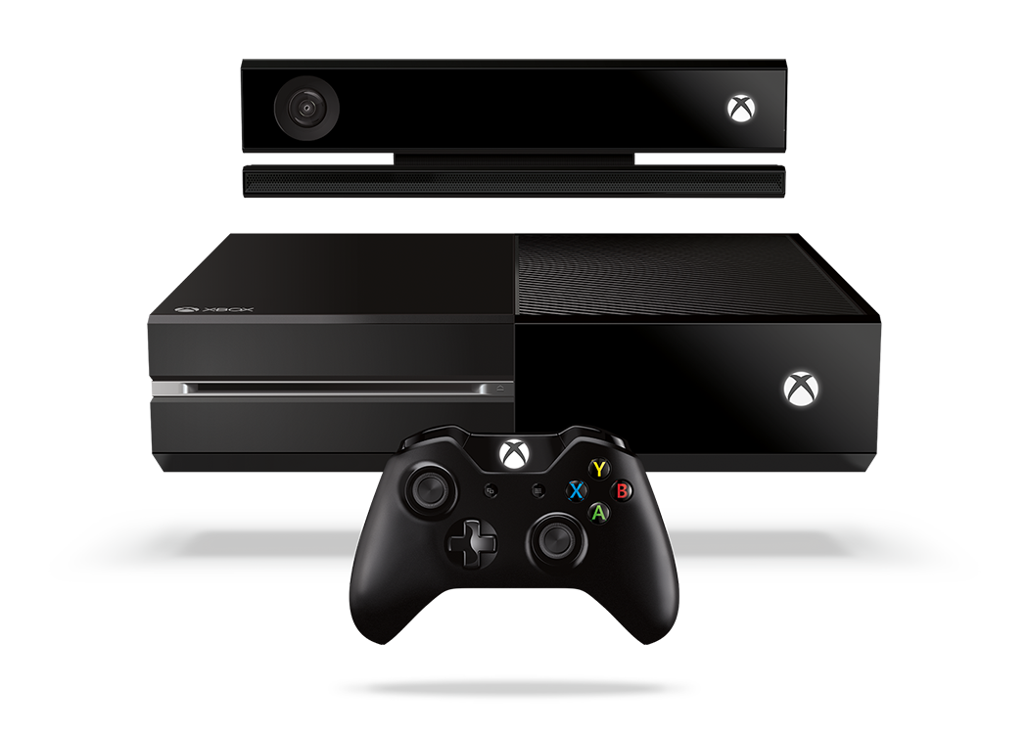
Complete an evaluation and enter to win!

Slide 25
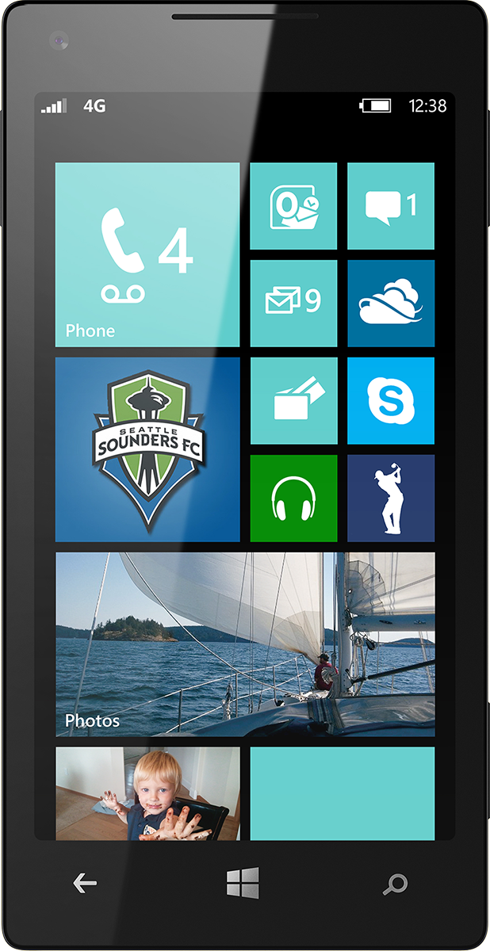
Evaluate this session
Scan this QR code to evaluate this session.

Slide 26
© 2014 Microsoft Corporation. All rights reserved. Microsoft, Windows, and other product names are or may be registered trademarks and/or trademarks in the U.S. and/or other countries.
The information herein is for informational purposes only and represents the current view of Microsoft Corporation as of the date of this presentation. Because Microsoft must respond to changing market conditions, it should not be interpreted to be a commitment on the part of Microsoft, and Microsoft cannot guarantee the accuracy of any information provided after the date of this presentation. MICROSOFT MAKES NO WARRANTIES, EXPRESS, IMPLIED OR STATUTORY, AS TO THE INFORMATION IN THIS PRESENTATION.

