Slide 1


Slide 2
ExpressRoute: Connecting Private and Public Clouds through Exchange Providers
Venkat Gattamneni Shane Guthrie
Ganesh Srinivasan Equinix
Microsoft Azure Noam Shendar
Zadara Storage

Slide 3
Agenda
ExpressRoute Overview
Equinix and ExpressRoute
Zadara Storage and ExpressRoute

Slide 4

Customers want Cloud on their networks
Customer site 2
Customer site 2
Public Cloud
Public Cloud
Private Network
Private Network
Customer site 1
Customer site 1
Public
internet
Public
internet
Customer DC
Customer DC
IPsec VPN over Internet
  Greater networking costs and higher latency
  Data traverses the Internet to reach public cloud
  Limited bandwidth
Cloud on your WAN
  Avoids risks from exposure to Internet
  Avoids complexity and added costs
  Provides lower latency, higher bandwidth and greater availability

Slide 5
What is ExpressRoute?
Customer site 2
Predictable performance
Azure
ExpressRoute
Security
Private Network
Customer site 1
High throughput
Customer DC
Connect your private network with Azure via secure, high-throughput, low latency connections bypassing the Internet
Lower cost

Slide 6
Enterprise workloads
Storage, backup,
and recovery
Dev/test lab
BI/big data
Media
Hybrid apps
Productivity apps

Slide 7






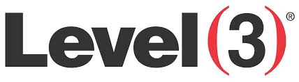
ExpressRoute Flavors and Partners
Connecting at an Exchange provider
Connecting via a Network service provider
Microsoft
Azure
Microsoft
Azure
Public
internet
Customer site 3
Customer site 2
WAN
Public
internet
Customer site
ExpressRoute
partner location
Customer site 1

Slide 8
ExpressRoute Bandwidth tiers
Exchange Provider Scenario
Monthly fee with included outbound data transfer.
Unlimited inbound data transfer included
200 Mbps
+
3TB/month
500 Mbps
+
7.5TB /month
99.9%
SLA
Dedicated
Circuit uptime
1 Gbps
+
15TB /month
10 Gbps
+
250TB /month

Slide 9

ExpressRoute locations
Locations:
Available Today
Washington D.C.
Silicon Valley, CA
London, UK
Coming Soon...
Additional sites in Europe, Asia, and North America
Global datacenters
ExpressRoute locations today

Slide 10
ExpressRoute and Equinix
Shane Guthrie, Director
Global Solution Innovation

Slide 11
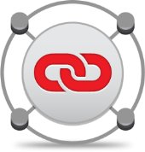


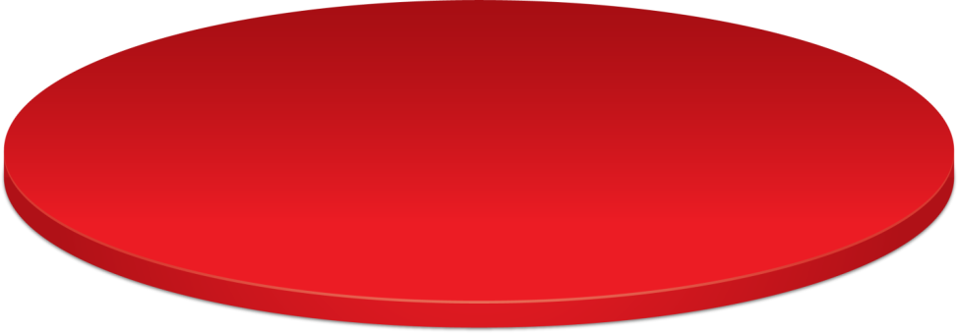

Equinix: A Platform for Interconnection
Global
Data Centers
100+ Data Centers
10M+ Square Feet
99.999% Uptime Record
Interconnection
1000+ Networks
140,000+ Cross Connects
100% of Tier 1 Network Routes
Business
Ecosystems
Equinix Marketplace™
4,500+ Global Customers
Revenue Opportunities

Slide 12
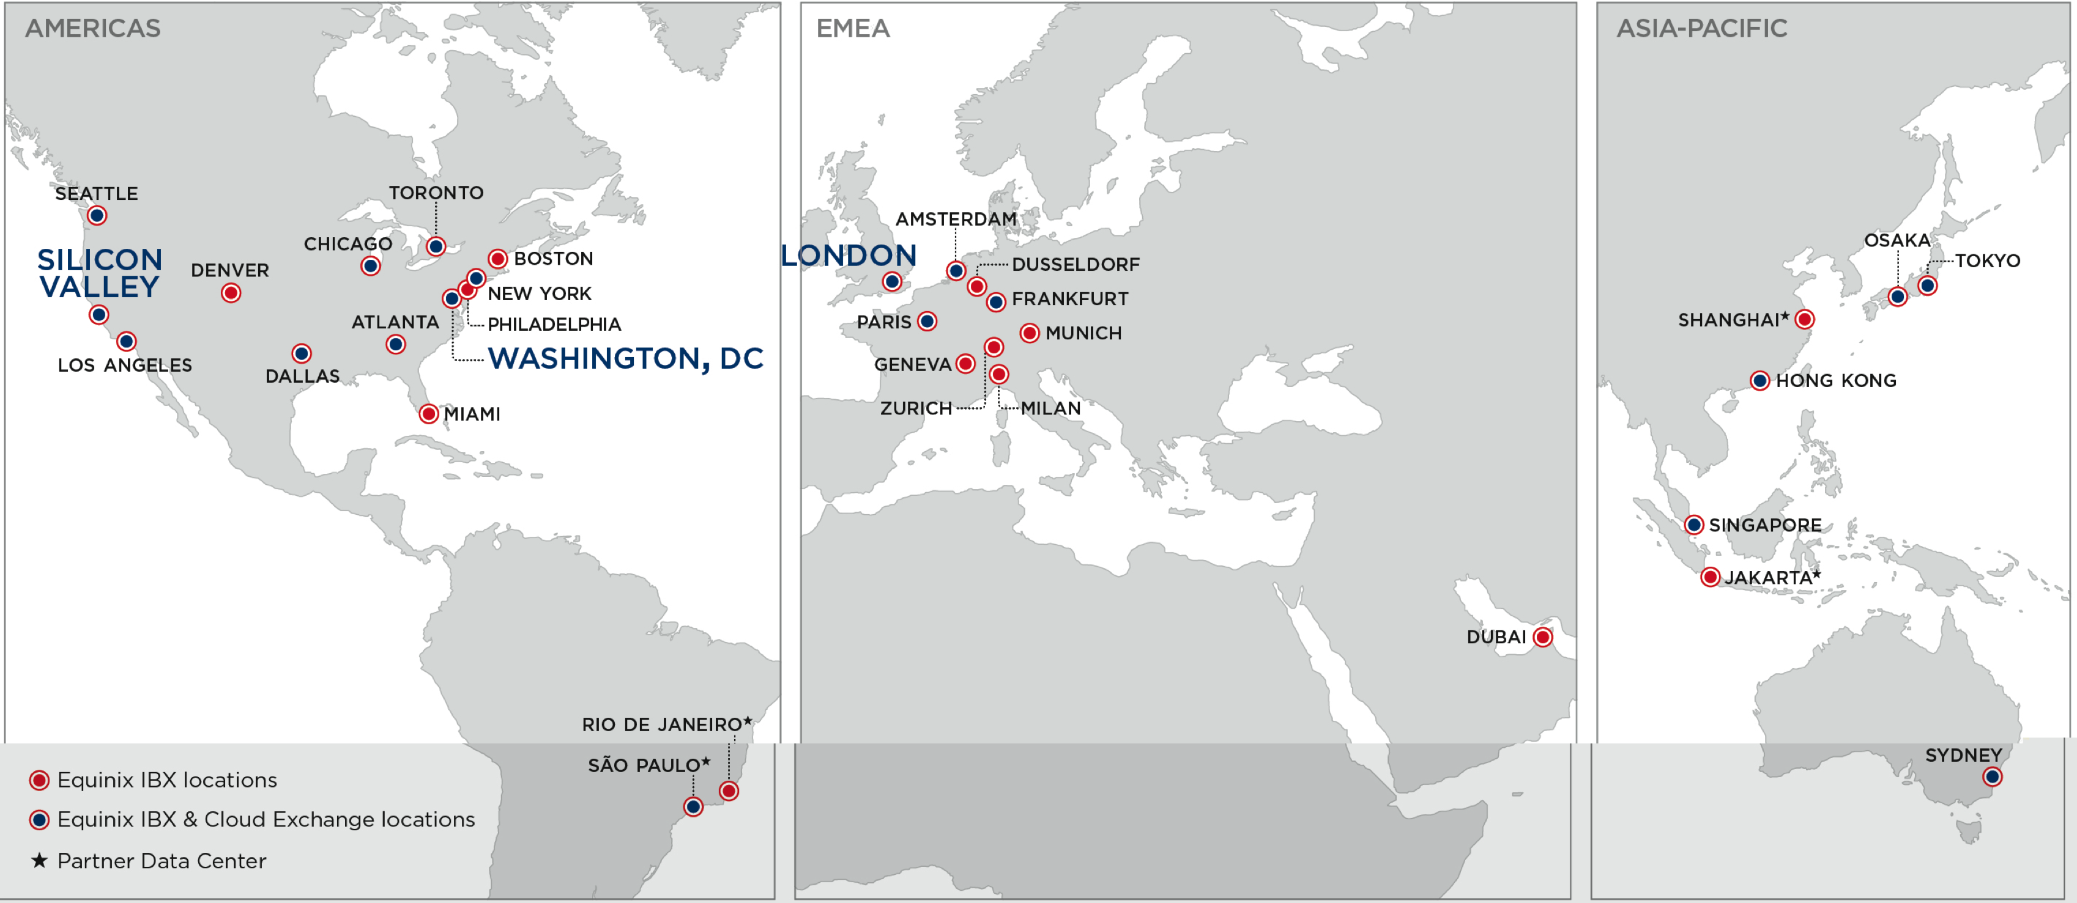
ExpressRoute and Equinix

Slide 13
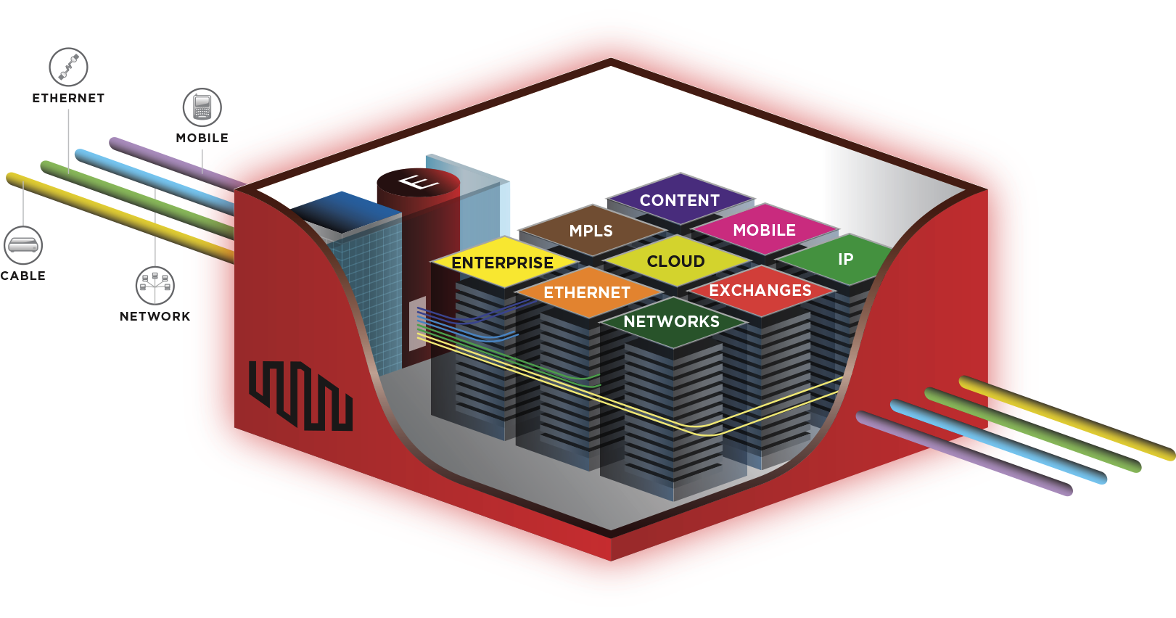
Equinix Cloud Exchange
Network Services
IP Transit
Ethernet
MPLS
Cloud Services
  IaaS
  SaaS
  PaaS
Value-Added Services: CDN, WAN Acceleration, Security

Slide 14
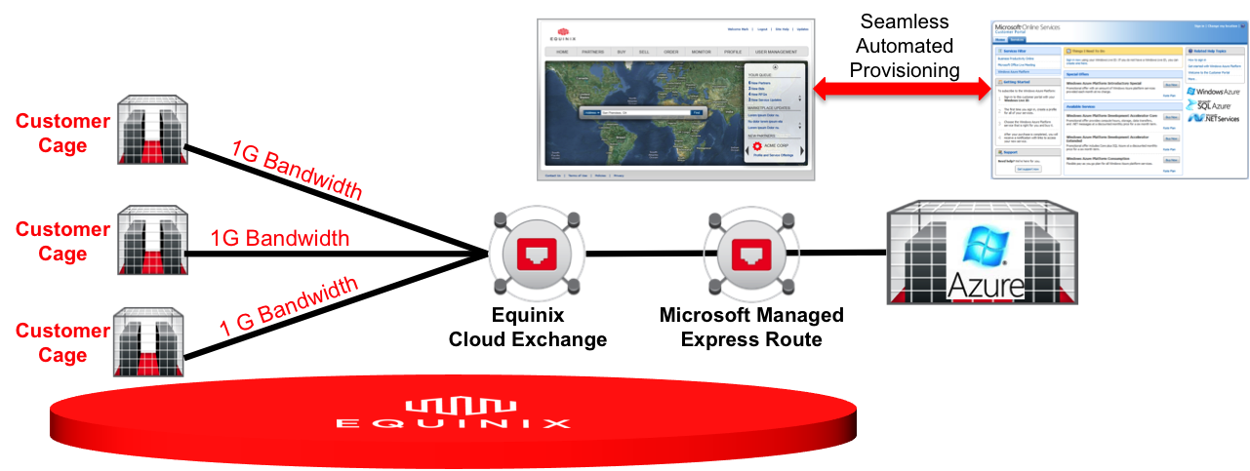
ExpressRoute on Cloud Exchange
Value Positioning:
Equinix Cloud Exchange allows Equinix customers to connect their corporate IT infrastructure directly to Azure Services through a secure, private, virtual connection.
By bypassing the public Internet, you can improve performance, reduce costs, increase security, and leverage cloud computing for more applications.
With Equinix Cloud Exchange and Azure Managed Express Route, you can treat Azure instances as part of your data center LAN, allowing full integration between cloud services and your internal applications.

Slide 15



Breakdown of Azure Express Route
MS Network Node components
  MSFT cage in select Equinix IBX Locations
  Contains networking equipment
  Fiber backhaul to Azure locations
    US East
    US West
  Connect to Equinix Cloud Exchange
Equinix Cloud Exchange
  Connects to MSFT Azure cage
  Connects Customer Cages
  Connects to additional NSPs
Azure
Node
Service Aggregation using ECX
Azure presence in Equinix IBX
Cloud
Exchange
Redundant Infrastructure, 99.999%
Alcatel-Lucent 7400-series switches
Automated provision through API / Portal
Service Transparency
1, 10G port options

Slide 16

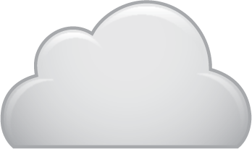

Azure Network Deployment in Equinix
1
Microsoft cage with networking gear and service functions for extending connectivity to Azure
Azure Region
1
2
Multiple, independent fiber links (10G) will connect the Azure connectivity nodes to the Equinix Cloud Exchange (ECX).
ISP
Azure
Cage
3
ECX aggregates customer connectivity within the datacenter. ECX creates Virtual Circuits (VC) at various speeds between customer and Azure ports
Cloud
Exchange
3
2
4
Customer
Cage
4
Each customer will connect into (2) separate ECX switch ports using a fiber cross connect. This provided resilience and redundancy.
Customer
5
5
Customer connects fiber cross connects from the ECX to their CPE (switch/router)
Router is required to run BGP
Customer

Slide 17
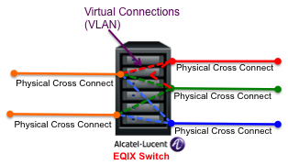






Equinix Interconnection Evolution
Internet Access
Direct Interconnect
Virtual Connections
Virtual Connection
Cloud
Customer
Cloud
Customer
1,10-Gb Fiber
Cloud
Provider
Mature Market adoption Emerging
PROS
Instant Connection
Flexible and Dynamic
Anywhere Access
ADOPTION BARRIERS
Low Throughput, High Latency
Data Loss and Privacy Risk
Unsecure, Unreliable
PROS
Secure and private
Consistent throughput
ADOPTION BARRIERS
Manual process - physical installations, doesn’t match instant nature of cloud
PROS
Secure and private
Consistent throughput
Flexible and Dynamic
Reduced provisioning times
ADOPTION BARRIERS
Low Density of existing users
Lack of defined price model

Slide 18
ECX Pricing for ExpressRoute
ECX Standard Pricing | NA ($US)
 | MRC | NRC
ECX 1 Gbps Port | $100.00 | $500.00
ECX 10 Gbps Port | $200.00 | $3,000.00
Virtual Circuit - Up to 200 Mbps CIR | $100.00
Virtual Circuit - Up to 500 Mbps CIR | $150.00
Virtual Circuit - Up to 1 Gbps CIR | $200.00
ECX Standard Pricing | NA ($US)
 | MRC | NRC
ECX 1 Gbps Remote Port | $500.00 | $500.00
Virtual Circuit - Up to 200 Mbps CIR | $100.00
Virtual Circuit - Up to 500 Mbps CIR | $150.00
Virtual Circuit - Up to 1 Gbps CIR | $200.00
1G “Remote Port” Option
  For customers coming through ExpressRoute partner patch panel
  Customers sign EQIX MCA and GTC, owns and pays EQIX for ECX port and VC
  Customer does their own L1/L2/L3 access with NSP and provides NSP LOA to EQIX.
Standard Pricing
  Two pricing components (ECX Port & VC for Cloud)
  Same VC price to connect to any Services
  A & Z sides both pay port fees, A side pays for VCs

Slide 19

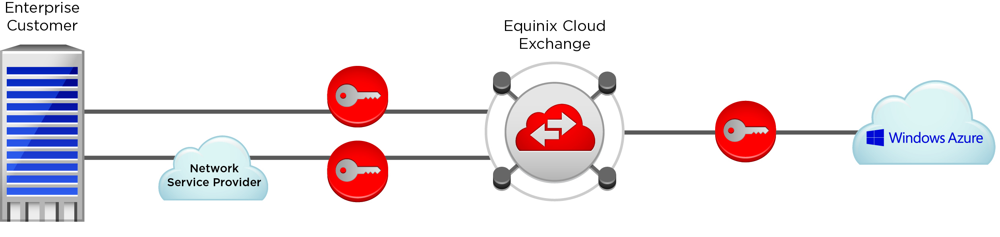
ECX Provisioning for Microsoft Azure
A
C
B
D
C
B
Enterprise Sets Up Azure Service
Enterprise establishes Azure compute and storage instances
Enterprise selects private connectivity option and IBX location
Azure Portal shows EQIX as EXP option which enterprise selects
Azure issues “service key”
Enterprise Sets Up Equinix Cloud Exchange Service
If Enterprise is Collocated in Equinix
  Purchase ECX Port. Configure via ECX Portal, select metro location, ECX port, virtual connection (VC) speed, and enter service key
If Enterprise is Not Customer of Participating ECX NSP
  Purchase ECX Remote Port. Obtain LOA from NSP for demarcation. Configure via ECX Portal, select metro location, ECX port, VC speed and enter service key
ECX Interacts with Azure
ECX uses API integration with MSFT to provision VC end to end to ExpressRoute in near real time
Enterprise can monitor provisioning status and VC connection status from ECX Portal
A
C
B

Slide 20
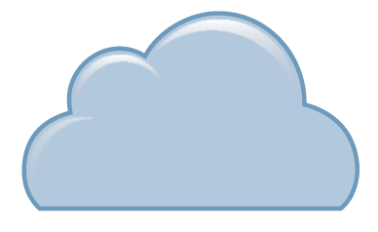
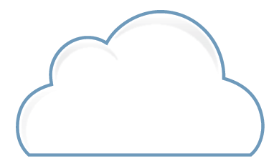



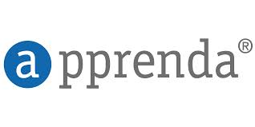
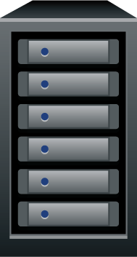





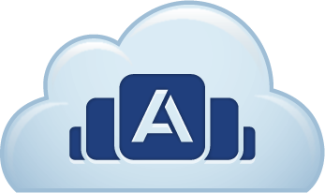






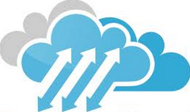
Hybrid Cloud Example Cases
Legacy App
Middleware
Web Proxy
Web Proxy
Cloud X
Legacy DB
Stateless Tier
Scale
Private
Hybrid
Public
Cost
Efficiency
Efficient for large steady state workload
Control
Compliance, Security and Performance needs for DNA: Data-Network-Application
CAPEX friendly
Agility
Instant access to Infrastructure
Scalability /
Elasticity
Pay as you go
OPEX friendly
Needs driven Scale up / down
Hybrid Cloud Use Cases offer Best of Both Worlds
Own Base, Rent Spike: Run the steady state workload in private while spike into public as needed. e.g. Unknown capacity - start in public, plan for private.
Control Data: Keep data secured in private cloud and leverage public compute resources. e.g. Compliance enforcement.
Control Network: Exchange / Internet gateway – Peer to Eyeball Networks. e.g. Netflix Open connect – Private CDN implementation.
Control Network: Virtual Network – extend the private network perimeter into the public cloud. e.g. Azure VNET
Control Apps: Business / Mission Critical apps in Private, Others in public. e.g. Analytics / backup / BCP - DR in public.
Control Apps: Development / Test in public, Production in private
Control Apps: Tiers within an application distributed between public / private. e.g. Legacy apps/ middleware tier in private, stateless / scalable tier in public.

Slide 21
Hyper-V Example
1
Customer workloads run in Azure
2
Virtualization infrastructure reside in an Equinix IBX location with Express Route
1
Azure
4
3
Customer creates virtualized environment on their internal resources
Azure
Cloud
Exchange
4
System Center orchestration tools interface into both environments
Scripted actions
Workload/data migrations
3
2
Customer Cage
Edge Router
NSP

Slide 22
Domain Joining Example
1
Systems and application running in Azure
2
On-Premise Directory Services process authentication requests
1
Azure
3
3
Authentication token sent back into Azure over secure connection
Azure
Cloud
Exchange
2
AD DS
Customer Cage
Edge Router
NSP

Slide 23
Virtual Desktop Example
1
Remote Desktops running in Azure
2
Customers can choose to run select functions on-premise
Remote Desktop GW
Remote Desktop Web
1
Azure
Azure
3
Directory services can run on-premise to maintain security through isolation
Cloud
Exchange
4
3
Data
2
AD DS
RD *
Customer Cage
Edge Router
4
User information can remain on-premise
File shares
User data
NSP

Slide 24
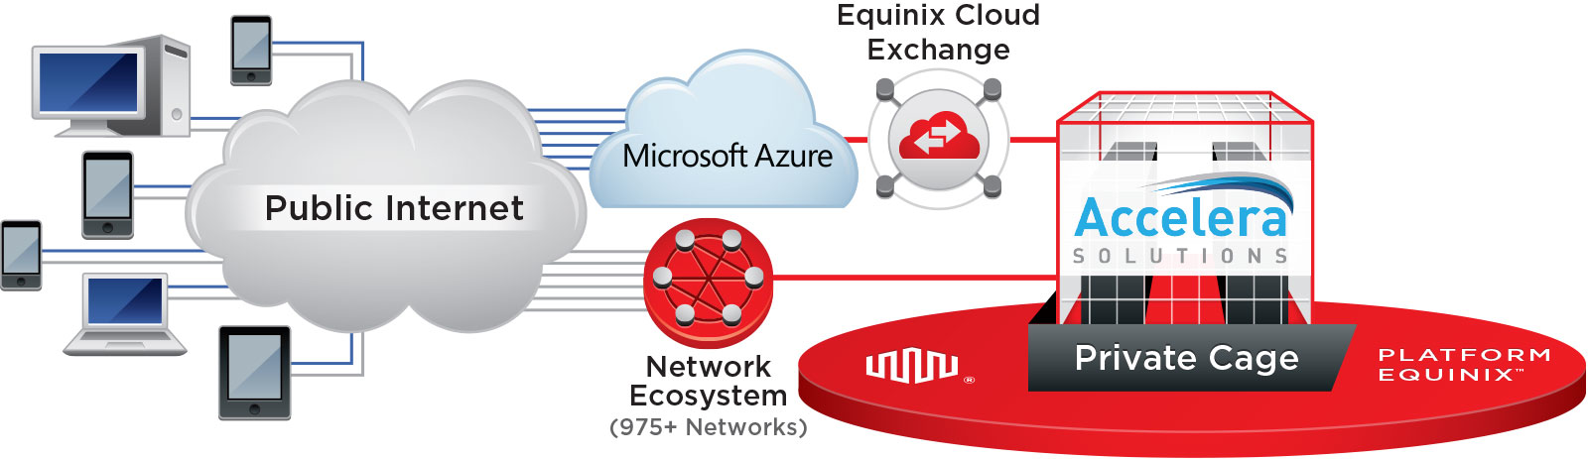
Accelera Solutions with ExpressRoute
Enterprise Users
Private Networks
Combines the best of custom solutions and flexibility with high performance, scalability, and Microsoft’s industry leading Azure Cloud
Custom VDI capability tailored to the client’s needs, integration with the client’s existing environment, minimal initial capital investments, rapid capacity expansion
Higher performance access to Azure
Increased reliability and security
ExpressRoute costs less than paying an ISP for access to Azure over Internet
Reduce initial hardware CAPEX by over $300k
Up to 30% overall IT savings over 5 year term

Slide 25


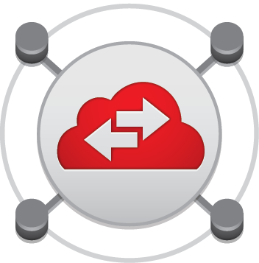
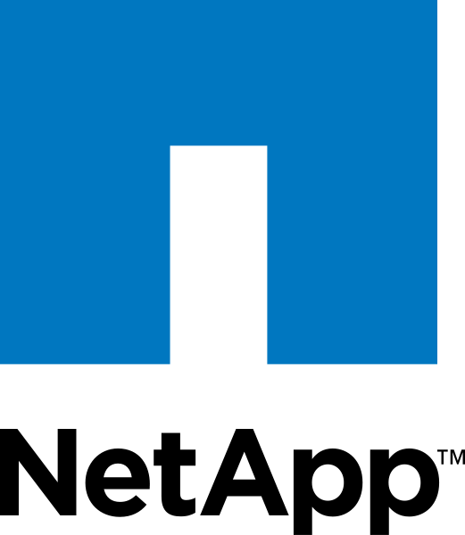
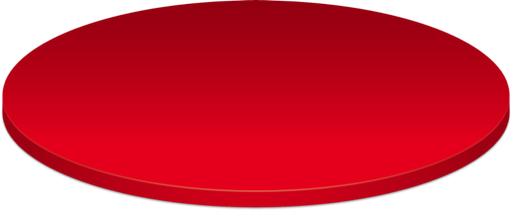


NetApp Performance on ExpressRoute
Internet
Private
Tested performance from Microsoft Azure over Equinix Cloud Exchange vs. access over Public Internet
Overall, 36% performance improvement
Ability to failover from local implementation to Azure with no performance change
Public
1Gb
1Gb
Equinix Cloud Exchange
Test Lab
36% Faster
Test: | % Improvement
Average IOps | 35.90%
Read IOps | 35.83%
Write IOps | 35.97%
Average MBps | 35.90%
Read MBps | 35.83%
Write MBps | 35.97%
Transactions per Second | 35.90%

Slide 26
ExpressRoute Demo
Ganesh Srinivasan
Microsoft Corporation

Slide 27
ExpressRoute and SharePoint DR
Equinix – Silicon Valley
SQL Always On
SharePoint
WEB
SharePoint
App
Active Directory
SQL
Witness
F5 BIG IP
Load Balancer
SharePoint
WEB
SharePoint
App
SQL Primary
Active Directory
ExpressRoute Circuit (1Gps)
Microsoft Azure - West US
AVSET: SPWEB
AVSET: SPAPP
SQL Replica
AVSET: AD
Sync Commit
for
Auto-Failover
Domain Controller

Slide 28
Zadara Storage via ExpressRoute
Noam Shendar
VP Business Development
Zadara Storage, Inc.

Slide 29
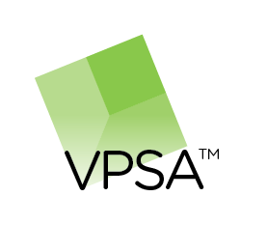

Enterprise Storage . . . as a Service . . .
Defined controller performance
Cache amount
Drive types
Raid types
Throughput for large files
Low latency
Block+file based access
Uptime
Cluster capable
Affordable
Elastic
Easily modified
Designed for multiple admins
Performance isolation
No up front costs
No commitment or short term
Virtual Private
Storage Array™
Enterprise Storage
as a Service
=
+

Slide 30
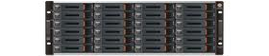




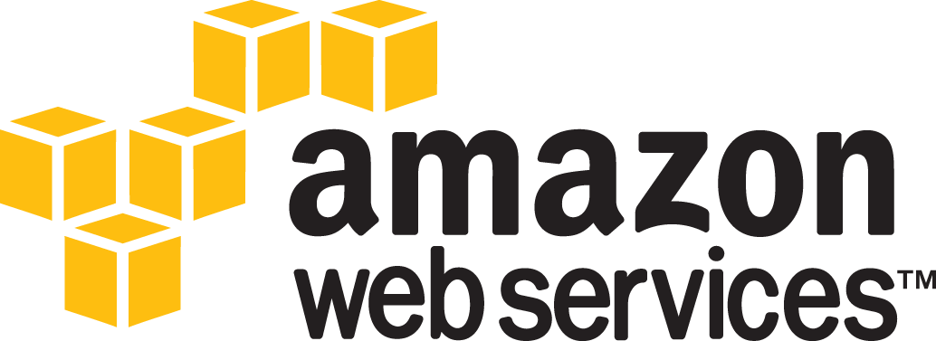
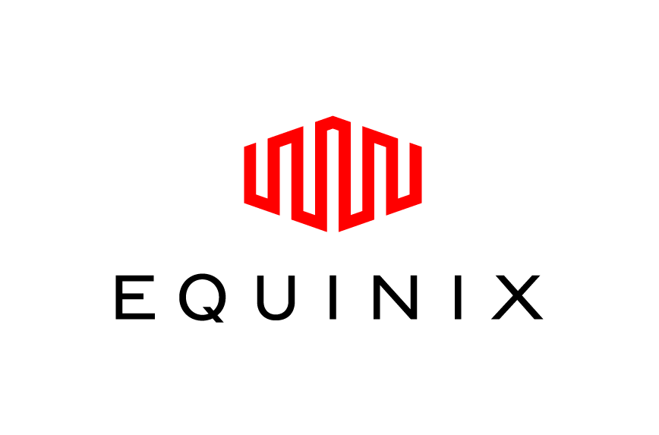
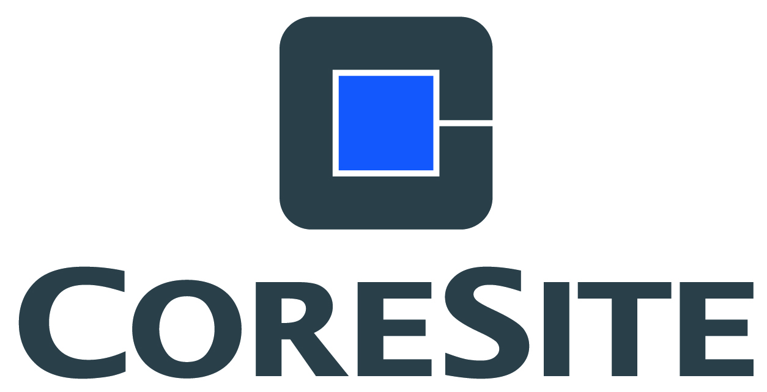
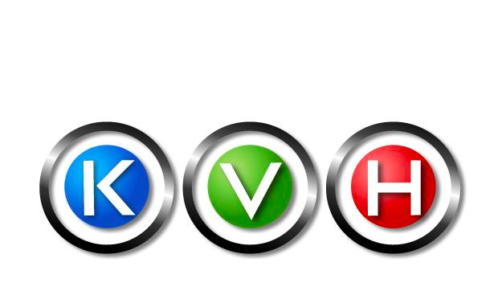

. . . Everywhere
At Service Providers
On Premise
Replication
At Colo Providers
Pure OpEx
Scales smoothly
to > 100PB
Six-Month Commit
Replication

Slide 31
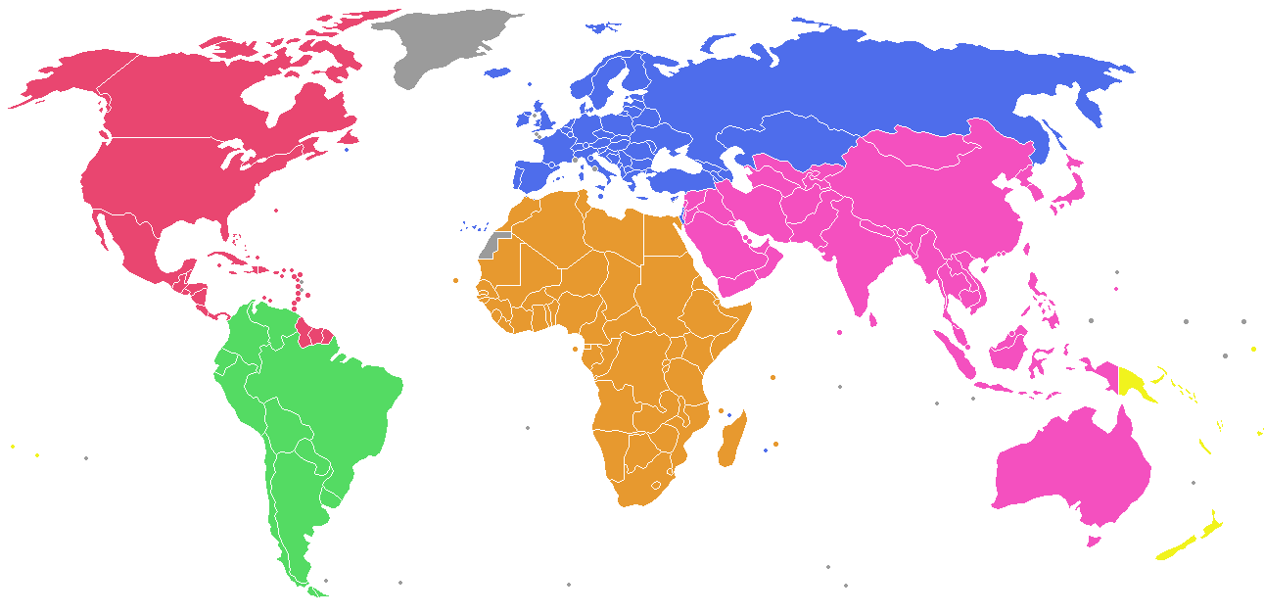


Global Footprint – Cloud Locations
Zadara Azure Regions
Other Zadara Regions

Slide 32
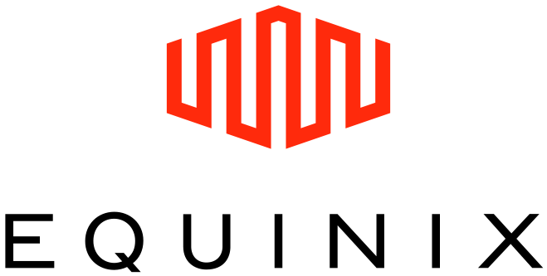

Zadara via ExpressRoute
VMs for App 1
VMs for App 2
DR VMs for App 1
DR VMs for App 2
Azure US West
Azure US East
Windows Azure
ExpressRoute
10G
10G
Windows Azure
ExpressRoute
Secure Remote Replication
Asynchronous and Compressed
Over the Public Internet
Silicon Valley
Washington, DC
Zadara Cloud West
Zadara Cloud East

Slide 33
Who Needs
Zadara Storage?

Slide 34

Block Storage Choices at Azure IaaS
Zadara Storage
Unique Capabilities:
  Large volumes
  Data Encryption
  RAID Selection
  Drive Type Selection
  High IO with HA
  Complete Monitoring
  Clustering / Vol. Sharing (SQL)
  NFS / CIFS / File Storage
  Remote Replication
  100% SLA
  Live, 24x7 Support Included
X
Local
(VM)
$$
Performance ➔
Drive
$
Availability ➔

Slide 35


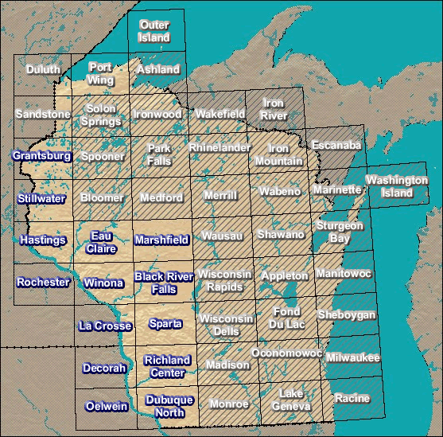
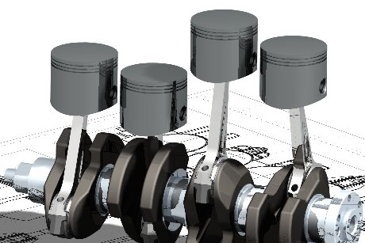
Common Customer Usage Scenarios
DATABASES
random IOPS,
clustering
for SQL
EDUCATION
encryption,
scale, and agility
for projects
GEOSPATIAL
large, POSIX-
compliant file store
ENTERPRISE NAS: scalable, isolated
file storage for CAD, Media, Big Data

Slide 36
VPSA™ in Action
Noam Shendar

Slide 37
Resources
Useful Contacts
  ExpressRoute Sales: ExpressRouteSales@microsoft.com
  Equinix Sales: ExpressRouteInfo@equinix.com
  Zadara Storage: Noam@ZadaraStorage.com Twitter: @NoamShen
Documentation
  ExpressRoute
    Azure ExpressRoute overview
    Azure ExpressRoute technical overview
    Azure ExpressRoute FAQs
    Azure ExpressRoute API reference for customers
    Azure PowerShell cmdlet reference for customers
  Equinix
    Equinix and ExpressRoute
  Zadara Storage
    VPSA and Azure

Slide 38
Related Sessions
DEV-B312 What’s new in Windows Azure IaaS
DEV-B346 What’s new in Windows Azure Networking
DEV-B311 Building highly available and scalable applications in Windows Azure
DEV-B360 Extending your premises to Windows Azure with Virtual Networks and ExpressRoute
DEV-B415 ExpressRoute: Connecting private and public clouds through Exchange Providers
DEV-B422 ExpressRoute: Connecting private and public clouds through WAN providers
DEV-B324 Security and Windows Azure IaaS
DEV-B328 Running your Dev/Test in Windows Azure
DEV-B375 Public Cloud Security: Surviving in a Hostile Multitenant Environment
DEV-B334 Disaster Recovery and Windows Azure IaaS
DEV-B338 IaaS: Hosting a Microsoft SharePoint 2013 Farm on Windows Azure
DEV-B361 Oracle in Windows Azure

Slide 39

Resources
Learning
  Sessions on Demand
  Microsoft Certification & Training Resources
http://channel9.msdn.com/Events/TechEd
www.microsoft.com/learning
TechNet
msdn
  Resources for IT Professionals
  Resources for Developers
http://microsoft.com/technet
http://microsoft.com/msdn

Slide 40



Complete an evaluation and enter to win!

Slide 41


Evaluate this session
Scan this
QR code
to evaluate
this session.

Slide 42


© 2014 Microsoft Corporation. All rights reserved. Microsoft, Windows, and other product names are or may be registered trademarks and/or trademarks in the U.S. and/or other countries.
The information herein is for informational purposes only and represents the current view of Microsoft Corporation as of the date of this presentation. Because Microsoft must respond to changing market conditions, it should not be interpreted to be a commitment on the part of Microsoft, and Microsoft cannot guarantee the accuracy of any information provided after the date of this presentation. MICROSOFT MAKES NO WARRANTIES, EXPRESS, IMPLIED OR STATUTORY, AS TO THE INFORMATION IN THIS PRESENTATION.

