Slide 1


Slide 2
Microsoft Azure Resource Manager
DEV-B224
Kevin Lam

Slide 3
Demo
Lots of resources

Slide 4
Today’s Challenge
It’s difficult to…
→ Deploy or update a group of resources, repeatedly
→ Manage permissions on a group of resources
→ Visualize a group of resources in a logical view, including monitoring/billing

Slide 5
SQL
D
A
T
ABASE
VI
R
T
U
AL M
A
CHINE
S
T
OR
A
GE
Singletons
  → Deploy becomes more complex
  → Proper use of resources becomes more abstract
  → Isolation makes communication a challenge

Slide 6
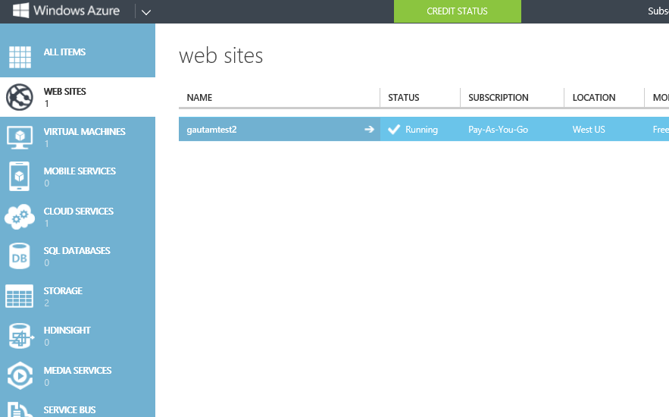
Resource Centric Views

Slide 7
Introducing Resource Manager
Application Lifecycle Container
Declarative solution for Deployment and Configuration
Consistent Management Layer

Slide 8
Resource Groups
  → Tightly coupled containers of multiple resources of similar or different types
  → Every resource *must* exist in one and only one resource group
  → Resource groups can span regions
RESOU
R
CE G
R
OUP

Slide 9
Coupling for Resources
Resource Group is a unit of management
Lifecycle: deployment, update, delete, status
→ Grouping: metering, billing, quota: applied & rolled up to group

Slide 10
Resource Group Lifecycle
Question:
Should these resources be in the same group or a different one?
Hint:
Do they have common lifecycle and management?
Answer:
Up to you.

Slide 11
Power of Repeatability
SQL-A
Instantiation of repeatable config.
Configuration → Resource Group
Azure Templates can:
Ensure Idempotency
Simplify Orchestration
Provide Cross-Resource Configuration and Update Support
Azure Templates are:
Source file, checked-in
Specifies resources and dependencies (VMs, WebSites, DBs) and connections (config, LB sets)
Parametized input/output
Website
[SQL CONFIG] VM (2x)
DEPENDS ON SQL
DEPENDS ON SQL
SQL - A
Website
Virtual
Machines
SQL
C
ONFIG

Slide 12
Add your own Power
Some resources can be extended allowing more code or data inside the resource
    AV agent inside a VM
    WordPress Web-deploy package on a Website
Allow for Scripting or Imperative configuration of resources
Extensible solution (Windows and Linux):
    VMM Agent
    DSC (in-VM PowerShell)
    Chef
    Puppet

Slide 13
Consistent Management Layer

Slide 14
So, what does this all mean…
Application Lifecycle Container
Deploy and Manage your application as you see fit
Declarative solution for Deployment and Configuration
Single click deployment of multiple instantiations of your application
Consistent Management Layer
The same experience of deployment and management whether you go from the Portal, Command Line, or Tools

Slide 15
Implementation Demo
Let’s see that work

Slide 16
Conclusions
→ Designed For you
→ Provides Predictability + Efficiency (Power of Repeatability)
→ Is Just the First Step
→ Works Everywhere

Slide 17
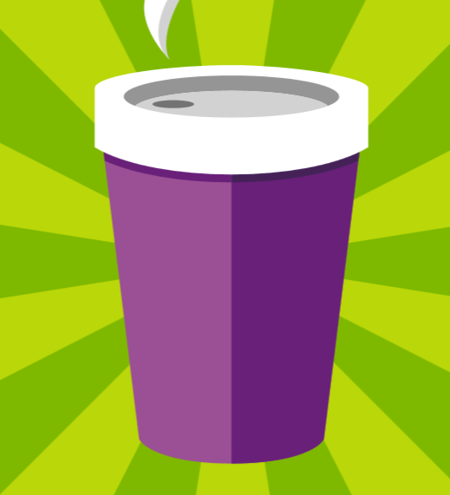







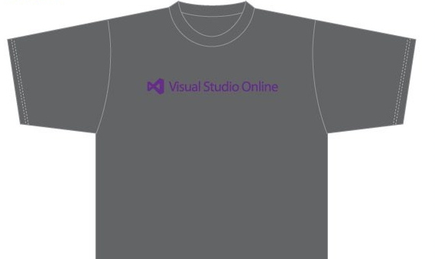

Visit the Developer Platform & Tools Booth
Having a friend
buy your coffee?
Yea, it’s kind of like that.
MSDN Subscribers get up to $150/mo in Azure credits.
Stop by the Developer Platform and Tools booth and visit the MSDN Subscriptions station to activate your benefits and receive a gift!
http://aka.ms/msdn_teched
3 Steps to New Gear! With Application Insights
Create a Visual Studio Online account http://visualstudio.com
Install Application Insights Tools for Visual
Studio Online http://aka.ms/aivsix
Come to our booth for a
t-shirt and a chance to win!
Alex Park
VSIP QR Tag Contests
Visit our booth to join the hunt for cool prizes!

Slide 18


Resources
Microsoft Engineering Stories
  Development tools & services for teams
  of all sizes
  How Microsoft Builds Software
  http://aka.ms/EngineeringStories
http://www.visualstudio.com
Visual Studio
Industry Partner
Program
Visual Studio | Integrate
  Meet Our New Visual Studio Online Partners
  or Join Now.
  http://vsipprogram.com
  Create Your Own Dev Environment
  http://integrate.visualstudio.com

Slide 19



Complete an evaluation and enter to win!

Slide 20


Evaluate this session
Scan this
QR code
to evaluate
this session.

Slide 21


© 2014 Microsoft Corporation. All rights reserved. Microsoft, Windows, and other product names are or may be registered trademarks and/or trademarks in the U.S. and/or other countries.
The information herein is for informational purposes only and represents the current view of Microsoft Corporation as of the date of this presentation. Because Microsoft must respond to changing market conditions, it should not be interpreted to be a commitment on the part of Microsoft, and Microsoft cannot guarantee the accuracy of any information provided after the date of this presentation. MICROSOFT MAKES NO WARRANTIES, EXPRESS, IMPLIED OR STATUTORY, AS TO THE INFORMATION IN THIS PRESENTATION.

