Slide 1


Slide 2
Anyone can build a SharePoint app with Microsoft Access
DEV-B227
Jeff Conrad – Senior SDET
Andrew Johnson – SDET II

Slide 3

Session Objectives And Takeaways
Objectives
Introduce Access 2013 and Access Services
Learn how to build data centric SharePoint apps with Access 2013
Key Takeaways
Access 2013 creates SharePoint apps
End-users can create these apps
These are centrally managed secure apps
Access 2013 web apps are different than Access desktop databases

Slide 4
Problems with Access Desktop Apps
Unknown/uncontrolled data applications
Bad/broken end-user applications
Inefficient business processes
Backlog of IT requests
No data access control/backup
Difficult application sharing
Lack of upgrade path

Slide 5
Why should you use Access to create SharePoint apps?

Slide 6
Access 2013 Platform Overview
Desktop Access Apps
Used by millions today
Access 2013 Web Apps
Brings Access databases into a new web-connected era
Data stored in SQL for Office 365 or on-premise server
Accessible everywhere through any browser
Easy sharing and no code
Data stored in a local file
Requires Access software to view and edit data
Rich functionality with VBA
Fully supported in 2013

Slide 7
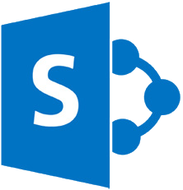
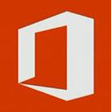
S
Fully functioning apps that run on the web within SharePoint
Hosted on SharePoint sites in the cloud
Access apps are SharePoint Apps
Apps for SharePoint
“Add-ins” of functionality for some Office programs
Placed within the document or in the task pane
Access apps can contain Apps for Office
Related session DEV-B226 – Rich extensions to SharePoint Apps using Microsoft Access
Apps for Office

Slide 8


Familiar Toolset Across Skill Levels
Power User
Pro Dev
Apps for SharePoint
Apps for Office
Access Services 2013
The easiest way for a non-developer to build and publish apps for SharePoint
“Napa” Office 365 Development Tools
A lightweight, in-browser development experience
Visual Studio 2013
A great end-to-end
development experience for highest customization

Slide 9

Access Apps: Virtues of Simple + Structured
Simple
Structured
Virtues
Low up-front investment
Easy to evolve and iterate
Easy adoption
One version of the truth
Easy to collaborate
Powerful analysis
Keeps data clean
Access
Hard to collaborate
Difficult to analyze
Multiple versions of the truth
Keeping data clean is a chore
High up-front investment
Hard to evolve and iterate
Hard to adopt
Vices

Slide 10
Demo
Build a SharePoint App in 60 seconds with Access table templates

Slide 11
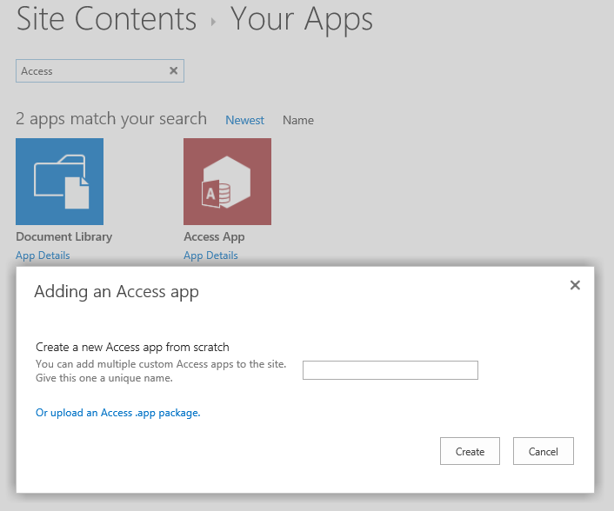
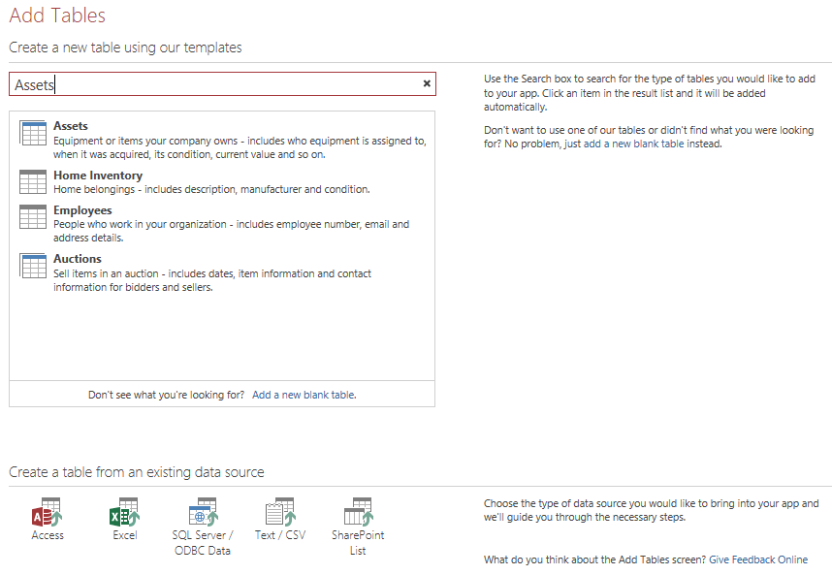
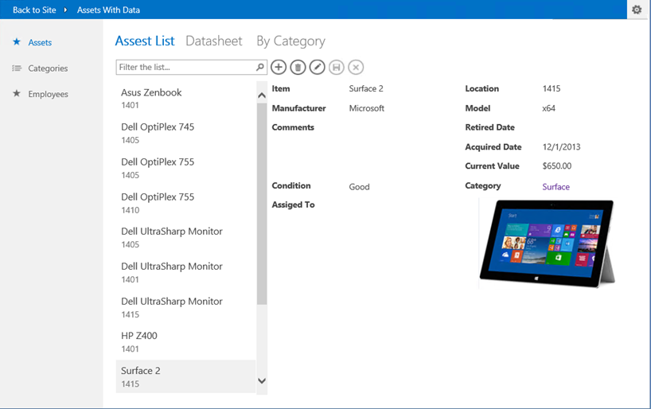
Build a SharePoint App in 60 Seconds
1. Create a custom web app
2. Add some tables using Table Templates
3. Ready to go

Slide 12
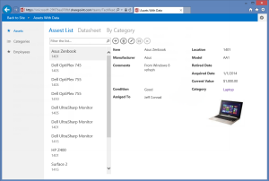


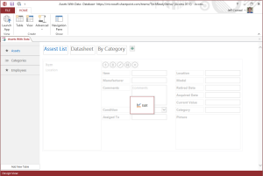

Architecture Overview
Web Browser
SharePoint on Office 365
SharePoint on premises
Access Services
Consumes
SQL DB
Access Client
Tables & Data
2012+
Creates
Azure

Slide 13
Access 2013 Web Apps
Web App Model
SharePoint
SQL Database
New App Model
SharePoint deployment
SQL back-end

Slide 14
New app model
Simplified design experience
Pre-defined Table Templates
Build a functioning SharePoint app in 60 seconds
Navigation elements automatically generated
Simple, code-free configuration and customization
Polished, professional results
Apps automatically have an attractive, easy-to-use interface
Consistent user experience across all apps

Slide 15
SharePoint deployment
Access Apps = SharePoint Apps
Same cross-browser support
Same multi-user accessibility: many people working on the same app at once
Same Active Directory-based permissions
Same SharePoint Store and App Catalog for distribution and discovery
Same simple install/uninstall
Same central IT control
Same branded and customizable themes
Same cloud-based hosting through Office 365

Slide 16




SQL back-end
The gold-standard for relational databases
  Speed and reliability
  Transparent to end user: if you don’t care, you don’t need to know
  Use common tools for advanced reports and custom integrations
  Developers can use existing skills to customize
  Future upgrade path
View and Edit Data
Advanced Reporting & Integration
Desktop Access Reports
Excel
Power View
Crystal Reports
Custom Websites (.NET, PHP, etc.)
Access Services
SQL Azure
Database Design

Slide 17
Demo
Using the new app model

Slide 18
Polished, Professional User Interface
2. Choose view
4. Add and edit items
1. Choose table
3. Search and filter

Slide 19
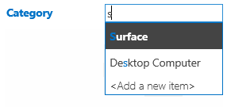
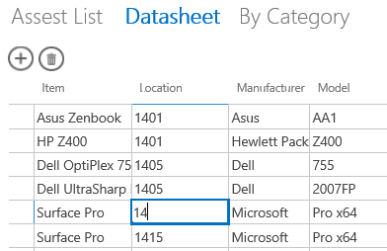
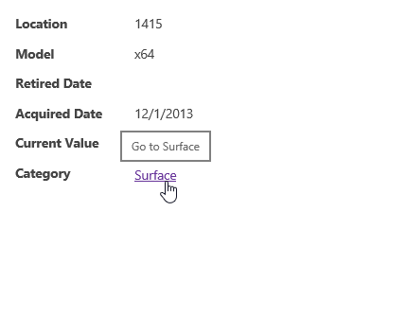
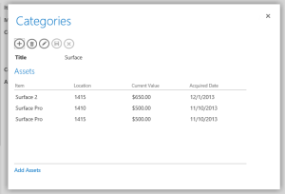
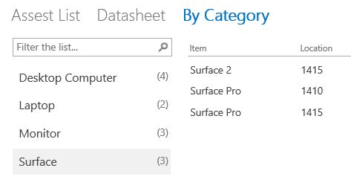
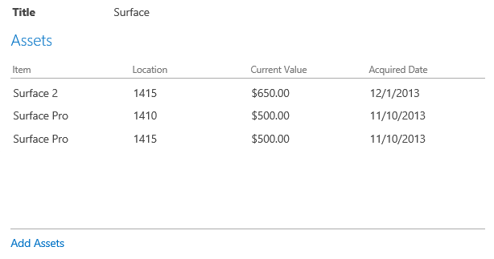

Polished, Professional User Interface
Autocomplete Control
Datasheet
Drill-Through Popups
Summary View
Related Items Control
Action Bar

Slide 20
Demo
Customizing the app

Slide 21

Start customization from browser
Open your app in Access to make design modifications

Slide 22
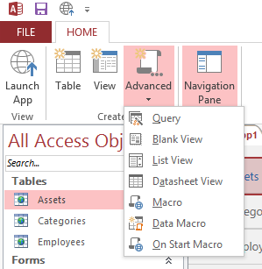
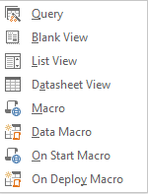
Creating design elements
Home → Create → Advanced
  Query
  Blank View
  List View
  Datasheet View
  Macro
  Data Macro
  On Start Macro
  On Deploy Macro
Expand Navigation Pane to view app objects

Slide 23
Creating tables
3 ways to get started with data
Start from scratch with a Blank Table
Get a head start with Table Templates
Use an existing data source

Slide 24
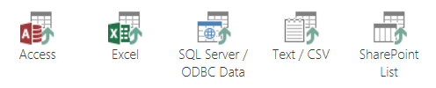
Migration of existing applications
Earlier version of Access
  Just the data and some relationships
  Navigation and UI are auto-generated for you
  Access front end investments could still be used
Excel spreadsheets
Other sources
  Like SQL Server or Lotus Notes

Slide 25
Demo
Consuming SharePoint Lists

Slide 26
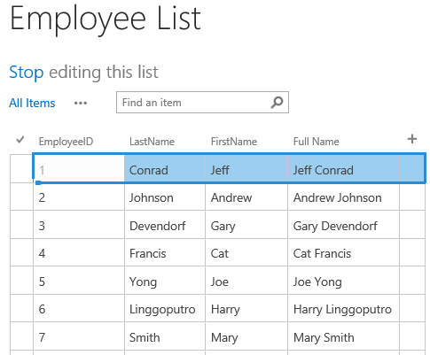
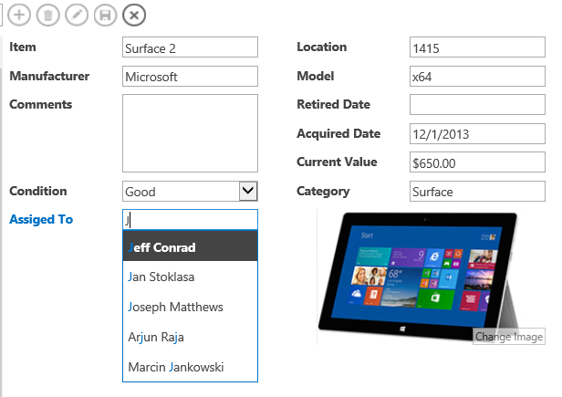
Linking to SharePoint Lists
Limitations of current release
Read-Only
No Data Macro support
List must be in the same site collection
SharePoint Lists are the only data-linking sources currently supported
Lookup field

Slide 27
Demo
Leverage Azure: Analyze with Excel and SQL Server
Link to Blog article

Slide 28
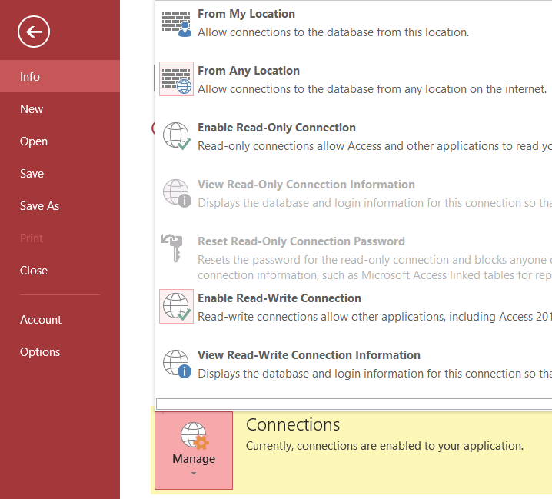
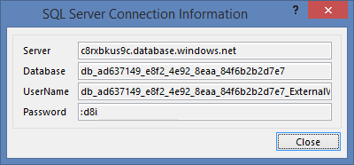
Real SQL Server Power
Enable Connections
Unobscured table names and field names
SQL Login

Slide 29
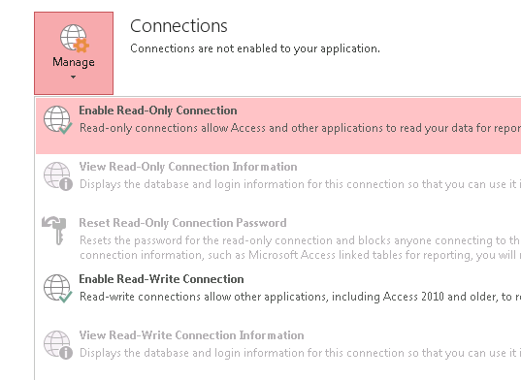
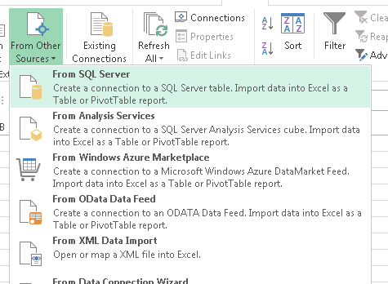
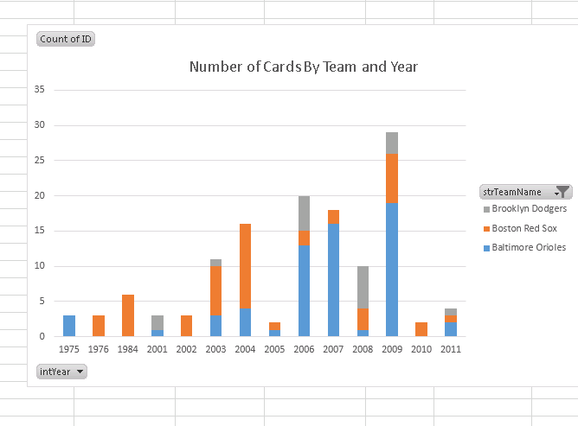
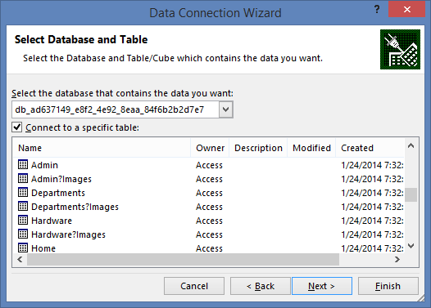
Visualize data in Excel
Authorize in Access
  Allow other programs to connect to the SQL Server database that powers your Access app. You’ll find all the necessary credentials in one place.
Connect anywhere
  Enter the SQL Server connection information from Access into your analysis program, and you’ll find all your database’s queries and tables available. SQL Server is an industry standard, so you have a choice of tools, from Excel to Crystal Reports.
Analyze and Report
  Take advantage of the powerful charting and analysis tools that Excel already provides, or analyze your data in a program of your choice.

Slide 30
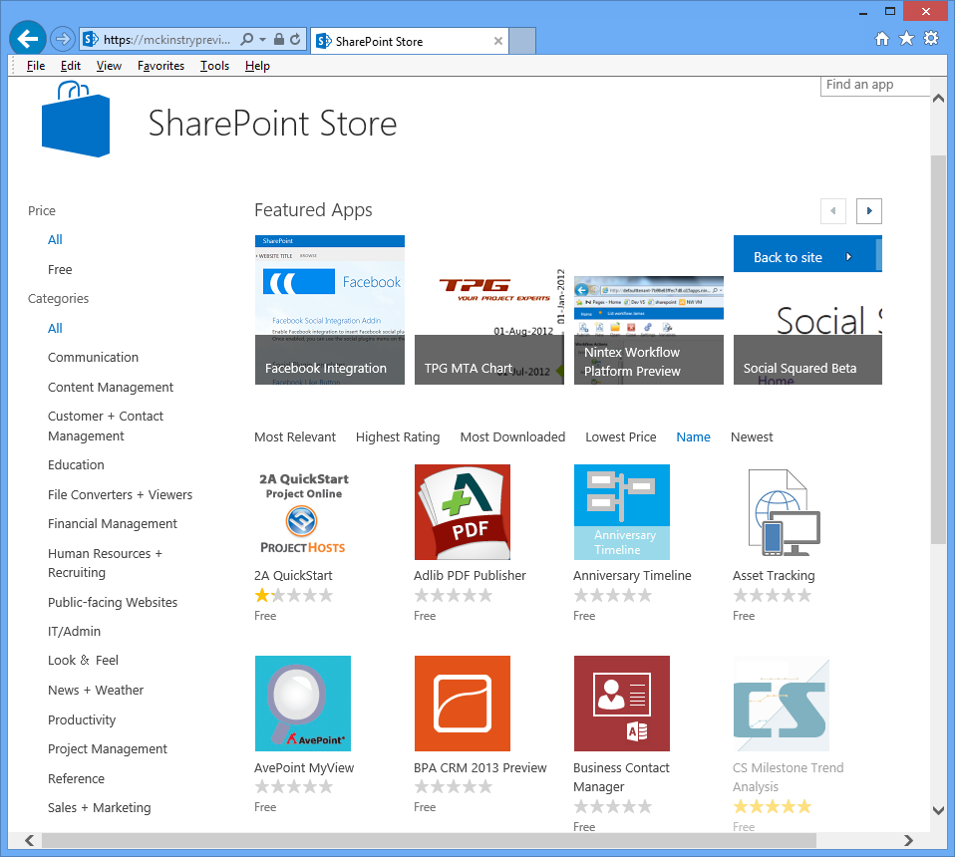
Backup, Packaging, and Publishing
Export data through Access Client
Save as App Package
Install on another SharePoint site
Publish to the SharePoint Store
Upgrade an App

Slide 31
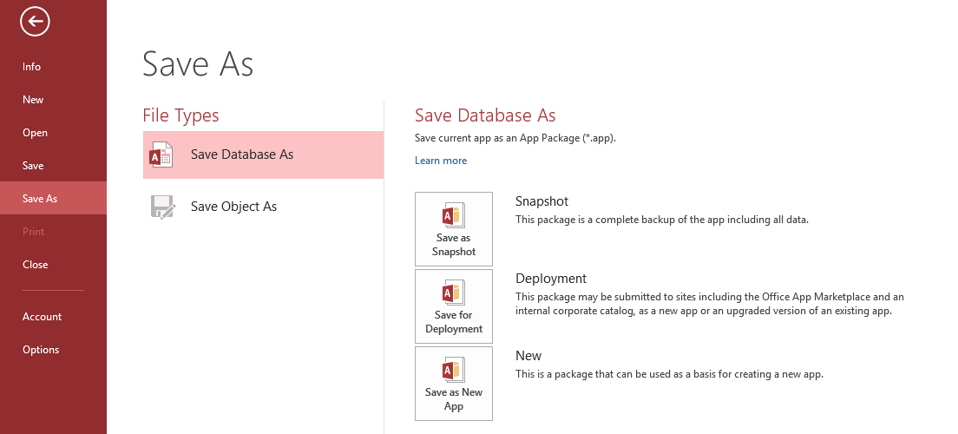
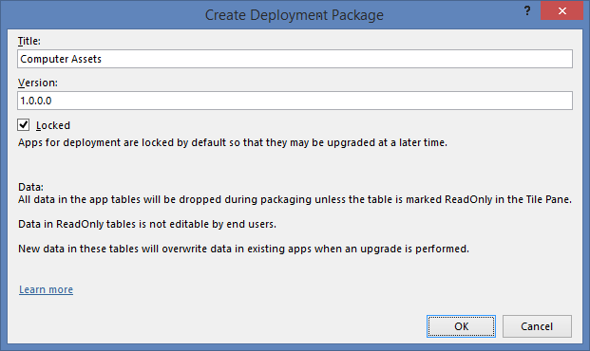
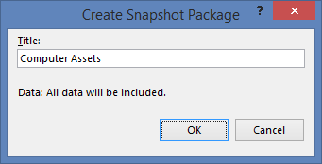
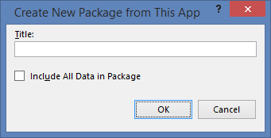
App Packaging
Link to session recording on this new feature

Slide 32
What’s next for Access Apps?
Completed work
Cascading combo box feature
Submitting Access 2013 Apps to the SharePoint Store
Coming Soon…
Apps for Office integration
App Upgrade/Lifecycle story

Slide 33
Internal Use Access Web App Examples
Reorganization of Office and Windows divisions
Ship readiness tracking app for product features
Attorney tracking app
TAP program tracking for support
Exchange service issue tracking
Training tracking and feedback

Slide 34
Demo
Examples of other types of Access apps

Slide 35

Team Admin now has a feature rich SharePoint app created quickly using the power of Access 2013, SharePoint, and Office 365.

Slide 36
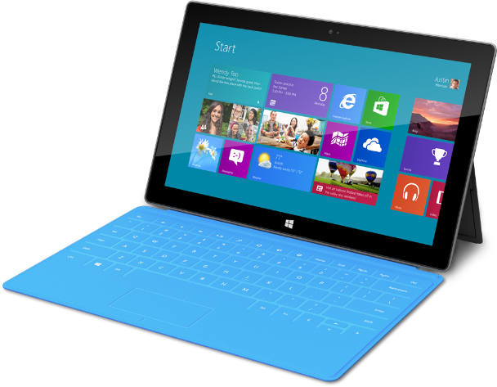
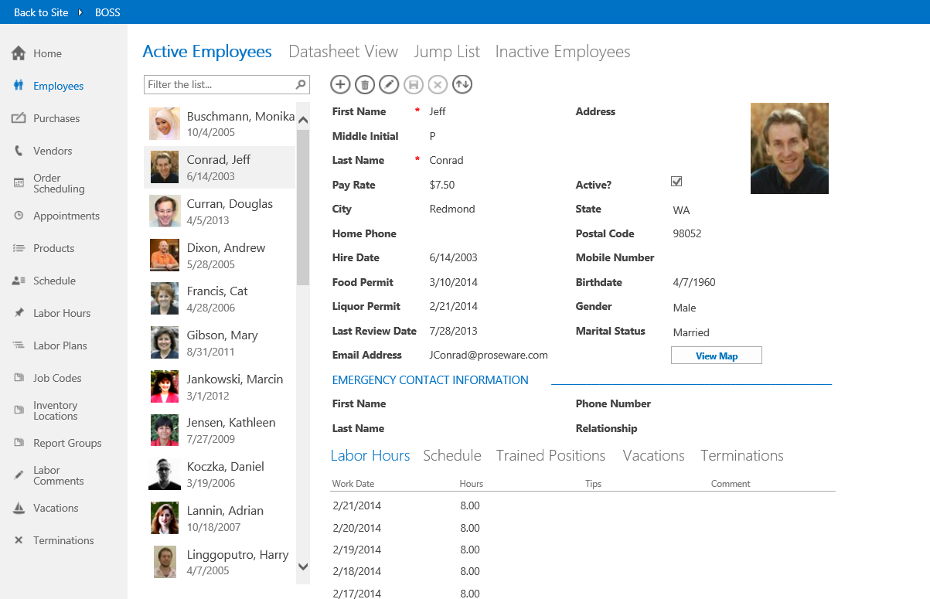
In Review: Session Objectives And Takeaways
Objectives
Introduced Access 2013 and Access Services
Learned how to SharePoint apps with Access 2013
Key Takeaways
Access 2013 creates SharePoint apps
End-users can create these apps
These are centrally managed secure apps
Access 2013 web apps are different than Access desktop databases
With Access web apps, the end-user gets the experience they want and IT gets the control that they want.

Slide 37

Book Resource
Microsoft Access 2013
Inside Out
Over 600 pages covering
Access 2013 web app topics
Available at the book store

Slide 38
Related content
Breakout Sessions – DEV-B226 Rich extensions to SharePoint Apps Using Microsoft Access
Wednesday, May 14th 3:15 PM – 4:30 PM
Find Us Later At. . .
Office Area – Microsoft Solutions Experience (MSE)
Ask the Experts
OFC-H203 Creating a SharePoint Application with Microsoft Access Services​

Slide 39
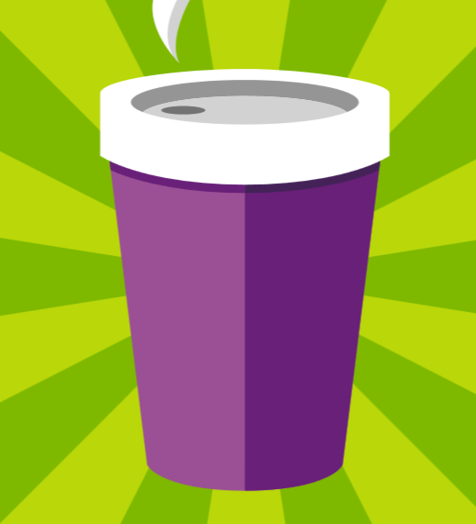
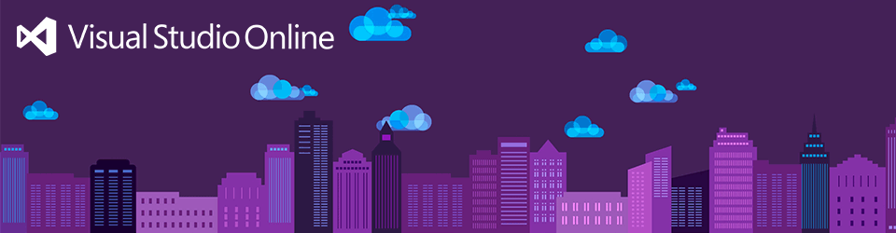





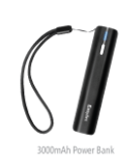
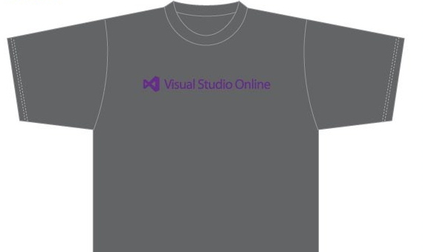
Visit the Developer Platform & Tools Booth
Having a friend
buy your coffee?
Yea, it’s kind of like that.
MSDN Subscribers get up to $150/mo in Azure credits.
Stop by the Developer Platform and Tools booth and visit the MSDN Subscriptions station to activate your benefits and receive a gift!
http://aka.ms/msdn_teched
3 Steps to New Gear! With Application Insights
Create a Visual Studio Online account http://visualstudio.com
Install Application Insights Tools for Visual
Studio Online http://aka.ms/aivsix
Come to our booth for a
t-shirt and a chance to win!
VSIP QR Tag Contests
Visit our booth to join the hunt for cool prizes!

Slide 40

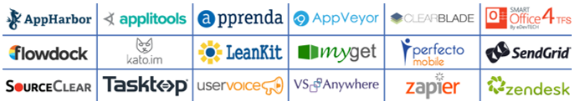
Resources
Microsoft Engineering Stories
  Development tools & services for teams
  of all sizes
  How Microsoft Builds Software
  http://aka.ms/EngineeringStories
http://www.visualstudio.com
Visual Studio
Industry Partner
Program
Visual Studio | Integrate
  Meet Our New Visual Studio Online Partners
  or Join Now.
  http://vsipprogram.com
  Create Your Own Dev Environment
  http://integrate.visualstudio.com

Slide 41



Complete an evaluation and enter to win!

Slide 42
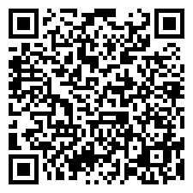

Evaluate this session
Scan this
QR code
to evaluate
this session.

Slide 43


© 2014 Microsoft Corporation. All rights reserved. Microsoft, Windows, and other product names are or may be registered trademarks and/or trademarks in the U.S. and/or other countries.
The information herein is for informational purposes only and represents the current view of Microsoft Corporation as of the date of this presentation. Because Microsoft must respond to changing market conditions, it should not be interpreted to be a commitment on the part of Microsoft, and Microsoft cannot guarantee the accuracy of any information provided after the date of this presentation. MICROSOFT MAKES NO WARRANTIES, EXPRESS, IMPLIED OR STATUTORY, AS TO THE INFORMATION IN THIS PRESENTATION.

