Slide 1
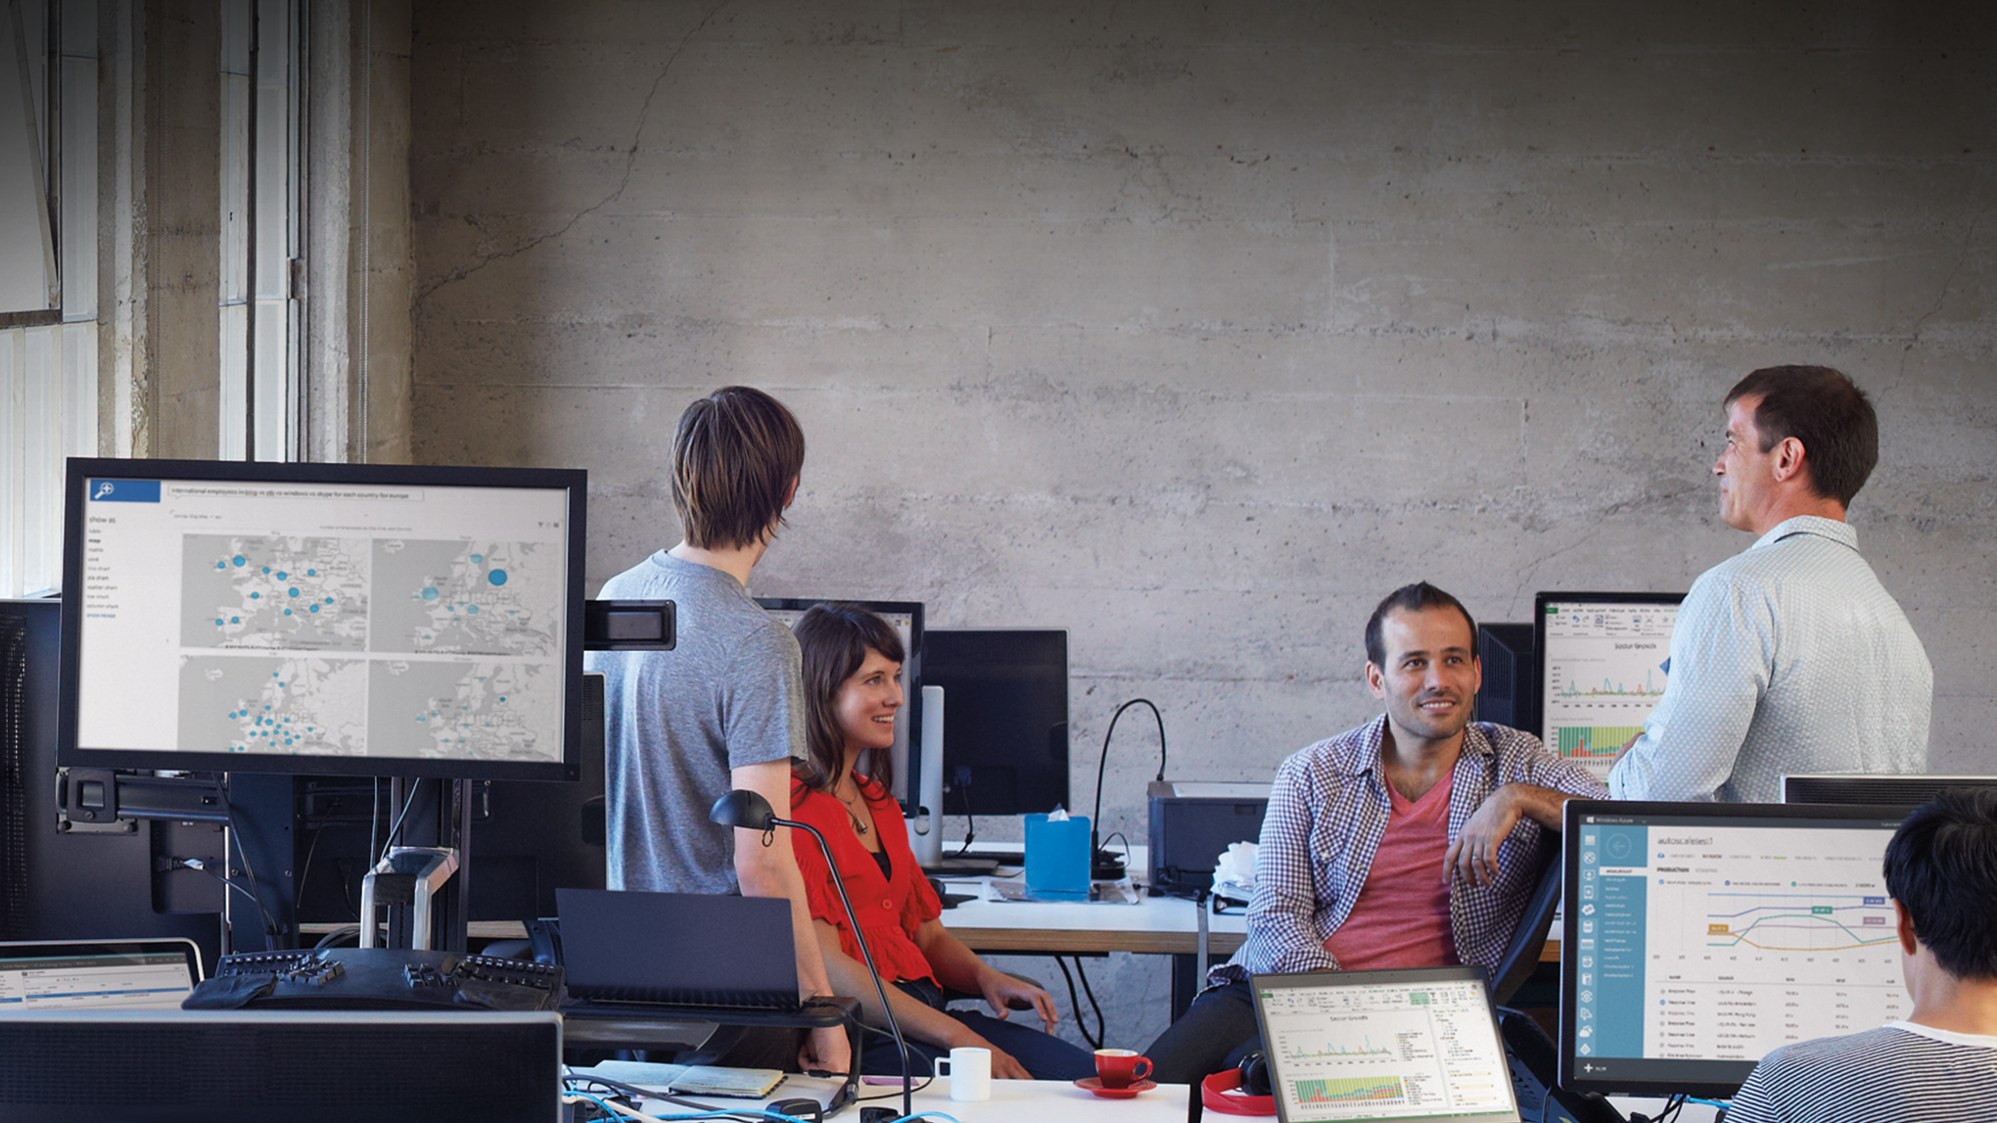

Slide 2
Deep Dive into Developing Advanced Microsoft SharePoint Applications Using Third-Party JavaScript
DEV-B229
Jeremy Thake

Slide 3
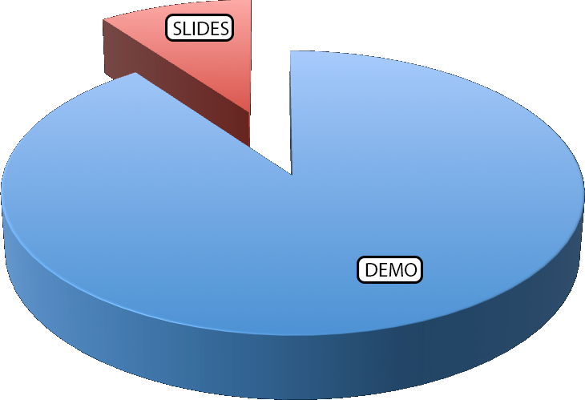
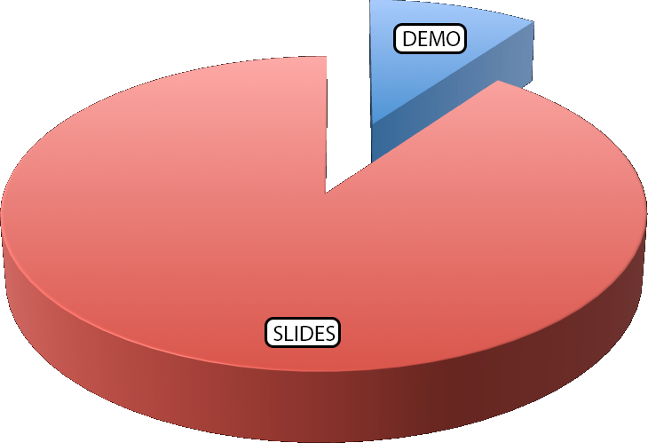
What Are You Interested In?

Slide 4
What is a SharePoint-Hosted App?
SharePoint-Hosted
App
Provided-Hosted
App
Hybrid
Apps

Slide 5
What is a Single Page App?
Single page, not a collection of pages
Why build a single page app?
Reduced round tripping
Works great in low bandwidth & offline
Highly interactive

Slide 6
Characteristics of a Single Page App
Routing & Navigation
  Deep Linking
History
Templated Views with Data Binding

Slide 7


SPA Presentation Frameworks
What to look for in a SPA presentation framework
  Routing & navigation
  Views & data binding
  Dependency injection & testability
AngularJS
Durandal
www.angularjs.org
www.durandaljs.com

Slide 8
Benefits of SharePoint-Hosted Apps as SPA’s
No external deployment steps
No extra costs & concerns
  Who is going to pay for this?
SPA’s yield a richer user experience
SPA’s facilitate building apps in modular approach
Leverage SharePoint for services and data storage
Protecting app business logic

Slide 9
Libraries I Used & Why
jQuery
Moment
FontAwesome
Breeze
SharePoint CSOM
SharePoint OData / REST API
AngularJS
  Animations
  Route
  Cookies
  Resource
  Sanitize

Slide 10
Resources
AngularJS - www.angularjs.org
Breeze - www.breezejs.com
SharePoint 2013 SPA Template - aconn.me/SphSpaTemplates
Courses: Search www.pluralsight.com for ‘SPA’, ‘Breeze’ & ‘Angular’

Slide 11
SharePoint Hosted App
Single Page App (SPA)

Slide 12
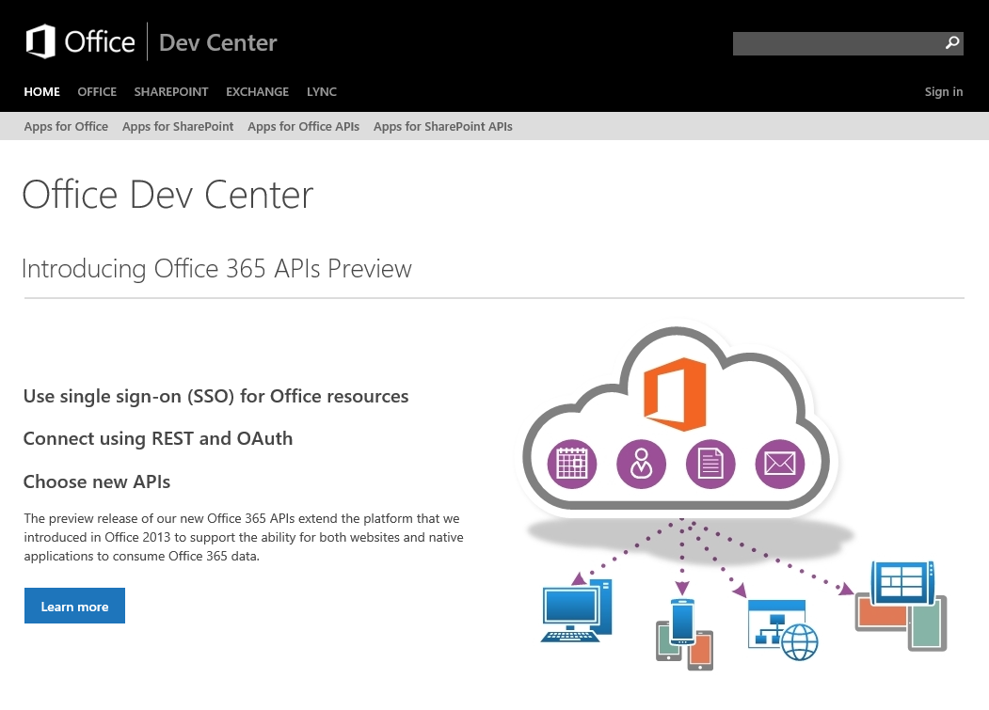
Dev.
Office
.com
One stop shop for Office Developer Platform

Slide 13



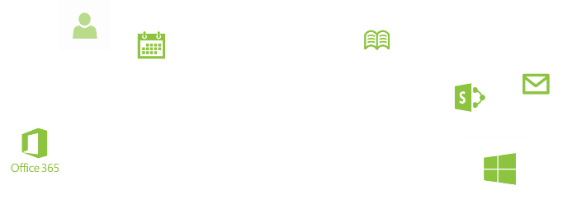
Calls to action
Explore our MSDN Library
  http://dev.office.com
Play with our code samples
http://aka.ms/OfficeDevSamples
Follow our Patterns & Practices
http://aka.ms/OfficeDevPnP
  Get Answers
  http://aka.ms/AskSharePoint
  http://aka.ms/AskOffice
Give Feedback
Drive our roadmap http://aka.ms/OfficeDevFeedback

Slide 14
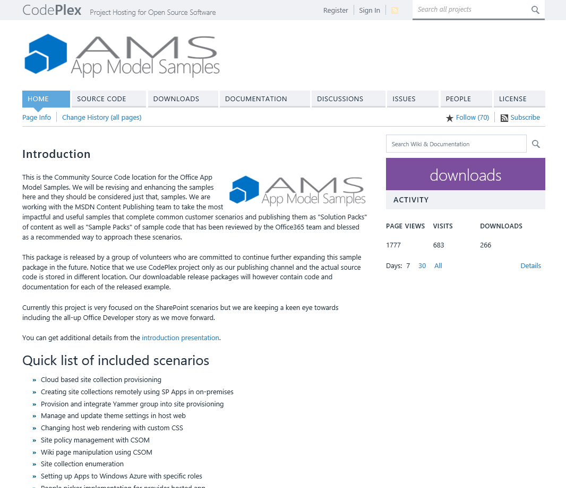
aka.ms/OfficeAMS
Patterns and practices
  Providing App Model Patterns for common
  Full Trust Code scenarios
30+ Visual Studio projects
Common scenarios
  Branding
  Site provisioning
  Remote event receivers
  Large file support
  Taxonomy driven navigation
  And much more…
Contribute
  Open source coming soon!

Slide 15
Related content – Breakouts
OFC-B254 Integrating Yammer and Microsoft SharePoint Using .NET
Monday, May 12 1:15 PM - 2:30 PM Room: 350D
DEV-B230 Most Commonly Asked for On-Premises Customizations Reimagined as Applications for SharePoint
Monday, May 12 3:00 PM - 4:15 PM Room: 350D
DEV-B319 Get Started Developing Applications for Microsoft Office and
SharePoint Server 2013
Monday, May 12 4:45 PM - 6:00 PM Room: 332A
DEV-B231 Office Power Hour: New Developer APIs and Features for
Applications for Office
Tuesday, May 13 8:30 AM - 9:45 AM Room: 381A
DEV-B227 Anyone Can Build a SharePoint Application with Microsoft Access
Tuesday, May 13 8:30 AM - 9:45 AM Room: 332A
OFC-B274 Implementing Microsoft SharePoint 2013 Hybrid for Search, Business Connectivity Services, Microsoft OneDrive for Business and Yammer
Tuesday, May 13 1:30 PM - 2:45 PM Room: 360A

Slide 16
DEV-B232 Creating Cloud Hosted Line-of-Business Applications with Apps for Office, Microsoft Office 365, Microsoft Azure, and Windows Phone 8
Wednesday, May 14 8:30 AM - 9:45 AM Room: 340
OFC-B311 A Practical Use of External Data Sources
Wednesday, May 14 8:30 AM - 9:45 AM Room: 360A
DEV-B357 Developing Office 365 Cloud Business Applications
Wednesday, May 14 5:00 PM - 6:15 PM Room: Hilton L2 Ballrm C
DEV-B387 Deep Dive into Mail Compose Applications APIs
Wednesday, May 14 5:00 PM - 6:15 PM Room: 352D
DEV-B386 Setting Up Your On-Premises Environment for App Development
Thursday, May 15 10:15 AM - 11:30 AM Room: 320A
DEV-B228 Build Connected Productivity Apps for SharePoint and Office
Thursday, May 15 10:15 AM - 11:30 AM Room: Hilton L2 Ballrm C
DEV-B390 SharePoint Power Hour: New Developer APIs and Features for Apps for SharePoint
Thursday, May 15 1:00 PM - 2:15 PM Room: 360A
DEV-B389 Who Are You and What Do You Want? Working with OAuth in Microsoft SharePoint 2013
Thursday, May 15 2:45 PM - 4:00 PM Room: 310A

Slide 17
Related content – Labs
DEV-H207 Developing Applications for Microsoft SharePoint 2013 with Visual Studio 2013
OFC-H308 Building Task Pane Applications for Microsoft Office 2013
OFC-H309 Building Visual Studio-Based Workflows in Microsoft SharePoint 2013
OFC-H310 Building Windows 8 Applications with Microsoft SharePoint 2013
OFC-H311 Business Connectivity Services (BCS) for Microsoft SharePoint 2013

Slide 18
Related content – Exam Prep
EXM04 Exam Prep: 70-331 and 70-332
MCSE: SharePoint (Microsoft SharePoint Server 2013)
Tuesday, May 13 8:30 AM - 9:45 AM Room: Hilton L2 Ballrm F

Slide 19
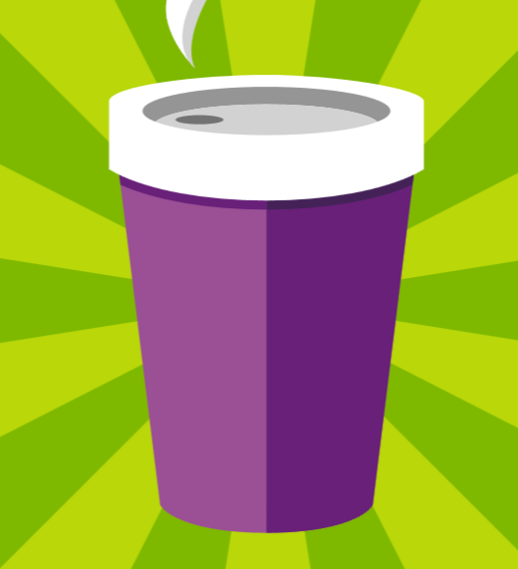
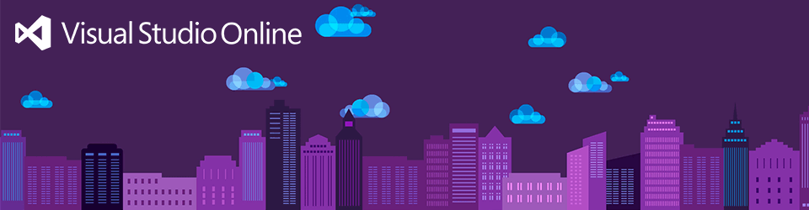




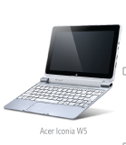

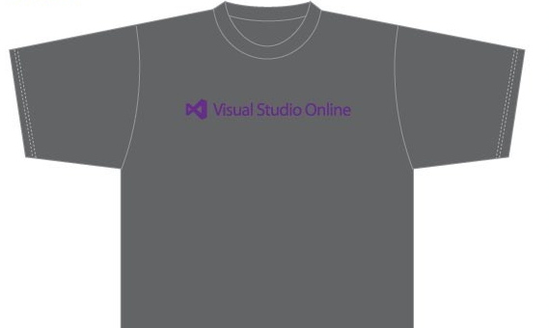

Visit the Developer Platform & Tools Booth
Having a friend
buy your coffee?
Yea, it’s kind of like that.
MSDN Subscribers get up to $150/mo in Azure credits.
Stop by the Developer Platform and Tools booth and visit the MSDN Subscriptions station to activate your benefits and receive a gift!
http://aka.ms/msdn_teched
3 Steps to New Gear! With Application Insights
Create a Visual Studio Online account http://visualstudio.com
Install Application Insights Tools for Visual
Studio Online http://aka.ms/aivsix
Come to our booth for a
t-shirt and a chance to win!
VSIP QR Tag Contests
Visit our booth to join the hunt for cool prizes!

Slide 20

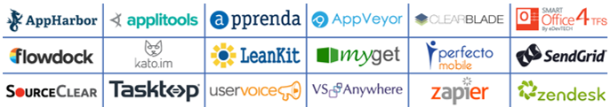
Resources
Microsoft Engineering Stories
  Development tools & services for teams
  of all sizes
  How Microsoft Builds Software
  http://aka.ms/EngineeringStories
http://www.visualstudio.com
Visual Studio
Industry Partner
Program
Visual Studio | Integrate
  Meet Our New Visual Studio Online Partners
  or Join Now.
  http://vsipprogram.com
  Create Your Own Dev Environment
  http://integrate.visualstudio.com

Slide 21



Complete an evaluation and enter to win!

Slide 22
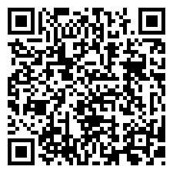

Evaluate this session
Scan this
QR code
to evaluate
this session.

Slide 23


© 2014 Microsoft Corporation. All rights reserved. Microsoft, Windows, and other product names are or may be registered trademarks and/or trademarks in the U.S. and/or other countries.
The information herein is for informational purposes only and represents the current view of Microsoft Corporation as of the date of this presentation. Because Microsoft must respond to changing market conditions, it should not be interpreted to be a commitment on the part of Microsoft, and Microsoft cannot guarantee the accuracy of any information provided after the date of this presentation. MICROSOFT MAKES NO WARRANTIES, EXPRESS, IMPLIED OR STATUTORY, AS TO THE INFORMATION IN THIS PRESENTATION.

