Slide 2


Slide 3


Introducing Hybrid Connections
DEV-B307
Santosh Chandwani
Sr. Program Manager, Microsoft Azure
santoshc@microsoft.com
@santoshc1

Slide 4



Evolving Enterprise Infrastructure
Corporate Network
Virtual Network

Slide 5
Motivation
Reinforce ability to rapidly create, test & deploy hybrid applications on Azure
Extend hybrid capabilities to all Azure services
Access existing on-premises resources without having to deploy custom code or infrastructure
Secure access without changing network configuration
Enterprise admins continue to have control and visibility

Slide 6
Introducing Hybrid Connections
Fast, easy way to build Hybrid Apps previews Today
Connect your Azure Websites & Mobile Services to on-premises resources
Secure access to resources with IT control
Included in Azure BizTalk Services

Slide 7
Key Features
Access to on-premises resources
  Connect to SQL Server, Web Services or most other that use TCP or HTTP connectivity
Works with most frameworks
  Support for .NET, PHP, Java, Python, Node.js for Websites and Node.js and .NET for Mobile Services*
No need to alter the network perimeter
  Doesn’t require a VPN gateway or Firewall changes to allow incoming traffic
  Applications have access only to the resource that they require
Maintains IT control over resources
  Support for Group Policy and Event/Audit Logging providing Admins control and visibility

Slide 8
Introducing BizTalk Services FREE Edition
Launching today
Makes it easy for developers to use Hybrid Connections at no charge
Hybrid Connections are now included with all BizTalk Services tiers

Slide 9

Hybrid Connections
Corporate Network
Microsoft SQL Server
Web Sites
Other published resources
Hybrid Connection
Hybrid Connection Manager
Mobile Services

Slide 10
Demonstration

Slide 11
Lift and Shift
You can move existing web workloads to Azure Websites whilst still connecting to on-premises data without changing any code.

Slide 12
Flow
Windows Azure
On Premises
Web Site
Hybrid Connection Manager
LOB App
Hybrid Connection
Mobile Service
Connects to ‘Hostname:Port’
Configuration: LOB App
Identified by Hostname:Port
Each Hybrid C
Multiple applications can share a Hybrid Connection to access
Applications on Azure access a resource the same way that they would if it was running on-premises

Slide 13
Cardinality
Each Hybrid Connection provides access to a single on-premises resource
Applications can use multiple Hybrid Connections to access on-premises resources
Multiple Applications can share a Hybrid Connection to access a resource
The on-premises Hybrid Connection Manager can be used as connector for multiple Hybrid Connections

Slide 14
Constraints
Supports resources using TCP and HTTP for connectivity
  Only static TCP ports are supported
  Currently, resources relying on dynamic port allocation cannot be used
Hybrid Connections don’t buffer or inspect traffic
  TLS can be negotiated end-to-end between the application and the on-premises resource
  Dynamic port redirection, as in case of FTP passive-mode or

Slide 15
Security
Uses Shared Access Signature Authorization
  Application and On-Premises Hybrid Connection Manager connect with separate keys and rights
Separate roles defined for on-premises connector & application
  Allows for credentials for each to be rolled independently
  Seamless and secure distribution & update of credentials to applications & Hybrid Connection Manager
Application authorization is independent
  You can use an authorization mechanism appropriate for the Hybrid Application
  In practice, depends on end-to-end authorization mechanisms supported across cloud/on-premises

Slide 16
Deployment considerations
Applications and On-premises Resources can be scaled out as usual
  Hybrid Connection Manager can be deployed on the resource server or in front of a load-balancer or cluster
Supports SQL Availability Groups and Clustering
  Features using redirection not supported: MultiSubnetFailover=true and ApplicationIntent=ReadOnly
Multiple instances of Hybrid Connection Manager supported
  Application connection requests are evenly distributed across the different instances

Slide 17
Enterprise IT in control
Manage resource access for Hybrid applications
  Group Policy controls for allowing access
  Administrators can designate resources to which Hybrid Applications have access
Event and Audit logging
  IT has insight into resources being accessed
  IT can use existing infrastructure investments for monitoring and control
Dashboard on Azure portal
  Access to connection health, status
  Will provide insights on usage and metrics

Slide 18
Included in BizTalk Services
 | Free | Developer | Basic | Standard | Premium
Price | $0 / month | ~$97 / month | ~$499 / month | ~$2,999 / month | ~$5,997 / month
Scale Limit | N/A | N/A | Up to 8 units | Up to 8 units | Up to 8 units
EAI Bridges per Unit | N/A | 25 | 25 | 125 | 500
EDI Agreements per Unit | N/A | 10 | 50 | 250 | 1000
Hybrid Connections per unit | 5 | 5 | 10 | 50 | 100
Hybrid Connection data transfer per unit | 5 GB | 5 GB | 50 GB | 250 GB | 500 GB
Archiving | N/A | Included | Not Included | Not Included | Included
High Availability | Not Included | Not Included | Included | Included | Included
Connection limits for each Hybrid Connection apply. Additional Hybrid data transfer billed at $1/GB.

Slide 19
Related content
DEV-B317: Mobile Line-of-Business Applications in Microsoft Azure
DEV-B381: What’s New with Microsoft Azure Websites
DEV-B364: How to Architect and Implement Hybrid Integration Solutions with Microsoft BizTalk Server and BizTalk Services
Find me later at Application Services booth

Slide 20
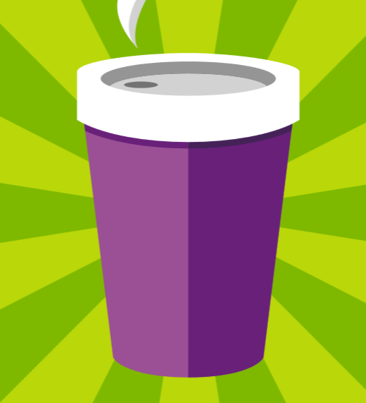
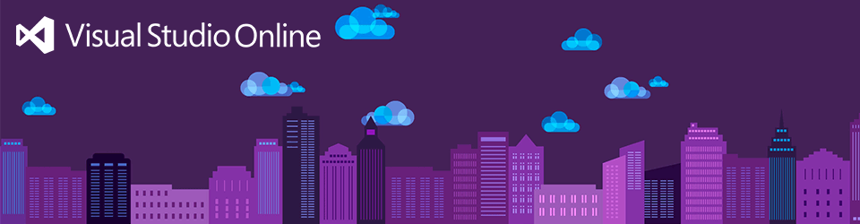

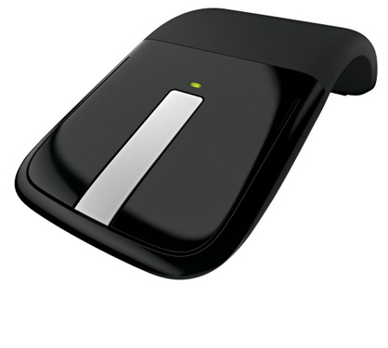



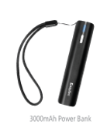
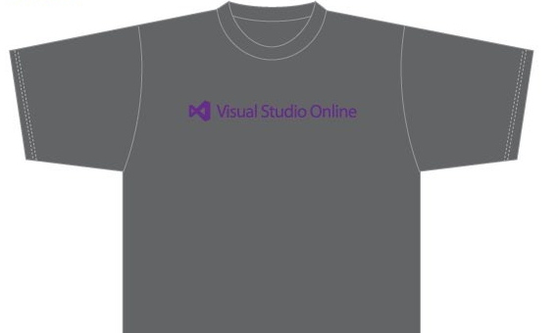
Visit the Developer Platform & Tools Booth
Having a friend
buy your coffee?
Yea, it’s kind of like that.
MSDN Subscribers get up to $150/mo in Azure credits.
Stop by the Developer Platform and Tools booth and visit the MSDN Subscriptions station to activate your benefits and receive a gift!
http://aka.ms/msdn_teched
3 Steps to New Gear! With Application Insights
Create a Visual Studio Online account http://visualstudio.com
Install Application Insights Tools for Visual
Studio Online http://aka.ms/aivsix
Come to our booth for a
t-shirt and a chance to win!
VSIP QR Tag Contests
Visit our booth to join the hunt for cool prizes!

Slide 21

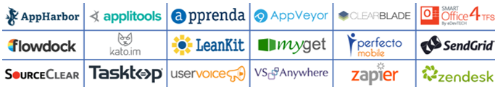
Resources
Microsoft Engineering Stories
  Development tools & services for teams
  of all sizes
  How Microsoft Builds Software
  http://aka.ms/EngineeringStories
http://www.visualstudio.com
Visual Studio
Industry Partner
Program
Visual Studio | Integrate
  Meet Our New Visual Studio Online Partners
  or Join Now.
  http://vsipprogram.com
  Create Your Own Dev Environment
  http://integrate.visualstudio.com

Slide 22



Complete an evaluation and enter to win!

Slide 23
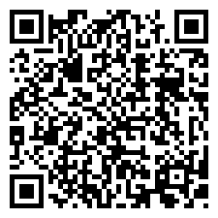

Evaluate this session
Scan this
QR code
to evaluate
this session.

Slide 24


© 2014 Microsoft Corporation. All rights reserved. Microsoft, Windows, and other product names are or may be registered trademarks and/or trademarks in the U.S. and/or other countries.
The information herein is for informational purposes only and represents the current view of Microsoft Corporation as of the date of this presentation. Because Microsoft must respond to changing market conditions, it should not be interpreted to be a commitment on the part of Microsoft, and Microsoft cannot guarantee the accuracy of any information provided after the date of this presentation. MICROSOFT MAKES NO WARRANTIES, EXPRESS, IMPLIED OR STATUTORY, AS TO THE INFORMATION IN THIS PRESENTATION.

