Slide 2
Salesforce Did What? Learn How Salesforce Built Libraries and Tools for .NET Developers
DEV-B308
Wade Wegner

Slide 3
https://github.com/WadeWegner

Slide 4
Let me show you what I built …
Salesforce Toolkits for .NET

Slide 5
ANNOUNCING: Contributing the Salesforce Toolkit for .NET to the .NET Foundation

Slide 6
I’m going to show you how we built it!
Segment 1
Portable class libraries
Extensibility
Async and Await
Segment 2
Functional Tests
Unit Tests
Segment 3
Mono.NET & Xamarin
Continuous Integration
Segment 4
Anonymous Types
Dynamics
Segment 5
NuGet
Segment 6
Community
License
Issues, Features, & Bugs
Pull requests

Slide 7
Segment 1 Portable class libraries Extensibility Async and Await

Slide 8
Segment 2 Functional Tests Unit Tests

Slide 9
Segment 3 Mono.NET & Xamarin Continuous Integration

Slide 10
Segment 4 Anonymous Types Dynamics

Slide 11
Segment 5 NuGet

Slide 12
Segment 6 Community License Issues, Features, & Bugs Pull requests

Slide 13
Review
Portable class libraries
Extensibility
Async and Await
Functional Tests
Unit Tests
Mono.NET & Xamarin
Continuous Integration
Anonymous Types
Dynamics
NuGet
Community
License
Issues, Features, & Bugs
Pull requests

Slide 14
Call to Action
Take a look at the Salesforce Toolkits for .NET
Build something!
Engage with the community; be available!

Slide 15
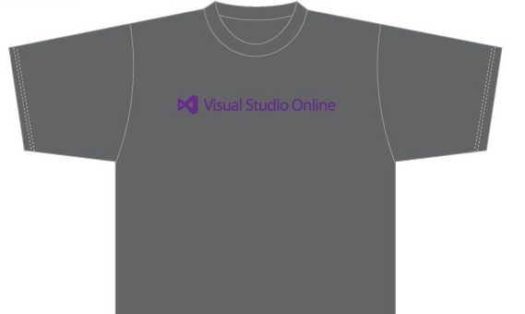
Visit the Developer Platform & Tools Booth
Having a friend buy your coffee?
Yea, it’s kind of like that.
MSDN Subscribers get up to $150/mo in Azure credits.
Stop by the Developer Platform and Tools booth and visit the MSDN Subscriptions station to activate your benefits and receive a gift!
http://aka.ms/msdn_teched
3 Steps to New Gear! With Application Insights
Create a Visual Studio Online account http://visualstudio.com
Install Application Insights Tools for Visual Studio Online http://aka.ms/aivsix
Come to our booth for a t-shirt and a chance to win!
VSIP QR Tag Contests
Visit our booth to join the hunt for cool prizes!

Slide 16
Resources
Microsoft Engineering Stories
Development tools & services for teams of all sizes
How Microsoft Builds Software
http://aka.ms/EngineeringStories
http://www.visualstudio.com
Visual Studio Industry Partner Program
Visual Studio | Integrate
Meet Our New Visual Studio Online Partners or Join Now.
http://vsipprogram.com
Create Your Own Dev Environment
http://integrate.visualstudio.com

Slide 17
Complete an evaluation and enter to win!

Slide 18
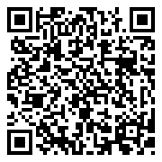
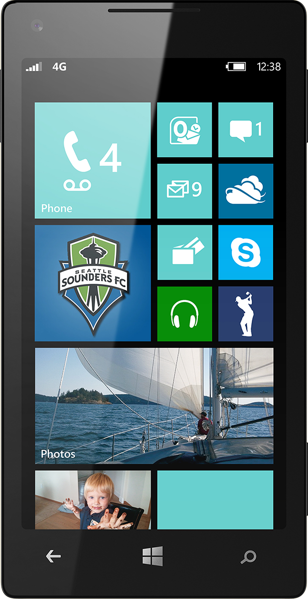
Evaluate this session
Scan this QR code to evaluate this session.

Slide 19
© 2014 Microsoft Corporation. All rights reserved. Microsoft, Windows, and other product names are or may be registered trademarks and/or trademarks in the U.S. and/or other countries.
The information herein is for informational purposes only and represents the current view of Microsoft Corporation as of the date of this presentation. Because Microsoft must respond to changing market conditions, it should not be interpreted to be a commitment on the part of Microsoft, and Microsoft cannot guarantee the accuracy of any information provided after the date of this presentation. MICROSOFT MAKES NO WARRANTIES, EXPRESS, IMPLIED OR STATUTORY, AS TO THE INFORMATION IN THIS PRESENTATION.

