Slide 2
Sharing Code and UI with Universal Projects and WinJS
DEV-B333
Kirupa Chinnathambi (@kirupa)

Slide 3
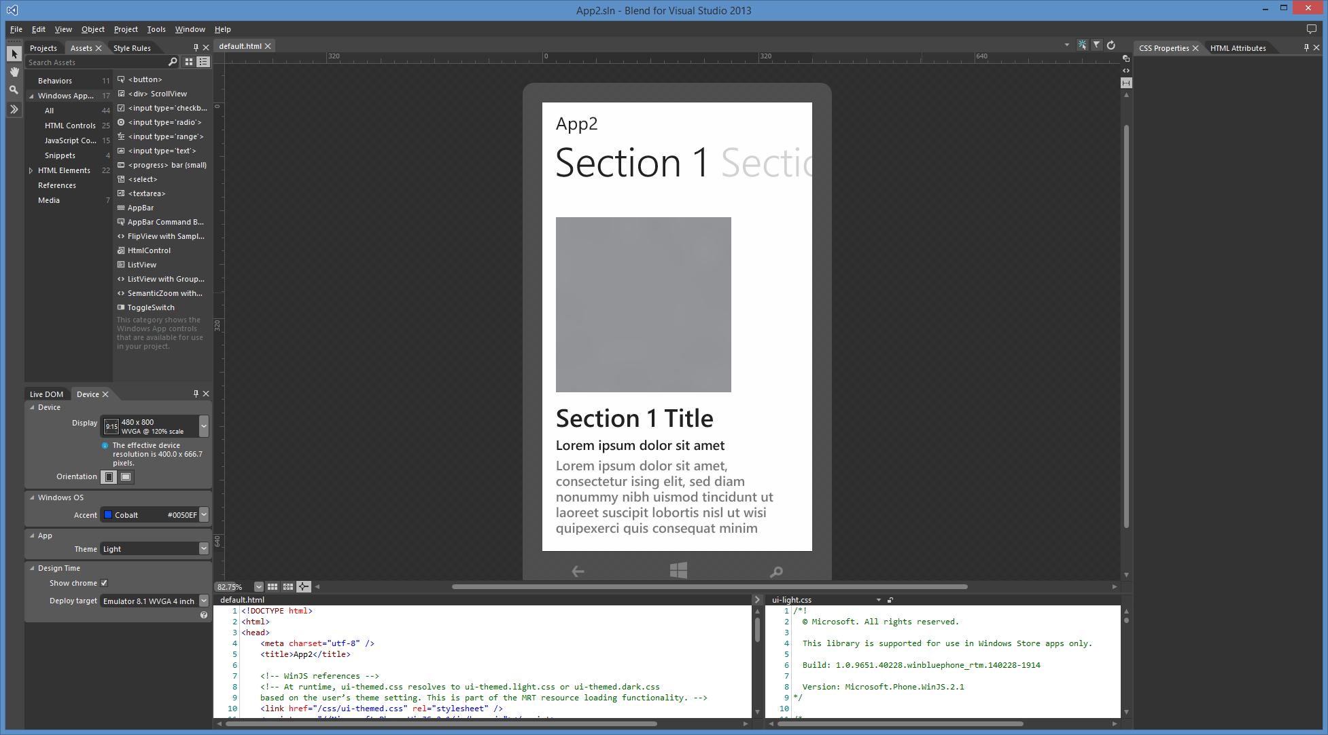
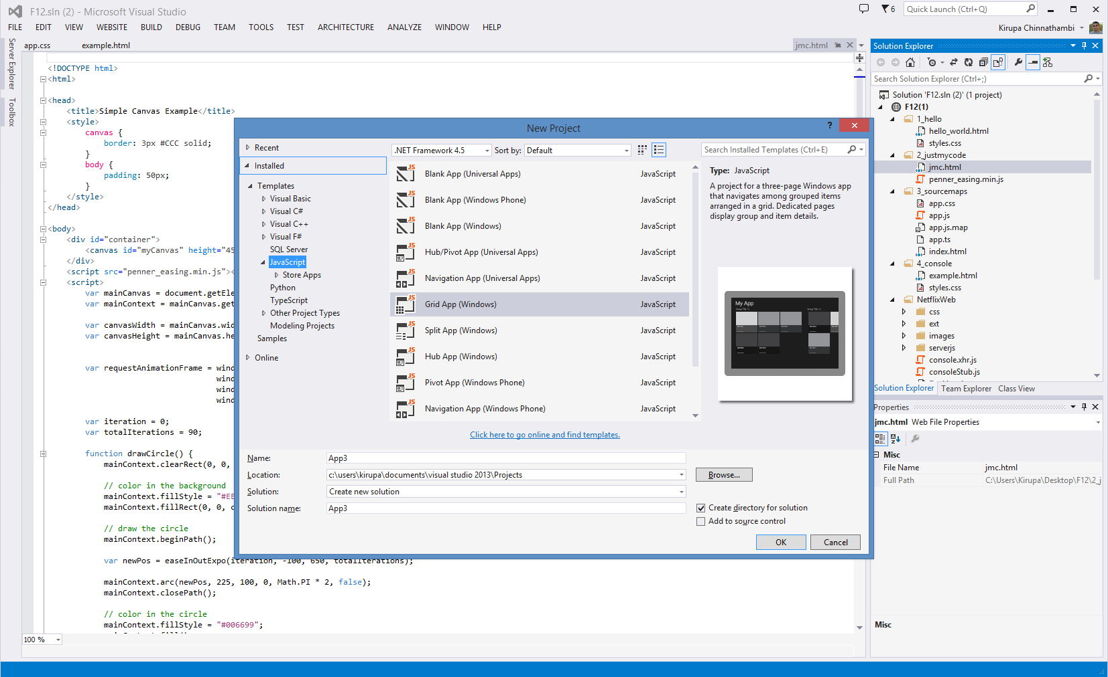

Slide 4
Raise your hand if you’ve built either a Windows Store or Windows Phone App?

Slide 5
agenda
What are Universal Projects?
Building Climeslug
Going from a Windows Store App to a Universal App
Conclusion + Q/A

Slide 6
What are Universal Projects?

Slide 7
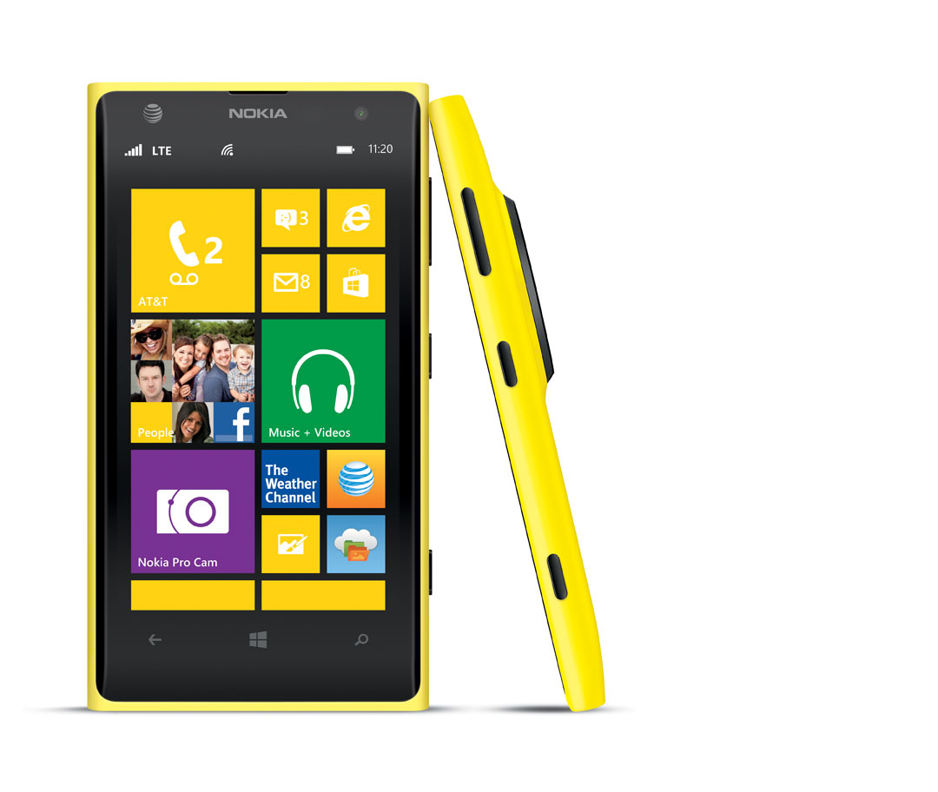
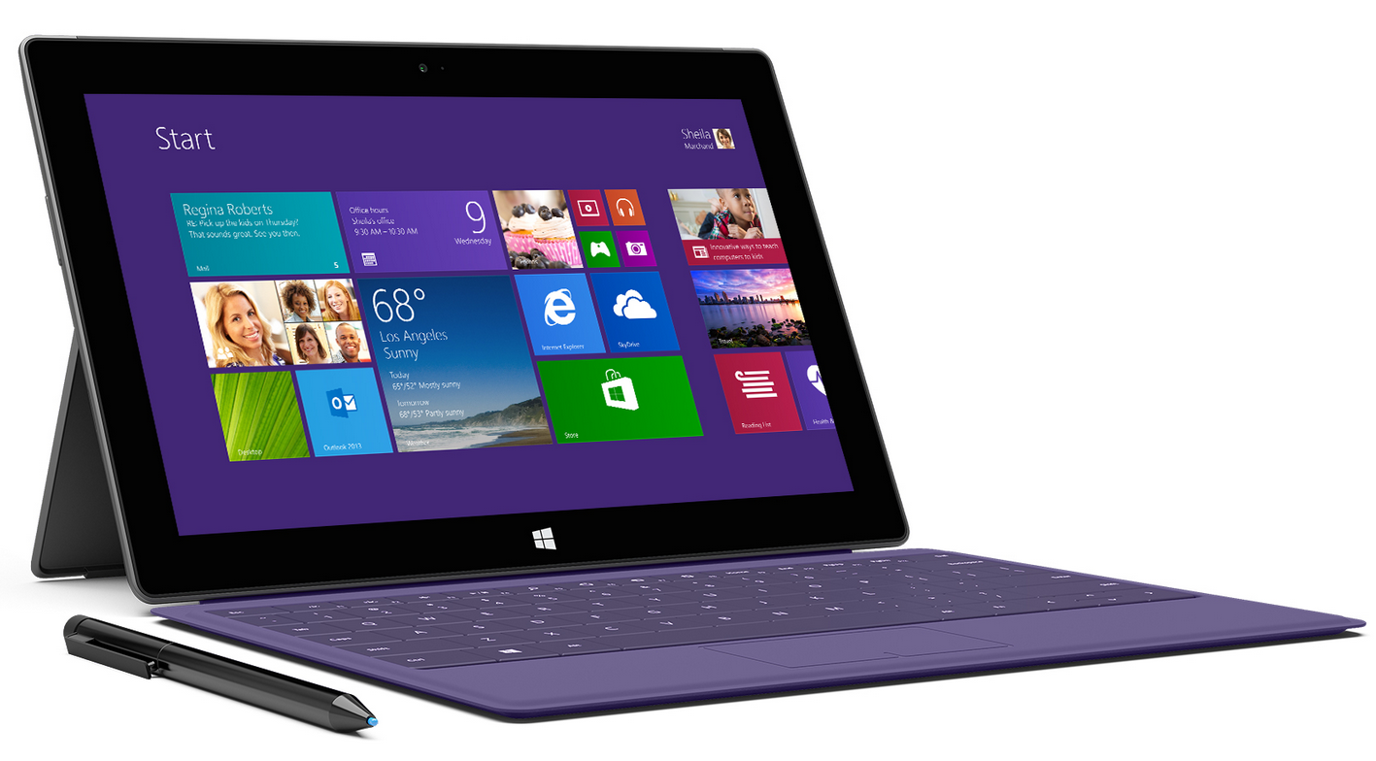
Windows Store Projects
Windows Phone Projects

Slide 8
Universal Projects

Slide 9
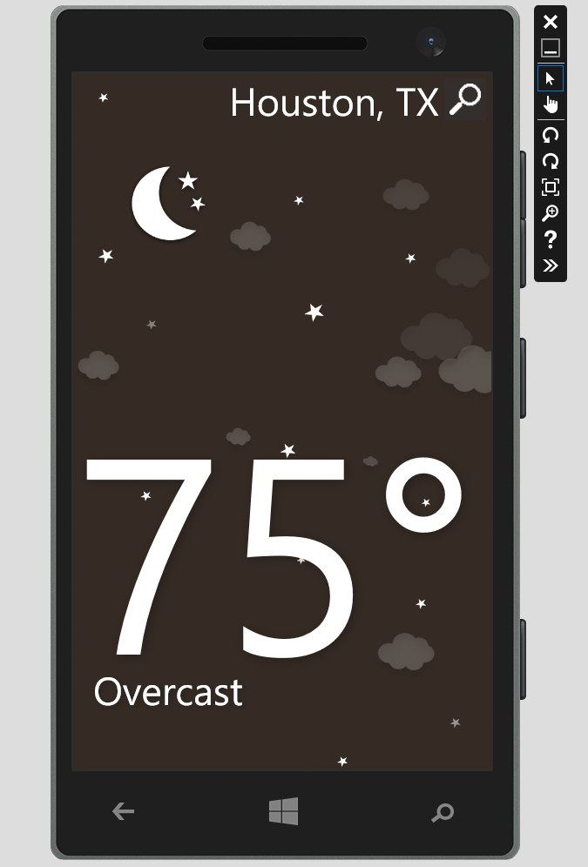

Slide 10
handy tip (1/3)
The Universal project structure is a way for you to make sense of your shared and non-shared content.
The contents of your Shared project simply get merged in with your platform-specific projects as part of deployment. (If there are name collisions, the platform-specific file always wins!)

Slide 11
handy tip (2/3)
Use Blend and have default.html from both the Windows Store and Windows Phone projects open. Switch between periodically to make sure everything works as expected.

Slide 12
handy tip (3/3)
You are building single page applications where default.html is platform specific but all of the content pages (aka fragments) can be loaded in a platform neutral way.

Slide 13
Going from a Windows Store app to a Universal App

Slide 14
Conclusion

Slide 15
acknowledgements
Let’s give a hand to Lena Yeoh and Billy Chow who helped create the design and graphics for Climeslug and Pick-a-Flick respectively.

Slide 16
Feel free to contact me if you have any questions or want to help with our future planning:
kirupac@microsoft.com
(oh, and follow me @kirupa)

Slide 17
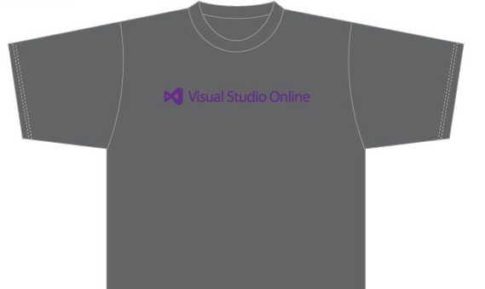
Visit the Developer Platform & Tools Booth
Having a friend buy your coffee?
Yea, it’s kind of like that.
MSDN Subscribers get up to $150/mo in Azure credits.
Stop by the Developer Platform and Tools booth and visit the MSDN Subscriptions station to activate your benefits and receive a gift!
http://aka.ms/msdn_teched
3 Steps to New Gear! With Application Insights
Create a Visual Studio Online account http://visualstudio.com
Install Application Insights Tools for Visual Studio Online http://aka.ms/aivsix
Come to our booth for a t-shirt and a chance to win!
VSIP QR Tag Contests
Visit our booth to join the hunt for cool prizes!

Slide 18
Resources
Microsoft Engineering Stories
Development tools & services for teams of all sizes
How Microsoft Builds Software
http://aka.ms/EngineeringStories
http://www.visualstudio.com
Visual Studio Industry Partner Program
Visual Studio | Integrate
Meet Our New Visual Studio Online Partners or Join Now.
http://vsipprogram.com
Create Your Own Dev Environment
http://integrate.visualstudio.com

Slide 19
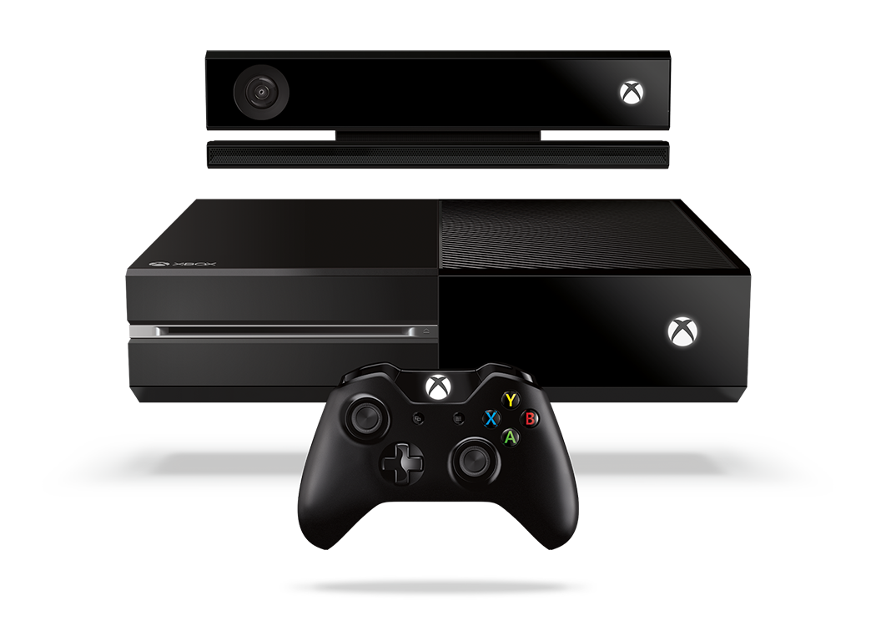
Complete an evaluation and enter to win!

Slide 20
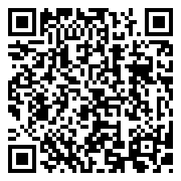
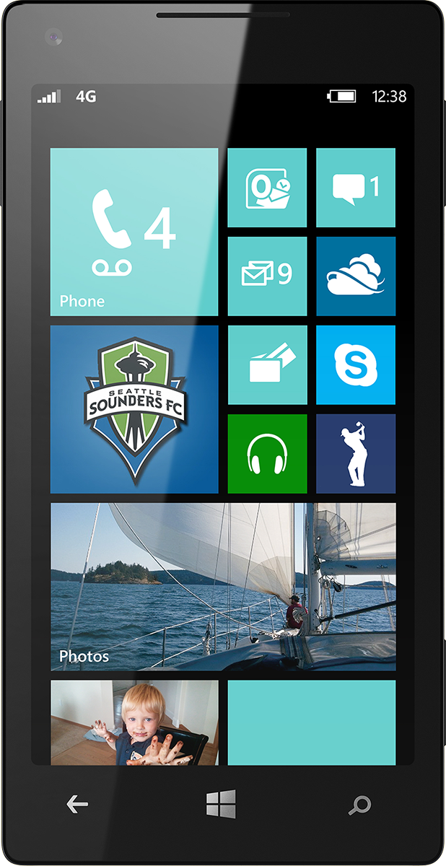
Evaluate this session
Scan this QR code to evaluate this session.

Slide 21
© 2014 Microsoft Corporation. All rights reserved. Microsoft, Windows, and other product names are or may be registered trademarks and/or trademarks in the U.S. and/or other countries.
The information herein is for informational purposes only and represents the current view of Microsoft Corporation as of the date of this presentation. Because Microsoft must respond to changing market conditions, it should not be interpreted to be a commitment on the part of Microsoft, and Microsoft cannot guarantee the accuracy of any information provided after the date of this presentation. MICROSOFT MAKES NO WARRANTIES, EXPRESS, IMPLIED OR STATUTORY, AS TO THE INFORMATION IN THIS PRESENTATION.

