Slide 1


Slide 2
Using the Cloud-Based Load Testing Service and Application Insights to Find Scale and Performance Bottlenecks in Your Applications
DEV-B335
Vibhor Agarwal
Principal GPM – Testing Tools

Slide 3
Agenda
Why load testing?
Cloud load testing
Application insights

Slide 4
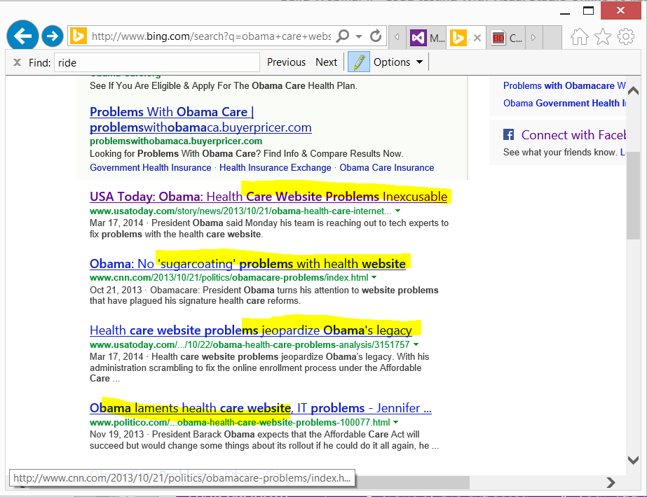

Slide 5



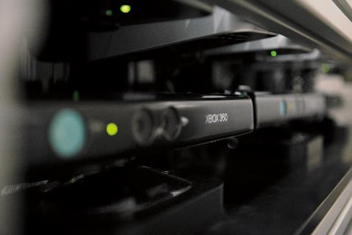
Why Load Testing?
1
2
3
4
Performance
testing:
How fast will
the application
code perform?
Load
testing:
How will the application behave in front of the expected users load?
Stress
testing:
What is point of users-load that will break your application?
Capacity planning:
Will the application
be able to scale up
to the expected
future capacity?

Slide 6
Demo
On-Prem Load Testing

Slide 7
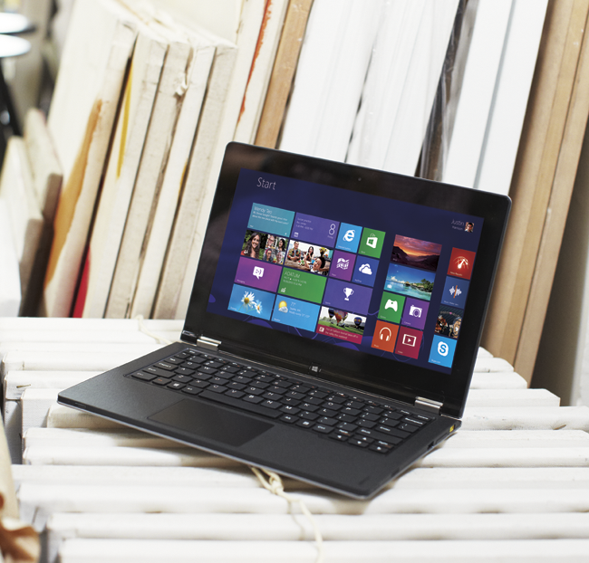
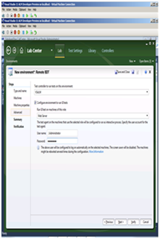

What is needed to make that work?
Appropriate/buy/
steal computers
Net load testing can be:
Expensive to setup
Provisioning is complex
Slow to scale
Costly to maintain
Install your software/agents
Physically setup computers
Replicate this to all the computers

Slide 8
Demo
Cloud Load Testing

Slide 9



Benefits of cloud load testing
1
2
3
4
No need to
setup your own infrastructure
and maintain it.
Get infrastructure in cloud when
you need it.
Use the same load test project which you use for on premises today.
Scale out easily
in case of doing stress testing.

Slide 10




Cloud Load testing today

Slide 11
Architecture - How does it work?
Load Test Web Service
Worker
Test Agent Pool - Dynamic
Azure Tables
Results Database
Visual Studio 2013
Azure Blobs

Slide 12








Visual Studio Online
Build service | Load testing service | Continuous deployment to Azure | Application insights | Code editing
Lab management | Release management | Load testing | SharePoint | Project Server | System Center
Source
Repos
Agile
Planning
Team
Rooms
Test Case Management
Feedback Management
Build and Continuous Integration
Team Foundation Server
Visual Studio Online

Slide 13
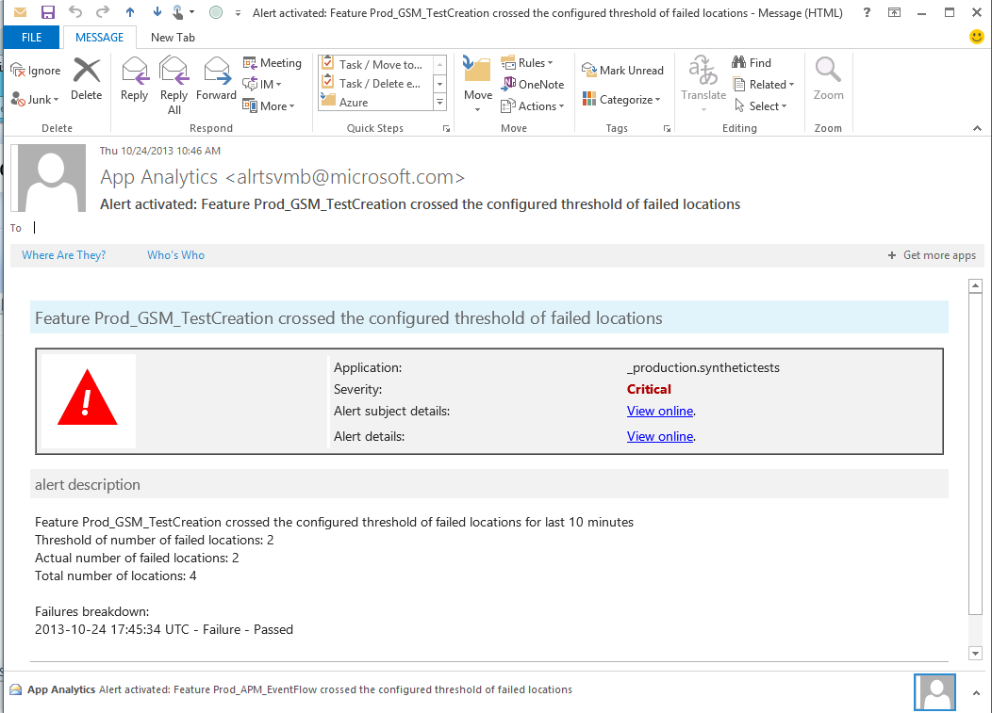
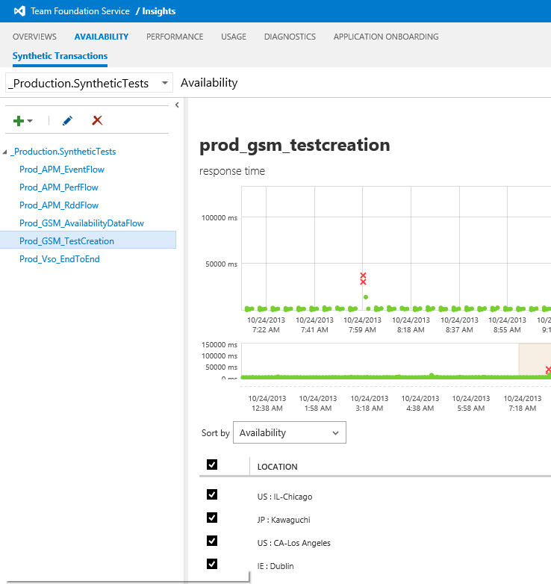
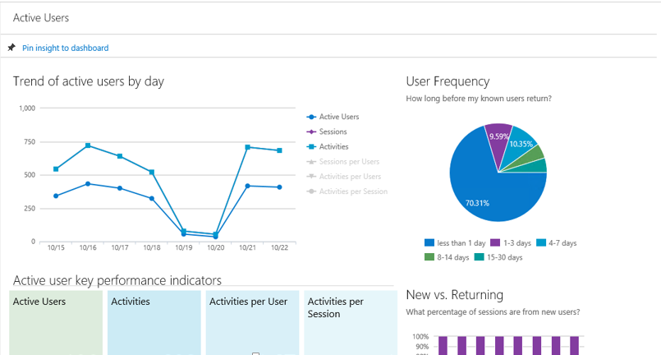
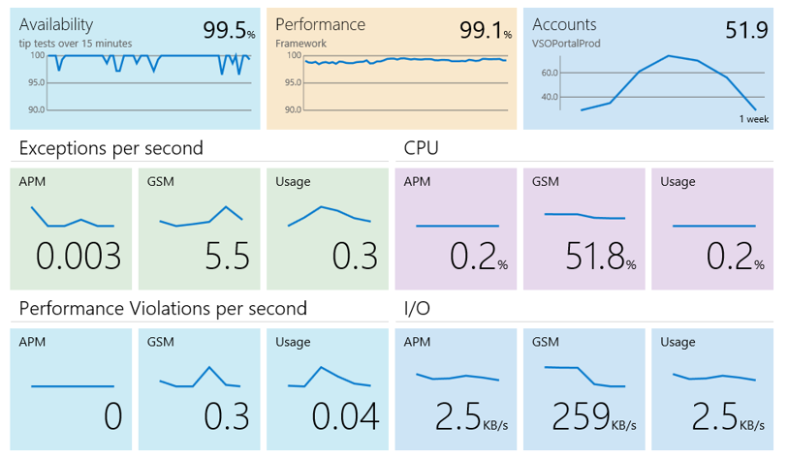
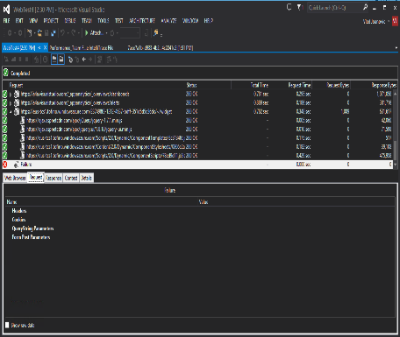
Application insights
Available
Performing
Succeeding
Health dashboards
Notifications and
deep insights
Usage dashboards
Is my application available
and performing for users?
One dashboard.
Where do we invest next?
Show me top features and
customer usage patterns.
What’s wrong?
Show me suspicious
code and test cases.

Slide 14
Upcoming features
Get customer counters from Application Insights with load test
REST APIs to queue Load Tests
Geo-specific load generation
Richer analysis/reporting

Slide 15
Who can use cloud load testing?
One who has Ultimate and has an account with VSO
Single URL to get started: http://aka.ms/loadtfs
Application is available on the internet
      Can use IP Range for applications behind firewall
15,000 user-minutes free every month
Support:
      Contact Visual Studio Online support
      ‘vsoloadtest@Microsoft.com’ for direct contact with the team

Slide 16
For more info
http://aka.ms/loadtfs
http://aka.ms/aidemo

Slide 17
References
Recommendation on how to perform load testing
in cloud from Visual Studio Online team
Case Study on cloud load testing with Eovendo
NORAD tracks Santa

Slide 18
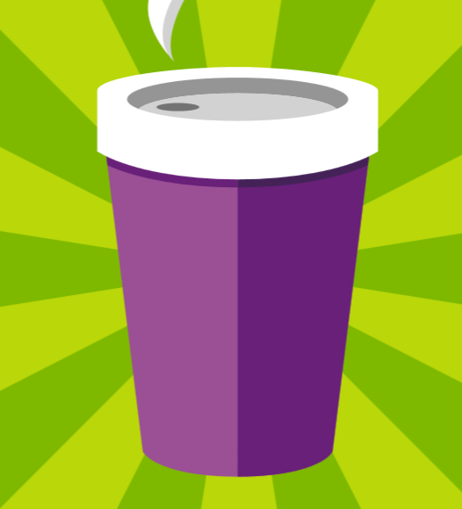







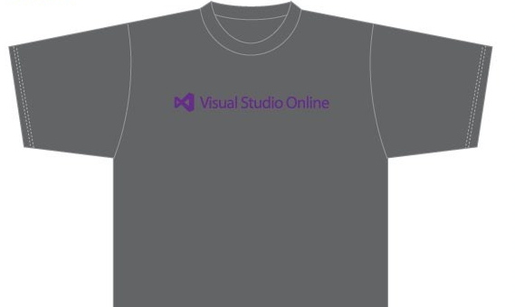

Visit the Developer Platform & Tools Booth
Having a friend
buy your coffee?
Yea, it’s kind of like that.
MSDN Subscribers get up to $150/mo in Azure credits.
Stop by the Developer Platform and Tools booth and visit the MSDN Subscriptions station to activate your benefits and receive a gift!
http://aka.ms/msdn_teched
3 Steps to New Gear! With Application Insights
Create a Visual Studio Online account http://visualstudio.com
Install Application Insights Tools for Visual
Studio Online http://aka.ms/aivsix
Come to our booth for a
t-shirt and a chance to win!
VSIP QR Tag Contests
Visit our booth to join the hunt for cool prizes!

Slide 19

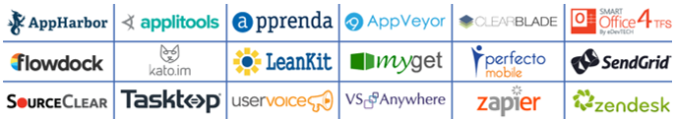
Resources
Microsoft Engineering Stories
  Development tools & services for teams
  of all sizes
  How Microsoft Builds Software
  http://aka.ms/EngineeringStories
http://www.visualstudio.com
Visual Studio
Industry Partner
Program
Visual Studio | Integrate
  Meet Our New Visual Studio Online Partners
  or Join Now.
  http://vsipprogram.com
  Create Your Own Dev Environment
  http://integrate.visualstudio.com

Slide 20



Complete an evaluation and enter to win!

Slide 21
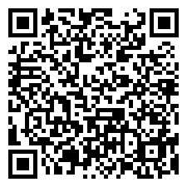

Evaluate this session
Scan this
QR code
to evaluate
this session.

Slide 22


© 2014 Microsoft Corporation. All rights reserved. Microsoft, Windows, and other product names are or may be registered trademarks and/or trademarks in the U.S. and/or other countries.
The information herein is for informational purposes only and represents the current view of Microsoft Corporation as of the date of this presentation. Because Microsoft must respond to changing market conditions, it should not be interpreted to be a commitment on the part of Microsoft, and Microsoft cannot guarantee the accuracy of any information provided after the date of this presentation. MICROSOFT MAKES NO WARRANTIES, EXPRESS, IMPLIED OR STATUTORY, AS TO THE INFORMATION IN THIS PRESENTATION.

