Slide 2
The Future of C# and VB
DEV-B336
Dustin Campbell and Mads Torgersen

Slide 3
Project Roslyn
A reimplementation of C# and VB compilers
In C# and VB
With rich public APIs
On CodePlex
The .NET compiler platform

Slide 4
Why Roslyn?
OSS
Team
Clean architecture to evolve on
Partners
Source-based tools and extensions
Developers
Richer C# IDE experience
10s
1,000s
1,000,000s

Slide 5
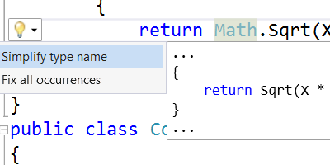
Let’s look at...
Rich IDE experiences
Custom diagnostics
New language features

Slide 6
Demo
Roslyn

Slide 7
Call to action
Use the IDE and language features
Dip your toes in custom diagnostics
Consider forking the compiler source
Give us feedback

Slide 8
Related talks
Mon 1:15pm: The Present and Future of .NET
Mon 4:15pm: The Next Generation of .NET
Tue 1:30pm: The Future of C# and VB
Tue 3:15pm: VS Power User: Tips and Tricks
Thu 10:15am: Async Best Practices for C# and VB
Find us:
Tue 6:30pm-8:30pm: Ask the Experts
Wed 10:45am-3:15pm: MSE booths

Slide 9
Roslyn, C# and VB resources
MSDN: http://www.msdn.com/roslyn
Download preview: http://aka.ms/Roslyn
CodePlex: http://roslyn.codeplex.com
Roslyn source browser: http://source.roslyn.codeplex.com
See also: OSS for F#: http://visualfsharp.codeplex.com

Slide 10
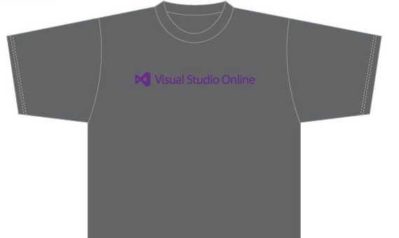
Visit the Developer Platform & Tools Booth
Having a friend buy your coffee?
Yea, it’s kind of like that.
MSDN Subscribers get up to $150/mo in Azure credits.
Stop by the Developer Platform and Tools booth and visit the MSDN Subscriptions station to activate your benefits and receive a gift!
http://aka.ms/msdn_teched
3 Steps to New Gear! With Application Insights
Create a Visual Studio Online account http://visualstudio.com
Install Application Insights Tools for Visual Studio Online http://aka.ms/aivsix
Come to our booth for a t-shirt and a chance to win!
VSIP QR Tag Contests
Visit our booth to join the hunt for cool prizes!

Slide 11
Resources
Microsoft Engineering Stories
Development tools & services for teams of all sizes
How Microsoft Builds Software
http://aka.ms/EngineeringStories
http://www.visualstudio.com
Visual Studio Industry Partner Program
Visual Studio | Integrate
Meet Our New Visual Studio Online Partners or Join Now.
http://vsipprogram.com
Create Your Own Dev Environment
http://integrate.visualstudio.com

Slide 12
Complete an evaluation and enter to win!

Slide 13
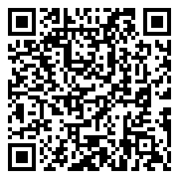
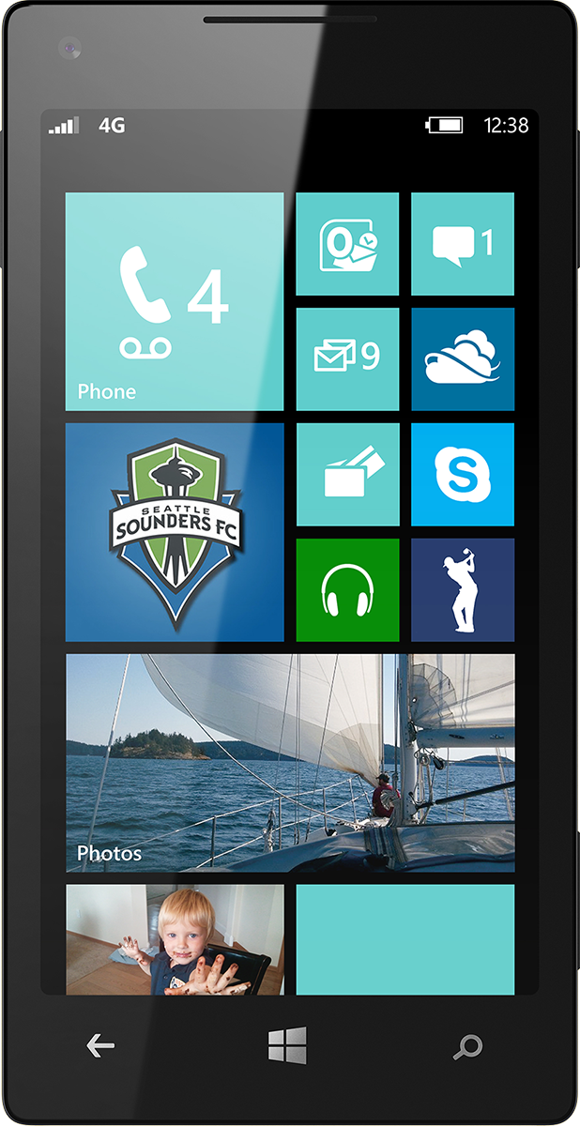
Evaluate this session
Scan this QR code to evaluate this session.

Slide 14
© 2014 Microsoft Corporation. All rights reserved. Microsoft, Windows, and other product names are or may be registered trademarks and/or trademarks in the U.S. and/or other countries.
The information herein is for informational purposes only and represents the current view of Microsoft Corporation as of the date of this presentation. Because Microsoft must respond to changing market conditions, it should not be interpreted to be a commitment on the part of Microsoft, and Microsoft cannot guarantee the accuracy of any information provided after the date of this presentation. MICROSOFT MAKES NO WARRANTIES, EXPRESS, IMPLIED OR STATUTORY, AS TO THE INFORMATION IN THIS PRESENTATION.

