Slide 2
High-Volume, Low Latency Mobile Push Notifications
DEV-B345
Chris Risner

Slide 3
Agenda
Push Notifications
Microsoft Azure
Azure Notification Hubs
Tags
Templates
Client vs Server Registration
Questions

Slide 4
Push Notifications are BIG
Provide updates to users
Alert users when app isn’t running
Trigger background sync
Pull users back into your apps!

Slide 5
Push Notifications I Receive
Emails
Game updates
Flight reminder
Rental car reminder
Appointments
Video chat requests
Data usage alerts
Bills due

Slide 6
Push Notification Lifecycle
App registers with provider
App gets token
App sends token to backend
Push requested
Backend delivers push to provider
Provider pushes to device
Platform
Notification
Service
App back-end

Slide 7
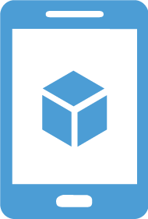
Microsoft Azure
IaaS
PaaS
BaaS
SaaS
Infrastructure-as-a-Service
Platform-as-a-Service
Backend-as-a-Service
Software-as-a-Service
host
build
~consume
consume

Slide 8
Notification Hubs
Cross-platform Push Notifications
Highly scalable
Managed

Slide 9
Cross-Platform Push
Client SDKs for
Android – GCM and ADM
iOS – APNS
Windows Phone – MPNS
Windows Store – WNS
Capable of pushing to specific platform or to all at once
Server SDKs for
REST API
.NET
Node.JS
Java

Slide 10
Highly Scalable
Part of Azure Service Bus
Three levels of scale
Free
Basic
Standard
Millions of push notifications in minutes

Slide 11
Managed
Notification Hubs deals with
Storing device registration information
Signing push requests and sending to PNS
Dealing with invalid push ID registrations
Handling templates and tags
You just need to
Configure your hub and app
Register with the PNS
Pass along the push ID

Slide 12
Using Notification Hubs
App registers with provider
App gets token
App sends token to Hub
Push requested
Hub delivers push to provider
Provider pushes to device
Hub handles expired tokens
iOS app
Windows app
MPNS
GCM
WNS
APNs
App back-end
ADM
Notification Hub

Slide 13
Demo Creating a Hub Configuring a Hub

Slide 14
Tags

Slide 15
Tags
Clients register with set of tags
Tags are strings tied to the Push ID
Requests to push to a Tag will push to connected Push IDs
“Interest based push”

Slide 16
Tags: Example
App back-end
Tag:”TechEd”
Notification Hub
Tag:”Build”
Tag:”TechEd”

Slide 17
Other Tag Usages
Conference name
Username
Zip code
Sports team
Band name
Stock ticker

Slide 18
Demo Registering with Tags Pushing with Tags

Slide 19
Tag Expressions
Logic based tag pushed
Social: “All of this group but me”
Group:id && !user:id
Version and platform
Version:1.0 && platform:iOS
Events: “Anyone interested in the game”
FollowTeam:SeaHawks || FollowTeam:Broncos || EventInterest:SuperBowl

Slide 20
Templates

Slide 21
Templates
Clients can specify templates when registering
Templates specify format of payload when specific time of push is sent
If “Message” push is sent, send it in this format { alert : “$info” }
Enables app backend to send platform independent messages
i.e. push to all the devices with this tag
Multiple templates per device
Different tags per template

Slide 22
Demo Registering with Templates Pushing to all the devices!

Slide 23
Client vs Server Registration

Slide 24
Registering from the Client
Client app talks directly with Notification Hub
Sends over the wire
Push ID (Channel URI, Registration ID, Token)
Tags
Templates
Notification Hub Listen Connection String
Not completely secure

Slide 25
Registering from the Server
Authenticate the request before registering
Is the user who they say they are?
Can still specify tags and templates
Great for setting up registrations from a web app
Good for when an app update requires a user’s registrations being updated
i.e. manager adding an employee to a group

Slide 26
Registering from the Server
createId()
upsert({id}, channel, tags)
App back-end
Notification Hub
{id}

Slide 27
Demo Register from Mobile Services

Slide 28
Try it Yourself
Sign up for an Azure trial http://azure.com
Activate your MSDN subscription http://msdn.com
Check out Notification Hubs http://aka.ms/NH
SDKs: https://github.com/Azure/azure-notificationhubs
Contact Info
chrisner@microsoft.com
http://chrisrisner.com
@chrisrisner

Slide 29
Related content
Sessions
DEV-B330: What’s New in Mobile Services and Notification Hubs
Tuesday, May 13th – 3:15 pm – 4:30 pm
DEV-B343: Building Microsoft Azure Mobile Services with Visual Studio
Thursday, May 15th – 1:00 pm – 2:15 pm
WIN-B211: Live Tiles and Notifications for Windows Phone 8.1
Thursday, May 15th – 8:30 am – 9:45 am
WIN-B218: Multi-Tasking and Event-Triggered Background Processing for Windows Apps
Wednesday, May 15th – 8:30 am- 9:45 am
Labs
DEV-H216: Real-Time Web Applications with Microsoft ASP.NET SignalR

Slide 30
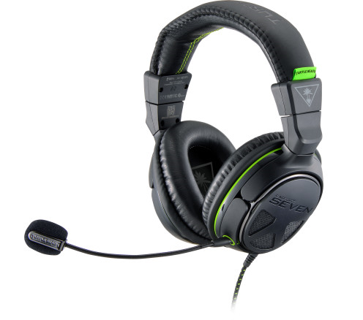
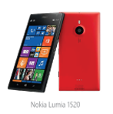
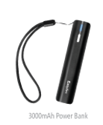
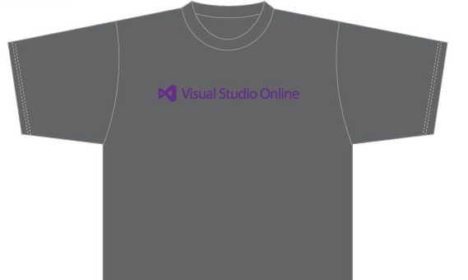
Visit the Developer Platform & Tools Booth
Having a friend buy your coffee?
Yea, it’s kind of like that.
MSDN Subscribers get up to $150/mo in Azure credits.
Stop by the Developer Platform and Tools booth and visit the MSDN Subscriptions station to activate your benefits and receive a gift!
http://aka.ms/msdn_teched
3 Steps to New Gear! With Application Insights
Create a Visual Studio Online account http://visualstudio.com
Install Application Insights Tools for Visual Studio Online http://aka.ms/aivsix
Come to our booth for a t-shirt and a chance to win!
VSIP QR Tag Contests
Visit our booth to join the hunt for cool prizes!

Slide 31
Resources
Microsoft Engineering Stories
Development tools & services for teams of all sizes
How Microsoft Builds Software
http://aka.ms/EngineeringStories
http://www.visualstudio.com
Visual Studio Industry Partner Program
Visual Studio | Integrate
Meet Our New Visual Studio Online Partners or Join Now.
http://vsipprogram.com
Create Your Own Dev Environment
http://integrate.visualstudio.com

Slide 32
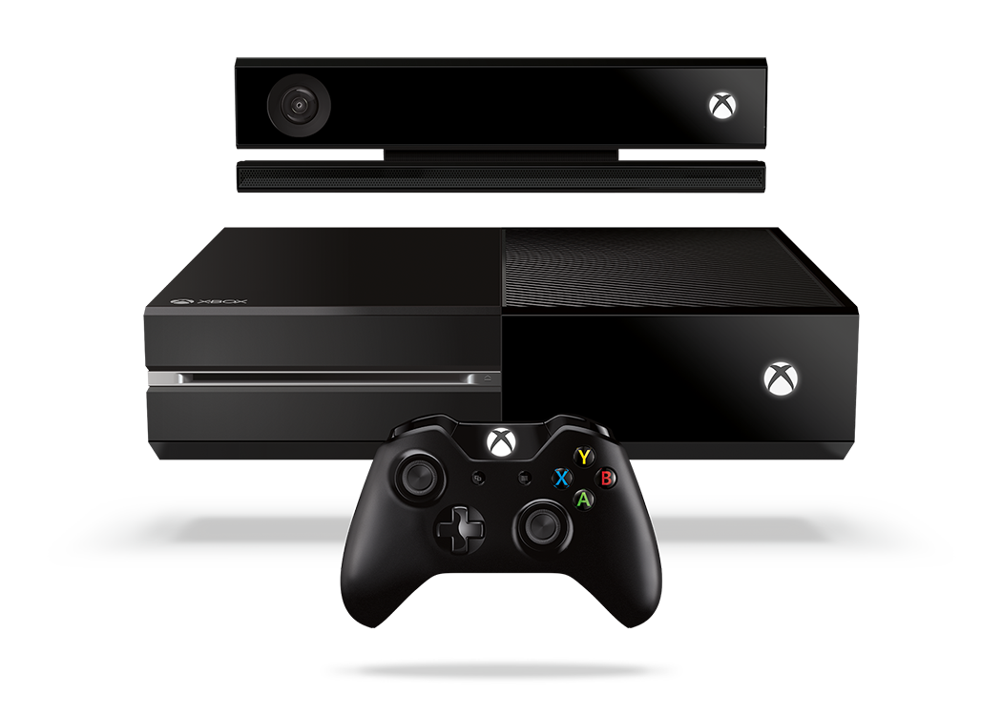
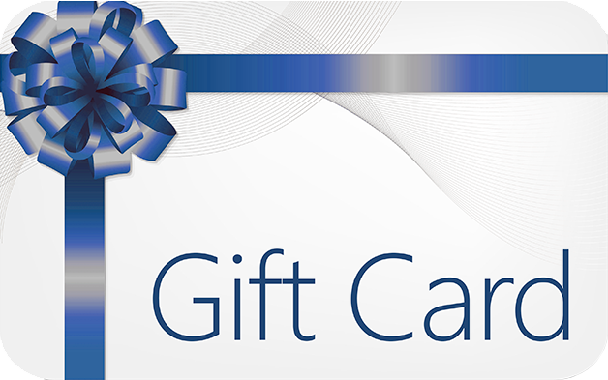
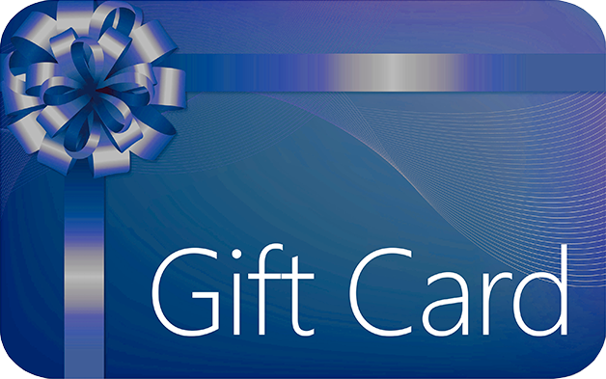
Complete an evaluation and enter to win!

Slide 33
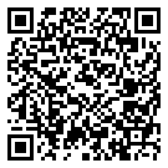
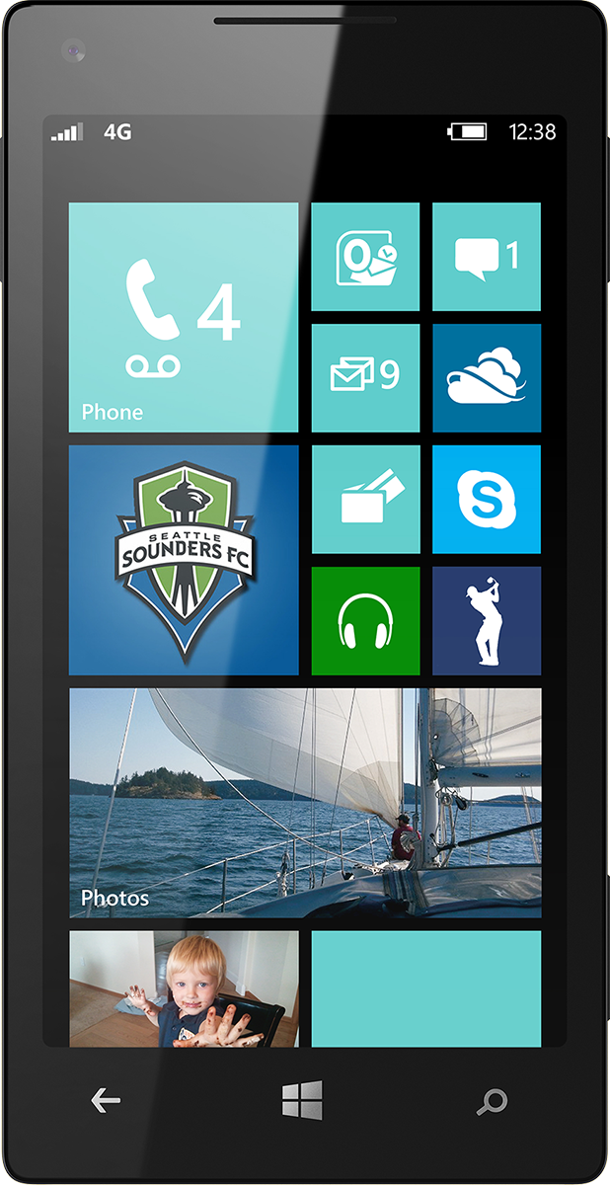
Evaluate this session
Scan this QR code to evaluate this session.

Slide 34
© 2014 Microsoft Corporation. All rights reserved. Microsoft, Windows, and other product names are or may be registered trademarks and/or trademarks in the U.S. and/or other countries.
The information herein is for informational purposes only and represents the current view of Microsoft Corporation as of the date of this presentation. Because Microsoft must respond to changing market conditions, it should not be interpreted to be a commitment on the part of Microsoft, and Microsoft cannot guarantee the accuracy of any information provided after the date of this presentation. MICROSOFT MAKES NO WARRANTIES, EXPRESS, IMPLIED OR STATUTORY, AS TO THE INFORMATION IN THIS PRESENTATION.

