Slide 2
Introducing Azure API Management
DEV-B351
Josh Twist
@joshtwist

Slide 3
welcome.

Slide 4
my name is Josh Twist. follow me @joshtwist (optional)

Slide 5
introduction to azure api management.

Slide 6
and you are?

Slide 7
IT Pro or Developer?

Slide 8
let’s talk about apis and how they can boost your business

Slide 9
Extending a platform
new channels, more customers
developers
API
partners
employees

Slide 10
“In little more than a decade, APIs have transitioned from relative obscurity to become the ‘digital glue’ that empowers developers to create new software applications, partnerships and even new businesses. This business-to-developer market is quickly becoming one of the fastest growing opportunities within cloud computing”
Byron Deeter, partner at Bessemer Venture Partners. Investor in Box, DocuSign, Twilio and SendGrid.
http://venturebeat.com/2013/08/31/api-economy/

Slide 11
Business models
direct monetization
public
private
Indirect monetization

Slide 12
So you want an API program?
How do you engage with developers?
How do you reduce TTFSC?
How do you enforce your business policies?
How do you make your legacy API modern?
How do you understand their behavior?
How do you protect your core business systems?
API Management

Slide 13
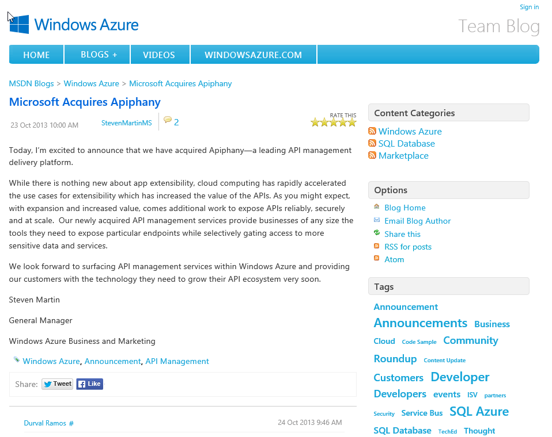
October 23, 2013

Slide 14
announcing
AZURE API MANAGEMENT

Slide 15
WINDOWS AZURE API
DEVELOPER PORTAL
DEVELOPERS
PROXY
API
APPS
API
PUBLISHER
PORTAL
Can be hosted anywhere and authored in any language on any platform.
PUBLISHER / ADMIN
AZURE API
MANAGEMENT

Slide 16
DEMO
AZURE API MANAGEMENT

Slide 17
much preview, nice feature
Developer Experience
Self-Registration
Subscriptions
Documentation
Console
Issues Forum
Dashboard
Proxy & Policies
Call and bandwidth quotas
Rate limit
Caching
HTTPS
Authenticate with Basic
CORS / x-domain calls
Find and replace string
Re-write URL
Mask URLs
JSONP
JSON to/from XML
Set header or parameter
IP filter
Wildcard operations
Security
Custom developer ID
Social Developer ID
API key authentication
Basic Authentication
Reports
Calls
Bandwidth
Cache hits/misses
Status codes
API and service response time
Proxy response time
Filter any report by product API Operation
Admin Experience
API specification
Product management
Policies Editor
Developer management
Content management
Configurable notifications

Slide 18
Thanks
check out DEV-B382 tomorrow at 8:30am [352D] “Azure API Management for fun and profit”
preview available in azure right now (go try)
updates already in the pipeline
… and more coming regularly
keen to engage with customers
reach us at apimgmt@microsoft.com

Slide 19
Tweet me your api-puns. E.g.
apiphany
apidashery
apiness
flapi birds
@joshtwist
jtwist@microsoft.com
azure.microsoft.com/apim

Slide 20
Preferred text layout, 2-color (no bullets)
Main topic 1: size 40pt
Size 20pt for the subtopics
Size 20pt for the subtopics
Main topic 2: size 40pt
Size 20pt for the subtopics
Size 20pt for the subtopics
Main topic 3: size 40pt
Size 20pt for the subtopics
Size 20pt for the subtopics

Slide 21
Adjusting list levels
Main topic 1: size 40pt
Size 20pt for the subtopics
Size 20pt for the subtopics
Main topic 2: size 40pt
Size 20pt for the subtopics
Size 20pt for the subtopics
Main topic 3: size 40pt
Size 20pt for the subtopics
Size 20pt for the subtopics
Use the “Decrease List Level” and “Increase List Level” tools on the Home Menu to change text levels.
Try this:
Place your cursor in any row of text to the left that says “Size 20pt for subtopics”
Next click the Home tab, and then on the “Decrease List level” tool. Notice how the line moves up one level.
Now try placing your cursor in one of the “Main topic…” lines of text. Click the “Increase List Level” tool and see how the text is pushed in one level
Use these 2 tools to adjust your text levels as you work

Slide 22
Bullet points layout with Subhead Subhead
Example of a bulleted slide with a subhead
Set the slide title to “Sentence case”
Set subheads to “Sentence case”
In “bulleted” slide layouts, level 2 text is 24pt
Level 3 text is 24 pt
Level 4 text is 20pt
Level 5 text is 20pt
Hyperlink style
www.microsoft.com

Slide 23
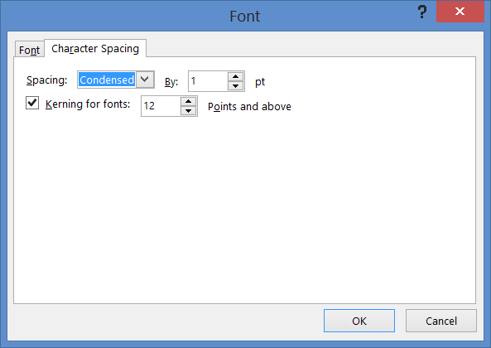
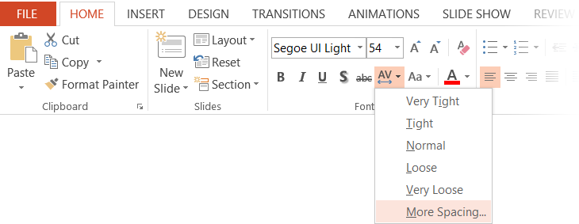
Character spacing
Type that is size 54pt and larger should be condensed by 1pt
Type that is smaller than 54pt should be normal

Slide 24
Software code slide
This slide layout uses Consolas, a monotype font which is ideal for showing software code.

Slide 25
Segoe is our typeface
The simplest executions of Segoe are often the most beautiful. Let’s make our words engaging and our ideas clear by adopting a less-is-more approach to typography. Limit type to no more than three sizes in a layout. Set all copy in sentence case, limit the use of lowercase, and keep paragraphs flush left.

Slide 26
Font info
Font, size, and color for text have been formatted for you in the Slide Master
This template uses Segoe UI and Segoe UI Light, standard fonts included in Windows 7/8
If you are running Windows 7 or 8, no fonts are needed. If you are running Windows Vista or earlier, you will need to install Segoe UI Light.
When connected to CorpNet, you can find Segoe UI here: \\showsrus\images\Corporate_Fonts\PC\Segoe UI\Segoe_UI_Font_family
Copy the .ttf fonts into your C:\Windows\Fonts folder

Slide 27
Presentation fonts/typography
What are the font choices and sizes?
Any font size 28pt or larger should use Segoe UI Light
Any type that is less than 28pt should use Segoe UI
On one slide, try to use a maximum of 3 font sizes
Where to start
Control focus by using scale versus bullets
Use color to draw focus when necessary
Start with main topic at 40pt and subtopics at 20pt
Title/sentence casing and periods
Title text should be “sentence case”
All supporting slide text should be sentence case except for names and products

Slide 28
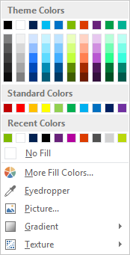
Slide palette info
The PowerPoint palette for this template has been built for you and is shown below. Avoid using too many colors in your presentation.
Select the 4th color from the left for subheads and 1st level non-bulleted text color, or wherever “color” text is preferred over the default black/white text
Accent colors 1-6 – (6 Theme Colors to the far right)
Text
Light 2
Accent 1
Accent 2
Accent 3
Accent 4
Accent 5
Accent 6
Use Accent 1 as the main accent color. Use Accent 2 and Accent 3 when additional colors are needed.
Use Accents 4-6 sparingly – only when more colors are necessary.

Slide 29
Section Title

Slide 30
Lots of data? Minimalize and plan
Gray is used to de-emphasize data that is less important. Use cool gray 3 or cool gray 7. See slide 7 for color formulas.
All elements have the same interior margins as text blocks.
When a chart or graphic, has more elements than can easily be aligned to the grid, align the outer edges of the group, top, bottom, left and right edges to the grid.
It is preferable to keep the group aligned to the left border.
130M
140M
125M
Other
Other
Other
Other
Other
Other

Slide 31
Pie chart 1

Slide 32
Pie chart 2

Slide 33
Horizontal bar chart
Label 1
Label 2
Label 3
Label 4
Label 5

Slide 34
Line chart
Label 1
Label 2
Label 3

Slide 35
Chart Example

Slide 36
3 column table Tables are easy to modify
Table header | Table header | Table header
To modify table, first click anywhere in table, so the Table Tools menu is highlighted at top | Layout > To add rows, click into cell and choose, Insert Above or Insert Below | Layout > Shrink or expand column widths by adjusting the Cell Size, or set them to same size with Distribute
To modify the table layout, click Table Tools > Layout To modify the table style, click Table Tools > Design | Layout > To add columns, click into cell and choose Insert Left or Insert Right | Layout > Use Alignment settings to adjust text alignment and cell margins
 |  | Tip: To quickly add a row, place cursor in this last cell and hit Tab key

Slide 37
4 column table Tables are easy to modify
Table header | Table header | Table header | Table Header
To modify table, first click anywhere in table, so the Table Tools menu is highlighted at top | Layout > To add rows, click into cell and choose, Insert Above or Insert Below | Layout > Shrink or expand column widths by adjusting the Cell Size, or set them to same size with Distribute
To modify the table layout, click Table Tools > Layout To modify the table style, click Table Tools > Design | Layout > To add columns, click into cell and choose Insert Left or Insert Right | Layout > Use Alignment settings to adjust text alignment and cell margins | Tip: To quickly add a row, place cursor in this last cell and hit Tab key

Slide 38
Special content slide layouts

Slide 39
Section title
Speaker Name

Slide 40
Section title

Slide 41
Section title

Slide 42
Demo
Name

Slide 43
Video

Slide 44
There are over 1 million words in the English language.

Slide 45
“ Add a quote here. Design is easier than it looks, and more important than it seems.”
Author’s Name

Slide 46
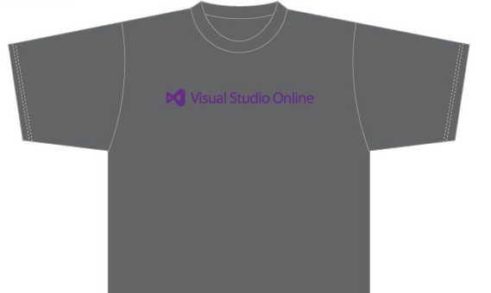
Visit the Developer Platform & Tools Booth
Having a friend buy your coffee?
Yea, it’s kind of like that.
MSDN Subscribers get up to $150/mo in Azure credits.
Stop by the Developer Platform and Tools booth and visit the MSDN Subscriptions station to activate your benefits and receive a gift!
http://aka.ms/msdn_teched
3 Steps to New Gear! With Application Insights
Create a Visual Studio Online account http://visualstudio.com
Install Application Insights Tools for Visual Studio Online http://aka.ms/aivsix
Come to our booth for a t-shirt and a chance to win!
VSIP QR Tag Contests
Visit our booth to join the hunt for cool prizes!

Slide 47
Resources
Microsoft Engineering Stories
Development tools & services for teams of all sizes
How Microsoft Builds Software
http://aka.ms/EngineeringStories
http://www.visualstudio.com
Visual Studio Industry Partner Program
Visual Studio | Integrate
Meet Our New Visual Studio Online Partners or Join Now.
http://vsipprogram.com
Create Your Own Dev Environment
http://integrate.visualstudio.com

Slide 48
Resources
Learning
Sessions on Demand
Microsoft Certification & Training Resources
http://channel9.msdn.com/Events/TechEd
www.microsoft.com/learning
TechNet
msdn
Resources for IT Professionals
Resources for Developers
http://microsoft.com/technet
http://microsoft.com/msdn

Slide 49
Complete an evaluation and enter to win!

Slide 50
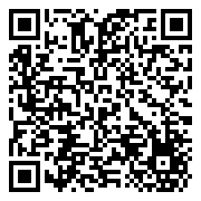
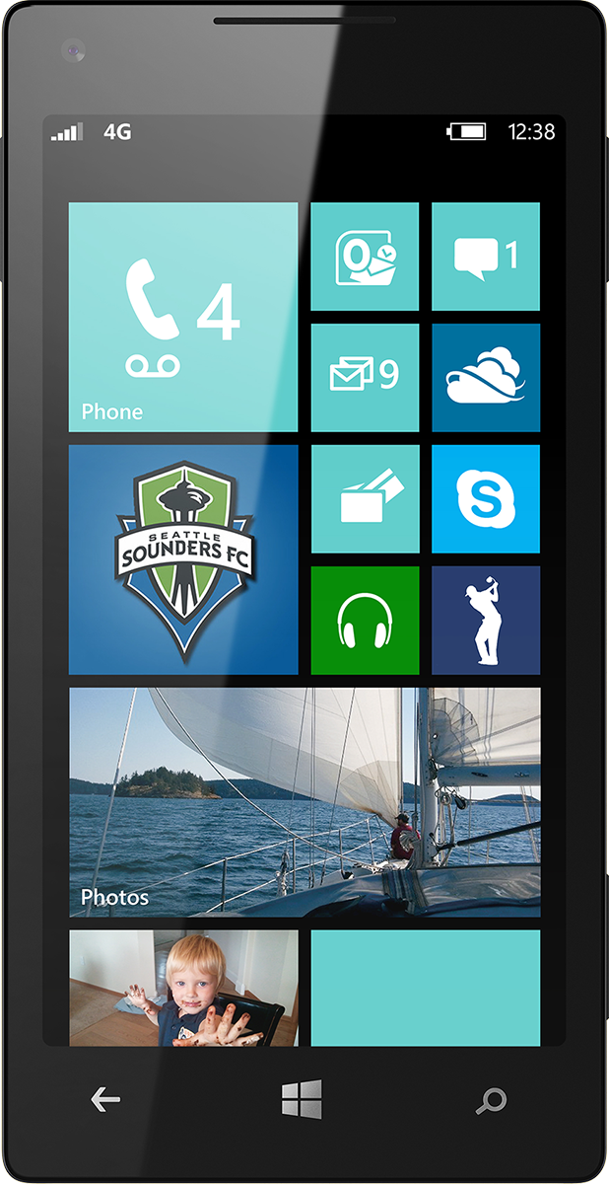
Evaluate this session
Scan this QR code to evaluate this session.

Slide 51
© 2014 Microsoft Corporation. All rights reserved. Microsoft, Windows, and other product names are or may be registered trademarks and/or trademarks in the U.S. and/or other countries.
The information herein is for informational purposes only and represents the current view of Microsoft Corporation as of the date of this presentation. Because Microsoft must respond to changing market conditions, it should not be interpreted to be a commitment on the part of Microsoft, and Microsoft cannot guarantee the accuracy of any information provided after the date of this presentation. MICROSOFT MAKES NO WARRANTIES, EXPRESS, IMPLIED OR STATUTORY, AS TO THE INFORMATION IN THIS PRESENTATION.

