Slide 1


Slide 2

Industrial-Strength
Entity Framework
DEV-B356
John Mason/Rob Vettor
Senior Development Consultants
Microsoft Premier Services

Slide 3
Introduction
Who we are/What we do
  Developer Consultants -- Premier Developer Practice
  Help large customers get more from Microsoft tools and technologies
  Advise companies on how to inject modern technologies and design principles into their existing systems
EF is powerful, broad and complex
  EF is more mature and feature-rich than ever
  Allows you to focus on delivering business value quickly with less risk
In this session, we’ll focus on improvements in EF where we’ve seen our clients face challenges

Slide 4
What is an Enterprise Application?

Slide 5
Enterprise Applications…
Are complex, presumptive Architecture systems that client got to work, usually with some degree of technical debt
Contain certain key characteristics (some exist, others desired):
Data Aware
Transactional
Concurrent
Performant
Compliant
Fault-Tolerant (again – desired)
Usable (almost always desired)

Slide 6
Simple Layered (Multitier) Model
Presentation Tier
Usability Happens Here
Supports
Clients
Application/Business Tier
(Most) Functionality Happens Here
Owns
Integrations and orchestrations
Data Tier
Persistence Happens Here
Manages
Data Sources

Slide 7
More Complex Layered (Multitier) Model
Supports
Clients
Presentation Tier
Usability Happens Here
Business Tier
Service Layer
Owns
Integrations and orchestrations
Business Processes, KPIs
Business Rules Engine
Workflow
Unit of Work, LINQ, etc.
Manages
Data Sources
Data Tier
Persistence Happens Here

Slide 8
Complex Layered Multitier Model
Tests
Supports
Clients
Thick Client, Browser, Mobile, Tablet
Business Tier
Tests
Service Layer
Owns
Integrations and orchestrations
Business Processes, KPIs
Business Rules Engine
Workflow
Mocks via IoC
Unit of Work, LINQ, etc.
Data Tier
Tests
Data Sources
Manages
POCO Objects
Entity Frameworks
Mocks via IoC

Slide 9
Enterprise Apps are…
DataAware

Slide 10
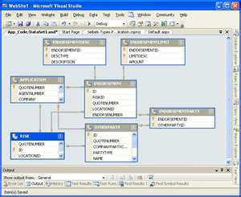

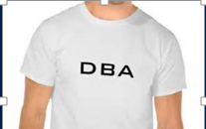
What is a Model?
EF exposes Entity Data Model – where the magic happens
Code against object model without regard to structure of underlying database
Simplifies shape of the data for each party: Stakeholders, Devs and DBA
Database
Object Model
Customer
Customer
Addresses
Database
Tables
Phone
Entity
Classes
Order
Order
Product
US Product
UK Product
Model/Mappings
FK Product

Slide 11
Model Simplifies The Data
  Validates your understanding - removes technical mystery
  Stakeholders can easily understand
  Reduces complexity
Defining the model
  Sketch data model for enterprise
  Create initial mappings
  Identify functional groupings
Every abstraction has a cost
  Models have overhead
  Overloading model with entire entity graph may not make sense
  Often better to work with smaller subsets of functional groups

Slide 12
Model Segregation
Break model up into smaller functional contexts
  Perhaps shipping is conceptually different from ordering? Inventory from purchasing?
  You can have several models (EDMs) that segment the business domain
  We call these “functional contexts”
Benefits
  Each functional context targets a specific area of the business domain
  Reduces complexity
  Functionality can evolve and refactor can occur on separate timelines

Slide 13
Improve Model By Refactoring
Decompose entity classes into functional groupings
Each represented by separate, but related EF context
Customer
Customer
Functional
Context
Addresses
Abbreviated customer table
with Read-Only Fields
Customer Context
Phone
Database
Category
Mappings
Customer
Order
Product
Order
US Product
Functional
Context
Intl Order
Category
Intl Order
UK Product
Supplier
Supplier
FK Product
Order Context

Slide 14
Enterprise Apps are…
Transactional

Slide 15
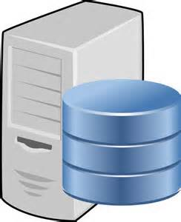
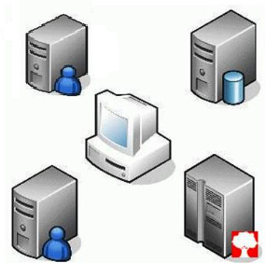
Transaction
  Group of related operations performed as single unit of work
  Either succeeds (Commit) or fails (Rollback) as unit
  Guarantees data consistency/integrity
Basic Types
  Local…
      Single-Phased (1 database) handled directly by database provider
  Distributed…
      Affects multiple resources
      Coordinated by 3rd party transaction manager component
      Implement Two-phased commit

Slide 16
Local Transactions
Implicit
  Built into EF’s internal architecture - Automatic
  SaveChanges() operation invokes implicit transaction
Explicit – Two Types
  BeginTransaction() API – Full control of transaction within EF context
  UseTransaction() – Share existing transaction (enlisted) with EF context
    Open connection/transaction outside EF and share with context
Product 1
Product 2
Product 3
  EF scans context for changes
  Wraps all updates as an Unit of Work
Product 4
Product 5
  Context Object

Slide 17
Demo
Default EF Transaction Behavior
Maximizing Transaction Control - BeginTransaction API
Sharing transaction with EF context - UseTransaction API

Slide 18

Best Practices - Transactions
Favor implicit local transactions, when possible
  All you need in most cases
  Automatic when calling SaveChanges()
  Implements Unit of Work Pattern
Explicit Local Transaction
  Leverage BeginTransaction() API to maximize transaction control
  Leverage UseTransaction() API to share external local transaction
Distributed Transactions
  Favor TransactionScope (demo code) for operations, including non-database resources

Slide 19
Enterprise Apps are…
Concurrent

Slide 20


Concurrency
  When multiple users attempt to modify the same data at the same time
  Two Models
    Optimistic Concurrency
      Pro: Rows not locked between initial query and update
      Con: Database values can be overwritten by others during your update
    Pessimistic Concurrency
      Pro: Row locked until operation complete
      Con: Not scalable – excessive locking – can cause lock escalation heartburn!
      Con: No out-of-the-box support in ADO.NET/EF
Whose changes are saved?
Same Record

Slide 21

Concurrency in EF
  Out-of-box, EF implements optimistic concurrency – Last in, wins
  Can easily detect concurrency conflicts by adding concurrency token
  EF, upon update/delete, will automatically add concurrency check to where clause
  If concurrency conflict, EF will throw DbUpdateConcurrencyException
Configure concurrency token
modelBuilder.Entity<Phone>().Property(x => x.RowVersion)
.IsConcurrencyToken()
.HasDatabaseGeneratedOption(DatabaseGeneratedOption.Computed);
You
exec sp_executesql N'UPDATE [dbo].[Phones]
SET [Type] = @0 WHERE (([Id] = @1) AND ([RowVersion] = @2))
SELECT [RowVersion] FROM [dbo].[Phones] WHERE @@ROWCOUNT > 0 AND [Id] = @1',
N'@0 nchar(10),@1 int,@2 binary(8)',@0=N'Home',@1=2894,@2=0x0000000000004656
EF

Slide 22
Resolve Concurrency Conflicts
Client Wins
  Out-of-the-box behavior
Server Wins
  First in stays – your changes discarded
Notify User of Conflict(s)
  Classic Model: Keep earlier changes
  Give you opportunity to re-input
Code Custom Algorithm
  Let the business decide (BRE)
Maintains three copies of data
Original
Values
Current
Values
Database
Values

Slide 23
Demo
Custom Concurrency Algorithm:
Merging Results

Slide 24
Enterprise Apps are…
Performant

Slide 25
Performance in Apps
Defining Performance
  Performance is an emergent property that represents the blending of all the latency in a solution and it’s underlying infrastructure
Measuring Performance
  Cannot improve what you don’t measure
  Two kinds of KPI’s exist: business and application.
  Use the application KPIs to keep track of application metrics that are meaningful to you.
Performance Impactors
  You can buy your way out of bandwidth issues, but not latency.
  This must be considered up front.

Slide 26
Performance Pillar:
Efficient Queries

Slide 27

Default Query Behavior
  EF transforms to provider-
  specific SQL and executes
  Developers write strongly-
  typed LINQ expression
Request
LINQ Query
SQL Query
DAL
Entity Framework
Query Execution Engine
Database
UI
Untyped SQL
Result Set
Response
Strongly-Typed
Entity Objects
  EF materializes untyped SQL result
  set into strongly-typed entities

Slide 28
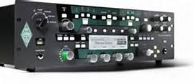

Query Performance
Is Your SQL Efficient?
  Customers assume LINQ is smarter than it actually is
  It looks like SQL, but doesn’t necessarily act like SQL
  EF will get you data, but not necessarily efficiently
Must Profile LINQ Queries
  Structure of LINQ expressions can have tremendous impact on query performance
  EF knows your model, but doesn’t understand your model
  Cannot determine query efficiency from the LINQ expression
The Truth is in the SQL execution plan
  Let’s look at an execution plan…

Slide 29
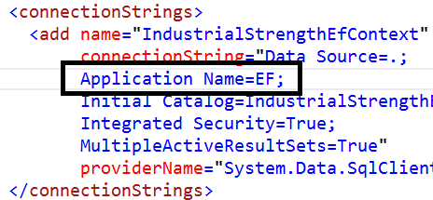
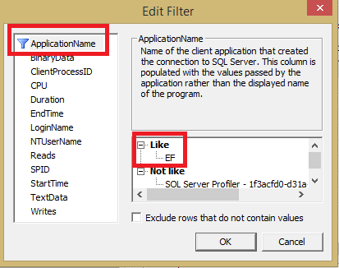
Profiling Check List
Set Application Name Attribute
Run SQL Trace
Run Query Analyzer
SET STATISTICS TIME ON/OFF
Review Actual Execution Plan

Slide 30
Demo
Profile LINQ Query with SQL Profiler

Slide 31

What About Stored Procedures?
EF Loves to Generate SQL
  Default behavior - Developers write LINQ → EF generates SQL
Sprocs Always Option
  Simple to map select/update operations to stored procedures
  EF generates method from which to invoke
Consistency Across EF
  Same experience…
  Generates ADO.NET plumbing
  Returns materialized results
  Full change tracking
Right tool for the Job

Slide 32

Performance Best Practices
Profile Early/Profile Often
  Slow performing operations/Bottlenecks/Complex queries
Must Haves…
  Application Name connection string attribute
  Set Statistics Time (On/Off)
  Actual vs. Estimated Execution Plan
Don’t Fear the Sproc
  Stored procedures are first-class citizens and have a place in EF
  Customers often blend both EF queries and stored procedures in hybrid approach
  Common customer usage pattern for large applications
Disregard Performance
at your own Peril!

Slide 33
Performance Pillar:
Asynchronous Operations

Slide 34
Async
EF 6 Exposes Asynchronous Operations
  Most EF/IQueryable<T> methods now Async-enabled
  Leverages recent Async/Await pattern
Fast and Fluid Experience
  Increase client responsiveness/server scalability
  Prevents blocking of main thread for long-running operations
  Enables async operations without managing background threads
SaveChangesAsync() | FirstOrDefaultAsync() | ToListAsync()
LoadAsync() | SumAsync() | MaxAsync
ExecuteSqlCommandAsync() | AnyAsync() | FindAsync()

Slide 35
Demo
Asynchronous Queries

Slide 36
Performance Pillar:
Caching

Slide 37
Performance Enhancements
Overall Query Construction
Performance Improvements
EF v1
EF 4
EF 4.1, 4.2
EF 5
EF 4.3
EF 6
To leverage, must implement EF 5+ and .NET Framework 4.5+

Slide 38

Query Caching
Earlier
    Dev builds Linq query
    Compiler builds expression tree
    EF parses tree and constructs SQL query
    Repeated each time query executed – duplicate work and $$$
Now, Autocompiled Queries
    EF 5+ ➔ SQL query constructed once, stored in EF query cache and reused
    Parameterized – same query/different parameter values
    For your application, all user share this cache (App Domain)
    Supports up to 800 queries

Slide 39
How Does Query Caching Work?
LINQ Query
Compile to Query
Store SQL and Hash
Return SQL
Hash Exist in Cache?
Add Parameters to SQL
Create Hash
for Query
Return SQL
from Cache
DB

Slide 40
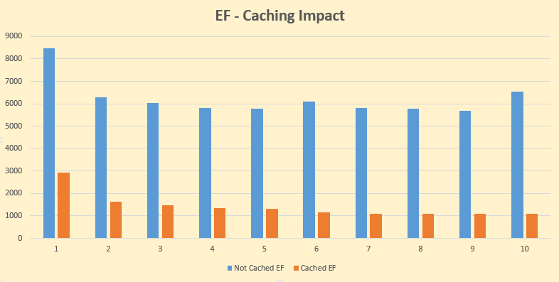
Query Caching

Slide 41
Closing Thoughts…

Slide 42
Step 0: Learn the Framework
The framework is complex
  In our experience, after a 2 hour chalk talk, many customers jump into EF without investing time to understand it
  The next time we hear from them is when they are in trouble
  Looks simple, but…
Allocate time to learn
  Allocate time for the team to learn EF
  Make one team member the EF expert – the go-to person
  Must understand LINQ and subtle nuances of each
  Must understand immediate vs. deferred execution
For Microsoft Premier Customers,
  Recommend Premier EF Training

Slide 43
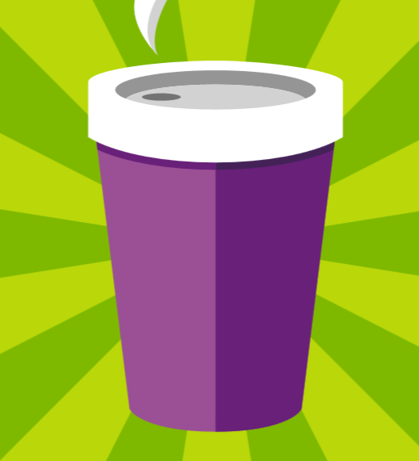
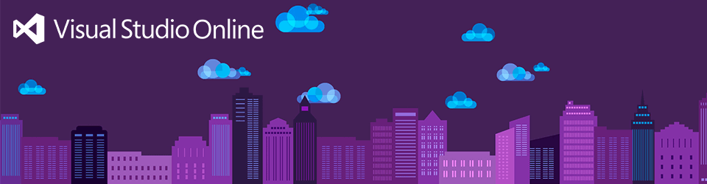






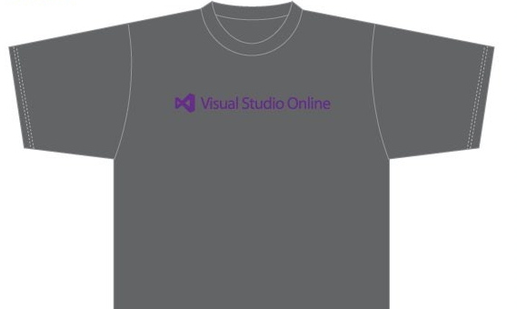
Visit the Developer Platform & Tools Booth
Having a friend
buy your coffee?
Yea, it’s kind of like that.
MSDN Subscribers get up to $150/mo in Azure credits.
Stop by the Developer Platform and Tools booth and visit the MSDN Subscriptions station to activate your benefits and receive a gift!
http://aka.ms/msdn_teched
3 Steps to New Gear! With Application Insights
Create a Visual Studio Online account http://visualstudio.com
Install Application Insights Tools for Visual
Studio Online http://aka.ms/aivsix
Come to our booth for a
t-shirt and a chance to win!
VSIP QR Tag Contests
Visit our booth to join the hunt for cool prizes!

Slide 44


Resources
Microsoft Engineering Stories
  Development tools & services for teams
  of all sizes
  How Microsoft Builds Software
  http://aka.ms/EngineeringStories
http://www.visualstudio.com
Visual Studio
Industry Partner
Program
Visual Studio | Integrate
  Meet Our New Visual Studio Online Partners
  or Join Now.
  http://vsipprogram.com
  Create Your Own Dev Environment
  http://integrate.visualstudio.com

Slide 45



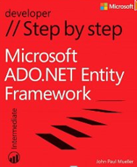
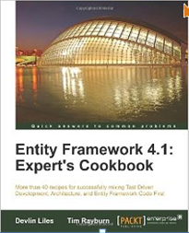
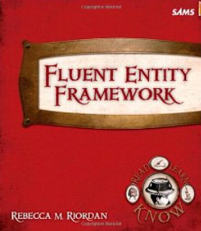
Resources
Entity Framework Resource Site
  http://msdn.com/data/ef
Chalk Talk and Workshop
  Premier Services offers a number of Entity Framework chalk talks and workshops
Books

Slide 46
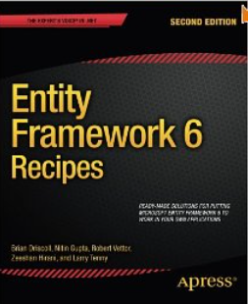
Resources
Co-Authored by Rob Vettor
Book Signing at the Apress booth @ 11:30 AM Thurs

Slide 47

Resources
Learning
  Sessions on Demand
  Microsoft Certification & Training Resources
http://channel9.msdn.com/Events/TechEd
www.microsoft.com/learning
TechNet
msdn
  Resources for IT Professionals
  Resources for Developers
http://microsoft.com/technet
http://microsoft.com/msdn

Slide 48



Complete an evaluation and enter to win!

Slide 49


Evaluate this session
Scan this
QR code
to evaluate
this session.

Slide 50


© 2014 Microsoft Corporation. All rights reserved. Microsoft, Windows, and other product names are or may be registered trademarks and/or trademarks in the U.S. and/or other countries.
The information herein is for informational purposes only and represents the current view of Microsoft Corporation as of the date of this presentation. Because Microsoft must respond to changing market conditions, it should not be interpreted to be a commitment on the part of Microsoft, and Microsoft cannot guarantee the accuracy of any information provided after the date of this presentation. MICROSOFT MAKES NO WARRANTIES, EXPRESS, IMPLIED OR STATUTORY, AS TO THE INFORMATION IN THIS PRESENTATION.

Slide 51
Appendix

Slide 52
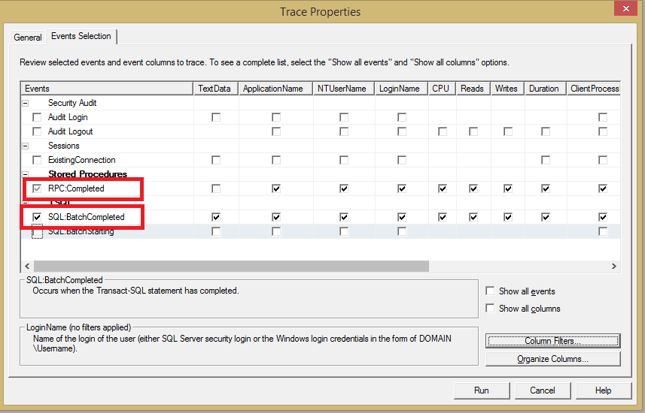
SQL Trace Filtering

Slide 53




Profiling Tools
Profiling Tools
  IntelliTrace (Visual Studio)
  SQL Profiler (SQL Server)
  Red Gate Database Profiler
  EF Profiler (Hibernating Rhinos)
  ORM Profiler (Solution Design, Inc.)
  MiniProfiler-EF

Slide 54

Read-Only Data
Disable Change Tracking
  For data that will not be updated, simply add AsNoTracking clause to query…
AsNoTracking
  Only fetches data
  No caching or change tracking operations
  Reduces execution time/memory consumption
  Substantial performance gain when retrieving large number of items
  Affects only the current query
var customers = ctx.Customers.AsNoTracking().ToList();

