Slide 1


Slide 2

Hybrid ALM:
Using Team Foundation Server and Visual Studio Online Together
DEV-B363
Steven Borg
Co-Founder and Strategist, Northwest Cadence
steven.borg@nwcadence.com
@stevenborg

Slide 3

Housekeeping
Steven Borg, Northwest Cadence
Steven.Borg@nwcadence.com
@stevenborg
Please don’t forget your evaluation!

Slide 4
Today’s Presentation
Why Application Lifecycle Management?
List of Integration Scenarios
Team Foundation Server vs Visual Studio Online
  Demos – App Insights, Cloud Load Testing, Cloud Build, Reporting, Customization
Back to the Integration Scenarios
  Discussion: OpsHub Migration Utility, TFS Integration Platform
Tools to integrate VSO and TFS
  Demos – OpsHub Integration, Git

Slide 5
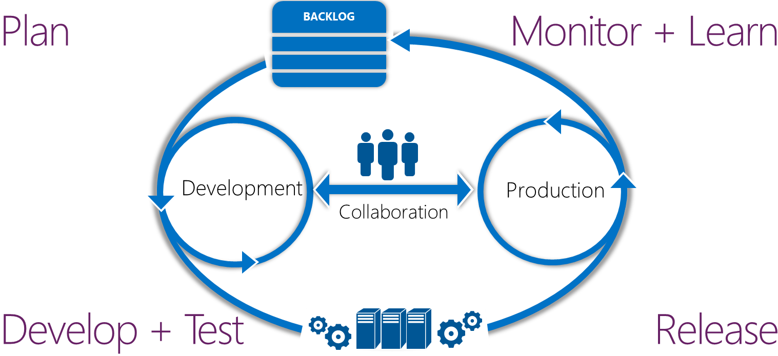
Application lifecycle management
Modern app development
Continuous value delivery and rapid response to change

Slide 6


Industry trends
Technology
Multi-platform
Multi-device
Cloud services
User-centric
Social
People & Processes
Continuous feedback
Continuous quality
Continuous delivery
Heterogeneous
development teams

Slide 7

Evolving ALM and DevOps dynamics
Diverse teams
Team autonomy
Agility in development and production

Slide 8
Integration Scenarios

Slide 9
Integration Scenarios
Don’t integrate – choose one or the other
Integrate because you want the features of both
Integrate because you have external teams
Offshore
Outsourced
Open Source
Integrate because you are the external team
Consultant / Partner
Service Provider

Slide 10
TFS vs VSO
The Smackdown

Slide 11







ALM your way
Build Service | Load Testing Service | Continuous Deployment to Azure | Application Insights | Code Editing
Lab Management | Release Management | Load Testing | SharePoint | Project Server | System Center
Source
Repos
Agile
Planning
Team
Rooms
Test Case Management
Feedback Management
Build and Continuous Integration
Team Foundation Server
Visual Studio Online

Slide 12
ALM in the cloud with Visual Studio Online
REQUIREMENTS
Plan
BACKLOG
Monitor + Learn
Agile Portfolio Management
Kanban customization
Application Insights
Work item tagging
Stakeholder feedback
requests
Development
Production
Collaboration
Release
Develop +Test
Team Rooms
Work item charts
Automated builds and CI
Flexible version control
Code discussions
Continuous Deployment
Cloud load testing
Web-based test management
Browser-based lightweight IDE
No infrastructure overhead | Pay as you use services | Available anywhere | Connected IDE

Slide 13
TFS and VSO
Work items, version control, and build
Agile product / project management
Test case management
Heterogeneous development
Easy setup*
Collaborate with anyone*

Slide 14
TFS vs VSO
TFS
Customized work items
SharePoint integration
Data warehousing
Reporting
CodeLens support
IP stored on premise
Supports Active Directory
VSO
Application Insights
Cloud Load Testing
Cloud Build
Always on latest version
Trivial install
Supports Microsoft IDs

Slide 15
Demo:
Visual Studio Online
Steven Borg
Northwest Cadence
@stevenborg

Slide 16
Thoughts?

Slide 17
Demo:
Team Foundation Server
Steven Borg
Northwest Cadence
@stevenborg

Slide 18
Thoughts?

Slide 19
Integration Scenarios
Don’t integrate – choose one or the other
Integrate because you want the features of both
Integrate because you have external teams
Offshore
Outsourced
Open Source
Integrate because you are the external team
Consultant / Partner
Service Provider

Slide 20
Tools to Integrate

Slide 21
Migration (to VSO):
OpsHub Migration Utility

Slide 22
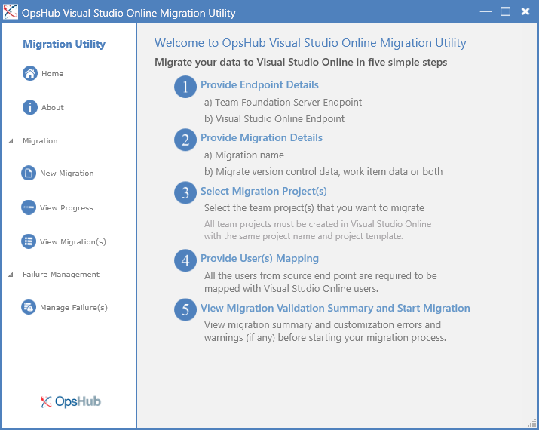
TFS to VSO in 5 easy steps
Provide endpoints
Provide migration
details
Select projects
Provide user
mapping
Start migration

Slide 23
Migration Wills and Wont’s
Will Migrate:
From Team Foundation Server 2010, 2012, 2013
Standard process templates
Version control history, work item attachments and links
Won’t Migrate
Anything from outside Team Foundation Server
Builds, lab environments, team rooms or event history
Security & Permissions
Team & Personal favorites, alerts and work item queries
Customized process templates
OpsHub provides additional tools to support more complex migration scenarios

Slide 24
Migration (to TFS):
Microsoft Download Tool

Slide 25
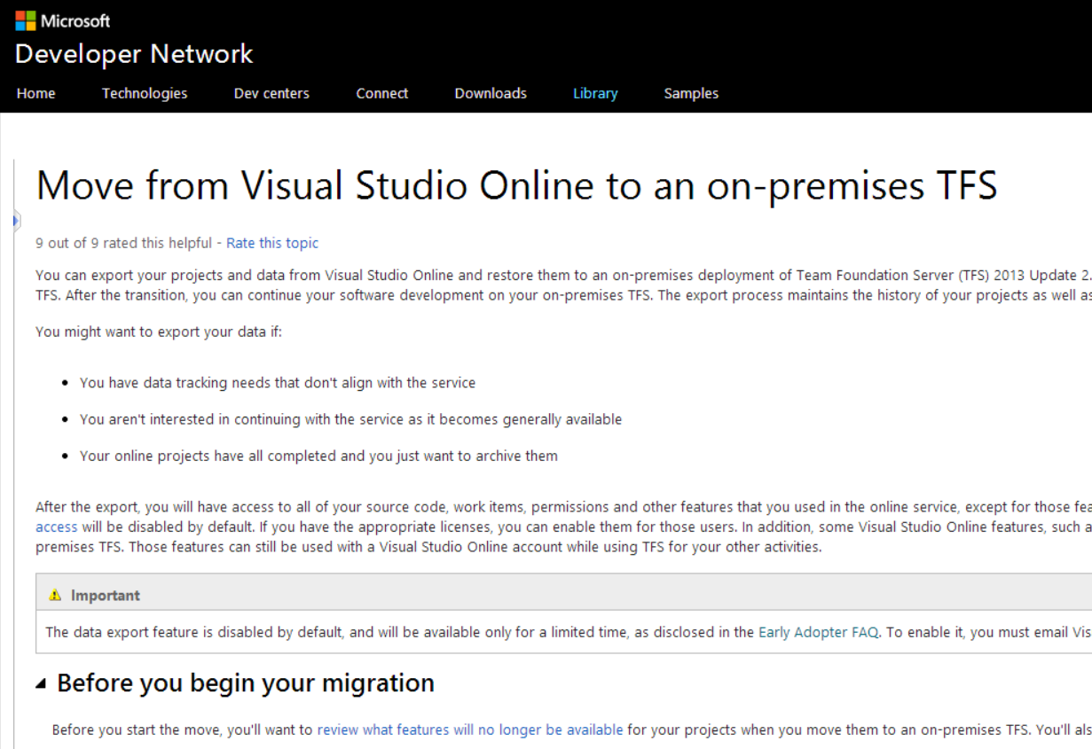
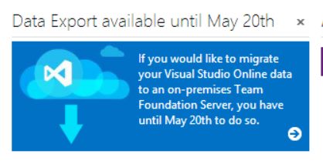
VSO to TFS in 4 easy steps
Export projects
Import to SQL
(as a TPC db)
Attach collection
Finalize details

Slide 26
Integrate VSO and TFS:
OpsHub Integration Manager

Slide 27



















OpsHub Integration Manager
OpsHub supports over 30 leading ALM systems and continues to grow…
Supported Entities:
Defects, Requirements, Work Items, Test Cases, Test Plan, Test Results, Tasks, Suggestions, Features, Use Cases, User Stories, Custom Entities

Slide 28
Demo:
OpsHub Integration Manager
Steven Borg
Northwest Cadence
@stevenborg

Slide 29
Integrate VSO and TFS:
TFS Integration Platform

Slide 30
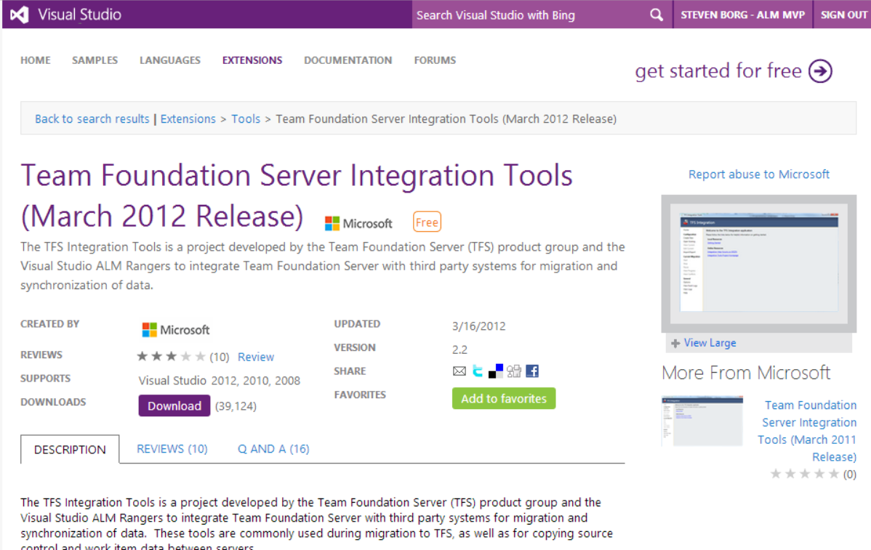
TFS Integration Platform
CodePlex –
Open Source
Visual Studio
Gallery
ALM Rangers

Slide 31
Integrate VSO and TFS:
Git – Source Code Only!

Slide 32
Demo:
Git (source only)
Steven Borg
Northwest Cadence
@stevenborg

Slide 33
Questions on
Hybrid ALM?
Steven Borg
Co-Founder and Strategist, Northwest Cadence
steven.borg@nwcadence.com
@stevenborg

Slide 34
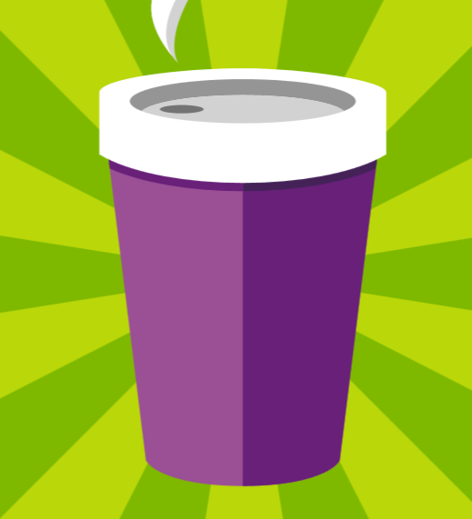







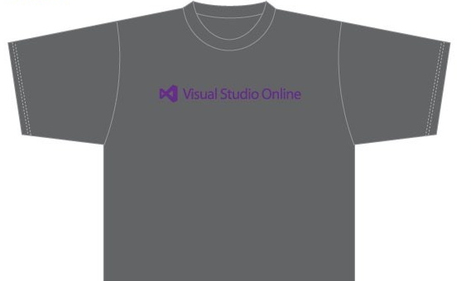
Visit the Developer Platform & Tools Booth
Having a friend
buy your coffee?
Yea, it’s kind of like that.
MSDN Subscribers get up to $150/mo in Azure credits.
Stop by the Developer Platform and Tools booth and visit the MSDN Subscriptions station to activate your benefits and receive a gift!
http://aka.ms/msdn_teched
3 Steps to New Gear! With Application Insights
Create a Visual Studio Online account http://visualstudio.com
Install Application Insights Tools for Visual
Studio Online http://aka.ms/aivsix
Come to our booth for a
t-shirt and a chance to win!
VSIP QR Tag Contests
Visit our booth to join the hunt for cool prizes!

Slide 35

Resources
Microsoft Engineering Stories
  Development tools & services for teams
  of all sizes
  How Microsoft Builds Software
  http://aka.ms/EngineeringStories
http://www.visualstudio.com
Visual Studio
Industry Partner
Program
Visual Studio | Integrate
  Meet Our New Visual Studio Online Partners
  or Join Now.
  http://vsipprogram.com
  Create Your Own Dev Environment
  http://integrate.visualstudio.com

Slide 36



Complete an evaluation and enter to win!

Slide 37
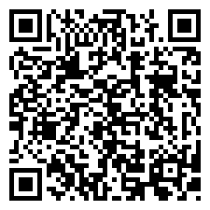

Evaluate this session
Scan this
QR code
to evaluate
this session.

Slide 38


© 2014 Microsoft Corporation. All rights reserved. Microsoft, Windows, and other product names are or may be registered trademarks and/or trademarks in the U.S. and/or other countries.
The information herein is for informational purposes only and represents the current view of Microsoft Corporation as of the date of this presentation. Because Microsoft must respond to changing market conditions, it should not be interpreted to be a commitment on the part of Microsoft, and Microsoft cannot guarantee the accuracy of any information provided after the date of this presentation. MICROSOFT MAKES NO WARRANTIES, EXPRESS, IMPLIED OR STATUTORY, AS TO THE INFORMATION IN THIS PRESENTATION.

