Slide 1


Slide 2

Using Functional, Exploratory and Acceptance Testing to Release with Confidence
DEV-B367
Benjamin Day

Slide 3


Benjamin Day
Brookline, MA
Consultant, Coach, & Trainer
Microsoft MVP for Visual Studio ALM
Team Foundation Server, Software Testing,
Scrum, Software Architecture
Scrum.org Classes
  Professional Scrum Developer (PSD)
  Professional Scrum Foundations (PSF)
www.benday.com, benday@benday.com, @benday

Slide 4
The title for this talk is long.

Slide 5
“Using Functional, Exploratory and Acceptance Testing to Release with Confidence”

Slide 6
(Alternate title, please.)

Slide 7
“How do you know you’ve tested your app?”

Slide 8
“Kick it over the wall to QA.”

Slide 9
That’s the magical black box school of software testing.

Slide 10
Step 1:
Write an app of dubious quality.

Slide 11
Step 2:
Throw said app into the magical black box of QA.

Slide 12
Step 3a:
Receive bugs.

Slide 13
Step 3b:
(Grrrrrr.)

Slide 14
Step 4:
Fix the bugs.

Slide 15
Step 5:
Chuck the marginally less crummy app back at QA.

Slide 16
Step 6:
More bugs.

Slide 17
Step 7:
Repeat until no more bugs.*
* - or until deadline date

Slide 18
Step 8:
Eventually release the code into the wild where it is then devoured by wolves used by users who send the actual bugs.

Slide 19
Sound familiar?

Slide 20
Why are you getting so many bugs?

Slide 21
On many teams,
QA is an unmeasurable afterthought.

Slide 22
Delays in dev → “kwality kode”

Slide 23
“kwality kode” → magical QA

Slide 24

“We’ve only got 4 minutes to save the world test the app.”
-Madonna

Slide 25
You scramble to figure out…

Slide 26
…what needs to be tested?
…what’s been tested?
…what works?
…what doesn’t work?
…were the bugs really fixed?

Slide 27
Exploratory testing?

Slide 28
Did the user acceptance tests get done?

Slide 29
Did the users even look at this thing?

Slide 30
Basically, are we good to go?

Slide 31
Feeling overwhelmed?

Slide 32
Stressed out?

Slide 33
Do you feel confident about releasing this app?

Slide 34
It doesn’t have to be this way.

Slide 35
In a build-test-release cycle that works well, you’ll have…

Slide 36
Transparency.

Slide 37
Traceability.

Slide 38
Team communication.

Slide 39
When it works…
Transparency
  Everyone knows what’s going on
Traceability
  Test plan is known & what’s tested is known
Team Communication
  Bugs, requirements, test plans, etc. is shared/discussed by
  devs, testers, management, and stakeholders.

Slide 40
The goal:
Release your code and know it’s been tested and how.

Slide 41
Here are the steps to do this with
Team Foundation Server &
Microsoft Test Manager.

Slide 42
Here’s the plan.

Slide 43
When you get new functionality…
Create a test suite & test cases for it.
The test cases describe the steps.
  Readable by all
It’ll be in TFS
  Collaborate
Encourage your developers to look at it.

Slide 44
When you’re ready to test…
Test using TFS’s web-based test tools
Test using Microsoft Test Manager (MTM)
Helps you to follow the test plan
Helps you to record bugs

Slide 45
While you’re testing…
Use TFS to track the testing effort
Assign test cases to individuals
Encourage stakeholders to review and run user acceptance tests
Export / print test cases

Slide 46
Start automating…
Minimize testing tedium with MTM’s Action Recordings
Associate Coded UI tests to test cases
Automatically run tests against builds in virtual environments

Slide 47
Demos.
Create test plans via the web.
Associate test plans to requirements.

Slide 48
The Relevant Nouns.
Test Plan
  Main container for your testing efforts
  Related to sprint
Test Suite
  Static Suite
  Requirement-based Suite
  Query-based Suite
Test Case
  Instructions and expected outcomes for testing
  Distinct paths through your app

Slide 49
Demos.
Create test plan with parameters
Bulk entry with grid
Create shared parameters
Create shared step
Open test plan in MTM
Add test plan from Excel

Slide 50
Two ways to run tests.

Slide 51
Via the web.

Slide 52
Via Microsoft Test Manager.

Slide 53
Demos.
Run some test cases via the web
Create a Bug with comments and an attachment
Go to the Test Plan in MTM and refresh.
  View the status of the test plan.
  (HINT: failures)
View the Test Results in MTM
View the bug in TFS web interface

Slide 54
Testing via the web
Lightweight
Don’t have to install anything
Cross-platform
Streamlined

Slide 55
Testing via Microsoft Test Manager
Full-featured
Exploratory Testing
Lightweight automation using Action Recordings
Full automation using Coded UI tests
Highly detailed bugs in TFS
Test Settings

Slide 56
Test Settings let you configure the diagnostic data that is captured when tests are run.

Slide 57
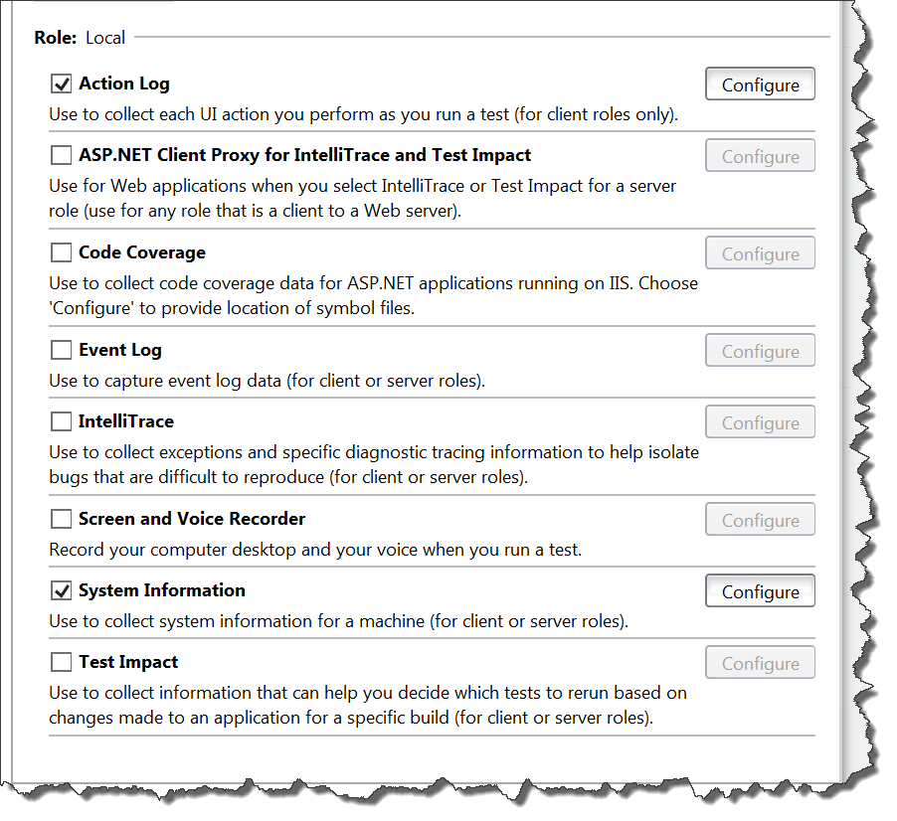
Test Settings: Data & Diagnostics

Slide 58
Demos.
Run tests with Action Log & Video
Create Action Recordings
Create a Bug
Open bug in TFS with video

Slide 59
Automated build, deploy, test.
Associate Coded UI tests to Test Case
Define lab environment
Create Lab Management Build
Run Coded UI tests as part of the build

Slide 60
Demos.
Associate Coded UI test to Test Case
Define a lab environment
Tour of a Lab Management build

Slide 61
“How do you know you’ve tested your app?”

Slide 62
“How do you know you’ve tested your app?”
You have a known test plan.
You have proof that you executed it.
You have automated tools to help you test faster.
You have tools to track & fix the defects.

Slide 63
Any last questions?

Slide 64
Thank you.
www.benday.com | benday@benday.com

Slide 65
Thank you.
http://www.benday.com | benday@benday.com

Slide 66
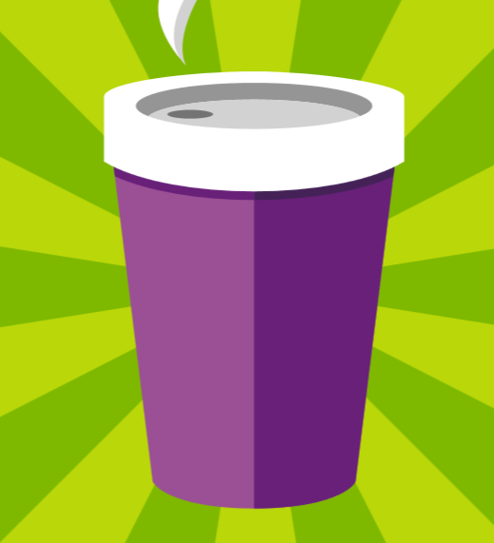







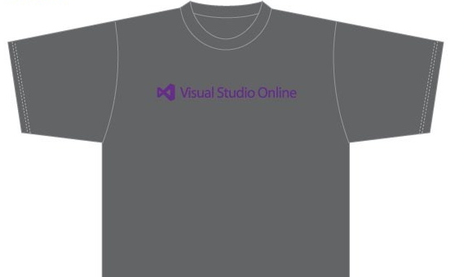

Visit the Developer Platform & Tools Booth
Having a friend
buy your coffee?
Yea, it’s kind of like that.
MSDN Subscribers get up to $150/mo in Azure credits.
Stop by the Developer Platform and Tools booth and visit the MSDN Subscriptions station to activate your benefits and receive a gift!
http://aka.ms/msdn_teched
3 Steps to New Gear! With Application Insights
Create a Visual Studio Online account http://visualstudio.com
Install Application Insights Tools for Visual
Studio Online http://aka.ms/aivsix
Come to our booth for a
t-shirt and a chance to win!
VSIP QR Tag Contests
Visit our booth to join the hunt for cool prizes!

Slide 67


Resources
Microsoft Engineering Stories
  Development tools & services for teams
  of all sizes
  How Microsoft Builds Software
  http://aka.ms/EngineeringStories
http://www.visualstudio.com
Visual Studio
Industry Partner
Program
Visual Studio | Integrate
  Meet Our New Visual Studio Online Partners
  or Join Now.
  http://vsipprogram.com
  Create Your Own Dev Environment
  http://integrate.visualstudio.com

Slide 68



Complete an evaluation and enter to win!

Slide 69
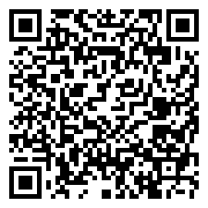

Evaluate this session
Scan this
QR code
to evaluate
this session.

Slide 70


© 2014 Microsoft Corporation. All rights reserved. Microsoft, Windows, and other product names are or may be registered trademarks and/or trademarks in the U.S. and/or other countries.
The information herein is for informational purposes only and represents the current view of Microsoft Corporation as of the date of this presentation. Because Microsoft must respond to changing market conditions, it should not be interpreted to be a commitment on the part of Microsoft, and Microsoft cannot guarantee the accuracy of any information provided after the date of this presentation. MICROSOFT MAKES NO WARRANTIES, EXPRESS, IMPLIED OR STATUTORY, AS TO THE INFORMATION IN THIS PRESENTATION.

