Slide 1


Slide 2
The Future of
.NET on the Server
DEV-B385
“The Lesser Scotts”
Scott Hanselman and Scott Hunter

Slide 3

1.8B
From 64k embedded systems,
PCs, tablets, phones, up to
and past 64-way Cloud Servers
active installs
of .NET
6M
.NET professional
developers

Slide 4
What we are hearing from customers
“Our role is more important than ever before”
“We are required to innovate and deliver much faster”
“I need a cross-device development strategy”
“Open Source enriches the platform and the community
“…but I have existing applications to run and evolve”

Slide 5
.NET – Current state of Web and Services
Standards
based
  Productivity of Visual Studio + Flexibility of Web
  Interactive HTML / CSS tools for web apps that look and behave the same across any browser
Highly
interactive apps
  Powerful tools and technologies for interactive apps
  Develop JavaScript/TypeScript complex logic with powerful editing, debugging and diagnostics.
Suited for
LOB apps
  Supports demanding needs of LOB apps
  Hybrid cloud requirements, flexibility, productivity,
  Tools to develop and test complex web applications that scale.

Slide 6

Our new approach to building .NET
.NET innovation
  Innovation at the core for your existing and future applications
.NET
Flexibility and agile delivery
  Continuous modular releases
OSS
Openness
  Transparent, open and
  community driven

Slide 7

The .NET Foundation
.NET API for Hadoop WebClient
Composition (MEF2)
MEF (Managed Extensibility Framework)
.NET Compiler Platform ("Roslyn")
Windows Phone Toolkit
.NET Map Reduce API for Hadoop
Entity Framework
WnsRecipe
.NET Micro Framework
Rx (Reactive Extensions)
Couchbase for .NET
ASP.NET Web Pages
ASP.NET MVC
Xamarin.Mobile
System.Drawing
Openness
Community
Rapid innovation
ASP.NET Web API
Mimekit
Mailkit
Xamarin.Auth
ASP.NET SignalR
Web Protection Library
OWIN Authentication Middleware
Linq to Hive
Windows Azure .NET SDK
Join the conversation with the community
http://www.dotnetfoundation.org
@dotnetfdn // #dotnetfdn

Slide 8


ASP.NET vNext and the Modern Web
Totally Modular
Faster Development Cycle
Seamless transition
from on-premises to cloud
Choose your Editors
and Tools
Open Source
with Contributions
OSS
Cross-Platform
Fast

Slide 9

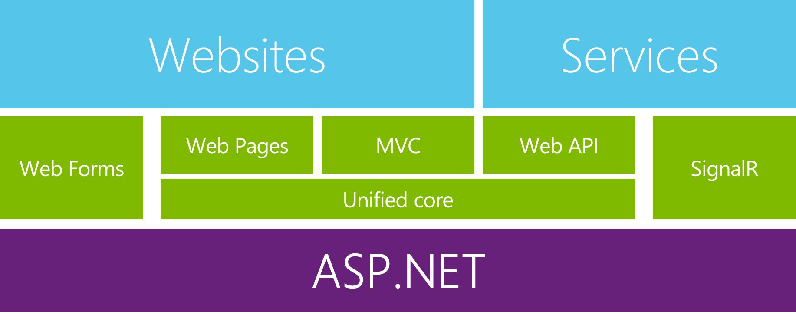
Enabling the Modern Web and Cloud
Extending Application Types
Enterprise LOB on Web
Enterprise LOB desktop apps with web backend
Modern Web applications
Common Improvements
Consistency
Modularization
Tracing & Diagnostics
Dependency Injection
Familiar frameworks

Slide 10
Modern Web – Agility
Faster Development Cycle
Features are shipped as packages
Framework ships as part of the application
More Control
Zero day security bugs patched by Microsoft
Same code runs in development and production
Developer opts into new versions, allowing breaking changes

Slide 11
Modern Web - Fast
Runtime Performance
Faster startup times
Lower memory / higher density (> 90% reduction)
Modular, opt into just features needed
Use a raw socket, framework or both
Development productivity and low friction
  Edit code and refresh browser
  Flexibility of dynamic environment with the power of .NET
  Develop with Visual Studio, third party and cloud editors

Slide 12
Modern Web – Cloud
Seamless transition from on-premises to cloud
Cloud ready
Configuration
Session
Cache
Diagnostics
  Run/Debug in Cloud
  Tracing/Logging without re-deploy

Slide 13
Modern Web – Cross Platform
Runtime
Windows, Mac, Linux
Editors
Visual Studio, Text, Cloud editors
No editors (command line)
OSS
Open Source with Contributions

Slide 14
ASP.NET vNext - Summary
MVC, Web API, Web Pages 6, SignalR 3, EF 7
Feature | .NET vNext | .NET vNext (Cloud Optimized)
Cloud Ready | * | *
Modular Design | * | *
Dependency Injection | * | *
Consistent Tracing / Debugging | * | *
Faster Development (No Build Step) | * | *
Open Source | * | *
Full Side by Side (framework deployed inside application) |  | *
Fast startup, Low memory / High throughput (best of class) |  | *

Slide 15
ASP.NET vNext - Compatibility
Web Forms, MVC 5, Web API 2, Web Pages 3, SignalR 2, EF 6
  Fully supported on .NET vNext
MVC, Web API, Web Pages 6, SignalR 3, EF 7
  Breaking changes:
    New project system
    New configuration system
    MVC / Web API / Web Pages merge
    No System.Web, new lightweight HttpContext (not System.Net.Http)
.NET vNext (Cloud Optimized)
  Subset of the .NET vNext Framework
    Things you depend on might not be available yet (images, etc)

Slide 16

Future of .NET
.NETvNext
Openness
Client apps
Web and services
  Windows Store, WPF, Windows Forms,
  Console apps and related libraries.
  ASP.NET vNext: Web Forms, MVC, Web Pages, Web API, SignalR
  WCF
Multi-purpose
  Device optimized
  Native compilation
  Small footprint, side-by-side
  Cross-device enabled
  Cloud optimized
  High throughput
  Small footprint, side-by-side
  Cross-platform enabled
Specialized
Common
  Runtime
  Compilers
  Libraries
  Next gen JIT (“RyuJIT”)
  SIMD (Data Parallelization)
  .NET Compiler Platform (“Roslyn”)
  Languages innovation
  BCL and PCL
  Entity Framework

Slide 17



Summary
Providing the best end-to-end development experience…
…on your terms
Platform
Framework
Tools
…or bring your own
…or bring your own
…or bring your own

Slide 18
.NET Futures
“The Core”

Slide 19
.NET Compiler Platform (“Roslyn”)
Scenarios/usage cases
C#
VB
Language and IDE
Next generation of .NET Compilers
API: open platform
Rich IDE experiences/refactoring
Code analysis
Custom diagnostics
Open Source compilers
“Roslyn” is the basis for .NET
and Visual Studio vNext
API
VS dev experience extensibility
OSS
Open Source

Slide 20
.NET Compiler
Platform (“Roslyn”)
C#, VB
Source code
.exe/.dil
IL assemblies
FROM
Isolated/closed compilers
Hard to extend dev experience
Established .NET compilers
Open platform
for developers
TO
API: open platform
Rich IDE experiences/refactoring
Code analysis
Custom diagnostics
Open Source compilers
C#, VB
Source code
.exe/.dil
IL assemblies
.NET Compilers Platform
(a.k.a. ROSLYN)

Slide 21
Next generation .NET runtime
Brand new .NET JIT compiler (codename “RyuJIT”)
Benefits
Application startup
and performance
Learn:
http://aka.ms/RyuJITinfo
SIMD: Single Instruction, Multiple Data
Benefits
  New library for parallelized processing of graphics
  Up to 8X scale up
Learn:
Developer preview available as part of RyuJIT CTP3

Slide 22
ASP.NET vNext 101

Slide 23
Project System,
Packages, & NuGet

Slide 24
WebAPI and MVC
Convergance

Slide 25
DI Built-in

Slide 26
EF7
“Diet Entity Framework Zero with Lime”

Slide 27
Community
Glimpse on ASP.NET vNext

Slide 28
ASP.NET vNext - Summary
MVC, Web API, Web Pages 6, SignalR 3, EF 7
Feature | .NET vNext | .NET vNext (Cloud Optimized)
Cloud Ready | * | *
Modular Design | * | *
Dependency Injection | * | *
Consistent Tracing / Debugging | * | *
Faster Development (No Build Step) | * | *
Open Source | * | *
Full Side by Side (framework deployed inside application) |  | *
Fast startup, Low memory / High throughput (best of class) |  | *

Slide 29
Future of .NET
.NETvNext
Openness
Client apps
Web and services
  Windows Store, WPF, Windows Forms,
  Console apps and related libraries.
  ASP.NET vNext: Web Forms, MVC, Web Pages, Web API, SignalR
  WCF
Multi-purpose
  Device optimized
  Native compilation
  Small footprint, side-by-side
  Cross-device enabled
  Cloud optimized
  High throughput
  Small footprint, side-by-side
  Cross-platform enabled
Specialized
Common
  Runtime
  Compilers
  Libraries
  Next gen JIT (“RyuJIT”)
  SIMD (Data Parallelization)
  .NET Compiler Platform (“Roslyn”)
  Languages innovation
  BCL and PCL
  Entity Framework

Slide 30
Track resources
Check out our
“Future of .NET on the Server” Deep Dive
coming up next with
Principal Developer David Fowler
and
Scott Hanselman

Slide 31
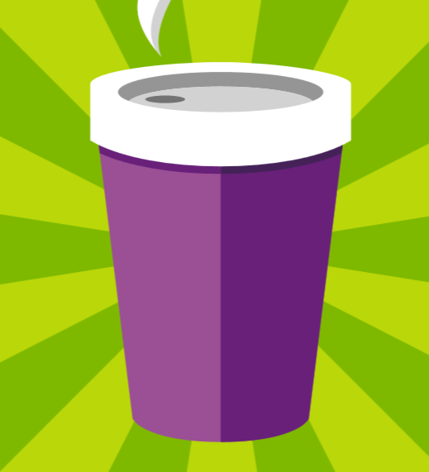







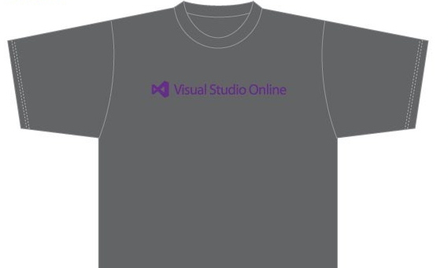

Visit the Developer Platform & Tools Booth
Having a friend
buy your coffee?
Yea, it’s kind of like that.
MSDN Subscribers get up to $150/mo in Azure credits.
Stop by the Developer Platform and Tools booth and visit the MSDN Subscriptions station to activate your benefits and receive a gift!
http://aka.ms/msdn_teched
3 Steps to New Gear! With Application Insights
Create a Visual Studio Online account http://visualstudio.com
Install Application Insights Tools for Visual
Studio Online http://aka.ms/aivsix
Come to our booth for a
t-shirt and a chance to win!
VSIP QR Tag Contests
Visit our booth to join the hunt for cool prizes!

Slide 32


Resources
Microsoft Engineering Stories
  Development tools & services for teams
  of all sizes
  How Microsoft Builds Software
  http://aka.ms/EngineeringStories
http://www.visualstudio.com
Visual Studio
Industry Partner
Program
Visual Studio | Integrate
  Meet Our New Visual Studio Online Partners
  or Join Now.
  http://vsipprogram.com
  Create Your Own Dev Environment
  http://integrate.visualstudio.com

Slide 33



Complete an evaluation and enter to win!

Slide 34


Evaluate this session
Scan this
QR code
to evaluate
this session.

Slide 35


© 2014 Microsoft Corporation. All rights reserved. Microsoft, Windows, and other product names are or may be registered trademarks and/or trademarks in the U.S. and/or other countries.
The information herein is for informational purposes only and represents the current view of Microsoft Corporation as of the date of this presentation. Because Microsoft must respond to changing market conditions, it should not be interpreted to be a commitment on the part of Microsoft, and Microsoft cannot guarantee the accuracy of any information provided after the date of this presentation. MICROSOFT MAKES NO WARRANTIES, EXPRESS, IMPLIED OR STATUTORY, AS TO THE INFORMATION IN THIS PRESENTATION.

