Slide 2
See How Microsoft Game Studios Uses Visual Studio Online Application Insights to Gain Early Warning of Performance Issues, Failures, and Pinpoint the Root Causes
DEV-B391
Kyle McClellan, Developer
Vlad Joanovic, Program Manager

Slide 3
Agenda Slide
What is Application Insights?
Services and Devices
Your Service or Device app has a problem – now what?
How Microsoft Studios uses App Insights
Alerting
Dashboards
Resources
Summary

Slide 4
Application Insights
For Services and Device apps:
Available
Performing
Succeeding
Delivered as a Service – VS Online -> Azure Portal Preview
VSIX integration with VS 2013
Reduce mean time to detect problems
Reduce mean time to resolve problems
Ensure your application is succeeding

Slide 5
Services and AI Telemetry
AI Telemetry for Services
WebTests
Browser
Server
URL
Ping
WebTests
Insert
Javascript
snipet
Custom
Events
MMA (default): APM
Perf, Exception,
Memory
Java: APM, Perf, Exception
MMA (custom):
Windows
Perf
Counters
Collect Logs
Nlog
Log4Net
Trace
Build Events
Default
Server
Side
Events
Custom
Events
Legend:
Easy to configure: No coding, simple, fast, few clicks.
Requires more time: could require coding, more clicks.

Slide 6
Devices and AI Telemetry
AI Telemetry for Services
Device App
Default
Phone or Store
Events
Custom
Events
Legend:
Easy to configure: No coding, simple, fast, few clicks.
Requires more time: could require coding, more clicks.

Slide 7
Getting Started for Services
2 Options:
Visual Studio project (new or existing)
App already installed on server
From Visual Studio
Use VSIX to add to new project or existing project
Deploy app or run locally
Install Microsoft Monitoring Agent on the server
Azure PaaS - modify cscfg and add startup task
Windows Azure Web Sites – coming soon
An application that is already deployed
Download ApplicationInsights.config from portal
Install Microsoft Monitoring Agent on the server
Use VSIX to add to project

Slide 8
Getting Started

Slide 9
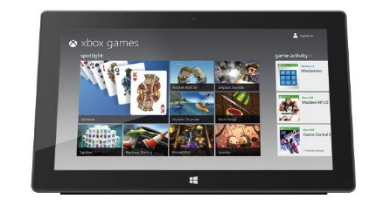
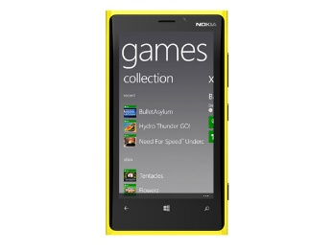
Microsoft Game Studios
CMS (Content, in the cloud)
Commerce (Micro-transactions, lots of them)
Azure
resident
Multi-instance
Dynamically
scalable

Slide 10
Studios App Insights

Slide 11
Game service scenarios
Predict scale
Investigate real data
Respond to service incidents

Slide 12
Predicting scale
Marketplace Service
Commerce Web Roles
Wallet
Service
Inventory
Service
Service
Emulator

Slide 13
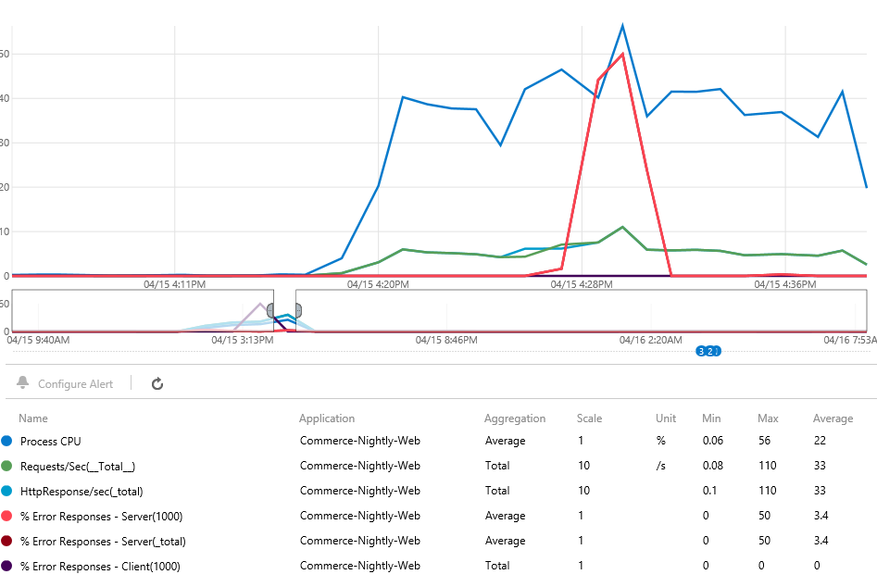
Load Test as seen in App Insights
150 RPS
Observed: Commerce service degrades around 150 RPS with 3 medium roles

Slide 14
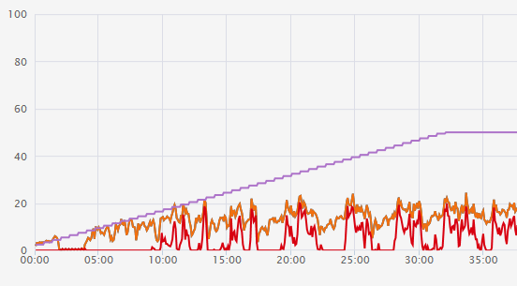
Load Test as seen in Visual Studio
150 RPS
User Load
We get a more detailed view in Visual Studio; failures on a 4 minute interval

Slide 15
Investigating latency
December 25th, 6am
Email alerts start flying
Service latency has increased exponentially

Slide 16
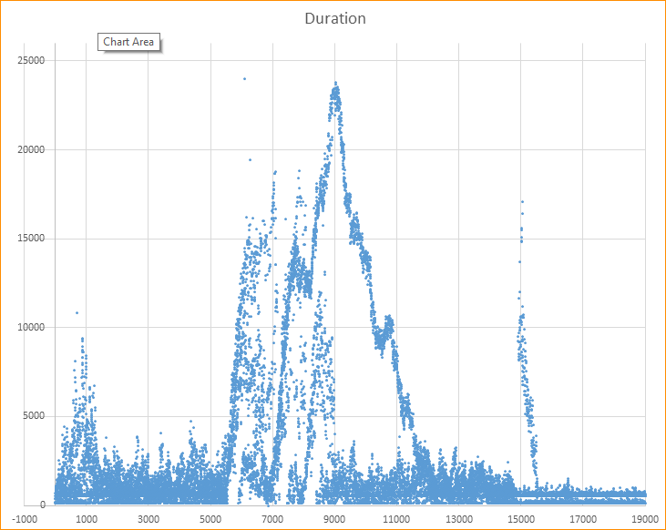
The culprit? Adding an instance
Auto-scale starts
New instance online

Slide 17
Adding an instance? Why?
0
1
2
3
Auto-scale
starts
New instance online
Key
Azure Topography Update
Capacity reduced by 33%
Online – Accepting Requests
Offline – Configuration Update
Offline – Starting New VM
Time

Slide 18
(Overlaid, because it looks cool)
Auto-scale
starts
New instance online

Slide 19
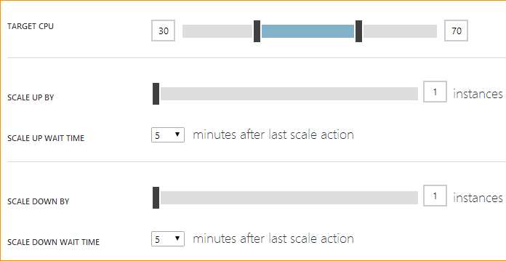
Latency. Got it. What’s my takeaway?
+
=
(Rolling update – 3 instances)
(High auto-scale target – 70%)
Latency
Reduce auto-scale target for low instance counts
2~50%, 3~60%, 4~70%

Slide 20
Service engineering is cyclical
Monitor
Understand
Mitigate
Resolve
Investigate
Improve
Alert

Slide 21
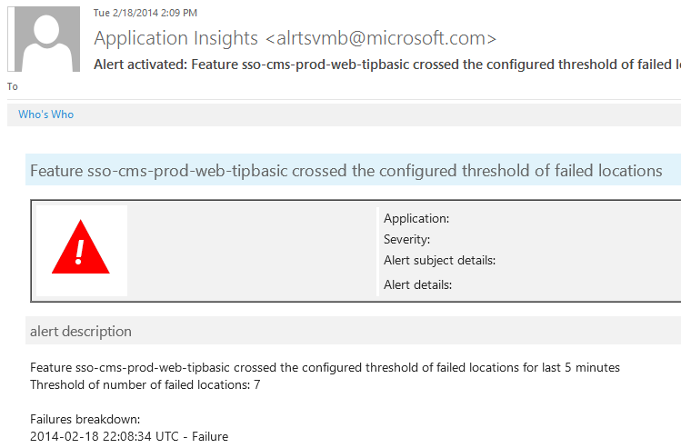
Monitor & Alert

Slide 22
Investigate & Understand

Slide 23
Mitigate & Resolve
Azure Storage
CMS Web Roles
Content Provider
Azure
Cache
Thread Pool’s exhausted; add more threads
Detect degradation in code and swap to cache

Slide 24
Improve
Invest in operational intelligence early
Treat it as a corollary to unit testing
Use throughout your application lifecycle

Slide 25
Application Insights configuration
ApplicationInsights.config
APM
Logs
Settings configure-able through ApplicationInsights.config
PerformanceThreshold – default 5 seconds
SensitivityThreshold – default 100 ms
Namespaces – default All
EnableAllExceptions – default all
MemoryEventSettings – default true
Virtual or private memory used by a worker process
Log settings
Log4Net, NLog, Trace Listener
BuildInfo integration
For VS project information and deployment markers

Slide 26
Your Windows Phone app crashes
Import, analyze and solve windows phone app crashes
Download StackTraceData excel file from Windows Phone app store
Run tool
View and analyze results
Fix crashes and improve your app
Tool available now
https://wpinsights.codeplex.com/releases/view/120079
Mike Smacinih

Slide 27
Alerting and Dashboards
Alert over perf metrics, dashboards for surfacing key metrics at a glance
Alert over metrics. Email for alert activation and resolution
Dashboards to capture key metrics at a glance

Slide 28
Participate in
Visual Studio design research
Usability feedback
Quick pulse studies
Low-fidelity prototypes
http://aka.ms/VSUxResearch

Slide 29
Related content
DEV-B309 Make Data-Driven, High-Impact Improvements to an Application with Application Insights
DEV-B323 Building Multi-Device Apps with the New Visual Studio Tooling for Apache Cordova
DEV-B222 Rapidly Detect Application Outages with Visual Studio Online Application Insights
Wednesday, May 14 1:30 PM - 2:45 PM
DEV-B335 Using the Cloud-Based Load Testing Service and Application Insights to Find Scale and Performance Bottlenecks in Your Applications
Wednesday, May 14 10:15 AM - 11:30 AM Room: 332A
Find Me Later At. . . Expo hall Application Insights booth

Slide 30
Track resources
http://aka.ms/AIVSIX
http://aka.ms/ApplicationInsightsForum
http://aka.ms/AIUserVoice
http://aka.ms/AIbug
http://aka.ms/ApplicationInsightsBlog
http://aka.ms/ApplicationInsightsDocs
http://aka.ms/AppInsightsDemo
http://aka.ms/AIBuild

Slide 31
Summary
Application Insights is a key part of the application lifecycle
Questions Application Insights can help with:
Is my application up?
Is my application performing?
Is my application succeeding?
Try Application Insights out on your existing or future applications
Visual Studio Online
Limited Preview

Slide 32
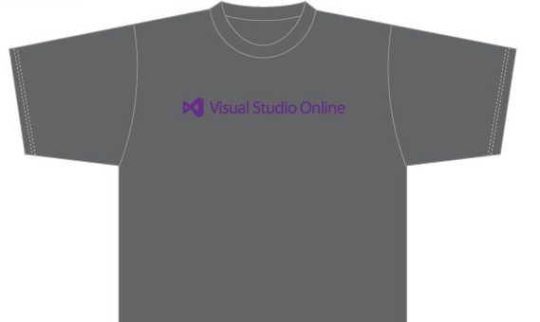
Visit the Developer Platform & Tools Booth
Having a friend buy your coffee?
Yea, it’s kind of like that.
MSDN Subscribers get up to $150/mo in Azure credits.
Stop by the Developer Platform and Tools booth and visit the MSDN Subscriptions station to activate your benefits and receive a gift!
http://aka.ms/msdn_teched
3 Steps to New Gear! With Application Insights
Create a Visual Studio Online account http://visualstudio.com
Install Application Insights Tools for Visual Studio Online http://aka.ms/aivsix
Come to our booth for a t-shirt and a chance to win!
VSIP QR Tag Contests
Visit our booth to join the hunt for cool prizes!

Slide 33
Resources
Microsoft Engineering Stories
Development tools & services for teams of all sizes
How Microsoft Builds Software
http://aka.ms/EngineeringStories
http://www.visualstudio.com
Visual Studio Industry Partner Program
Visual Studio | Integrate
Meet Our New Visual Studio Online Partners or Join Now.
http://vsipprogram.com
Create Your Own Dev Environment
http://integrate.visualstudio.com

Slide 34
Complete an evaluation and enter to win!

Slide 35
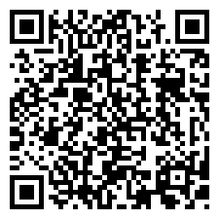
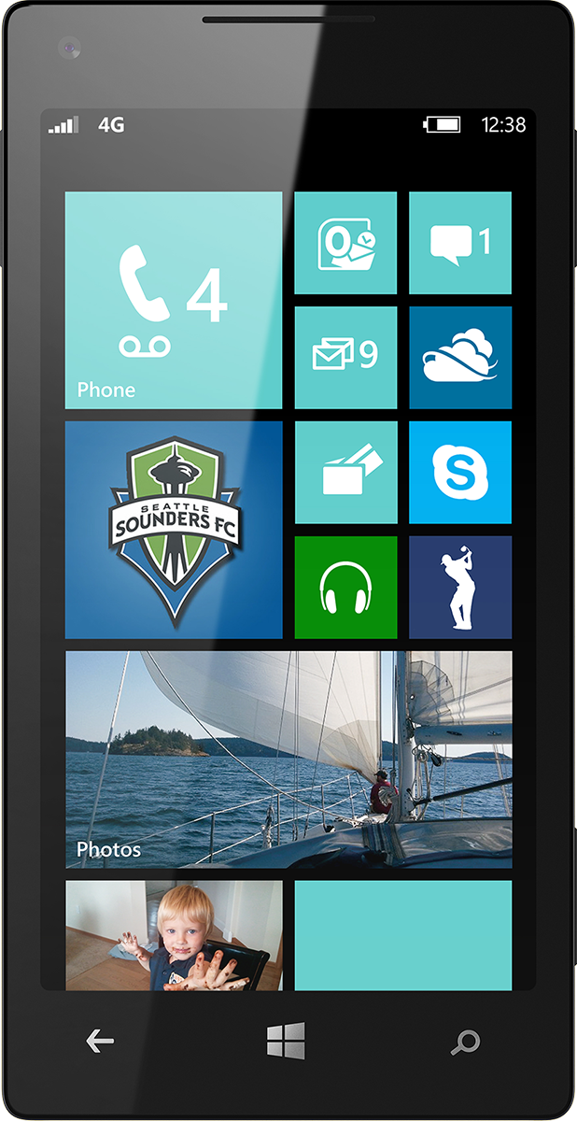
Evaluate this session
Scan this QR code to evaluate this session.

Slide 36
Questions?
Contact info
Vlad Joanovic vladj@microsoft.com
Kyle McClellan kylemc@microsoft.com

Slide 37
© 2014 Microsoft Corporation. All rights reserved. Microsoft, Windows, and other product names are or may be registered trademarks and/or trademarks in the U.S. and/or other countries.
The information herein is for informational purposes only and represents the current view of Microsoft Corporation as of the date of this presentation. Because Microsoft must respond to changing market conditions, it should not be interpreted to be a commitment on the part of Microsoft, and Microsoft cannot guarantee the accuracy of any information provided after the date of this presentation. MICROSOFT MAKES NO WARRANTIES, EXPRESS, IMPLIED OR STATUTORY, AS TO THE INFORMATION IN THIS PRESENTATION.

