Slide 1


Slide 2
Planning a Scalable End-to-End Multi-Tier Application on Microsoft Azure Web Sites
DEV-B414
Byron Tardif
Program Manager
Azure Websites

Slide 3
Agenda
Setting expectations and context
Architecting for scale – a web app journey to scalability
Scaling ‘real-world’ applications

Slide 4
Massive Scale & Ready For Business Web Apps
Slow Site
Downtime
Losing Business
Web Apps
  blogs.office.com, blog.surface.com, Skype & Bing dev center, Nokia, more…
  Examples: mobile apps, web APIs, facebook games, many more...
Ready for business
  Extremely low to ‘no perceived’ downtime (99.95% - 99.99%)
  Performance and (global) low latency
  ‘Easy’ to manage: DevOps, test, deploy, configure, monitor & analytics
Massive Scale
  Many tens of millions of requests per day (100M or higher)
  Peak Request per Second of many thousands (5K – 10K RPS)

Slide 5
Scalability is:
The ability of a system (a web site),
to handle a growing amount of work
(http traffic) in a capable manner,
(doesn’t go belly up) or its ability to be enlarged to accommodate that growth
Source:
http://en.wikipedia.org/wiki/Scalability

Slide 6
Scaling Options
Scale Up
– aka Vertical Scaling
  Increase resources capacity within existing node
Scale Out
– aka Horizontal Scaling
  Increase resources capacity by adding nodes

Slide 7
Architecting for Scale
A web app’s journey towards scalability

Slide 8
Application Scale Journey
>100,000
RPS
>10,000
RPS
>100
RPS
Level 1
Level 2
Boss Level
# of users

Slide 9
Architecting for Scale
Level 1: Beginners

Slide 10

Level 1 – Photo Gallery (untouched)
Database stored on local disk
Session state stored in local memory
Images stored on local disk*
State-Full Application
Website
<code>
Content
DB
Session
*Local disk should be treated as a shared resource in Azure Websites

Slide 11
Level 1 – Photo Gallery (untouched)
Scale Testing Results
Scale Count | Scale Size | Test Duration | Max User Count | Avg Pages/Sec | Avg Page Time (sec) | Avg RPS (Visual Studio) | WAWS RPS | Failed Tests | Total Tests | Failed Tests (%)
1 | MED | 15 | 2 | 0.27 | 1.16 | 1.77 | 1 | 0 | 77 | 0.0
1 | MED | 15 | 20 | 1.9 | 6.5 | 14.2 | 18 | 0 | 559 | 0.0
1 | MED | 15 | 50 | 3.48 | 10.4 | 39.5 | 45 | 1 | 980 | 0.1
1 | MED | 15 | 80 | 5.58 | 12.5 | 51.5 | 55 | 0 | 1639 | 0
1 | MED | 15 | 120 | 4.95 | 22.5 | 47.8 | 50 | 19 | 1446 | 1.3

Slide 12
Architecting for Scale
Level 2: Expert

Slide 13


Level 2 – Horizontally Scalable Photo Gallery
Strategy:
Website
<code>
Content
DB
Session

Slide 14
Level 2 – Horizontally Scalable Photo Gallery
Strategy:
Move database to cloud (SQL Azure)
Move site content to blob (Azure Storage)
Make site stateless
  Non-Sticky Session
Horizontal scale Web Tier

Slide 15
Level 2 – Horizontally Scalable Photo Gallery
Scale Testing Results
Scale Count | Scale Size | Test Duration | Max User Count | Avg Pages/Sec | Avg Page Time (sec) | Avg RPS (Visual Studio) | WAWS RPS | Failed Tests | Total Tests | Failed Tests (%)
1 | LARGE | 15 | 20 | 2.91 | 0.13 | 23.4 | 21 | 0 | 849 | 0.0
1 | LARGE | 15 | 100 | 14.4 | 0.15 | 232 | 77 | 0 | 4247 | 0.0
1 | LARGE | 15 | 200 | 29.2 | 0.14 | 966 | 155 | 0 | 8563 | 0.0
1 | LARGE | 15 | 300 | 43.6 | 0.24 | 2535 | 231 | 0 | 12839 | 0.0
1 | LARGE | 15 | 1000 | 141 | 0.67 | 8135 | 735 | 0 | 20591 | 0.0
3 | LARGE | 20 | 1500 | 198 | 1.37 | 19855 | 1297 | 1 | 32763 | 0.0
3 | LARGE | 25 | 2000 | 242 | 2.12 | 24896 | 1547 | 870 | 53496 | 1.6

Slide 16
Level 2 – Horizontally Scalable Photo Gallery
Strategy:
Configure Auto Scale
Optimize Website Code
Optimize SQL
Add Cache Layer
Use CDN for content, *.js & *.css
Leverage other services
  Put videos on youtube

Slide 17
Application Scale Journey
>100,000
RPS
>10,000
RPS
>100
RPS
Level 1
Level 2
Boss Level
# of users

Slide 18
Architecting for Scale
Level 3: BOSS Level

Slide 19
Level 3 – Globally Scalable Photo Gallery
Moving towards a global presence
West US
My Site
Replica (A)
East US
My Site
Replica (B)

Slide 20
Level 3 – Globally Scalable Photo Gallery
Moving towards a global presence
Gaps:
  Web app is ‘local’ to a single region
  Images stored in ‘local’ data center
  Database in ‘local’ data center
Goals:
  Active / Active replication across regions
Benefits:
  Bigger Scale
  Lower Latency
  Higher Uptime and DR

Slide 21
Level 3 – Globally Scalable Photo Gallery
Architecture:
West US
East US
Website
Website
Webjob
Webjob

Slide 22
Level 3 – Globally Scalable Photo Gallery
Architecture:
‘Copy’ images to remote regions
Use queue (CQRS*) to update DB
Asynchronous data processing with Webjobs
Add Traffic Manager
Controlled and synchronized deployment (Site Slots)
West US
Website
Webjob
* Command Query Responsibility Segregation adds latency and app complexity

Slide 23
Level 3 – Globally Scalable Photo Gallery
Caution:
Using a queue to sync DB access can/may lead to eventual consistency
Syncing database works for ‘most’ scenarios
Active / Active state is app dependent
West US
Website
Webjob

Slide 24
Application Scale Journey
>100,000
RPS
>10,000
RPS
>100
RPS
Level 1
Level 2
Boss Level
# of users

Slide 25
Scaling a real world app
Massive Scale WordPress

Slide 26
Summary
Azure Web Sites can scale to answer all you business scale needs
Your web sites is always running with Azure Web Sites (no perceived downtime…)
Azure Web Sites has rich core functionality
It is easy to develop and maintain my web site

Slide 27
Related content
DEV-B383 Automating Microsoft Azure with the Management Libraries
DCIM-B304 Using Windows Azure Pack to Bring the Cloud On-Premises
WIN-IL204 Building and Deploying ASP.NET Applications using Microsoft Azure
DCIM-IL304 Introducing Windows Azure Pack
Find Me Later at:
    email: byvinyal@microsoft.com
    twitter: @bktv99

Slide 28
Track resources
Getting Started with WebJobs SDK
Deep Dive into Hidden Gems, Tips and Tricks for Azure Web Sites

Slide 29
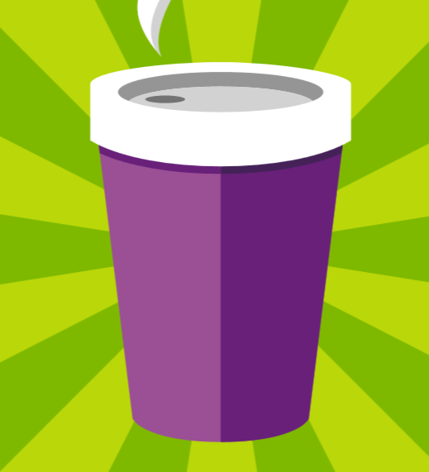


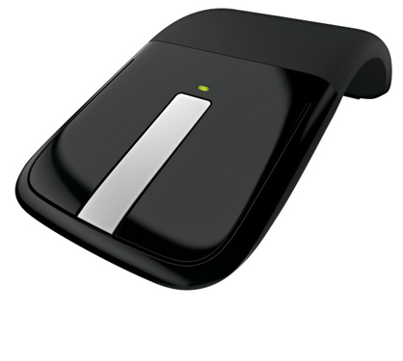




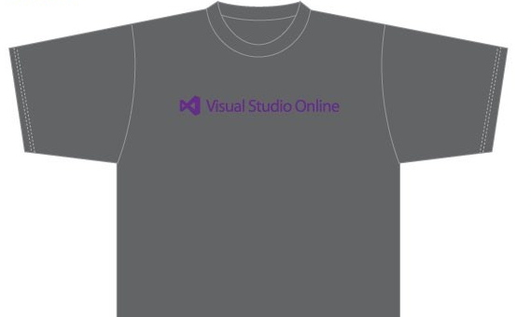
Visit the Developer Platform & Tools Booth
Having a friend
buy your coffee?
Yea, it’s kind of like that.
MSDN Subscribers get up to $150/mo in Azure credits.
Stop by the Developer Platform and Tools booth and visit the MSDN Subscriptions station to activate your benefits and receive a gift!
http://aka.ms/msdn_teched
3 Steps to New Gear! With Application Insights
Create a Visual Studio Online account http://visualstudio.com
Install Application Insights Tools for Visual
Studio Online http://aka.ms/aivsix
Come to our booth for a
t-shirt and a chance to win!
VSIP QR Tag Contests
Visit our booth to join the hunt for cool prizes!

Slide 30


Resources
Microsoft Engineering Stories
  Development tools & services for teams
  of all sizes
  How Microsoft Builds Software
  http://aka.ms/EngineeringStories
http://www.visualstudio.com
Visual Studio
Industry Partner
Program
Visual Studio | Integrate
  Meet Our New Visual Studio Online Partners
  or Join Now.
  http://vsipprogram.com
  Create Your Own Dev Environment
  http://integrate.visualstudio.com

Slide 31



Complete an evaluation and enter to win!

Slide 32


Evaluate this session
Scan this
QR code
to evaluate
this session.

Slide 33


© 2014 Microsoft Corporation. All rights reserved. Microsoft, Windows, and other product names are or may be registered trademarks and/or trademarks in the U.S. and/or other countries.
The information herein is for informational purposes only and represents the current view of Microsoft Corporation as of the date of this presentation. Because Microsoft must respond to changing market conditions, it should not be interpreted to be a commitment on the part of Microsoft, and Microsoft cannot guarantee the accuracy of any information provided after the date of this presentation. MICROSOFT MAKES NO WARRANTIES, EXPRESS, IMPLIED OR STATUTORY, AS TO THE INFORMATION IN THIS PRESENTATION.

